Slide 1



PATHPILOT
A Career guide at your finger tips
PSID SIH 1434
Problem Statement: Making career choices and AI based counselling accessible to every child at secondary level along with aptitude tests and detailed career paths

Slide 2
BASIC DETAILS OF THE TEAM AND THE PROBLEM STATEMENT
Ministry: DoSEL
PS Code: SIH-1434
Problem Statement Title: Making career choices and AI based counselling accessible to every child at secondary level along with aptitude tests and detailed career paths.
Team Name: CRTL+ALT+DEL
Team Leader Name: Shreya Tiwari
Institute Code (AISHE): 420
Institute Name: DR SPM INTERNATIONAL INSTITUTE OF INFORMATION
TECHNOLOGY NAYA RAIPUR
Theme Name: SMART EDUCATION

Slide 3



OUR SOLUTION

Slide 4
INTRODUCTION
Assisting individuals in making informed career choices.
OpenAI API integration for personality trait analysis.
Features: Personalized Career Counseling, Profession Road Maps, NEP Counseling.
Addressing the need for career guidance in a dynamic job market
Predict Job Safety Score
Marks-Based Subject Suggestions

Slide 5


Motivation
Empower individuals through informed career choices.
Address the complexity of the evolving job market.
Unlock personal potential for confident decisions.
Foster growth and professional development.
Contribute to future success aligned with passions.
Provide crucial support for high school students in NEP 2020 changes.

Slide 6
NATIONAL EDUCATION POLICY 2020 & PATHPILOT
Transforms Indian education into an equitable knowledge society
PathPilot Aligns by suggesting 11th-12th-grade subject combinations.
Eight categories, like Humanities, Mathematics-Computing, Vocational Education, Physical Education, Arts Education, Social Science, and Inter-Disciplinary Subjects.
Students choose three categories, four subjects each, totaling 16.
PathPilot Simplifies choices with personalized subject suggestions.
It navigates NEP 2020 complexities for a seamless educational transition.

Slide 7
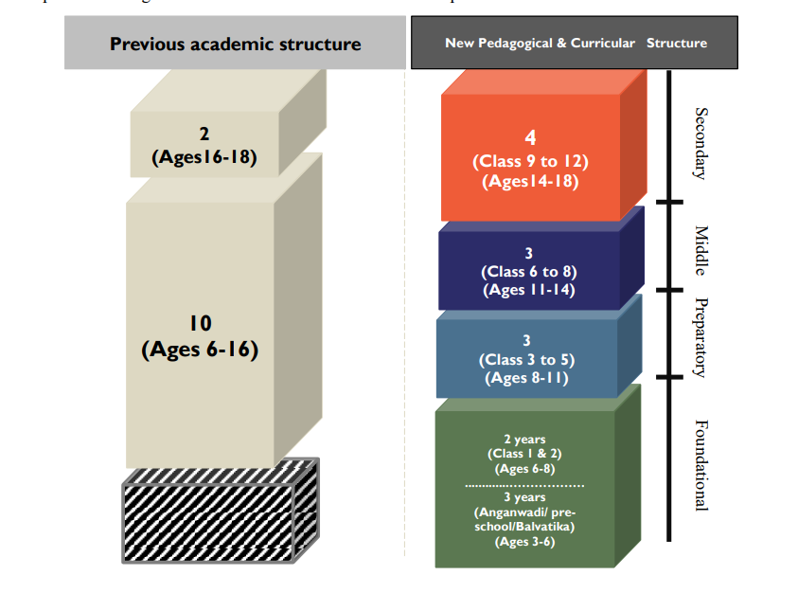

Slide 8

DIFFERENCE FROM ALREADY EXISTING MODELS
NEP 2020 Focus: Unique emphasis on navigating the complexities of National Education Policy 2020, a feature absent in existing models.
Interactive UI: Engaging and enjoyable personality quiz for a more children-friendly and interactive experience.
Comprehensive Guidance: Beyond personality results, Pathpilot offers detailed career roadmaps, providing a holistic and practical approach to career navigation.
Integrated Risk Assessment for Future Careers: While there exists models that predict risks associated with different career options in future there is none that provides this integrated with career counselling, this makes the project a one-stop solution for every career related query.
Input based subject combination suggestion: Users can input their 10th-grade marks to receive tailored subject suggestions aligning with their academic performance.

Slide 9

Proposed Solution/ Methodology
Developing an interactive frontend/ UI of the project using HTML, CSS and JavaScript
Developing the backend using OpenAI API and MERN Stack that generates personality traits and possible career paths using quiz inputs
Integrate both backend and the frontend and making them work effectively

Slide 10
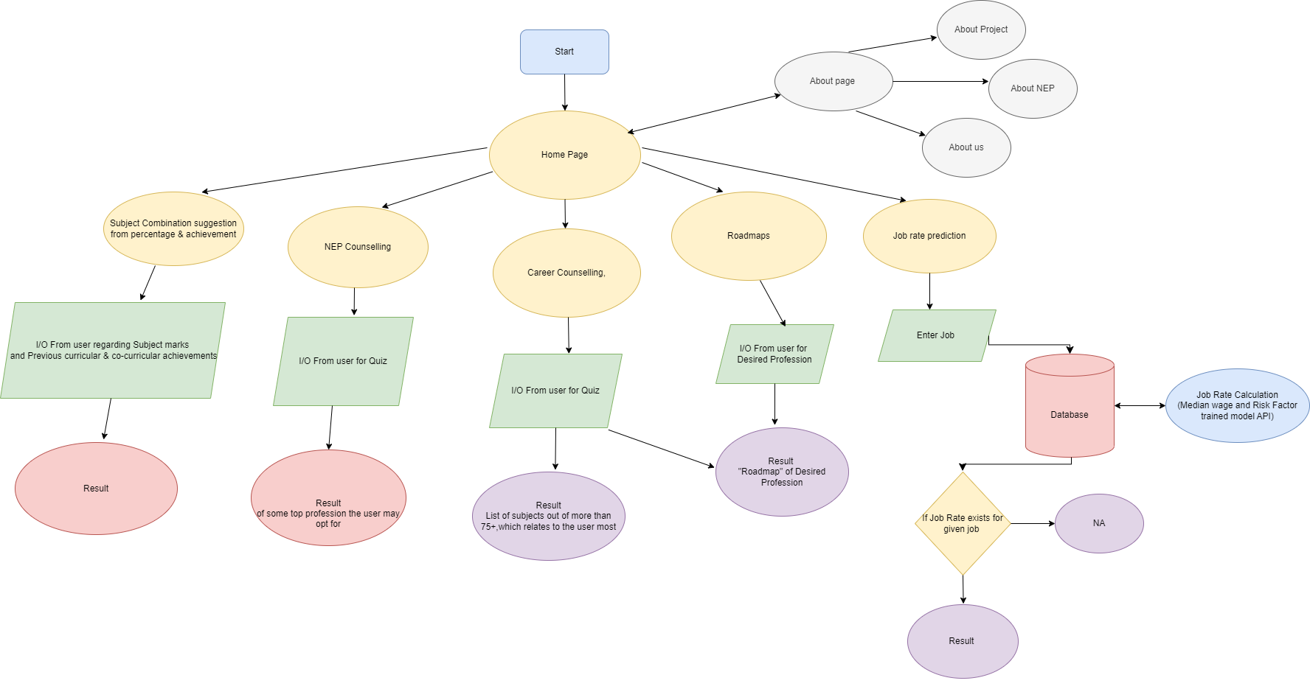
FLOWCHART

Slide 11
USE CASES
Career Exploration:
Users can explore a wide range of career options based on their personality traits, helping them make informed decisions about their professional paths.
Roadmaps for Success:
Individuals can access step-by-step roadmaps for specific professions, providing actionable guidance on how to pursue and succeed in their chosen careers.
NEP Counseling for Students:
High school students benefit from personalized subject combination suggestions, aligning with the National Education Policy 2020, easing the decision-making process for 11th and 12th-grade studies.

Slide 12
USE CASES
Educational Planning:
Users can strategically plan their academic journey, combining insights from personality quizzes with detailed career roadmaps to create a customized educational plan.
Skill Development:
The platform assists users in identifying and developing essential skills required for their chosen careers, fostering continuous personal and professional growth.
Identify a safer career option:
With the help of integrated risk assessment model for future careers, users can predict the job score on a scale of 10 and be sure about the future scopes in their chosen career path.

Slide 13
FUTURE SCOPE
Device Compatibility:
Extend compatibility to various devices, ensuring users can access Pathpilot on smartphones, tablets, and desktops.
Develop a mobile application to enhance accessibility and provide on-the-go guidance.
2. Multilingual Support:
Translate the platform into multiple languages and dialects.
Increase accessibility for users with diverse linguistic backgrounds.

Slide 14
FUTURE SCOPE
3. Awareness Campaigns:
Collaborate with school teachers to increase awareness among students about the benefits of using Pathpilot.
Provide resources for educators to incorporate Pathpilot into career counseling sessions.
4. Continuous Improvement:
Regularly update and iterate the platform based on user feedback and emerging educational trends.
Explore additional features to further enrich the user experience and guidance provided.

Slide 15
REFERENCES
[1] Learning to Answer Psychological Questionnaire for Personality Detection By Feifan Yang, Tao Yang, Xiaojun Quan, Qinliang Su
School of Computer Science and Engineering, Sun Yat-sen University, China
[2] McIlveen, Peter F. and Patton, Wendy A. (2007) Narrative career counselling: Theory and exemplars of practice. Australian Psychologist 42(3):pp. 226-235.
[3] Using Qualitative Assessment in Career Counselling by MARY MCMAHON & WENDY PATTON School of Learning and Development, Queensland University of Technology, Kelvin Grove Campus, Victoria Park Road, Kelvin Grove, QLD 4059, Australia (∗author for correspondence, E-mail: m.mcmahon@qut.edu.au)
[4] Dr. Imtiyaj Mansoori (March 2023). Time to Change the Dance: Implications of the National Education Policy, 2020 on Career Guidance Practice in India International Journal of Economic Perspectives,17(03) 17-36 UGC CARE 2 Retrieved from https://ijeponline.com/index.php/journal.

Slide 16
THANK
YOU

