Slide 1
Employee Salary Prediction
CAPSTONE PROJECT
Presented By:
Name: Shaurya Pundir
College Name: Graphic Era Deemed to be University
Department:- Computer Science

Slide 2
OUTLINE
Problem Statement
System Development Approach
Algorithm & Deployment
Result
Conclusion
Future Scope
References

Slide 3
Problem Statement
Predicting an employee's salary class is a critical task for HR analytics, workforce planning, and economic forecasting.
Organizations often struggle to identify patterns in demographic and professional attributes that influence salary outcomes.
This project aims to build a predictive model that classifies whether an employee earns more than $50K or not based on key personal and job-related features.
Using a machine learning approach, we analyze structured data such as age, occupation, education, and work hours.
The final model is deployed using a Streamlit web application for real-time and batch salary class predictions.

Slide 4
System Approach
🔧 System Requirements:
Hardware:
64-bit system, minimum 8 GB RAM, multi-core CPU
Software:
OS: Windows/Linux/MacOS
Python 3.10+
Jupyter Notebook (for training & development)
Streamlit (for deployment)
📦 Libraries Required:
Data Handling:
pandas, numpy
Data Visualization:
matplotlib, seaborn
Machine Learning / Deep Learning:
scikit-learn, tensorflow, keras
Model Deployment:
streamlit
Model Serialization & Encoding:
LabelEncoder, joblib (optional for .pkl), h5py (for .h5 models)

Slide 5
Algorithm & Deployment
Data Collection
Used the Adult Income Dataset from the UCI Machine Learning Repository.
Contains demographic and employment details to predict salary category (>50K or <=50K).
Data Preprocessing
Handled missing values, label encoding for categorical features.
Standardized numerical columns for some models.
Model Building & Training Trained and compared multiple classification algorithms:
✅ Decision Tree Classifier
✅ Random Forest Classifier
✅ Multi-Layer Perceptron (MLP) using Keras
Evaluated all models using accuracy, precision, recall, and confusion matrix.
Model Selection & Saving
MLP achieved the best generalization(84) performance and was saved as .h5 for deployment.
Other models used for comparison and validation of performance.
Deployment
Created an interactive Streamlit Web App as the frontend.
App loads the .h5 model, accepts user input, preprocesses it, and returns predictions.
Also supports batch predictions via CSV file upload.

Slide 6
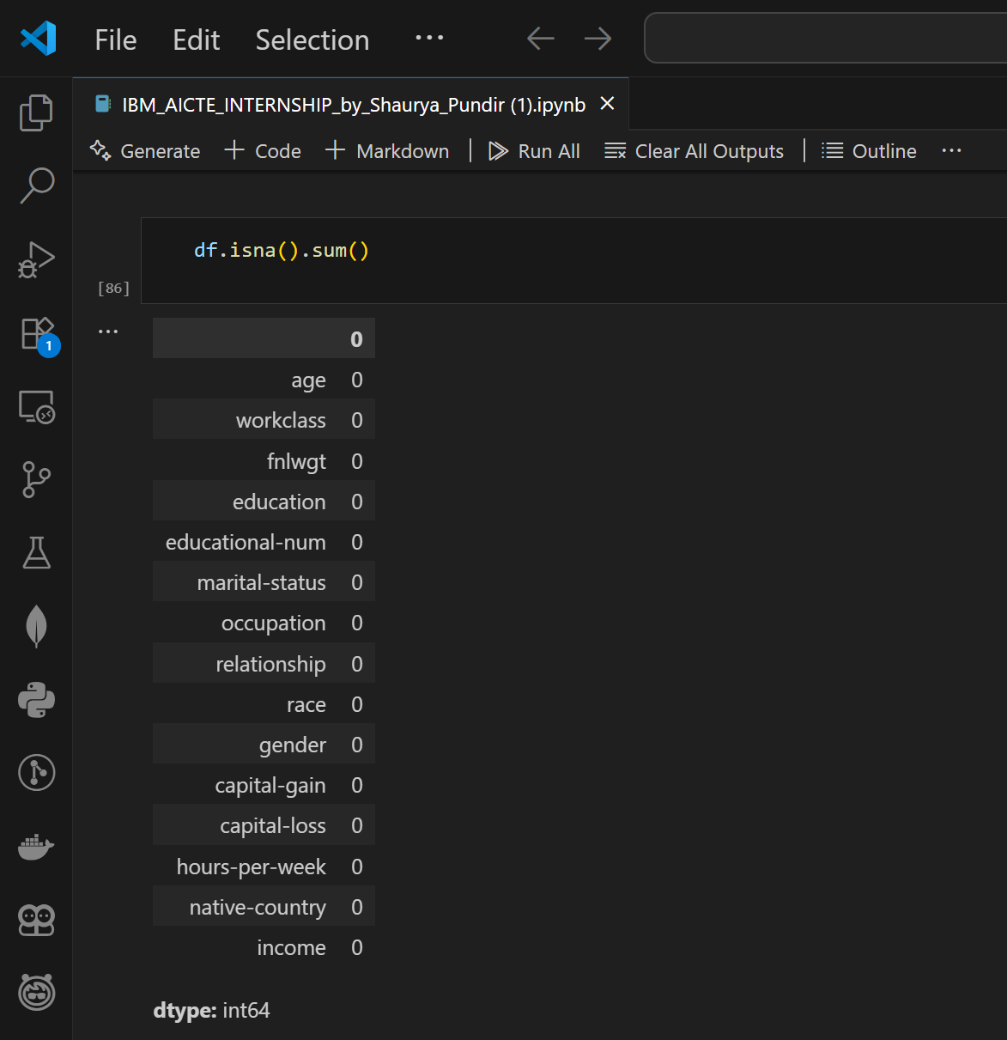
Result
Model Comparisons:
Model | Accuracy | Comments
Decision Tree | ~82% | Simple but prone to overfitting
Random Forest | ~85% | Better generalization
MLP (Neural Network) | ~86%+ | Best performance (used in app)
Code & Output Screenshots:
1) Data preprocessing

Slide 7
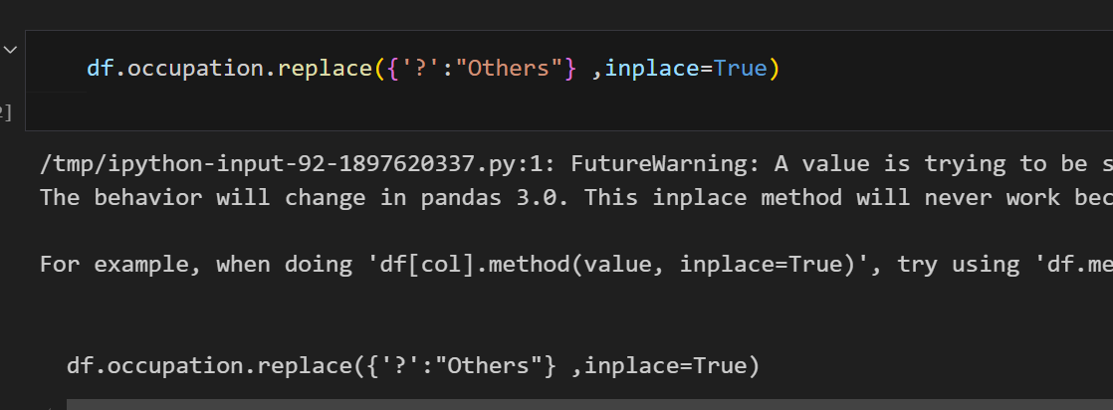
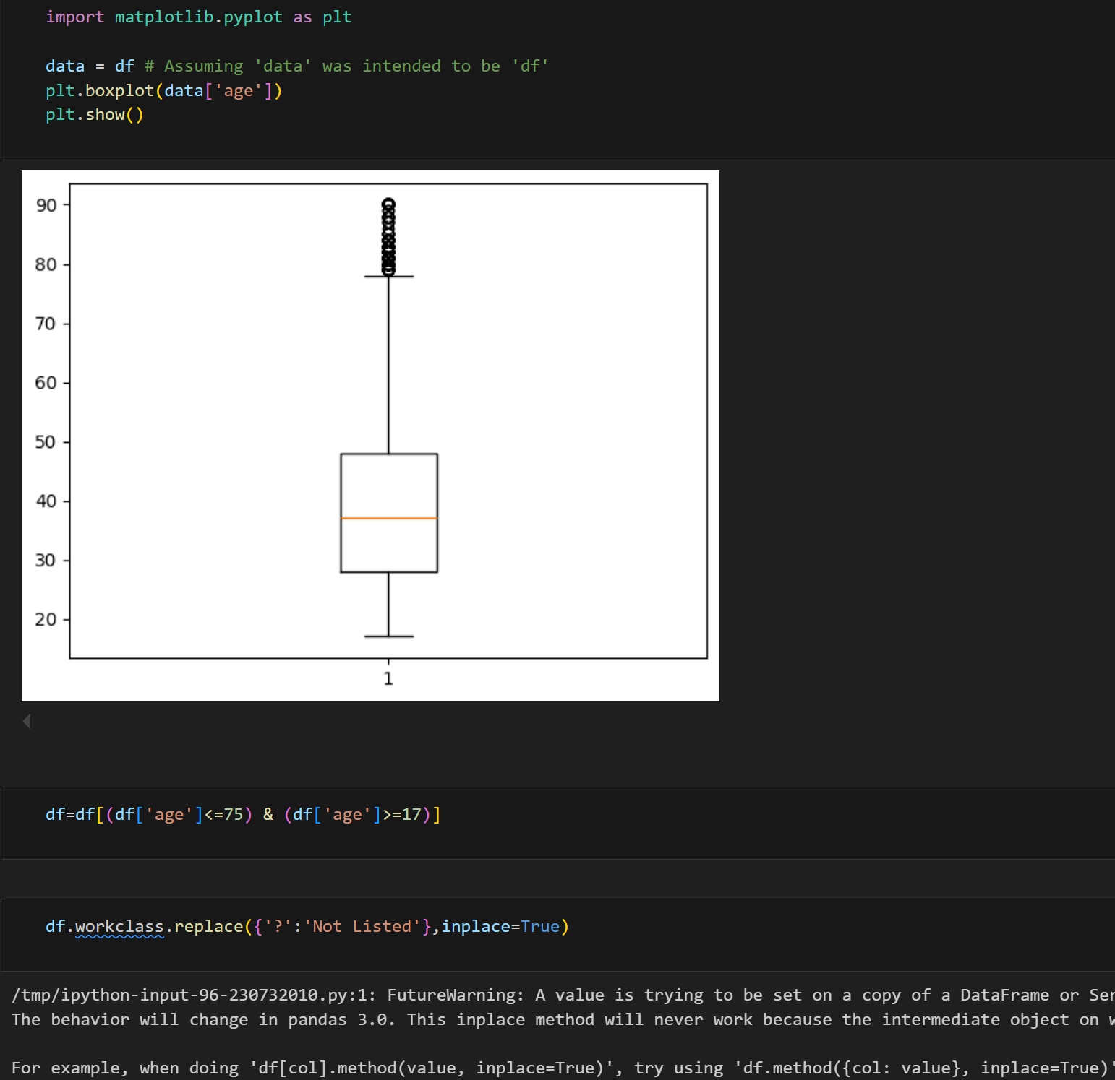
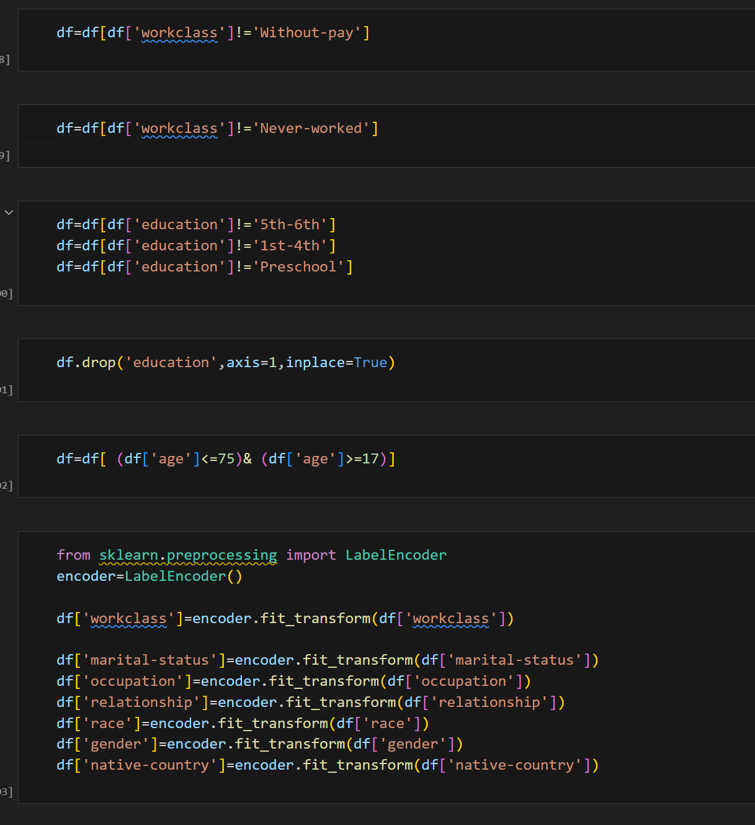

Slide 8
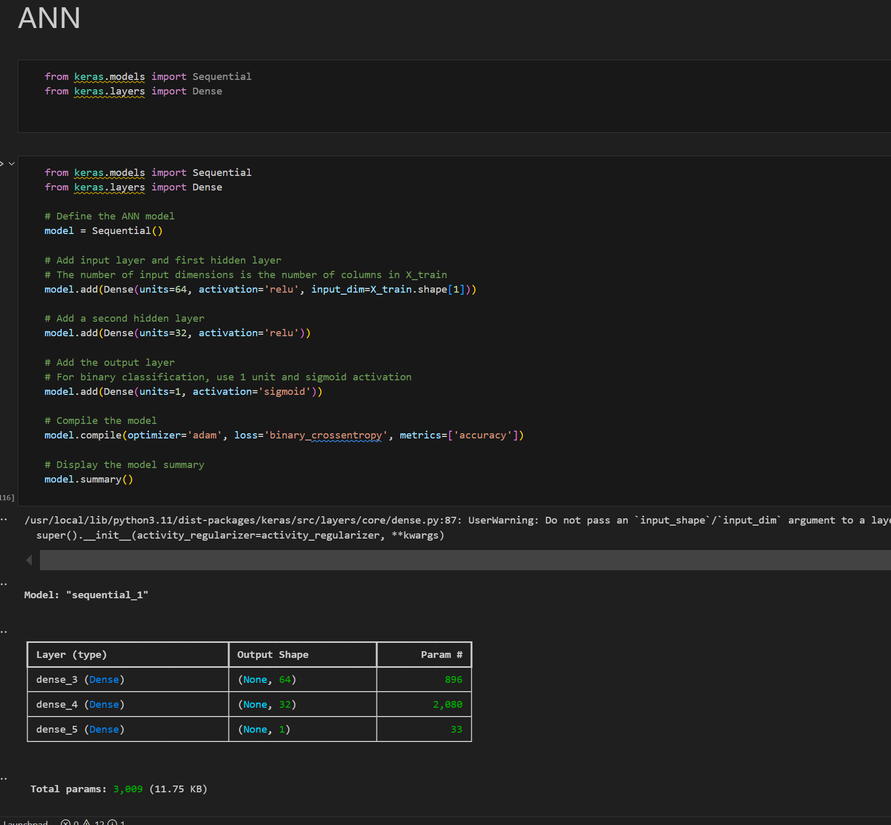
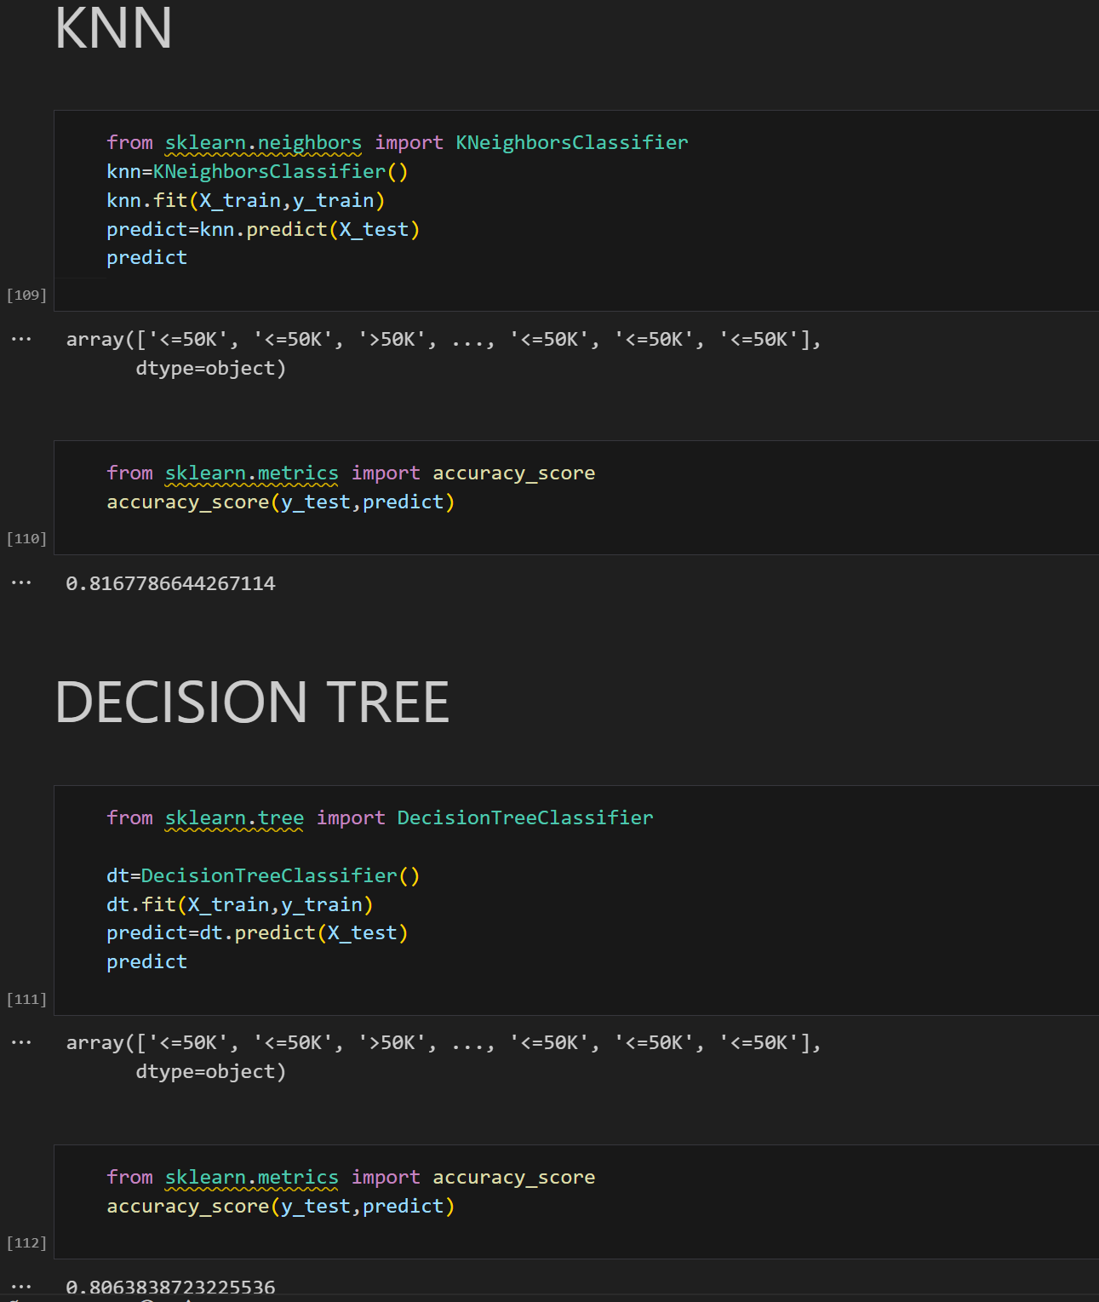
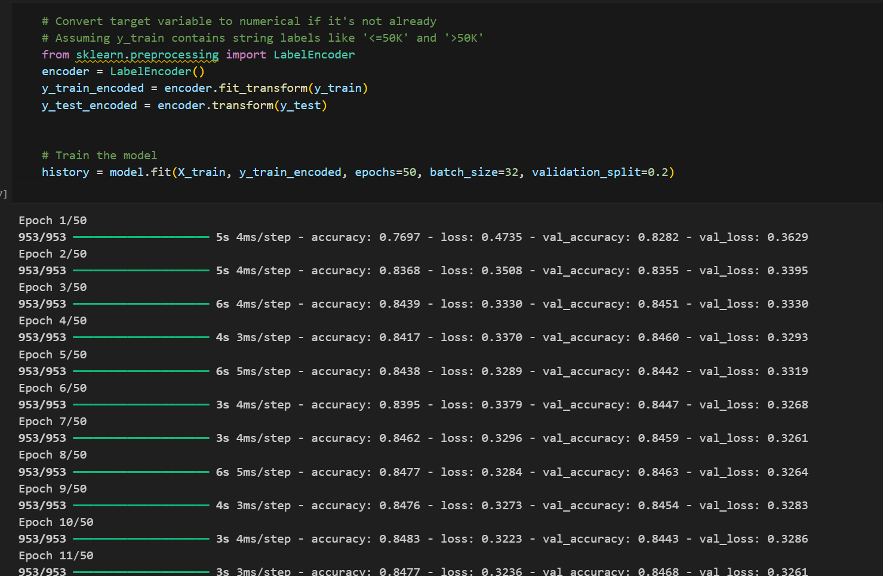
2) Model training:-

Slide 9
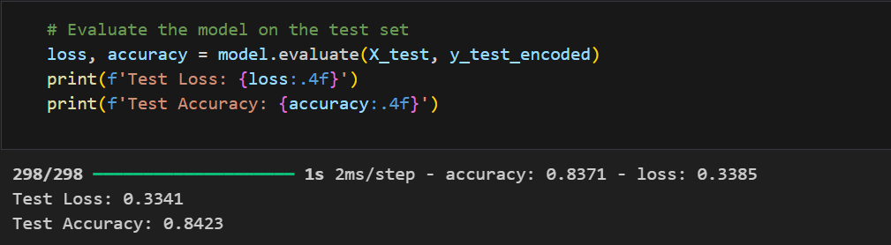
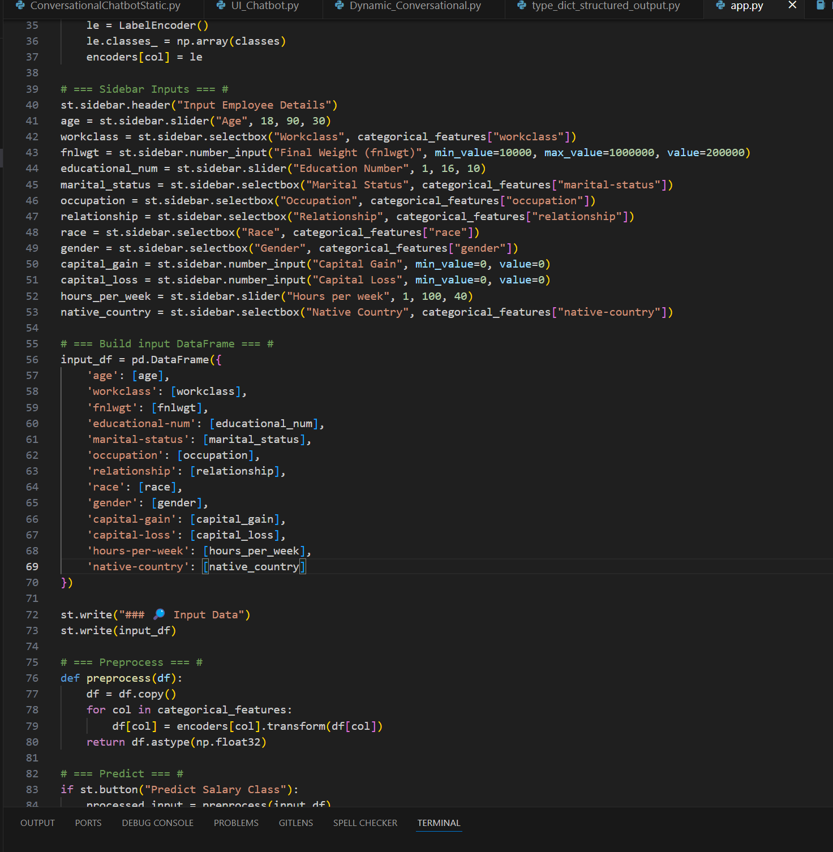
3)Streamlit App running in the browser:-

Slide 10
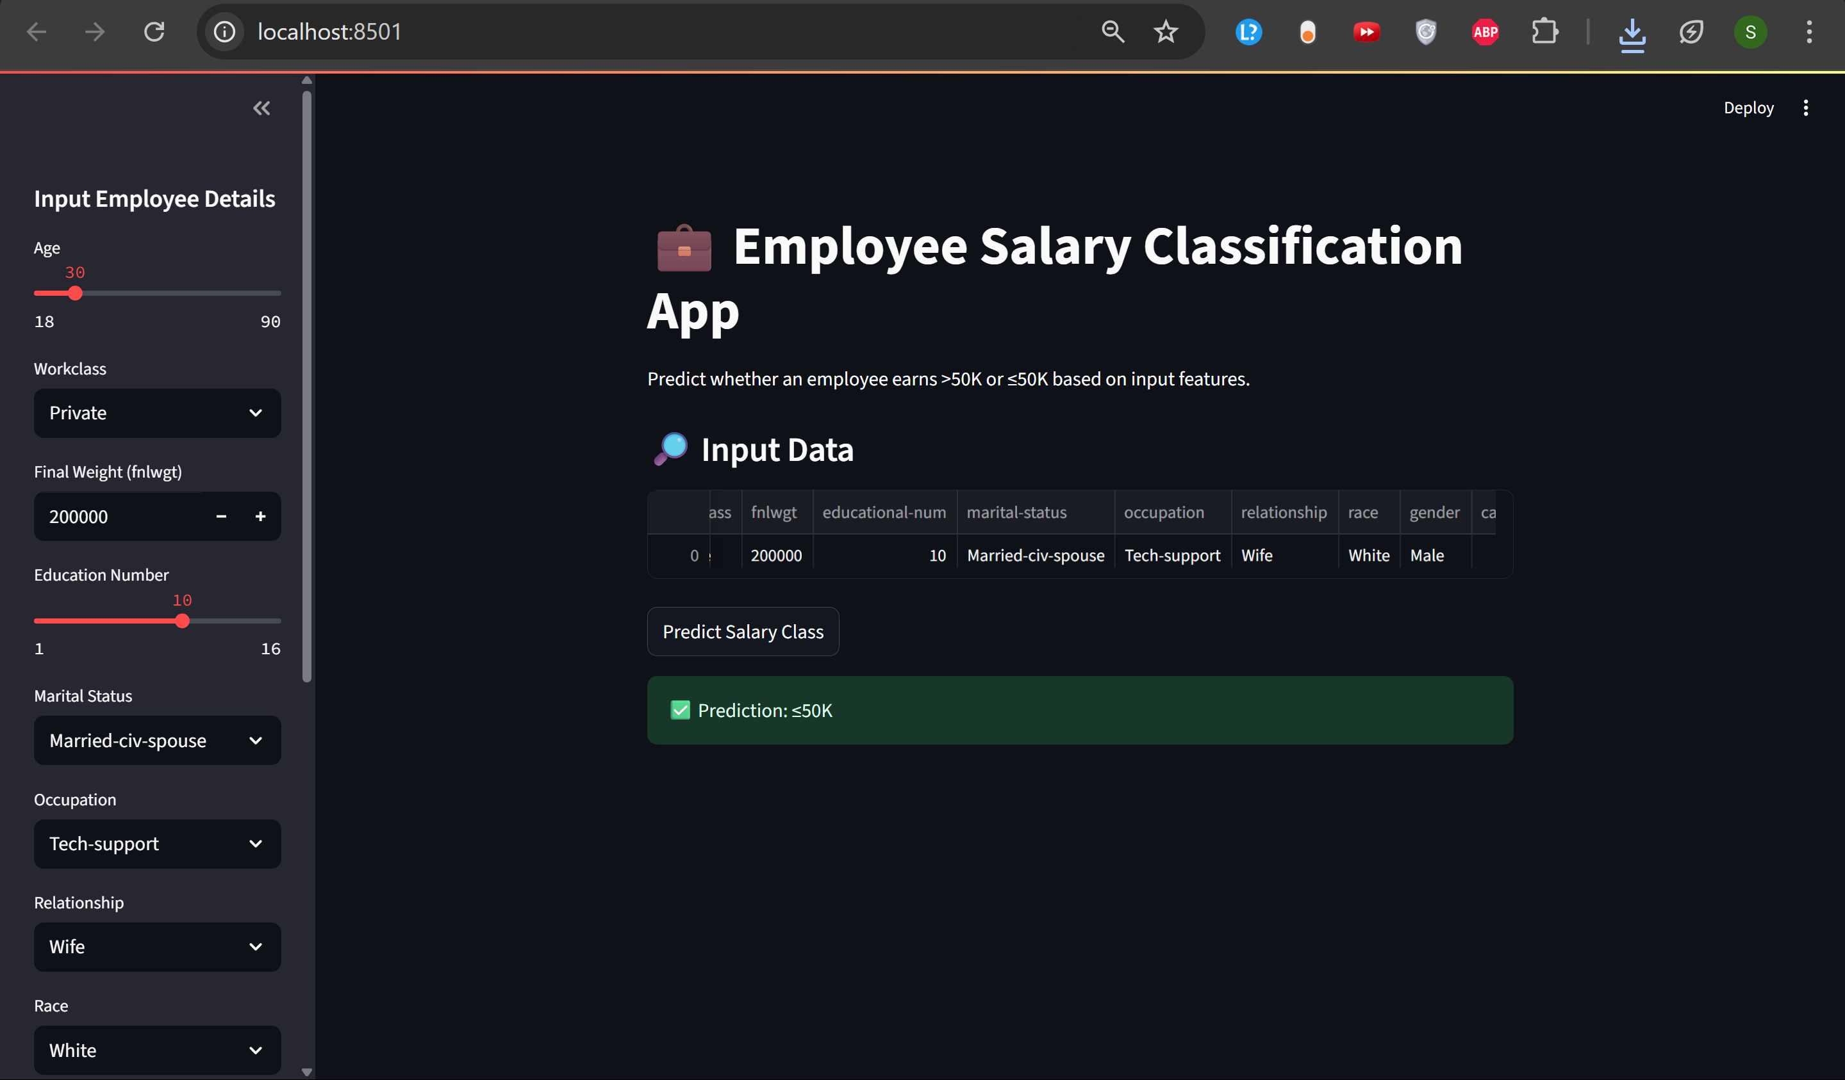
GITHUB LINK:-
https://github.com/ShauryaPundirGraphicEra/Edunet-AICTE-Internship-Project

Slide 11
Conclusion
The goal of predicting whether an individual earns >50K or ≤50K based on personal and professional attributes was successfully achieved
using multiple machine learning models.
Among all tested algorithms, the Multi-Layer Perceptron (MLP) showed the highest prediction accuracy (~86%), making it the best choice
for deployment.
A user-friendly Streamlit web application was developed to allow real-time and batch predictions, making the solution accessible and
interactive.
Challenges Faced:
Preprocessing categorical variables (encoding) while ensuring consistency during both training and deployment.
Model input shape mismatches during integration of .h5 Keras model with the Streamlit app.
Balancing dataset features and avoiding overfitting, especially with Decision Trees.

Slide 12
Future scope(Optional)
Integrate additional real-world data to improve model generalization.
Add model explanation features (e.g., SHAP or LIME) to improve interpretability.
Enhance the UI with input validations and allow model selection in the app itself.

Slide 13
References
UCI Machine Learning Repository – Adult Dataset https://archive.ics.uci.edu/ml/datasets/adult (Used for training and testing the salary classification models)
Scikit-learn Documentation https://scikit-learn.org/stable/documentation.html (Used for Decision Tree and Random Forest model development)
TensorFlow/Keras Documentation https://www.tensorflow.org/guide/keras (Used to design and train the MLP neural network)
Streamlit Documentation https://docs.streamlit.io/ (Used to build and deploy the interactive web application)
Géron, Aurélien. Hands-On Machine Learning with Scikit-Learn, Keras, and TensorFlow, 2nd Edition. (For guidance on best practices in model building and deployment)

Slide 14
THANK YOU

