Slide 1
Secure Cloud Vault
Cloud-Native Secure Asset Storage Platform
Secure Cloud Vault is a cloud-based application that enables users to securely upload, manage, and retrieve sensitive digital assets. The system combines secure authentication, cloud storage, integrity verification, and modern security practices to protect user files while providing seamless accessibility.
- Shauryan Shindhu

Slide 2
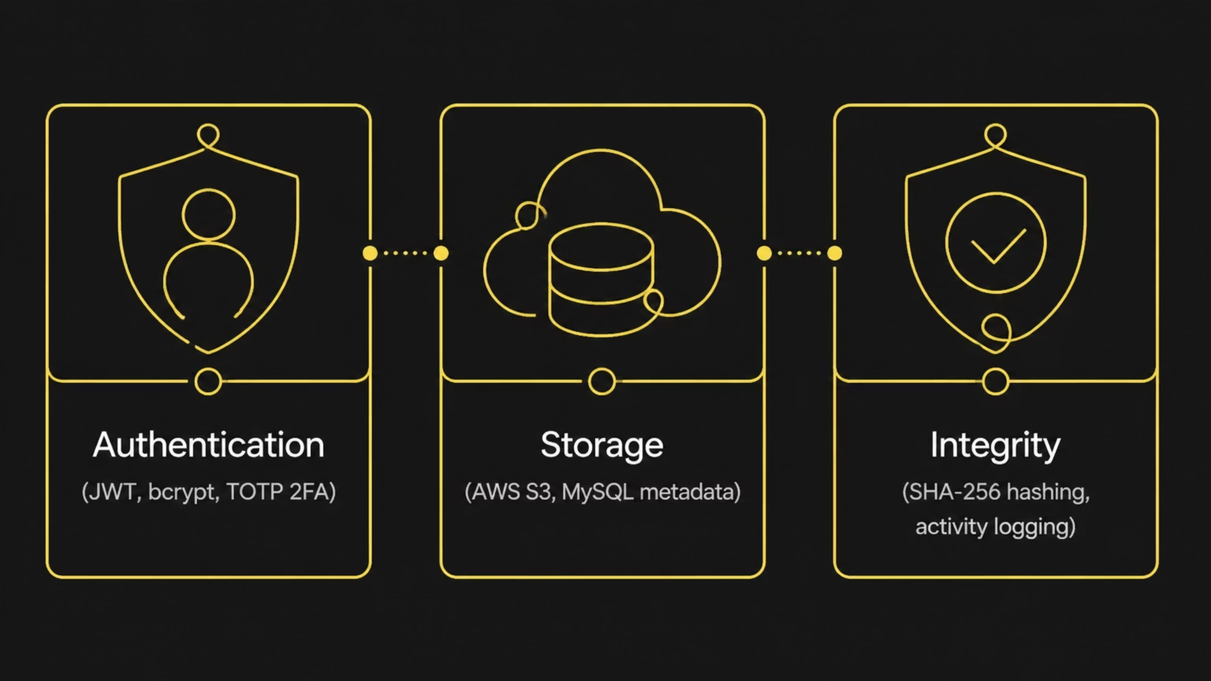
Objective & Problem Statement
Problem Statement
Project Objectives
Traditional file storage solutions often lack strong authentication, integrity verification, and centralized activity monitoring, making sensitive files vulnerable to unauthorized access and tampering.
Build a secure cloud-based file storage platform
Implement JWT-based authentication
Enable Two-Factor Authentication (TOTP)
Securely store files in AWS S3
Maintain file integrity using SHA-256 hashing
Store metadata securely in MySQL
Provide secure file upload, download, and deletion

Slide 3
Technology Stack
Frontend
Backend
React 19
Vite
React Router
Axios
HTML/CSS
FastAPI
Python
SQLAlchemy
JWT Authentication
bcrypt
PyOTP (2FA)
Boto3
Database
Cloud & Deployment
MySQL
AWS S3
Docker
Docker Compose

Slide 4
System Workflow & Architecture
The system uses a secure, layered workflow where the frontend handles user interaction, the backend manages logic, authentication protects access, and storage is split between database metadata and encrypted file handling with integrity verification.
Security Mechanisms
Data Flow
JWT-based session authentication
bcrypt password hashing
Two-Factor Authentication (TOTP)
SHA-256 integrity check
Activity logging for audit trails
Users authenticate via React frontend
Backend validates credentials and issues JWT tokens
File metadata stored in MySQL
Files uploaded to and retrieved from AWS S3
SHA-256 hashes verify file integrity on retrieval
Pre-signed URLs provide secure, time-limited access

Slide 5

Key Features & Real-World Applications
Implemented Features
User Registration & Secure Login
JWT Authentication & Two-Factor Authentication
Secure File Upload, Download & Deletion
AWS S3 Integration & SHA-256 File Integrity Verification
Activity Logging & Dockerized Deployment
Real-World Applications
Similar Enterprise Solutions
Enterprise Secure Document Storage
Healthcare Records
Banking & Financial Documents
Legal Case Files
Government Confidential Data
Educational Document Repository
HashiCorp Vault (Secret Management)
AWS Secrets Manager
Azure Key Vault
Google Secret Manager

Slide 6
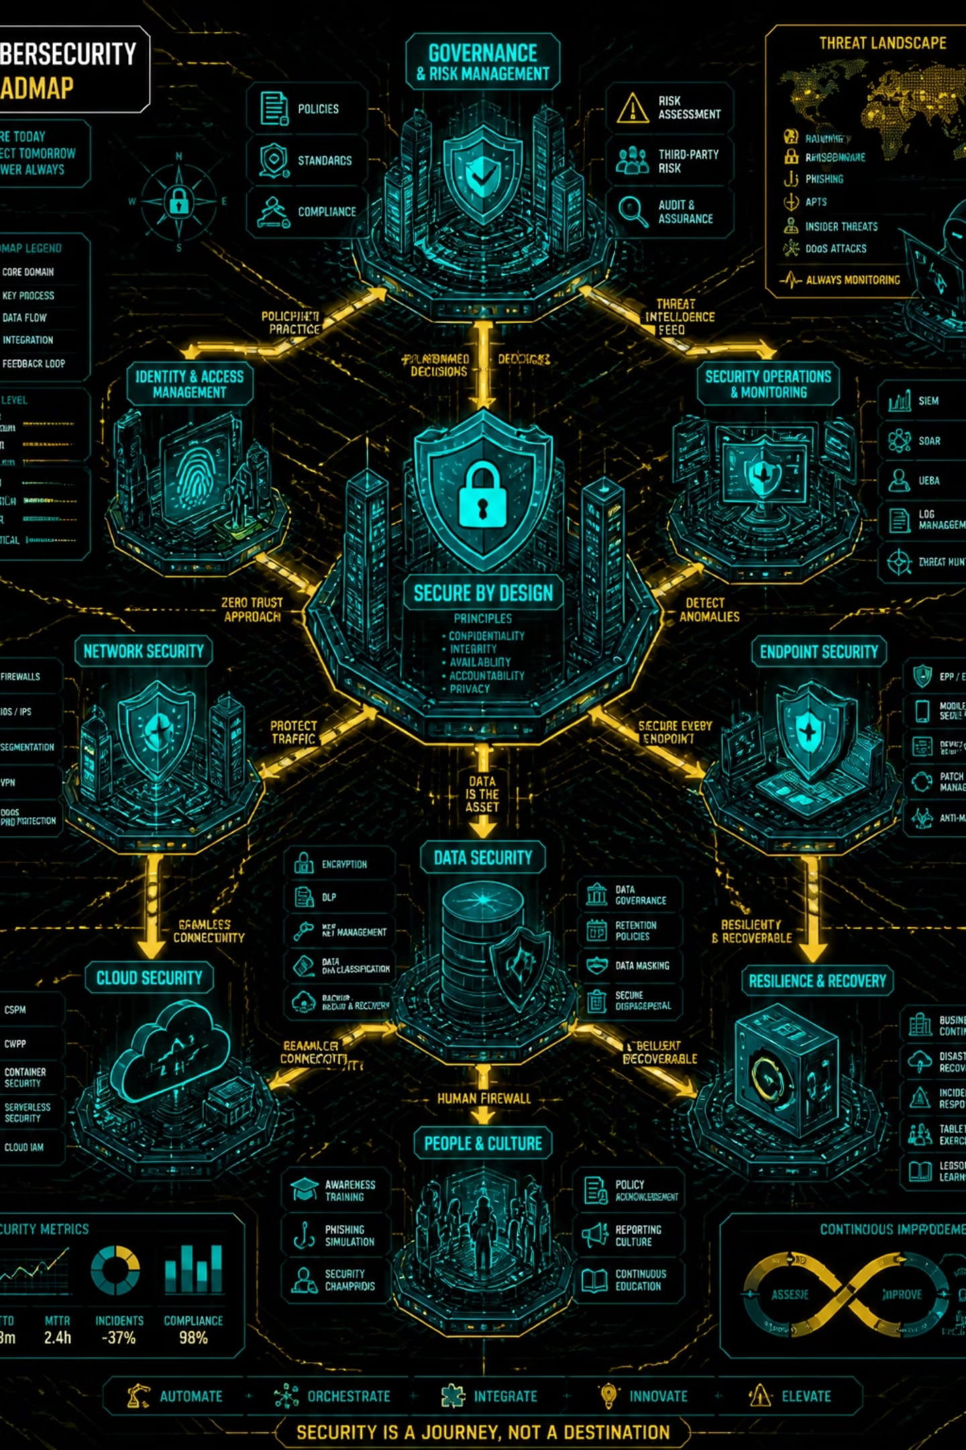






Future Enhancements
Enhanced Security
RBAC — Role-Based Access Control with Admin, User, and Auditor levels
Zero Trust Model — Continuously verify users, devices, and requests
Step-Up Authentication — OTP/Passkey/Biometric verification for sensitive downloads
AWS Security Services
AWS KMS — Centralized encryption key management
AWS Secrets Manager — Secure storage for API keys and credentials
AWS CloudTrail & CloudWatch — Audit logging and real-time security alerts
DevSecOps
Secure CI/CD Pipeline — Automated SAST, dependency scanning, and container scanning before deployment

Slide 7






Conclusion
Secure Cloud Vault demonstrates how modern cloud technologies and cybersecurity best practices can be combined to build a secure, scalable, and cloud-native file storage platform. The system successfully integrates JWT authentication, Two-Factor Authentication, AWS S3 storage, SHA-256 integrity verification, and Dockerized deployment into a cohesive solution for protecting sensitive digital assets.
Secure Authentication
Cloud Storage Integration
JWT tokens, bcrypt hashing, and TOTP-based 2FA
Seamless AWS S3 file management with pre-signed URLs
File Integrity Verification
Dockerized Deployment
SHA-256 hashing ensures files remain unaltered
Containerized architecture for consistent, portable deployment
Enterprise-Ready Design
Scalable Architecture
Scalable architecture suitable for production environments
Built to grow with increasing user and storage demands

Slide 8
Thank You

