Slide 1
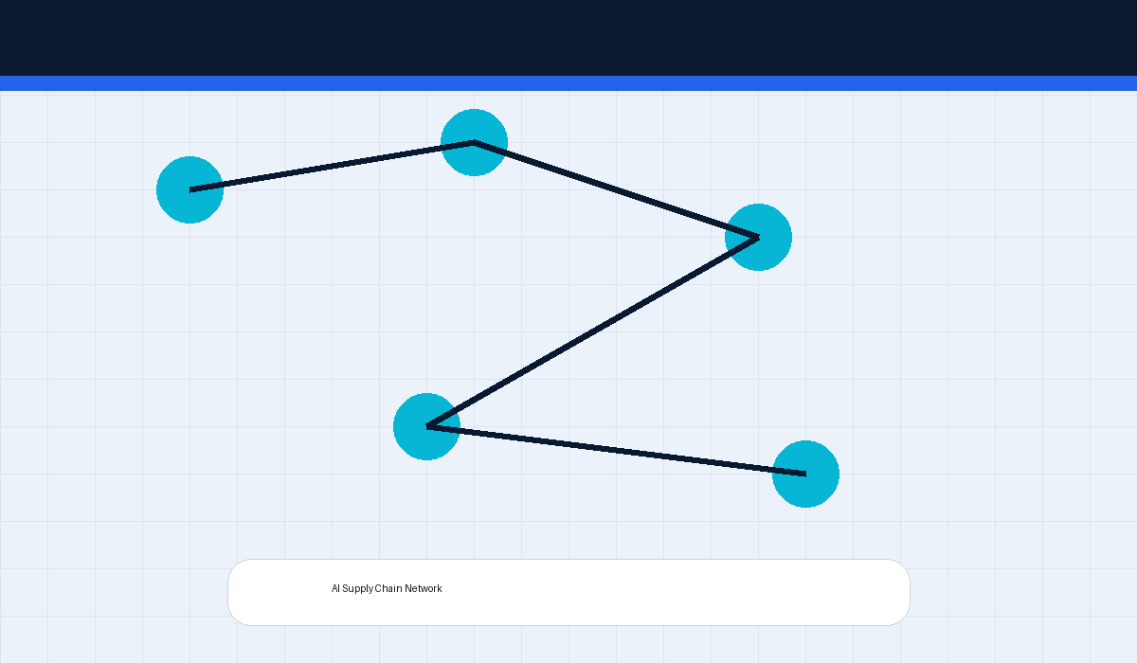
AI-Powered Factory Optimization System
Enterprise Machine Learning Internship Project
AI-driven logistics optimization platform
Predictive lead-time estimation system
Factory recommendation intelligence engine
Enterprise operational analytics framework
Enterprise Internship Presentation • AI Factory Optimization

Slide 2
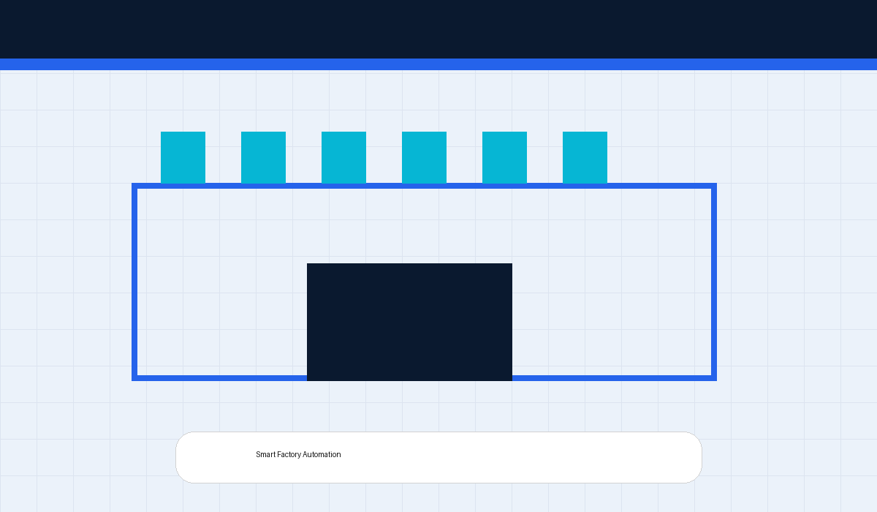
Industry Problem Statement
Supply Chain & Logistics Challenges
Inefficient factory allocation increases delays
Traditional systems lack predictive intelligence
Operational inefficiencies increase logistics cost
Businesses require scalable AI optimization systems
Enterprise Internship Presentation • AI Factory Optimization

Slide 3
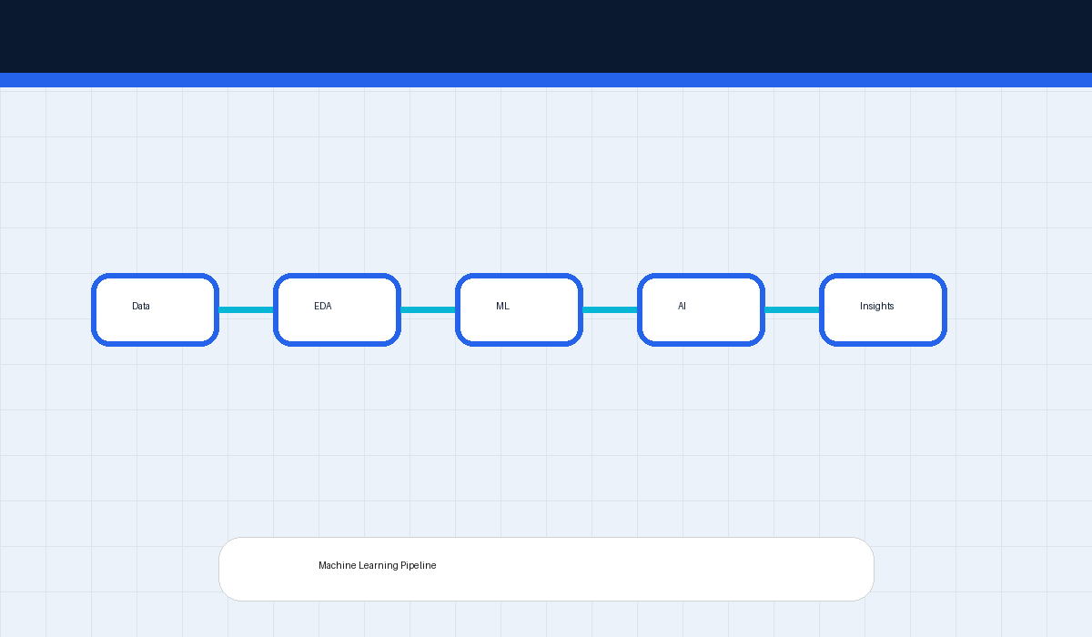
Project Objectives
Optimization & Decision Intelligence Goals
Predict delivery lead times using ML
Optimize product-to-factory allocation
Reduce operational delays and risk
Build scalable enterprise recommendation engine
Enterprise Internship Presentation • AI Factory Optimization

Slide 4
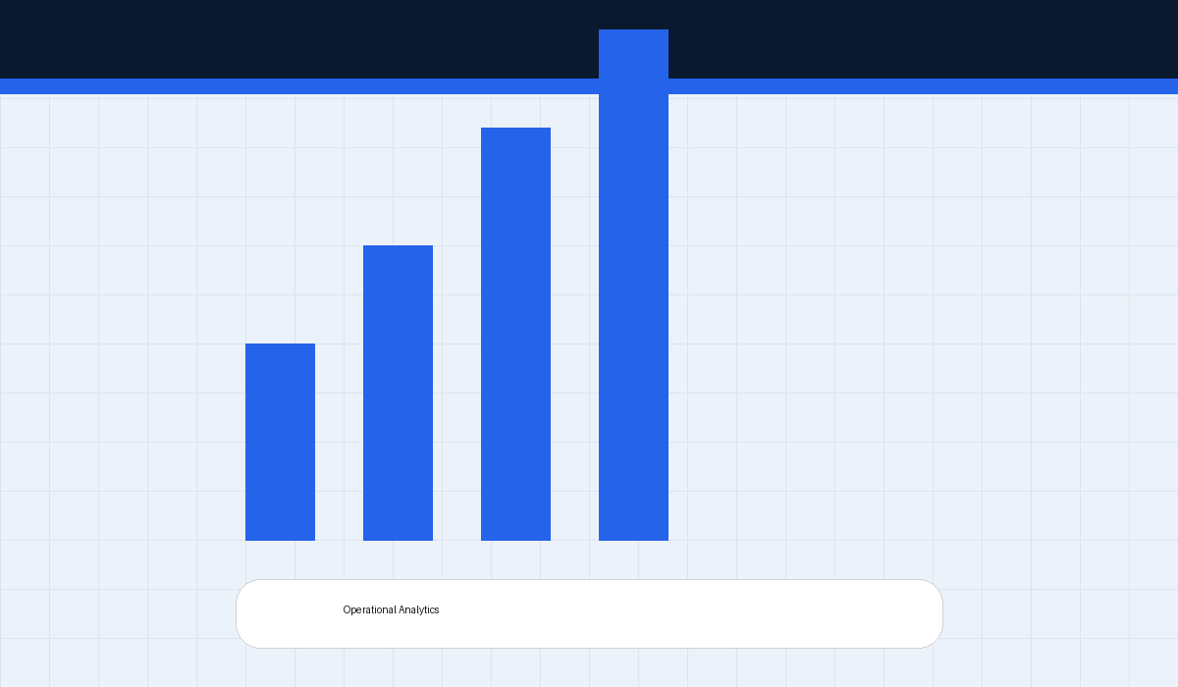
Dataset & Feature Engineering
Operational Data Processing Pipeline
Processed logistics, regional and sales data
Generated lead-time and distance metrics
Applied Label Encoding for ML processing
Created operational simulation variables
Enterprise Internship Presentation • AI Factory Optimization

Slide 5
Machine Learning Architecture
Predictive Analytics Workflow
Implemented Random Forest Regressor
Performed Train/Test split validation
Evaluated MAE, RMSE and R² metrics
Generated predictive operational insights
Enterprise Internship Presentation • AI Factory Optimization

Slide 6
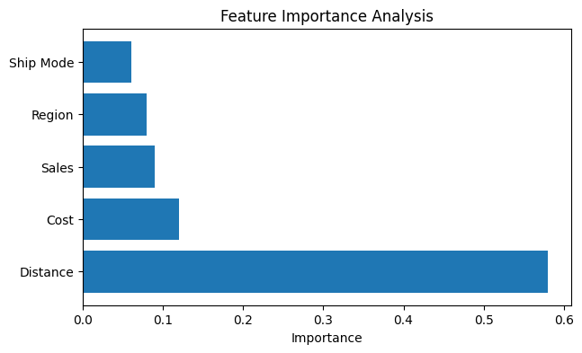
Feature Importance Insights
Operational Intelligence Analysis
Distance identified as strongest operational factor
Sales and cost influenced logistics performance
Regional behavior affected delivery efficiency
Insights support AI-driven factory optimization
Enterprise Internship Presentation • AI Factory Optimization

Slide 7
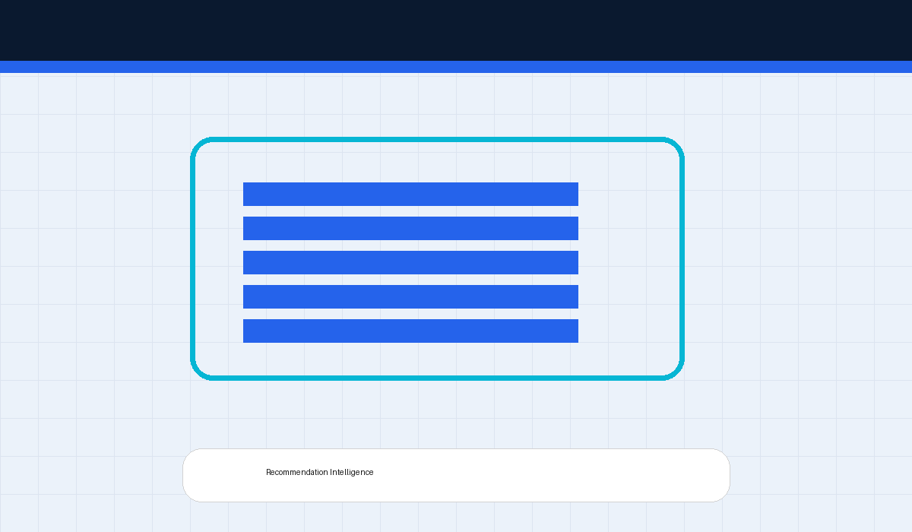
Recommendation Engine
AI Decision Intelligence System
Simulates alternate factory assignments
Predicts lead-time performance scenarios
Ranks factories using ML predictions
Calculates improvement opportunities
Enterprise Internship Presentation • AI Factory Optimization

Slide 8
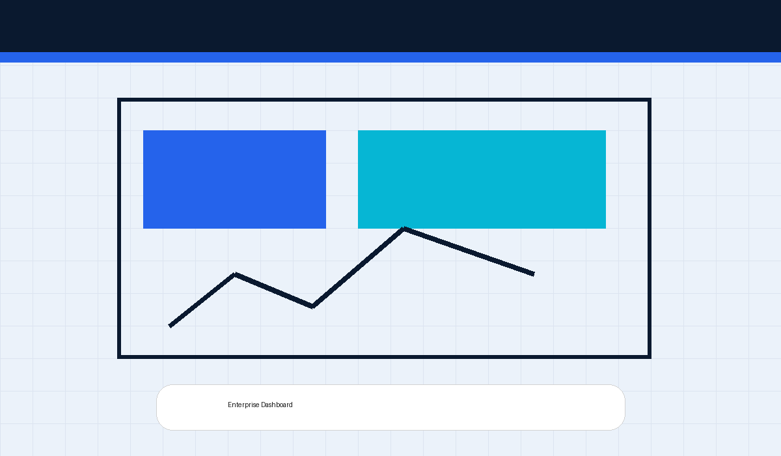
Business Impact & Results
Enterprise Value Generated
Improved logistics optimization capability
Enabled AI-assisted operational decisions
Reduced estimated delivery delays
Designed scalable enterprise-ready architecture
Enterprise Internship Presentation • AI Factory Optimization

Slide 9
Future Scope
Advanced Enterprise Enhancements
Real-time GPS & warehouse integration
IoT-enabled supply-chain monitoring
Reinforcement Learning optimization
Interactive Streamlit dashboard deployment
Enterprise Internship Presentation • AI Factory Optimization

Slide 10
Conclusion
AI for Smarter Supply Chains
Machine Learning enhances logistics intelligence
Recommendation systems improve operational planning
Predictive analytics supports enterprise optimization
Architecture scalable for future deployment
Enterprise Internship Presentation • AI Factory Optimization

