Slide 1
Intelligent AI-Driven Pre-Construction Feasibility Analyzer
R26-IT-154 | Final Presentation and Viva
IT22542724 Ranaweera K.A. IT22110770 Shavinka Y.G.K.
IT22542892 Samuditha T.A.V. IT22547460 Shamindi E.E.
Supervisor: Mr. Ravi Supunya Co-Supervisor: Ms. Suriya Kumari
Notes:
Good morning. We are group R26-IT-154. Our project is an integrated pre-construction feasibility analyzer for residential projects in Sri Lanka.

Slide 2
PP2 Comments and Actions Taken
 | PP2 panel comment | Action taken | Evidence / outcome
C1 | “Better validate the result.” | Area is recalculated on the server, not trusted from the phone | Measured against a surveyed plot on site and compared with the deed area
C2 | “Increase the validation accuracy.” | Detection and wall tracing are now handled separately | Checked against hand-measured plans; every corrected clash is re-checked automatically
C3 | “Show the violating points clearly.” | A rule check was added beside the risk model | Every result is traced back to the official requirement it came from
C4 | “Better validate the result.” | Tested on data the model had never seen | Predictions plotted against the actual values, with the deciding factors shown
Notes:
Every PP2 comment was about validation. These are the four actions and what each produced. C1 and C3 validation is still running, and we say that openly.

Slide 3
Problem in Brief
Buying land without knowing the land condition and flood risk makes it unsafe to build
Reading 2D blueprints by hand takes too much time and causes human errors
Building without knowing the approvals and laws leads to heavy legal fines
Budgets calculate the building cost but forget the future maintenance
There is no single system to check the land, plans, laws and budget together
Affected: homebuilders and landowners · small and medium contractors · quantity surveyors and architects
Notes:
These four questions are answered separately today, by different people at different times. No single system joins them before building starts.

Slide 4
Design Excellence over Existing Solutions
Existing tools price the building cost only
Clash tools report design problems but do not correct them
Land assessment tools look at the site on its own
One shared project record — the boundary drives the quantities, which price the bill
Clashes are corrected and re-checked, not only reported
Approval waiting time enters the same schedule
Runs on an ordinary laptop
Notes:
Existing tools stop short. Our inventive step is the shared project record and the fact that a detected clash is corrected and re-verified, not just reported.

Slide 5

IT22542724 | Ranaweera K.A.
Component 1 — Environmental and Site Condition Analysis
An installable phone app the owner uses on site, online or offline
Measures the land boundary — mark the corners or walk the perimeter
Gives the area in square metres and perches, and the perimeter
Checks slope, flood risk and whether the land can be built on
Fit
Produces the site record every other component reads.
Evidence
Measured against a surveyed plot on site; invalid boundaries are rejected.
Limitation
Accuracy depends on the phone's GPS and an open view of the sky.
IT22542724 | Kavith Ashwin Ranaweera | R26-IT-154
Notes:
Kavith Ashwin Ranaweera — Component 1 — Environmental and Site Condition Analysis. Fit: Produces the site record every other component reads. Evidence: Measured against a surveyed plot on site; invalid boundaries are rejected. Limitation: Accuracy depends on the phone's GPS and an open view of the sky.

Slide 6

IT22110770 | Shavinka Y.G.K.
Component 2 — Structural Design Interpretation and Quantification
Reads a house plan and finds the doors, windows and structural parts
Traces the walls and measures the quantities automatically
Finds design clashes, corrects them and re-checks the correction
Rebuilds the plan as a 3D view and an editable drawing file
Fit
Supplies the quantities that C4 prices.
Evidence
Checked against hand-measured plans; every corrected clash is re-checked.
Limitation
Tuned to standard 2D residential drawings; a poor scan lowers accuracy.
IT22110770 | Kavindu Shavinka | R26-IT-154
Notes:
Kavindu Shavinka — Component 2 — Structural Design Interpretation and Quantification. Fit: Supplies the quantities that C4 prices. Evidence: Checked against hand-measured plans; every corrected clash is re-checked. Limitation: Tuned to standard 2D residential drawings; a poor scan lowers accuracy.

Slide 7

IT22542892 | Samuditha T.A.V.
Component 3 — Legal, Regulatory and Approval Risk Assessment
Collects the official approval requirements for each application type
Checks the submission and names the missing or wrong document
Shows the rule that is broken and the action needed to fix it
Flags documents it could not verify instead of passing them silently
Fit
Turns approval risk into waiting days for C4's schedule.
Evidence
Every violation traces back to a named official requirement.
Limitation
Covers the application types collected so far; the authority still decides.
IT22542892 | Vinusha Samuditha | R26-IT-154
Notes:
Vinusha Samuditha — Component 3 — Legal, Regulatory and Approval Risk Assessment. Fit: Turns approval risk into waiting days for C4's schedule. Evidence: Every violation traces back to a named official requirement. Limitation: Covers the application types collected so far; the authority still decides.

Slide 8
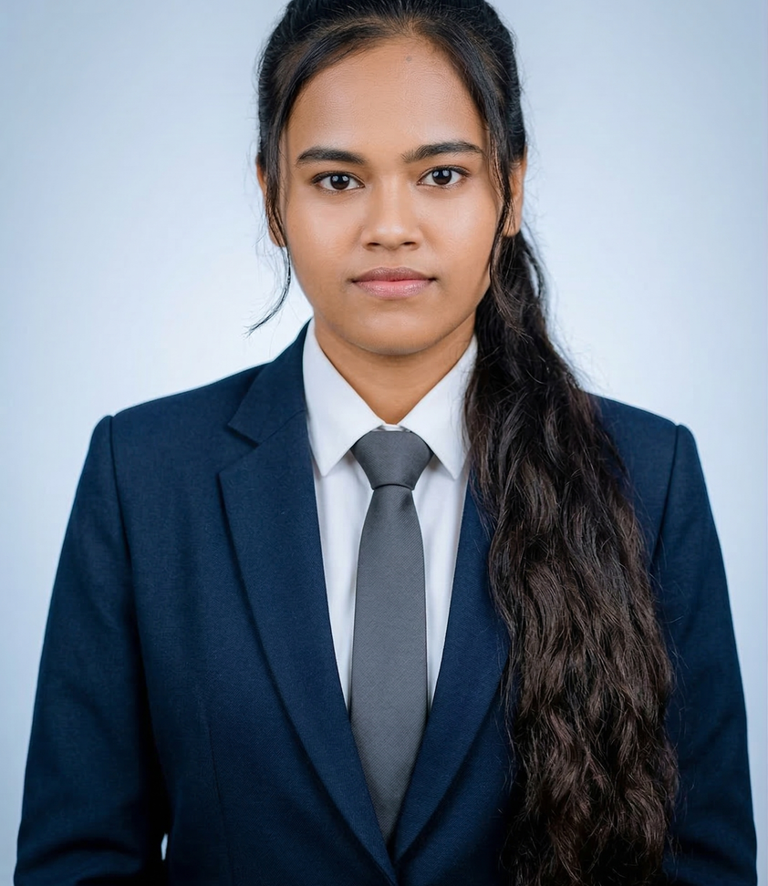
IT22547460 | Shamindi E.E.
Component 4 — Integrated Feasibility Advisor
Builds the bill of quantities in the standard national format
Prices it from current market rates, showing how old each rate is
Creates the construction schedule, including approval waiting time
Predicts the building's service life and the 50-year running cost
Fit
Where the three upstream parts become one number.
Evidence
Tested on data the model never saw; predictions plotted against actuals.
Limitation
Market rates change, so an old bill has to be re-priced before use.
IT22547460 | Emalsha Shamindi | R26-IT-154
Notes:
Emalsha Shamindi — Component 4 — Integrated Feasibility Advisor. Fit: Where the three upstream parts become one number. Evidence: Tested on data the model never saw; predictions plotted against actuals. Limitation: Market rates change, so an old bill has to be re-priced before use.

Slide 9
Results — How the System Was Validated
C1 — boundary measured on a surveyed plot and compared with the deed area
C2 — extracted quantities checked against hand-measured plans
C2 — every clash the system corrects is automatically re-checked
C3 — every reported violation traced back to the official requirement
C4 — tested on data the model never saw, predictions plotted against actuals
Full analysis completes in about a second on an ordinary laptop
The detailed figures for each component are reported in the thesis.
Notes:
Rather than reading numbers out, this slide shows how each component was checked. The detector over-reports rather than misses, which is the safer error for a quantity take-off. The full tables are in the thesis.

Slide 10
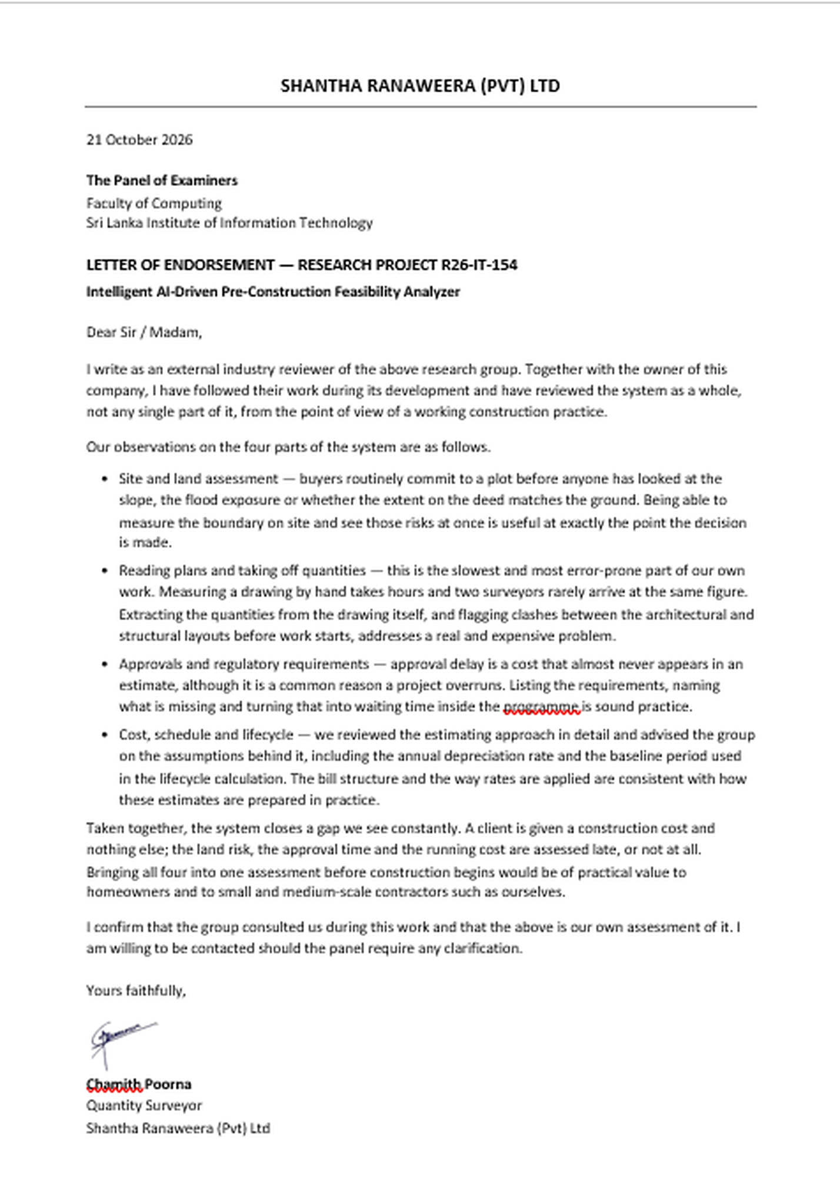
User Feedback and Testimonials
Industry review
Shantha Ranaweera (Private) Limited
Reviewed by the company's quantity surveyor, Chamith Poorna, and by the company owner
Both followed the project through development and reviewed the complete system, not one component
They advised on the estimating assumptions, including the depreciation rate and the lifecycle baseline
Their signed letter of endorsement is attached and available to the panel
A structured acceptance test with further practitioners is scheduled before the thesis submission.
Signed 21 October 2026
Notes:
Two industry reviewers from Shantha Ranaweera (Private) Limited — their quantity surveyor and the company owner — followed the project and signed a letter of endorsement covering the whole system. The signed letter is available for the panel.

Slide 11
Limitations of the System
Scope is single-storey residential projects in one local authority area
Boundary accuracy depends on the phone's GPS and an open view of the sky
Plan reading is tuned to standard 2D drawings; a poor scan lowers accuracy
Market rates change, so an old bill of quantities must be re-priced
The system advises — the approval decision still rests with the authority
Notes:
These are scope limits, not data problems. We would rather state a limit than defend something we cannot support.

Slide 12
Future Improvements
Extend from single-storey homes to multi-storey and commercial projects
Cover every local authority in Sri Lanka, not one jurisdiction
Submit approval applications directly to the authority from the platform
Price the bill from live contractor and supplier quotations
Build a national cost and lifecycle database from completed projects
Public mobile release, with a 3D walkthrough the client can view on site
Notes:
These are scheduled before the thesis submission. Thank you — we are happy to take questions.

