Slide 1
GRAPHS

Slide 2
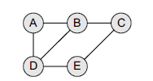

Graph Definition
A graph G is defined as an ordered set (V, E), where
V(G) represents the set of vertices and E(G) represents the edges that connect these vertices.
V(G) = {A, B, C, D and E}
E(G) = {(A, B), (B, C), (A, D), (B, D), (D, E), (C, E)}.
There are five vertices or nodes and six edges in the graph.
A graph can be directed or undirected.
In an undirected graph, edges do not have any direction associated with them. That is, nodes can be traversed from A to B as well as from B to A.
In a directed graph, edges form an ordered pair. If there is an edge from A to B, then there is a path from A to B but not from B to A.
The edge (A, B) is said to initiate from node A (also known as initial node) and terminate at node B (terminal node).

Slide 3
Graph Terminology
Adjacent nodes or neighbors
For every edge, e = (u, v) that connects nodes u and v, the nodes u and v are the end-points and are said to be the adjacent nodes or neighbors.
Degree of a node
Degree of a node u, deg(u), is the total number of edges containing the node u.
Alternatively, Degree is the number of edges connected to a vertex
If deg(u) = 0, it means that u does not belong to any edge and such a node is known as an isolated node.

Slide 4
Path A path P written as P = {v0, v1, v2, ..., vn), of length n from a node u to v is defined as a sequence of (n+1) nodes. Here, u = v₀, v = v_{n} and v_{i–1} is adjacent to vi for i = 1, 2, 3, ..., n.
Closed path A path P is known as a closed path if the edge has the same end-points. That is, if v₀ = v_{n}.
Cycle A path in which the first and the last vertices are same. A simple cycle has no repeated edges or vertices (except the first and last vertices).
Simple path A path P is known as a simple path if all the nodes in the path are distinct with an exception that v0 may be equal to vn. If v0 = vn, then the path is called a closed simple path.

Slide 5
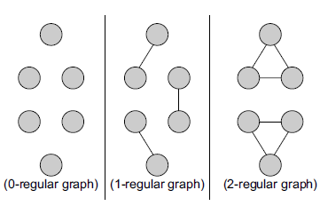
Regular graph:
It is a graph where each vertex has the same number of neighbors. That is, every node has the same degree.
A regular graph with vertices of degree k is called a k–regular graph or a regular graph of degree k.
Figure shows regular graphs.

Slide 6

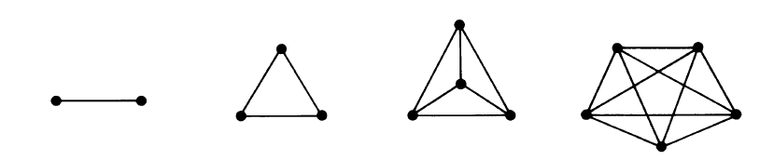
Connected graph A graph is said to be connected if for any two vertices (u, v) in V there is a path from u to v. That is to say that there are no isolated nodes in a connected graph.
A connected graph that does not have any cycle is called a tree. Therefore, a tree is treated as a special graph.
Complete graph A graph G is said to be complete if all its nodes are fully connected. That is, there is a path from one node to every other node in the graph. A complete graph has n(n–1)/2 edges, where n is the number of nodes in G.

Slide 7


Labelled graph or weighted graph.
In a weighted graph, the edges of the graph are assigned some weight or length. The weight of an edge denoted by w(e) is a positive value which indicates the cost of traversing the edge.
Multiple edges Distinct edges which connect the same
end-points are called multiple edges.
That is, e = (u, v) and e' = (u, v) are known as multiple edges of G.
Loop An edge that has identical end-points is called a loop. That is, e = (u, u).
Multi-graph A graph with multiple edges and/or loops is called a multi-graph.
Size of a graph The size of a graph is the total number of edges in it.

Slide 8
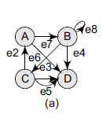
Directed Graphs
A directed graph G, also known as a digraph, is a graph in which every edge has a direction assigned to it. An edge of a directed graph is given as an ordered pair (u, v) of nodes in G.
For an edge (u, v),
The edge begins at u and terminates at v.
u is known as the origin or initial point of e. Correspondingly, v is known as the destination or terminal point of e.
u is the predecessor of v. Correspondingly, v is the successor of u.
Nodes u and v are adjacent to each other.

Slide 9
Terminology of a Directed Graph
Out-degree of a node The out-degree of a node u, written as outdeg(u), is the number of edges that originate from u.
In-degree of a node The in-degree of a node u, written as indeg(u), is the number of edges that terminate at u.
Degree of a node The degree of a node, written as deg(u), is equal to the sum of in-degree and out-degree of that node.
Therefore, deg(u) = indeg(u) + outdeg(u).
Isolated vertex A vertex with degree zero. Such a vertex is not an end-point of any edge.
Pendant vertex (also known as leaf vertex) A vertex with degree one.

Slide 10
Transitive Closure of a Directed Graph
For a directed graph G = (V,E), the transitive closure of G is a graph G* = (V,E*). In G*, for every vertex pair v, w in V there is an edge (v, w) in E* if and only if there is a valid path from v to w in G.
Where and Why is it Needed?
Finding the transitive closure of a directed graph is an important problem in the following computational tasks:
Transitive closure is used to find the reachability analysis of transition networks representing distributed and parallel systems.
It is used in the construction of parsing automata in compiler construction.
transitive closure computation is being used to evaluate recursive database queries (because almost all practical recursive queries are transitive in nature).

Slide 11
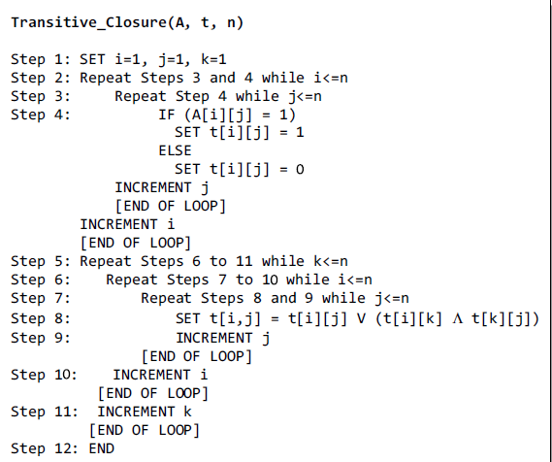
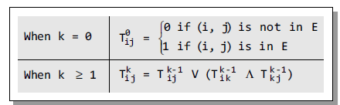
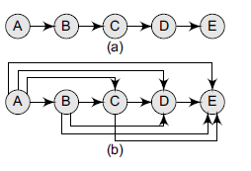

Algorithm for finding Transitive Closure

Slide 12
REPRESENTATION OF GRAPHS
There are two common ways of storing graphs in the computer’s memory. They are:
Sequential representation by using an adjacency matrix.
Linked representation by using an adjacency list that stores the neighbors of a node using a linked list.

Slide 13
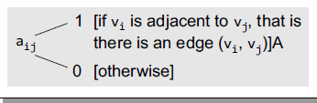
Adjacency Matrix Representation
An adjacency matrix is used to represent which nodes are adjacent to one another.
By definition, two nodes are said to be adjacent if there is an edge connecting them.
In a directed graph G, if node v is adjacent to node u,
then there is definitely an edge from u to v. That is, if v is adjacent to u, we can get from u to v by traversing one edge.
For any graph G having n nodes,
the adjacency matrix will have the dimension of n × n.
.

Slide 14
Adjacency Matrix Representation
An adjacency matrix is used to represent which nodes are adjacent to one another.
In an adjacency matrix, the rows and columns are labeled by graph vertices.
An entry aij in the adjacency matrix will contain 1, if vertices vi and vj are adjacent to each other.
If the nodes are not adjacent, aij will be set to zero.
Since an adjacency matrix contains only 0s and 1s, it is called a bit matrix or a Boolean matrix.
The entries in the matrix depend on the ordering of the nodes in G. Therefore, a change in the order of nodes will result in a different adjacency matrix.

Slide 15
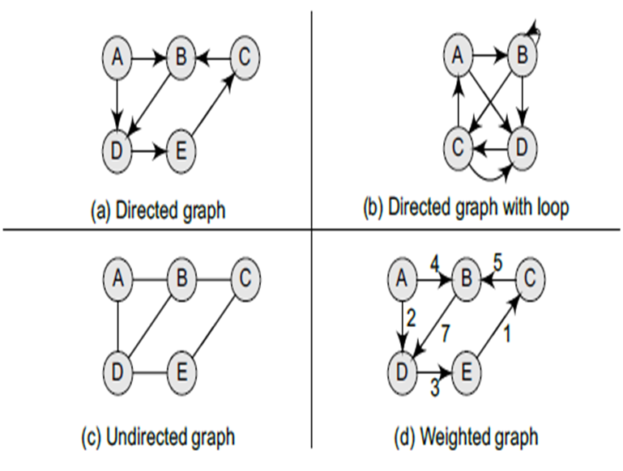
Examples - Adjacency Matrix Representation

Slide 16
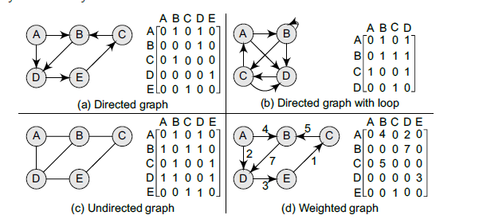
Examples - Adjacency Matrix Representation

Slide 17
From the above examples, we can draw the following conclusions:
For a simple graph (that has no loops), the adjacency matrix has 0s on the diagonal.
The adjacency matrix of an undirected graph is symmetric.
The memory use of an adjacency matrix is O(n²), where n is the number of nodes in the graph.
Number of 1s (or non-zero entries) in an adjacency matrix is equal to the number of edges in the graph.
The adjacency matrix for a weighted graph contains the weights of the edges connecting the nodes.

Slide 18
Adjacency List Representation
This structure consists of a list of all nodes in G.
Every node is in turn linked to its own list that contains the names of all other nodes that are adjacent to it.
The key advantages of using an adjacency list are:
It is easy to follow and clearly shows the adjacent nodes of a particular node.
It is often used for storing graphs that have a small-to-moderate number of edges. That is, an adjacency list is preferred for representing sparse graphs in the computer’s memory; otherwise, an adjacency matrix is a good choice.
Adding new nodes in G is easy and straightforward when G is represented using an adjacency list.
Adding new nodes in an adjacency matrix is a difficult task, as the size of the matrix needs to be changed and existing nodes may have to be reordered.

Slide 19
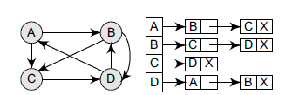
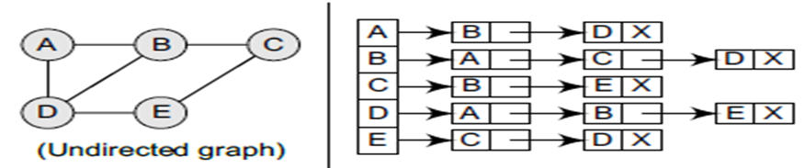

Examples- Adjacency List Representation

Slide 20

Represent the graph using 1. Adjency list 2. Adjency Matrix

Slide 21
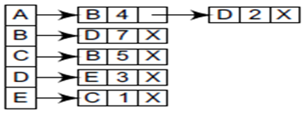
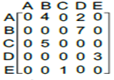

Slide 22
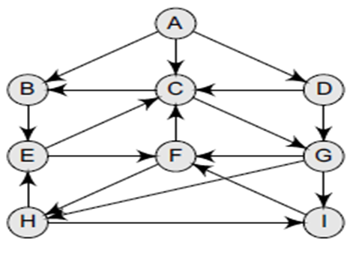
Represent the graph using 1. Adjency list 2. Adjency Matrix

Slide 23
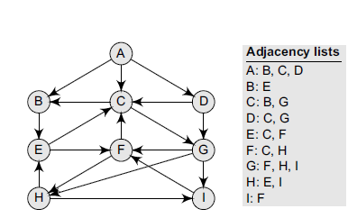

Slide 24
Video Lectures on Graphs can be found at following link
Graphs in Data Structures
https://youtu.be/5F6EGkM11M8
Finding Transitive Closure of Graph
https://youtu.be/3d-aVMItpTs
Graph representation in Computer's memory
https://youtu.be/lVxOlVnYL-8
Breadth First Search (BFS) Traversal Algorithm
https://youtu.be/7U9l4C4Qvlo
Depth First Search (DFS) Traversal Algorithm and Example
https://youtu.be/Zb5Iagxs6Og

