Slide 1
BCSE308L / BCSE308P • COMPUTER NETWORKS
FINAL COURSE
PROJECT REVIEW
Agent-Aware Networking: In-Network Classification and QoS for AI-Agent Traffic
Team ID: ______
Team members & register numbers:
Shashank Bhat M (24BDS0390)
Ananya Ganesan (24BDS0406)
Jobin John (24BDS0419)
Faculty mentor: Dr. Yoganand S
Review date: October 2026
Agent-Aware Networking • BCSE308L Final Review
Notes:
Agent-Aware Networking: a P4 switch that recognises AI-agent traffic per packet and gives each class its own QoS lane in the same pipeline pass. This final review covers the complete design, what we built and verified, our key findings and the future scope.

Slide 2
BCSE308L / BCSE308P • COMPUTER NETWORKS • FINAL COURSE PROJECT REVIEW
Project snapshot
PROBLEM
SOLUTION
OUTCOME
Agent tool-call bursts and human video calls are both TLS on port 443, so a switch queues them together and human p99 latency spikes.
A P4 switch labels every packet human, agent-interactive, agent-bulk or unknown with an in-switch decision tree and applies per-class QoS in the same pass.
Switch tables match the trained tree on 2,283 / 2,283 rows. Live BMv2 run verified the CPU punt, TLS registers and a DSCP 34 override.
At-a-glance
Target metric
Design target: human p99 −30% vs best baseline, <5% overhead
Environment
P4₁₆ on BMv2, Mininet choke_v1, Python SDN controller
Status
Built and verified: P4 pipeline compiled, live BMv2 path, 100% table equivalence
Contribution
Agent classification and QoS coupled in one pipeline pass
Agent-Aware Networking • Shashank Bhat M, Ananya Ganesan, Jobin John
02
Notes:
One-line summary. Problem: the network cannot tell agent bursts from human traffic. Solution: classify in the switch and act in the same pass. Outcome: bit-exact switch tables and a verified live packet path. Measuring the latency target on the Mininet grid is future scope.

Slide 3
BCSE308L / BCSE308P • COMPUTER NETWORKS • FINAL COURSE PROJECT REVIEW
Problem statement, objectives and scope
PROBLEM STATEMENT
OBJECTIVES
Switches cannot tell AI-agent traffic from human traffic: same TLS, ports and browsers.
53% of web traffic is automated [9]; 50 parallel MCP calls share one queue with a video call.
Label every packet in the switch: 4 classes, depth‑8 tree
Apply per-class DSCP, priority queue, ECN and meter in the same pass
Never block: uncertainty falls back to best effort (fail-open)
SCOPE AND ASSUMPTIONS
SUCCESS CRITERIA
Included: P4/BMv2 data plane, Python controller, offline ML, Mininet harness and four baselines
Assumptions: one choke-point switch, IPv4, 10–50 Mbps bottleneck; QoS only, never blocking
100% tree-to-table agreement (met: 2,283 / 2,283)
Live switch forwards, punts and marks per class (met on BMv2)
Restart-safe policy push: idempotent re-push (met, pytest)
Future scope: show ≥30% lower human p99 at <5% overhead
Agent-Aware Networking • Shashank Bhat M, Ananya Ganesan, Jobin John
03
Notes:
Both an agent's tool-call burst and a human call look like TLS on 443, so they share a queue. Objectives: line-rate classification, same-pass QoS, fail-open. Two success criteria are met and verified. Quantifying the latency target on the Mininet grid is future scope.

Slide 4
BCSE308L / BCSE308P • COMPUTER NETWORKS • FINAL COURSE PROJECT REVIEW
Background and related work
NETWORKING CONCEPTS
EXISTING APPROACHES
DiffServ DSCP [6], strict-priority queues, ECN [7], two-rate meters
SDN split; P4 parsing and match-action tables [1]
TLS ClientHello stays plaintext even in TLS 1.3
In-network ML [2]–[4], [10]: trees in switch tables, no QoS
Edge bot detection [8]: terminates TLS, allow/block only
DiffServ [6] marks by port or application, not by source
Related-work comparison
Method / source | Approach | Limitation | How our project differs
IIsy [2] / pForest [3] | Trees and forests mapped to match-action tables | Generic app classes; label not tied to QoS | Agent identity drives queue, DSCP, meter
Mousika [4] / Planter [10] | Distilled or automated trees on switches | Classification only | Same recipe plus fail-open QoS action
ACC-Turbo [5] | In-switch clustering → priority scheduling | Keyed on DDoS aggregates | Keyed on per-flow agent behaviour
Edge bot detection / Web Bot Auth [8] | CDN/WAF inspects HTTP after TLS termination | Allow/block; sees only proxied traffic | Line rate, no TLS termination, QoS not blocking
DiffServ [6] | Port/application-based DSCP marking | Cannot see who generates traffic | Behavioural features set the DSCP
Agent-Aware Networking • Shashank Bhat M, Ananya Ganesan, Jobin John
04
Notes:
In-network ML papers show trees can run in switch tables but stop at classification. ACC-Turbo is the closest classification-to-action precedent but targets DDoS. Edge bot detection blocks rather than schedules. We couple agent identity to QoS.

Slide 5
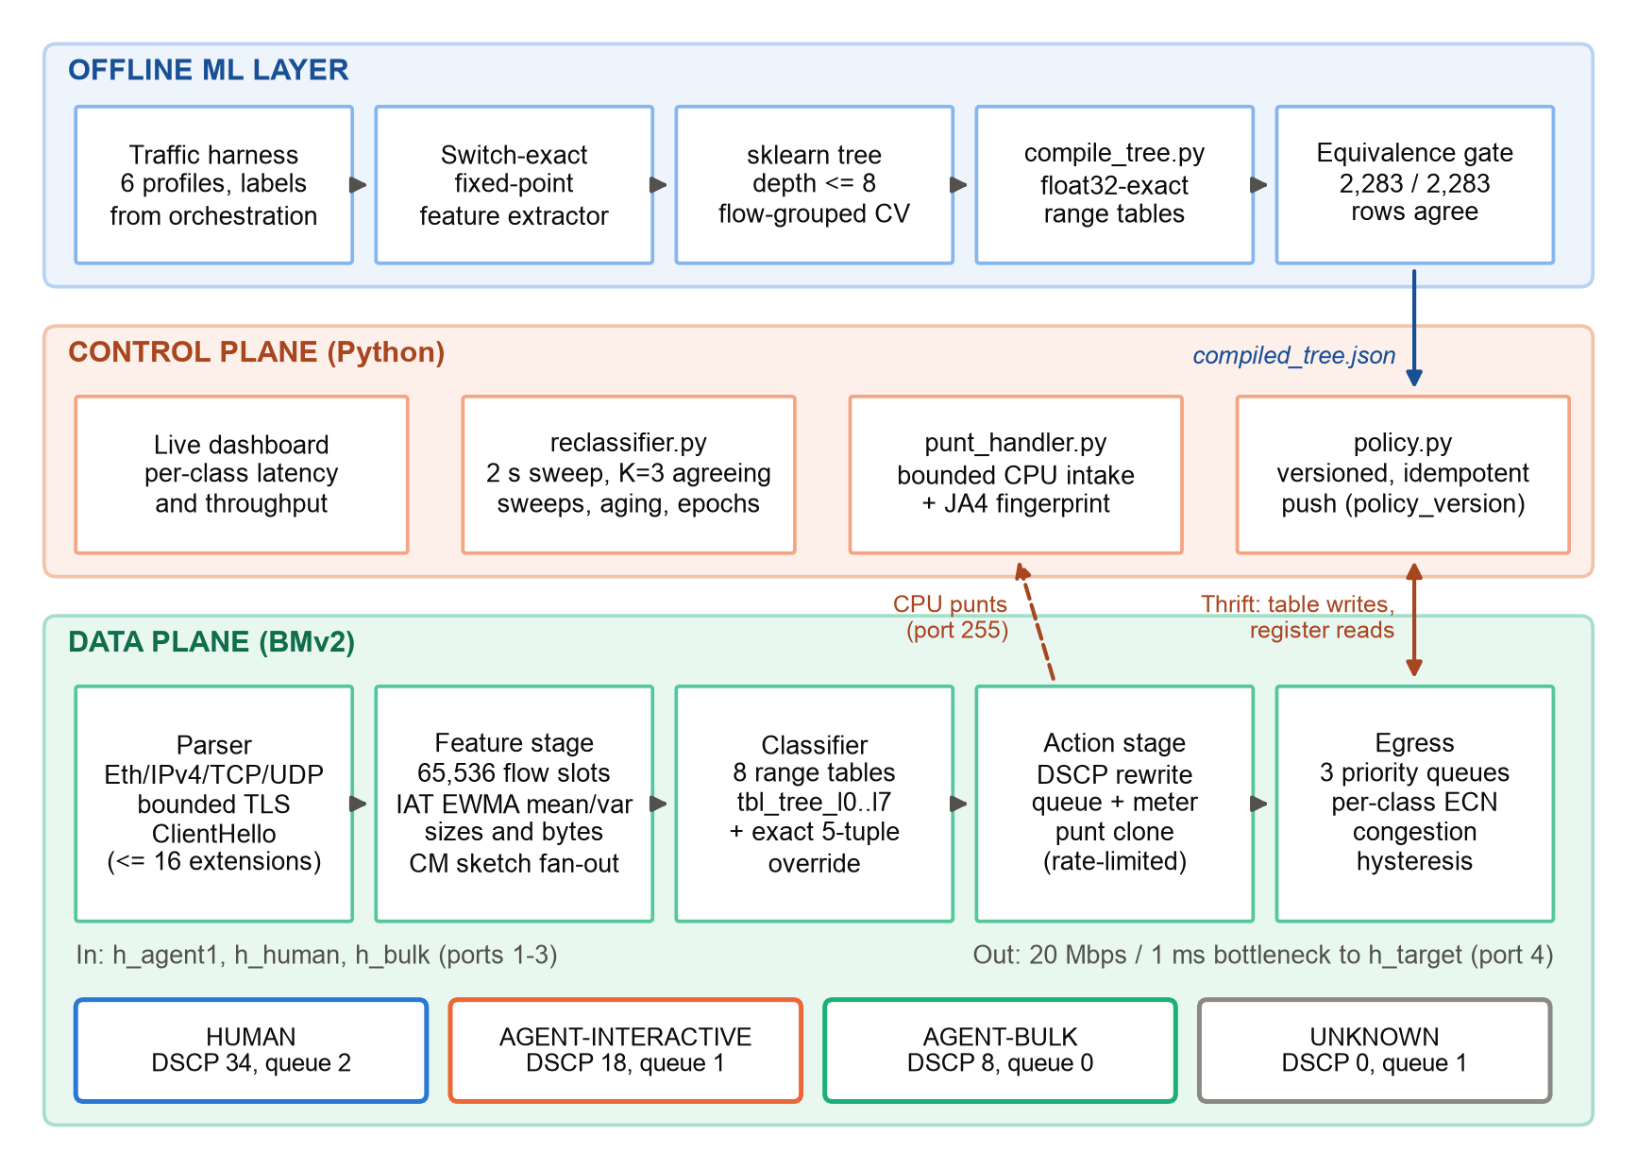
BCSE308L / BCSE308P • COMPUTER NETWORKS • FINAL COURSE PROJECT REVIEW
Proposed system architecture
ARCHITECTURE DIAGRAM
COMPONENTS
Data plane: agent_aware.p4 on BMv2
Controller: policy, punts, reclassifier
Offline ML: tree → range tables
DESIGN DECISIONS
The per-packet decision never leaves the switch; the tree runs as range tables, shifts only.
NETWORK PARAMETERS
10.0.0.0/24: h_agent1 .1, h_human .2, h_bulk .3 → h_target .100
Switch ports 1–4, CPU port 255; bottleneck 20 Mbps, 1 ms
DSCP 34 / 18 / 8 / 0 → queue 2 / 1 / 0 / 1
Agent-Aware Networking • Shashank Bhat M, Ananya Ganesan, Jobin John
05
Notes:
Three layers. The data plane parses, updates flow features, walks the compiled tree and applies the class treatment on every packet. The controller only refines: policy push, first-packet punts and periodic reclassification. The offline layer trains and compiles the tree and gates it on 100% equivalence.

Slide 6
BCSE308L / BCSE308P • COMPUTER NETWORKS • FINAL COURSE PROJECT REVIEW
Implementation and configuration
TOOLS AND ENVIRONMENT
IMPLEMENTATION STEPS
P4₁₆ v1model, p4c-bm2-ss (p4lang/p4c Docker)
BMv2 simple_switch with --priority-queues 3; Mininet
Python 3.11 ML/eval; scikit-learn, pandas, Scapy, pytest
Freeze contracts: classes, features, table names
Mirror the P4 fixed-point maths in Python
Train depth‑8 tree, compile, gate on 100% match
Build P4 pipeline and controller; verify on BMv2
KEY CONFIGURATION / CODE
DEMO EVIDENCE
HUMAN_INTERACTIVE dscp=34 queue=2 ecn=48
AGENT_INTERACTIVE dscp=18 queue=1 meter=M_AI
AGENT_BULK dscp=8 queue=0 meter=M_AB
UNKNOWN dscp=0 queue=1 (fail-open)
iat_ewma += (d - iat_ewma) >> 3 // saturating
Live BMv2: ClientHello forwarded byte-identical; CPU header e8 d6 00 01 00 01 00 00
reg_proto_meta = 33794; HUMAN override → DSCP 34
Offline demo: run_demo.sh, about 11 s, seed 1
Agent-Aware Networking • Shashank Bhat M, Ananya Ganesan, Jobin John
06
Notes:
The contracts file fixes every shared name and value. A Python mirror of the switch's fixed-point arithmetic prevents train/serve skew. The class map on the left is the frozen treatment table that the controller pushes at startup.

Slide 7
BCSE308L / BCSE308P • COMPUTER NETWORKS • FINAL COURSE PROJECT REVIEW
Test plan and validation
TEST SCENARIOS
EXPECTED RESULTS
OBSERVED RESULTS
Normal: ClientHello through live BMv2
Edge: punt header, override, fail-open
Restart: controller re-pushes policy
Byte-identical forwarding; right class and DSCP
Tree vs switch tables: 100% agreement
Re-push idempotent; version checked
All live BMv2 checks passed
2,283 / 2,283 rows agree; 479 tests pass
Test matrix
Test ID | Input / condition | Expected | Observed | Status / evidence
T1 Equivalence | 2,283 held-out feature rows | Tree = switch tables | 0 mismatches | Pass · equivalence.json
T2 Forwarding | 156 B ClientHello on port 1 | Same bytes on port 4 | Byte-identical | Pass · live BMv2
T3 Punt | First packet of a flow | CPU clone + 8 B header | e8 d6 00 01 00 01 00 00 | Pass · port 255
T4 TLS parse | ClientHello, 4 ext, ALPN h2 | Fields in reg_proto_meta | 33794 (0x8402) | Pass · register read
T5 Override | HUMAN entry in tbl_flow_override | Next packet DSCP 34 | DSCP 34 | Pass · live BMv2
T6 Host suite | Unit and property tests | All pass | 479 passed, 1 skipped | Pass · pytest
T7 Policy push | Controller restart, full re-push | Idempotent; policy_version checked | No duplicate entries | Pass · pytest (test_policy.py)
Agent-Aware Networking • Shashank Bhat M, Ananya Ganesan, Jobin John
07
Notes:
All seven tests pass with recorded evidence. T2 to T5 come from one live BMv2 run driven by the controller's own switch API. T7 checks that a controller restart re-pushes policy idempotently. The one skipped host test is the PTF module, which runs on a Linux BMv2 host.

Slide 8
BCSE308L / BCSE308P • COMPUTER NETWORKS • FINAL COURSE PROJECT REVIEW
Results and performance analysis
HELD-OUT RECALL BY CLASS (%)
KEY FINDING 1
Switch tables reproduce the tree exactly on all 2,283 held-out rows (zero mismatches). CV macro-F1 0.805 ± 0.015.
KEY FINDING 2
MCP tool-calling agents: 98.1% recall. Browser agents: 25.1%; most read as human (same Chromium TLS, pacing).
SCOPE
Depth-8 tree; 20% of flows held out (2,283 rows); synthetic corpus, seed 1. Offline evaluation, not live P4.
Evaluated offline on a seeded synthetic corpus; the live p99 and overhead grid is future scope.
Agent-Aware Networking • Shashank Bhat M, Ananya Ganesan, Jobin John
08
Notes:
Measured on the held-out 20% of flows. Agent-bulk and human recall are high; agent-interactive falls as packets accumulate because browser agents look human. The compiled tables agree with the tree on every held-out row, so whatever the tree learns is exactly what the switch will do.

Slide 9
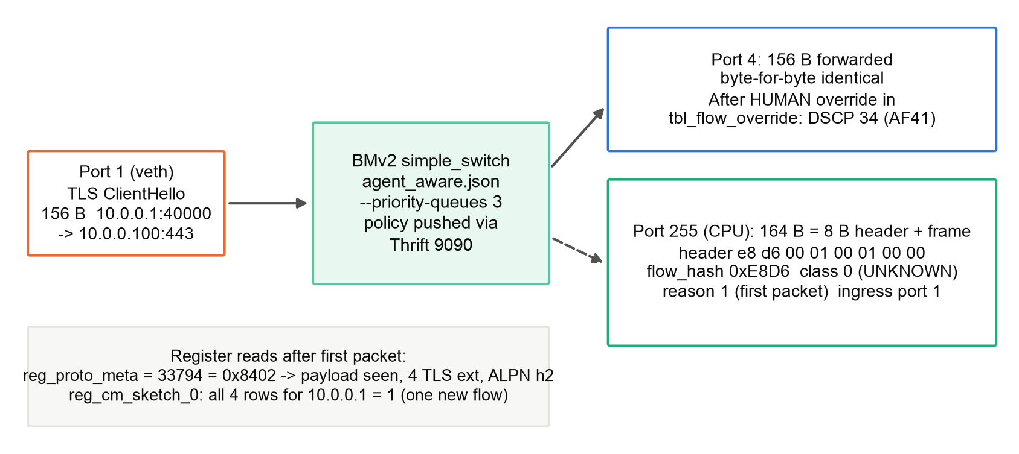
BCSE308L / BCSE308P • COMPUTER NETWORKS • FINAL COURSE PROJECT REVIEW
Packet flow, protocol analysis or live demonstration
LIVE BMv2 PACKET RUN (build/bmv2_smoke.py)
WHAT THE EVIDENCE SHOWS
One ClientHello exercises the whole path: forwarding, first-packet punt, TLS parse, CM sketch and a controller override.
DEMO SCRIPT
Push policy and tree over Thrift 9090
Send a ClientHello on port 1; identical bytes leave port 4
Read the CPU header and reg_proto_meta = 33794
Install a HUMAN override; the next packet has DSCP 34
Agent-Aware Networking • Shashank Bhat M, Ananya Ganesan, Jobin John
09
Notes:
This is the live switch evidence. The first packet is forwarded unchanged and cloned to the CPU port with our 8-byte header: class UNKNOWN because of the 6-packet warm-up, reason 1 first packet. The parser recorded four TLS extensions and ALPN h2. After the controller installs an override, the next packet leaves with DSCP 34.

Slide 10
BCSE308L / BCSE308P • COMPUTER NETWORKS • FINAL COURSE PROJECT REVIEW
Contribution, learning outcomes and CO mapping
PROJECT CONTRIBUTION
FUTURE SCOPE
A P4 pipeline coupling agent classification and QoS
Bit-exact tree compiler with a 100% equivalence gate
Punt and override loop verified on live BMv2
Mininet four-baseline grid: human p99 and overhead
Real agent-framework captures and retraining
Cross-flow session features for browser agents
Course outcome mapping — edit to match official course COs
Course outcome | Project evidence | Member contribution | Evidence location
Layered protocols and packet headers | Bounded Eth/IPv4/TCP/UDP/TLS parser, fail‑open | Ananya (parser), Shashank (mirror) | p4src/parser.p4, headers.p4
Switching and QoS: DiffServ, queues, ECN | Per-class DSCP, queue, ECN, meter | Ananya, Shashank | p4src/qos*.p4, common/contracts.py
SDN and programmable data planes | Versioned policy push, punts, reclassifier | Shashank | controller/
Network performance evaluation | Runner, p99 and CI metrics, baselines | Jobin, Shashank | eval/, harness/, results/
Agent-Aware Networking • Shashank Bhat M, Ananya Ganesan, Jobin John
10
Notes:
What we contribute, and how it maps to course outcomes. The CO wording should be aligned with the official course outcome list before submission.

Slide 11
BCSE308L / BCSE308P • COMPUTER NETWORKS • FINAL COURSE PROJECT REVIEW
Team contribution and project management
Individual accountability
Member / ID | Responsibility | Work completed / evidence | Contribution (%)
Shashank Bhat M (24BDS0390) | Contracts, controller, ML pipeline, integration | common/, controller/, ml/: policy push, equivalence gate, reclassifier | ~33%
Ananya Ganesan (24BDS0406) | P4 data plane: parser, features, classifier, QoS | p4src/: TLS parser, CM sketch, egress QoS, DiffServ baseline | ~33%
Jobin John (24BDS0419) | Harness, baselines, metrics, dashboard | harness/, eval/, dashboard/: FIFO, fair-queue, app-limiter adapters | ~33%
MILESTONES
REPOSITORY / REFERENCES
Review 1, 9 Sep 2026: contracts, M1 prototype → done
Review 2: TLS parser, tree compiler, equivalence → done
Final, Oct 2026: pipeline compiled, live BMv2 → done
Future scope: Mininet QoS grid, real agent corpus
github.com/ShawShank-Devmption/AgentQOS
Project report and IEEE paper draft
Key references: [1]–[8], slide 13
Agent-Aware Networking • Shashank Bhat M, Ananya Ganesan, Jobin John
11
Notes:
Each member owned one layer: Ananya the data plane, Shashank the contracts, controller and ML pipeline, Jobin the harness, baselines and metrics. Work was split equally.

Slide 12
BCSE308L / BCSE308P • COMPUTER NETWORKS • FINAL COURSE PROJECT REVIEW
Conclusion and key takeaways
WHAT WAS ACHIEVED?
WHAT DID YOU LEARN?
One-pass P4 pipeline: 33 tables, 3.45 MiB state
Live BMv2: punt, TLS metadata, DSCP 34 override
2,283 / 2,283 tree–table agreement
MCP agents 98.1% recall; bulk 99.3–100%
Browser agents read as human per flow: 25.1%
Post-quantum ClientHellos (to 1,899 B) span 2 segments
BMv2 needs --priority-queues 3 for class priority
float32 splits above 2²⁴ need exact integer bounds
SCOPE OF EVALUATION
FUTURE SCOPE
Classifier evaluated offline on a seeded synthetic corpus
Data plane verified on a live BMv2 switch
Controller: standalone Thrift daemon, Ryu-compatible
Mininet grid: 5 systems × 5 seeds, p99 and overhead
Real agent captures; session-level features
Scaling to 100k flows; Tofino hardware
Thank you • Questions & Discussion
Agent-Aware Networking • Shashank Bhat M, Ananya Ganesan, Jobin John
12
Notes:
We built the pipeline and verified it end to end on a live software switch, with bit-exact compilation. Key findings: browser agents look human within a flow; post-quantum ClientHellos of up to 1,899 bytes no longer fit one segment, so in-switch TLS features are eroding; and BMv2 needs three priority queues configured explicitly. Measuring human p99 protection on the Mininet grid is the main future scope.

Slide 13
BCSE308L / BCSE308P • COMPUTER NETWORKS • FINAL COURSE PROJECT REVIEW
References and supporting material
REFERENCES
APPENDIX / REPOSITORY
[1] P. Bosshart et al., “P4: Programming protocol-independent packet processors,” ACM SIGCOMM CCR, 2014.
[2] Z. Xiong and N. Zilberman, “Do switches dream of machine learning?” ACM HotNets, 2019.
[3] C. Busse-Grawitz et al., “pForest: In-network inference with random forests,” arXiv:1909.05680, 2019.
[4] G. Xie et al., “Mousika: Enable general in-network intelligence in programmable switches,” IEEE INFOCOM, 2022.
[5] A. G. Alcoz et al., “Aggregate-based congestion control for pulse-wave DDoS defense,” ACM SIGCOMM, 2022.
[6] K. Nichols et al., “Definition of the DS field,” RFC 2474, IETF, 1998.
[7] K. Ramakrishnan et al., “The addition of ECN to IP,” RFC 3168, IETF, 2001.
[8] A. Backman et al., “HTTP Message Signatures,” RFC 9421, IETF, 2024.
[9] Thales/Imperva, “2026 Imperva Bad Bot Report,” 2026.
[10] C. Zheng et al., “Automating in-network machine learning,” arXiv:2205.08824, 2022.
Code: AgentQOS on GitHub (link on slide 11)
Data: synthetic corpus, results/fanout_fix_20261028
Live run: build/bmv2_smoke.py
FINAL REVIEW CHECKLIST
✓ Results are measured (offline and live BMv2)
✓ Contributions identified (slide 11)
✓ References listed in IEEE style
✓ Screenshots readable
✓ No sensitive data (lab IPs only)
Agent-Aware Networking • Shashank Bhat M, Ananya Ganesan, Jobin John
13
Notes:
References in IEEE style. Every result in the deck is measured, either offline on the synthetic corpus or on a live BMv2 switch.

Slide 14
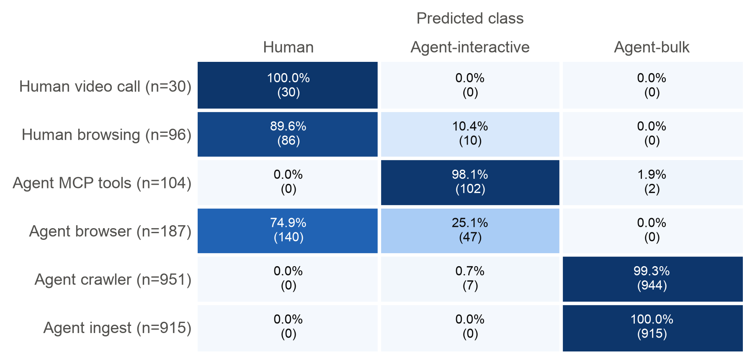
QUESTIONS & DISCUSSION
Thank you. Backup: where the classifier errs.
BACKUP: HELD-OUT CONFUSION BY WORKLOAD PROFILE (ROW %)
Rows are the generating workload (ground truth).
Browser agents share Chromium TLS and human-like pacing; session-grouped CV recall is 35.9% (MCP agents: 97.1%).
A 100-tree forest lifts browser recall to 65.4% but human-browsing recall falls to 46.1%.
BCSE308L / BCSE308P • Computer Networks
Notes:
Backup for questions on accuracy. Tool-calling agents and bulk agents separate cleanly; browser-driven agents do not, because per-flow features cannot see the between-page think time that distinguishes them. That needs session-level features.

