Slide 1
Agent-Aware Networking: In-Network Classification and QoS for AI-Agent Traffic
Line-rate human vs. AI-agent traffic classification in a P4 / BMv2 switch, using a compiled decision tree and a Ryu control plane
Shashank Bhat M (24BDS0390) • Ananya Ganesan (24BDS0406) • Jobin John (24BDS0419)
Dr. Yoganand S
Notes:
Agent-Aware Networking, AgentQOS. A P4 switch that tells AI-agent traffic from human traffic at line rate and gives each class its own QoS treatment. Review 2 covers the implementation since Review 1 on 9 September.

Slide 2




Review-2 Progress Agenda
EVALUATION SCOPE
1. Architecture
2. Implementation
3. Initial Testing
4. Pending Goals
Frozen contracts, three-layer design, P4 register and table map.
TLS-aware P4 parser, tree trainer and compiler, controller push, traffic harness.
Equivalence gate, P4 parser test suite, classification on a synthetic corpus.
In-switch feature registers, live classification, QoS actions, real-traffic corpus.
100% COMPLETED
REVIEW-2 FOCUS
IN PROGRESS
PLANNED (R3)
Notes:
Four parts. Architecture and contracts are complete. Implementation is today's focus. Testing is under way on a synthetic corpus. The in-switch classifier and QoS are Review-3 work.

Slide 3


Problem Statement & Objectives
PROJECT FOUNDATION
Problem Statement
Core Objectives
Indistinguishable traffic: an agent firing 50 parallel MCP tool calls and a human video call are both TLS on port 443, so they share one queue.
Detection off the forwarding path: bot detection runs at the HTTP/CDN edge, terminates TLS, and can only allow or block.
QoS blind to agents: DiffServ marks by port and application, not by who generates the traffic.
Line-rate classification: label every packet human, agent-interactive, agent-bulk or unknown with a depth-8 tree in switch tables.
Same-pass QoS: DSCP, priority queue, ECN threshold and meter applied per class.
Human protection: ≥30% lower human p99 latency than the best of four baselines, with <5% added per-packet latency.
Fail-open: uncertainty never blocks traffic; unknown flows get best effort.
Notes:
The problem: the network cannot tell an agent's burst of tool calls from a human's video call, because both are TLS on port 443. The objectives are line-rate classification, same-pass QoS, a measurable human-latency target, and fail-open behaviour.

Slide 4
Network Architecture & Layering
DESIGN & FRAMEWORK
Topology Type
APPLICATION LAYER (offline ML, traffic harness, live dashboard)
Trains the tree, compiles it to table entries, generates and measures traffic
choke_v1 in Mininet: 4 agent hosts, 1 human, 1 background and 1 target on one BMv2 switch; 20 Mbps, 1 ms bottleneck.
compiled tree JSON and class policy
Protocol Stack
CONTROL LAYER (Ryu SDN controller)
Startup policy push, first-packet punts, reclassification sweep
Ethernet, IPv4, TCP and UDP; bounded TLS ClientHello parsing; DSCP and ECN marking per class.
BMv2 Thrift / CLI: table writes, register reads, punts
DATA PLANE LAYER (P4 program on BMv2)
Parser → flow features → tree tables → QoS action, on every packet
Control Logic
Every packet is handled in the switch; the controller only refines, with idempotent writes and a policy_version register.
Notes:
Three layers. Every packet is handled in the data plane: parse, update flow features, look up the compiled tree, apply the class's QoS. The controller only refines decisions and pushes policy; the offline layer trains the tree and runs the experiments.

Slide 5




Implementation Tech Stack
ENVIRONMENT & TOOLS
P4 / BMv2
Ryu / Python
scikit-learn / pandas
Mininet / Scapy / PTF
Data-plane program and software switch; p4c compiler pinned in Docker.
SDN controller on Python 3.9; ML and tooling on Python 3.11.
Depth-8 decision tree, compiled to switch range tables.
Network emulation, packet crafting and P4 data-plane tests.
Engineering gates in CI: Ruff lint and format, pytest on Python 3.11 and 3.9, p4c compile, PTF parser suite, and the sklearn-vs-switch equivalence gate.
Notes:
P4 on the BMv2 software switch for the data plane, Ryu for control, scikit-learn for the tree, and Mininet, Scapy and PTF for emulation and testing. Every change passes lint, pytest on both Python versions, the P4 compile and the equivalence gate.

Slide 6
Implementation Progress (Review-2)
MILESTONE STATUS
Module ID | Module Description | Owner | Planned | Status | Verified by
MOD-01 | Shared contracts, choke_v1 topology, M1 forwarding | All | Review 1 | Completed | Lint and pytest gate; l2fwd.p4 compiles
MOD-02 | P4 headers and TLS-aware parser (P2.1) | Ananya | Review 2 | Completed | p4c build; PTF corner-case suite written
MOD-03 | Controller switch API and startup policy push (P3.2) | Shashank | Review 2 | Completed | Restart and idempotency tests
MOD-04 | ML: feature mirror, tree training, compiler, equivalence gate | Shashank | Review 2 | In testing | 100% table agreement (synthetic)
MOD-05 | Traffic harness, baselines, metrics, live dashboard | Jobin | Review 2 | In testing | Host tests pass; Linux runs pending
MOD-06 | In-switch features, classifier wiring, QoS (P3.1, P3.10, P3.13) | Ananya | Review 3 | Not started | —
MOD-07 | Punt handler and reclassifier (P3.11) | Shashank | Review 3 | Not started | —
Status follows each task's definition of done in docs/tasks.md. “In testing”: code complete and host-tested, evidence run pending.
Notes:
Three modules are complete, two are code-complete and in testing, and two start in Review 3. In testing means the code is written and host-tested, but its evidence run is still pending.

Slide 7


Working Demo: Traffic In, Verified Switch Tables Out
LIVE DEMO
1 · TRAFFIC
2 · TRAIN
3 · COMPILE
4 · VERIFY
5 · SWITCH SIDE
4,094
0.808
56
100%
46
synthetic flows
CV macro-F1
table entries
agreement
tests pass
6 human and agent workload types; real captured TLS ClientHellos
Depth-8 tree; 5 folds grouped by flow; ±0.016
Range-match entries for tbl_tree_l0 to tbl_tree_l7
2,283 of 2,283 held-out rows: tree and simulated switch match
Restart-safe policy push; the P4 parser compiles with p4c
results/demo/run_demo.sh one command · about 11 seconds · seed 1 · identical model hash on every run
Offline pipeline on a synthetic corpus. The live switch cannot classify yet: feature registers, classifier wiring and QoS are Review-3 work.
Notes:
Run results/demo/run_demo.sh from the repository root; it takes about 11 seconds and gives the same model hash every time. Walk the five steps as they print, then open the figures. Be explicit: this is an offline pipeline on synthetic data. The live switch cannot classify yet because the feature registers, classifier wiring and QoS are Review-3 work.

Slide 8
Experimental Testbed Setup
METHODOLOGY
7
1
20 Mbps
1 ms
Mininet hosts
BMv2 switch
bottleneck link
link delay
Traffic Generation Parameters
Human traffic
Agent traffic
Synthetic corpus (today's results)
MAWI backbone trace replayed with tcpreplay at 1.0× speed, plus a paced video-call-like stream from h_human.
Four runner adapters (Browser Use, Playwright, AutoGen, Claude + MCP) call an instrumented MCP target; bursts of 5, 20 or 50 new flows/s.
6 workload profiles × 40 clients, seed 1; every packet passes through the switch-exact feature extractor.
Status: topology, runners and baselines are implemented and host-tested; the first live Mininet/BMv2 run is pending on the Linux VM.
Notes:
The choke_v1 testbed: seven Mininet hosts around one BMv2 switch, with a 20 Mbps, 1 ms bottleneck to the target. Human traffic is MAWI trace replay plus a video-call-like stream; agent traffic comes from four runner adapters hitting an instrumented MCP server. Today's results use the synthetic corpus; the first live run is pending on the Linux VM.

Slide 9
Preliminary Results Analysis
PERFORMANCE DATA
100% switch-table agreement
2,283 of 2,283 held-out rows get the same class from the compiled tables as from the trained tree.
Macro-F1 0.808 ± 0.016
Five-fold cross-validation, grouped by flow so no flow straddles a fold.
Agent-interactive is the weak class
Recall falls 61% → 43% → 33% as packets accumulate; the misses are predicted human.
Synthetic, offline corpus (seed 1; 20% of flows held out). Numbers reflect the workload model, not live traffic.
Notes:
Held-out recall per class at the three checkpoints. Agent bulk is perfect, human is 86 to 100 percent, and agent-interactive is the weak class, falling from 61 to 33 percent. The compiled switch tables agree with the trained tree on every held-out row.

Slide 10
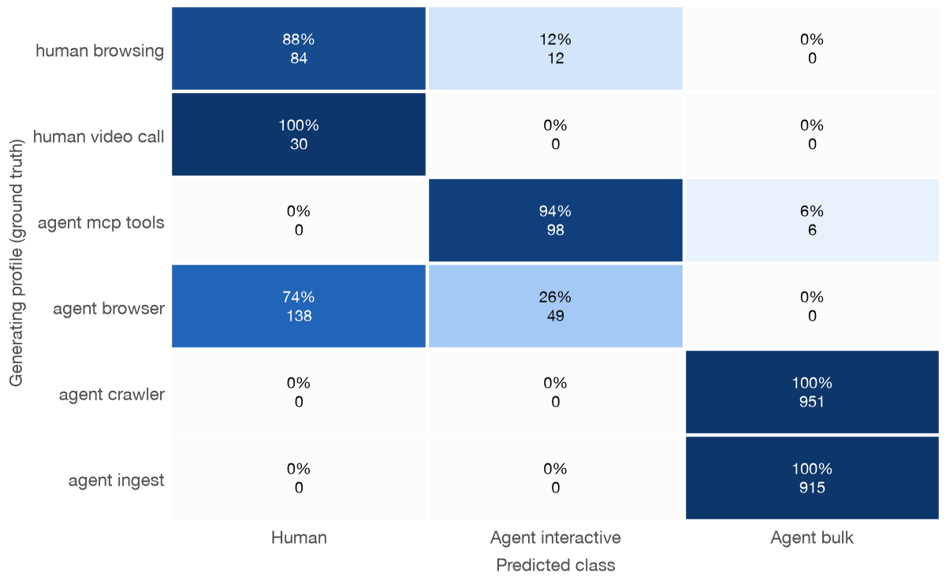
Where the Classifier Errs
PERFORMANCE DATA
Browser agents read as human
74% of browser-driven agent rows are predicted human: same Chrome TLS fingerprint, human-like pacing.
Tool-calling agents separate well
94% correct: the Python TLS fingerprint and machine pacing give them away.
Bulk is partly separable by design
Fan-out (~20 new flows/s) carries 67% of feature importance in this synthetic model.
Held-out rows, all checkpoints, row-normalised; rows are the generating workload (ground truth).
Notes:
Rows are the generating workload, which is the ground truth. Browser-driven agents are the whole problem: 74 percent are read as human, because they use the same Chrome TLS fingerprint and look human in the first 64 packets. Bulk scores perfectly partly because the synthetic model gives it a high connection fan-out.

Slide 11

Key Challenges Encountered
RISK & RESOLUTION
CHALLENGE 1 · ML PIPELINE
CHALLENGE 2 · DATA PLANE
CHALLENGE 3 · TRAFFIC CORPUS
Train/serve skew
Parsing TLS without loops
No labelled agent traffic
sklearn compares 32-bit floats while the switch compares integers; above 2^24 the floor of a threshold is the wrong boundary.
A ClientHello has variable-length fields and extensions, but a P4 parser cannot loop, and a parse failure must not block traffic.
No public dataset carries per-packet traffic from autonomous AI agents, so there was nothing to train on.
Solution implemented
Solution implemented
Solution implemented
A Python mirror of the P4 fixed-point arithmetic, a 100% equivalence gate in CI, and float32-exact table boundaries.
Bounded parse: at most 16 extensions of 512 B, every length checked; malformed packets forward as UNKNOWN (fail-open).
A seeded packet-level generator with real captured ClientHellos, run through the switch-exact extractor.
Notes:
One challenge per subsystem. Train/serve skew in the ML pipeline, solved with a bit-exact Python mirror and an equivalence gate. Parsing TLS without loops in P4, solved with a bounded, fail-open parser. No public agent traffic to train on, solved for now with a seeded packet-level generator.

Slide 12
Review-3 Target Deliverables
ROADMAP
1
Live in-switch classification
features.p4 flow registers, classifier wiring, and a bit-exact PTF replay against the Python feature extractor.
2
QoS and human protection
qos.p4 with DSCP, priority queues, ECN and meters; the protection preset; punt handler and reclassifier in the controller.
3
Real corpus and full evaluation
Capture four agent frameworks and MAWI human traces, retrain, then run 5 systems × 5 seeds and two demo rehearsals.
4
Close the TLS ClientHello gap
Post-quantum ClientHellos (Chrome: 1,899 B) span two segments, so TLS features read empty; align parser and extractor.
Notes:
Review 3 turns the offline pipeline into a live system: in-switch features and the classifier, QoS with human protection, the real corpus and the full evaluation grid. It also closes the TLS ClientHello gap we found, since post-quantum ClientHellos no longer fit in one segment.

Slide 13
Key References & RFC Standards
ACADEMIC RIGOR
[1] Bosshart, P., et al.
[5] RFC 2474 – Differentiated Services Field
“P4: Programming protocol-independent packet processors.” ACM SIGCOMM CCR, 2014.
Nichols, K., et al. IETF Standards Track, 1998.
[2] Xiong, Z., and Zilberman, N.
[6] RFC 3168 – Explicit Congestion Notification
“Do switches dream of machine learning? Toward in-network classification.” ACM HotNets, 2019.
Ramakrishnan, K., Floyd, S., and Black, D. IETF Standards Track, 2001.
[3] Busse-Grawitz, C., et al.
[7] RFC 8446 – TLS Protocol Version 1.3
“pForest: In-network inference with random forests.” arXiv:1909.05680, 2019.
Rescorla, E. IETF Standards Track, 2018.
[4] Barford, P., and Crovella, M.
[8] RFC 9421 – HTTP Message Signatures
“Generating representative Web workloads for network and server performance evaluation.” ACM SIGMETRICS, 1998.
Backman, A., Richer, J., and Sporny, M. IETF Standards Track, 2024.
Notes:
P4 itself, two in-network ML classification papers that our tree-to-table compilation follows, the SURGE web-workload model behind the synthetic human traffic, and the IETF standards for DiffServ, ECN, TLS 1.3 and HTTP message signatures.

Slide 14

Thank You!
Questions & Reviewer Suggestions
BCSE308L/P • Review-2 Evaluation Complete
Notes:
Thank you. We welcome questions and suggestions, especially on the evaluation plan for Review 3.

