Slide 1
Rllib for students at the ICE

Slide 2
About this document
This document is a mixture of a presentation and a FAQ/Manual
During presentation, ignore excessivly long text
Refer to some of the slides to get an idea on certain topics before asking Shawan questions

Slide 3
Where do I start?
Skip any of these steps,
If you feel they are not neccessary
Preparation:
Read Geron’s Hands on ML book
Watch David Silver’s (Google Deepmind) Video Series (starting here)
Read Angelo’s and Artur’s Master Thesis
(skip enything on Recurrent Neural Networks)
(skip results parts, read them later to see how results are expected to be presented)
Getting to know the framework:
Read this document and the README of the repository
Coding:
If you do now own a powerful GPU, set up your own remote development environment such that you comfortably test your code
The project files should be commented to give you an idea of what happens where

Slide 4
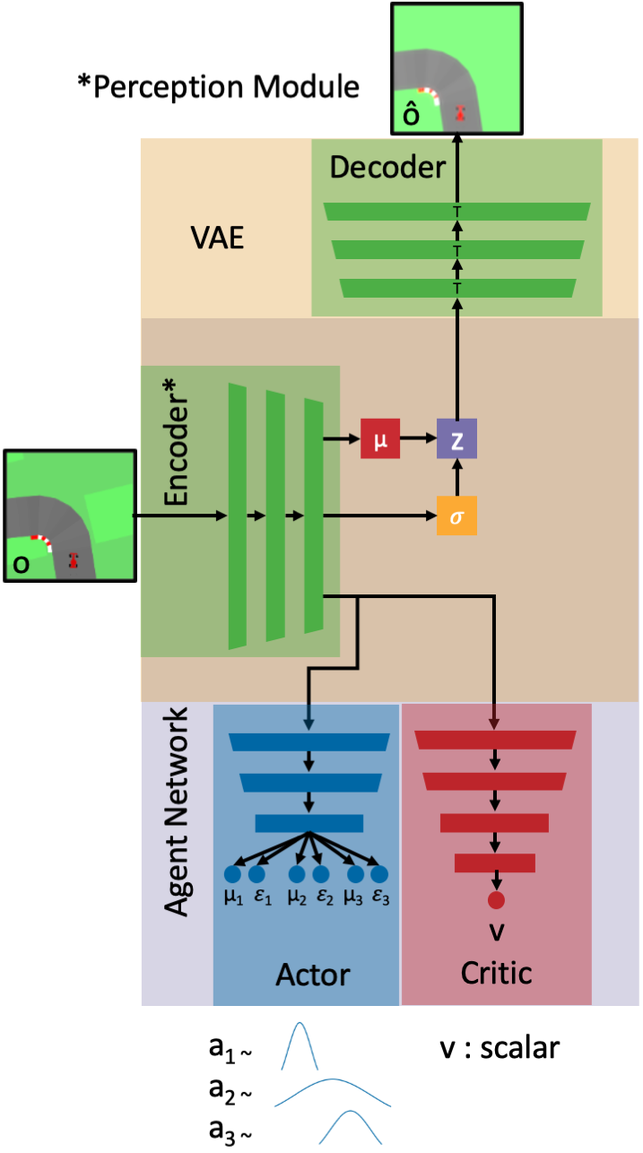
Idea of this framework? (1)
This slide assumes you have knowledge of terms such as VAE and policy gradient algorithms (if not, ask Shawan and google)
Over a couple of theses, students have come up with a rather efficient way of handling many basic RL problems.
The coloured blocks in the following diagram represent network layers of a neural network that has proven successful in the CarRacing-v0 environment.
This framework encapsulates training techniques used to train these networks, namely: Parallel PPO and VAE training.
The main idea is: We traing an encoder network with a VAE training and reuse it in a reinforcement learning agent.

Slide 5
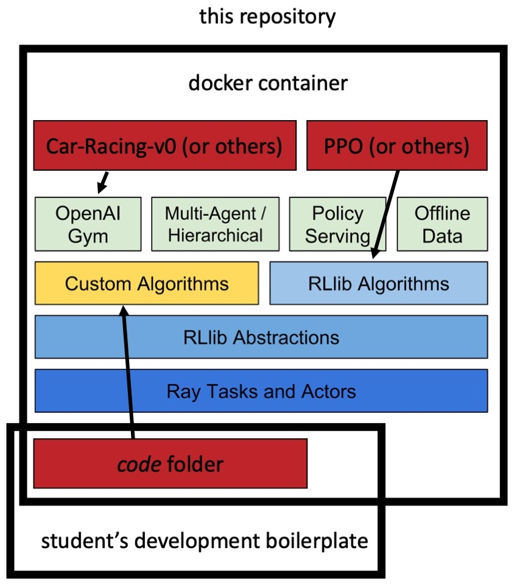
Idea of this framework? (2)

Slide 6
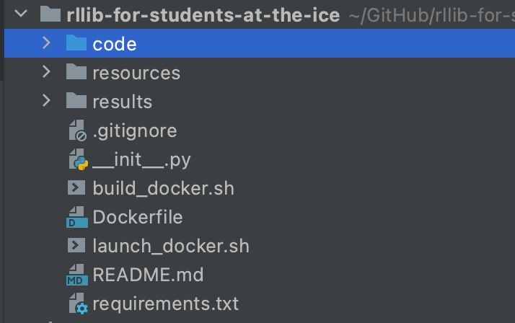
Framework Folder structure
program code
Highest level
results of experiments

Slide 7
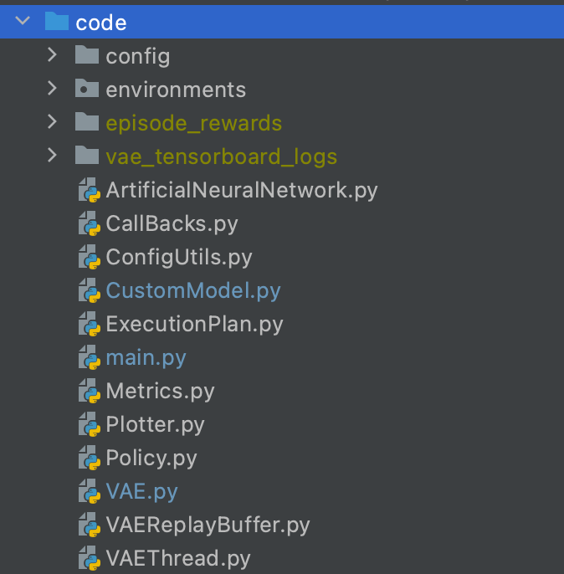
Framework Folder structure
Configuration for the framework, ray, tune and rllib
Code folder
Files that are specific to environments
Logs (that will hopefully soon appear in the results folder)
How do our networks look? (We use tf.keras for that)
How does the agent translates inputs to outputs?
How does the RLLib Trainer execute a training?
A VAE that uses networks from ArtificialNeuralNetwork.py
A thread that handles queues for the VAE Training

Slide 8
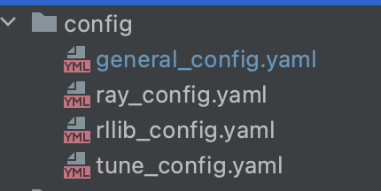
Framework Folder structure
Framework configuration
Standard neural network parameters, network depth,
Width, learning rate (…)
Ray parameters
Parameters directly related to RLlib
Parameters directly related to Ray’s tuning
Library – Ray.tune.

Slide 9
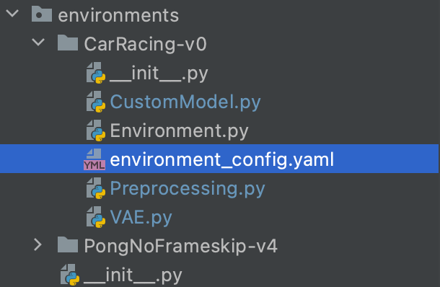
Framework Folder structure
Environments folder
Same as CustomModel in the code folder, but overwrites it
This is where your environment goes
Each folder int the environment directory goes here
Put here values specific to your environment
They will also overwrite values in other config files (!!!)
Same as VAE in the code folder, but overwrites it

Slide 10
How do I add my own environment?
In the environments folder, there are two examples
At the time of writing, CustomModel, Environment and VAE are all filenames that the framework will search for in your environment folder
You only need them if you want them to differ from the basic version that resides in the code folder
Remember to declare them properly in __init__.py, just like the two examples

Slide 11
Modes of execution
Execute the framework with python main.py –-help to see that you can
- - debug the framework. This results in only one worker and in the future possibly in local execution of the code (making it actually debuggable).
The two other modes are - - tune to use ray.tune with your config/tune.yaml config and the default mode which evaluates your configured parameters for a set number of steps

Slide 12
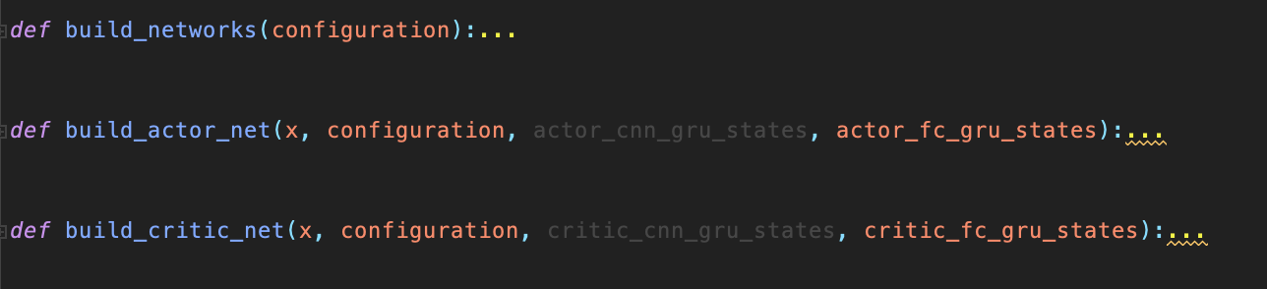
How do I change the structure of the ANNs?
Inside the ANN file, you find three methods which take your accumulated configuration as input.
Many network parameters, such as the number of layers in the encoder of the VAE, are declared in config/general_config.yaml.
You should overwrite them with your own environment_config.yaml in your environment folder.
If you desire major changes, you will have to change the three building functions and write some more code
There is some code in the ArtificialNeuralNetworks.py file that is closely related to CarRacing. This may be removed in further versions, but come from the fact that multiple student built ther thesis around this game.

Slide 13
How do I see if my VAE is working?
If you actually use the VAE, it will log it’s own image recustructions for an own tensorboard session.
Have a look at the vae_tensorboard_logs folder and use the standard command tensorboard –logdir . command.
If everything is working fine, you can see images and their reconstructions. If the recustructions look bad, your VAE training is bad

Slide 14
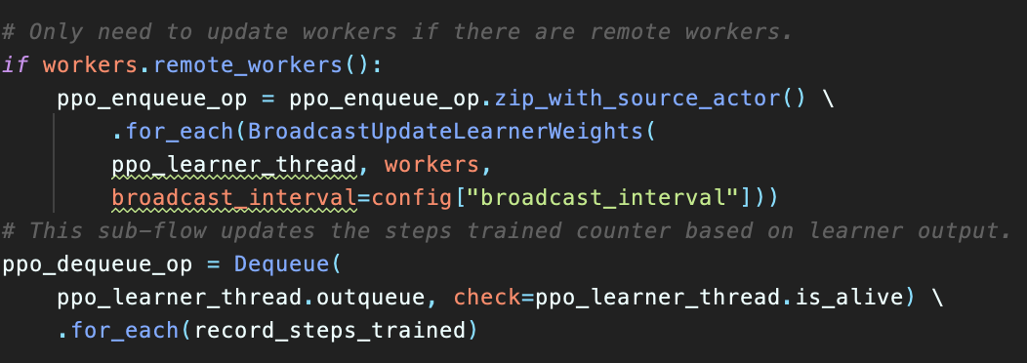
What is an execution plan?
The execution plan is a concept specific to RLLib
It defines there general flow of data when training your RL agent
Most importantly: It is not called repetitively, but relies on the concept of parallel iterators. Basically, the execution plan is an object that is returned by our execution_plan function that the RLLib trainer instance iterates over to make it sample, train, or do what ever you want.
See here “for_each” broadcasts the weights of the agent to all workers after every n iterations of the algorithm

Slide 15
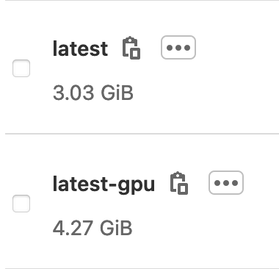

How to use docker with this framework?
The repository also includes a container registry
Get comfortable with docker before handling issues related to this
There exists a CPU and a GPU version, which also supports cuDNN and has been tested on Ubuntu 18.04 and CUDA 11.2
The code and results folder are mounted to /mnt/
Execute your trainings from /mnt/code headlessly, such as described in the repo
You only need build_docker.sh if you want to change the docker image, not when you change your own code

