Slide 1
Atomicals-JS Qt GUI Open source code, use at ur own risk！
✅ Tested on MacOS and Windows 11

Slide 2
1. install node.js (recommend version16 above) 2. install python3（python3.8 ~ python3.11） 3. download atomicals-js CLI library on Github make sure that you can use node and python in the command line tool
requirement

Slide 3
open your terminal(command line) and execute python ajs-qt-gui.py the script will install the dependencies automatically, just wait a sec.
how to run the scirpt

Slide 4
1. go to <设置> 2. choose the dir where atomicals-js locates 3. click <保存> 4. click <检查并安装> 5. click <初始化钱包> step 5 is not required you already have the wallets/wallet.json file in atomicals-js dir
How to Config

Slide 5
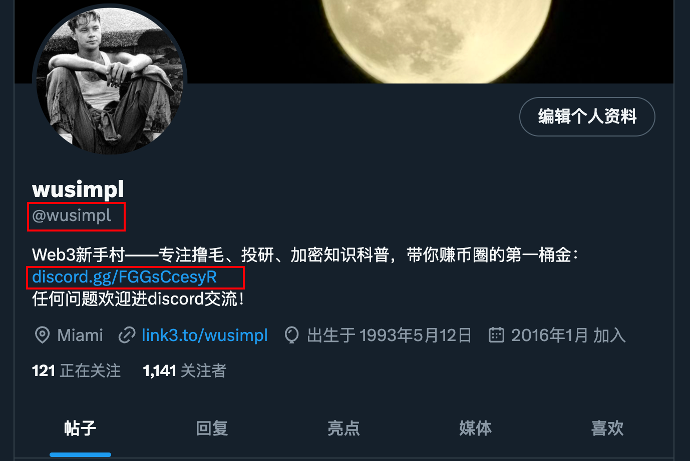
bug feedback in my discord：check my twitter profile for discord link

Slide 6
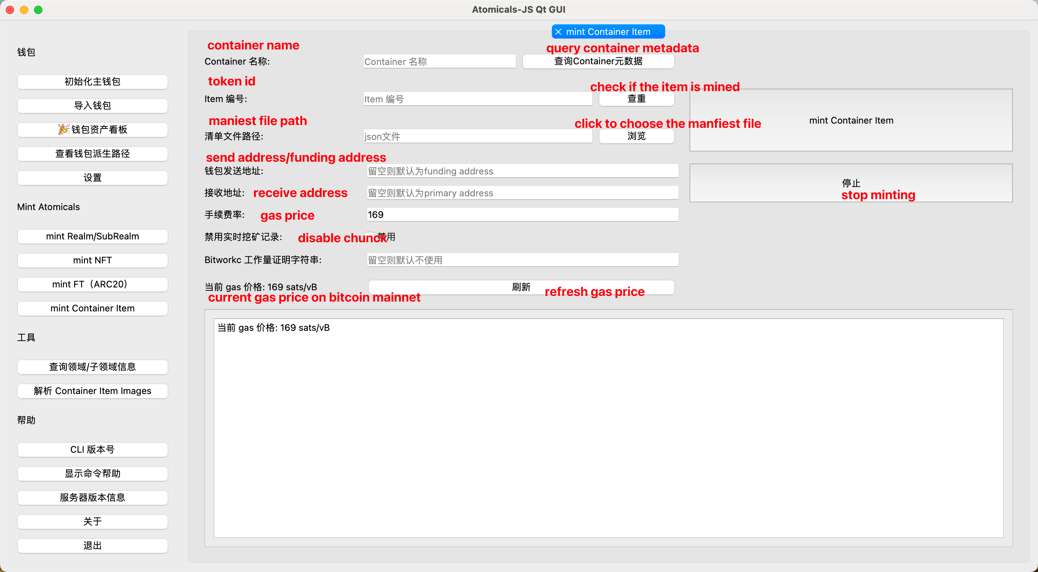
Chinese-English Contrast Table

Slide 7
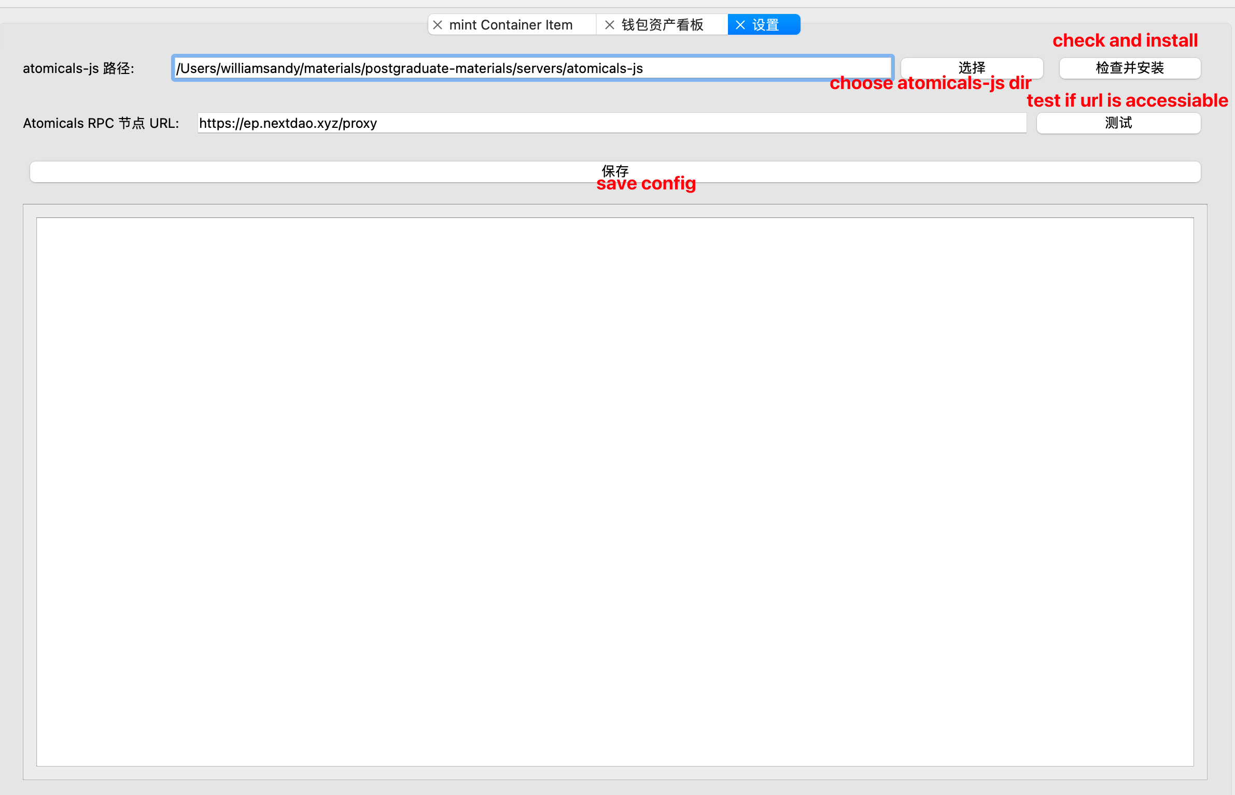

Slide 8
