Slide 1







Stack Overflow Developer Survey
Shawn Foster
September 17,2024

Slide 2



OUTLINE
Executive Summary
Introduction
Methodology
Results
Visualization – Charts
Dashboard
Discussion
Findings & Implications
Conclusion
Appendix

Slide 3

EXECUTIVE SUMMARY
The Data was sourced from a Stack Overflow survey, the IBM website, and GitHub job postings. It was gathered, cleaned, analyzed, and presented visually through dashboards.
The results indicate that JavaScript is currently the most widely used programming language and is expected to maintain its popularity. MySQL is the most utilized database at present, but PostgreSQL is anticipated to see increased demand in the future. Additionally, the majority of survey respondents are male, from the USA, and around 28 years old.

Slide 4

INTRODUCTION
The Stack Overflow annual developer survey is a comprehensive assessment of coders worldwide, offering valuable insights into trends, skills, and the development community's needs
This report utilizes data analysis to highlight both the current and future technological trends related to programming languages, databases and platforms.
The data was used to explore the following questions:
Which programming languages are currently in highest demand?
What database skills are most sought after?
What are the most popular IDEs or web frameworks?
Trends to highlight where the skillsets of developers are heading

Slide 5

METHODOLOGY
Data was collected through survey, API’s and Web scraping
Data wrangling
Exploratory data analysis
Analyzing data distribution
Handling outliers
Looking at correlations
Data Visualization
Highlight the distribution of data, relationships, composition and comparison of data
Dashboards

Slide 6
RESULTS

Slide 7
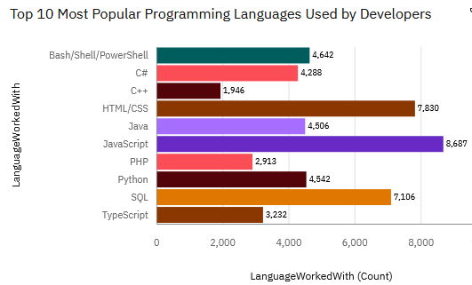
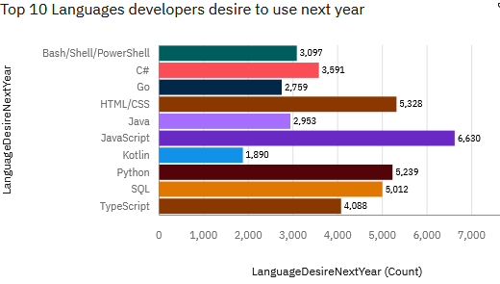
PROGRAMMING LANGUAGE TRENDS
Next Year
< Bar chart of top 10 programming languages for the next year goes here.>

Slide 8
PROGRAMMING LANGUAGE TRENDS - FINDINGS & IMPLICATIONS
Findings
JavaScript is currently the most popular programming language
Html/CSS is the second most popular programming language.
Python is getting ever more popular
Implications
The development of the frontend is very essential in the data profession. It is a necessary skill to attain for entry in the field.
Leaning python is essential in increasing ones competiveness in the job marketplace.

Slide 9
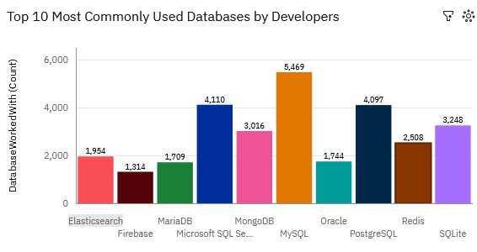
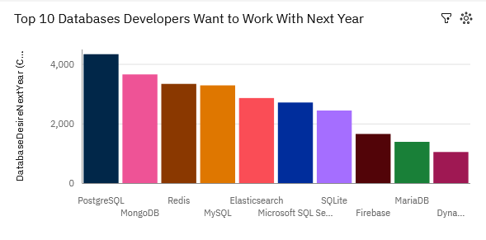
DATABASE TRENDS
Current Year
Next Year

Slide 10
DATABASE TRENDS - FINDINGS & IMPLICATIONS
Findings
MySQL is the database that data professionals use the most
PostgreSQL and MongoDB are popular databases currently and are getting more popular in the future
Implications
SQL is still an essential tool for data professional
OracleSQL is losing relevance as time passes
PostgreSQL and MongoDB are very established in the market.

Slide 11

DASHBOARD
https://github.com/Shawn-Foster1/ibm-data-analyst-capstone-projec/blob/main/capstone%20Dashboard.pdf

Slide 12
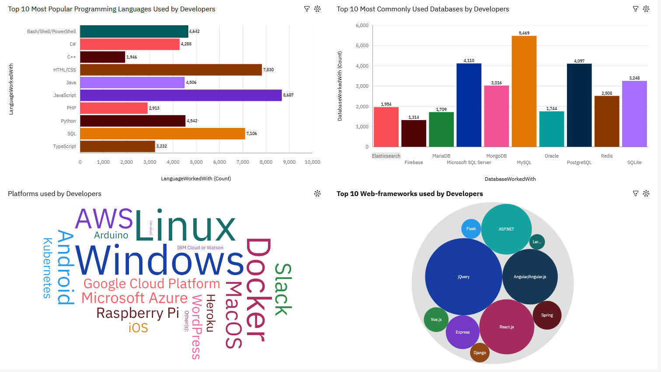
DASHBOARD TAB 1

Slide 13
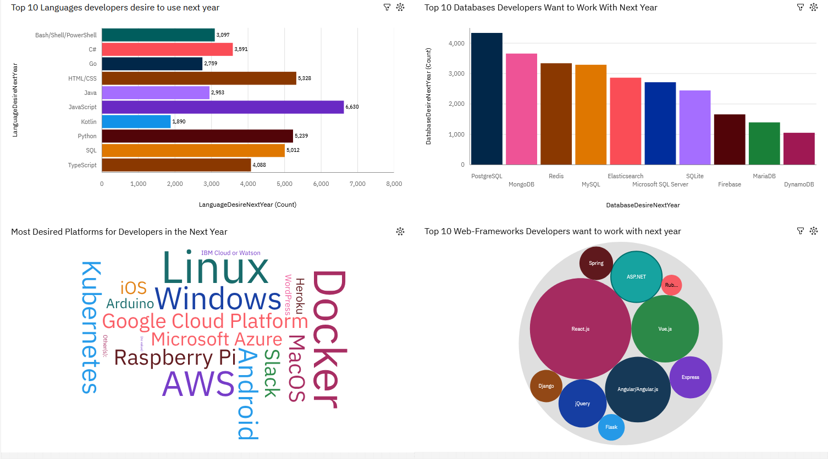
DASHBOARD TAB 2

Slide 14
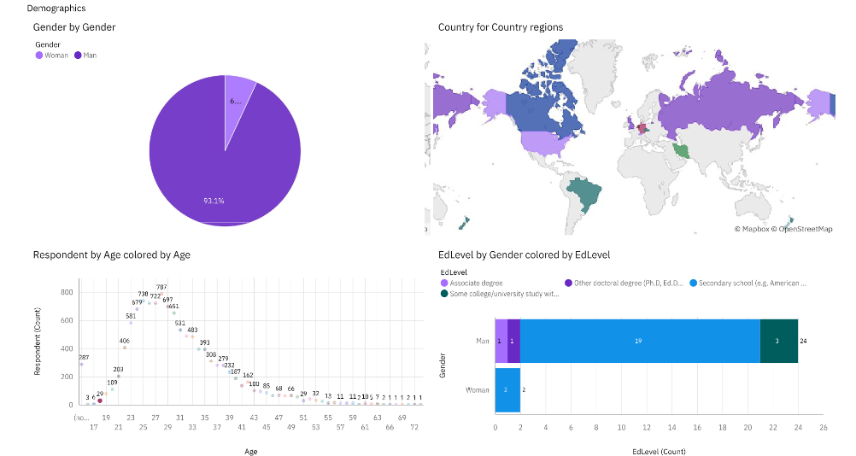
DASHBOARD TAB 3

Slide 15
DISCUSSION
Why upskilling is important
How relevant will OracleSQL be in the future?
What skills/software and databases are needed in a data professionals toolkit?

Slide 16
OVERALL FINDINGS & IMPLICATIONS
Findings
JavaScript, html/CSS and Python are popular programming languages currently and in the future.
Most individuals in the field have a bachelors degree
The sector is filled with the majority of people under 40 years of age
Most of the professionals are located in developed countries
Implications
More countries should have access to the latest technologies
Web development is still a very prominent skill to have 2
Gender and age should not be a limiting factor to employment in data

Slide 17

CONCLUSION
The field of data analysis is becoming more and more popular New technology
JavaScript and python are most popular languages among data professionals
To be a data professional, it is recommended to acquire software skills inclusive of programming languages and databases.
The recommended programming languages JavaScript, html/CSS and python along with databases of MySQL, PostgreSQL and MongoDB

Slide 18

APPENDIX
Include any relevant additional charts, or tables that you may have created during the analysis phase.

Slide 19
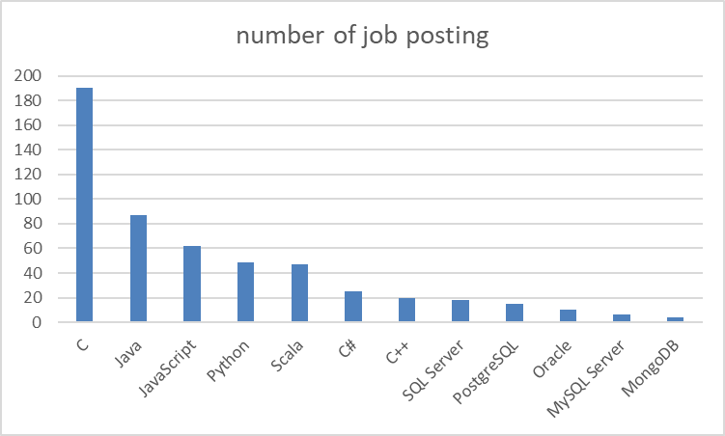
JOB POSTINGS

Slide 20
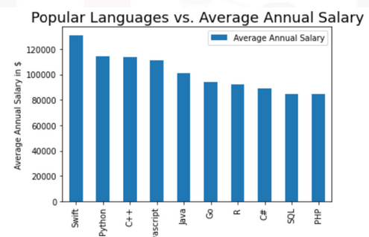
POPULAR LANGUAGES

