Slide 1
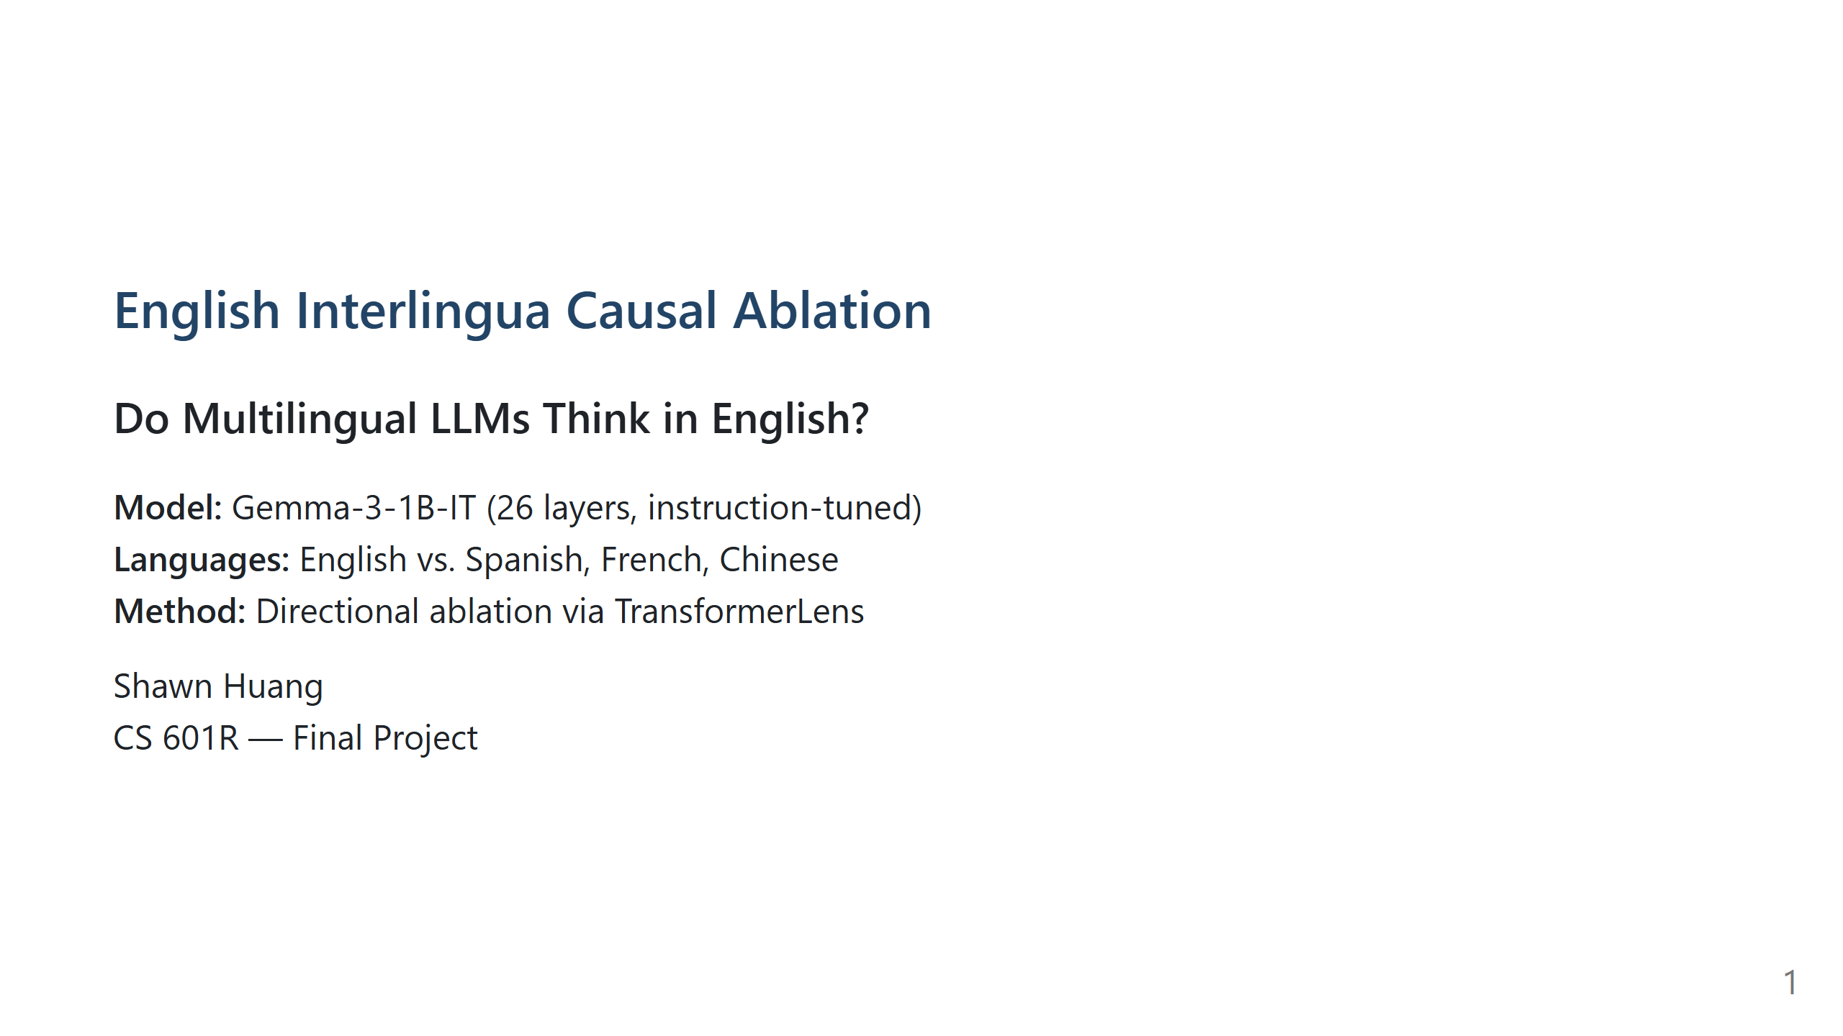

Slide 2
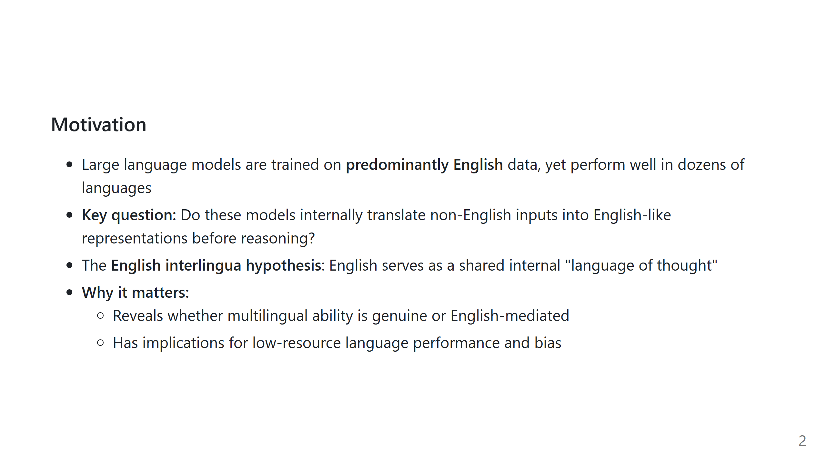

Slide 3
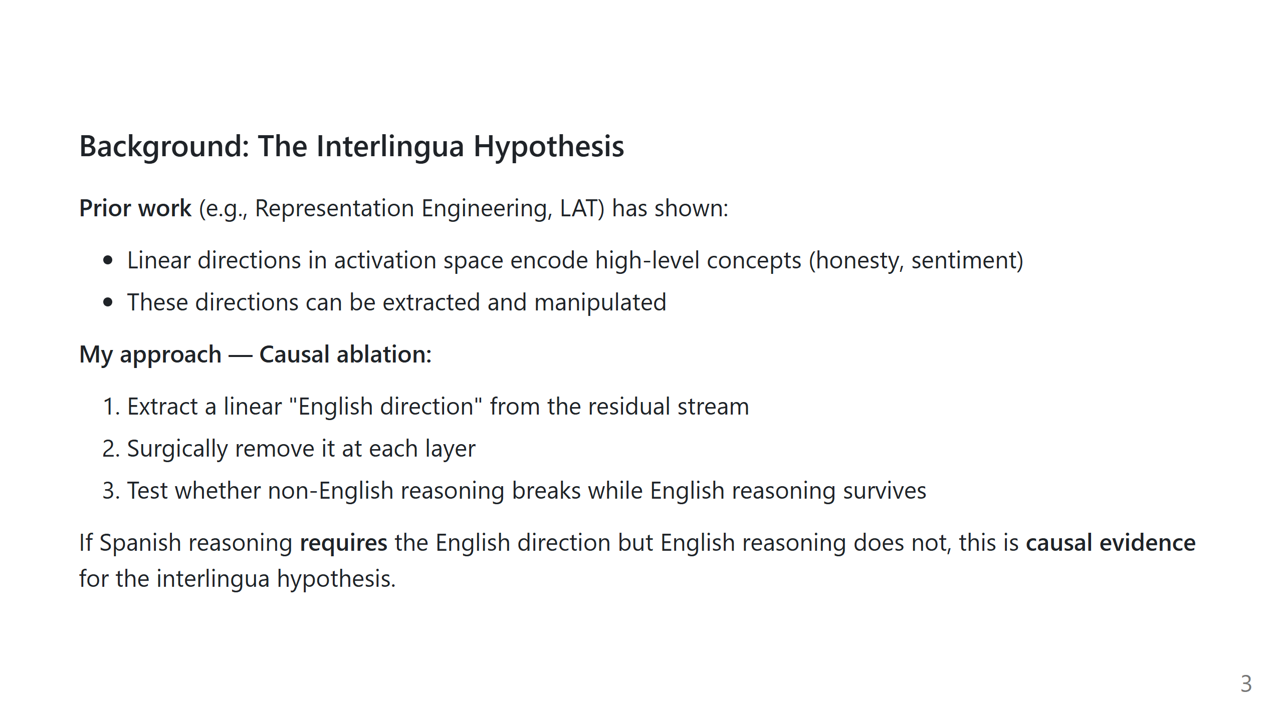

Slide 4
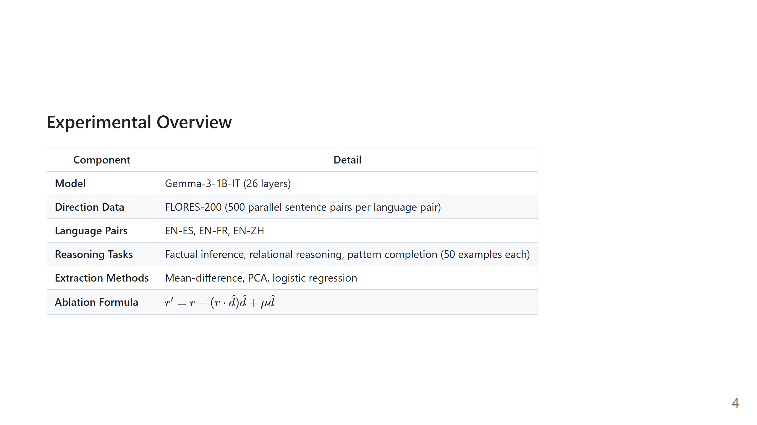
Notes:
![bg right:40% fit](placeholder_pipeline_diagram.png) Placeholder: Replace with a pipeline diagram if available

Slide 5
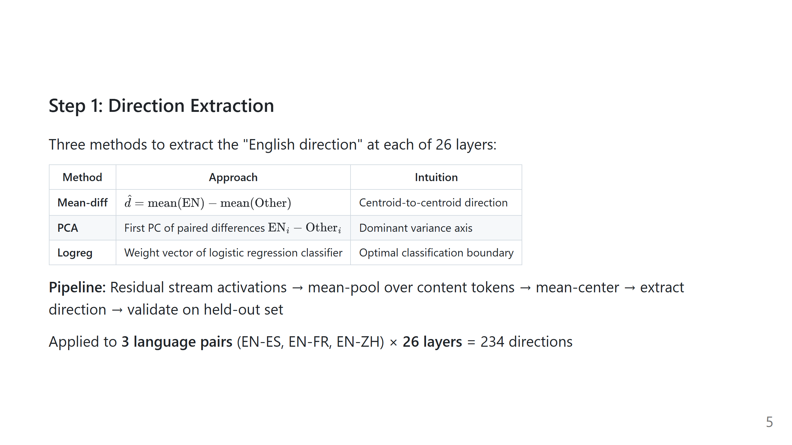

Slide 6
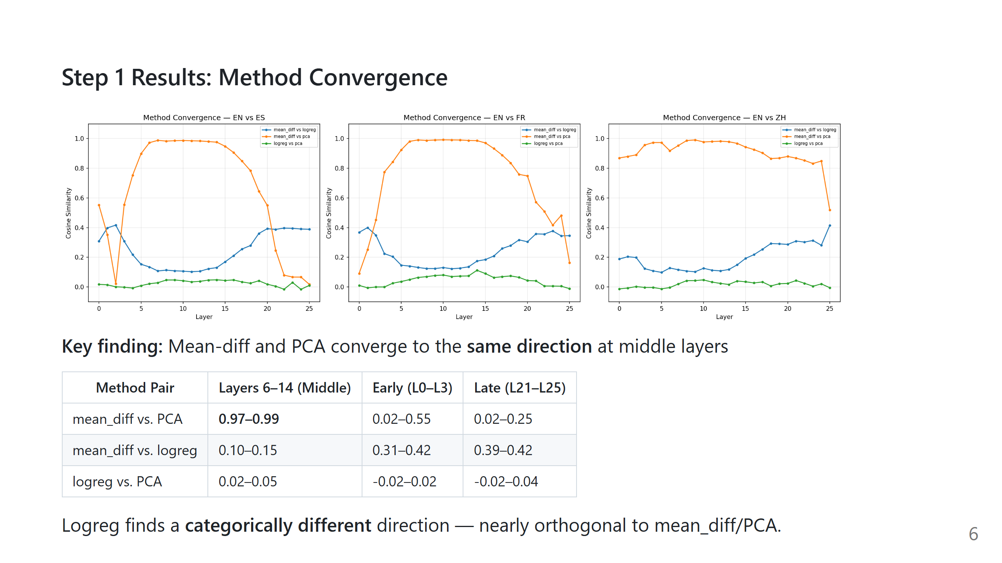
Notes:
Placeholder: Insert results/plots/convergence.png **[INSERT FIGURE: convergence.png]**

Slide 7
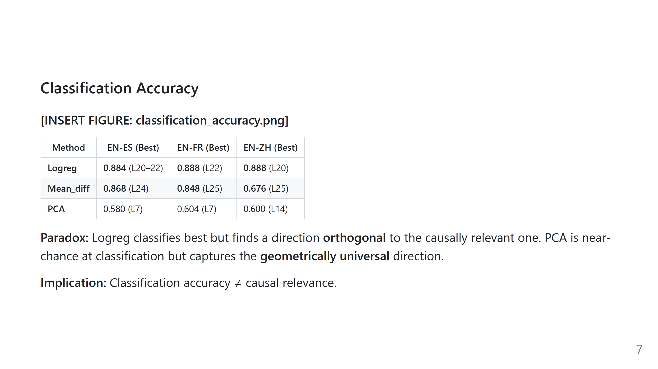
Notes:
Placeholder: Insert results/plots/classification_accuracy.png

Slide 8
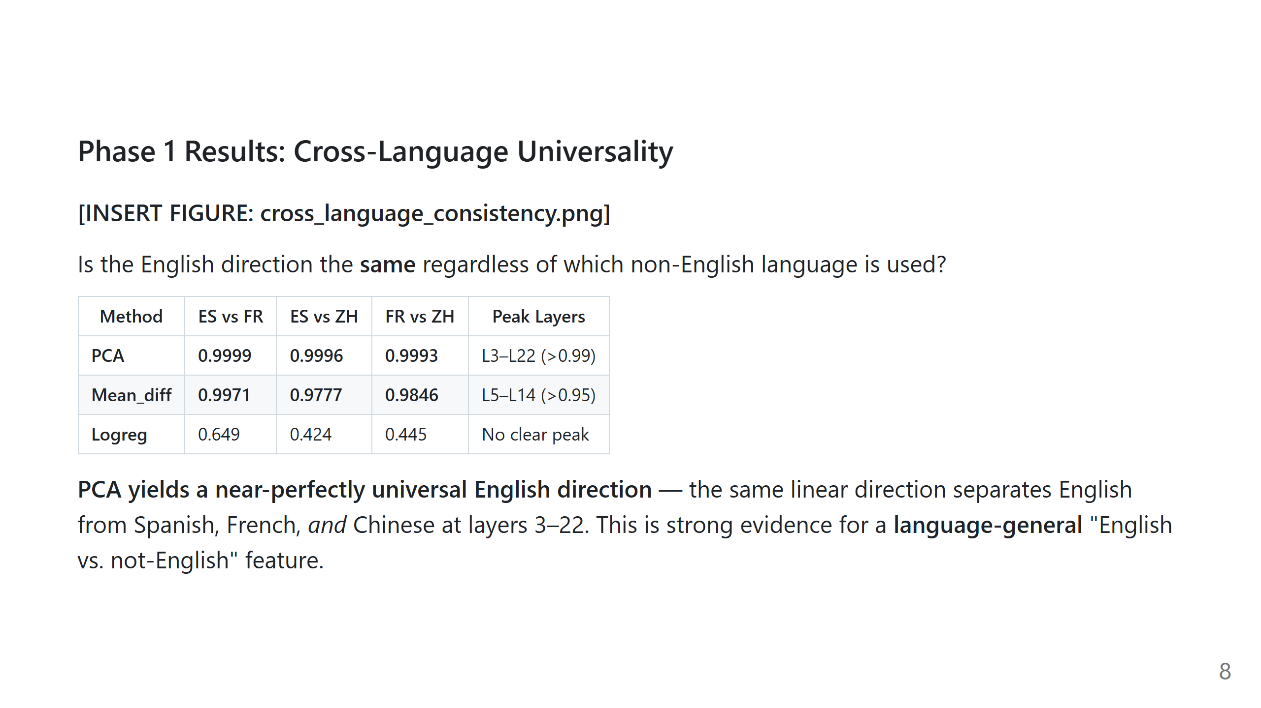
Notes:
Placeholder: Insert results/plots/cross_language_consistency.png

Slide 9
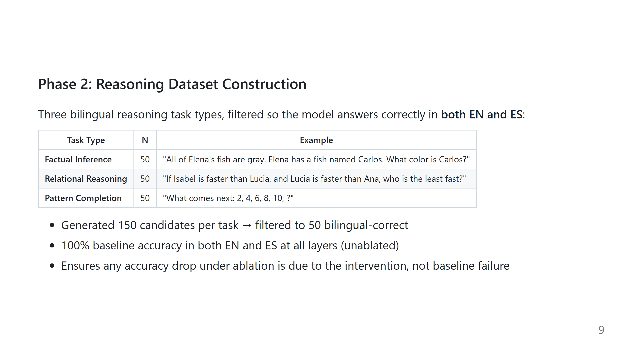

Slide 10
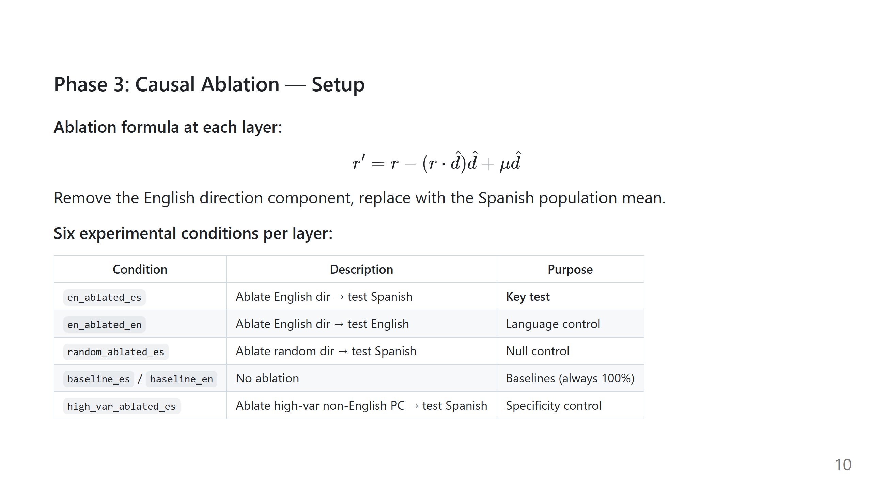

Slide 11
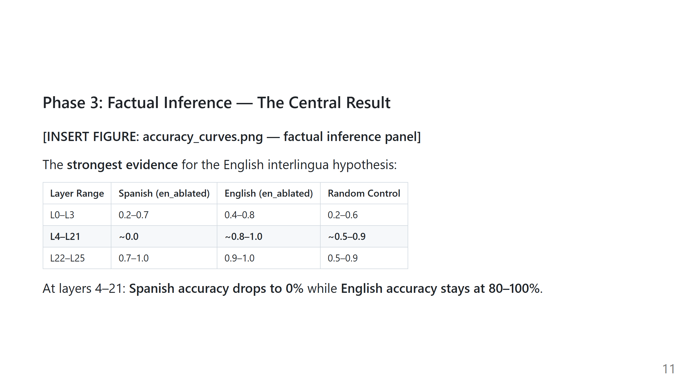
Notes:
Placeholder: Insert results/plots/accuracy_curves.png (factual panel)

Slide 12
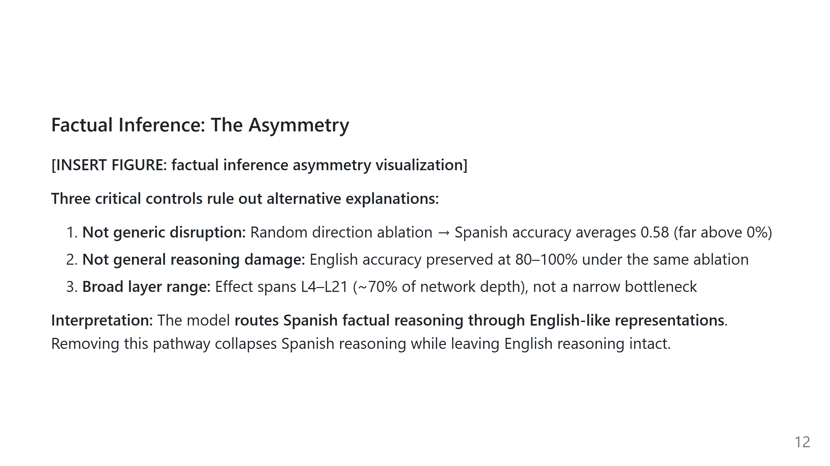
Notes:
Placeholder: Insert a bar chart or highlight table showing the asymmetry

Slide 13
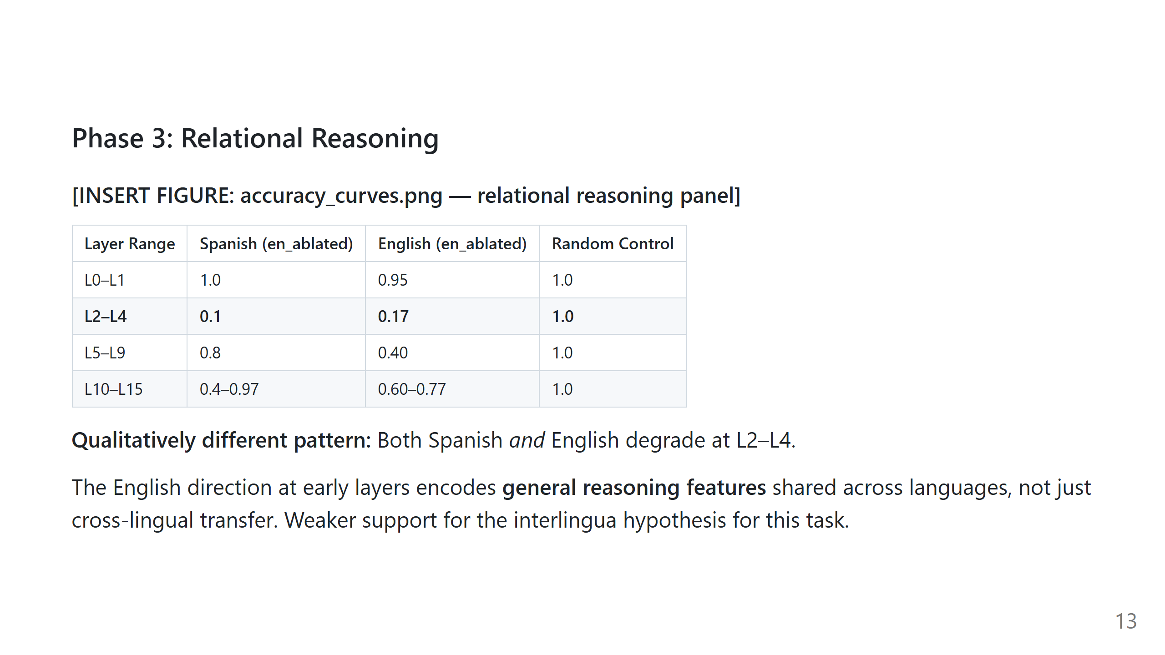
Notes:
Placeholder: Insert results/plots/accuracy_curves.png (relational panel)

Slide 14
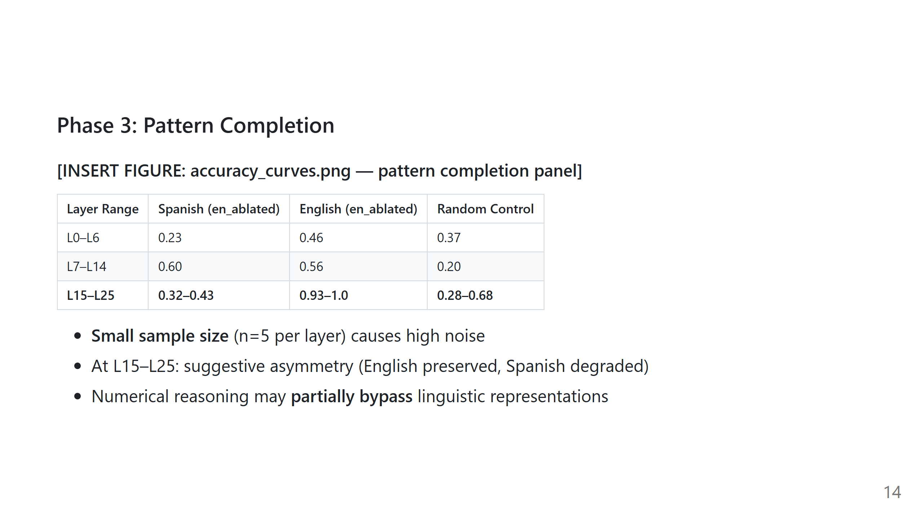
Notes:
Placeholder: Insert results/plots/accuracy_curves.png (pattern panel)

Slide 15
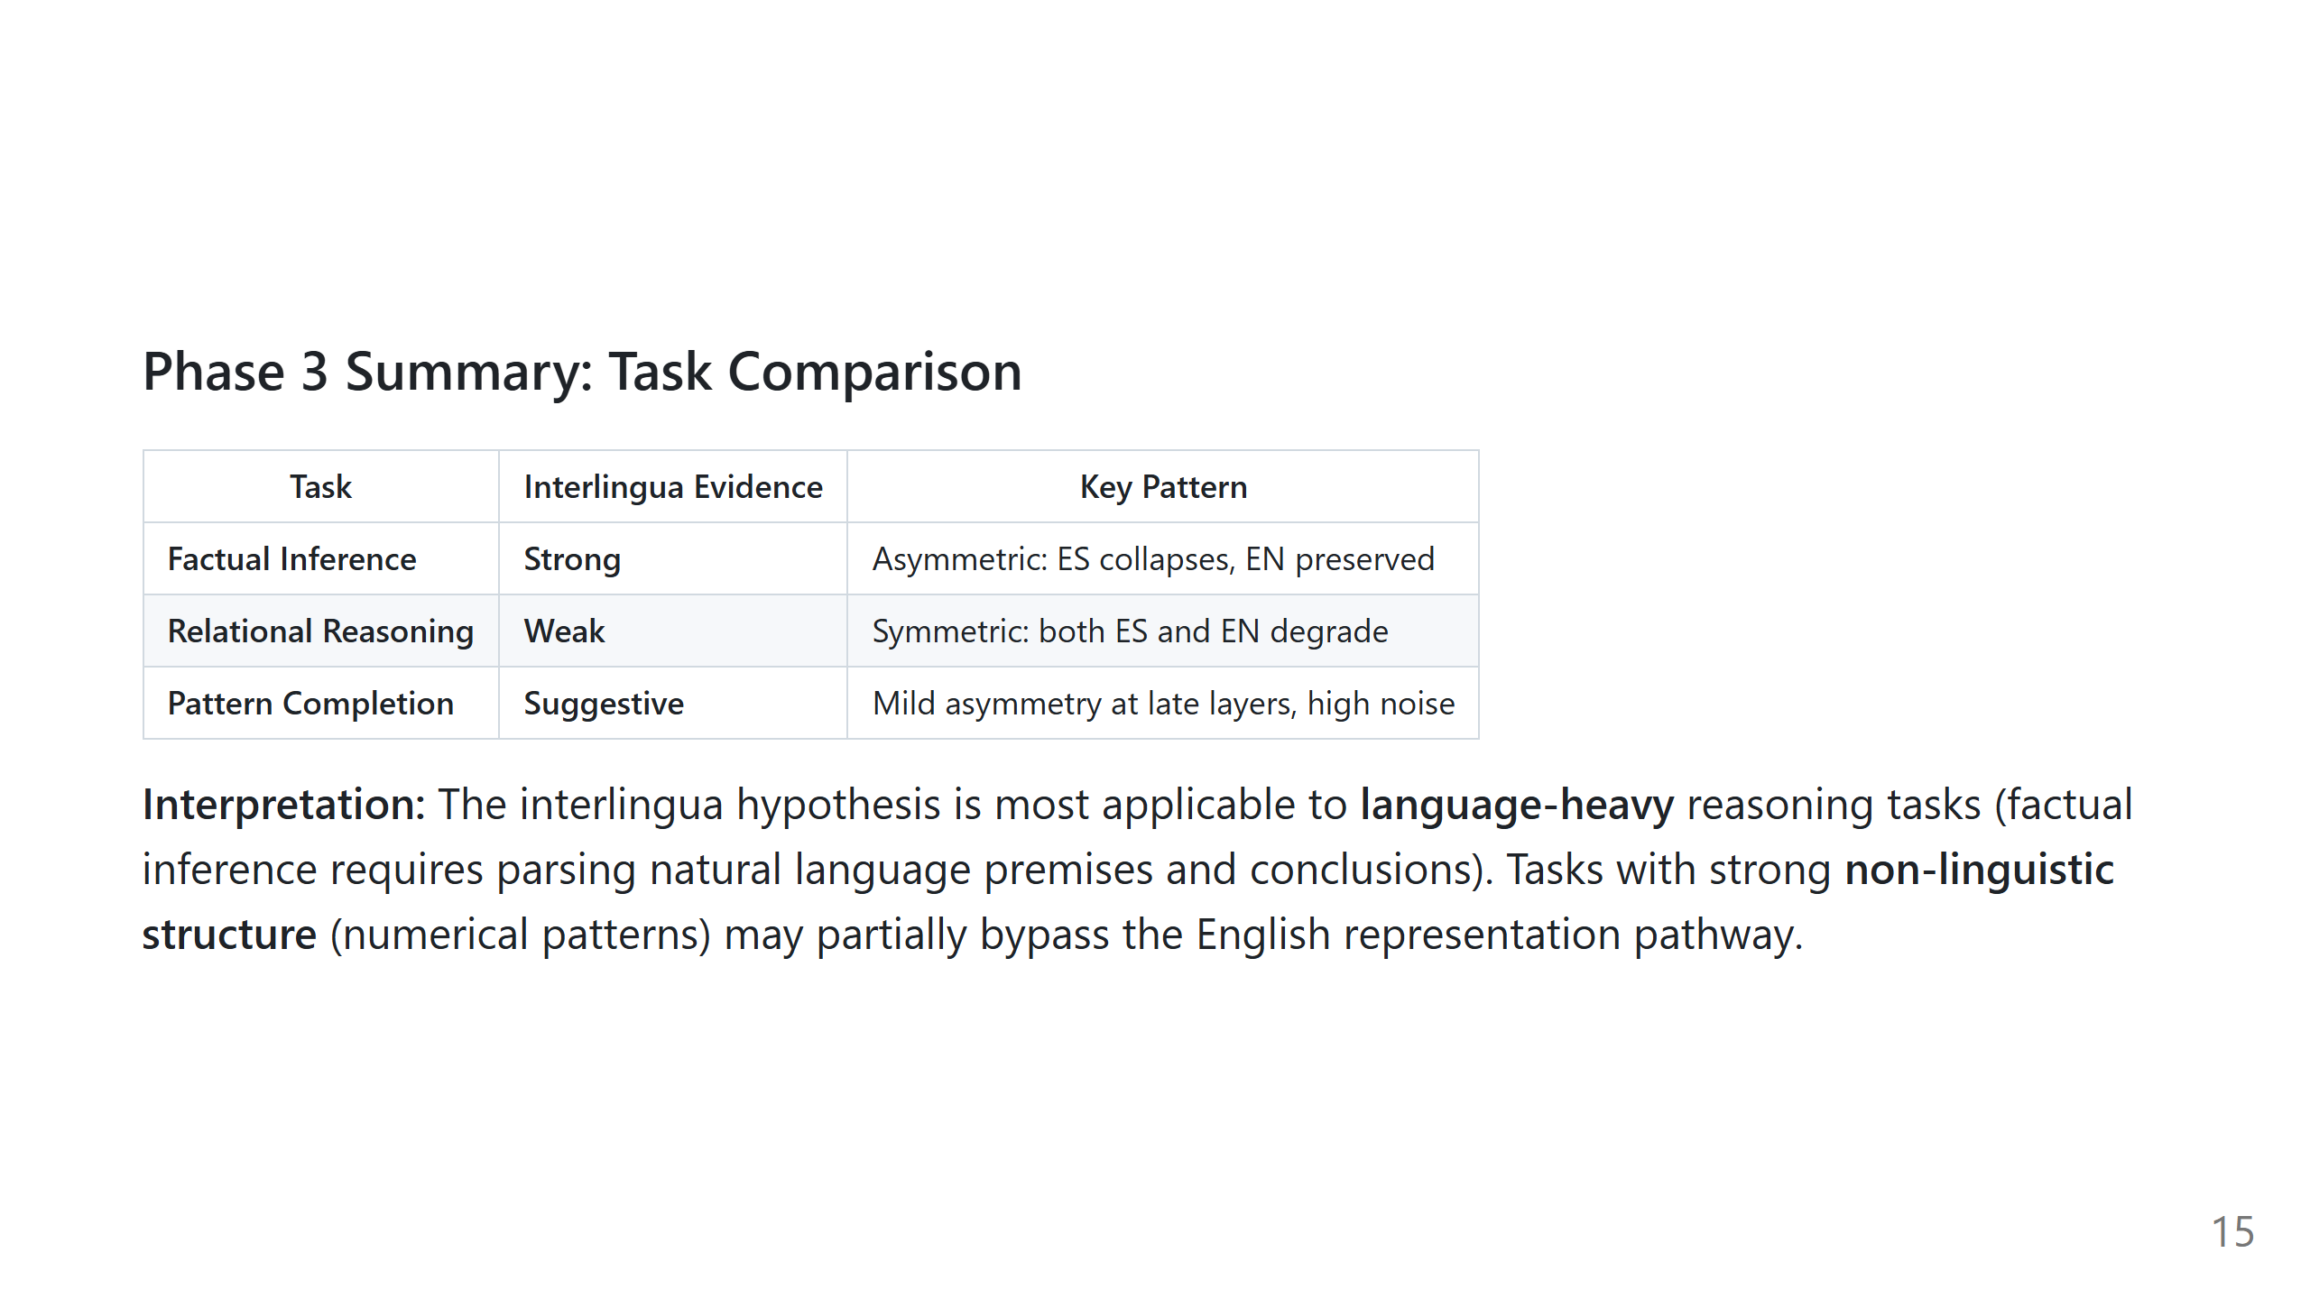

Slide 16
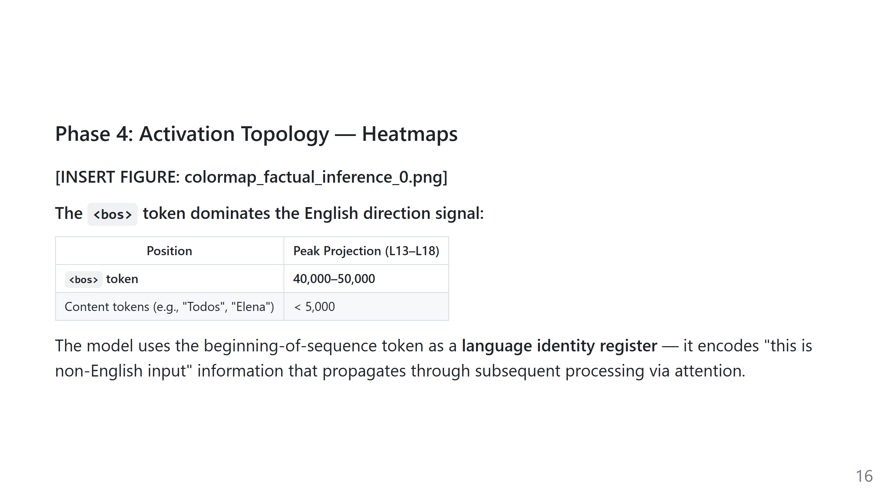
Notes:
Placeholder: Insert results/plots/colormap_factual_inference_0.png

Slide 17
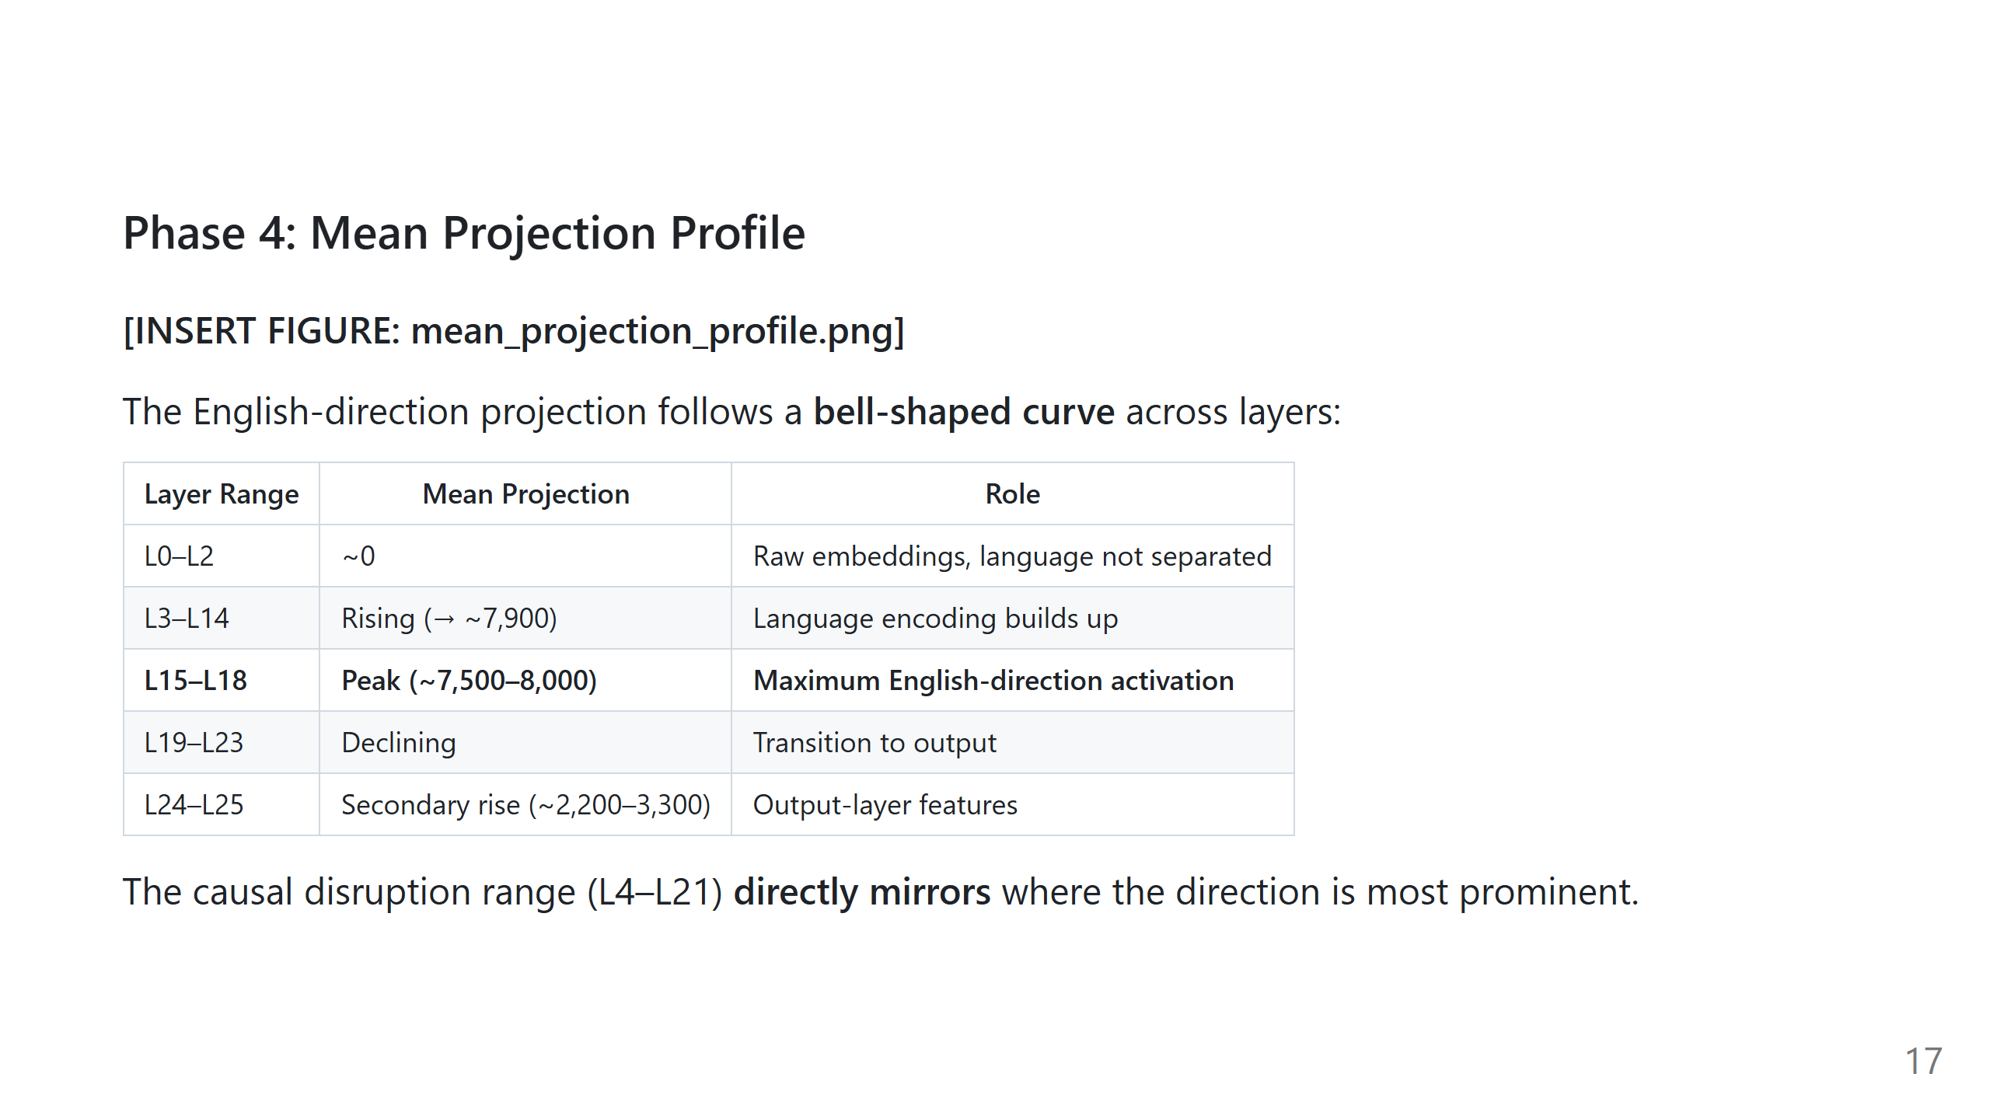
Notes:
Placeholder: Insert results/plots/mean_projection_profile.png

Slide 18
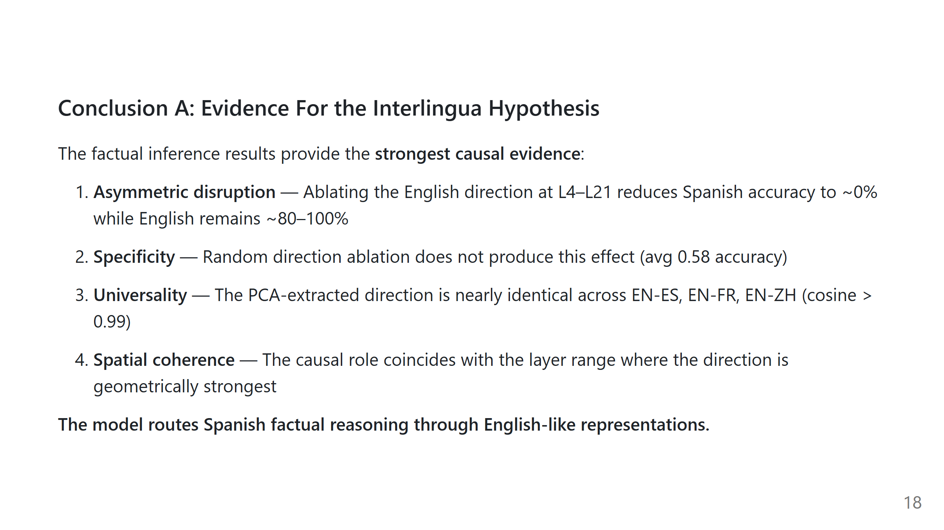

Slide 19
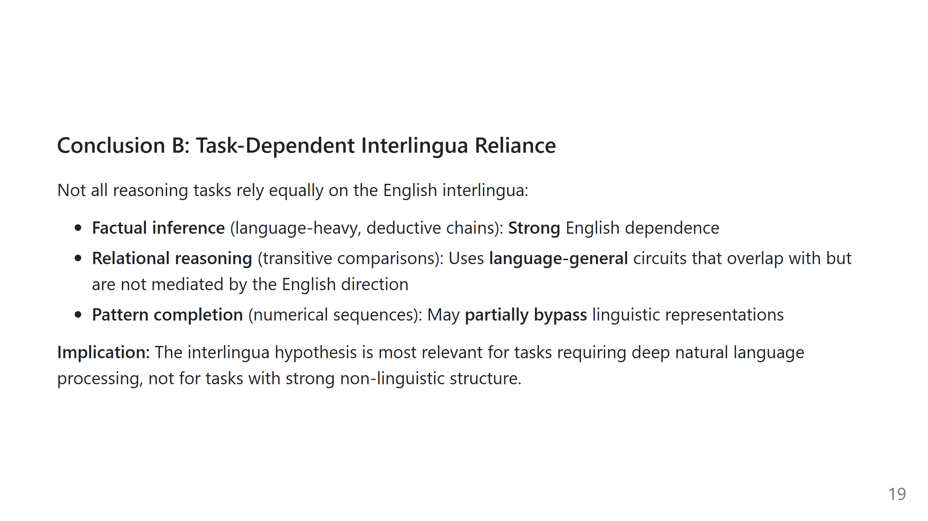

Slide 20
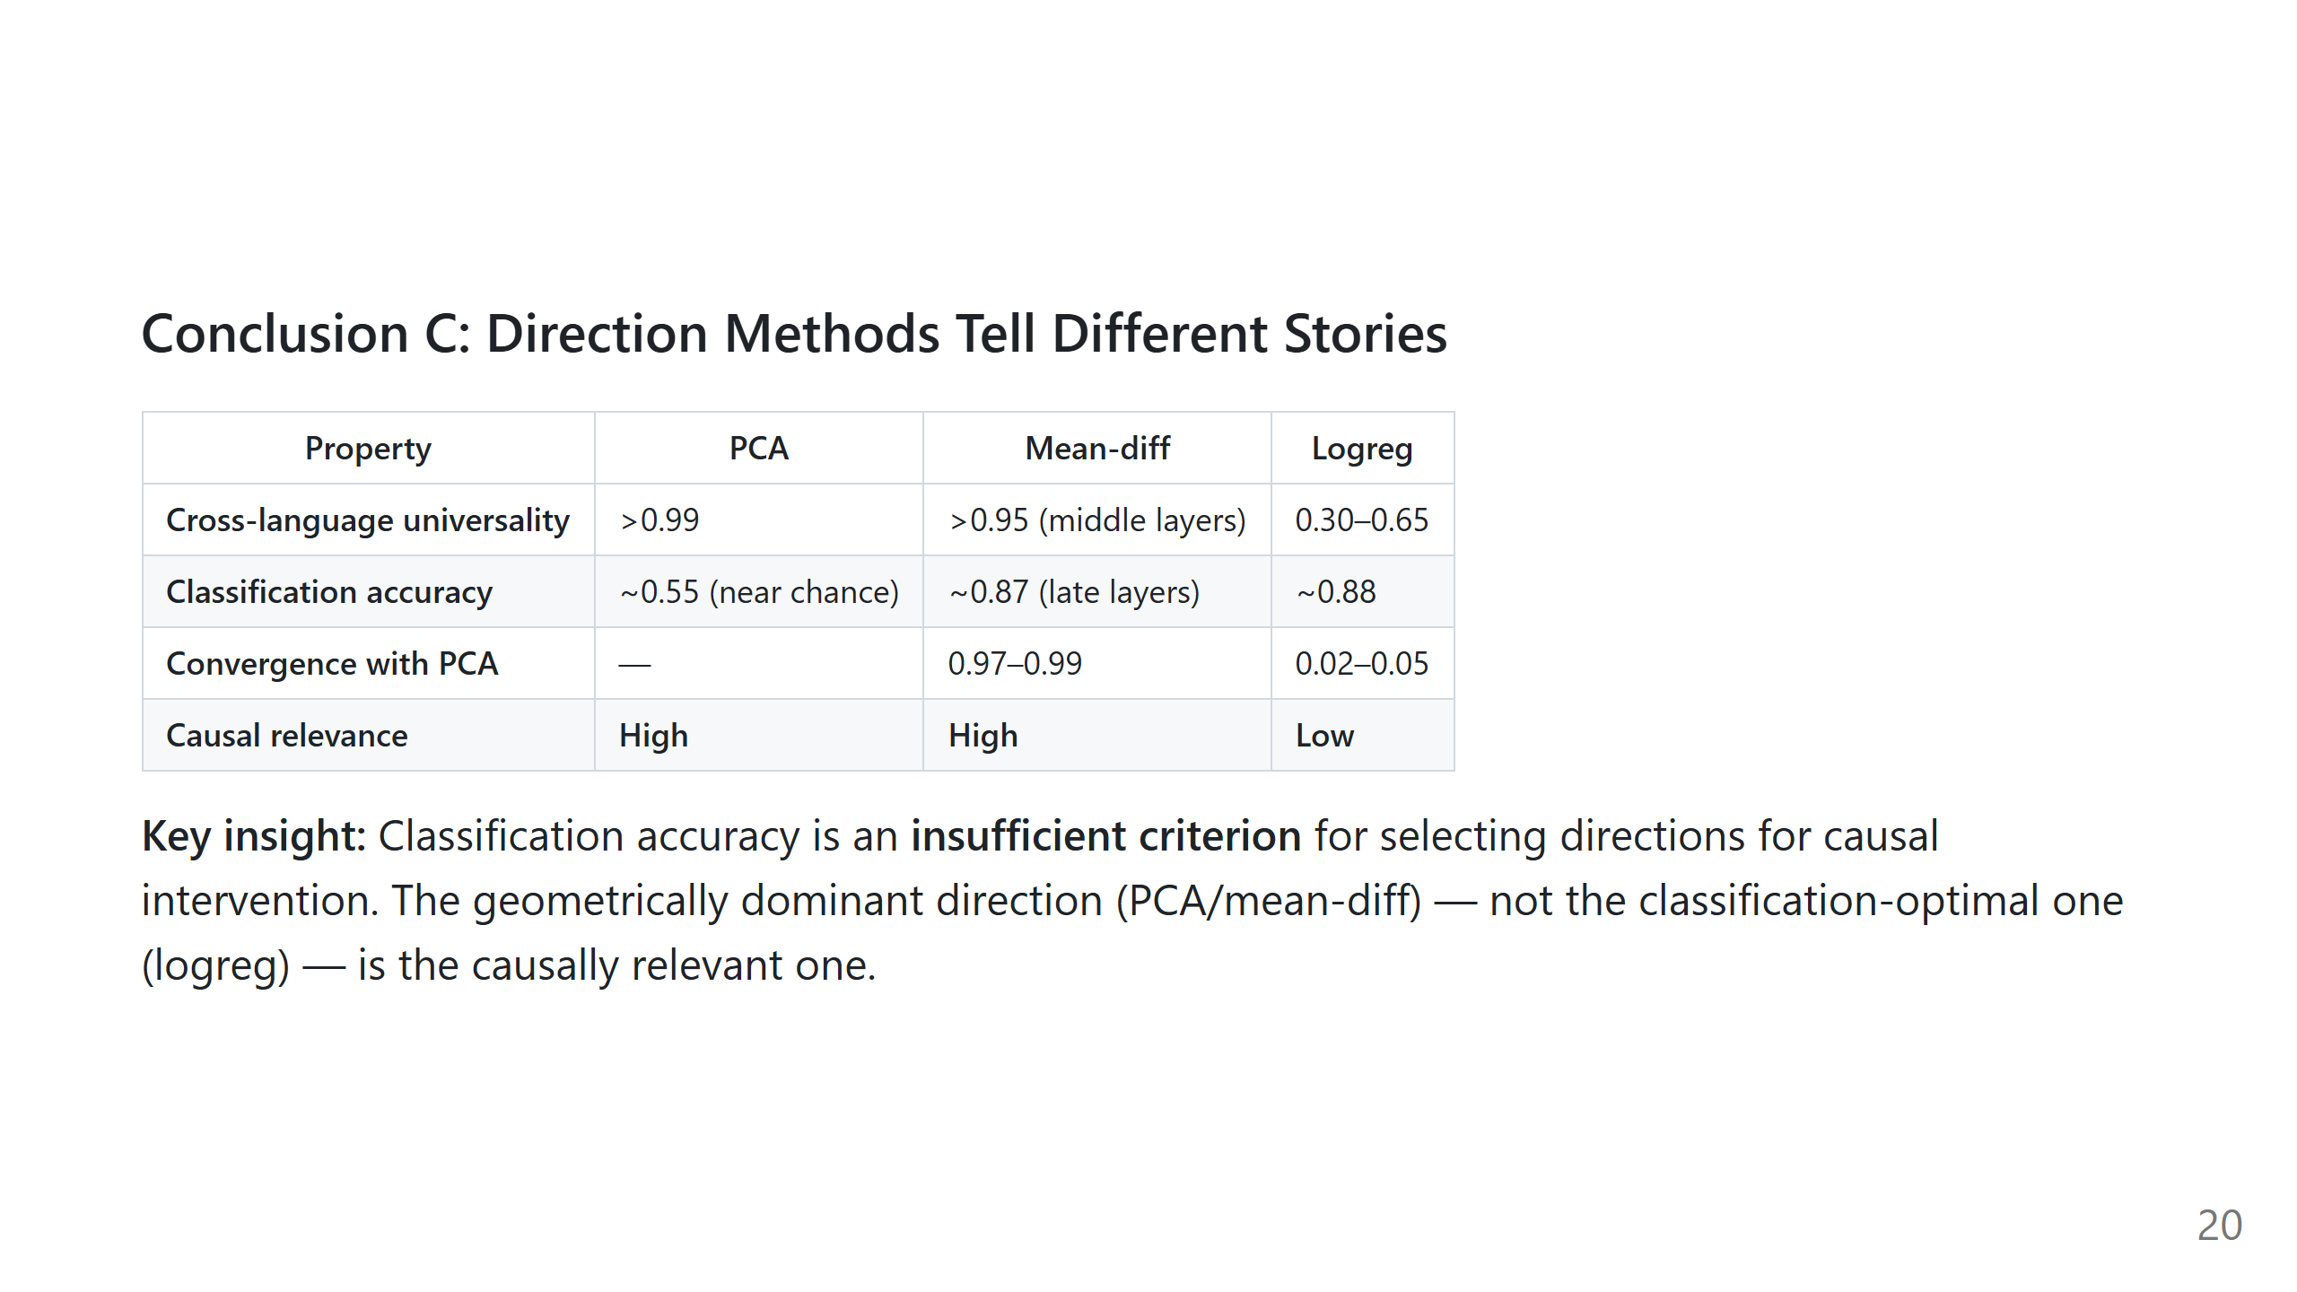

Slide 21
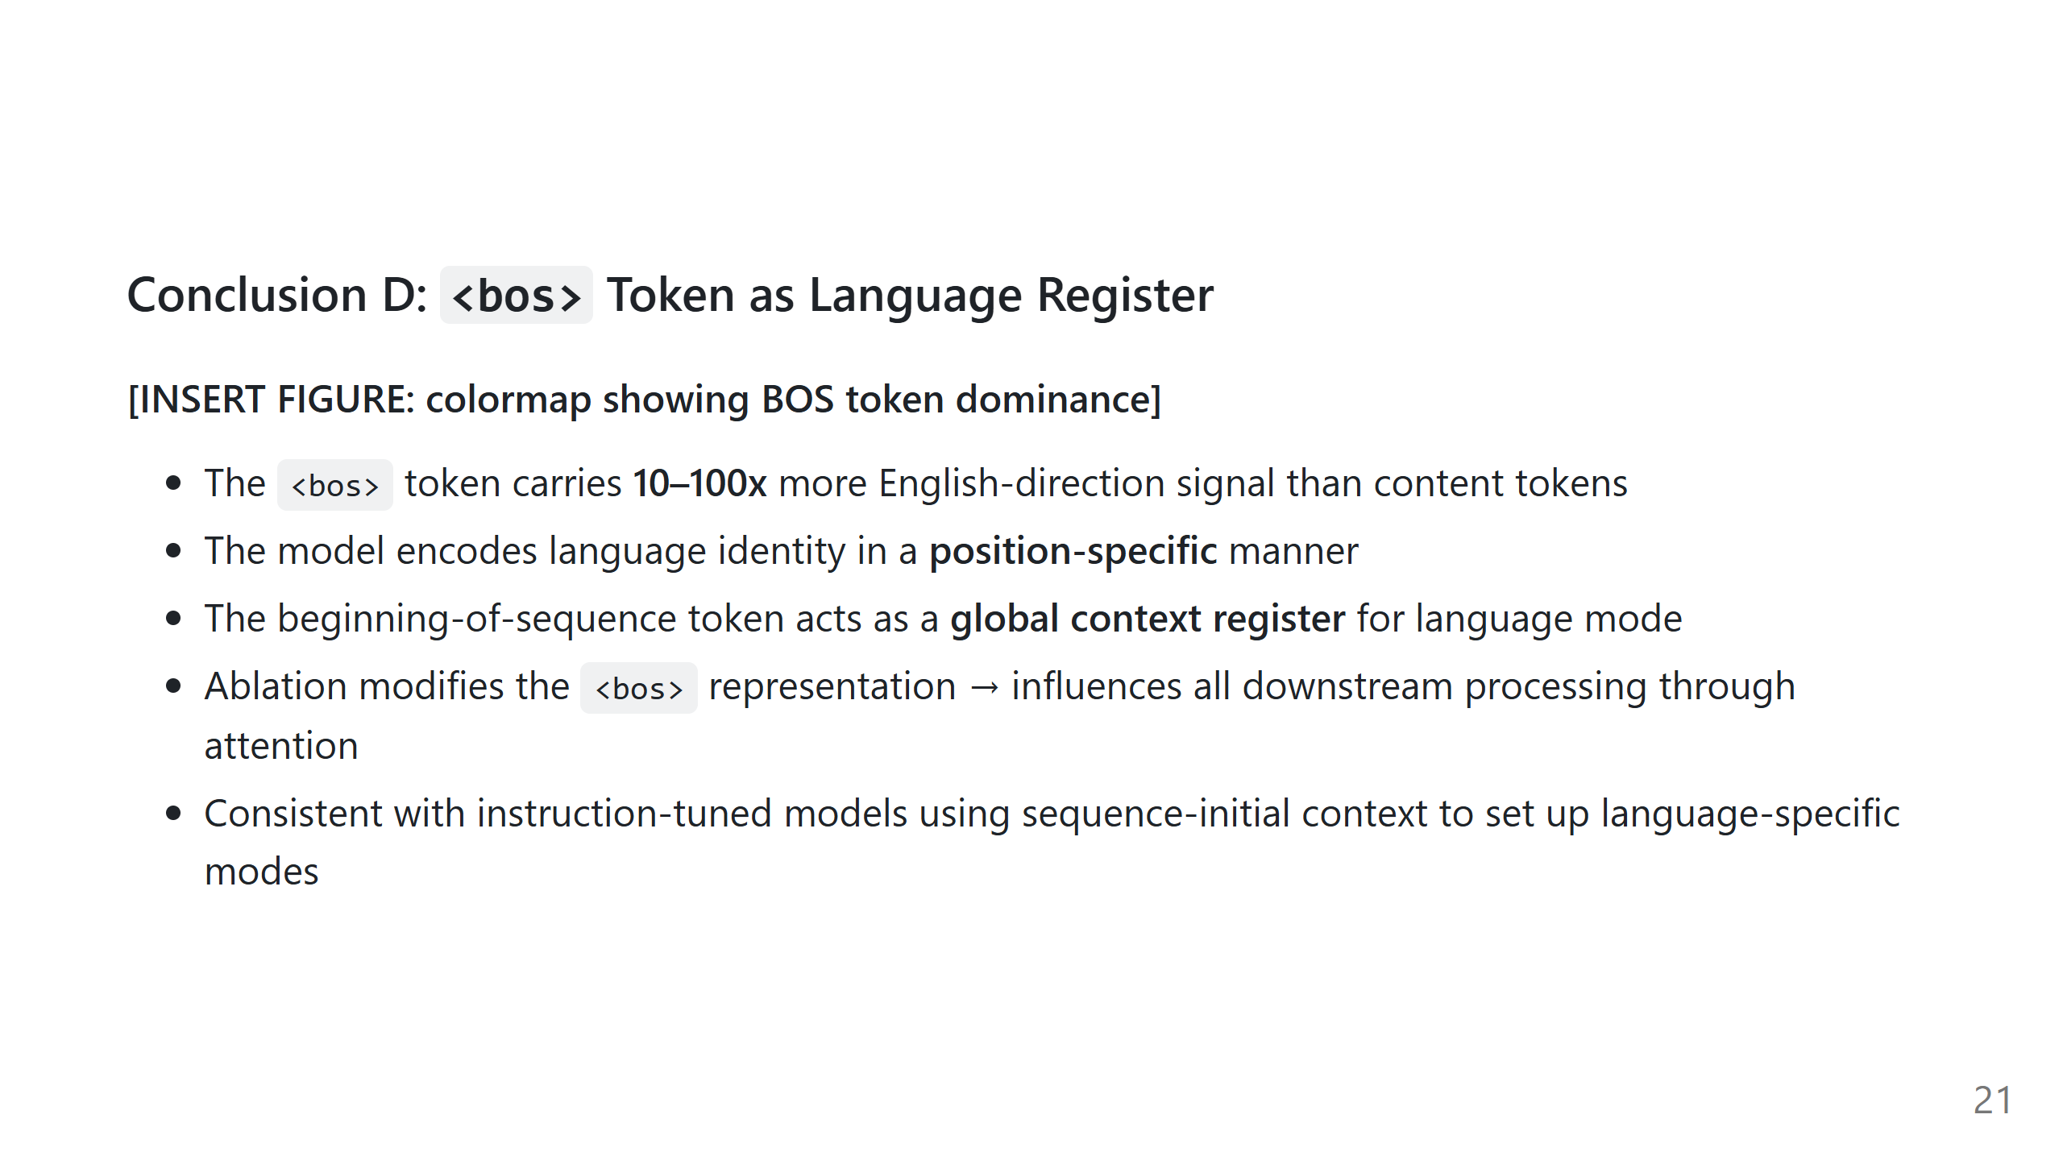
Notes:
Placeholder: Insert a colormap showing BOS dominance

Slide 22
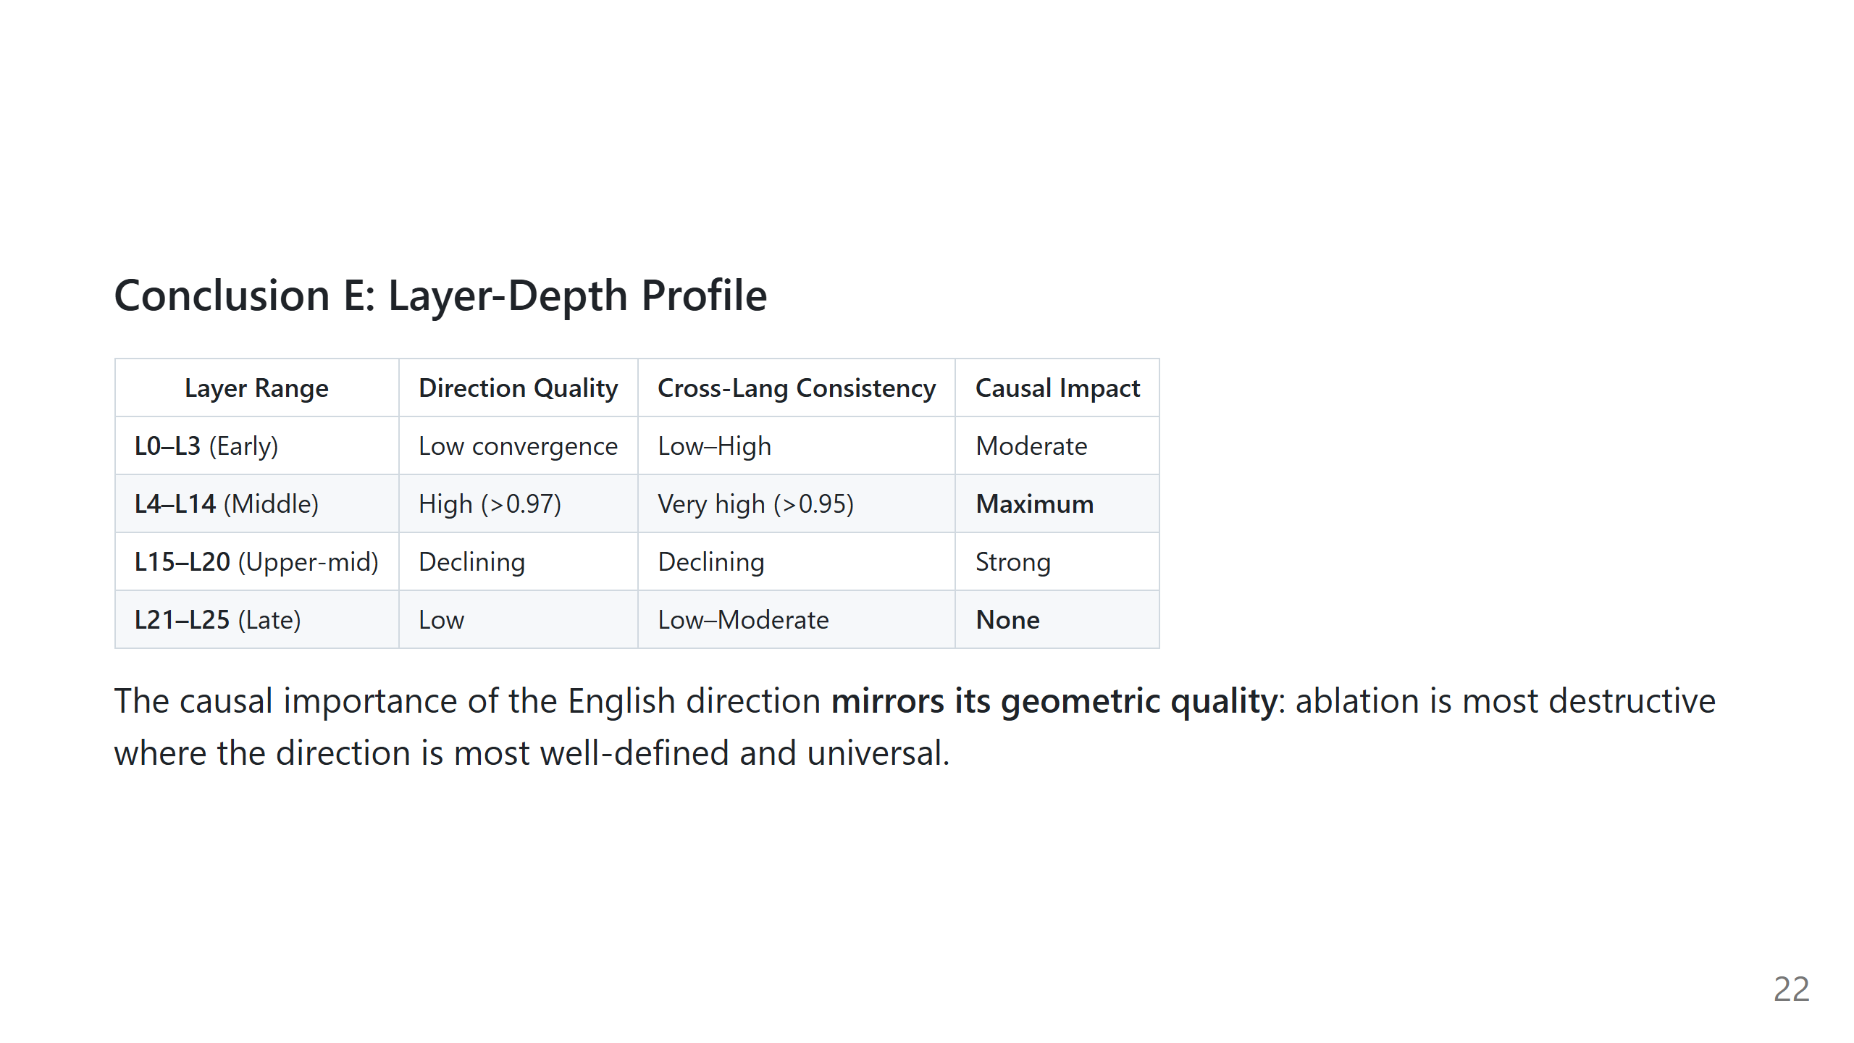

Slide 23
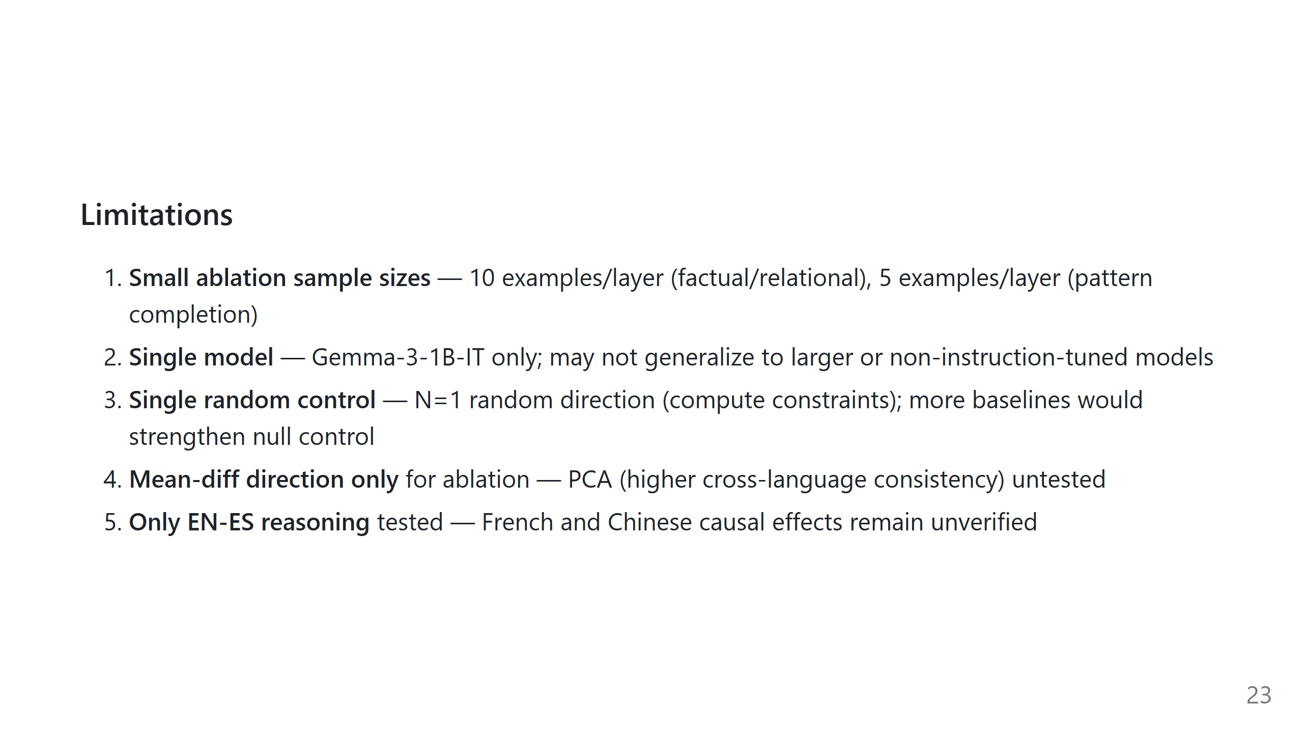

Slide 24
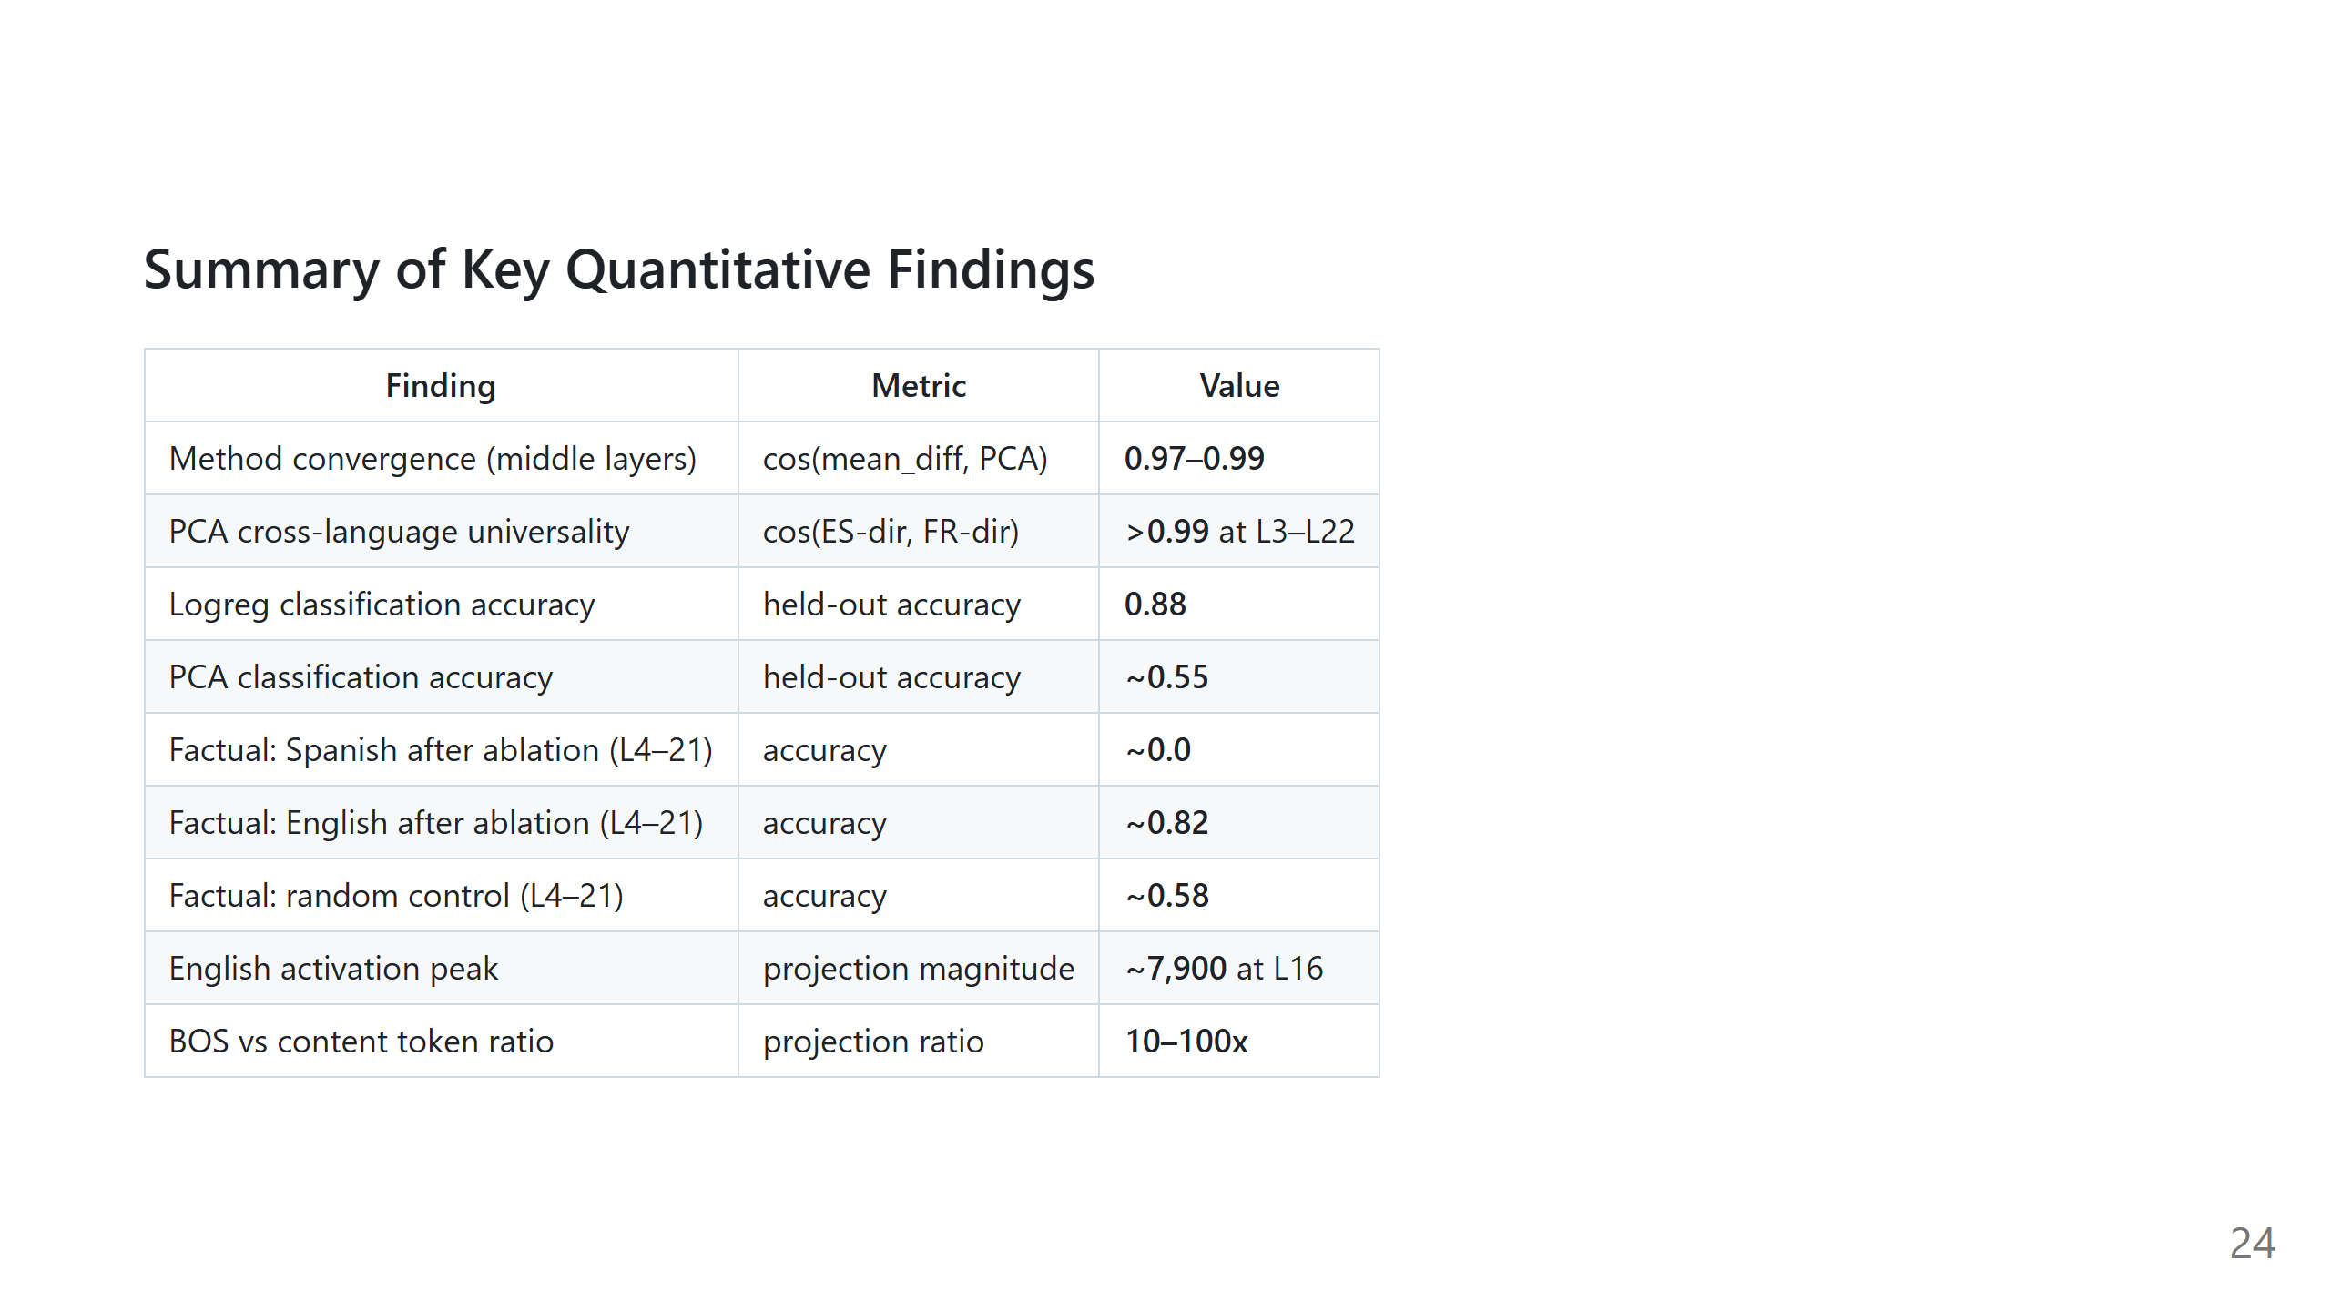

Slide 25
