Slide 1

Notes:
[Sources]
- Original supplied VU presentation template.

Slide 2

Medicine Recommendation System
Notes:
[Sources]
- main_file.docx.

Slide 3
Group Members Introduction
Student ID: BC190411036;
Team ID: themushtaq48;
Supervisor: Dr. Mushtaq Hussain;
Virtual University of Pakistan.
Notes:
[Sources]
- main_file.docx; srs.docx.

Slide 4

INTRODUCTION OF PROJECT
An educational AI-powered Streamlit prototype that preprocesses symptoms, compares Logistic Regression and a Keras neural network, predicts a probable condition, and ranks medicine candidates with confidence, explanation, safety notes, and a clinician-confirmation warning.
Notes:
[Sources]
- main_file.docx; srs.docx; implemented project.

Slide 5
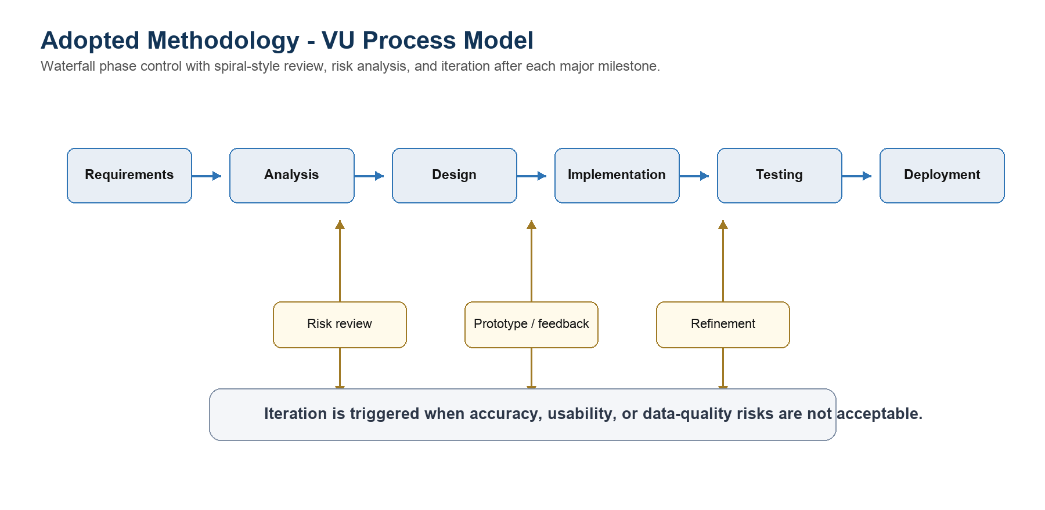
Notes:
[Sources]
- srs.docx process-model figure.

Slide 6
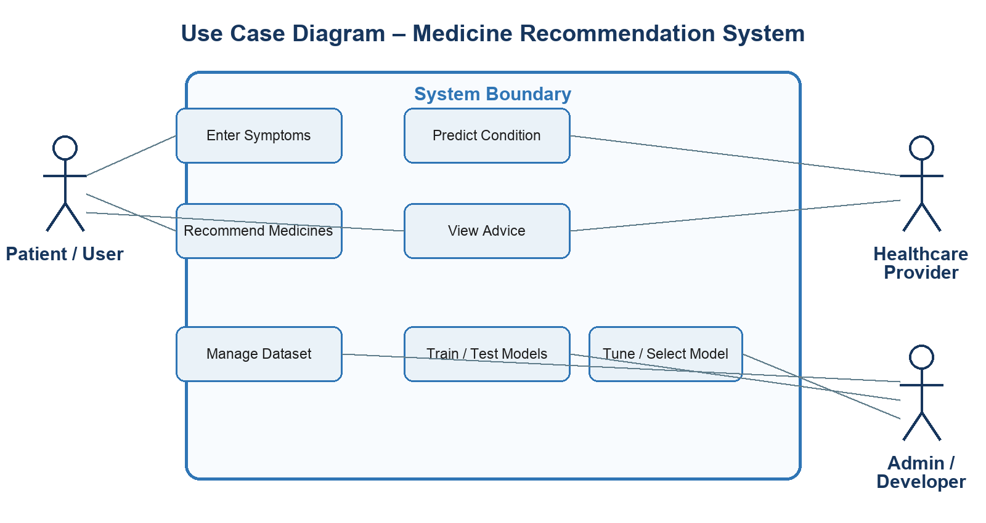
Use Case Diagram
Notes:
[Sources]
- srs.docx use-case figure.

Slide 7
Business Rules Catalog
FR-01: data preparation;
FR-02: ML/DL training and testing;
FR-03: model optimization;
FR-04: condition prediction and medicine ranking;
FR-05: Streamlit user interface.
Notes:
[Sources]
- srs.docx FR-01 to FR-05.

Slide 8
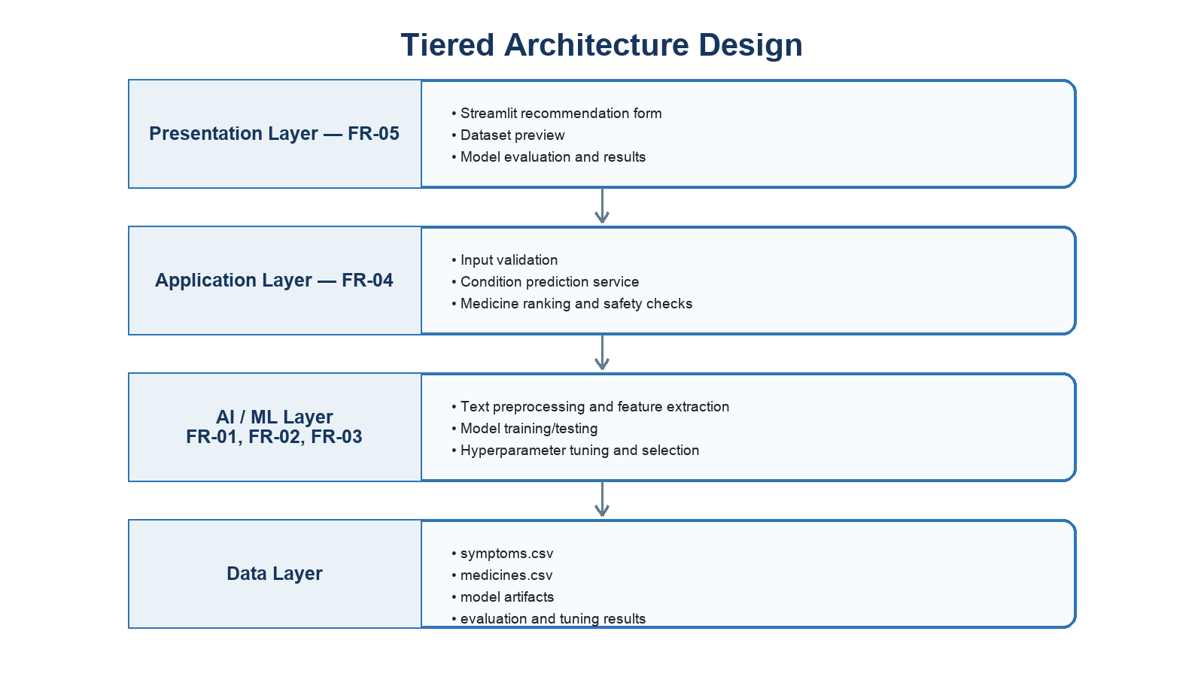
Architectural Design
Notes:
[Sources]
- design.docx architecture figure.

Slide 9
Team Structure
Student BC190411036: requirements, data preparation, model implementation, Streamlit interface, testing, documentation, and presentation.
Supervisor Dr. Mushtaq Hussain: academic guidance and review.
Notes:
[Sources]
- Project documentation.

Slide 10
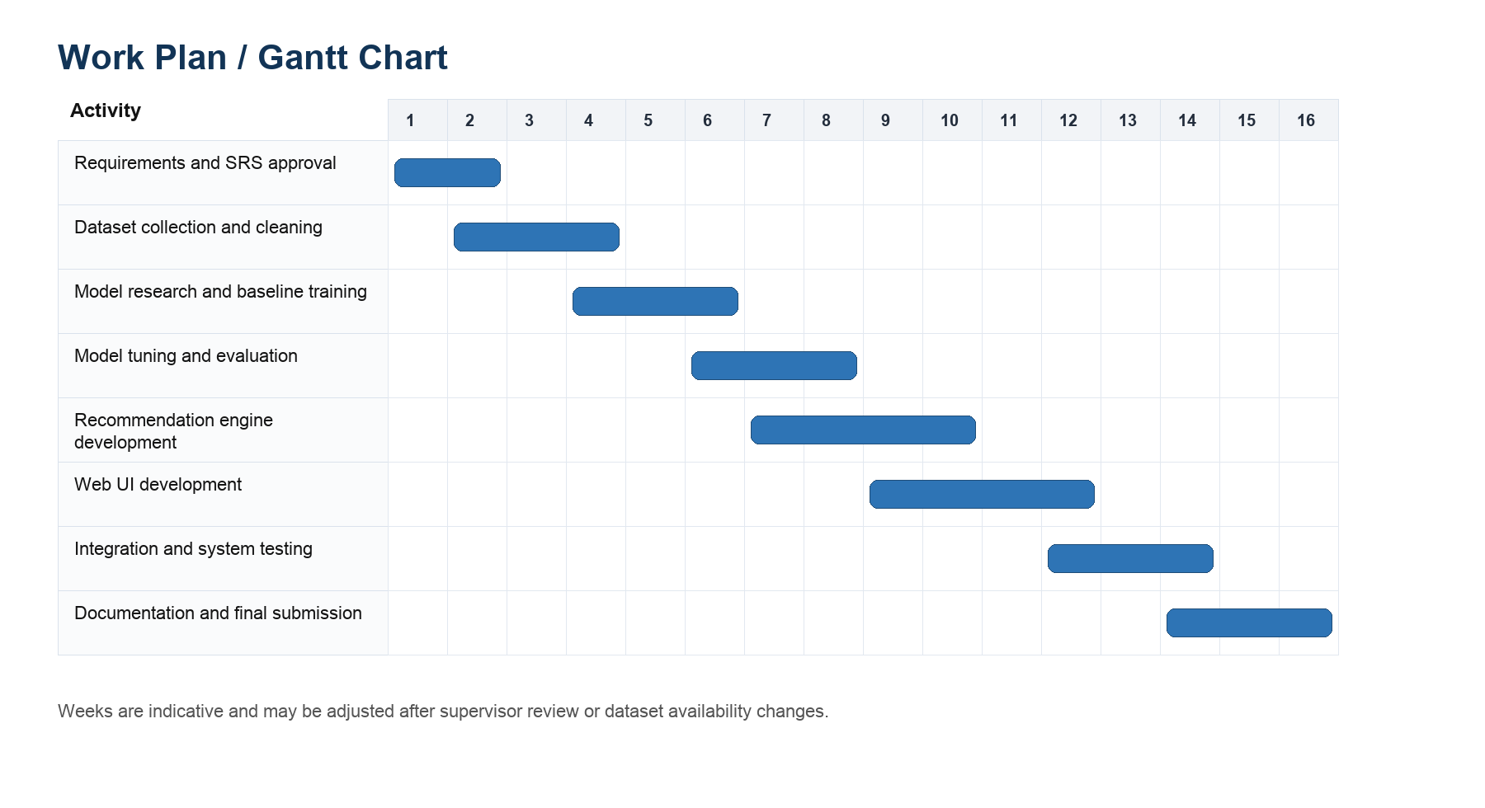
Project Schedule
Notes:
[Sources]
- srs.docx Gantt chart.

Slide 11
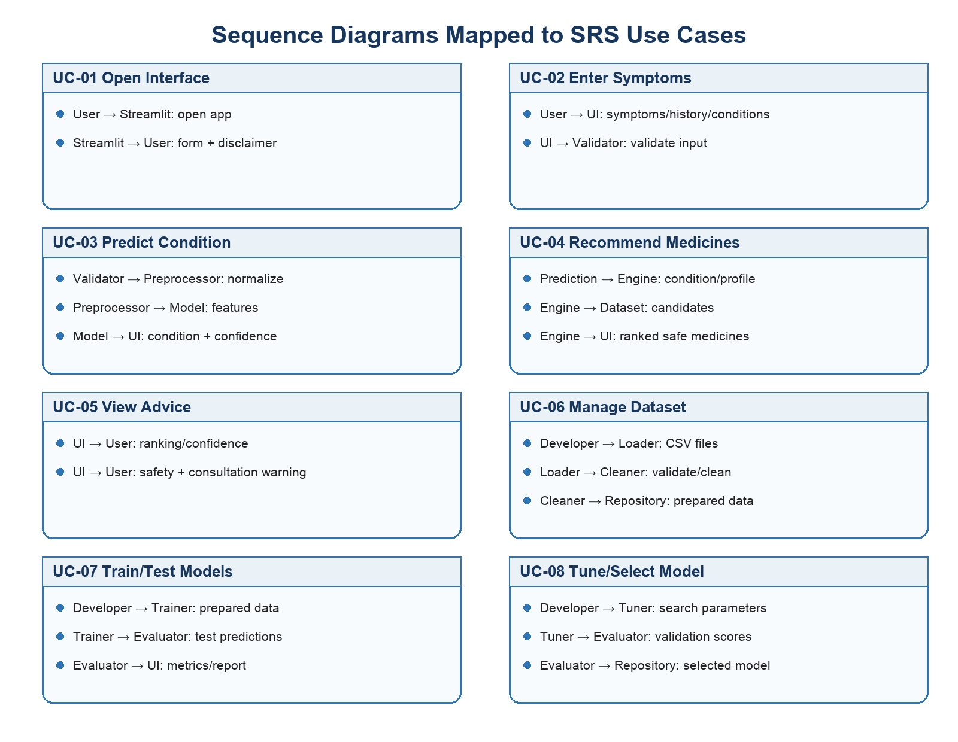
Sequence Diagrams
Notes:
[Sources]
- design.docx sequence figure.

Slide 12
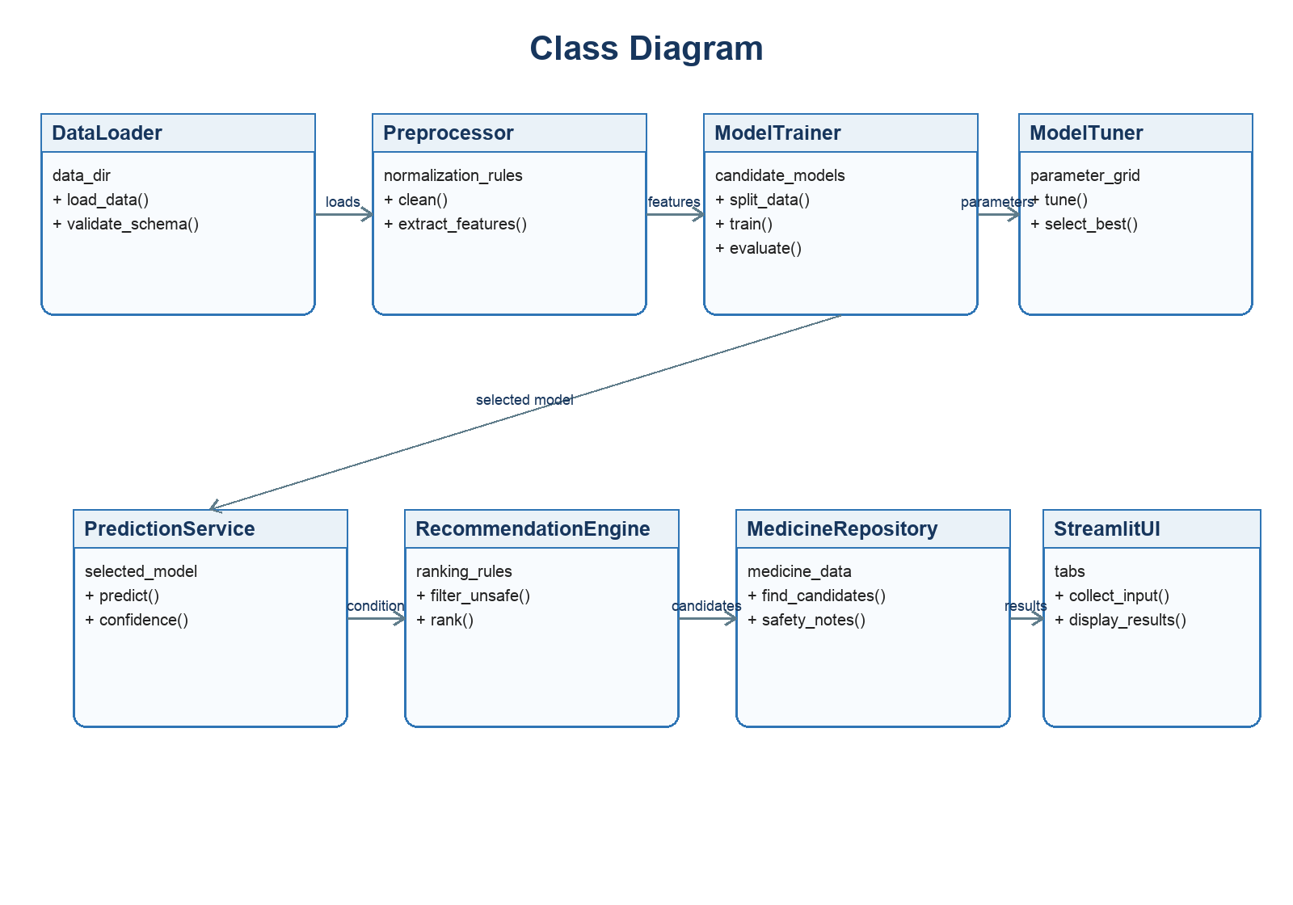
Logical Model/Class Diagram
Notes:
[Sources]
- design.docx class figure.

Slide 13
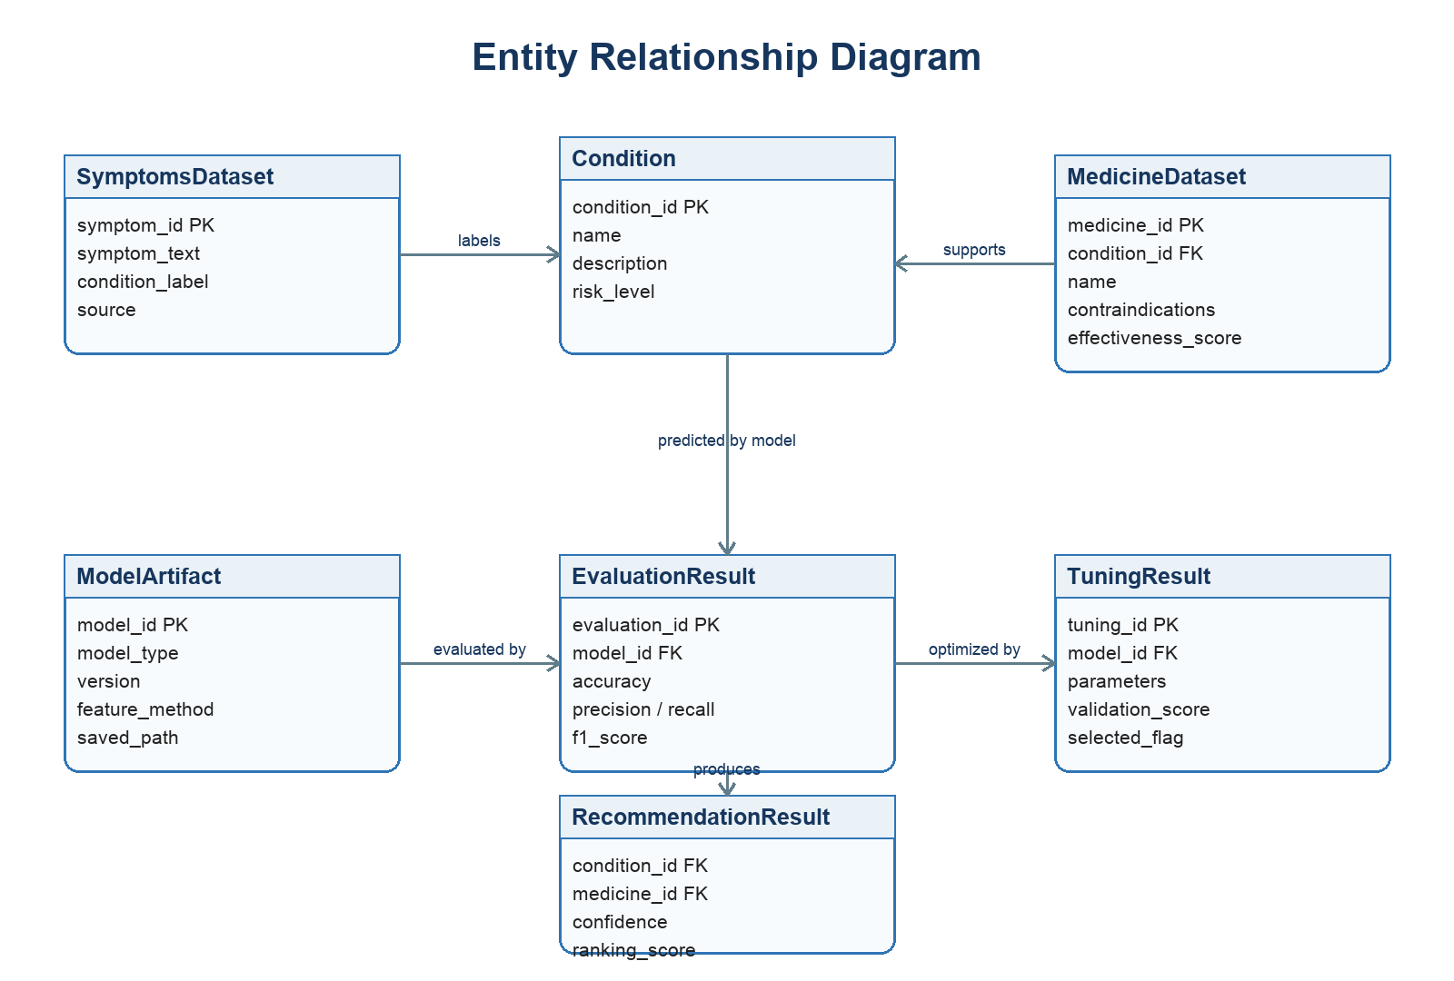
Entity-Relationship Diagram
Notes:
[Sources]
- design.docx ER figure.

Slide 14
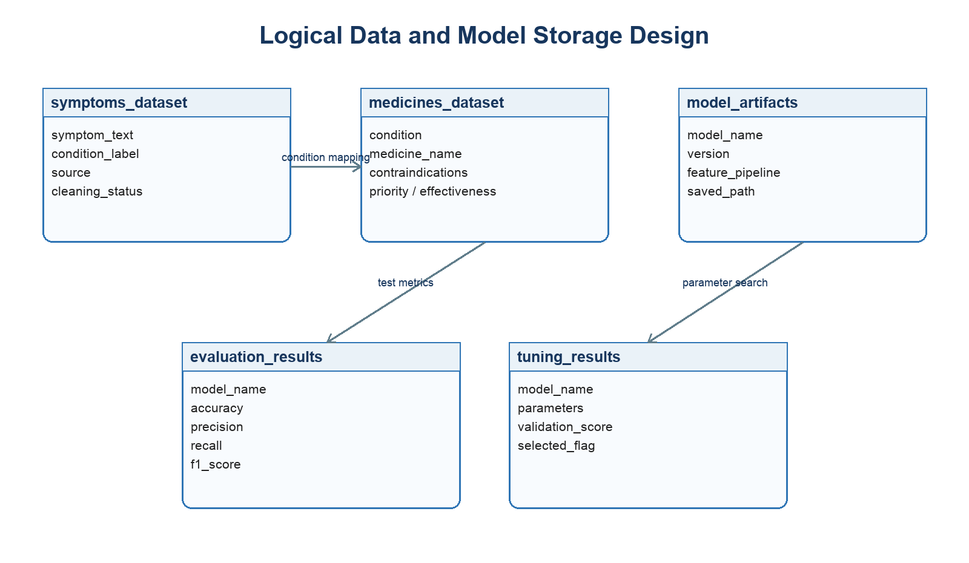
Database Diagram
Notes:
[Sources]
- design.docx storage figure.

Slide 15
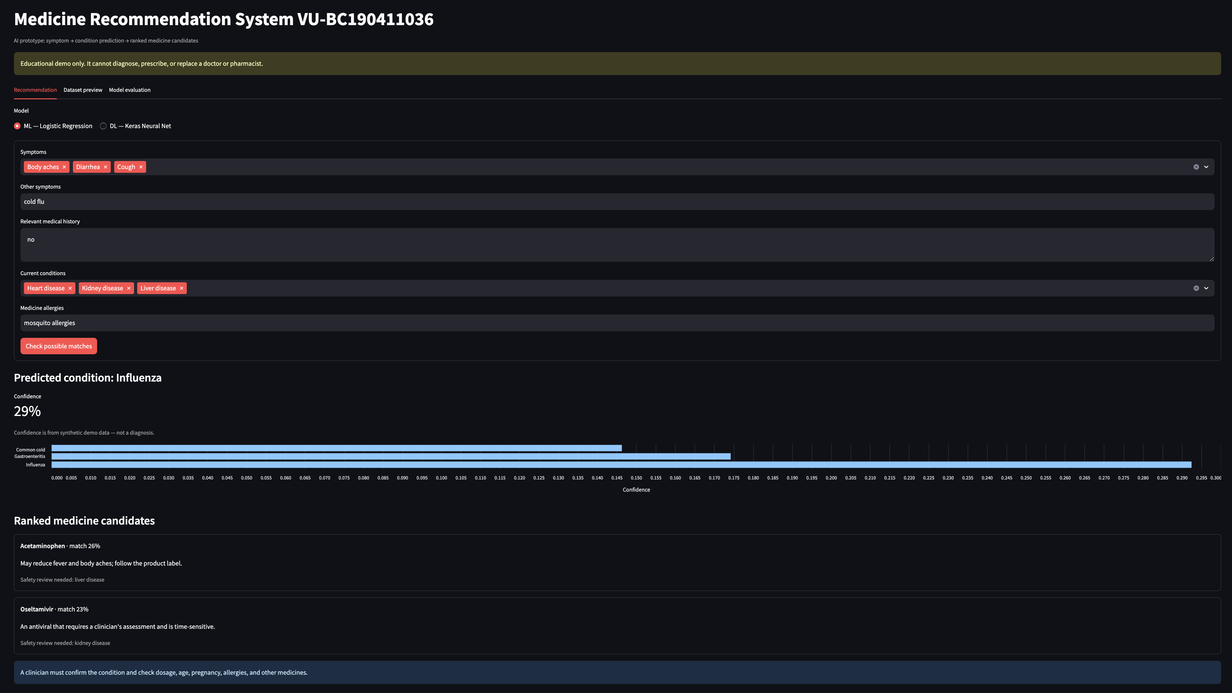
User Interfaces
Notes:
[Sources]
- User-supplied application screenshot.

Slide 16
Tools
Python
Pandas
NumPy
Scikit-learn
TensorFlow/Keras
Streamlit
Matplotlib
Seaborn
Jupyter Notebook
Google Colab and Visual Studio Code.
Notes:
[Sources]
- requirements.txt and project source files.

