Slide 1


Power Up!
Shawn Miller
Ben Kasper
Justin Oeters

Slide 2


Elevator Pitch
Gaming has been on a cultural tear since the swinging seventies. From the first Magnavox Odyssey, through the 16-bit era and into the modern age of gaming in 4k, video games have become ingrained in more of our daily lives.
With so many games out there today, how do we decide which is best?
Introducing the Power Up app. An app designed for simplicity and a clear user experience centered around the idea that anyone should be able to curate their own personal library of games. Starting from our robust database of video games, including everything from JRPGs to Metroidvanias and everything in between, the user can find the games that fit their needs and begin to build a personal library.
Motivation for development: There are a lot of opinions out there for the greatest games, but nowhere to simply build your own greatest games collection. This app’s motivation stems from this desire to have a simple yet effective way to track all our gaming desires.

Slide 3
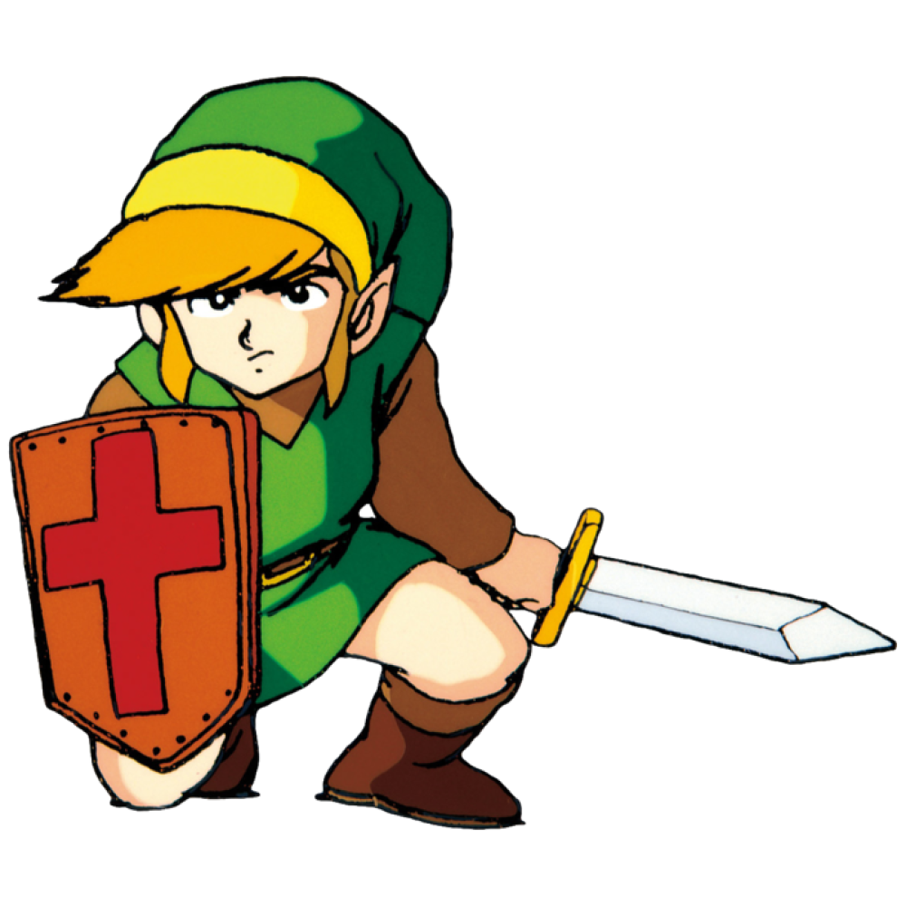
Concept
The Power Up app allows the user to create their own unique ID and log-in credentials. From there, they can begin to search for their games and click the save button to add them to their unique gaming library.
The site consists of 5 pages:
Home page where the user can see the games in the database (cannot ”save” without being logged in)
Game page to show single game data and holds save button
Signup page where user will sign up for a profile
Login page where existing users will sign back in
Favorites page where users can see their curated list of saved games
Once the user has completed their tasks, they can either log out or search for more games to add to their library

Slide 4
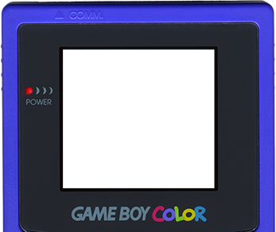
User Story
As a
Fan of Video Games
I want
To view the world’s most popular videos
So that
I can build my own wish list of games to play
Then
I can collaborate with other video game fans with similar interests

Slide 5



Process
Technologies used:
Heroku
Node.js and Express.js
Mongo DB
React
GraphQL
Apollo Server
Bootstrap (CSS)
JS, HTML, CSS
Breakdown of tasks and roles:
Group: brainstorm idea for app; general collaboration across all aspects of the project
Shawn: Database (incl. seeds), Server-side, React, GraphQL
Justin: React, queries, server-side, GraphQL
Ben: React, queries Wireframe, Presentation, README

Slide 6



Successes
Challenges
Coming together quickly on a concept for the project
Challenged ourselves intellectually
Overcame some of the initial struggles of connecting the server side to the client side
Getting data from server side to client side
Queries
GraphQL
IGDB API issues
Spent a lot of time debugging instead of adding new features

Slide 7

Demo

Slide 8

Directions for Future Development
Edit profile and edit blog options
Add review stars (e.g., 1-5 stars) to the inputs from the user when posting a review
Add feature to allow user to save their favorite searches to quickly go back
Add feature to allow user to follow other users and collaborate on game libraries
Add searches with filters
Connect to IGDB API

Slide 9
Links
Deployed Heroku App
Github Repo

