Slide 1
ENSE 470, Milestone 4
Team: Hell's Tech Support
Shawn Clake, Nikolas Lendvoy, Amruo Hasnoon
February 29, 2018

Slide 2
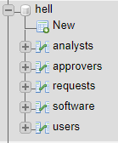
Database snapshot
Relational
MySQL
  Convenient
  Most (all?) SSE students understand SQL
5 Tables
  users
    analysts
    approvers
  software
  requests

Slide 3
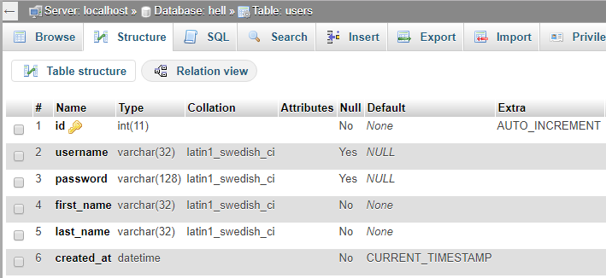
More Detailed – users table

Slide 4
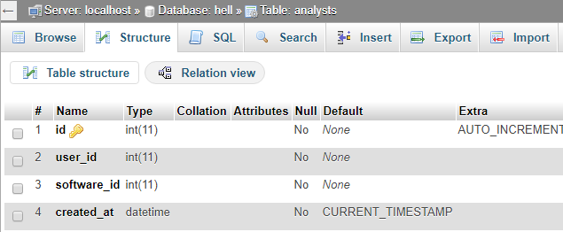
More Detailed – analysts table

Slide 5
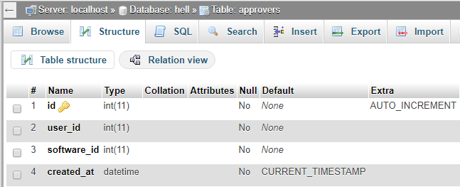
More Detailed – approvers table

Slide 6
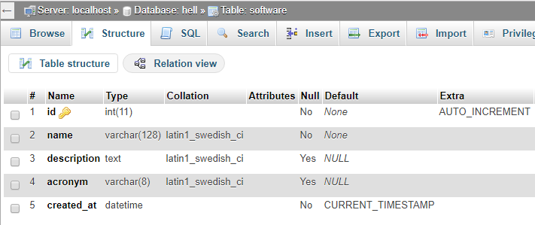
More Detailed – software table

Slide 7
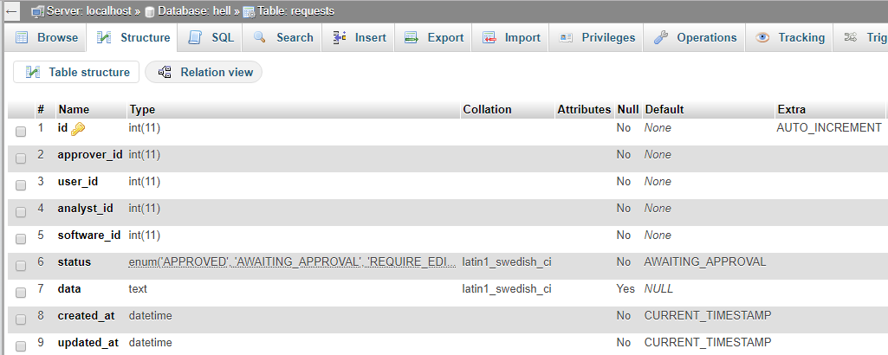
More Detailed – requests table

Slide 8
Thoughts
Similarity in names can get confusing when cleansing, is this necessary?
  Krystal Ball
  Crystal Ball
The same objectives could’ve been met with half the data.
Just enough data where we felt cleansing manually vs. writing a script to do it for us would’ve taken similar amounts of time ☹

Slide 9
Recall, user story map (release 1)
Briefly go over (display) your group’s user story map for your proposed MVP for release 1

Slide 10
Lo-fidelity prototype snapshots
Go through the lo-fi prototype snapshots for all user activities for your release 1
  Illustrate interactions
  Illustrate messaging and data flows
  NOTE: Try to show all / as much as you can, but be cognizant of your time
Describe your experience in creating the lo-fi prototype
  Technology used? (white board, paper/pencil, digital)
  Pros/Cons you experienced

Slide 11
Changes & Misc.
Have your plans changed since your group’s initial conception and project evolution
  Something you saw another team did was intriguing/inspiring
  Something you didn’t care for in your initial concept of your future VSM
Add other insights if you like but remember, your group’s report-out must be kept within 5 minutes

Slide 12
Group reflection
How did you feel about this milestone? What did you like about it? What did you dislike?
  Cleansing was tedious. Either more data which is easier to automate, or less data which is in an uglier form. We think the DB structure & lo-fi prototyping are the real objectives of this milestone.
What did you learn about yourself as you collaborated and worked through this milestone?
  [Response here]

Slide 13
Group reflection
How will you use what you have learned going forward?
  [Response here]
What “stuff & things” related to this milestone would you want help with?
  [Response here]

