Slide 1
ENSE 470, Milestone 2
HELL’s Tech Support
Shawn Clake, Nikolas Lendvoy, Amruo Hasnoon
January 25,2018

Slide 2
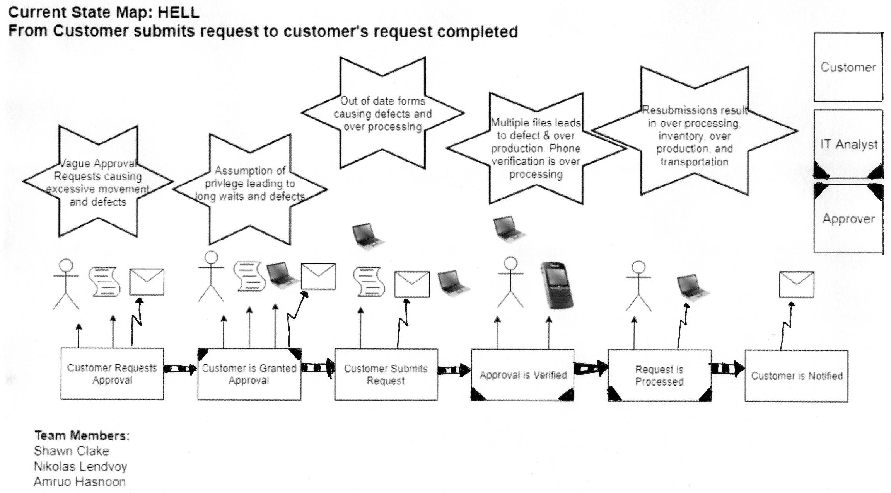
Current state Value Stream Map (VSM)

Slide 3
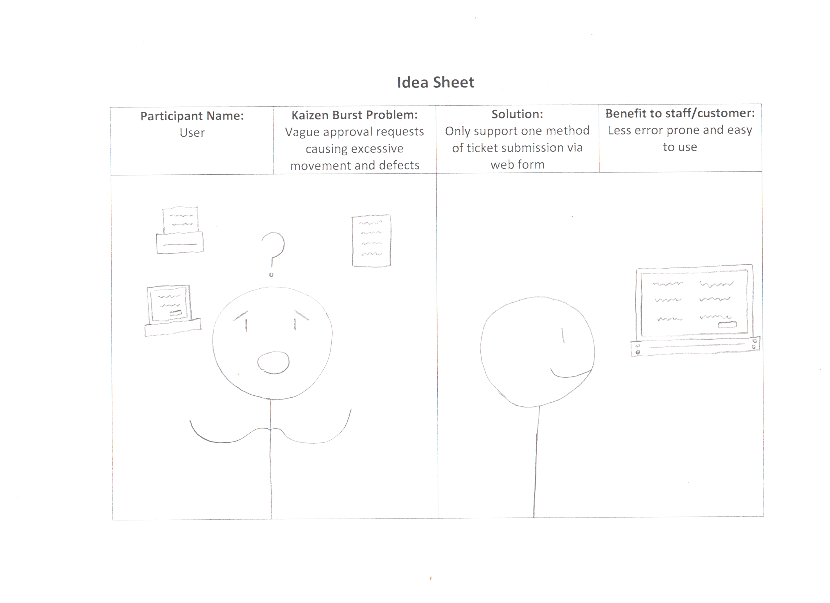

Slide 4
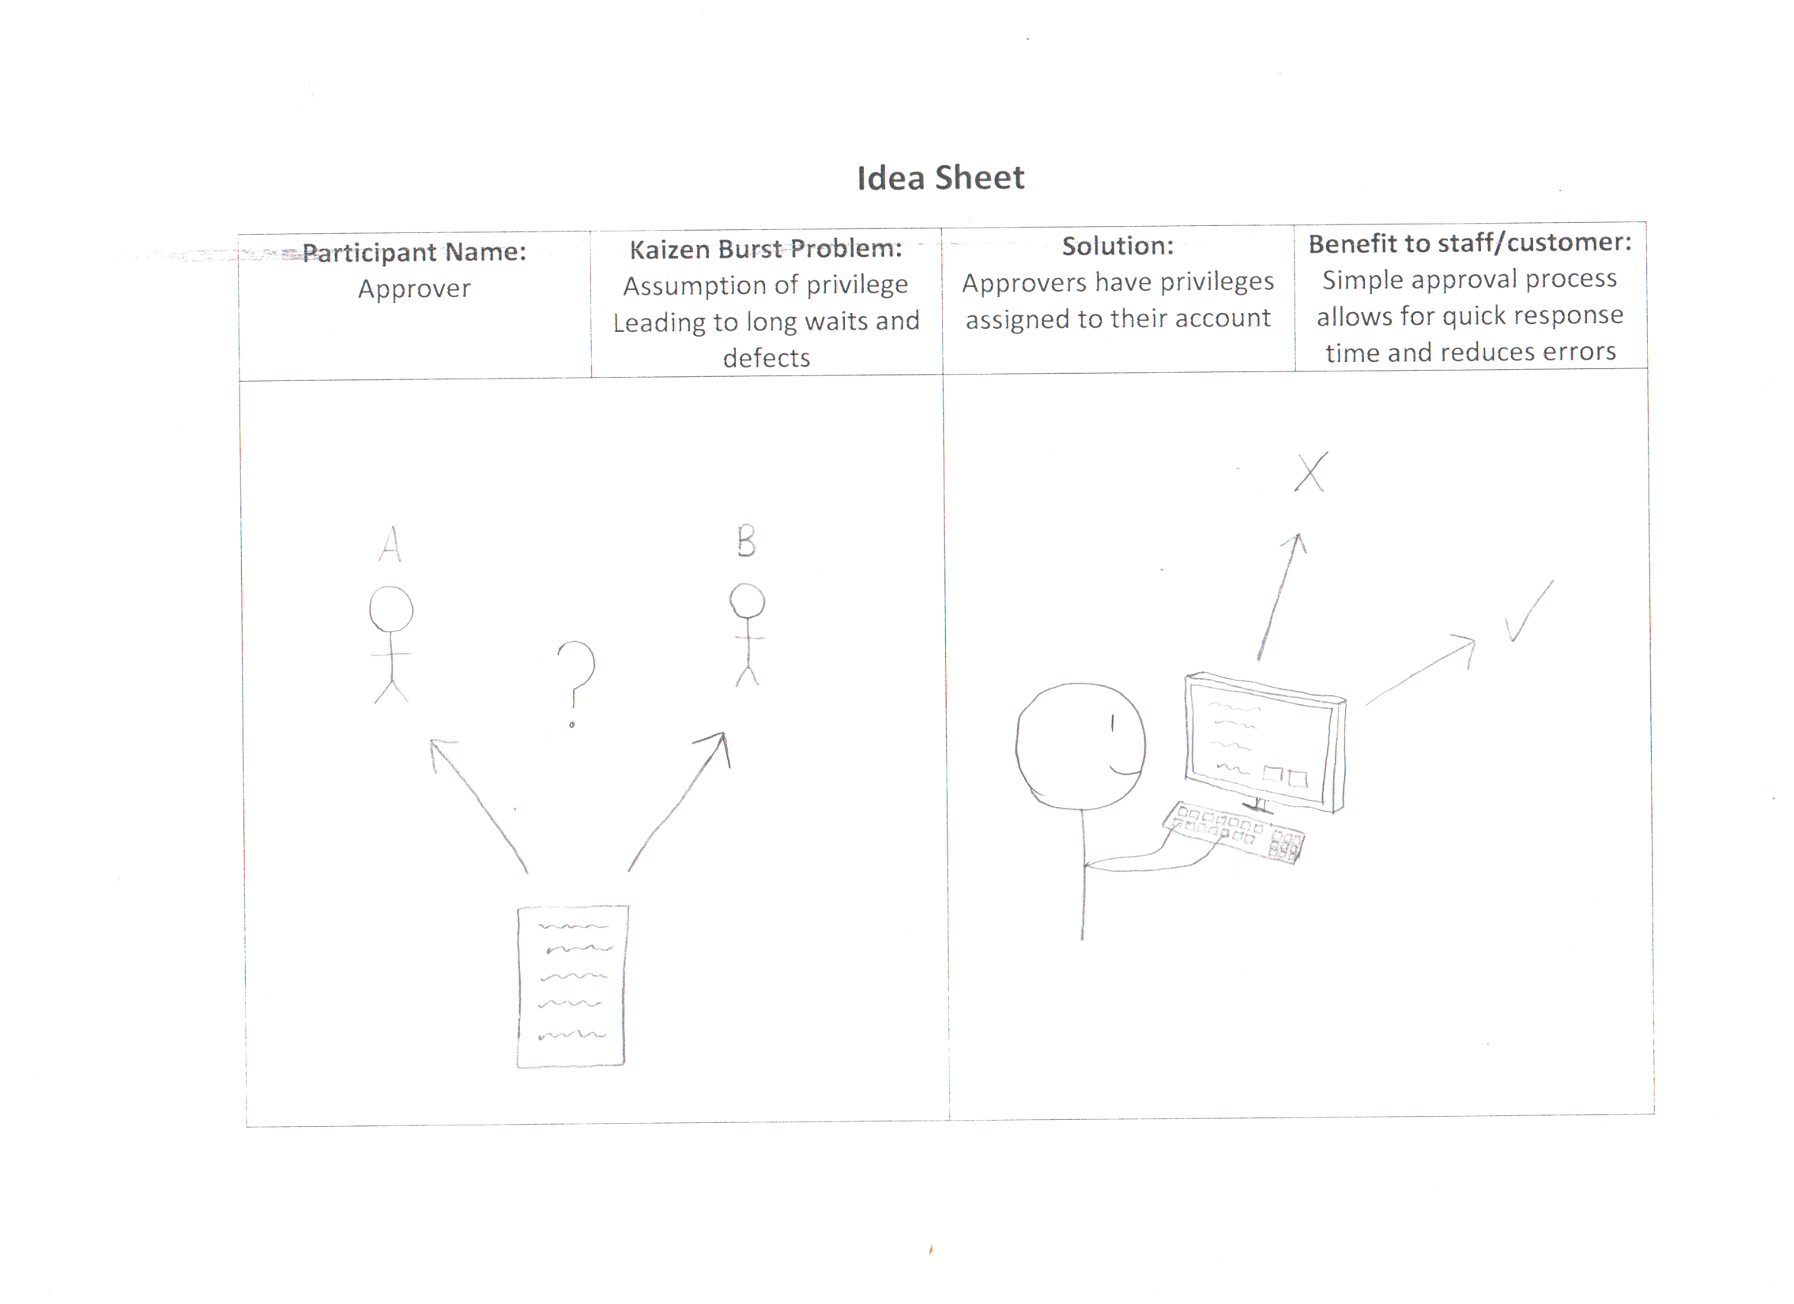

Slide 5
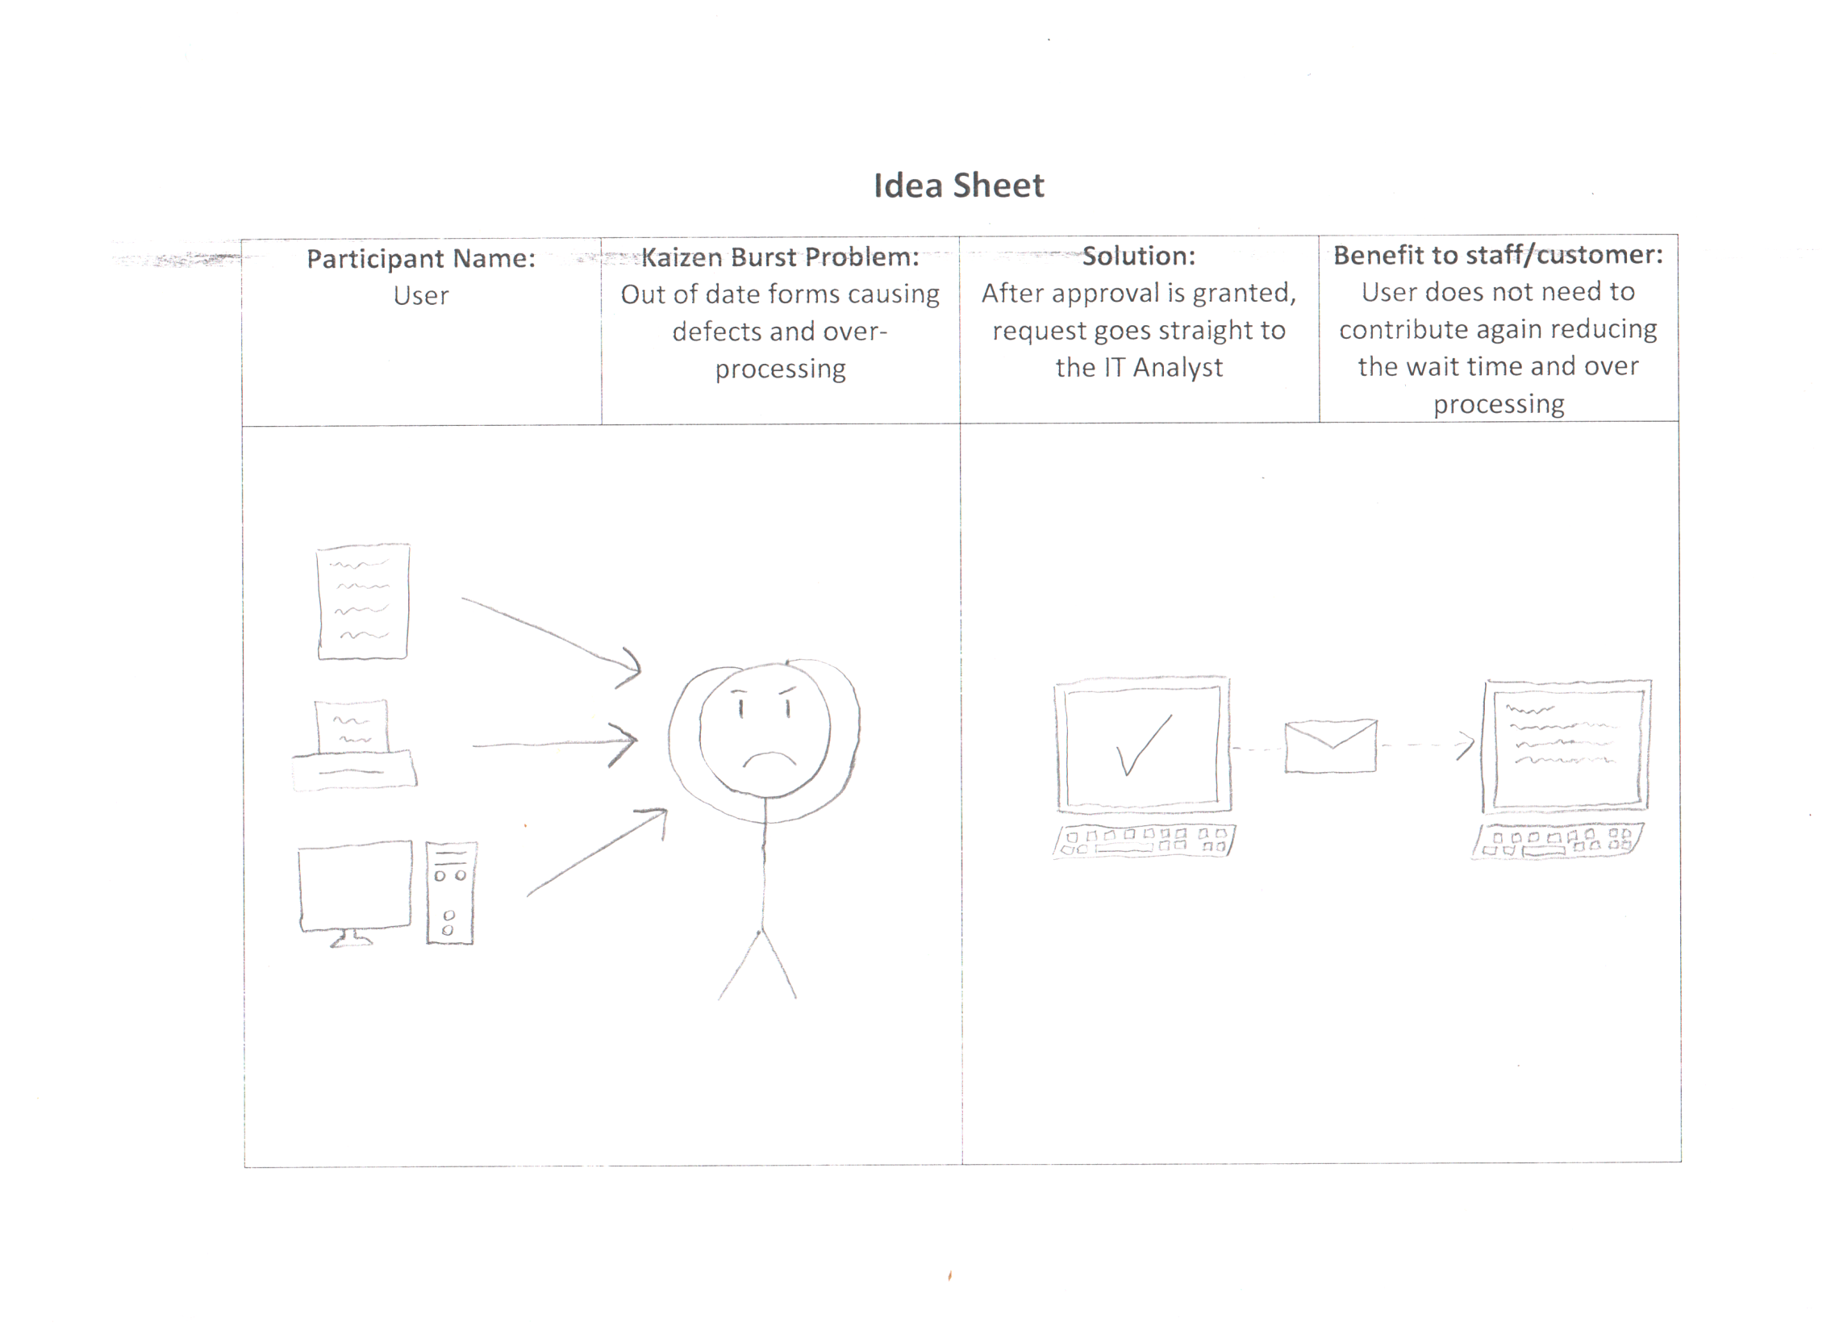

Slide 6
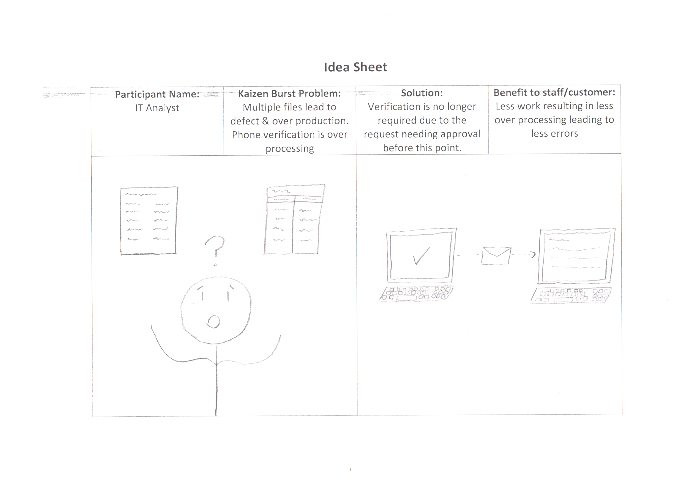

Slide 7
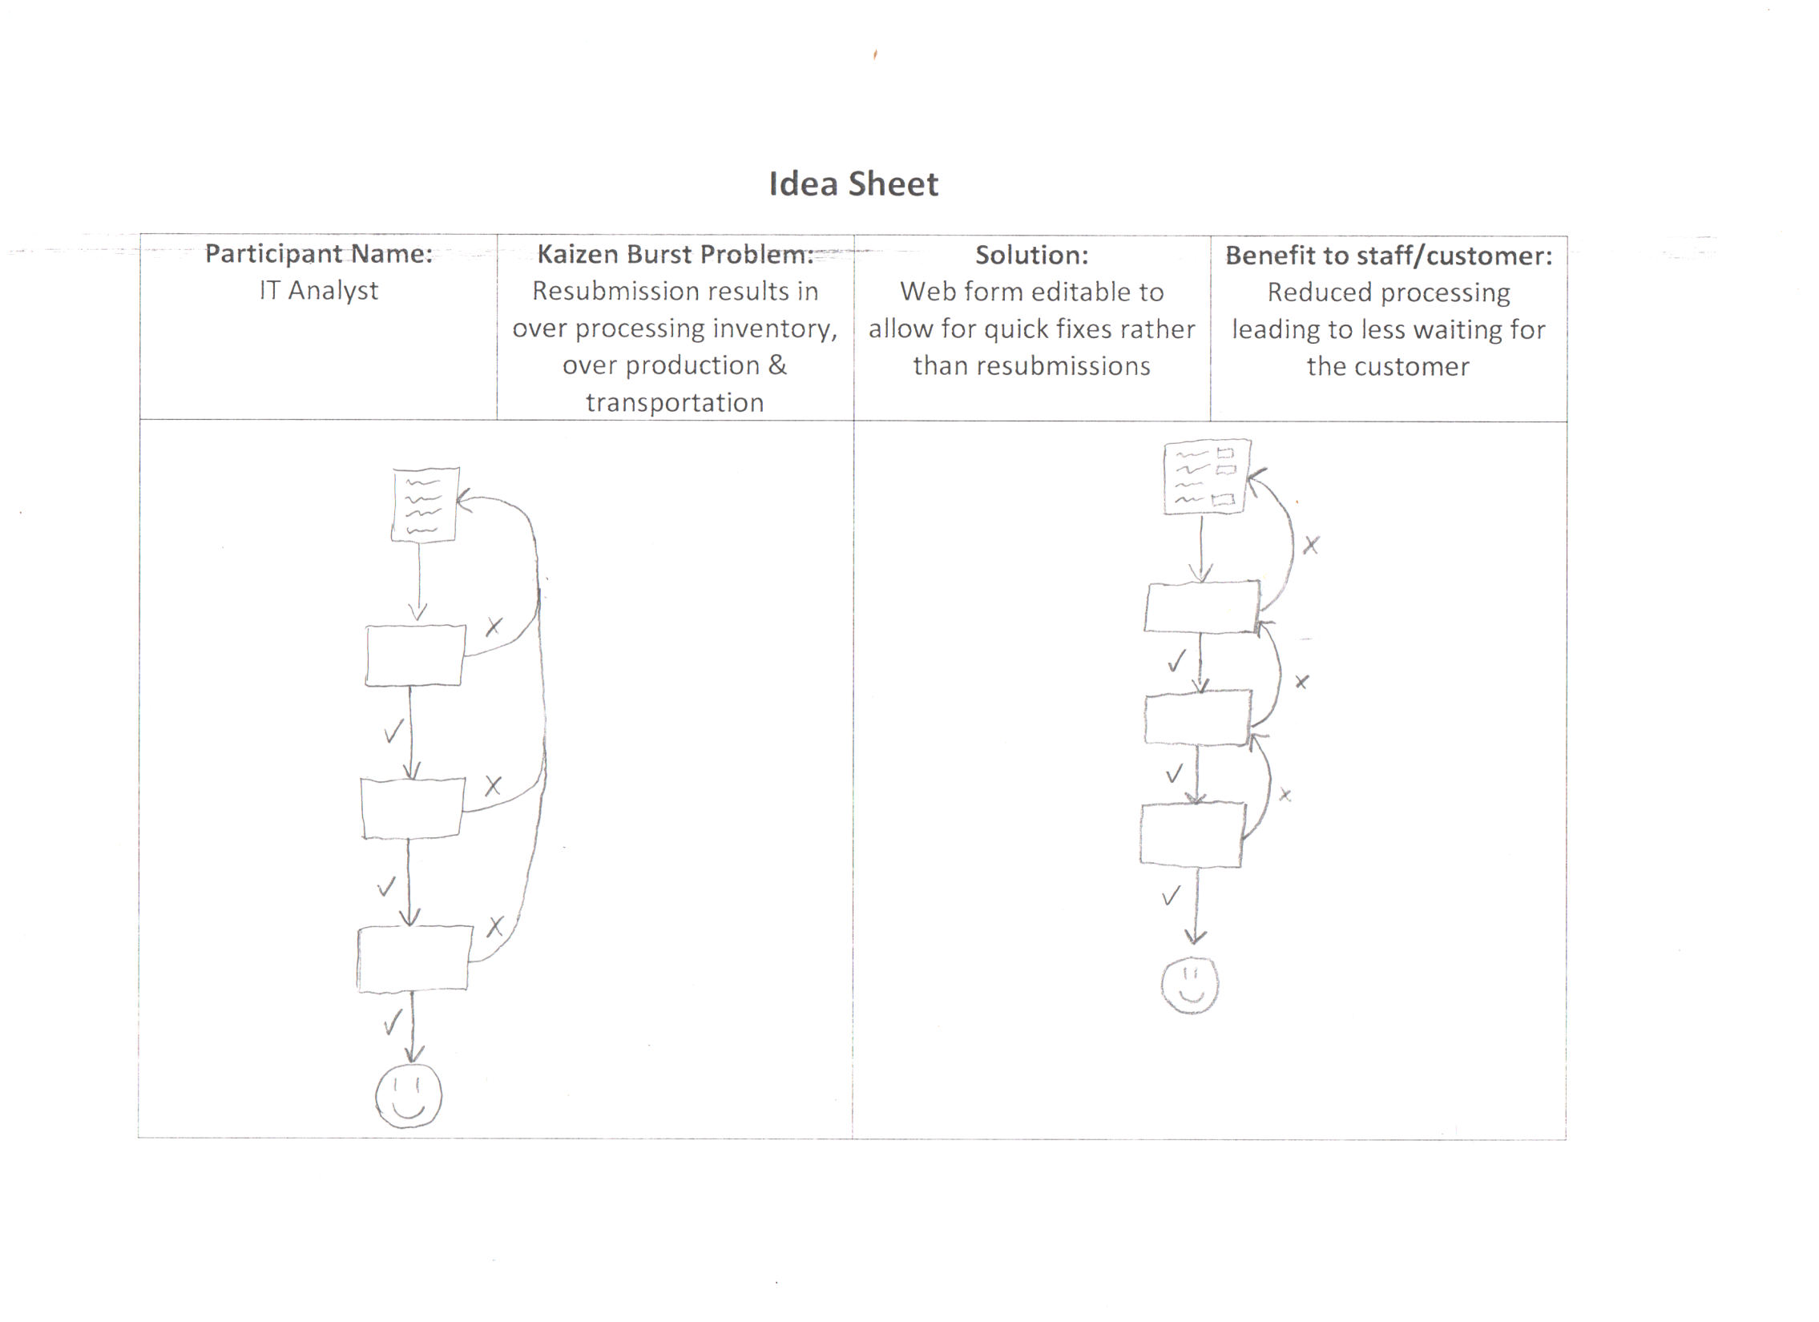

Slide 8
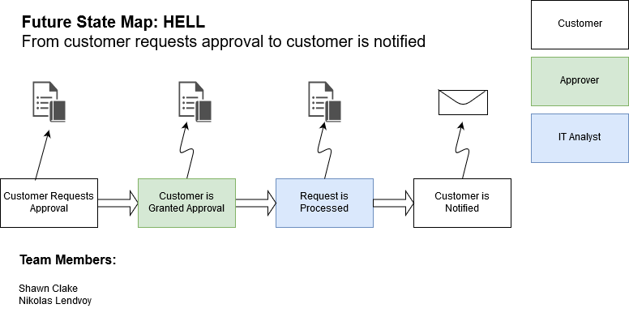

Slide 9
Current state Value Stream Map (VSM)

Slide 10
Group reflection
How did you feel about this milestone? What did you like about it? What did you dislike?
  This milestone allowed us to further expand on the ideas we during the last milestone and we enjoyed planning out our ideas with more detail.
What did you learn about yourself as you collaborated and worked through this milestone?
  We learned that using better software is a more effective use of our time. We also learned how to effectively distribute tasks among our members.
  Some member’s artwork is better than other’s.

Slide 11
Group reflection
How will you use what you have learned going forward?
  We will use these new ideas to efficiently work on future milestones and develop overall improved products.
What “stuff & things” related to this milestone would you want help with?
  Nothing comes to mind.

