Slide 1
ENSE 470, Milestone 6
Team: Hell's Tech Support
Shawn Clake, Nikolas Lendvoy, Amruo Hasnoon
February 29, 2018

Slide 2
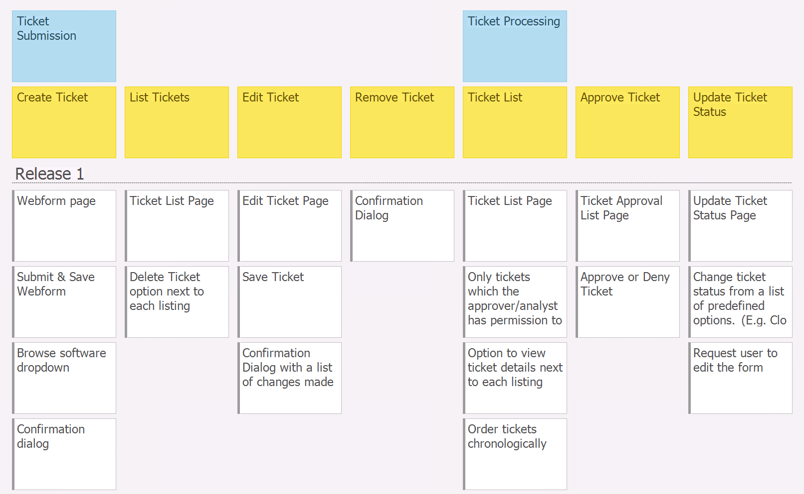
Executive summary - USM

Slide 3
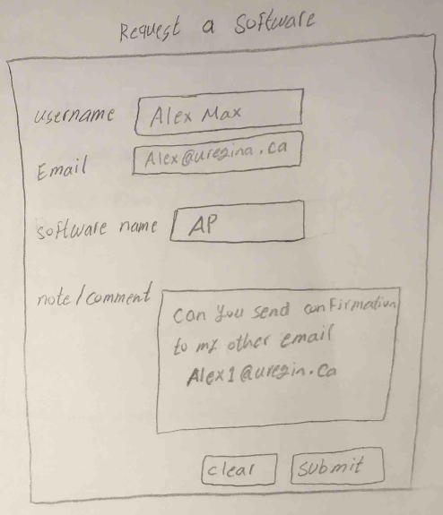
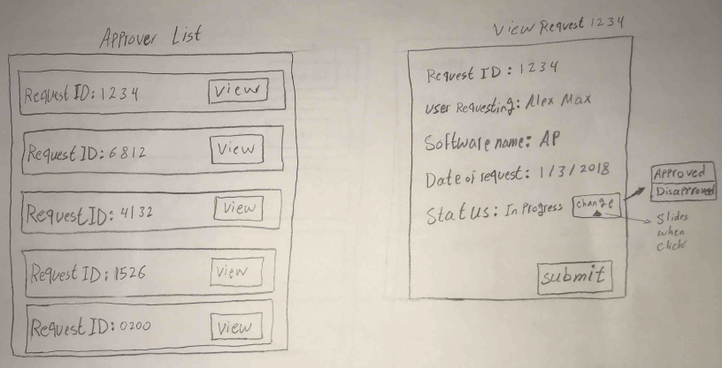
Executive summary – Low-Fi Overview
Technology used
  MySQL, HTML, CSS, PHP, JavaScript
Everything done, Login page was added to release 1.
Nothing was moved to a future release.

Slide 4
Demo
  http://144.217.7.184/
Illustrate some of the Acceptance Test-Driven Development test validations
Design patterns used?
  What, where, why, how?

Slide 5
Group reflection
How did you feel about this milestone? What did you like about it? What did you dislike?
  We liked this milestone because it gave us a sense of real progress and allowed to work through the development process.
What did you learn about yourself as you collaborated and worked through this milestone?
  Small projects like this make it difficult to collaborate between a team because most of the work can be done by a single person.
How will you use what you have learned going forward?
  We will use the processes we studied to better manage projects in the future.
What “stuff & things” related to this milestone would you want help with?
  No major issues.

