Slide 1
ENSE 470, Milestone 4
Team: Hell's Tech Support
Shawn Clake, Nikolas Lendvoy, Amruo Hasnoon
February 29, 2018

Slide 2
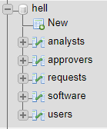
Database snapshot
Relational
MySQL
  Convenient
  Most (all?) SSE students understand SQL
5 Tables
  users
    analysts
    approvers
  software
  requests

Slide 3
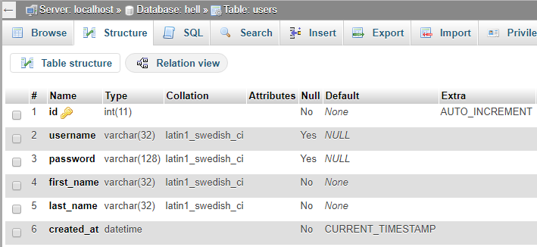
More Detailed – users table

Slide 4
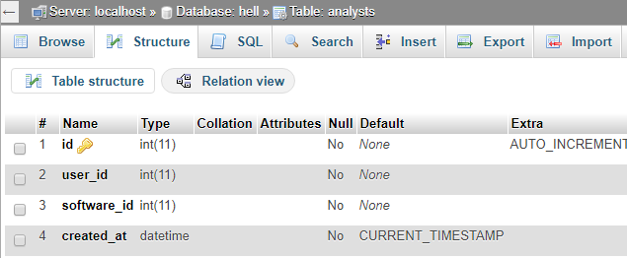
More Detailed – analysts table

Slide 5
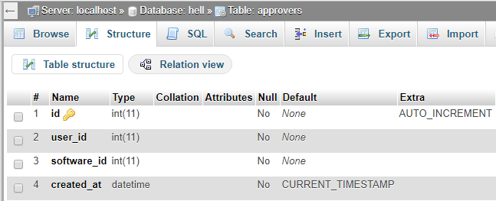
More Detailed – approvers table

Slide 6
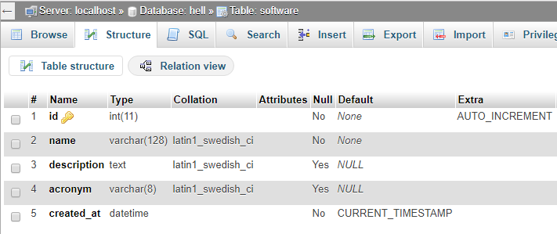
More Detailed – software table

Slide 7
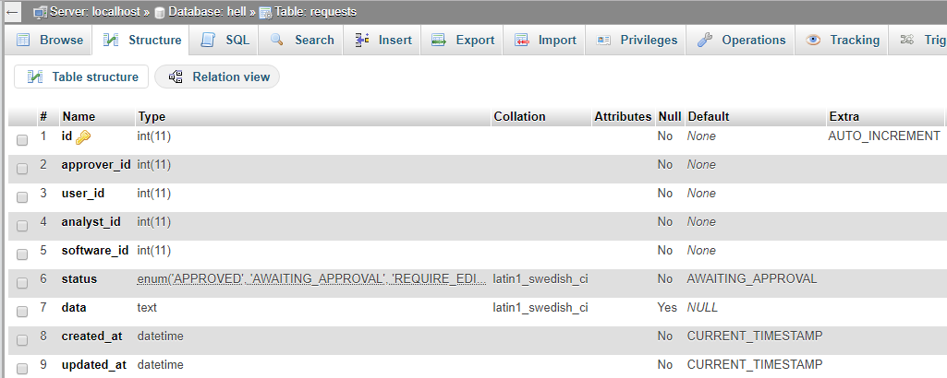
More Detailed – requests table

Slide 8
Thoughts
Similarity in names can get confusing when cleansing, is this necessary?
  Krystal Ball
  Crystal Ball
The same objectives could’ve been met with half the data.
Just enough data where we felt cleansing manually vs. writing a script to do it for us would’ve taken similar amounts of time ☹

Slide 9
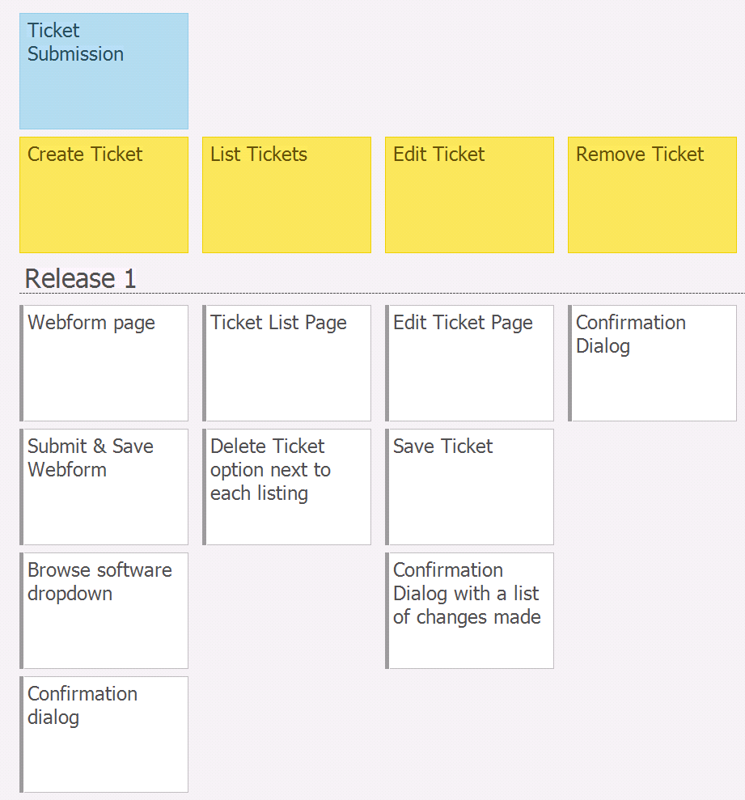
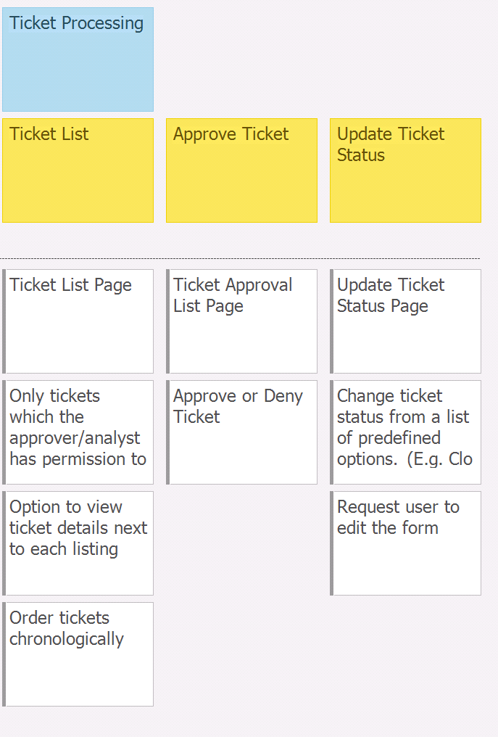

Slide 10
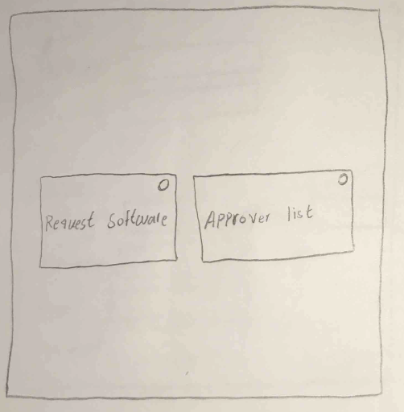
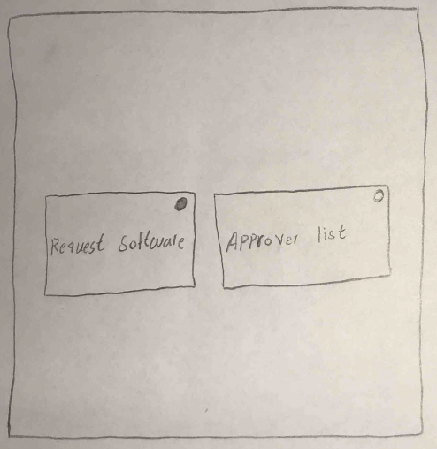
Lo-fidelity prototype snapshots

Slide 11
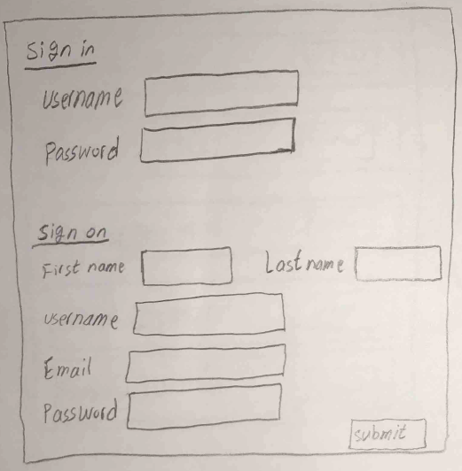
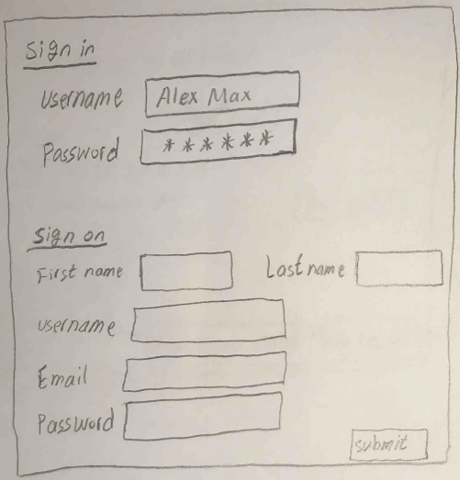

Slide 12
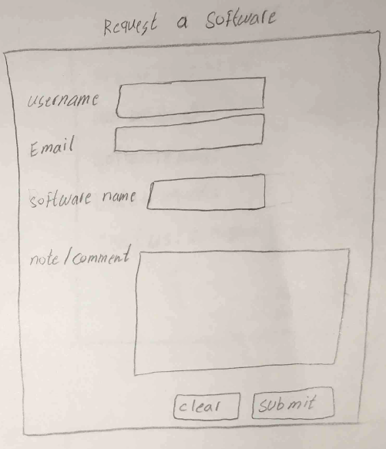
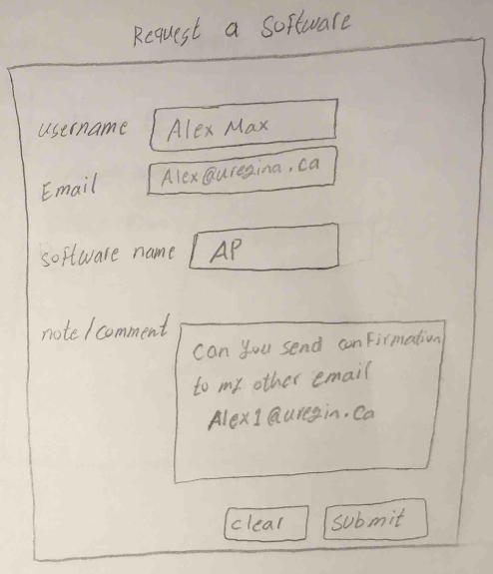

Slide 13
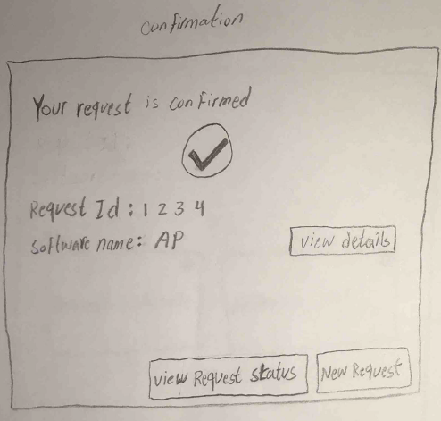
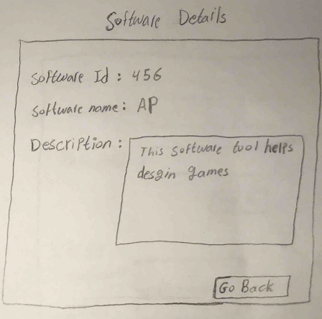

Slide 14
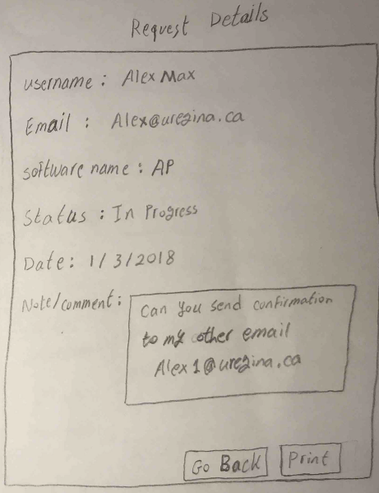

Slide 15
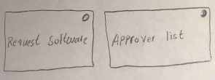
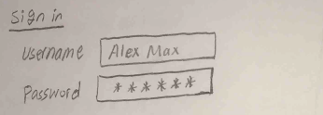
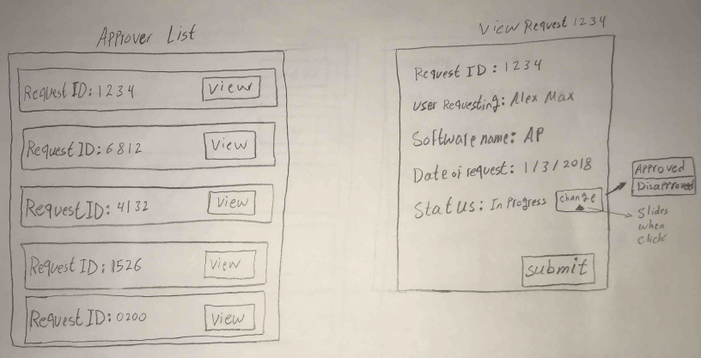

Slide 16
Lo-fidelity prototype snapshots
Describe your experience in creating the lo-fi prototype
  Technology used? Paper and pencil
  Pros: allows for easy editing, and adding new pages. Everyone is able to contribute if needed with no need for technology.
  Cons: Can get messy from eraser marks, smeared led, etc. Not always able to understand everyone’s writing/drawing

Slide 17
Changes & Misc.
Have your plans changed since your group’s initial conception and project evolution
  Nothing major has changed since the last milestone

Slide 18
Group reflection
How did you feel about this milestone? What did you like about it? What did you dislike?
  Cleansing was tedious. Either more data which is easier to automate, or less data which is in an uglier form. We think the DB structure & lo-fi prototyping are the real objectives of this milestone.
What did you learn about yourself as you collaborated and worked through this milestone?
  This milestone was difficult to discuss a group due to midterms, holidays etc. so we learned to divide work and follow each other’s instructions somewhat better.

Slide 19
Group reflection
How will you use what you have learned going forward?
  We will use our new diagrams and database info to guide us through future milestones.
What “stuff & things” related to this milestone would you want help with?
  No major concerns

