Slide 1
ENSE 470, Milestone 5
Team: Hell's Tech Support
Shawn Clake, Nikolas Lendvoy, Amruo Hasnoon
February 29, 2018

Slide 2
Acceptance Test-Driven Development (ATDD)
Describe your experience
  This activity did not change any major portions of the project
  This activity would have likely made the LO-FI prototyping easier because we would already have a list of scenarios made, however using the LO-FI diagrams made it easy to visualize the decisions made by the user and program

Slide 3
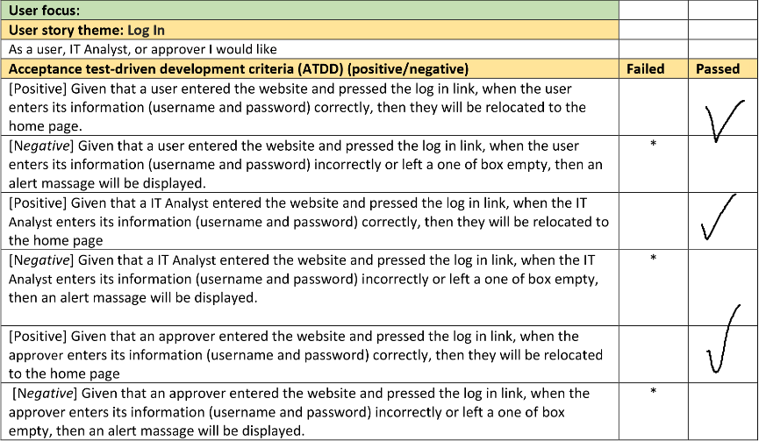
ATDDs

Slide 4
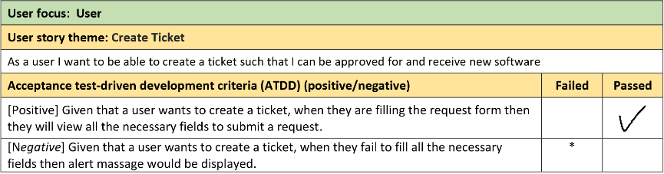
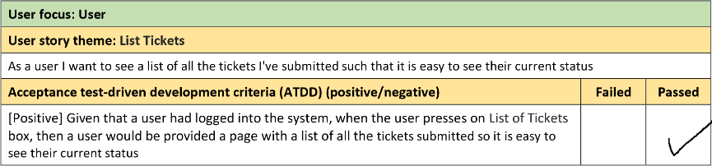

Slide 5
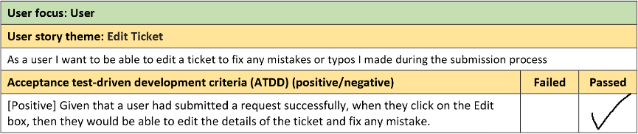
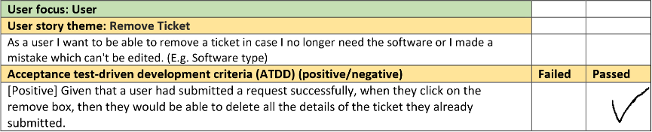

Slide 6
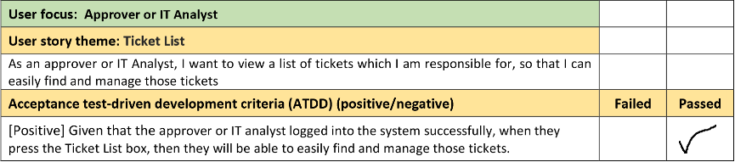
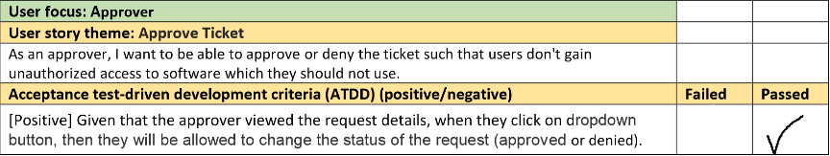

Slide 7
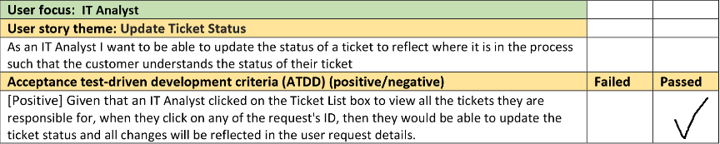
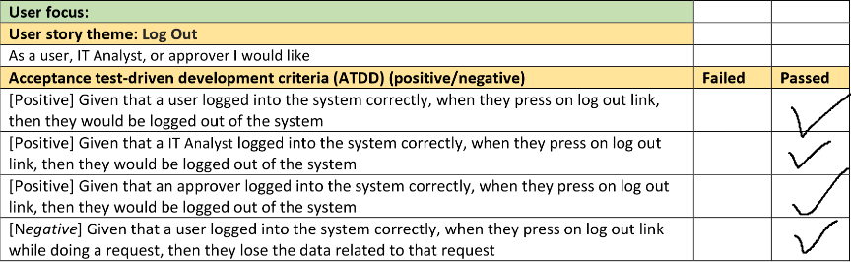

Slide 8
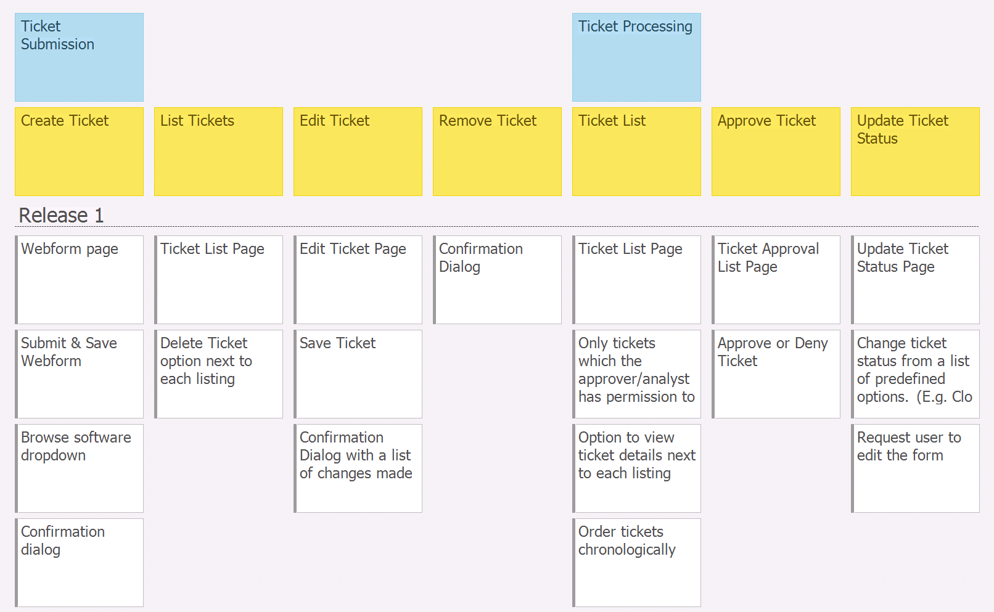
User story map

Slide 9
User story map
We’re on track to complete all we planned to.
We do not have any barriers at the moment.
We envision it would be possible to accomplish more than anticipated for Release 1.
NOTE: A sign-in page for users, approvers, and IT staff is complete as well

Slide 10
User story map
We’re on track to complete all we planned to.
We do not have any barriers at the moment.
We envision it would be possible to accomplish more than anticipated for Release 1.
NOTE: A sign-in page for users, approvers, and IT staff is complete as well

Slide 11
Changes & Misc.
Have your plans changed since your group’s initial conception and project evolution
  No plans have changed, however we added scenarios involving the login page

Slide 12
Group reflection
How did you feel about this milestone? What did you like about it? What did you dislike?
  The milestone went smoothly. It was a bit difficult working on both the program and documentation simultaneously
What did you learn about yourself as you collaborated and worked through this milestone?
  We’ve learned each other’s strengths and weaknesses. We have used that to develop our system more efficiently.
How will you use what you have learned going forward?
  We have used our team member’s specific abilities to develop our system more efficiently.
What “stuff & things” related to this milestone would you want help with?
  Perhaps have HI-FI prototypes/extra steps between milestones depending on project size

