Slide 1

WHAT’S IN MY CLOSET???

Slide 2
High Level Goal
Have a functioning application that will track what is in and out of my wife’s closet.
Track what is at the dry cleaners and what isn’t.

Slide 3
The Driving Factor
Before COVID when my wife went to work, she always wondered what was at the dry cleaners and what wasn’t.
She has too many clothes to keep track of.
WINE & PRIME
Drink wine and order from Amazon Prime.
Fedex delivery shows up on Monday all the while you forgot you ordered anything at all (WINE&PRIME).

Slide 4
High Level Requirements
Full
Database to pull from (all clothing that goes to dry cleaners will be checked out).
Method to scan each piece of clothing that is used.
In in=true or out=false.

Slide 5
High Level Requirements
Stretch
Clothing broken down into different tables that pair well together for outfits.
Pants (by color), blouses (summer/winter, SL, LS, color), dresses (color, short, long), and maybe shoes.

Slide 6
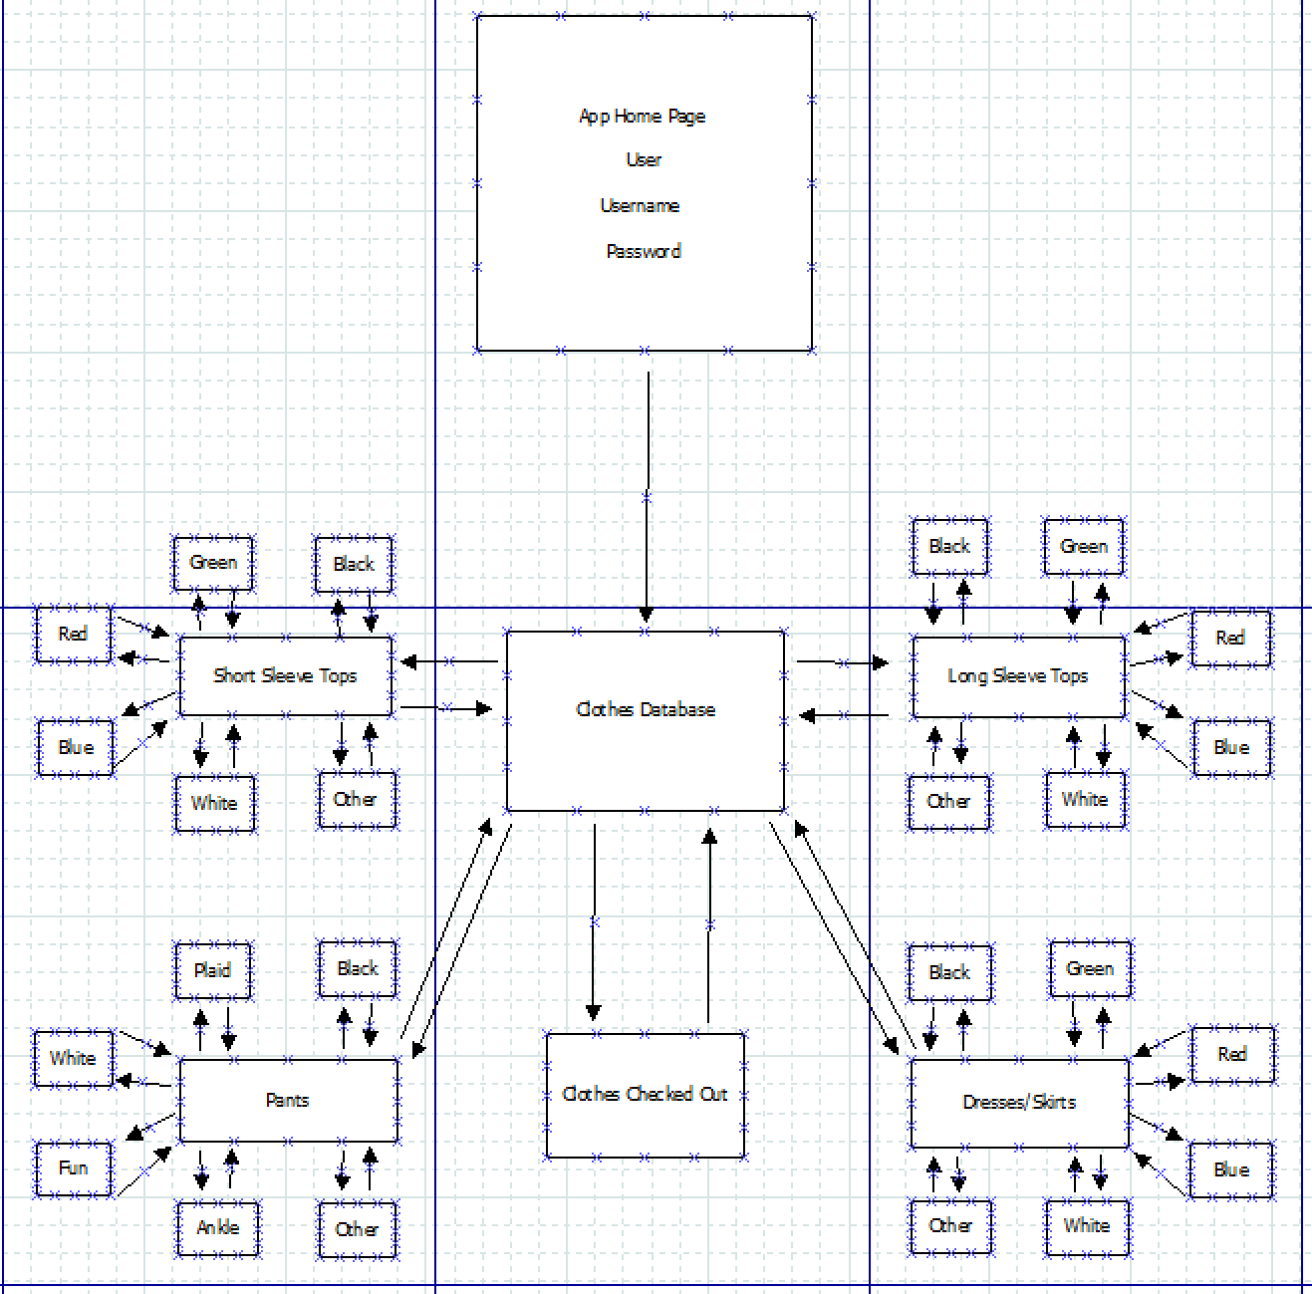
Diagram
Web stie
Visual Code

