Slide 1
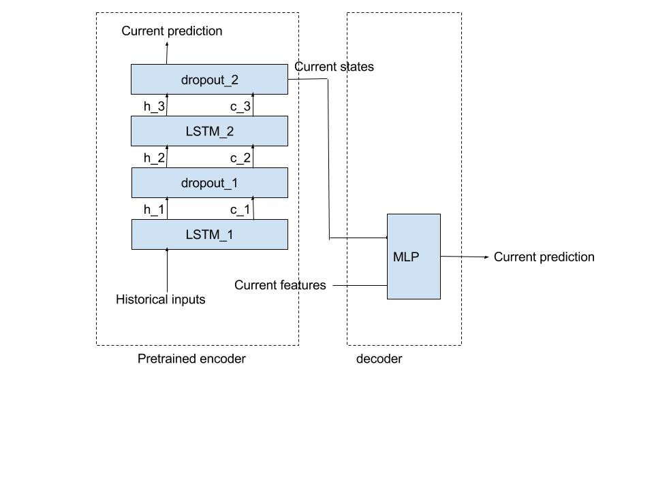
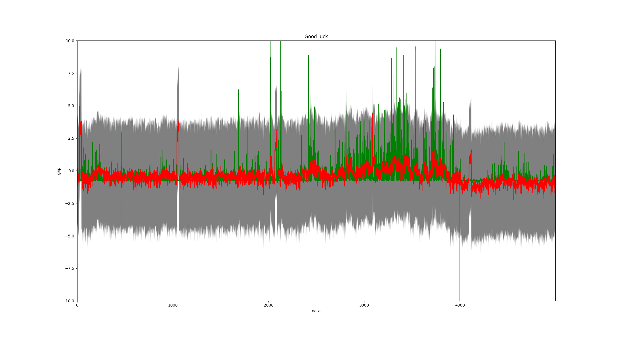

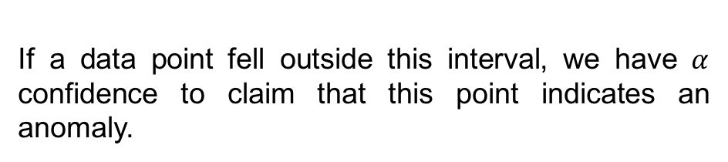
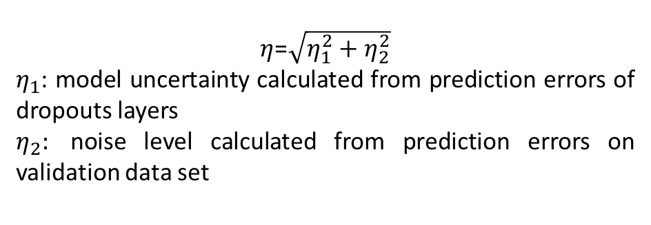
For a fitted parameters $W$ in a neural network $f^{W}()$, the tested data (x*, y*) have $α$ confidence to be within the interval determined by prediction y* and the prediction standard error $η$
${[y}^{∗}−z_{α/2}η$, $y^{∗}+z_{α/2}η]$
where $z_{α/2}$ is the upper bound of probability $α/2$ in standard Normal distribution.
If a data point fell outside this interval, we have $α$ confidence to claim that this point indicates an anomaly.
$η$=$\sqrt{η_{1}^{2}+η_{2}^{2}}$
$η_{1}$: model uncertainty calculated from prediction errors of dropouts layers
$η_{2}:$ noise level calculated from prediction errors on validation data set
Gap value
True value
Predicted value
Acceptance interval with 0.95 confidence
Objects detected in time series

