Slide 1
Secure Android Application for Patient Data Transfer
SE 4450
Anton Ostia Shawn Hesch

Slide 2
Background
Doctors wanted a mobile solution to securely send patient information
Clinical and Pharmacogenetic Predictors of Circulating Atorvastatin and Rosuvastatin Concentration in Routine Clinical Care
Study by the Genomics lab at the University Hospital
Uses patients genotype to determine recommended dosage

Slide 3
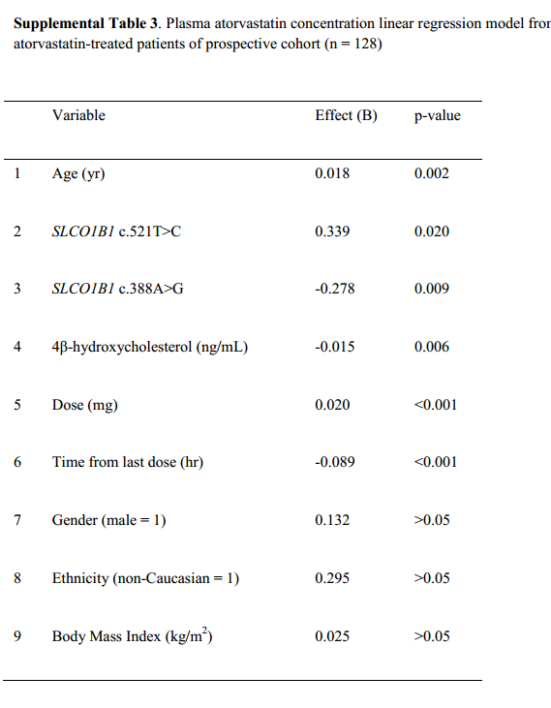
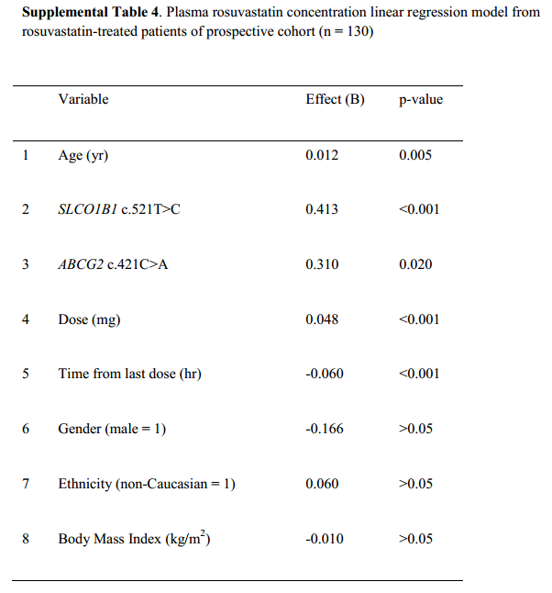
Research Findings

Slide 4
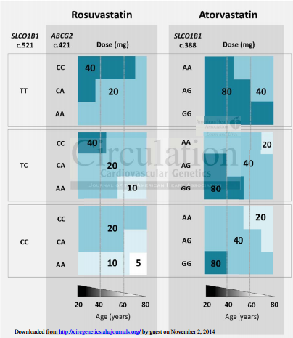
Research Findings

Slide 5
The Project
Mobile solution to allow patients to view their personal prescription information
Will allow doctors to concentrate more time on research
Create mock database based on hospitals structure
Must hide some information from patients and prevent attacks

Slide 6
The Project
Implement security measures at both backend and application levels
Proof of concept for funding deployable system
Personalized medication app
Security requirements for accessing actual hospital database beyond scale of assignment

Slide 7





Language, SDK, API, Platforms

Slide 8
Functional Requirements
Display various user information (name, age, gender, prescription, dosage)
Display maximum dosage for either atorvastatin or rosuvastatin if the patient is taking one of them
Connect to database to update local data
Notify user of invalid internet connection
Provide one way communication to patient
Send push notification when doctor sends a message
Provide secure authentication at login

Slide 9
Use Case Diagram

Slide 10
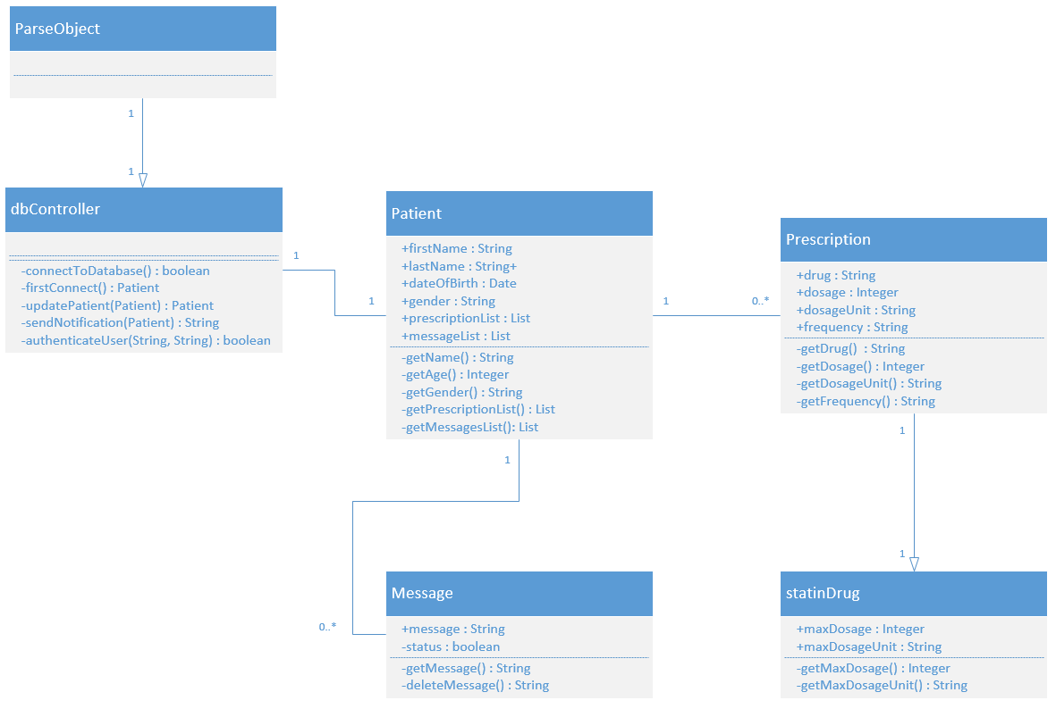
Class Diagram

Slide 11
Non-Functional Requirements
Usability
No training required
Interface will be intuitive
Security
All connections are made with HTTPS and TLS, and Parse will reject all non-HTTPS connections, preventing Man-in-the-Middle attacks
Application will not be able to update data on the server
Application will ensure only valid queries

Slide 12
Non-Functional Requirements
Scalability
In 2012, Parse announced more than 10,000 applications running on their platform with a 40% month-over-month growth rate
Currently used by Cisco, Cadillac, Food Network, etc.
Performance
All users will be able to view all user information within 5 seconds after logging in

Slide 13
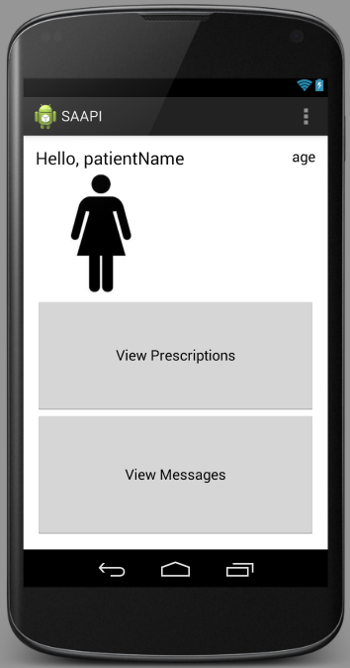
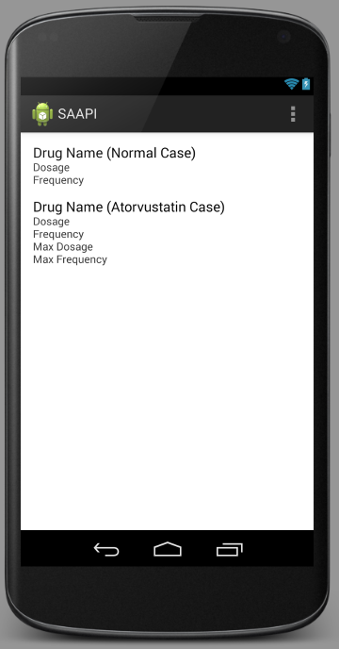
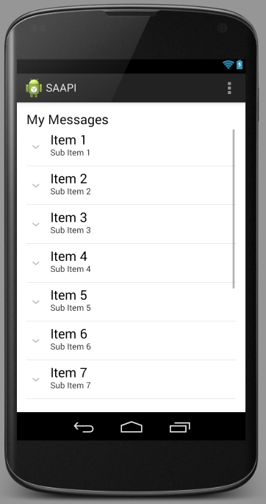
Mock-ups of Layout

Slide 14
References
http://techcrunch.com/2012/03/26/parse-beta/
https://parse.com/docs/data#security-classes
http://circgenetics.ahajournals.org/content/early/2013/07/22/CIRCGENETICS.113.000099.short

