Slide 1
Secure Android Application for Patient Information
SE 4450
Anton Ostia Shawn Hesch
Notes:
Anton

Slide 2
Background
Doctors wanted a mobile solution to securely send a patient medical information
Clinical and Pharmacogenetic Predictors of Circulating Atorvastatin and Rosuvastatin Concentration in Routine Clinical Care
Study by the Genomics lab at the University Hospital
Uses patients genotype to determine recommended dosage
Notes:
Shawn

Slide 3
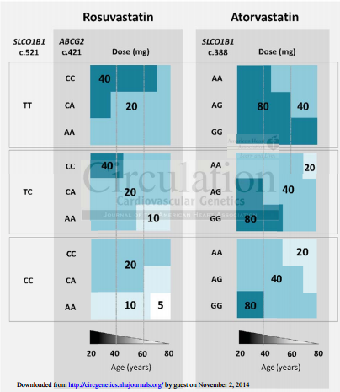
Research Findings
Notes:
Shawn

Slide 4
Early Goals
Mobile solution to allow patients to view their personal prescription information
Create mock database based on hospitals structure
Provide one-way communication from the doctors to the patients
Implement security measures at both backend and application levels
Notes:
Anton

Slide 5
Application Benefits
Proof of concept for funding deployable system
Personalized medication app
Security requirements for accessing actual hospital database beyond scale of assignment
Will allow doctors to concentrate more time on research
Notes:
Shawn

Slide 6





Language, SDK, API, Platforms
Notes:
Anton

Slide 7
Functional Requirements
Display various user information (name, age, gender, prescription, dosage)
Display maximum dosage for either atorvastatin or rosuvastatin if the patient is taking one of them
Connect to database to update local data
Provide one way communication to patient
Send push notification when doctor sends a message
Provide secure authentication at login
Notes:
Anton

Slide 8
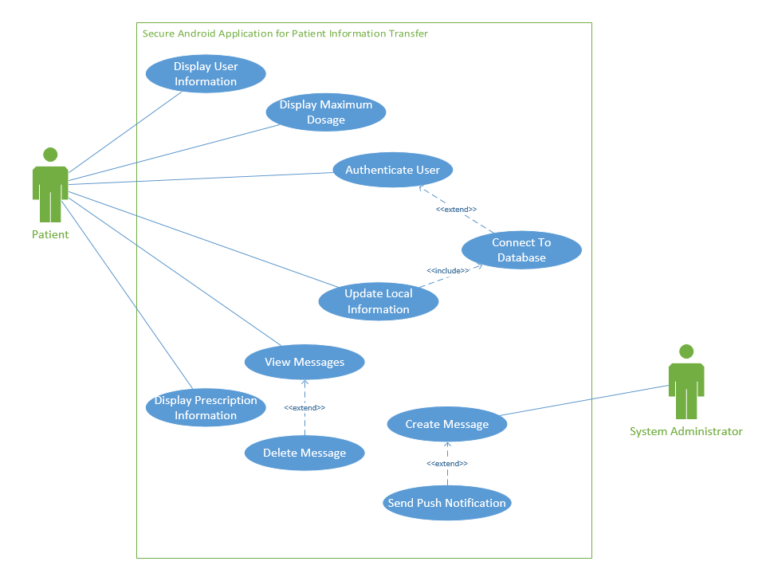
Use Case Diagram
Notes:
Shawn

Slide 9
Non-Functional Requirements
Usability
No training required
Interface will be intuitive
Security
All connections are made with HTTPS and TLS, and Parse will reject all non-HTTPS connections, preventing Man-in-the-Middle attacks
Application will ensure only valid queries (no injections)
Notes:
Shawn

Slide 10
Non-Functional Requirements
Scalability
In 2012, Parse announced more than 10,000 applications running on their platform with a 40% month-over-month growth rate
Currently used by eBay, Groupon, McDonalds
Performance
All users will be able to view all user information within 5 seconds after logging in
Notes:
Anton

Slide 11
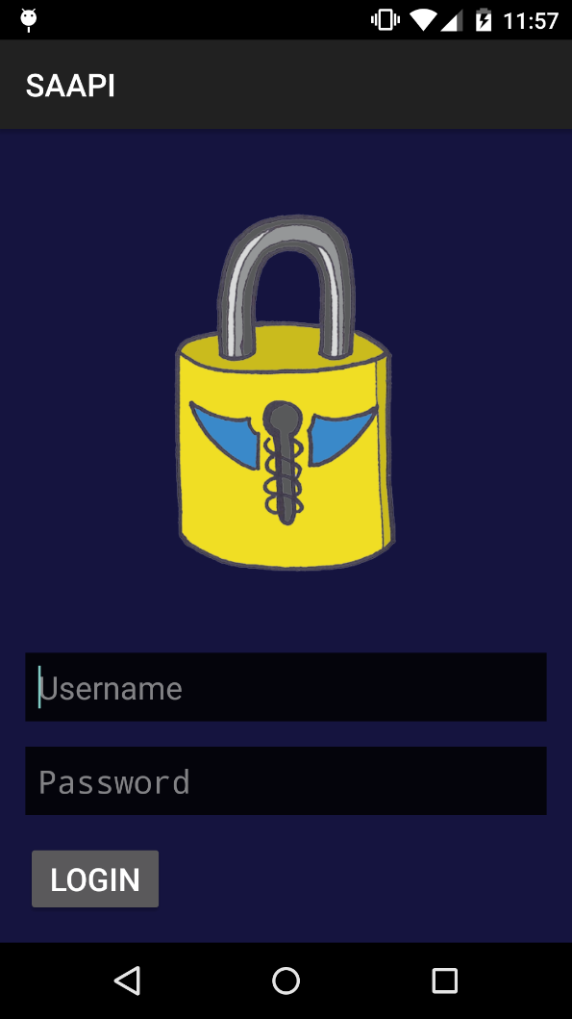
Features – Secure Login
Ensure data privacy
Connect to parse
Setup quick login
Notes:
Shawn

Slide 12
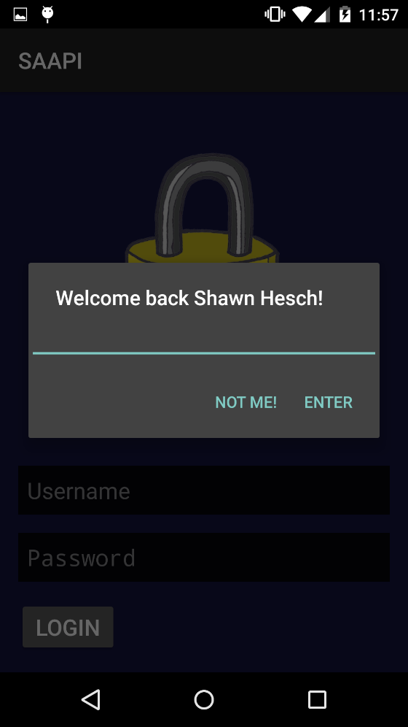
Features – Quick Login
Allow quick access to information
Encrypted information stored on device
Notes:
Shawn

Slide 13
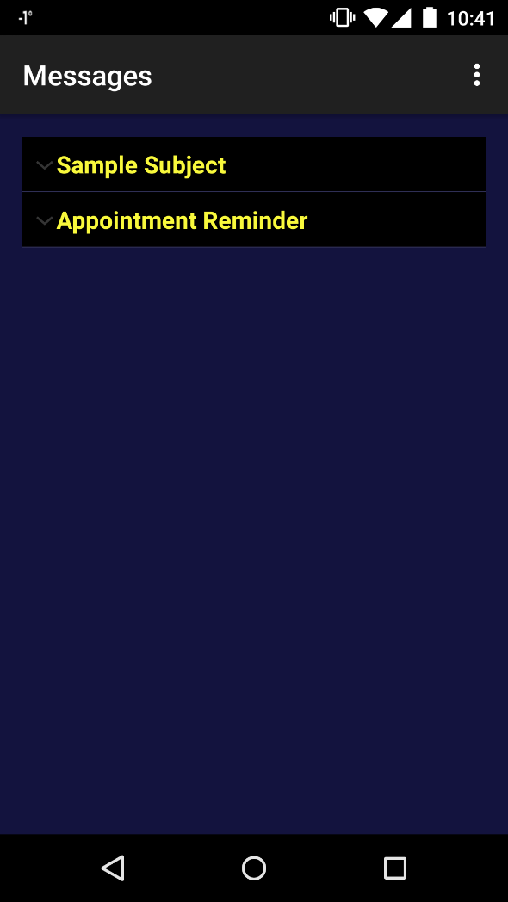
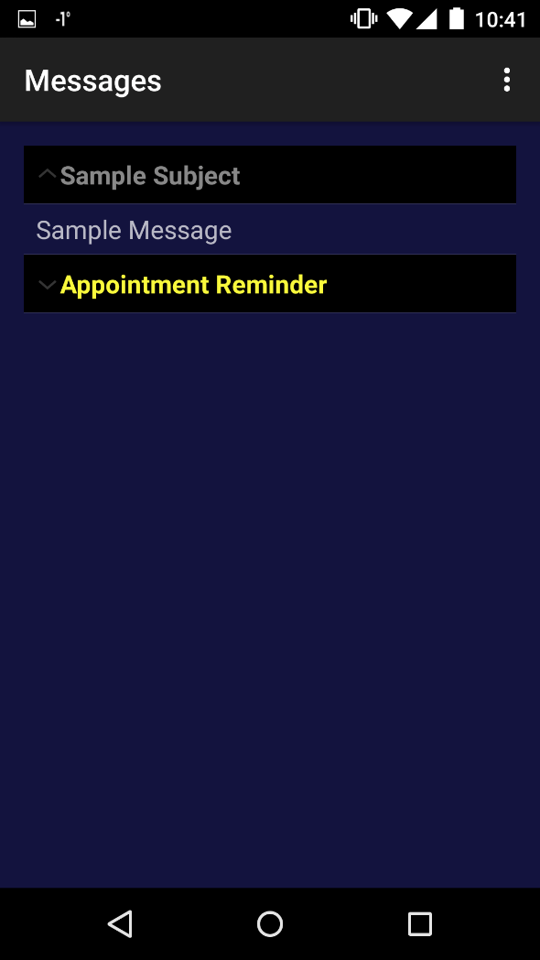
Features - Messaging
Sorted By Date
Mark Messages As Read (Grey)
Click to read message
Notes:
Anton

Slide 14
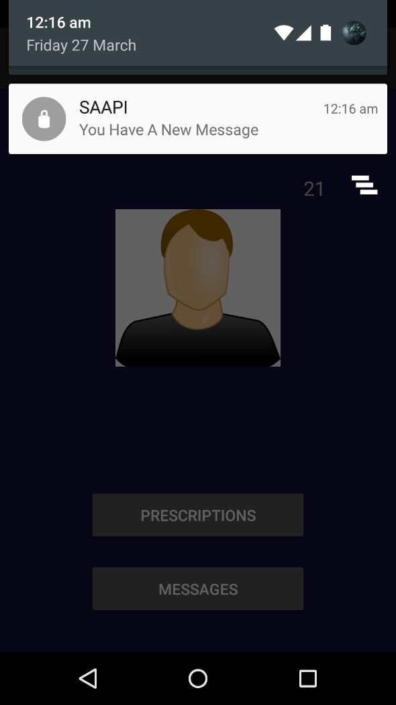
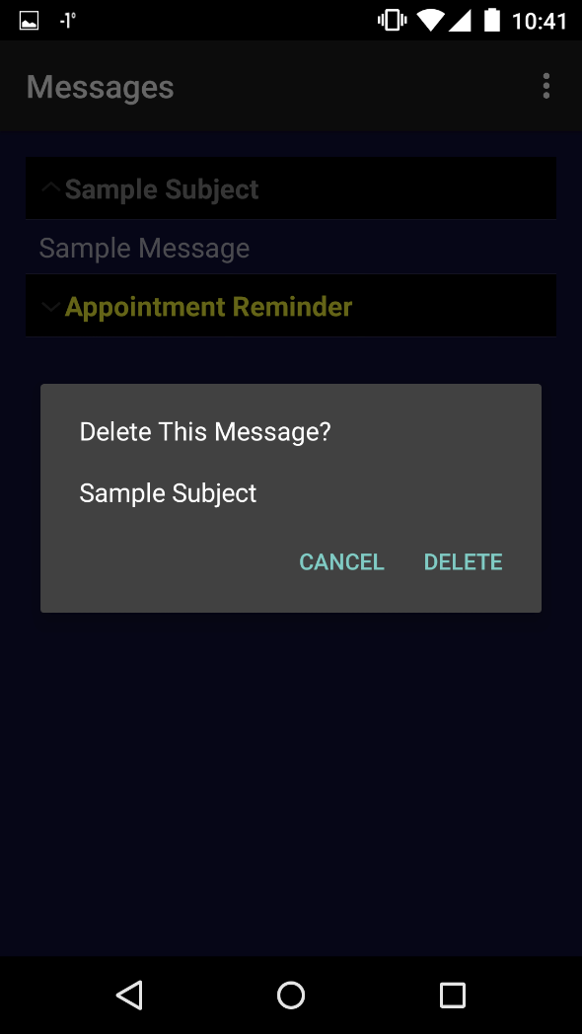
Features - Messaging
Push Notifications
Delete Message
App doesn’t need to be running
Notes:
Anton

Slide 15
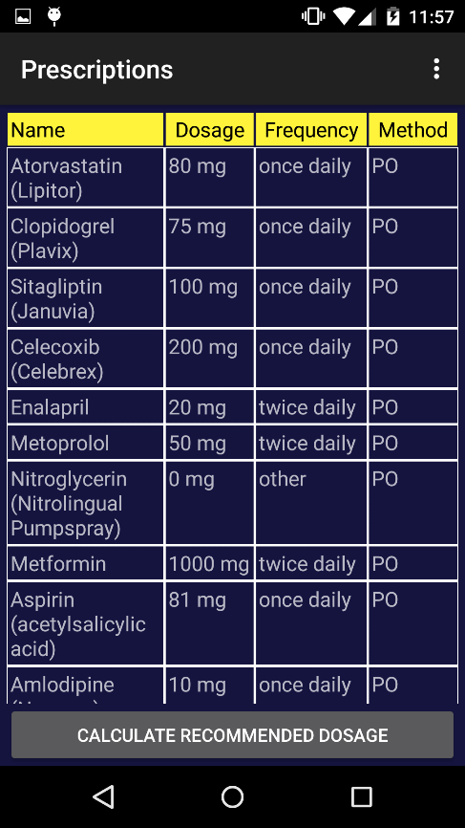
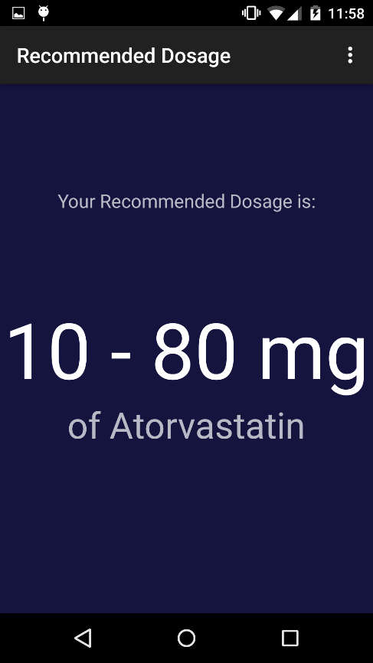
Features - Prescriptions
List of Prescriptions
View dosage range of specific drug
Notes:
Shawn

Slide 16
References
http://techcrunch.com/2012/03/26/parse-beta/
https://parse.com/docs/data#security-classes
http://circgenetics.ahajournals.org/content/early/2013/07/22/CIRCGENETICS.113.000099.short

