Slide 1
Secure Android Application for Patient Data Transfer
SE 4450
Anton Ostia Shawn Hesch

Slide 2
Background
Study by the Genomics lab at the University Hospital
Doctors wanted a mobile solution to securely send patient information

Slide 3
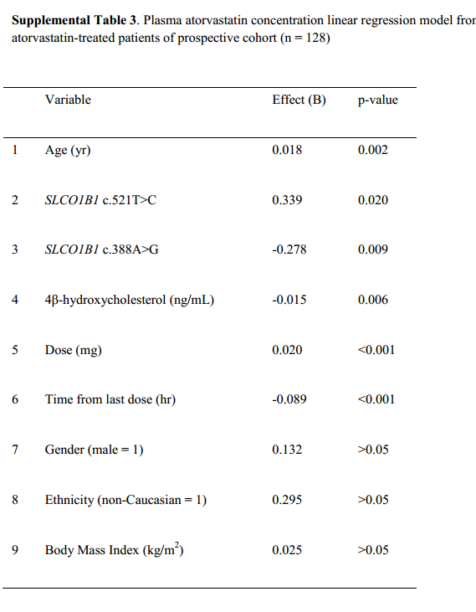
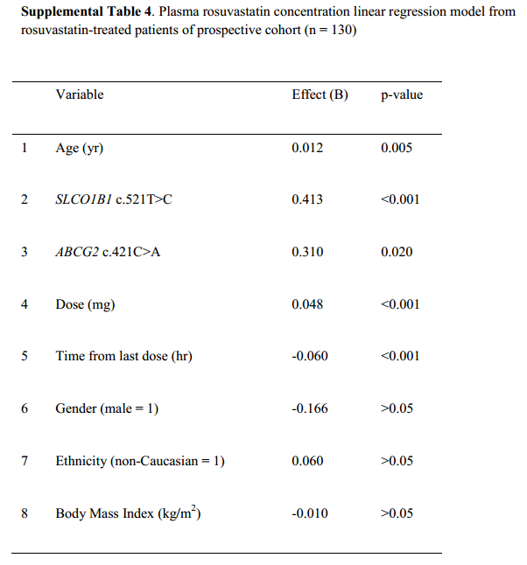
Research Findings

Slide 4
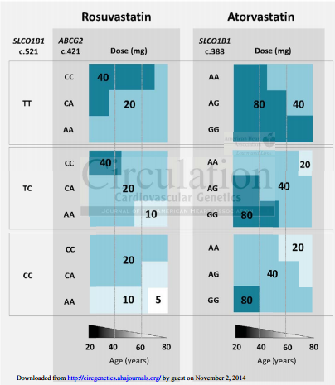
Research Findings

Slide 5
The Project
Hello

Slide 6



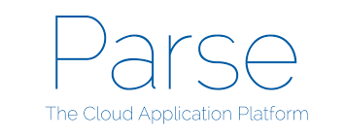
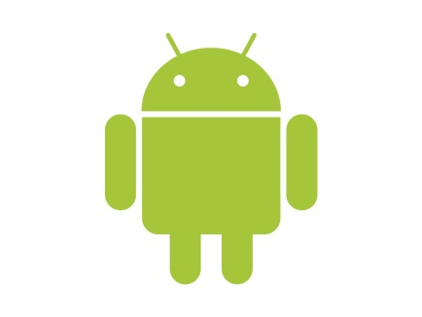
Language, SDK, API, Platforms

Slide 7
Functional Requirements
Display various user information (name, age, gender, prescription, dosage)
Display maximum dosage for either atorvastatin or rosuvastatin if the patient is taking one of them
Connect to database to update local data
Notify user of missing internet connection
Display messages from doctor
Send push notification when doctor sends a message
Provide secure authentication at login

Slide 8
Use Case Diagram

Slide 9
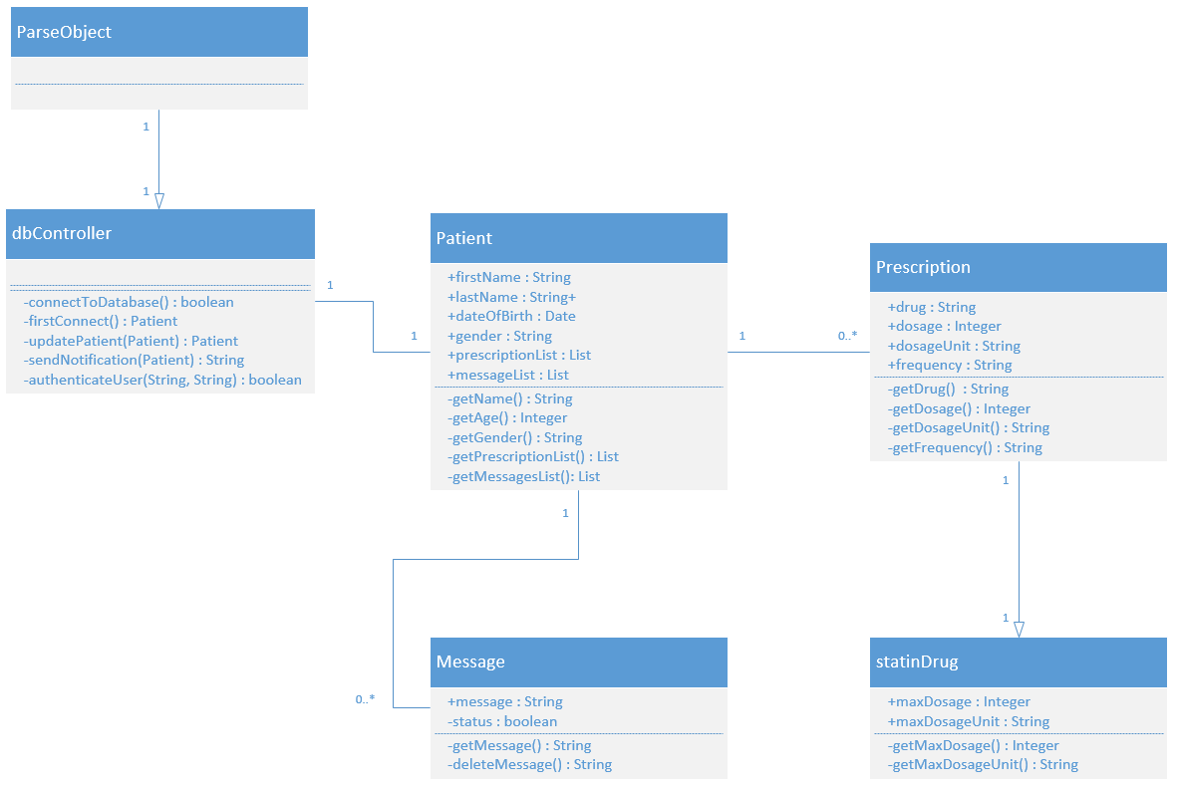
Class Diagram

Slide 10
Non-Functional Requirements
Usability
No training required
Interface will be intuitive
Security
All connections are made with HTTPS and SSL, and Parse will reject all non-HTTPS connections, preventing Man-in-the-Middle attacks
Application will not be able to update data on the server
Application will ensure only valid queries

Slide 11
Non-Functional Requirements
Scalability
In 2012, Parse announced more than 10,000 applications running on their platform with a 40% month-over-month growth rate
Currently used by Cisco, Cadillac, food Network, etc.
Performance
All users will be able to view all user information within 5 seconds after logging in

Slide 12
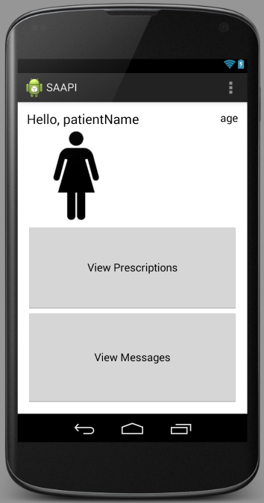
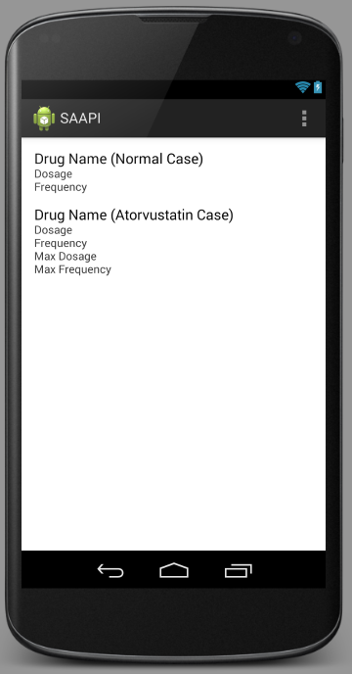
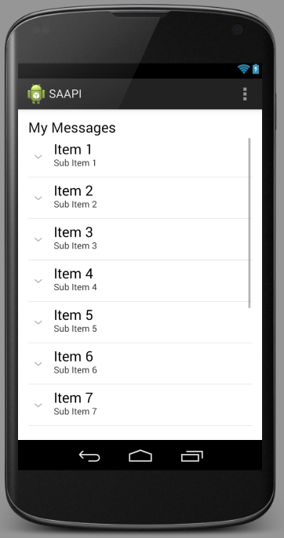
Rough Screenshots of Structure

Slide 13
References
http://techcrunch.com/2012/03/26/parse-beta/
https://parse.com/docs/data#security-classes
http://circgenetics.ahajournals.org/content/early/2013/07/22/CIRCGENETICS.113.000099.short

