Slide 1




Building a Better Model with Data Augmentation
Edge Impulse Imagine Conference 2021
Please go here: bit.ly/ei-workshop-data-augmentation
The More You Know!
Full Course: Computer Vision with Embedded Machine Learning
bit.ly/cv-with-embedded-ml
Twitter: @ShawnHymel
Instagram: shawn_hymel
LinkedIn: linkedin.com/in/ShawnHymel/

Slide 2
Schedule
Examine old model (CNN)
Saliency and CAM demo
Examine image augmentation techniques
Generate augmented dataset
Train new model (same CNN)

Slide 3
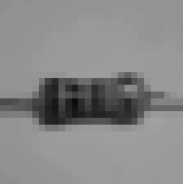
2D Convolution
2D Max Pooling
2D Convolution
2D Max Pooling
Flatten to Vector
Softmax
P(bg)
P(cap)
P(diode)
P(led)
P(res)

Slide 4
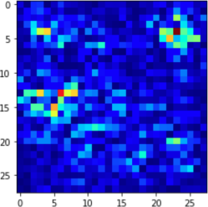
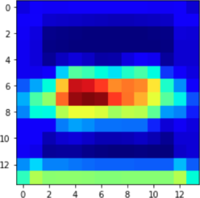
Saliency map – which pixels in the input image were most important
(28x28)
2D Convolution
(28x28)
Grad-CAM
2D Max Pooling
Class activation map (CAM) – which features from the final convolution step were most important
2D Convolution
2D Max Pooling
(14x14)
Flatten to Vector

Slide 5


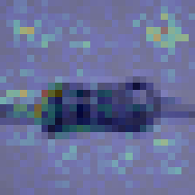
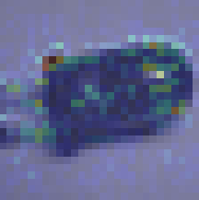
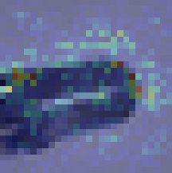
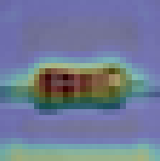
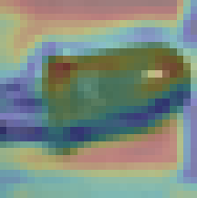
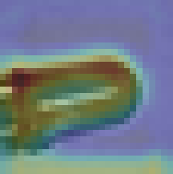
Actual: Resistor
Predicted: Resistor
Actual: LED
Predicted: LED
Actual: LED
Predicted: Resistor
Saliency map
Saliency map
Saliency map
Grad-CAM
Grad-CAM
Grad-CAM

Slide 6
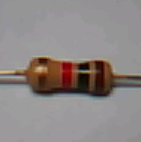
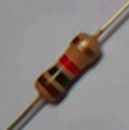
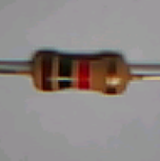
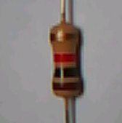
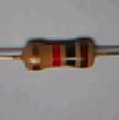
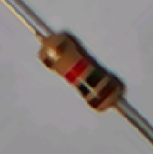
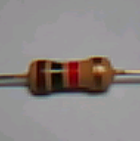
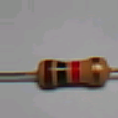
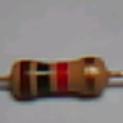
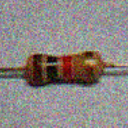
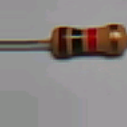
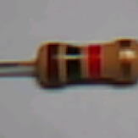
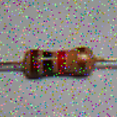
Flip
Rotate
1 image → 13 images
250 images → 3250 images
Translate
Crop
Noise

