Slide 1






proportional
integral
+
input
+
+
process
(plant)
output
Σ
Σ
(set point)
-
+
derivative
PID controller
feedback

Slide 2
proportional
integral
+
input
+
+
process
(plant)
output
Σ
Σ
(set point)
-
+
derivative
PID controller
feedback

Slide 3
process
(plant)

Slide 4
input
signal
process
(plant)

Slide 5
input
signal
process
(plant)
output

Slide 6
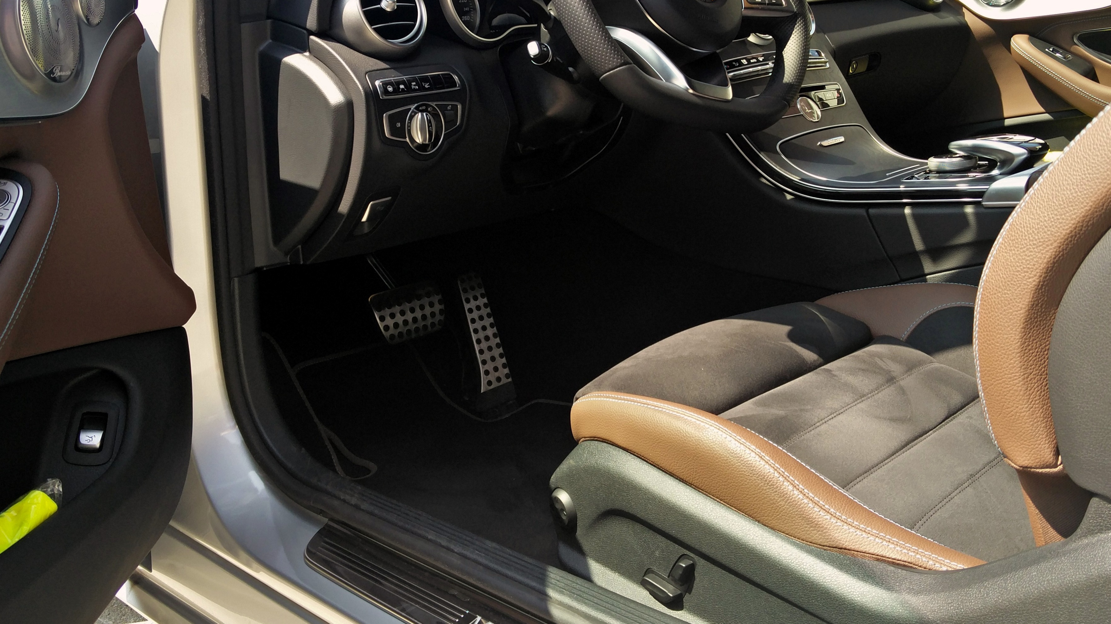

Slide 8
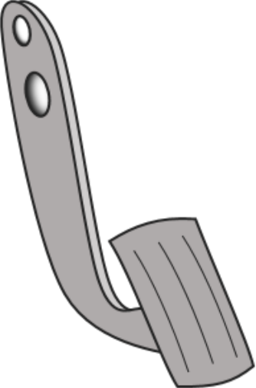

Slide 9
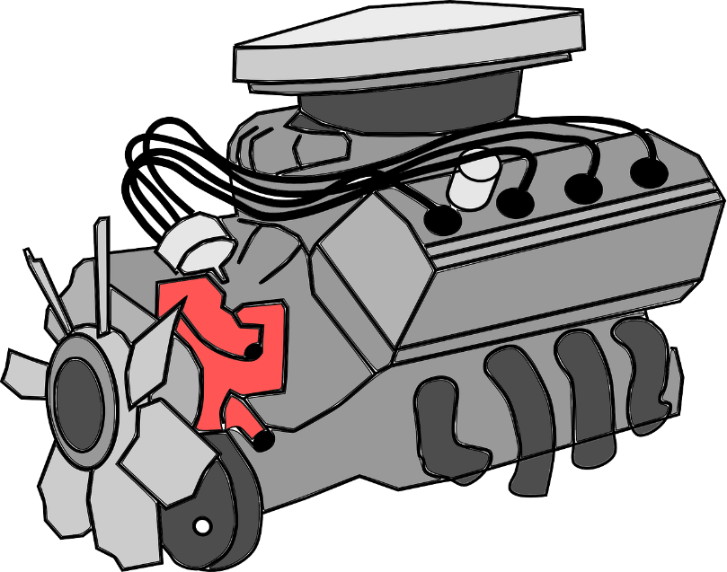

Slide 10
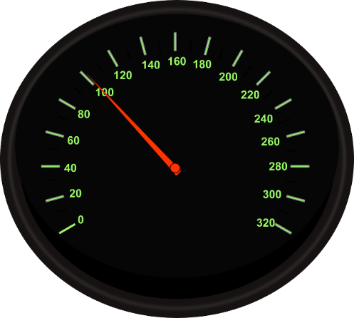

Slide 13
input
signal
process
(plant)
output

Slide 14
input
signal
process
(plant)
output

Slide 15
input
signal
process
(plant)
output
accelerator
position

Slide 16
input
signal
process
(plant)
output
accelerator
position
speed

Slide 17
accelerator
position
goal:
maintain speed
speed

Slide 18

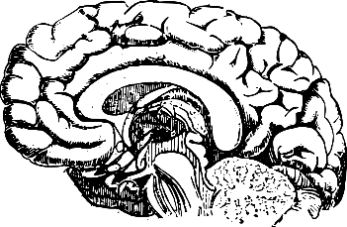
controller
accelerator
position
goal:
maintain speed
speed

Slide 19
controller
accelerator
position
goal:
maintain speed
speed

Slide 20
controller
accelerator
position
goal:
maintain speed
speed

Slide 21
closed-loop system
controller
accelerator
position
goal:
maintain speed
speed

Slide 22

closed-loop system
controller
accelerator
position
goal:
maintain speed
speed

Slide 23
controller
output
input
controller
process
(plant)
output
(set point)

Slide 24
controller
output
input
controller
process
(plant)
output
(set point)
goal:
maintain speed

Slide 25
controller
output
input
controller
process
(plant)
output
(set point)
accelerator
position
goal:
maintain speed

Slide 26
controller
output
input
controller
process
(plant)
output
(set point)
accelerator
position
goal:
maintain speed
speed

Slide 27
open-loop system
controller
output
input
controller
process
(plant)
output
(set point)
accelerator
position
goal:
maintain speed
speed

Slide 28
closed-loop system
controller
output
input
+
error
controller
process
(plant)
output
Σ
(set point)
-
feedback

Slide 29
closed-loop system
controller
output
input
+
error
controller
process
(plant)
output
Σ
(set point)
-
feedback

Slide 30
closed-loop system
controller
output
input
+
error
controller
process
(plant)
output
Σ
(set point)
-
feedback

Slide 31
proportional
input
+
process
(plant)
output
Σ
(set point)
-
P controller
feedback

Slide 32
proportional
input
+
process
(plant)
output
Σ
(set point)
desired
position
(10 km)
-
P controller
feedback

Slide 33
proportional
input
+
process
(plant)
output
Σ
(set point)
position
desired
position
(10 km)
-
P controller
feedback

Slide 34
proportional
distance to
goal [km]
input
+
process
(plant)
output
Σ
(set point)
position
desired
position
(10 km)
-
P controller
feedback

Slide 35
proportional
speed
[km/h]
distance to
goal [km]
input
+
process
(plant)
output
Σ
(set point)
position
desired
position
(10 km)
-
P controller
feedback

Slide 36

0
10 km
Position [km] | e(t) | K_{p}·e(t)

Slide 37
0
10 km
Position [km] | e(t) | K_{p}·e(t)
0 | 10 - 0 = 10 | 5 · 10 = 50 km/h

Slide 38
0
10 km
Position [km] | e(t) | K_{p}·e(t)
0 | 10 - 0 = 10 | 5 · 10 = 50 km/h
3 | 10 - 3 = 7 | 5 · 7 = 35 km/h

Slide 39
0
10 km
Position [km] | e(t) | K_{p}·e(t)
0 | 10 - 0 = 10 | 5 · 10 = 50 km/h
3 | 10 - 3 = 7 | 5 · 7 = 35 km/h
5 | 10 - 5 = 5 | 5 · 5 = 25 km/h

Slide 40
0
10 km
Position [km] | e(t) | K_{p}·e(t)
0 | 10 - 0 = 10 | 5 · 10 = 50 km/h
3 | 10 - 3 = 7 | 5 · 7 = 35 km/h
5 | 10 - 5 = 5 | 5 · 5 = 25 km/h
7 | 10 - 7 = 3 | 5 · 3 = 15 km/h

Slide 41
0
10 km
Position [km] | e(t) | K_{p}·e(t)
0 | 10 - 0 = 10 | 5 · 10 = 50 km/h
3 | 10 - 3 = 7 | 5 · 7 = 35 km/h
5 | 10 - 5 = 5 | 5 · 5 = 25 km/h
7 | 10 - 7 = 3 | 5 · 3 = 15 km/h
8 | 10 - 8 = 2 | 5 · 2 = 10 km/h

Slide 42
0
10 km
Position [km] | e(t) | K_{p}·e(t)
0 | 10 - 0 = 10 | 5 · 10 = 50 km/h
3 | 10 - 3 = 7 | 5 · 7 = 35 km/h
5 | 10 - 5 = 5 | 5 · 5 = 25 km/h
7 | 10 - 7 = 3 | 5 · 3 = 15 km/h
8 | 10 - 8 = 2 | 5 · 2 = 10 km/h
9 | 10 - 9 = 1 | 5 · 1 = 5 km/h

Slide 43
0
10 km
Position [km] | e(t) | K_{p}·e(t)
0 | 10 - 0 = 10 | 5 · 10 = 50 km/h
3 | 10 - 3 = 7 | 5 · 7 = 35 km/h
5 | 10 - 5 = 5 | 5 · 5 = 25 km/h
7 | 10 - 7 = 3 | 5 · 3 = 15 km/h
8 | 10 - 8 = 2 | 5 · 2 = 10 km/h
9 | 10 - 9 = 1 | 5 · 1 = 5 km/h
10 | 10 - 10 = 0 | 5 · 0 = 0 km/h

Slide 44
0
10 km
Position [km] | e(t) | K_{p}·e(t)
0 | 10 - 0 = 10 | 5 · 10 = 50 km/h
3 | 10 - 3 = 7 | 5 · 7 = 35 km/h
5 | 10 - 5 = 5 | 5 · 5 = 25 km/h
7 | 10 - 7 = 3 | 5 · 3 = 15 km/h
8 | 10 - 8 = 2 | 5 · 2 = 10 km/h
9 | 10 - 9 = 1 | 5 · 1 = 5 km/h
10 | 10 - 10 = 0 | 5 · 0 = 0 km/h
10
K_{p}=5
0
t
speed [km/h]
50
K_{p}=5
0
t

Slide 45
0
10 km
Position [km] | e(t) | K_{p}·e(t)
0 | 10 - 0 = 10 | 5 · 10 = 50 km/h
3 | 10 - 3 = 7 | 5 · 7 = 35 km/h
5 | 10 - 5 = 5 | 5 · 5 = 25 km/h
7 | 10 - 7 = 3 | 5 · 3 = 15 km/h
8 | 10 - 8 = 2 | 5 · 2 = 10 km/h
9 | 10 - 9 = 1 | 5 · 1 = 5 km/h
10 | 10 - 10 = 0 | 5 · 0 = 0 km/h
10
K_{p}=2
K_{p}=5
0
t
speed [km/h]
50
K_{p}=5
K_{p}=2
0
t

Slide 46
0
10 km
Position [km] | e(t) | K_{p}·e(t)
0 | 10 - 0 = 10 | 5 · 10 = 50 km/h
3 | 10 - 3 = 7 | 5 · 7 = 35 km/h
5 | 10 - 5 = 5 | 5 · 5 = 25 km/h
7 | 10 - 7 = 3 | 5 · 3 = 15 km/h
8 | 10 - 8 = 2 | 5 · 2 = 10 km/h
9 | 10 - 9 = 1 | 5 · 1 = 5 km/h
10 | 10 - 10 = 0 | 5 · 0 = 0 km/h
10
K_{p}=2
K_{p}=5
K_{p}=10
0
t
speed [km/h]
K_{p}=10
50
K_{p}=5
K_{p}=2
0
t

Slide 47
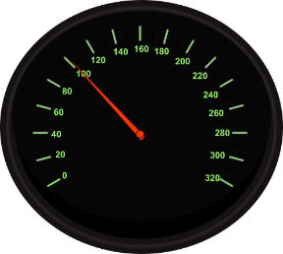
set point: 100 km/h

Slide 48

set point: 100 km/h
accelerator position: 0..10 cm

Slide 49
set point: 100 km/h
accelerator position: 0..10 cm
assumption: 100 km/h with pedal at 5 cm

Slide 50
set point: 100 km/h
accelerator position: 0..10 cm
assumption: 100 km/h with pedal at 5 cm
Speed [km/h] | e(t) | K_{p}·e(t)

Slide 51
set point: 100 km/h
accelerator position: 0..10 cm
assumption: 100 km/h with pedal at 5 cm
Speed [km/h] | e(t) | K_{p}·e(t)
0 | 100 - 0 = 100 | 0.1 · 100 = 10 cm

Slide 52
set point: 100 km/h
accelerator position: 0..10 cm
assumption: 100 km/h with pedal at 5 cm
Speed [km/h] | e(t) | K_{p}·e(t)
0 | 100 - 0 = 100 | 0.1 · 100 = 10 cm
30 | 100 - 30 = 70 | 0.1 · 70 = 7 cm

Slide 53
set point: 100 km/h
accelerator position: 0..10 cm
assumption: 100 km/h with pedal at 5 cm
Speed [km/h] | e(t) | K_{p}·e(t)
0 | 100 - 0 = 100 | 0.1 · 100 = 10 cm
30 | 100 - 30 = 70 | 0.1 · 70 = 7 cm
50 | 100 - 50 = 50 | 0.1 · 50 = 5 cm

Slide 54
set point: 100 km/h
accelerator position: 0..10 cm
assumption: 100 km/h with pedal at 5 cm
Speed [km/h] | e(t) | K_{p}·e(t)
0 | 100 - 0 = 100 | 0.1 · 100 = 10 cm
30 | 100 - 30 = 70 | 0.1 · 70 = 7 cm
50 | 100 - 50 = 50 | 0.1 · 50 = 5 cm
60 | 100 - 60 = 40 | 0.1 · 40 = 4 cm

Slide 55
set point: 100 km/h
accelerator position: 0..10 cm
assumption: 100 km/h with pedal at 5 cm
Speed [km/h] | e(t) | K_{p}·e(t)
0 | 100 - 0 = 100 | 0.1 · 100 = 10 cm
30 | 100 - 30 = 70 | 0.1 · 70 = 7 cm
50 | 100 - 50 = 50 | 0.1 · 50 = 5 cm
60 | 100 - 60 = 40 | 0.1 · 40 = 4 cm
60 | 100 - 60 = 40 | 0.1 · 40 = 4 cm

Slide 56
set point: 100 km/h
accelerator position: 0..10 cm
assumption: 100 km/h with pedal at 5 cm
Speed [km/h] | e(t) | K_{p}·e(t)
0 | 100 - 0 = 100 | 0.1 · 100 = 10 cm
30 | 100 - 30 = 70 | 0.1 · 70 = 7 cm
50 | 100 - 50 = 50 | 0.1 · 50 = 5 cm
60 | 100 - 60 = 40 | 0.1 · 40 = 4 cm
60 | 100 - 60 = 40 | 0.1 · 40 = 4 cm
⋮ | ⋮ | ⋮

Slide 57
set point: 100 km/h
accelerator position: 0..10 cm
assumption: 100 km/h with pedal at 5 cm
Speed [km/h] | e(t) | K_{p}·e(t)
0 | 100 - 0 = 100 | 0.1 · 100 = 10 cm
30 | 100 - 30 = 70 | 0.1 · 70 = 7 cm
50 | 100 - 50 = 50 | 0.1 · 50 = 5 cm
60 | 100 - 60 = 40 | 0.1 · 40 = 4 cm
60 | 100 - 60 = 40 | 0.1 · 40 = 4 cm
⋮ | ⋮ | ⋮
100
0
t
speed [km/h]
100
0
t

Slide 58
set point: 100 km/h
accelerator position: 0..10 cm
assumption: 100 km/h with pedal at 5 cm
Speed [km/h] | e(t) | K_{p}·e(t)
0 | 100 - 0 = 100 | 0.1 · 100 = 10 cm
30 | 100 - 30 = 70 | 0.1 · 70 = 7 cm
50 | 100 - 50 = 50 | 0.1 · 50 = 5 cm
60 | 100 - 60 = 40 | 0.1 · 40 = 4 cm
60 | 100 - 60 = 40 | 0.1 · 40 = 4 cm
⋮ | ⋮ | ⋮
100
0
t
steady-state
error
speed [km/h]
100
0
t

Slide 59
proportional
input
+
process
(plant)
output
Σ
(set point)
-
P controller
feedback

Slide 60
proportional
integral
+
input
+
+
process
(plant)
output
Σ
Σ
(set point)
-
PI controller
feedback

Slide 61

set point: 100 km/h
accelerator position: 0..10 cm
assumption: 100 km/h with pedal at 5 cm
100
0
t

Slide 62

set point: 100 km/h
accelerator position: 0..10 cm
assumption: 100 km/h with pedal at 5 cm
100
0
t

Slide 63

set point: 100 km/h
accelerator position: 0..10 cm
assumption: 100 km/h with pedal at 5 cm
100
0
t

Slide 64
set point: 100 km/h
accelerator position: 0..10 cm
assumption: 100 km/h with pedal at 5 cm
1
100
0
t

Slide 65
set point: 100 km/h
accelerator position: 0..10 cm
assumption: 100 km/h with pedal at 5 cm
1
100
0
t

Slide 66
set point: 100 km/h
accelerator position: 0..10 cm
assumption: 100 km/h with pedal at 5 cm
1
100
Speed [km/h] | e(t) | K_{p}·e(t) K_{p}=0.1 | K_{i}·Σe(t) K_{i}=0.01 | Sum
0
t

Slide 67
set point: 100 km/h
accelerator position: 0..10 cm
assumption: 100 km/h with pedal at 5 cm
1
100
Speed [km/h] | e(t) | K_{p}·e(t) K_{p}=0.1 | K_{i}·Σe(t) K_{i}=0.01 | Sum
0 | 100 | 10.0 cm | 0.01 · 100 = 1.0 cm | 11 cm
0
t

Slide 68
set point: 100 km/h
accelerator position: 0..10 cm
assumption: 100 km/h with pedal at 5 cm
1
100
Speed [km/h] | e(t) | K_{p}·e(t) K_{p}=0.1 | K_{i}·Σe(t) K_{i}=0.01 | Sum
0 | 100 | 10.0 cm | 0.01 · 100 = 1.0 cm | 11 cm
30 | 70 | 7.0 cm | 0.01 · 170 = 1.7 cm | 8.7 cm
0
t

Slide 69
set point: 100 km/h
accelerator position: 0..10 cm
assumption: 100 km/h with pedal at 5 cm
1
100
Speed [km/h] | e(t) | K_{p}·e(t) K_{p}=0.1 | K_{i}·Σe(t) K_{i}=0.01 | Sum
0 | 100 | 10.0 cm | 0.01 · 100 = 1.0 cm | 11 cm
30 | 70 | 7.0 cm | 0.01 · 170 = 1.7 cm | 8.7 cm
50 | 50 | 5.0 cm | 0.01 · 220 = 2.2 cm | 7.2 cm
0
t

Slide 70
set point: 100 km/h
accelerator position: 0..10 cm
assumption: 100 km/h with pedal at 5 cm
1
100
Speed [km/h] | e(t) | K_{p}·e(t) K_{p}=0.1 | K_{i}·Σe(t) K_{i}=0.01 | Sum
0 | 100 | 10.0 cm | 0.01 · 100 = 1.0 cm | 11 cm
30 | 70 | 7.0 cm | 0.01 · 170 = 1.7 cm | 8.7 cm
50 | 50 | 5.0 cm | 0.01 · 220 = 2.2 cm | 7.2 cm
70 | 30 | 3.0 cm | 0.01 · 250 = 2.5 cm | 5.5 cm
0
t

Slide 71
set point: 100 km/h
accelerator position: 0..10 cm
assumption: 100 km/h with pedal at 5 cm
1
100
Speed [km/h] | e(t) | K_{p}·e(t) K_{p}=0.1 | K_{i}·Σe(t) K_{i}=0.01 | Sum
0 | 100 | 10.0 cm | 0.01 · 100 = 1.0 cm | 11 cm
30 | 70 | 7.0 cm | 0.01 · 170 = 1.7 cm | 8.7 cm
50 | 50 | 5.0 cm | 0.01 · 220 = 2.2 cm | 7.2 cm
70 | 30 | 3.0 cm | 0.01 · 250 = 2.5 cm | 5.5 cm
80 | 20 | 2.0 cm | 0.01 · 270 = 2.7 cm | 4.7 cm
0
t

Slide 72
set point: 100 km/h
accelerator position: 0..10 cm
assumption: 100 km/h with pedal at 5 cm
1
100
Speed [km/h] | e(t) | K_{p}·e(t) K_{p}=0.1 | K_{i}·Σe(t) K_{i}=0.01 | Sum
0 | 100 | 10.0 cm | 0.01 · 100 = 1.0 cm | 11 cm
30 | 70 | 7.0 cm | 0.01 · 170 = 1.7 cm | 8.7 cm
50 | 50 | 5.0 cm | 0.01 · 220 = 2.2 cm | 7.2 cm
70 | 30 | 3.0 cm | 0.01 · 250 = 2.5 cm | 5.5 cm
80 | 20 | 2.0 cm | 0.01 · 270 = 2.7 cm | 4.7 cm
80 | 20 | 2.0 cm | 0.01 · 290 = 2.9 cm | 4.9 cm
0
t

Slide 73
set point: 100 km/h
accelerator position: 0..10 cm
assumption: 100 km/h with pedal at 5 cm
1
100
Speed [km/h] | e(t) | K_{p}·e(t) K_{p}=0.1 | K_{i}·Σe(t) K_{i}=0.01 | Sum
0 | 100 | 10.0 cm | 0.01 · 100 = 1.0 cm | 11 cm
30 | 70 | 7.0 cm | 0.01 · 170 = 1.7 cm | 8.7 cm
50 | 50 | 5.0 cm | 0.01 · 220 = 2.2 cm | 7.2 cm
70 | 30 | 3.0 cm | 0.01 · 250 = 2.5 cm | 5.5 cm
80 | 20 | 2.0 cm | 0.01 · 270 = 2.7 cm | 4.7 cm
80 | 20 | 2.0 cm | 0.01 · 290 = 2.9 cm | 4.9 cm
⋮ | ⋮ | ⋮ | ⋮ | ⋮
0
t

Slide 74
set point: 100 km/h
accelerator position: 0..10 cm
assumption: 100 km/h with pedal at 5 cm
1
100
Speed [km/h] | e(t) | K_{p}·e(t) K_{p}=0.1 | K_{i}·Σe(t) K_{i}=0.01 | Sum
0 | 100 | 10.0 cm | 0.01 · 100 = 1.0 cm | 11 cm
30 | 70 | 7.0 cm | 0.01 · 170 = 1.7 cm | 8.7 cm
50 | 50 | 5.0 cm | 0.01 · 220 = 2.2 cm | 7.2 cm
70 | 30 | 3.0 cm | 0.01 · 250 = 2.5 cm | 5.5 cm
80 | 20 | 2.0 cm | 0.01 · 270 = 2.7 cm | 4.7 cm
80 | 20 | 2.0 cm | 0.01 · 290 = 2.9 cm | 4.9 cm
⋮ | ⋮ | ⋮ | ⋮ | ⋮
0
t
100
0
t

Slide 75
set point: 100 km/h
accelerator position: 0..10 cm
assumption: 100 km/h with pedal at 5 cm
100
0
t

Slide 76
set point: 100 km/h
accelerator position: 0..10 cm
assumption: 100 km/h with pedal at 5 cm
100
overdamped response
0
t

Slide 77
set point: 100 km/h
accelerator position: 0..10 cm
assumption: 100 km/h with pedal at 5 cm
100
0
t

Slide 78
set point: 100 km/h
accelerator position: 0..10 cm
assumption: 100 km/h with pedal at 5 cm
100
underdamped response
0
t

Slide 79
set point: 100 km/h
accelerator position: 0..10 cm
assumption: 100 km/h with pedal at 5 cm
100
0
t

Slide 80
set point: 100 km/h
accelerator position: 0..10 cm
assumption: 100 km/h with pedal at 5 cm
100
critically damped response
0
t

Slide 81
proportional
integral
+
input
+
+
process
(plant)
output
Σ
Σ
(set point)
-
PI controller
feedback

Slide 82
proportional
integral
+
input
+
+
process
(plant)
output
Σ
Σ
(set point)
-
+
derivative
PID controller
feedback

Slide 83

set point: 100 km/h
accelerator position: 0..10 cm
assumption: 100 km/h with pedal at 5 cm
100
0
t

Slide 84
set point: 100 km/h
accelerator position: 0..10 cm
assumption: 100 km/h with pedal at 5 cm
100
0
t

Slide 85

set point: 100 km/h
accelerator position: 0..10 cm
assumption: 100 km/h with pedal at 5 cm
100
0
t

Slide 86

set point: 100 km/h
accelerator position: 0..10 cm
assumption: 100 km/h with pedal at 5 cm
100
0
t

Slide 87
set point: 100 km/h
accelerator position: 0..10 cm
assumption: 100 km/h with pedal at 5 cm
1
100
0
t

Slide 88
set point: 100 km/h
accelerator position: 0..10 cm
assumption: 100 km/h with pedal at 5 cm
1
100
Speed [km/h] | e(t) | K_{p}·e(t) K_{p}=0.1 | K_{i}·Σe(t) K_{i}=0.018 | K_{d}·(e(t) - e(t-1)) K_{d}=0.1 | Sum
0
t

Slide 89
set point: 100 km/h
accelerator position: 0..10 cm
assumption: 100 km/h with pedal at 5 cm
1
100
Speed [km/h] | e(t) | K_{p}·e(t) K_{p}=0.1 | K_{i}·Σe(t) K_{i}=0.018 | K_{d}·(e(t) - e(t-1)) K_{d}=0.1 | Sum
0 | 100 | 10.0 cm | 1.8 cm | 0.1 · (100-100) = 0.0 cm | 11.8 cm
0
t

Slide 90
set point: 100 km/h
accelerator position: 0..10 cm
assumption: 100 km/h with pedal at 5 cm
1
100
Speed [km/h] | e(t) | K_{p}·e(t) K_{p}=0.1 | K_{i}·Σe(t) K_{i}=0.018 | K_{d}·(e(t) - e(t-1)) K_{d}=0.1 | Sum
0 | 100 | 10.0 cm | 1.8 cm | 0.1 · (100-100) = 0.0 cm | 11.8 cm
30 | 70 | 7.0 cm | 3.1 cm | 0.1 · (70-100) = -3.0 cm | 7.1 cm
0
t

Slide 91
set point: 100 km/h
accelerator position: 0..10 cm
assumption: 100 km/h with pedal at 5 cm
1
100
Speed [km/h] | e(t) | K_{p}·e(t) K_{p}=0.1 | K_{i}·Σe(t) K_{i}=0.018 | K_{d}·(e(t) - e(t-1)) K_{d}=0.1 | Sum
0 | 100 | 10.0 cm | 1.8 cm | 0.1 · (100-100) = 0.0 cm | 11.8 cm
30 | 70 | 7.0 cm | 3.1 cm | 0.1 · (70-100) = -3.0 cm | 7.1 cm
50 | 50 | 5.0 cm | 4.0 cm | 0.1 · (50-70) = -2.0 cm | 7.0 cm
0
t

Slide 92
set point: 100 km/h
accelerator position: 0..10 cm
assumption: 100 km/h with pedal at 5 cm
1
100
Speed [km/h] | e(t) | K_{p}·e(t) K_{p}=0.1 | K_{i}·Σe(t) K_{i}=0.018 | K_{d}·(e(t) - e(t-1)) K_{d}=0.1 | Sum
0 | 100 | 10.0 cm | 1.8 cm | 0.1 · (100-100) = 0.0 cm | 11.8 cm
30 | 70 | 7.0 cm | 3.1 cm | 0.1 · (70-100) = -3.0 cm | 7.1 cm
50 | 50 | 5.0 cm | 4.0 cm | 0.1 · (50-70) = -2.0 cm | 7.0 cm
70 | 30 | 3.0 cm | 4.5 cm | 0.1 · (30-50) = -2.0 cm | 5.5 cm
0
t

Slide 93
set point: 100 km/h
accelerator position: 0..10 cm
assumption: 100 km/h with pedal at 5 cm
1
100
Speed [km/h] | e(t) | K_{p}·e(t) K_{p}=0.1 | K_{i}·Σe(t) K_{i}=0.018 | K_{d}·(e(t) - e(t-1)) K_{d}=0.1 | Sum
0 | 100 | 10.0 cm | 1.8 cm | 0.1 · (100-100) = 0.0 cm | 11.8 cm
30 | 70 | 7.0 cm | 3.1 cm | 0.1 · (70-100) = -3.0 cm | 7.1 cm
50 | 50 | 5.0 cm | 4.0 cm | 0.1 · (50-70) = -2.0 cm | 7.0 cm
70 | 30 | 3.0 cm | 4.5 cm | 0.1 · (30-50) = -2.0 cm | 5.5 cm
80 | 20 | 2.0 cm | 4.9 cm | 0.1 · (20-30) = -1.0 cm | 5.9 cm
0
t

Slide 94
set point: 100 km/h
accelerator position: 0..10 cm
assumption: 100 km/h with pedal at 5 cm
1
100
Speed [km/h] | e(t) | K_{p}·e(t) K_{p}=0.1 | K_{i}·Σe(t) K_{i}=0.018 | K_{d}·(e(t) - e(t-1)) K_{d}=0.1 | Sum
0 | 100 | 10.0 cm | 1.8 cm | 0.1 · (100-100) = 0.0 cm | 11.8 cm
30 | 70 | 7.0 cm | 3.1 cm | 0.1 · (70-100) = -3.0 cm | 7.1 cm
50 | 50 | 5.0 cm | 4.0 cm | 0.1 · (50-70) = -2.0 cm | 7.0 cm
70 | 30 | 3.0 cm | 4.5 cm | 0.1 · (30-50) = -2.0 cm | 5.5 cm
80 | 20 | 2.0 cm | 4.9 cm | 0.1 · (20-30) = -1.0 cm | 5.9 cm
90 | 10 | 1.0 cm | 5.0 cm | 0.1 · (10-20) = -1.0 cm | 5.0 cm
0
t

Slide 95
set point: 100 km/h
accelerator position: 0..10 cm
assumption: 100 km/h with pedal at 5 cm
1
100
Speed [km/h] | e(t) | K_{p}·e(t) K_{p}=0.1 | K_{i}·Σe(t) K_{i}=0.018 | K_{d}·(e(t) - e(t-1)) K_{d}=0.1 | Sum
0 | 100 | 10.0 cm | 1.8 cm | 0.1 · (100-100) = 0.0 cm | 11.8 cm
30 | 70 | 7.0 cm | 3.1 cm | 0.1 · (70-100) = -3.0 cm | 7.1 cm
50 | 50 | 5.0 cm | 4.0 cm | 0.1 · (50-70) = -2.0 cm | 7.0 cm
70 | 30 | 3.0 cm | 4.5 cm | 0.1 · (30-50) = -2.0 cm | 5.5 cm
80 | 20 | 2.0 cm | 4.9 cm | 0.1 · (20-30) = -1.0 cm | 5.9 cm
90 | 10 | 1.0 cm | 5.0 cm | 0.1 · (10-20) = -1.0 cm | 5.0 cm
100 | 0 | 0.0 cm | 5.0 cm | 0.1 · (0-10) = -1.0 cm | 4.0 cm
0
t

Slide 96
set point: 100 km/h
accelerator position: 0..10 cm
assumption: 100 km/h with pedal at 5 cm
1
100
Speed [km/h] | e(t) | K_{p}·e(t) K_{p}=0.1 | K_{i}·Σe(t) K_{i}=0.018 | K_{d}·(e(t) - e(t-1)) K_{d}=0.1 | Sum
0 | 100 | 10.0 cm | 1.8 cm | 0.1 · (100-100) = 0.0 cm | 11.8 cm
30 | 70 | 7.0 cm | 3.1 cm | 0.1 · (70-100) = -3.0 cm | 7.1 cm
50 | 50 | 5.0 cm | 4.0 cm | 0.1 · (50-70) = -2.0 cm | 7.0 cm
70 | 30 | 3.0 cm | 4.5 cm | 0.1 · (30-50) = -2.0 cm | 5.5 cm
80 | 20 | 2.0 cm | 4.9 cm | 0.1 · (20-30) = -1.0 cm | 5.9 cm
90 | 10 | 1.0 cm | 5.0 cm | 0.1 · (10-20) = -1.0 cm | 5.0 cm
100 | 0 | 0.0 cm | 5.0 cm | 0.1 · (0-10) = -1.0 cm | 4.0 cm
100 | 0 | 0.0 cm | 5.0 cm | 0.1 · (0-0) = 0.0 cm | 5.0 cm
0
t

Slide 97
set point: 100 km/h
accelerator position: 0..10 cm
assumption: 100 km/h with pedal at 5 cm
1
100
Speed [km/h] | e(t) | K_{p}·e(t) K_{p}=0.1 | K_{i}·Σe(t) K_{i}=0.018 | K_{d}·(e(t) - e(t-1)) K_{d}=0.1 | Sum
0 | 100 | 10.0 cm | 1.8 cm | 0.1 · (100-100) = 0.0 cm | 11.8 cm
30 | 70 | 7.0 cm | 3.1 cm | 0.1 · (70-100) = -3.0 cm | 7.1 cm
50 | 50 | 5.0 cm | 4.0 cm | 0.1 · (50-70) = -2.0 cm | 7.0 cm
70 | 30 | 3.0 cm | 4.5 cm | 0.1 · (30-50) = -2.0 cm | 5.5 cm
80 | 20 | 2.0 cm | 4.9 cm | 0.1 · (20-30) = -1.0 cm | 5.9 cm
90 | 10 | 1.0 cm | 5.0 cm | 0.1 · (10-20) = -1.0 cm | 5.0 cm
100 | 0 | 0.0 cm | 5.0 cm | 0.1 · (0-10) = -1.0 cm | 4.0 cm
100 | 0 | 0.0 cm | 5.0 cm | 0.1 · (0-0) = 0.0 cm | 5.0 cm
0
t
critically damped response
0
t

Slide 98
proportional
integral
+
input
+
+
process
(plant)
output
Σ
Σ
(set point)
-
+
derivative
PID controller
feedback

Slide 99
proportional
integral
+
input
+
+
process
(plant)
output
Σ
Σ
(set point)
-
+
derivative
is known
PID controller
feedback

Slide 100
proportional
solve for
integral
+
input
+
+
process
(plant)
output
Σ
Σ
(set point)
-
+
derivative
is known
PID controller
feedback

Slide 101
proportional
solve for
integral
+
input
+
+
process
(plant)
output
Σ
Σ
(set point)
-
+
derivative
is known
transfer function:
Y(s) = H(s)·X(s)
PID controller
feedback

Slide 102
proportional
integral
+
input
+
+
process
(plant)
output
Σ
Σ
(set point)
-
+
derivative
is unknown
PID controller
feedback

Slide 103
output
proportional
t
integral
+
input
+
+
process
(plant)
output
Σ
Σ
(set point)
-
+
derivative
is unknown
PID controller
feedback

Slide 104
output
proportional
t
integral
+
input
0
process
(plant)
output
+
Σ
+
Σ
(set point)
-
+
derivative
0
is unknown
PID controller
feedback

Slide 105
output
proportional
t
integral
+
input
0
process
(plant)
output
+
Σ
+
Σ
(set point)
-
+
derivative
0
is unknown
PID controller
feedback

Slide 106
output
proportional
t
integral
+
input
+
+
process
(plant)
output
Σ
Σ
(set point)
-
+
derivative
0
is unknown
PID controller
feedback

Slide 107
output
proportional
t
integral
+
input
+
+
process
(plant)
output
Σ
Σ
(set point)
-
+
derivative
is unknown
PID controller
feedback

Slide 108
k_p = 1 # Tune this
k_i = 0 # Tune this
k_d = 0 # Tune this
interval = 0.001 # e.g. 1 ms
# Loop forever
error_prev = 0
integral = 0
while True:
# Get value from sensor (feedback)
val = read_from_sensor()
# Calculate the PID terms
error = setpoint – val
integral = integral + (error * interval)
derivative = (error – error_prev) / interval
output = (k_p * error) + (k_i * integral) + (k_d * derivative)
# Save value for next iteration
error_prev = error
# Wait for interval time
sleep(interval)

Slide 109
