Slide 1


Intro to Embedded Rust
Hackaday Supercon 2025
Get started: github.com/ShawnHymel/workshop-embedded-rust

Slide 2
Agenda
About Rust
Exercise 1: Blinky
Exercise 2: Ownership and Borrowing
Exercise 3: I²C Temperature Sensor
Get started: github.com/ShawnHymel/workshop-embedded-rust

Slide 3
Prerequisites
Working with microcontrollers
Arduino
MicroPython
CircuitPython
Better: C/C++ with vendor tools
STM32
ESP-IDF
Memory management
Stack vs. heap
Pointers in C/C++

Slide 4
Bad C
int* ptr = malloc(sizeof(int));
*ptr = 42;
...
free(ptr);
printf("%d\n", *ptr);
Do this to prevent
memory leaks
Undefined behavior

Slide 5

Brief History of Rust
2013: Garbage collection removed. Hoare steps down. Core team of 6.
2009: Mozilla officially sponsors the Rust project
2020: Mozilla lays off 250 employees, disbands Servo team
2011: Logo
2006: Graydon Hoare begins designing Rust as a personal project
2010: Ownership system added
2012: v0.1 released. Original OCaml compiler rewritten in Rust
2021: Rust Foundation formed with AWS, Google, Huawei, Microsoft, Mozilla
2015: v1.0 released. Core features and API stabilized.
“Blackberry Leaf Rust Fungus” by John Tann,
used under CC BY 2.0 (Wikimedia Commons)

Slide 6
Memory Management Tradeoffs
 | Examples | Pros | Cons
Manual memory management | C, C++ | Fast runtime (no overhead) Predictable performance Smaller program size | Error prone (runtime bugs) Development complexity (track allocations)
Garbage collection | Python, Java, JavaScript | Safe (no/fewer memory bugs) Automatic cleanup (faster development) | No low-level memory control Slower and unpredictable performance Larger program size
Ownership model | Rust | Safe (no/fewer memory bugs) Faster runtime (no/smaller overhead) Smaller program size | Development complexity Learning curve (understanding the borrow checker)

Slide 7
Ownership Model
Each value in Rust has an owner
There can only be one owner of a value at a time
When the owner goes out of scope, the value will be dropped
let s1 = String::from("hello");
let s2 = s1;
// println!("{}", s1);
println!("{}", s2);
s1 “owns” the string
Ownership is moved from s1 to s2
This would cause a compile error!
This prints the contents of s2

Slide 8
Ownership Model
Each value in Rust has an owner
There can only be one owner of a value at a time
When the owner goes out of scope, the value will be dropped
fn say_hello() {
let s1 = String::from("hello");
let s2 = s1;
println!("{}", s2);
}
s2 goes out of scope, so the string data is dropped (memory is freed)

Slide 9
Systems Language
Manual memory management
Direct hardware control
Zero-cost abstractions
Predictable performance
Inline assembly support

Slide 10
Rust Limitations
Steep learning curve
Slow development time
Slow compile times
Borrow checker
Generate copies of generics (monomorphization)
Traits system
Large binary sizes
Static linking by default
Monomorphization
Standard library

Slide 11
Rust Limitations
No stable application binary interface (ABI)
ABI: low-level specification that defines how compiled components communicate (specific to CPU architecture and OS)
C has a widely-adopted, stable ABI
Other languages can easily call programs/written in C
Rust ABI not standardized, so other languages can’t call Rust libraries
Workaround: expose a C-compatible interface
Limits Rust’s growth and adoption

Slide 12
Embedded Rust Limitations
Relatively new ecosystem
Breaking changes in libraries
Cargo helps manage dependencies
Limited official silicon vendor support
Lack of mature drivers and libraries
No mature RTOS option
Embassy – async framework
RTIC – interrupt-based concurrency framework
Smaller knowledge base and community than embedded C

Slide 13
Exercise 1: Blinky
github.com/ShawnHymel/workshop-embedded-rust

Slide 14
Exercise 2: Ownership and Borrowing
github.com/ShawnHymel/workshop-embedded-rust

Slide 15
Pointers and References
fn main() {
let x = 42;
let raw_ptr: *const i32 = &x;
let reference = &x;
println!("x lives at: {:p}", &x);
println!("raw pointer: {:p}", raw_ptr);
println!("reference: {:p}", reference);
}

Slide 16
Pointers and References
fn main() {
let x = 42;
let raw_ptr: *const i32 = &x;
let reference = &x;
println!("x lives at: {:p}", &x);
println!("raw pointer: {:p}", raw_ptr);
println!("reference: {:p}", reference);
}

Slide 17
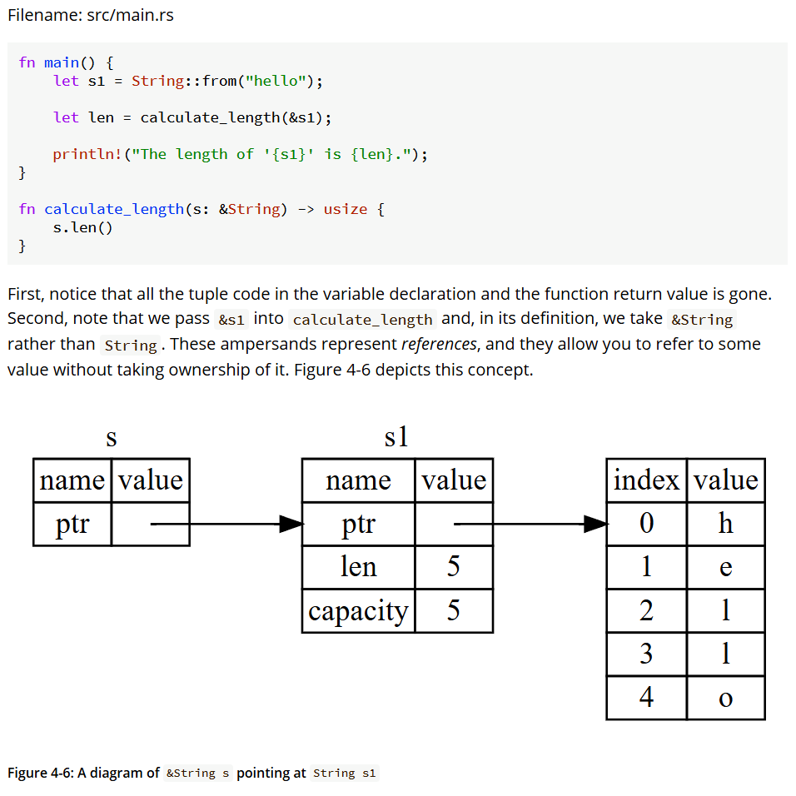

Slide 18
Pointers and References
struct SensorReading {
value: u16,
timestamp_ms: u32,
}
my_ref
reading
name | value
ptr
name | value
value | 4
timestamp_ms | 100

Slide 19
Ownership and Borrowing Rules
Each value in Rust has an owner.
There can only be one owner at a time.
When the owner goes out of scope, the value will be dropped.
You can have either one mutable reference or any number of immutable references.
References must always be valid.
If you move out part of a value, you cannot use the whole value anymore.
Slices are references to the whole value and follow the same borrowing rules.

