Slide 1
Reinforcement Learning for Robotics
Get started: github.com/ShawnHymel/workshop-reinforcement-learning-for-robotics
Shawn Hymel
edge lab LIVE!

Slide 2
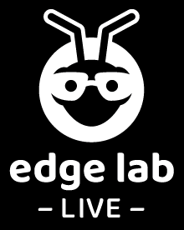
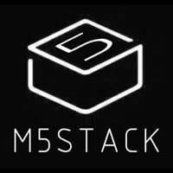
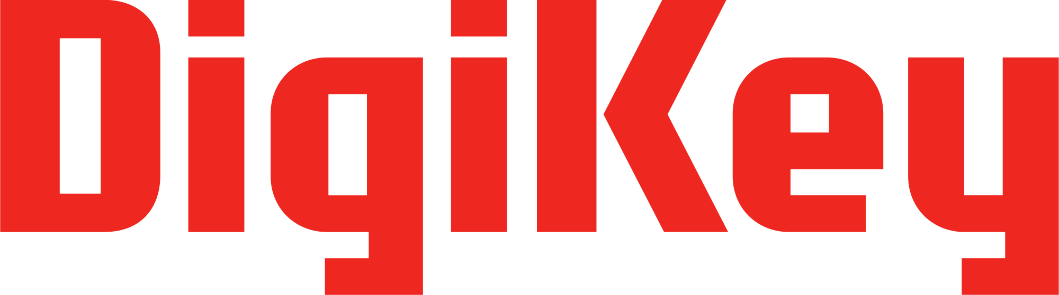
Thank you for sponsoring this workshop!

Slide 3
Train Agent and Install Software
Start training RL agent
  github.com/ShawnHymel/workshop-reinforcement-learning-for-robotics
Install Arduino and libraries
  github.com/ShawnHymel/workshop-reinforcement-learning-for-robotics
Build robot
  Follow instructions in robot kit

Slide 4
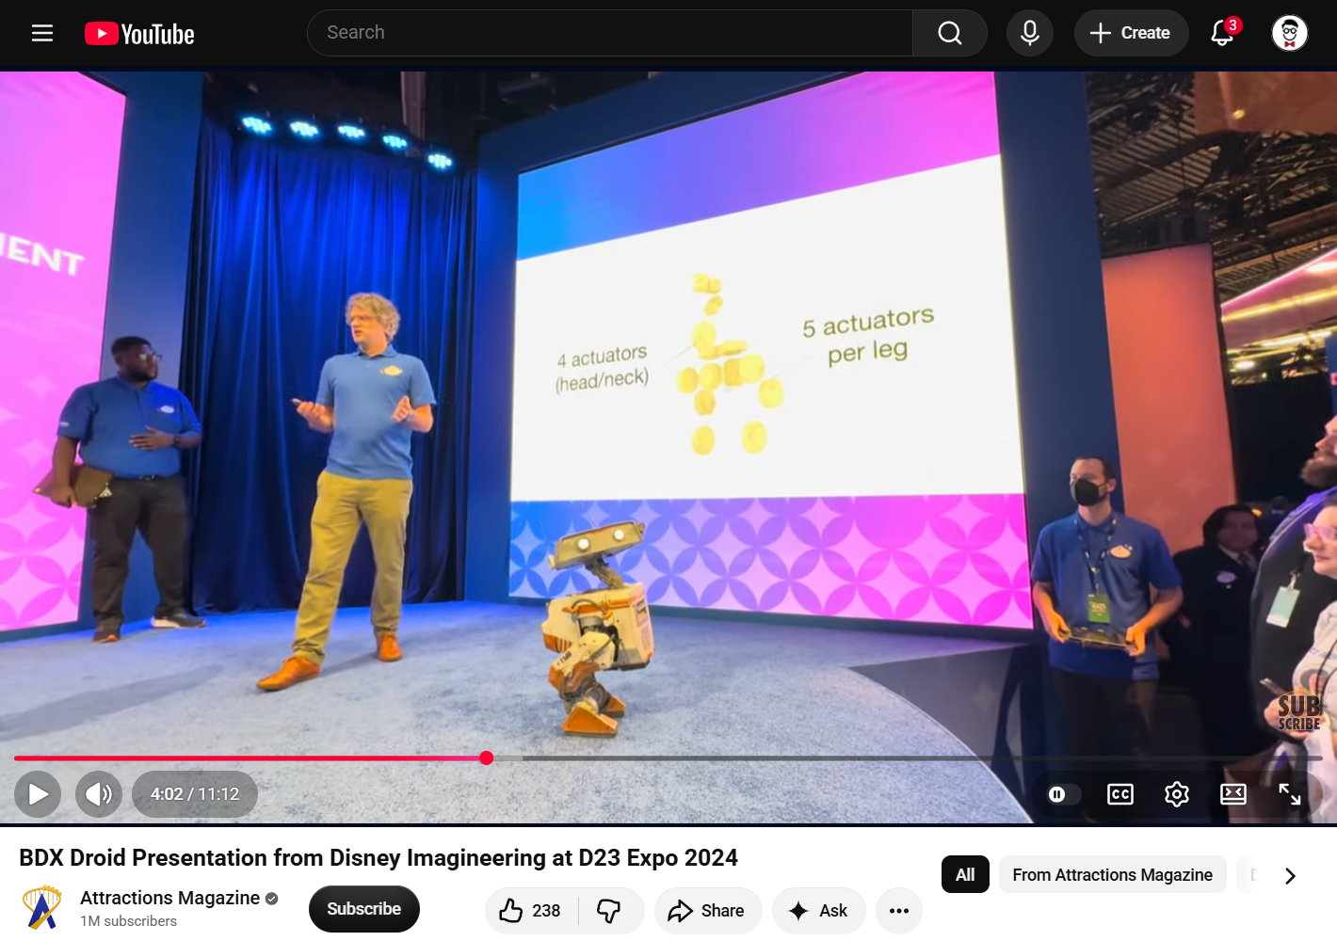
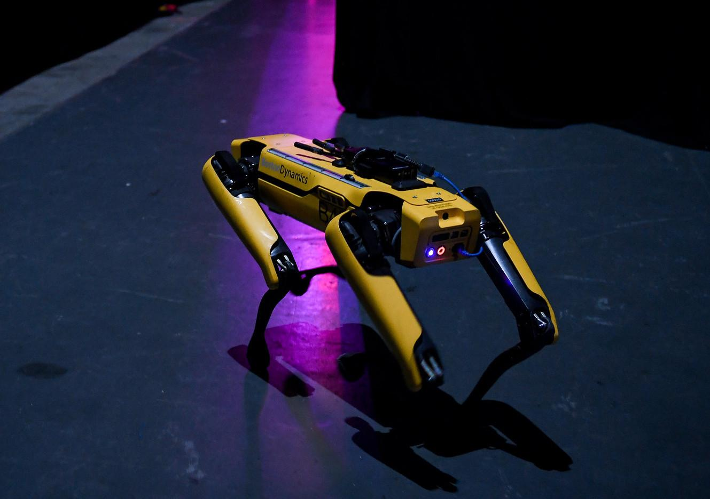
Why Reinforcement Learning?
Pros:
Robust policies that can tackle new environments
Compute is front-loaded
Infer actions from human teachers/animators
Cons:
Non-deterministic (no guarantees)
Imprecise
Setup and simulation training time
“SpotMini prior to going on Centre Stage” by Web Summit, used under CC BY 2.0
Notes:
Classical controls still used in:
industrial manipulators (precision required)
aerospace certifications (traceability and determinism required)
process control systems (PID and MPC easier to implement and offer determinism)

Slide 5
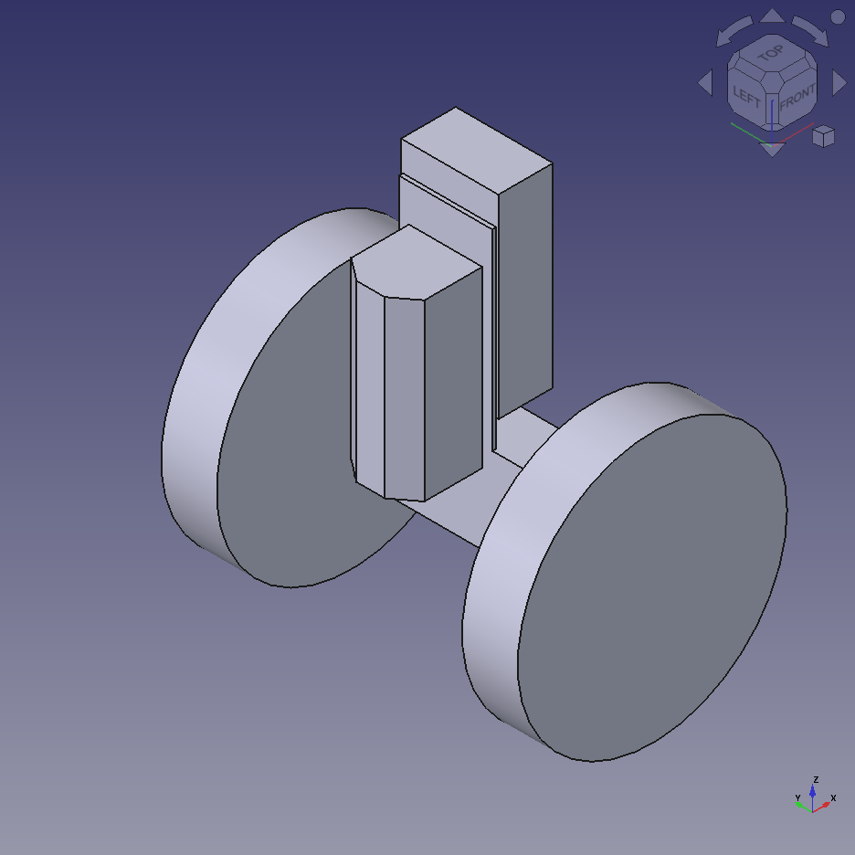
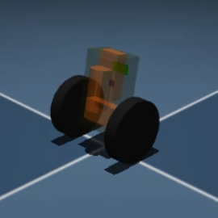
CAD to Simulator
CAD
chassis.stl
Simulator
Export
meshes
wheel_left.stl
wheel_right.stl
Reference mesh files
URDF or
MJCF file
FreeCAD, Fusion 360, SolidWorks, etc.
Mass and inertia information
MuJoCo, Gazebo, Isaac Sim, etc.
Import into simulator
XML descriptor

Slide 6
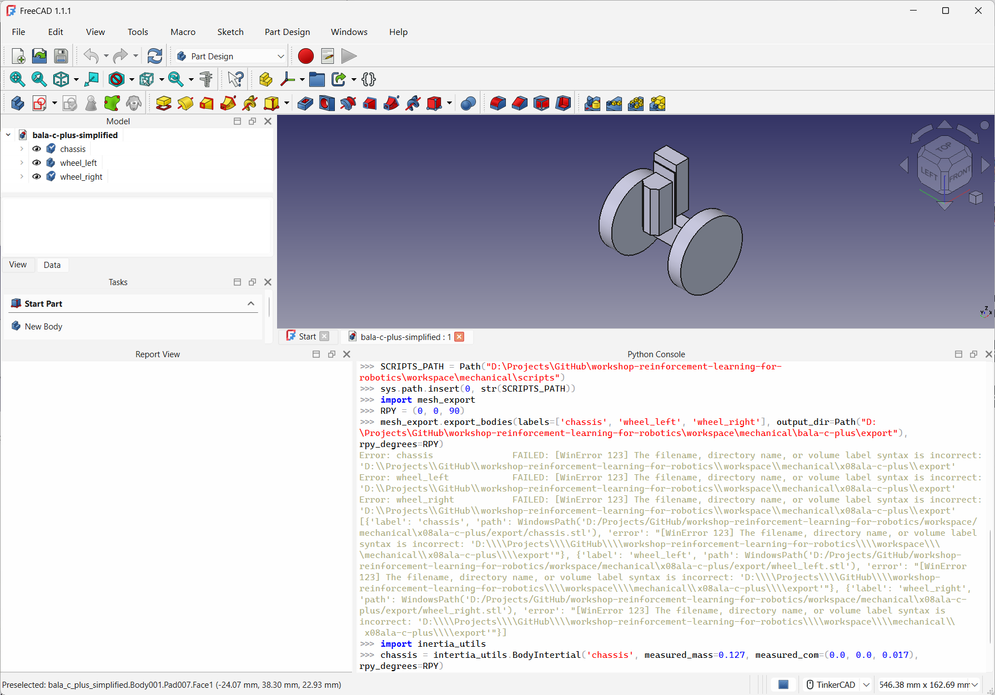
FreeCAD Export

Slide 7
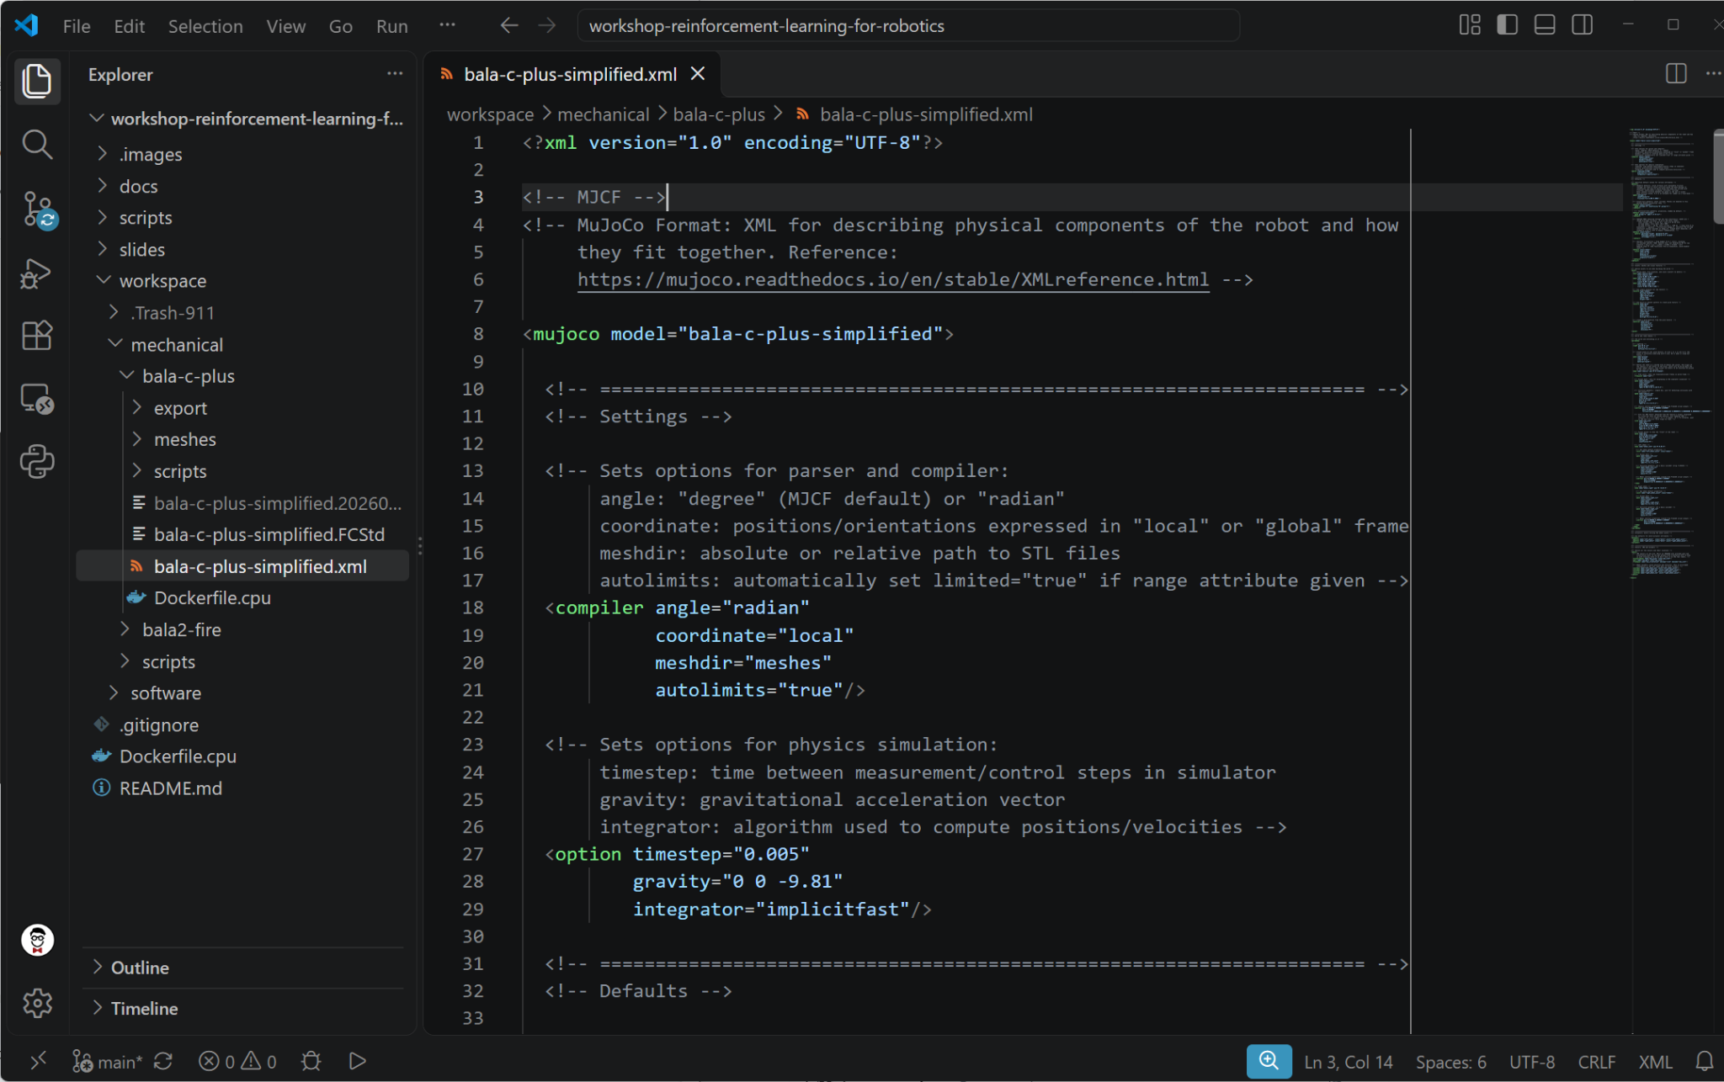
MJCF File
workspace/mechanical/bala-c-plus/bala-c-plus-simplified.xml

Slide 8
Reinforcement Learning: Balance Bot
Observation
IMU:
pitch, pitch_rate, yaw_rate
Estimations:
est_cmd_vel, est_cmd_pos, est_heading
Robot chassis, wheels, floor, etc.
Bala-C
Motors/actuators
Reward
alive - A⋅pitch² - B⋅action² - C⋅est_cmd_vel² - D⋅est_cmd_pos² - E⋅est_heading² -
F⋅(action - prev_action)²
Agent
Action
Environment
Action
Left motor: [-1.0, 1.0]
Right motor: [-1.0, 1.0]

Slide 9
Actor/Critic Agent
Actor (policy)
neural network
Action
[left_motor,
right_motor]
Observation
Critic
neural network
Predicted return
v(s)
Goal: minimize error between predicted and actual return

Slide 10
Actor/Critic Agent
Goal: maximize return v(s)
Actor (policy)
neural network
Action
[left_motor,
right_motor]
Observation
Used in training process
Critic
neural network
Predicted return
v(s)
Goal: minimize error between predicted and actual return

Slide 11
Deploy Actor
Actor (policy)
neural network
Action
[left_motor,
right_motor]
Observation

Slide 12
Proximal Policy Optimization
Collect a rollout
  Run the current policy (some exploration)
  Number of timesteps
  Record observations, actions, and rewards
Update the critic
  Use backpropagation
  Goal: given an observation, predict total future discounted rewards (return)
Score each action
  Advantage = actual future rewards - critic’s prediction
  “Did this turn out better or worse than expected?”
Update the actor
  Make better-than-expected rewards more likely
  Clipping: prevent the actor from making drastic changes to its behavior in a single update
Repeat until desired performance level

Slide 13
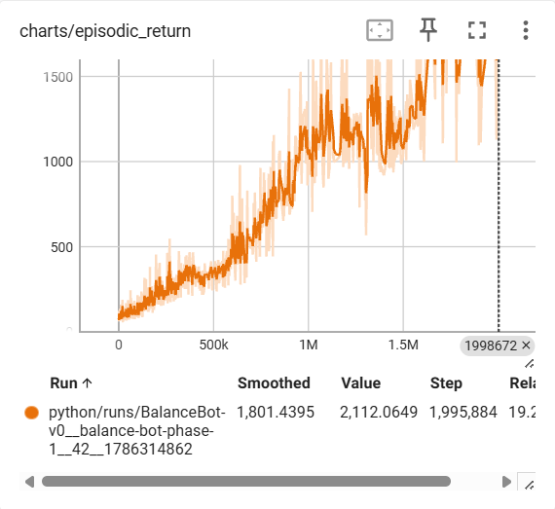
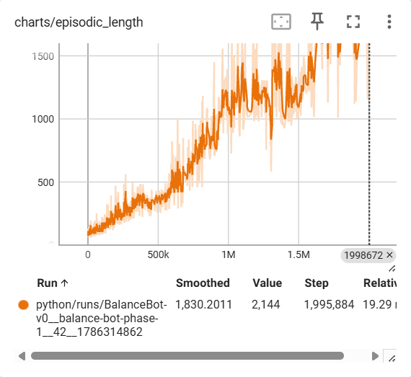
Charts You Should Care About
Total actual rewards from completed episodes
Episode length (timesteps) from completed episodes

Slide 14
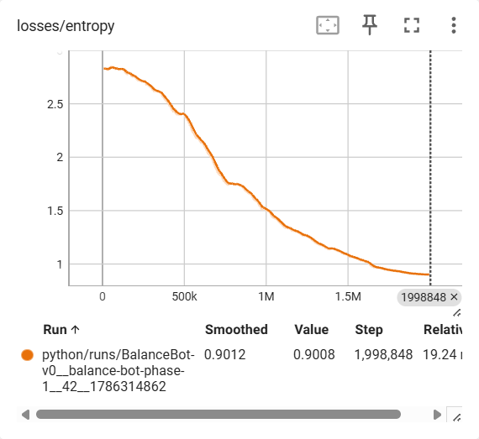
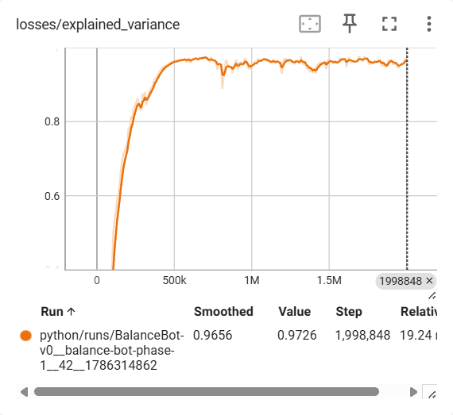
Charts You Should Care About
Spread of action probabilities from actor NN. Shows how much actor is committing to actions (explore vs. exploit).
Compare critic vs. actual returns:
1.0: critic predicted perfectly
0: no better than predicting the batch average return at each timestep
Negative: critic is worse than predicting the mean
Notes:
Batch average return: mean return at each timestep
Critic should be better than that…it should be able to differentiate among the different states in order to more accurately predict the state value (expected discounted return from any given state/observation)

Slide 15
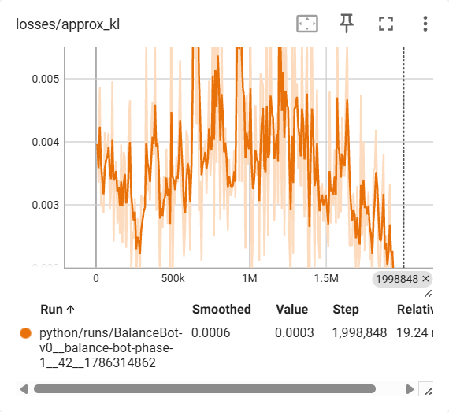
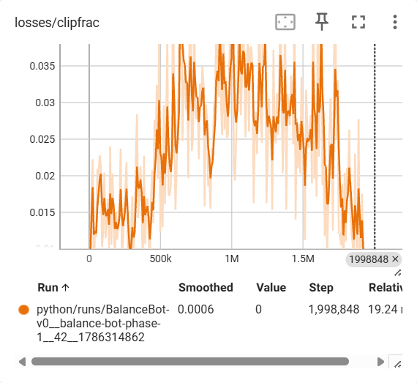
Charts You Should Care About
KL divergence: how far the policy’s action distribution has moved from the policy that collected the batch. ~0.01-0.02 is healthy.
Fraction of samples whose probability ratio (new policy vs. old) moved beyond +/-20% (the objective stops rewarding further movement). ~0.1–0.3 is healthy.
Notes:
Both measure how aggressively the policy was changed during the actor update.
Not aggressive enough (and returns not acceptable): need more samples/episodes (learning takes too long) or increase learning rate
Too aggressive: could prematurely collapse policy spread (settle on exploitation too fast without exploring). Try lowering the learning rate, fewer update epochs, or larger batches (more steps per rollout).
Keeping the (new) policy near the rollout (old) policy keeps the batch valid for both the actor's importance correction and the critic's targets.

Slide 16
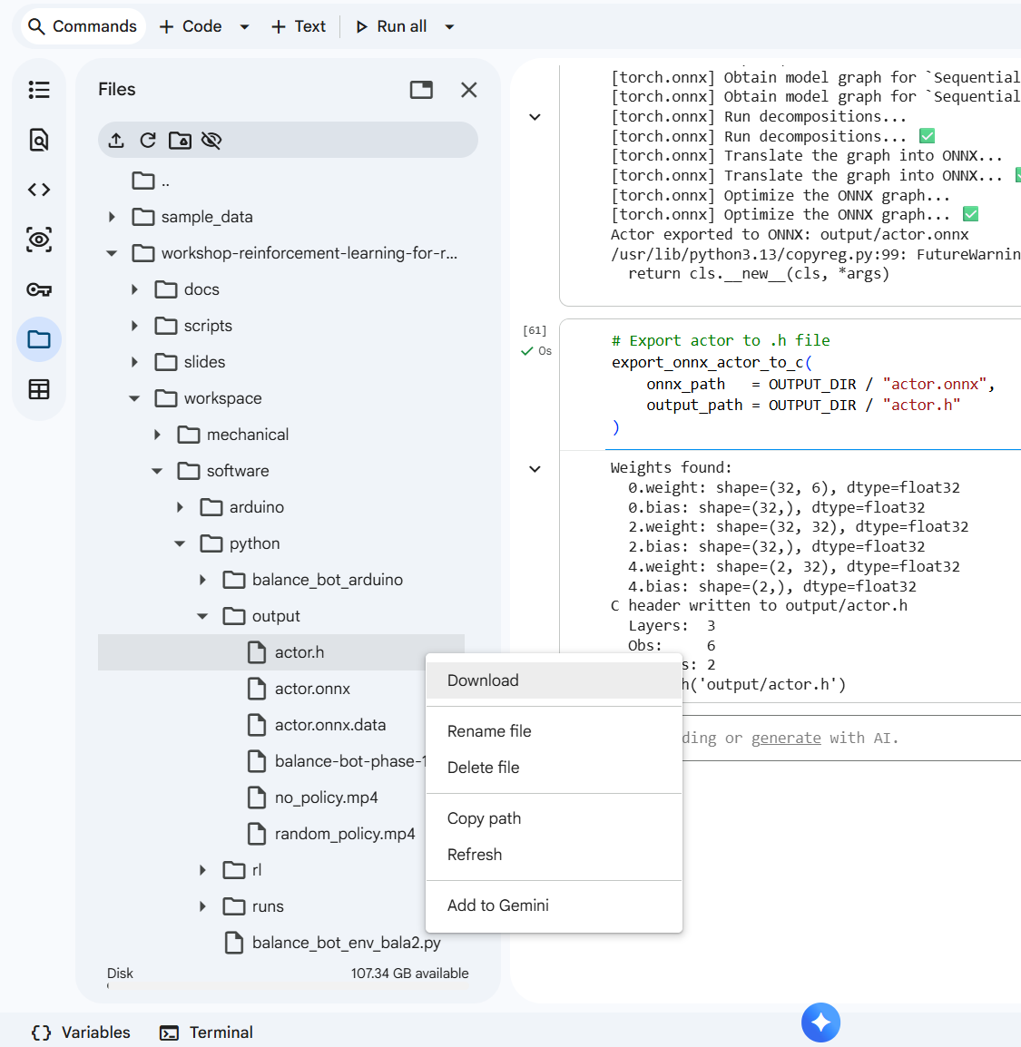
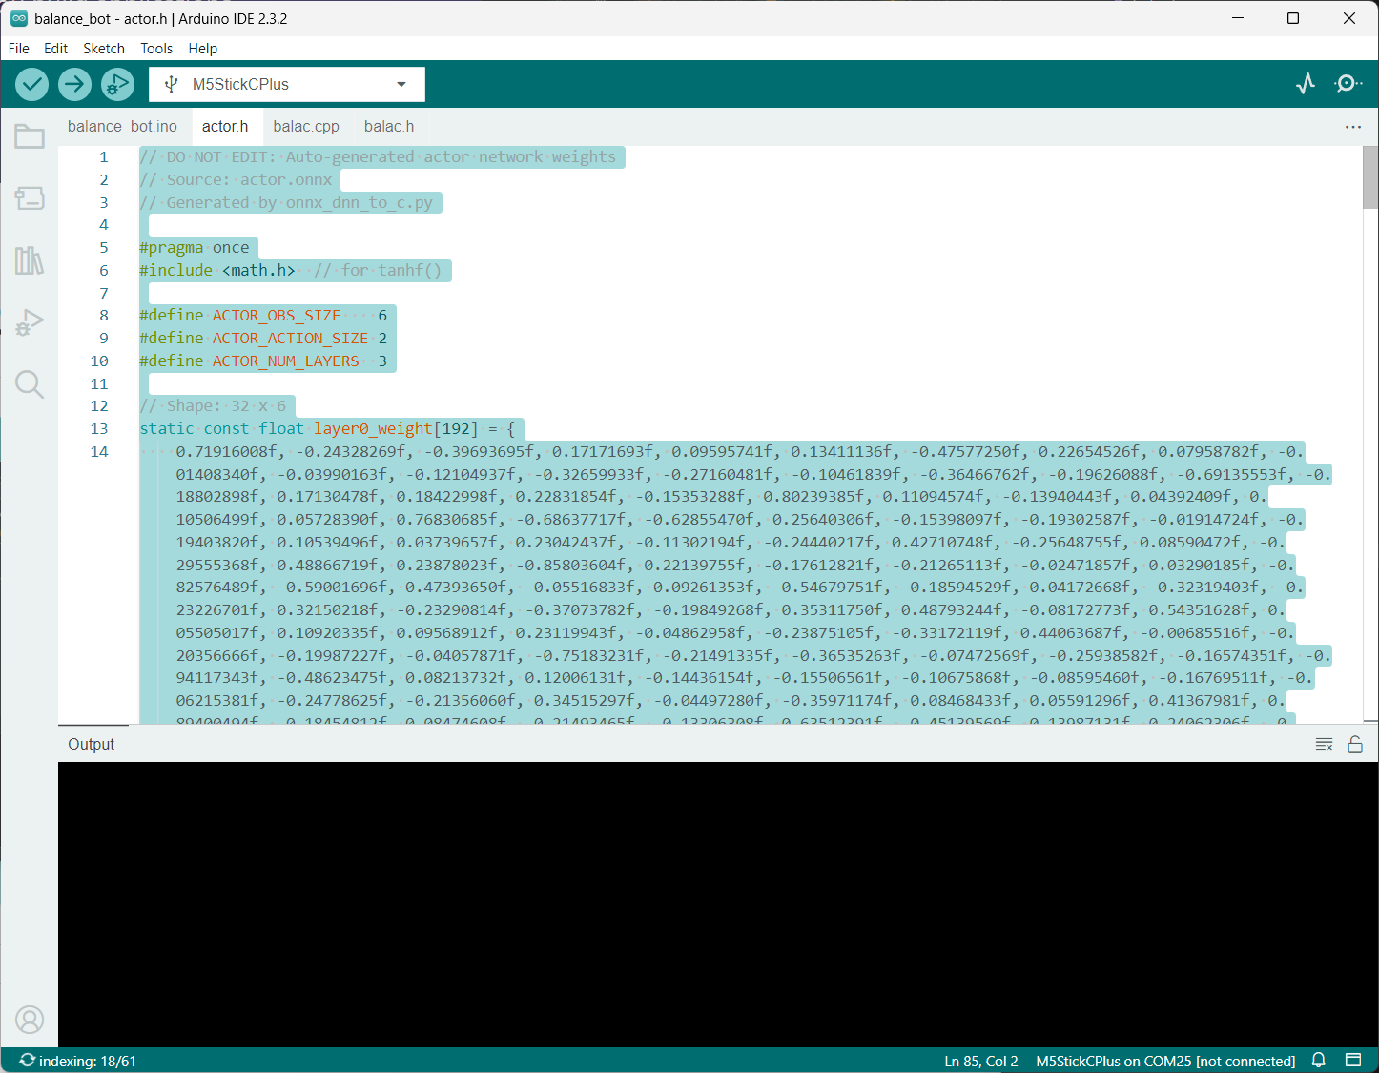
Deploy actor.h

Slide 17
Upload
USB stick
  Install Arduino
  Unzip and copy board definition files
  Unzip and copy libraries
Copy actor.h to workspace/software/arduino/balance_bot_bala_c/
Connect robot to computer using USB cable
Upload sketch to robot

Slide 18
RC Demo

Slide 19
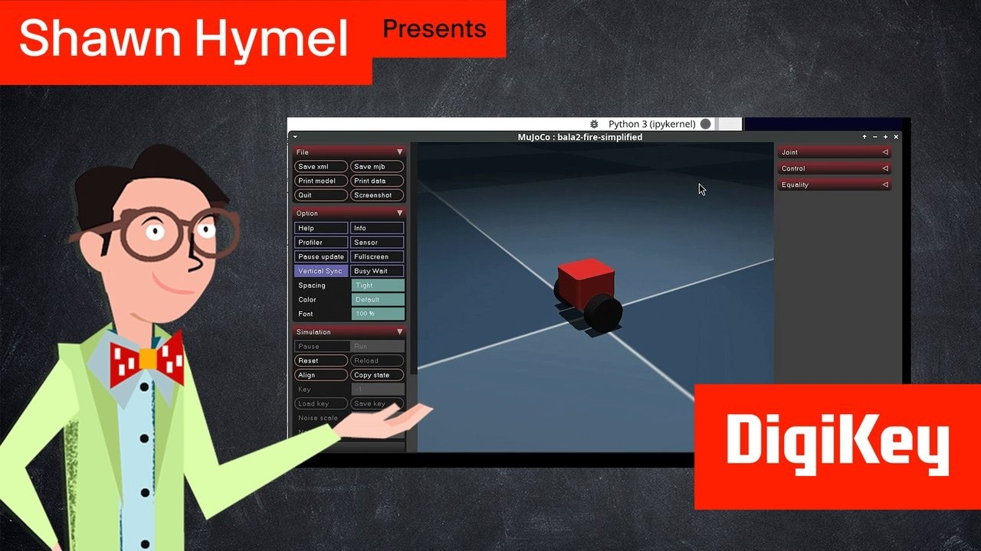
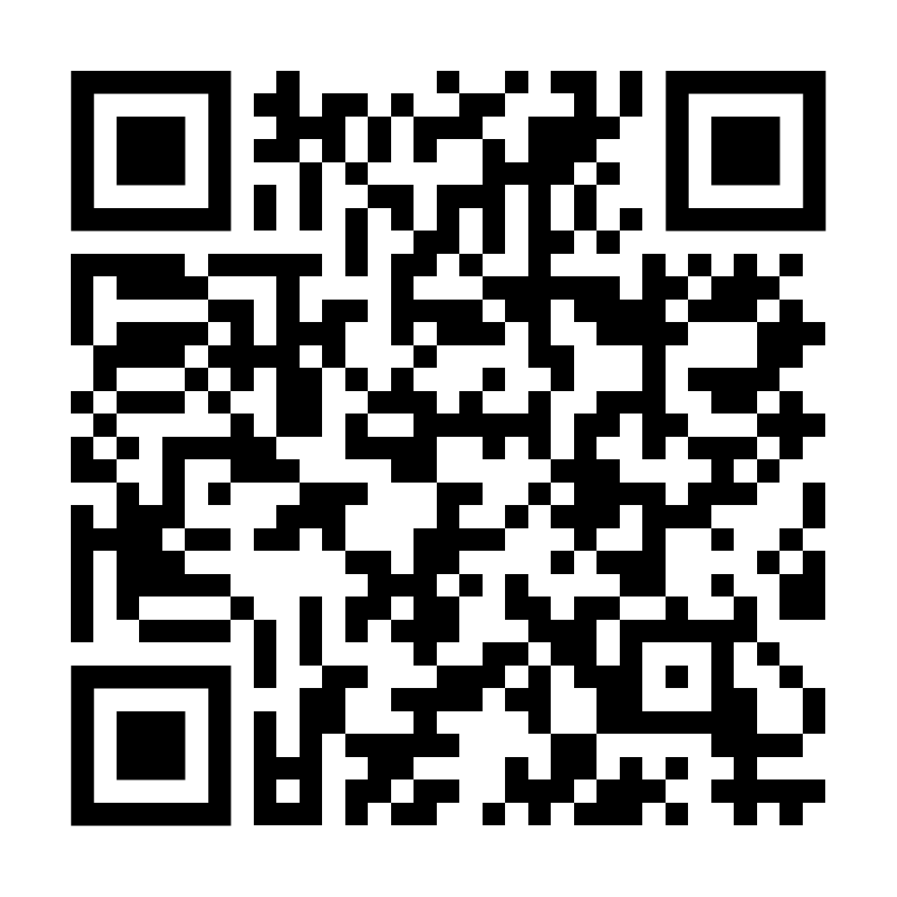
Dive Deeper
youtube.com/watch?v=kGish1q_WC8&list=PLYExBrZNJeQg

Slide 20
Dive Deeper (“I Like Math” Edition)
Grokking Deep Learning by Andrew W. Trask
Blog post series
  shawnhymel.com/blog
Reinforcement Learning Coursera Specialization
  coursera.org/specializations/reinforcement-learning

Slide 21




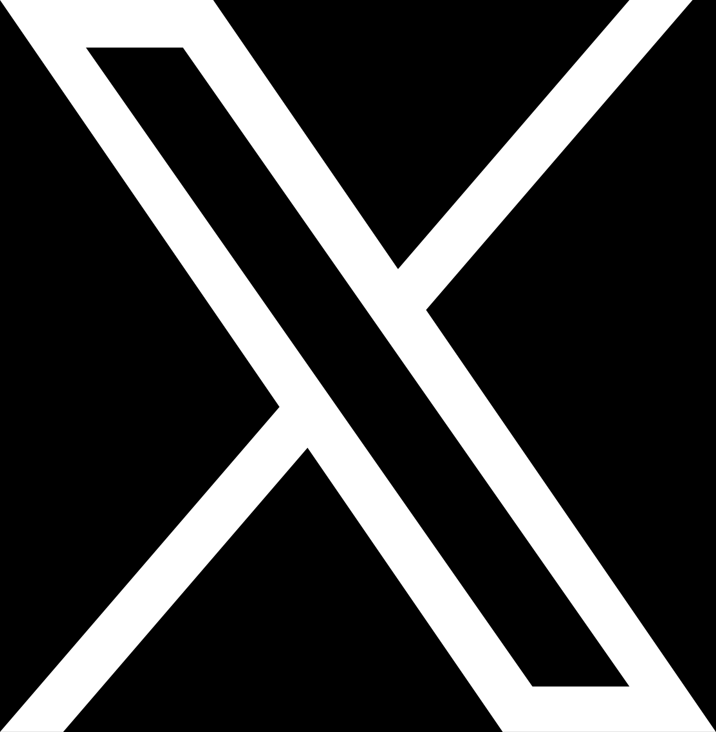

Tell Me More
github.com/ShawnHymel/workshop-reinforcement-learning-for-robotics
masto.ai/@shawnhymel
shawn_hymel
in/shawnhymel
@ShawnHymel
@shawnhymel

