Slide 1


Reinforcement Learning for Robotics
github.com/ShawnHymel/workshop-reinforcement-learning-for-robotics

Slide 2
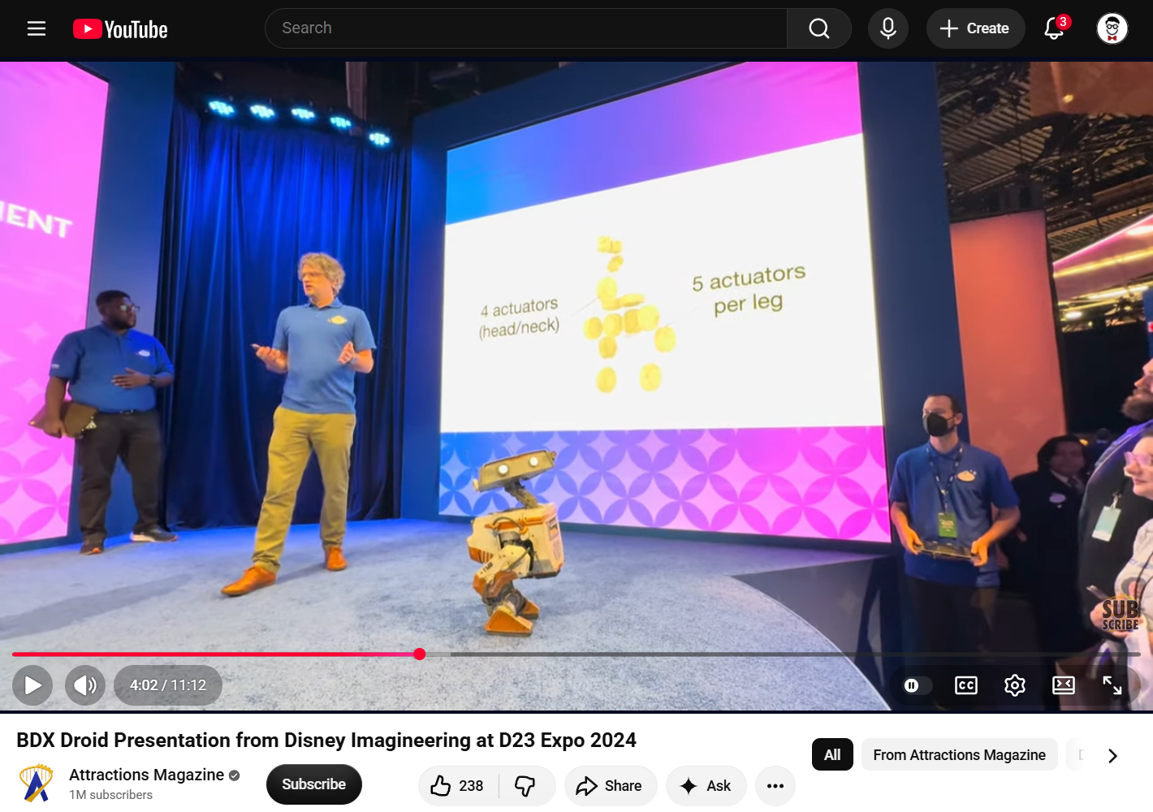
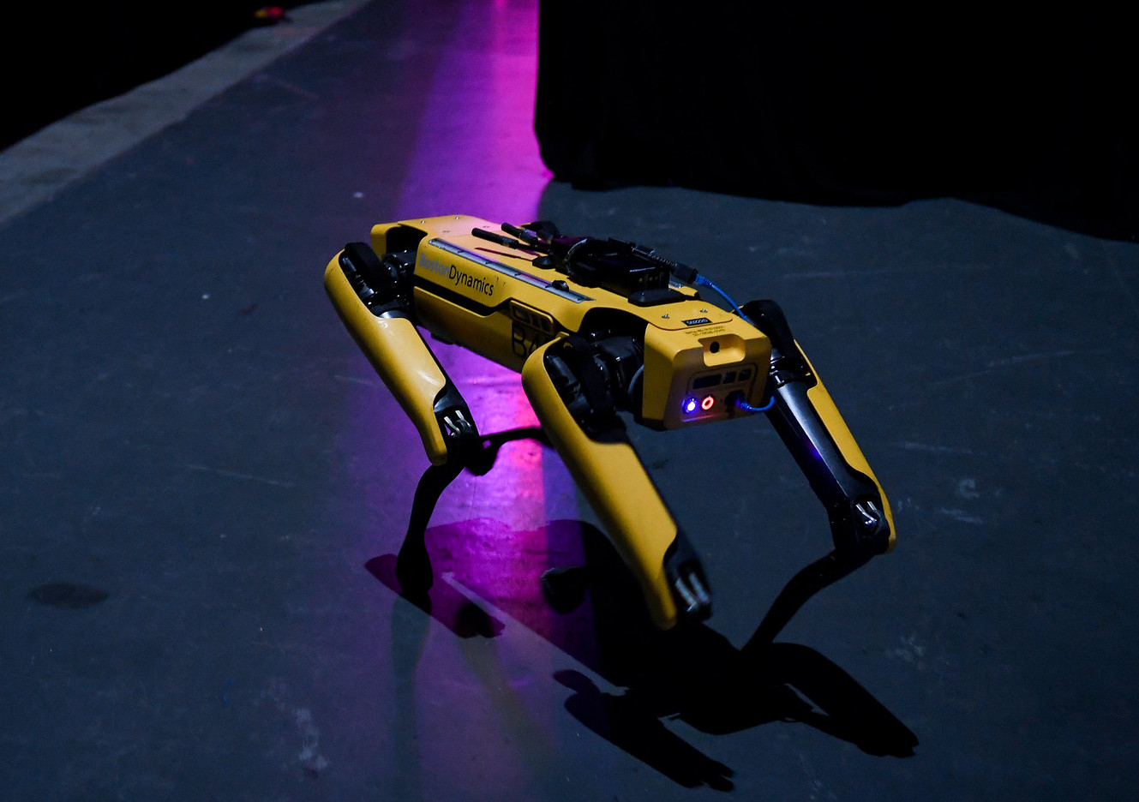
Why Reinforcement Learning?
Pros:
Robust policies that can tackle new environments
Compute is front-loaded
Infer actions from human teachers/animators
Cons:
Non-deterministic (no guarantees)
Imprecise
Setup and simulation training time
“SpotMini prior to going on Centre Stage” by Web Summit, used under CC BY 2.0
Notes:
Classical controls still used in:
industrial manipulators (precision required)
aerospace certifications (traceability and determinism required)
process control systems (PID and MPC easier to implement and offer determinism)

Slide 3
Screen: Training Phase 1

Slide 4
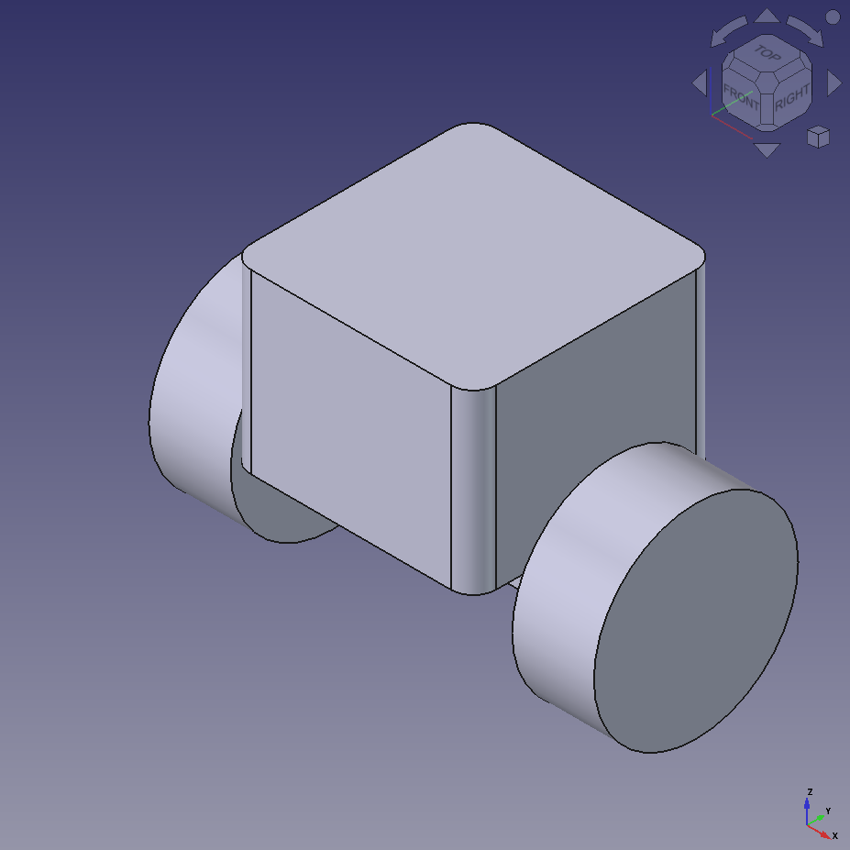
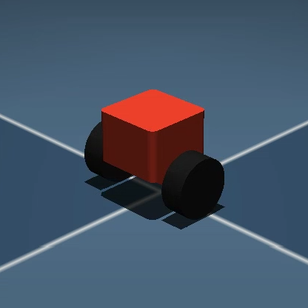
CAD to Simulator
CAD
chassis.stl
Simulator
Export
meshes
wheel_left.stl
wheel_right.stl
Reference mesh files
URDF or
MJCF file
FreeCAD, Fusion 360, SolidWorks, etc.
Mass and inertia information
MuJoCo, Gazebo, Isaac Sim, etc.
Import into simulator
XML descriptor

Slide 5
Screen: FreeCAD and MJCF

Slide 6
Screen: Training Phase 2

Slide 7
Reinforcement Learning: Balance Bot
Robot chassis, wheels, floor, etc.
Observation
IMU:
pitch, pitch rate
Motor encoders:
left/right wheel angular velocity
Bala2
Motors/actuators
Reward
alive - (A*pitch^2) - (B*action^2) - (C*(x^2 + y^2)) - D*abs(yaw_rate)
Agent
Action
Environment
Action
Left motor: [-1.0, 1.0]
Right motor: [-1.0, 1.0]

Slide 8
Reinforcement Learning: Balance Bot
Robot chassis, wheels, floor, etc.
Observation
IMU:
pitch, pitch rate
Estimate:
velocity, yaw rate, position, heading
Bala-C Plus (no encoders)
Motors/actuators
Reward
alive - (A*pitch_err^2) - (B*action^2) - (C*cmd_vel^2) – (D*cmd_pos^2) – (E*heading_est^2)
Agent
Action
Environment
Action
Left motor: [-1.0, 1.0]
Right motor: [-1.0, 1.0]

Slide 9
Actor/Critic Agent
Actor (policy)
neural network
Action
[left_motor,
right_motor]
Observation
Critic
neural network
Predicted return
v(s)

Slide 10
Deploy Actor
Actor (policy)
neural network
Action
[left_motor,
right_motor]
Observation

Slide 11
Screen: CleanRL PPO

Slide 12
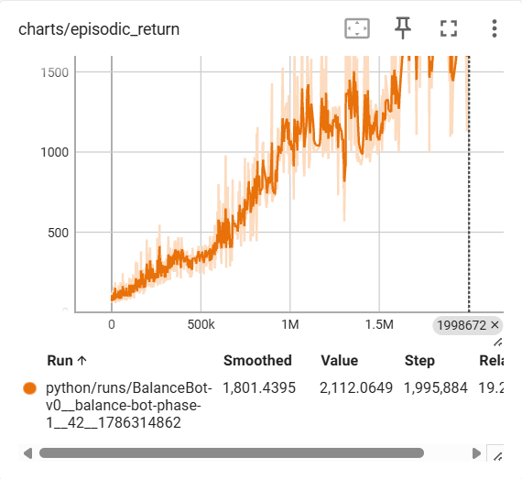
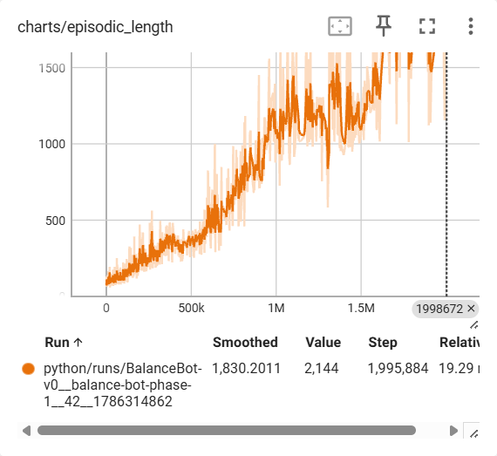
Charts You Should Care About
Total actual rewards from completed episodes
Episode length (timesteps) from completed episodes

Slide 13
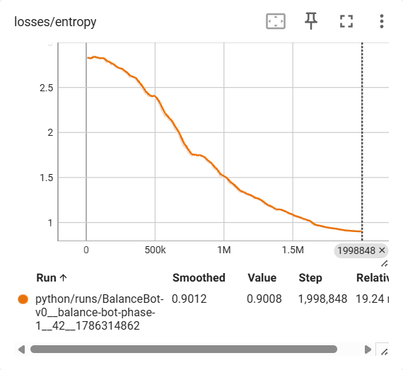
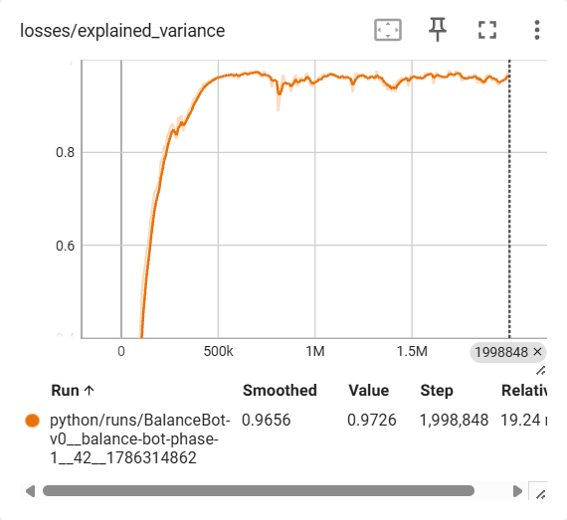
Charts You Should Care About
Spread of action probabilities from actor NN. Shows how much actor is committing to actions (explore vs. exploit).
Compare critic vs. actual returns:
1.0: critic predicted perfectly
0: no better than predicting the batch average return at each timestep
Negative: critic is worse than predicting the mean
Notes:
Batch average return: mean return at each timestep
Critic should be better than that…it should be able to differentiate among the different states in order to more accurately predict the state value (expected discounted return from any given state/observation)

Slide 14
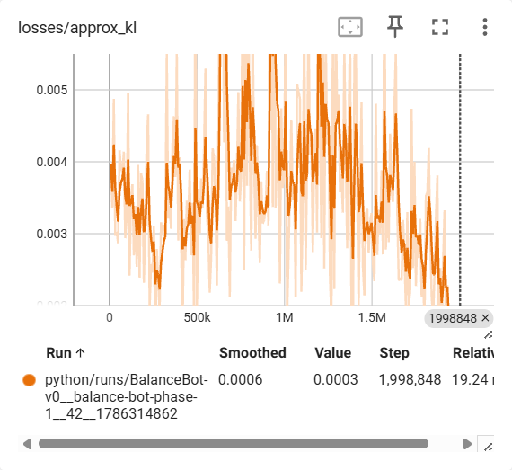
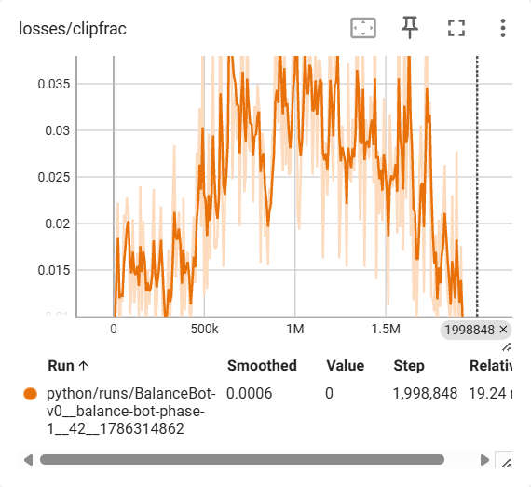
Charts You Should Care About
KL divergence: how far the policy’s action distribution has moved from the policy that collected the batch. ~0.01-0.02 is healthy.
Fraction of samples whose probability ratio (new policy vs. old) moved beyond +/-20% (the objective stops rewarding further movement). ~0.1–0.3 is healthy.
Notes:
Both measure how aggressively the policy was changed during the actor update.
Not aggressive enough: need more samples/episodes (learning takes too long)
Too aggressive: could prematurely collapse policy spread (settle on exploitation too fast without exploring), and it can also degrade critic’s value estimates, which in turn degrade the actor’s updates.
Keeping the (new) policy near the rollout (old) policy keeps the batch valid for both the actor's importance correction and the critic's targets.

Slide 15
Screen: Training Phase 3

Slide 16
Position, Velocity, Heading Estimation
# Command leaky integration: proportional
# to forward velocity/position
cmd = 0.5 * (action[0] + action[1])
cmd_vel = 0.995 *
(cmd_vel + cmd * dt)
cmd_pos = 1.0 *
(cmd_pos + cmd_vel * dt)
Bala-C Plus
(no encoders)
# Non-leaky yaw rate integration
yaw_rate = -1 * read_gyro_y()
heading = 1.0 * (heading + yaw_rate * dt)

Slide 17
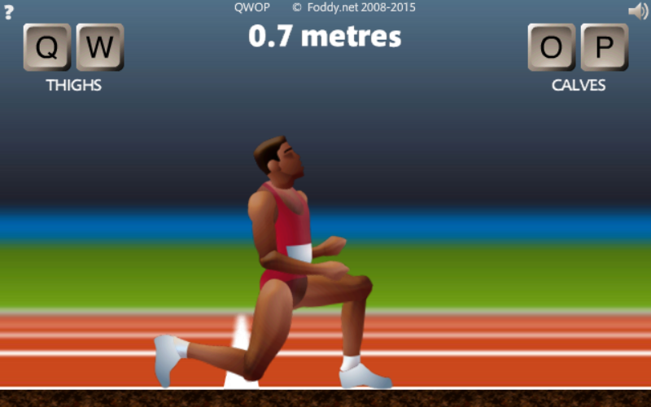
Curriculum Learning
Train policy on easier version of task
Progressively introduce harder tasks
Similar to teaching e.g. math: arithmetic > algebra > calculus
Without it, agents often never learn or learn some unintended workaround
Art: hand-tuning stages
Automated/parallelized phases

Slide 18
Screen: Environment

Slide 19
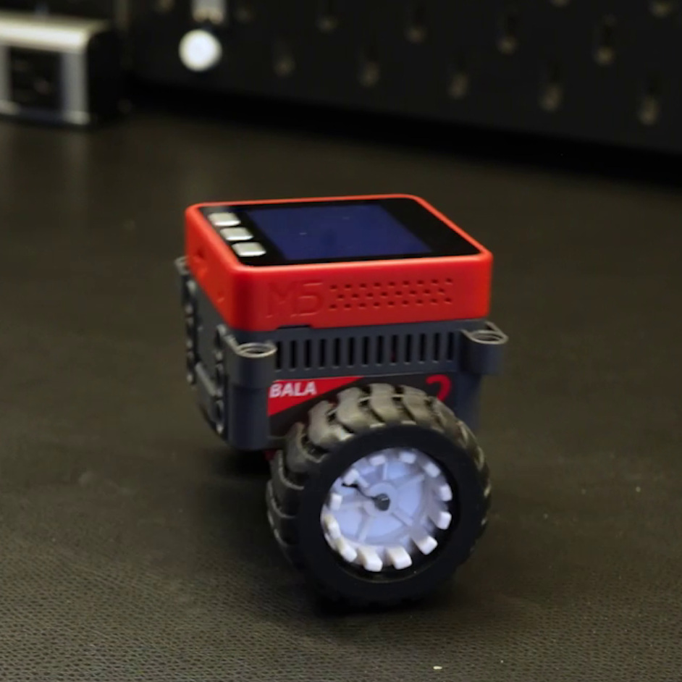
Sim-to-Real Gap
Simulation does not 100% accurately represent physical robot
Modelling inaccuracies
Electrical/mechanical physical variations/tolerances
Sensor/motor noise
Action lag time
Result: what worked in sim does not always work (nearly as well) in the real world
Simulator

Slide 20
Fixing the Sim-to-Real Gap
Perfectly model everything in simulation
Ensures closest match between sim and reality
Requires lots of painstaking measurements
Requires tight tolerances on electrical/mechanical components
Post-processing
Relatively straightforward
Known fixes e.g. filters, boosts
Less robust (compromise by using parts of classical control methods)
Domain randomization
Creates a robust policy that can handle variations
More training time
Notes:
More ways: on-device learning

Slide 21
Domain Randomization
Vary some environmental factor (e.g. on robot, in the world) each episode or each timestep
Creates robust policy that can handle similar (but not exact) tasks
Policy that figures out how to work with slight hardware variances (sim-to-real gap)
Examples:
Starting pitch and pitch rate
Motor gain (voltage sag, asymmetry)
Sensor noise
Mass and friction
Bumps and obstacles
Gravity (balance on uneven surfaces)

Slide 22
Screen: Deploy

Slide 23
Going Further
RL for Robotics video series:
youtube.com/watch?v=kGish1q_WC8
My blog posts:
shawnhymel.com/blog/
Sutton & Barto:
incompleteideas.net/book/the-book-2nd.html
Grokking Deep RL:
manning.com/books/grokking-deep-reinforcement-learning
David Silver lectures: youtube.com/watch?v=2pWv7GOvuf0&list=PLqYmG7hTraZDM-OYHWgPebj2MfCFzFObQ

Slide 24
The End

