Slide 1
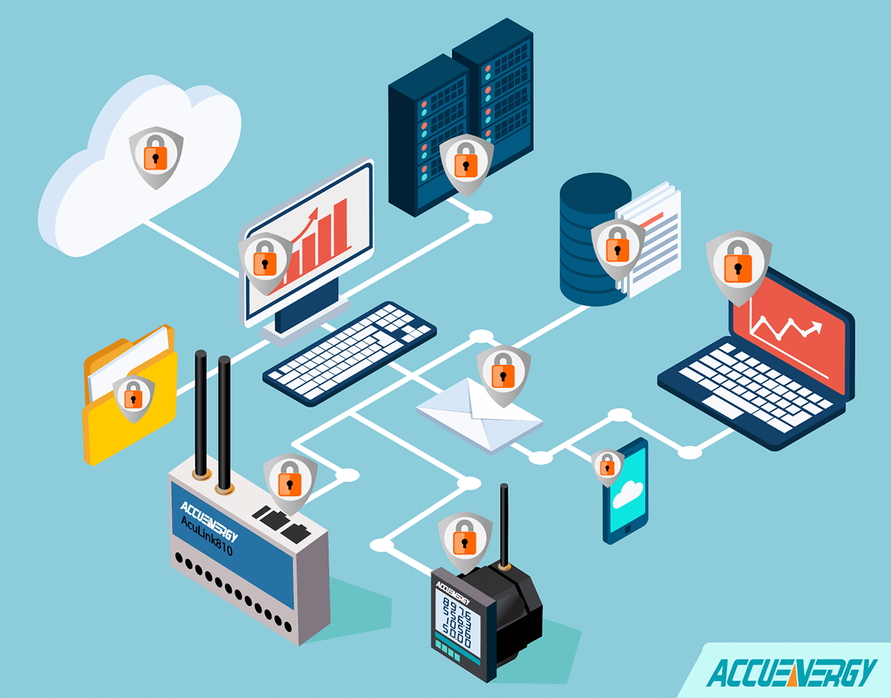
What is TLS
An encryption system called Transport Layer Security was created to provide end-to-end security for web-based communications.
To prevent manipulation and eavesdropping, the Internet Engineering Task Force (IETF) adopted TLS as the default protocol.
The padlock icon at the top left corner of the web browser denotes secure browsing sessions
TLS is also utilised by programmes like email, file transfers, and audio and video conferencing. The vast majority of protocols, including HTTP, SMTP, FTP, XMPP, and many others, are also interoperable with TLS.

Slide 2
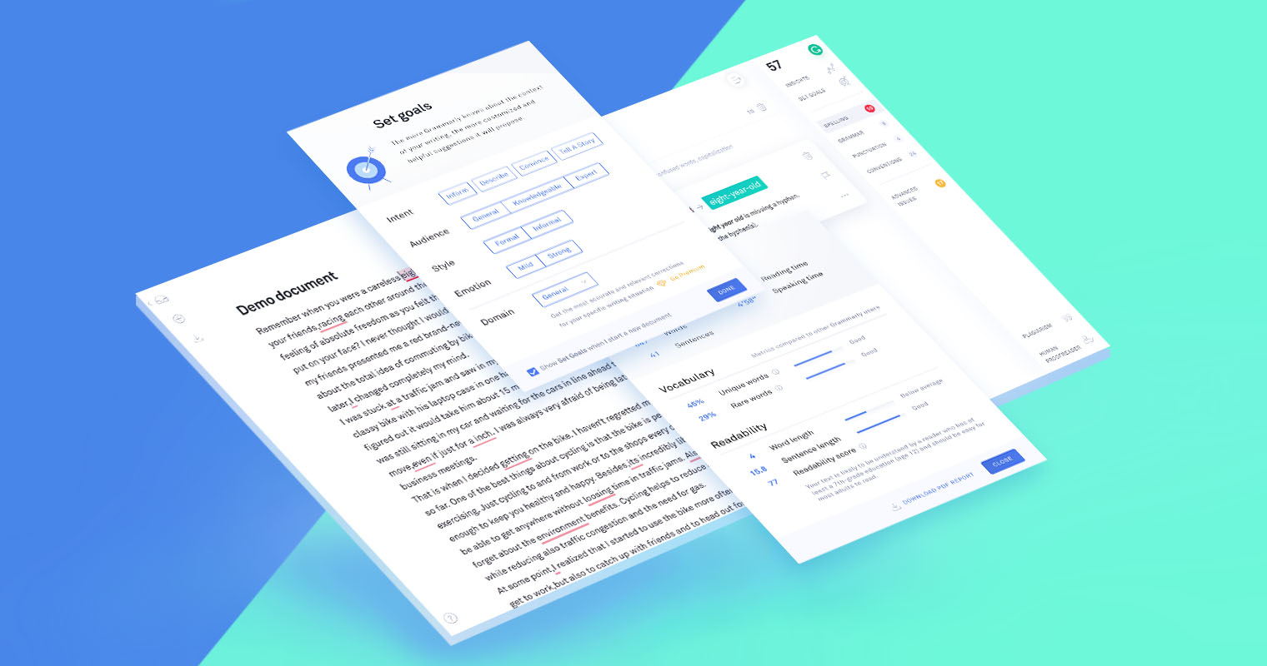
How Does TLS Work
To provide a secure communication channel between the client and server.
The TLS protocol definition moves via two layers, the TLS handshake protocol and the TLS record protocol, once the client and server have decided to interact over TLS.
Combining symmetric and asymmetric cryptography is a feature of TLS protocols.
Depending on the supported cypher suites and the key exchange mechanism in use, a TLS handshake involves a series of exchanges between the client and server.

Slide 3
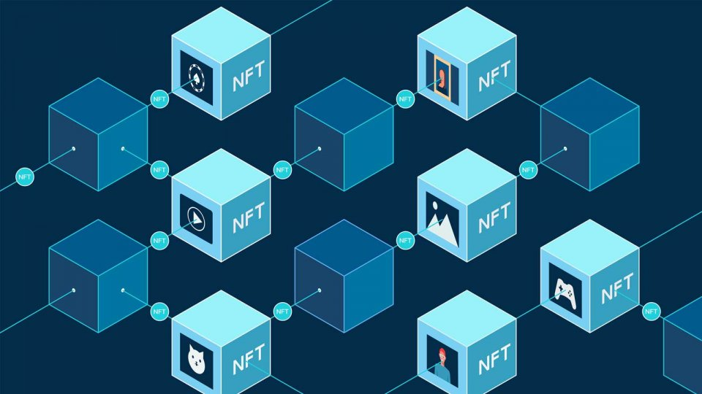
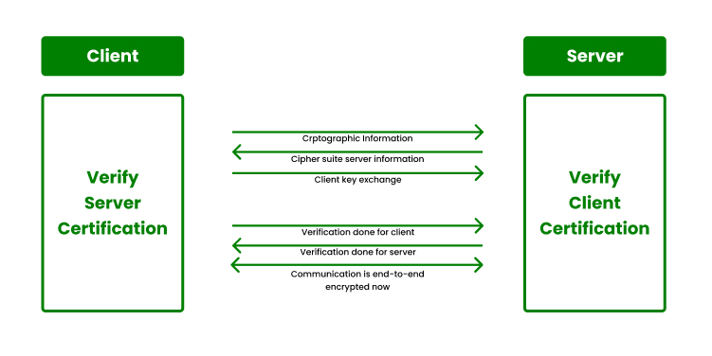
How Does TLS Work
The TLS record protocol uses symmetric cryptography to create distinct session keys for each connection after the decryption technique is decided upon during the handshake stage.
These keys allow for ongoing communication throughout the session.
The record protocol also adds a message authentication code based on hashing to any data being delivered (HMAC).

Slide 4

TLS Implementation
TLS Stack - A TLS (Transport Layer Security) stack is a particular way to implement the TLS protocol, which enables secure internet connection.
A TLS stack is often made up of several software layers that cooperate to offer secure communication between two endpoints.
Cipher Suites - A collection of cryptographic methods used in the TLS (Transport Layer Security) protocol are referred to as cypher suites.
TLS Configuration - The parameters and settings used to create a secure connection between two endpoints using the TLS protocol are referred to as TLS (Transport Layer Security) configuration.
TLS 1.2 and TLS 1.3 are versions that are frequently used.

Slide 5

Purpose of TLS
Most websites now use TLS encryption as normal procedure to safeguard web apps from data manipulation and eavesdropping.
Without TLS, sensitive data being exchanged online, including login credentials, personal data, and credit card numbers, is susceptible to theft.
TLS helps defend online applications against data breaches and distributed denial-of-service (DDoS) assaults in addition to protecting the personal information of individual users.
TLS support is now standard in the majority of browsers.

