Slide 1
Shopping System
Team Gas

Slide 2
Problem Statement
Consumer have to travel a certain distance for the product
Not all store and businesses have the exact item for the customer
There is limited time of when the store is opened and shut
Traditional online shopping platform is separate with payment and delivery enterprises
Cross-enterprise information changing increase the rick of privacy leak

Slide 3
Solution of Problem
Build a system to connect retailer, consumers, bank account and delivery all together
Efficient network to let customers track their order’s processing
Seller or retailer may easily edit product detail and automatically change stock information
Validation checks greatly reduced application errors and increase customer’s privacy information security

Slide 4
Approach
Designed a common object — order, and bind it to user account. In this way handle the cross-enterprise request
Designed a product object to support the shopping function

Slide 5
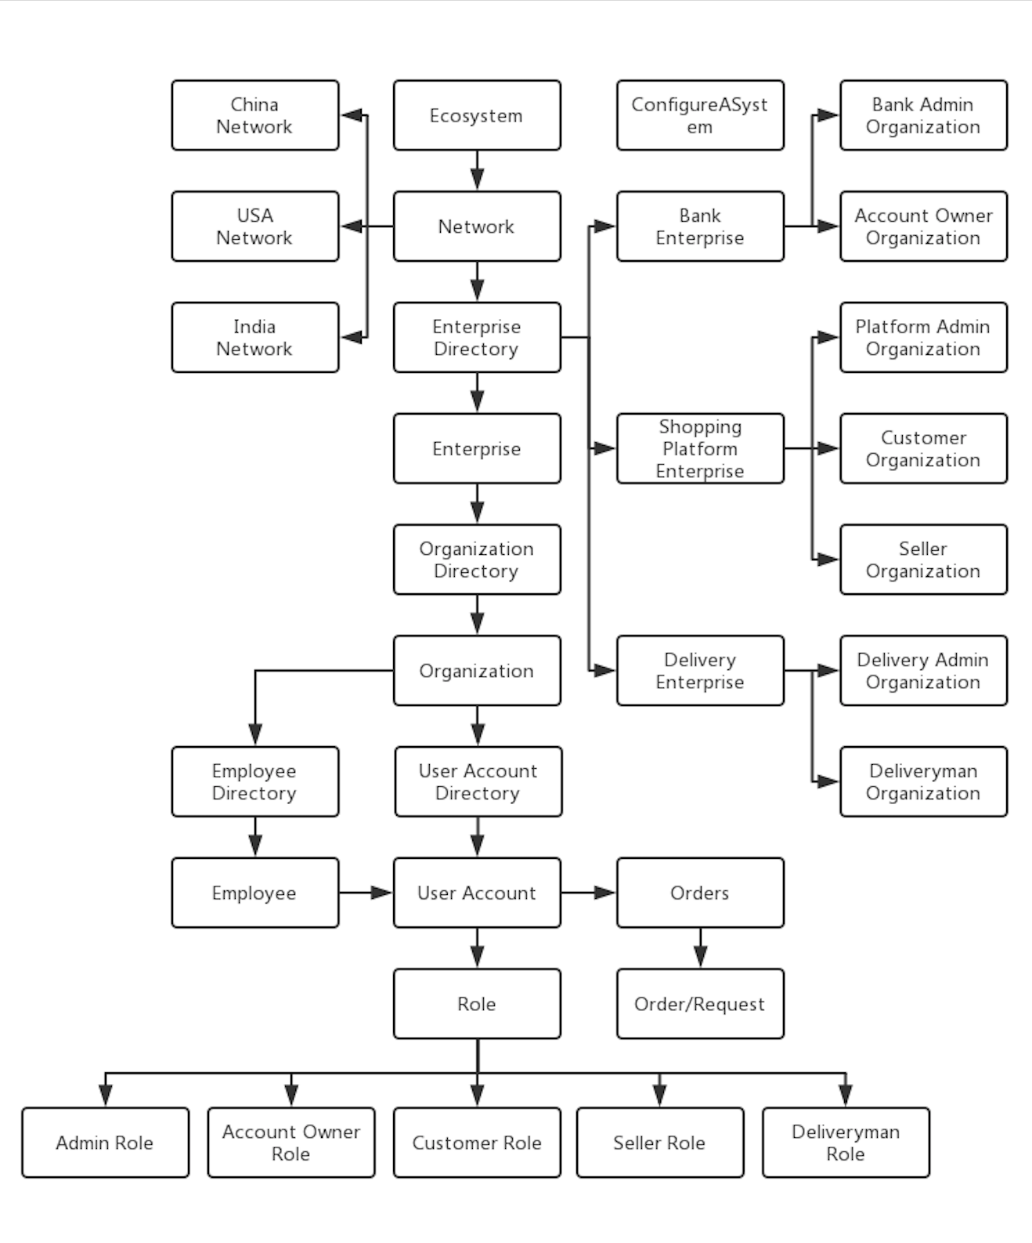
Design
Object Model

Slide 6
Use case

Slide 7
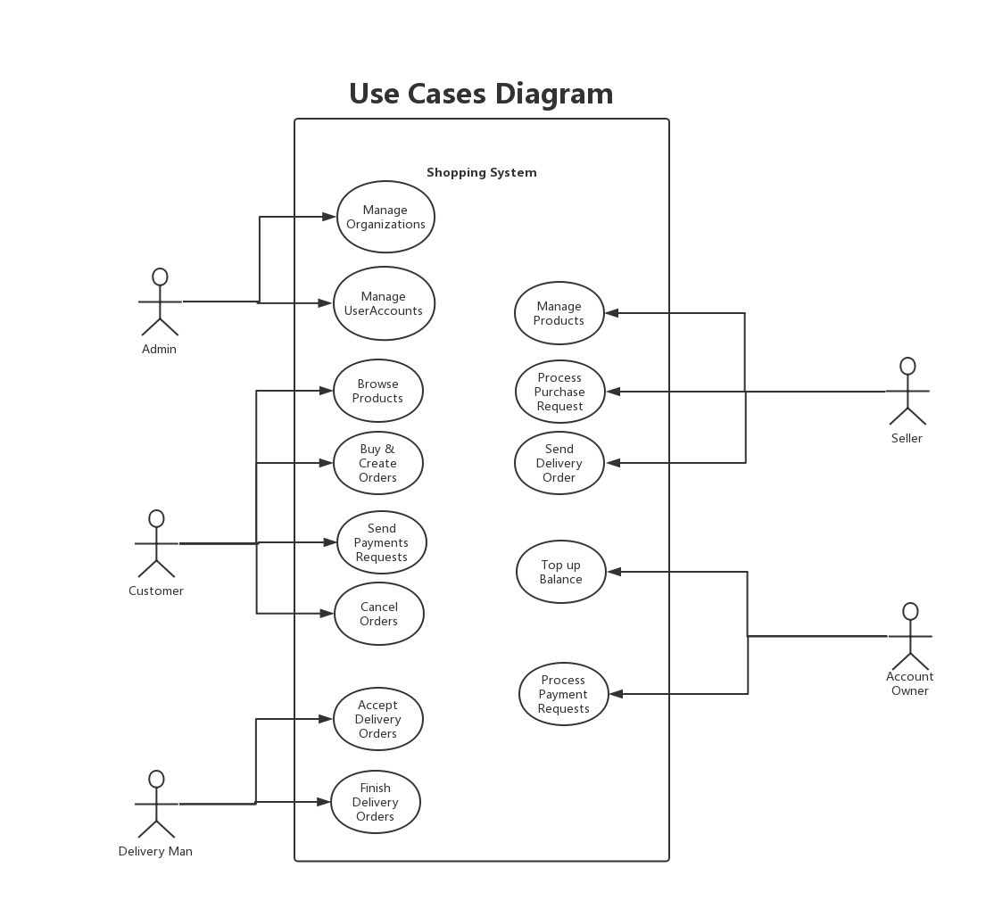

Slide 8
Work Flow

Slide 9
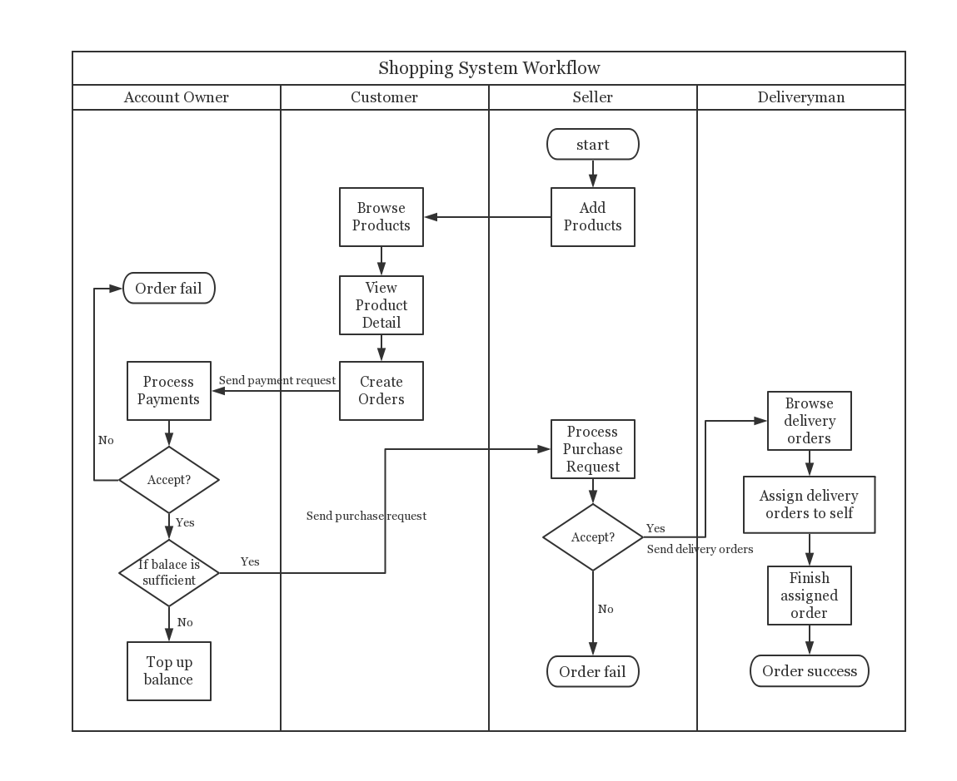

Slide 10
Key Screenshots

Slide 11
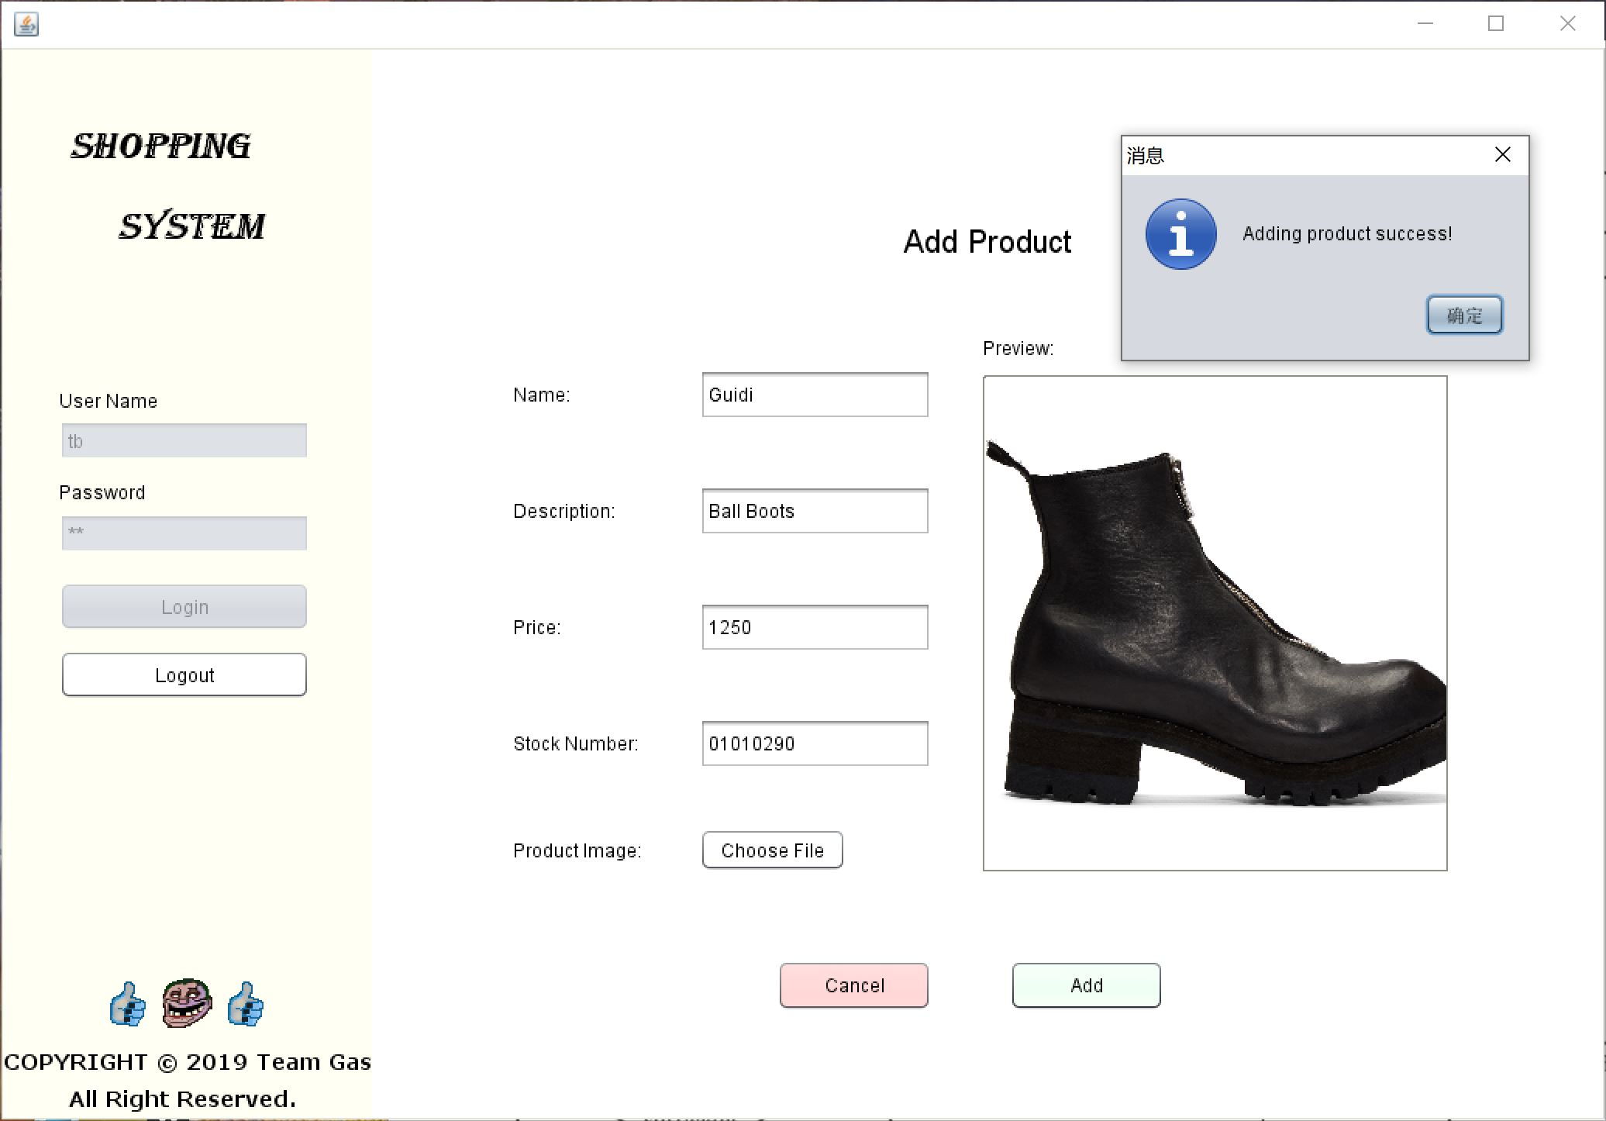
Seller Add Products

Slide 12
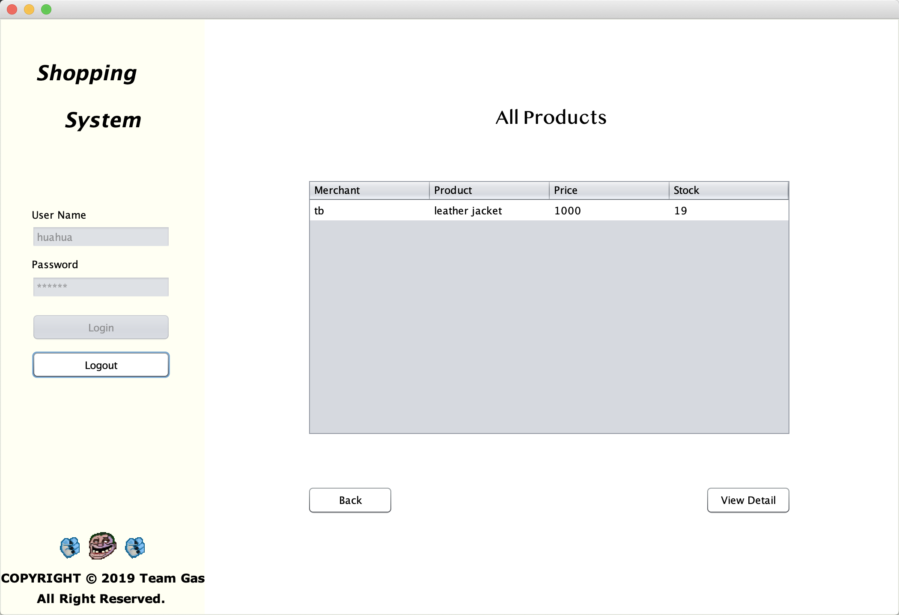
Customer Browse Products

Slide 13
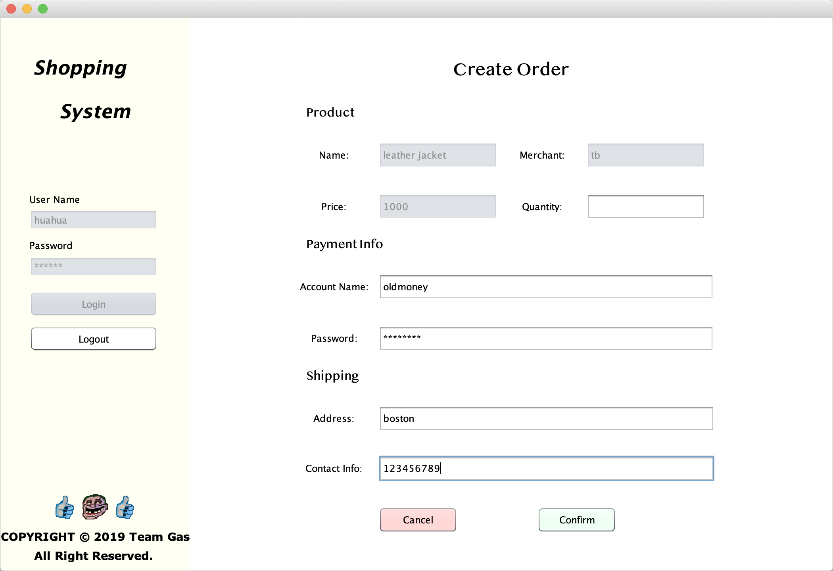
Customer Create Order

Slide 14
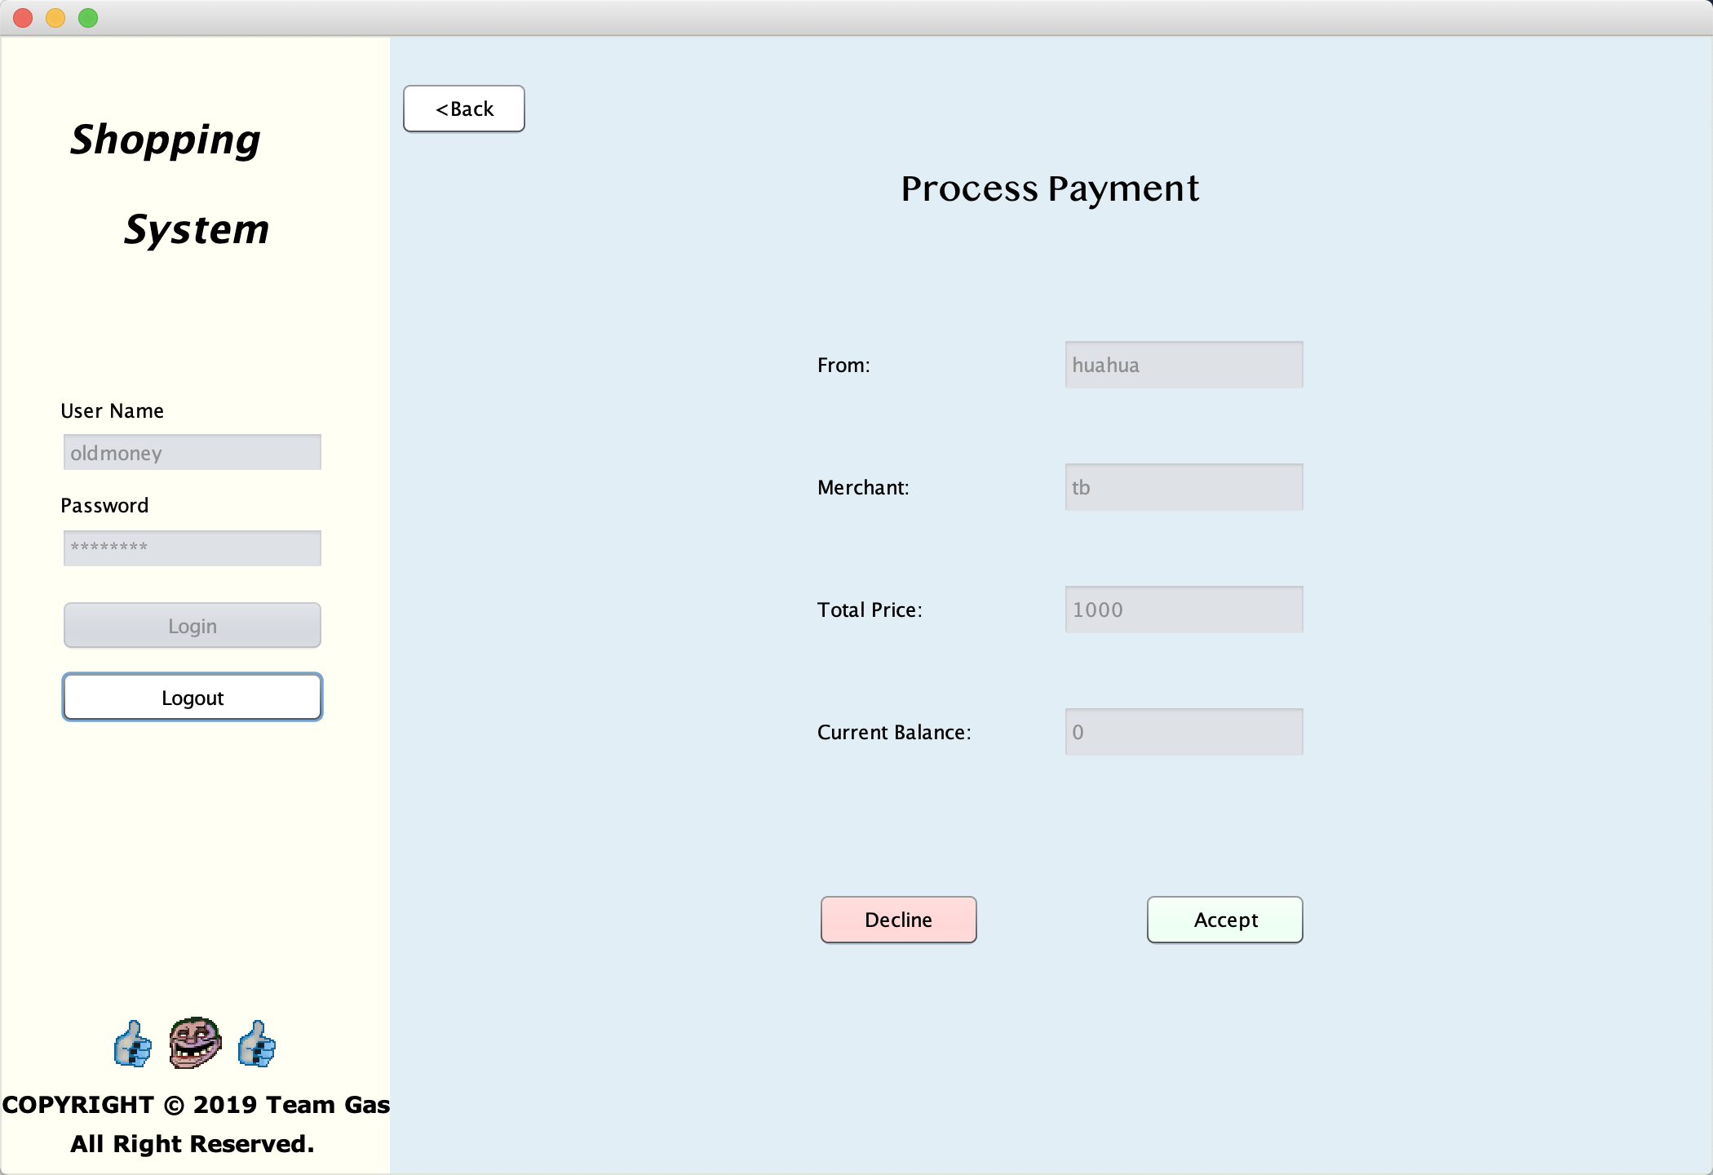
Account Process Payment

Slide 15
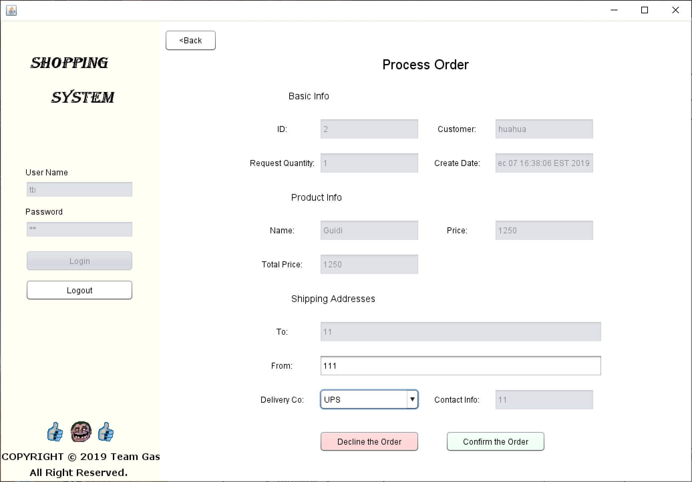
Seller Process Purchase

Slide 16
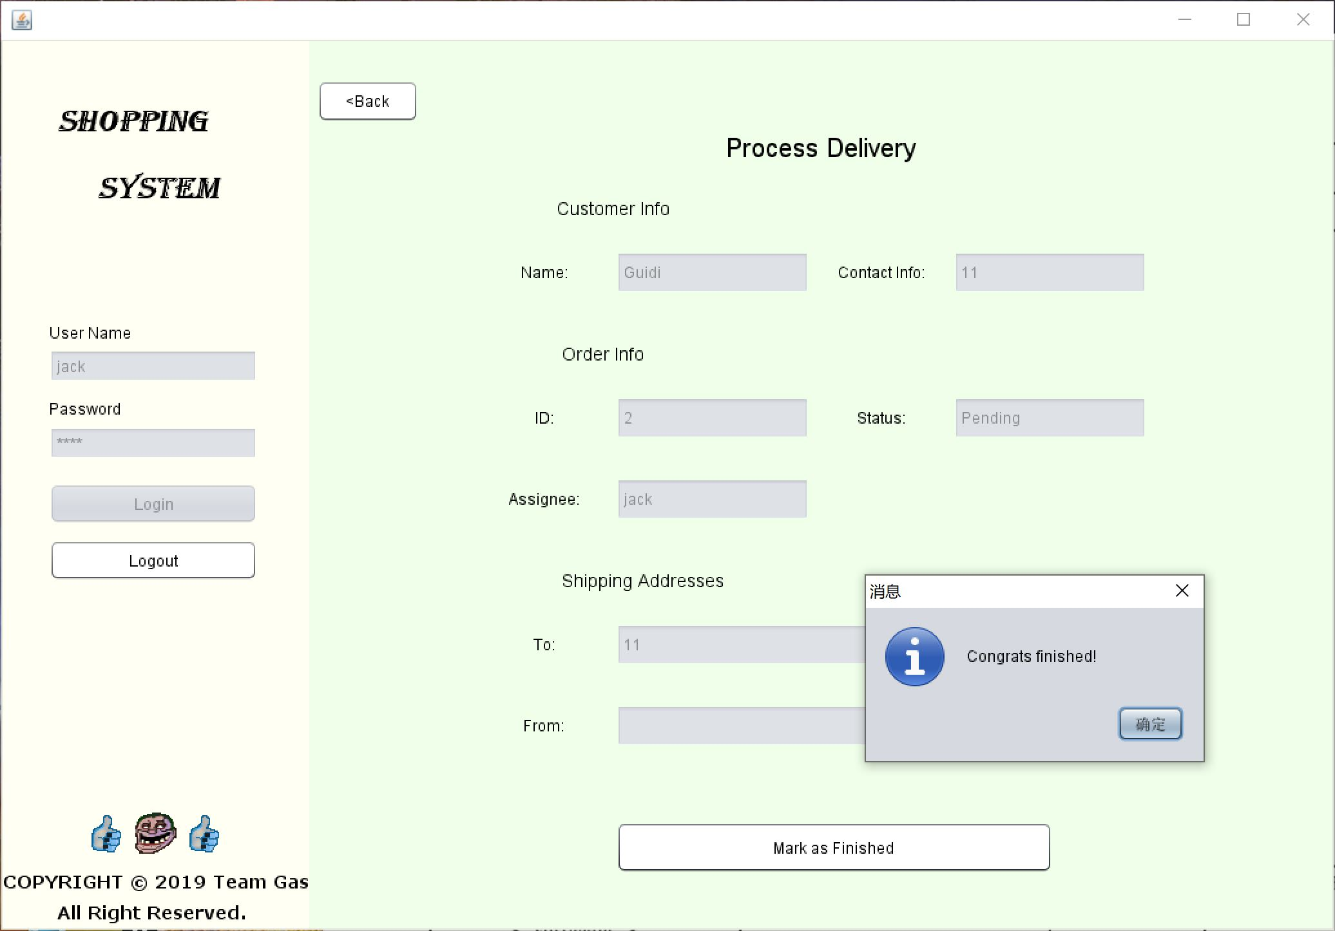
Deliveryman Finish Delivery

