Slide 1


Regression Assignment
Shawn Shakiba
1

Slide 2
Analysis of Data
For the most part, the data was very clean, without a lot of missing values
Since the dataset was huge, the data was filtered by the month of September as mentioned in the assignment instructions which resulted in a DF with the shape (90363, 29)
Running df.info() to got a sense of the data we are working with.
After that df.isnull().sum() was ran to see how many values each column is missing.
Then, df.describe() was ran to get basic statistics of numerical columns.
Following df.describe, I decided to check for correlations.
The following slide contains a screenshot of correlation heatmap, using the help of chatGPT to help write a code that visualizes correlations in the dataset.

Slide 3
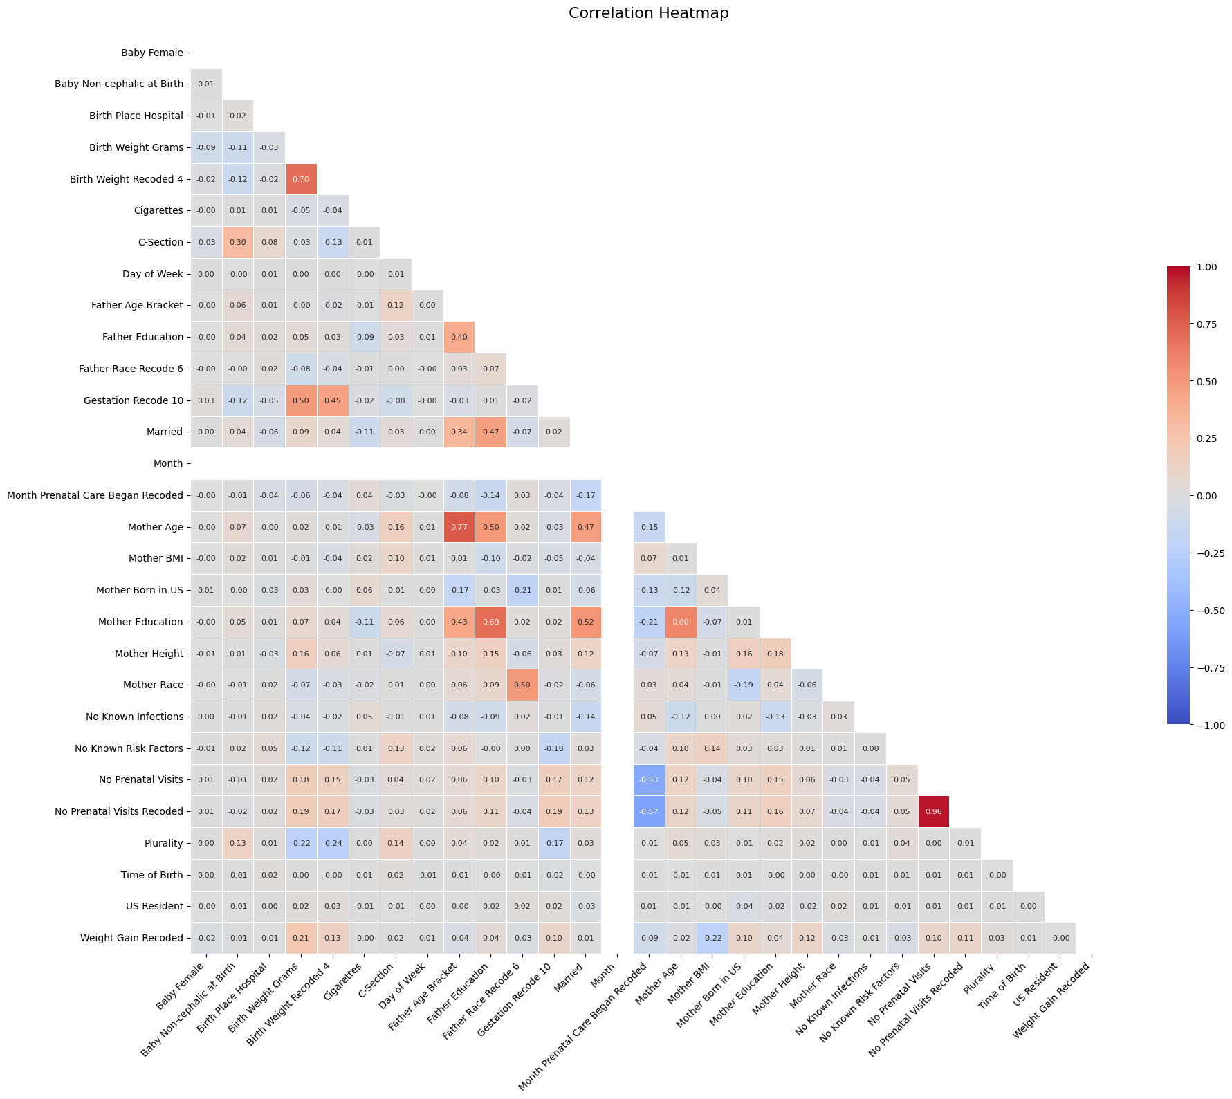
Analysis of Data, Correlation Heatmap

Slide 4
Analysis of Data Continued
Based on the correlation heatmap, I decided to drop No Prenatal Visits Recoded because we already have No Prenatal Visits in the dataset and they are heavily correlated.
After that I ran df.isnull().sum() to see how many values each column is missing.
Then check for missing values in different columns to decide how to impute them later in the pipeline
Numeric values were imputed with mean. I plotted the distribution of numeric columns and since they are fairly normal without extreme outliers, I decided to choose mean. The following slide contains a visual representation of the distributions.
For non-numeric columns, I decided to choose most frequent as they are more likely to be repeated again, and it helps maintain the existing distributions without introducing unnecessary bias to our models.

Slide 5
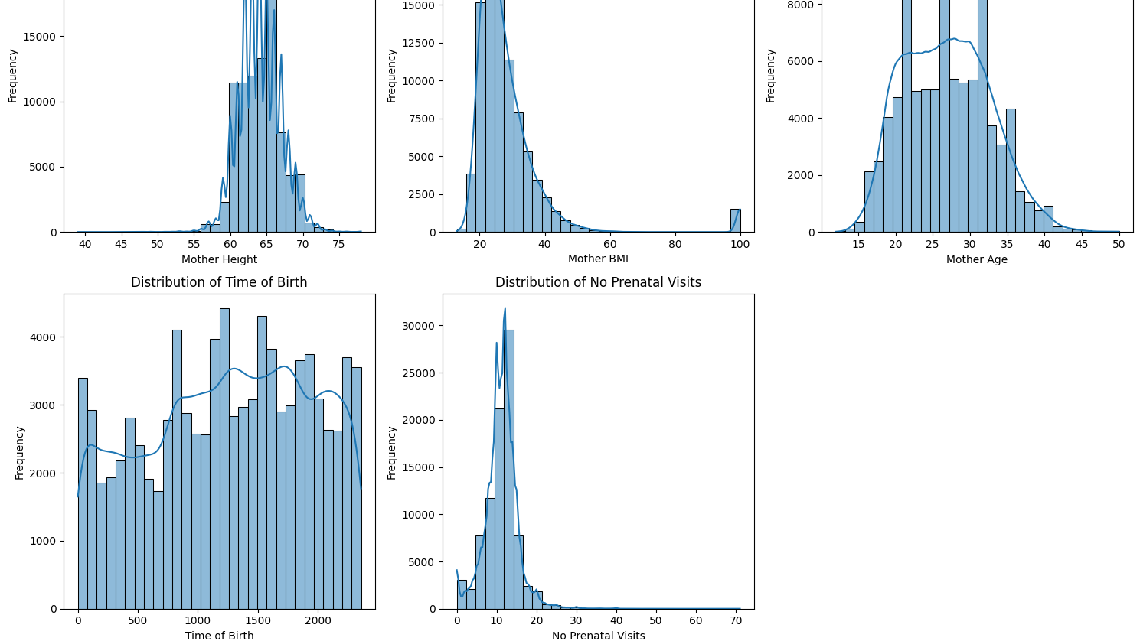

Slide 6
Analysis of Data Continued
Lastly, I had to decide if the data required stratification.
Once again, consulting chatGPT, I did an an “ANOVA” analysis to see if there are statistically significant differences between the means of two or more independent groups.
The differences in birth weights across races, while present, are not extreme (all means are within about 200g of each other). It seems that there is no need for stratification. The following slide contains a visual representation.
Then I binned the time of the day the babies were born to see the distribution in each bin which were pretty similar.
I also scaled the numeric values in the pipeline using standard scaler since they were in a different scale (Height, weight, etc..)

Slide 7
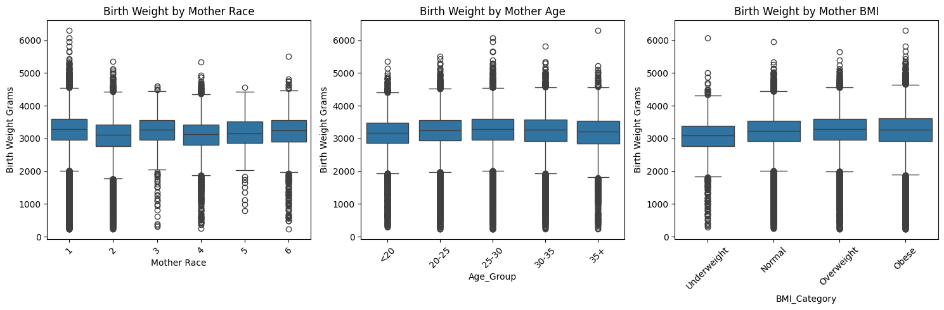

Slide 8
The Pipeline
I created three list containing the names of categorical, ordinal and numeric attributes.
For numerical attributes, I created a numeric pipeline with an imputation strategy based on mean (explained earlier) and standard scaling strategies.
For categorical attributes, I created a pipeline that imputes based on most frequent and encodes the data using onehot encoder.
For ordinal attributes, I did a similar imputation strategy based on most frequent values and Ordinal encoder.
Finally, they were all passed into full pipline. I decided against using polynomials because it took a long time for my code to run.
A visual representation of the pipeline is provided in the following slide.

Slide 9
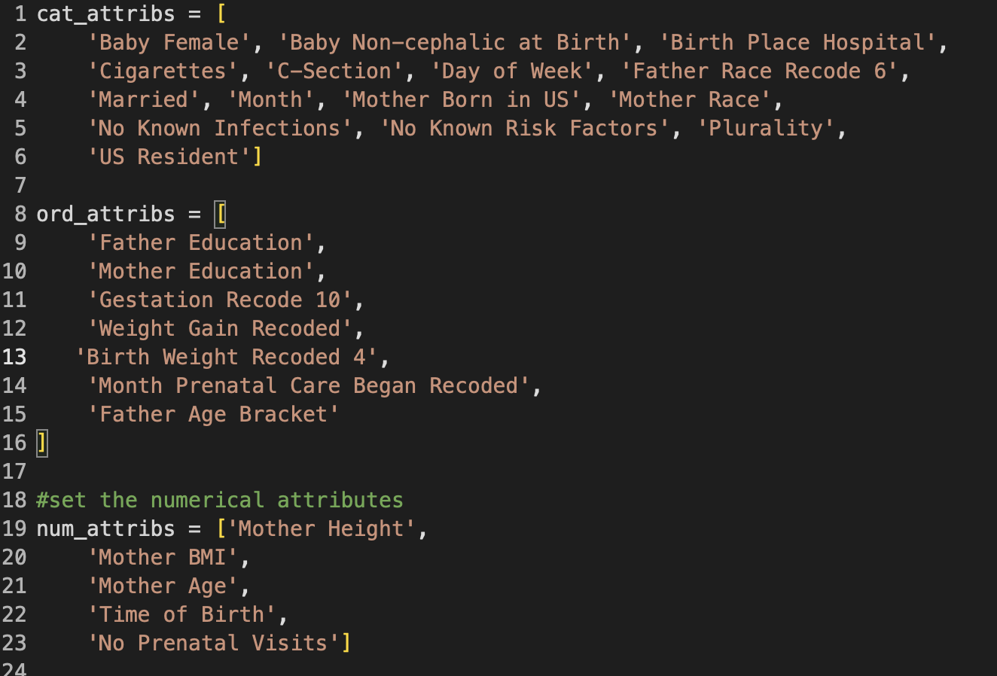
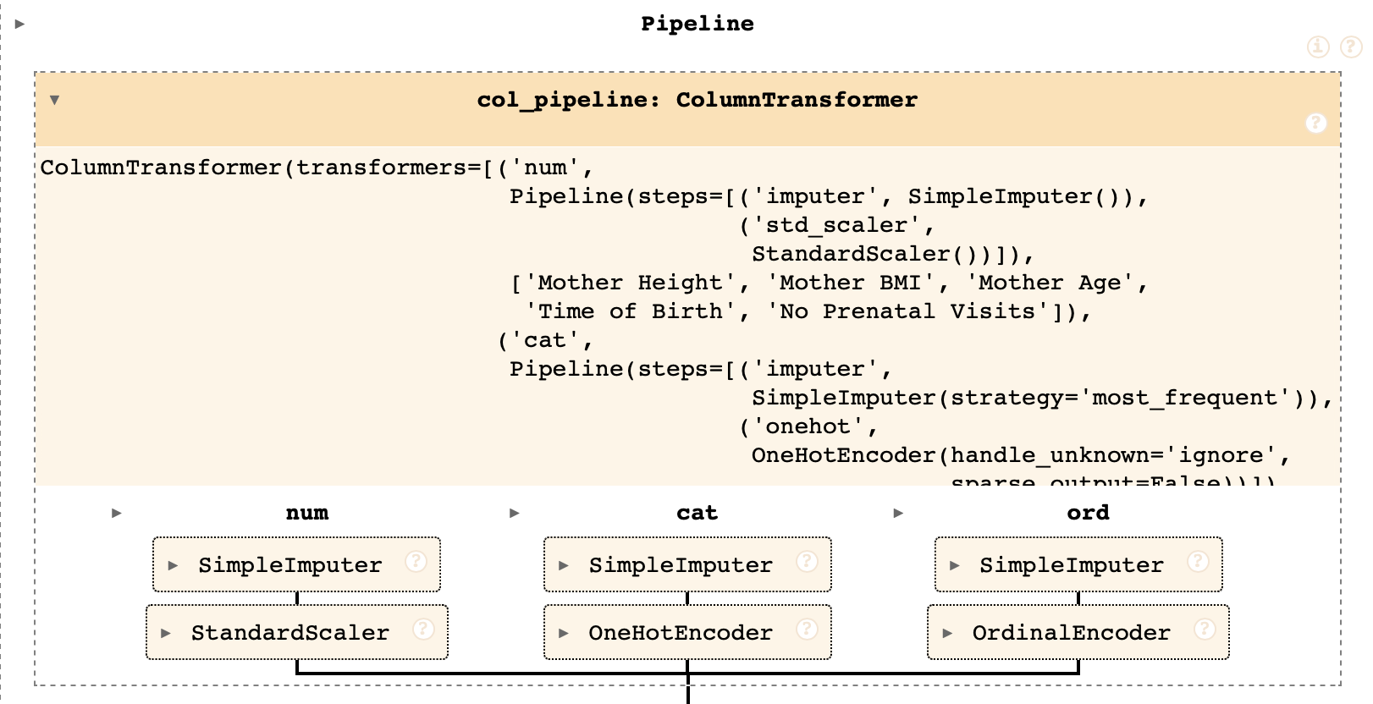

Slide 10
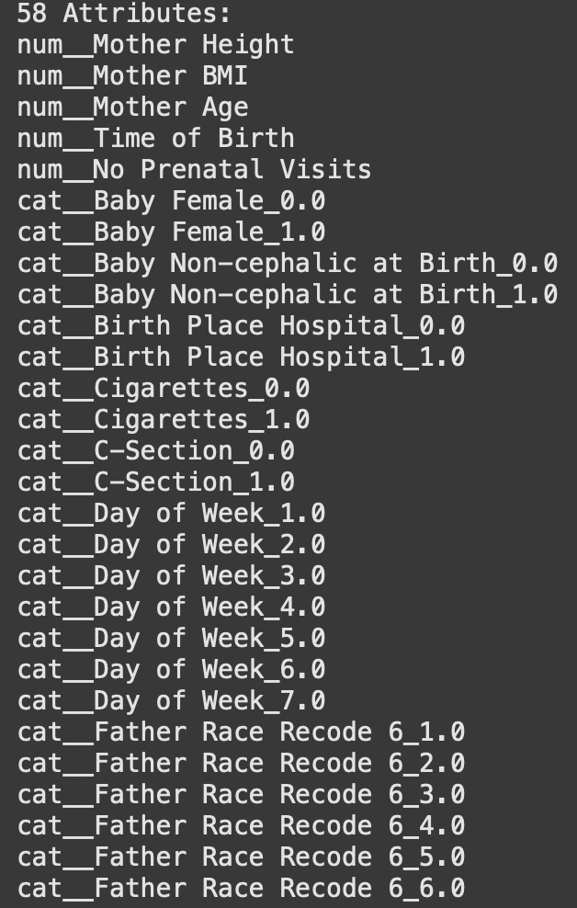
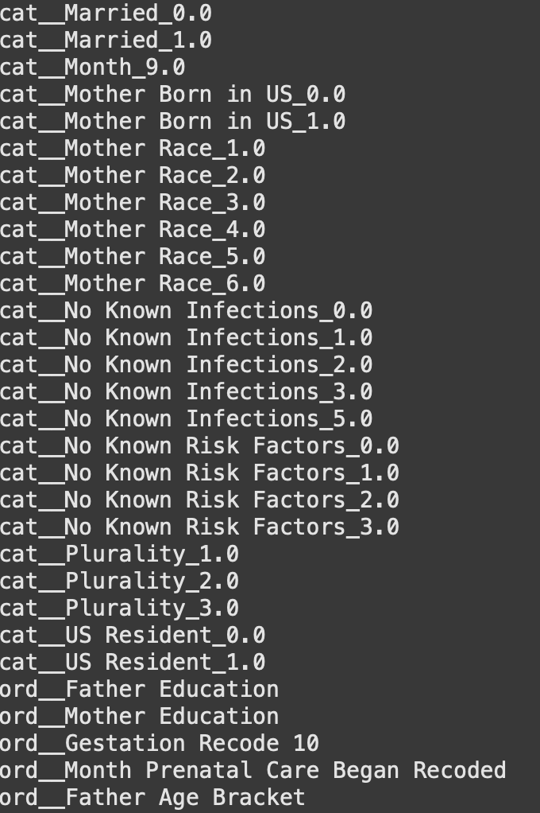
Model Features
The pipeline feeds 58 features to my models depicted here:

Slide 11
Results
 | RMSE | Describe Methodology Used
Naïve Baseline | 574 | y_train.mean()
Model | Training RMSE | Training Cross Validation RMSE | Test RMSE
Linear Model (Ridge) | 472 | 472 | 467
Non-Linear Model (HistGradientBoost)* | 415 | 427 | 422
Indicate which model performed the “best” by circling it putting a star next to it.
Notes:
Model assessment should include assessment as to the validity of the model and if it is overfitting or underfitting the data

Slide 12
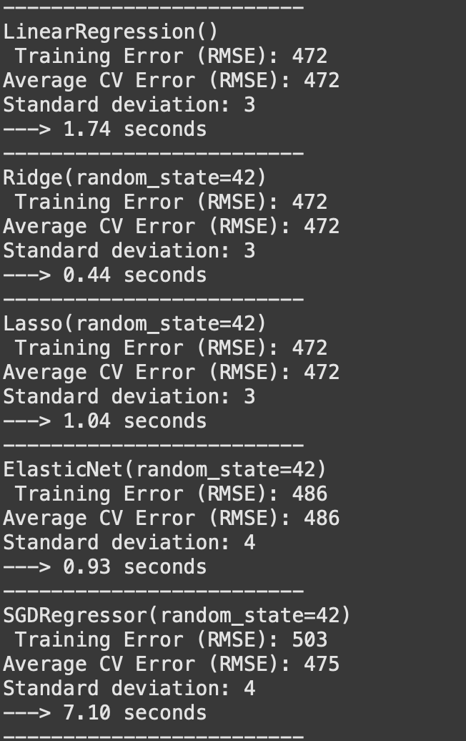
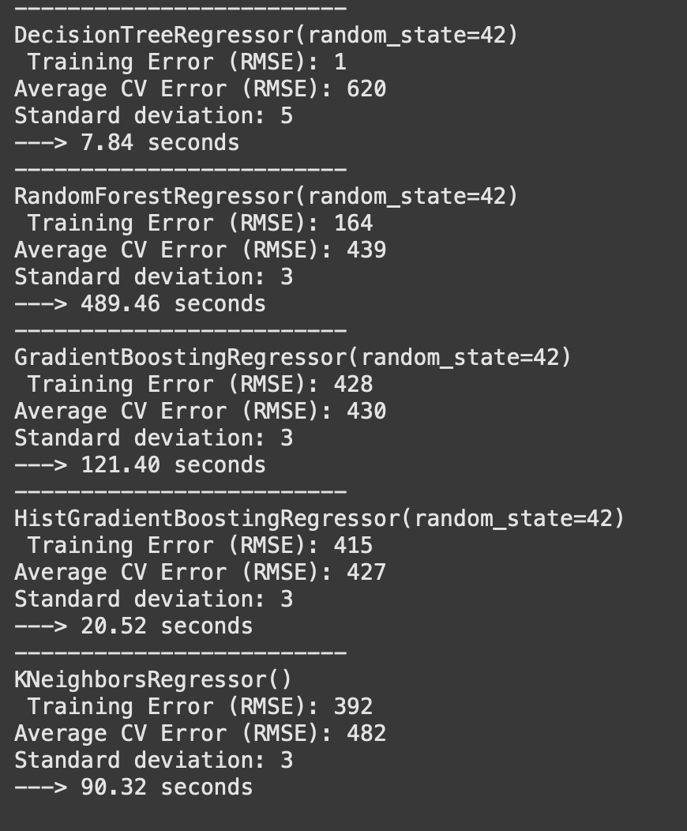
Comparing models

Slide 13
Linear Model
I chose Ridge since it was the fastest. The RMSE was pretty similar to other linear algorithms as depicted in the previous slide.
I created a pramgrid to find the best alpha value.
472.01 - {'alpha': 10}
I used a cross validation of 5.
Prediction | Birth Weight
1 | 3825.202795
2 | 3384.246326
3 | 2855.867455
4 | 2992.827607
5 | 3240.909572

Slide 14
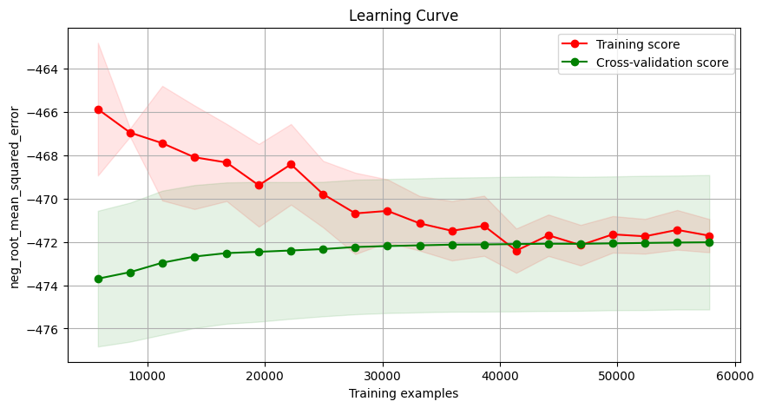
Ridge Learning Curve

Slide 15
Non-Linear Model
I used HistGradientBoostingRegressor for my non-Linear Model as it has the best performance and was very efficient
Then I create a pramgrid with the following hyperparameters:
Learning rate
Max iterations
L2 regularization
A gridsearch with a cross validation of 5 produced the following results depicted in the next slide.
Prediction | Birth Weight
1 | 3614.735739
2 | 3340.103693
3 | 2521.648541
4 | 3206.758602
5 | 3224.701406

Slide 16
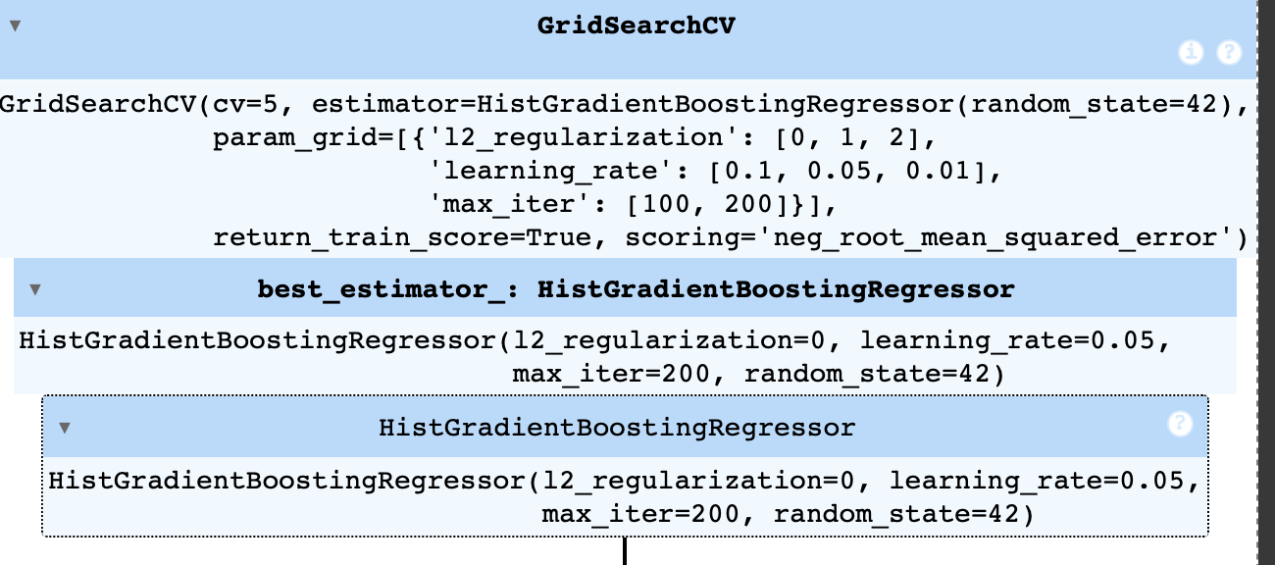
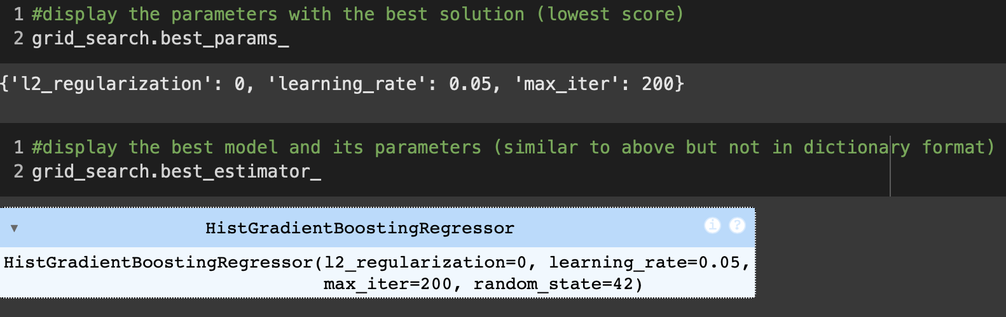

Slide 17
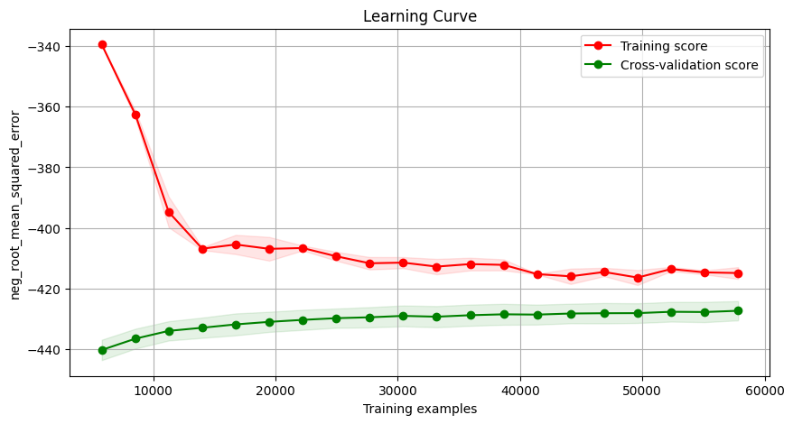
HistGradientBoostRegressor Learning Curve

Slide 18
Recommendations
Would you use your “best” model to help make a prediction?
While the model shows improved performance over the baseline (RMSE reduction from 574 to 422), I would be cautious about using it for clinical predictions because:
The error margin of 422 grams (nearly 1 pound) is clinically significant for newborns
The learning curve shows signs of overfitting (gap between training and validation scores)
Are there other data attributes/features that you think could enhance the value of this model?
Based on the current dataset, I don’t think any further feature engineering is necessary. Please note that I have no expertise in the field and if this model were to be used in a real world application, I would consult an expert on what other features could enhance the model. A quick google search tells me that factors such as previous pregnancy outcomes, detailed health metrics during pregnancy, genetics, and ultrasound measures could help us enhance our predictions.
Do you have any data bias concerns?
There are several potential sources of bias that I could think of in the dataset such as: demographic representation, healthcare access bias, lack of standardization of measurements across different hospitals. To identify and minimize biases, it is necessary to consult with someone with domain expertise in the medical field and gain a better understanding of how this data is collected.

