Slide 1

CVPDL: Computer Vision Practice
with Deep Learning
Homework #1
Object Detection
Wen-Huang Cheng (鄭文皇)
National Taiwan University
wenhuang@csie.ntu.edu.tw

Slide 2
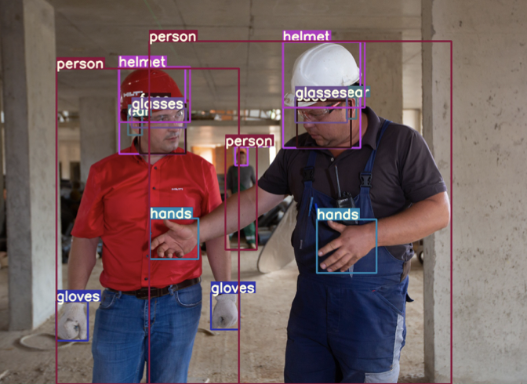
HW1 - Object Detection
TOPIC: Object Detection for Occupational Injury Prevention
Input: 2D RGB image
Task: localization and classification
Output: N x [points, confidence]

Slide 3
Model Constraints
Model Constraints for this Homework
You must use either Transformer-based or Mamba-based model.
Failing to do so will result in a deduction of 50 points.
Within these constraints, any method and pre-trained weights are allowed
Recommended Model Structure
Transformer based method
DETR, deformable DETR
B. Mamba based method
Vision-Mamba, Mamba-YOLO

Slide 4
Dataset Description
Download Link: link
Training Set: 4319 images
Validation Set: 2160 images
DO NOT use the validation set for training
Testing Set: 1620 images
DO NOT try to find the ground truth
Violating the rules on this page will result in a score of zero.
If you are uncertain about the legitimacy of the usage, email the TAs for clarification

Slide 5
Dataset Description
0 Person
1 Ear
2 Earmuffs
3 Face
4 Face-guard
5 Face-mask-medical
6 Foot
7 Tools
8 Glasses
9 Gloves
10 Helmet
11 Hands
12 Head
13 Medical-suit
14 Shoes
15 Safety-suit
16 Safety-vest
The dataset contains a total
of 17 categories.

Slide 6
Grading Policies
Baseline (validation set) (40%)
Simple baseline (20%) : 0.35 mAP
Strong baseline (20%) : 0.45 mAP
Performance ranking (testing set) (30%)
Linear grading
Report (30%)

Slide 7
Evaluation Metric
Evaluation Metric
We’ll use the metric taught in class – Average Precision
Please refer to the course slides or this intro
The performance will be evaluated by this function
mAP is used for all evaluation
i.e., AP at IoU = [50:5:95]

Slide 8
Report
Draw the architecture of your object detector
In brief and clear
It would be fine to copy the figure from the paper
Implement details
e.g.: augmentation, loss function, parameter settings
Table of your performance for validation set (mAP, AP₅₀, AP₇₅
Visualization and discussion
Demonstrate the detection results, discussion for the long tail effect, etc.

Slide 9
Submission Rules
Deadline
2024/10/16 (Wed.) 23:59
Upload filename and format
hw1_<student-id>.zip (e.g. hw1_D12345678.zip )
Submit to NTU cool
Do not upload the dataset (or 10 points will be deducted )

Slide 10
Submission Rules
Your submission should be a zipped file with the following structure:
hw1_<student-id>.zip
|-- hw1_<student-id> (Should contain this folder, not separate files)
|-------- hw1_<student-id>.pdf (Your report)
|-------- valid_<student-id>.json (Your prediction file of validation set)
|-------- test_<student-id>.json (Your prediction file of test set) |-------- Codes for training and testing |-------- README file
Your environment details
How to run your code

Slide 11
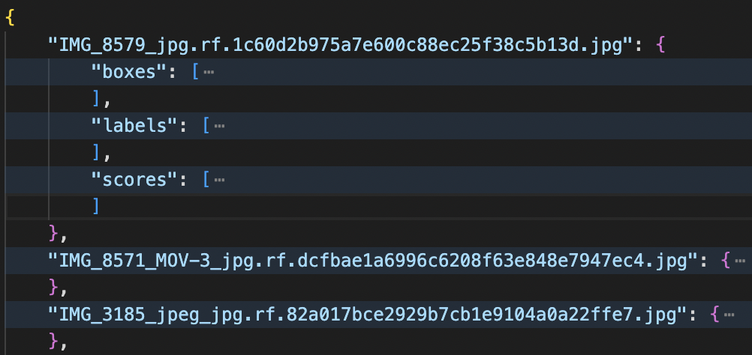
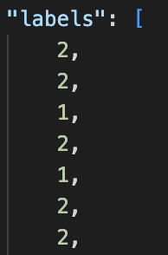
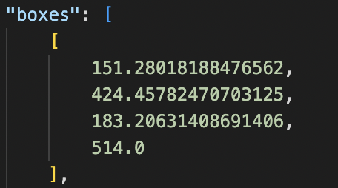
Output JSON format
sample_submission.json will be provided
Check your performance on the validation set
$ python eval.py <your_prediction.json> <valid_target.json>
The coordinate format for training set : Normalized (x_center, y_center, width, hight)
The coordinate format for valid_target.json and the test set : (x_min, y_min, x_max, y_max)

Slide 12
Homework Guidelines
Step 1: Confirm the Model to Use
Determine if the model is Transformer-based or Mamba-based.
Use resources like the official GitHub, PyTorch Lightning, or Transformers library.
Step 2: Adapt the Model for the Dataset
Check if pre-trained weights are available and identify how to fine-tune the model (e.g., modifying the output layer).
Confirm the model's input and output coordinate formats (may need preprocess or post-process).
Step 3: Fine-tune the Model on the Dataset
Set up the validation function and ensure model weights are saved.
Monitor the training process to ensure loss convergence.

Slide 13
Homework Guidelines
Step 4: Output Predictions for Validation and Test Sets
Ensure the output JSON can be evaluated by eval.py for calculating the score.
Save files in the specified format: valid_<student-id>.json and test _<student-id>.json
Step 5: Write the Report and Submit
Prepare the report and submit all necessary files according to the provided guidelines.

Slide 14
Useful Resources
Train HuggingFace DETR on Custom Dataset: Colab Notebook
Transformers Tutorials: GitHub Repository
Mamba-YOLO: GitHub Repository
DINO: GitHub Repository

Slide 15
Any Question
cvpdl.ta.2024@gmail.com

