Slide 1
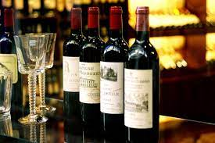
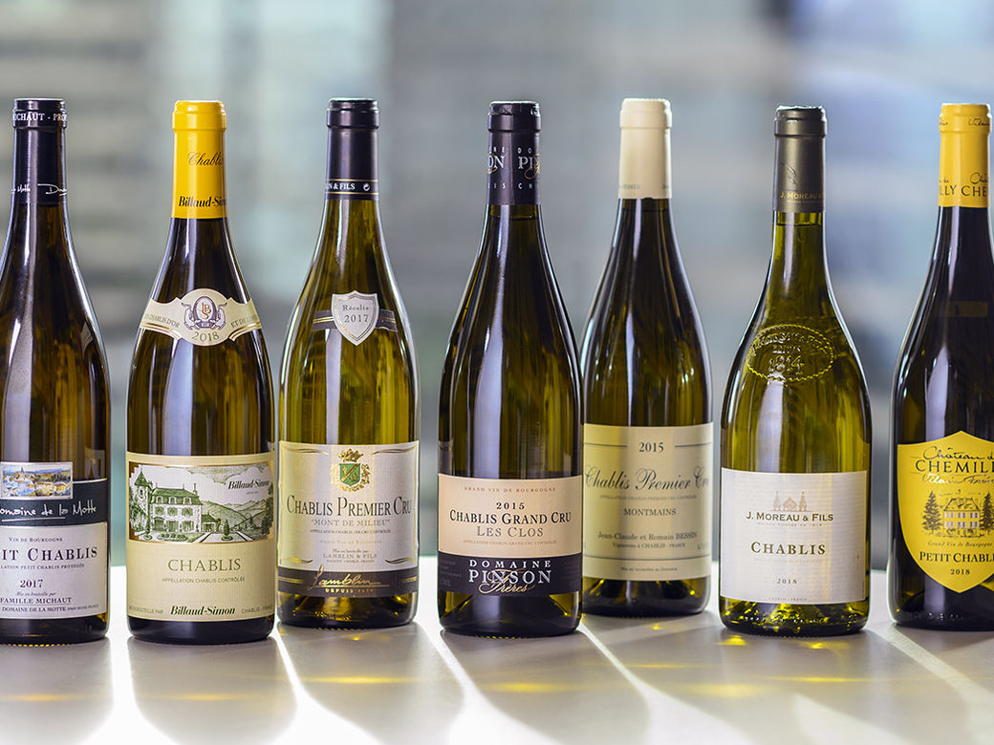
UCI資料集分析
第十組:
唐生祐、楊哲睿
謝宜均、黃諺維

Slide 2
資料來源
來源:UCI-Wine Quality Data Set
https://archive.ics.uci.edu/ml/datasets/Wine+Quality
欄位數:12
資料數:winequality-red.csv-1599筆資料
winequality-white.csv-4898筆資料

Slide 3
欄位資料
fixed acidity(固定酸、非揮發性酸)
volatile acidity(揮發性酸)
citric acid(檸檬酸)
residual sugar(剩餘糖分、殘糖)
chlorides(氯化物)
free sulfur dioxide(游離二氧化硫)
total sulfur dioxide(總二氧化硫)
density(密度)
pH(酸鹼度)
sulphates(硫酸鹽)
alcohol(酒精)
quality(品質)

Slide 4
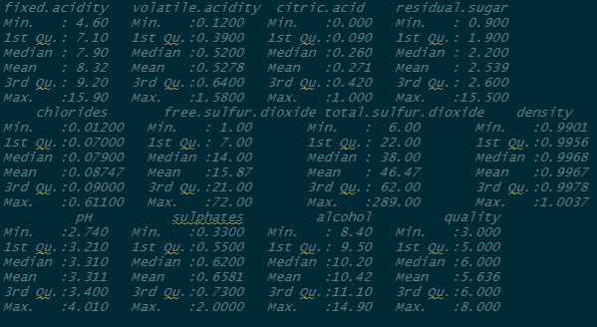
R-winequality-red
資料概況

Slide 5
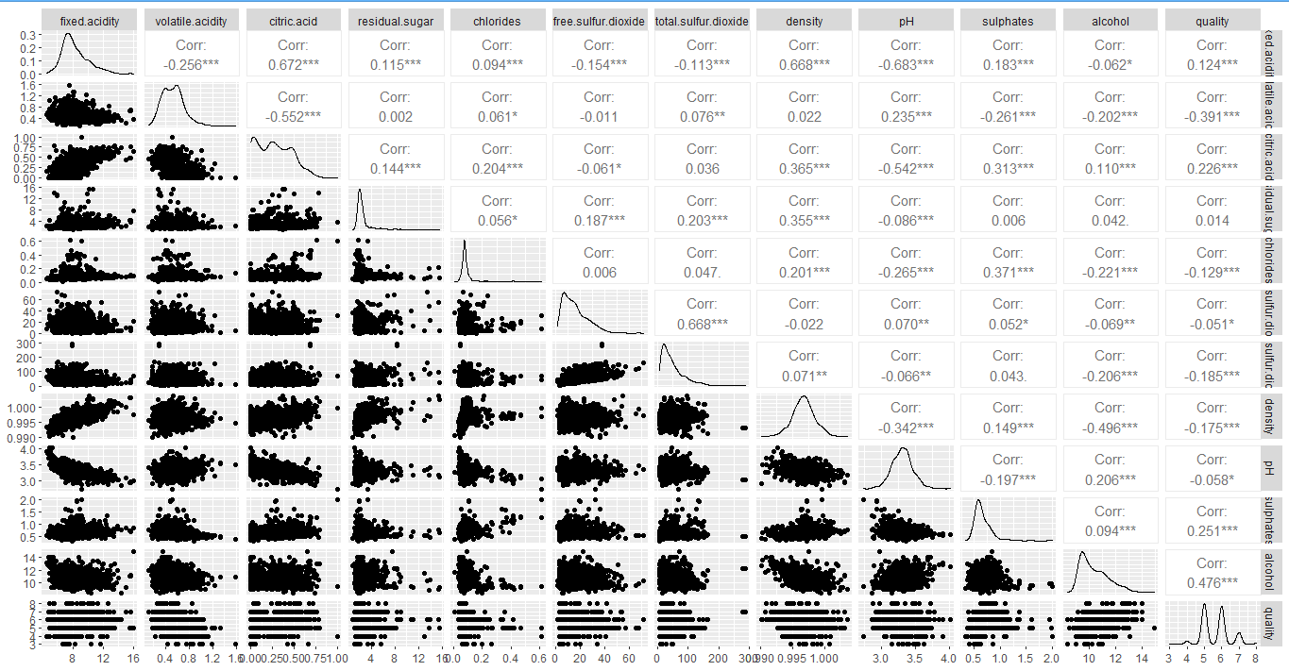
R-winequality-red

Slide 6
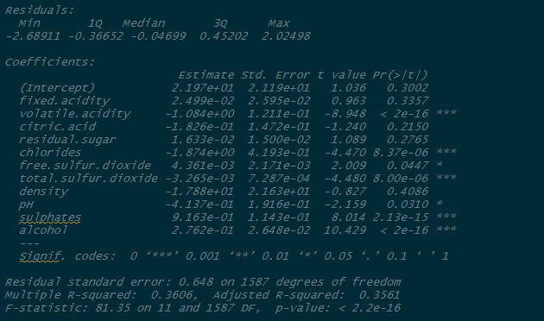
R-winequality-red
RES_01=lm(quality~.,data=winequality.red)

Slide 7
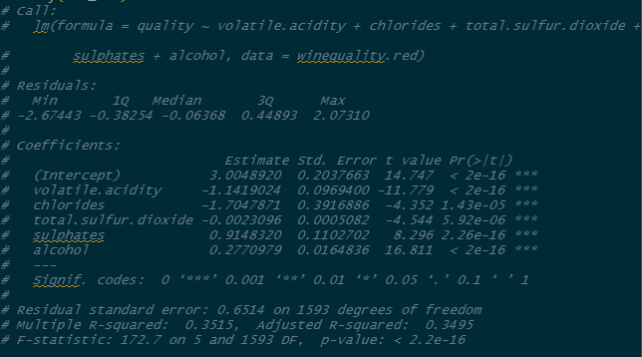
R-winequality-red
RES_011=lm(quality~volatile.acidity+chlorides+total.sulfur.dioxide+sulphates+alcohol,data=winequality.red)

Slide 8
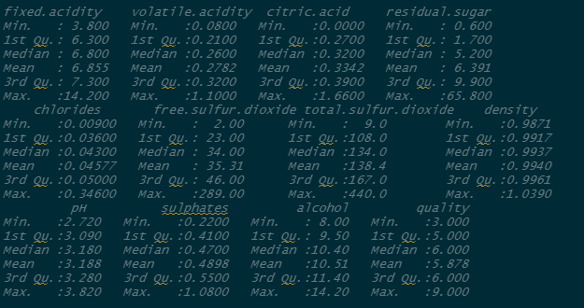
R-winequality-white
資料概況

Slide 9
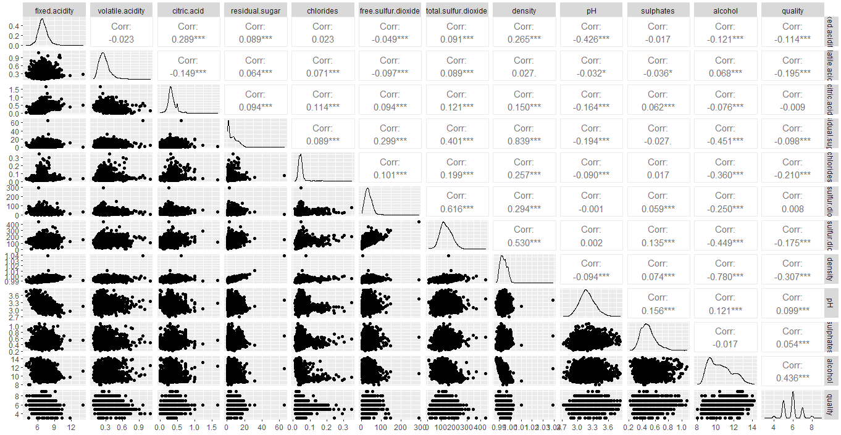
R-winequality-white

Slide 10
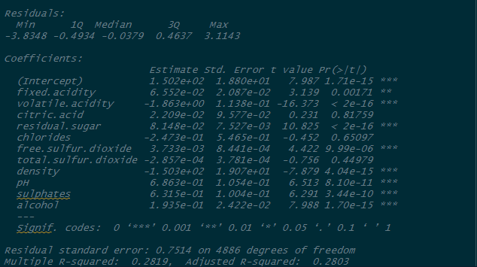
R-winequality-white
RES_02=lm(quality~.,data=winequality.white)

Slide 11
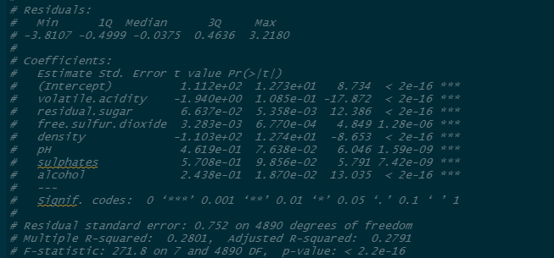
R-winequality-white
RES_022=lm(quality~volatile.acidity+residual.sugar+free.sulfur.dioxide+density+pH+sulphates+alcohol,data=winequality.white)

Slide 12
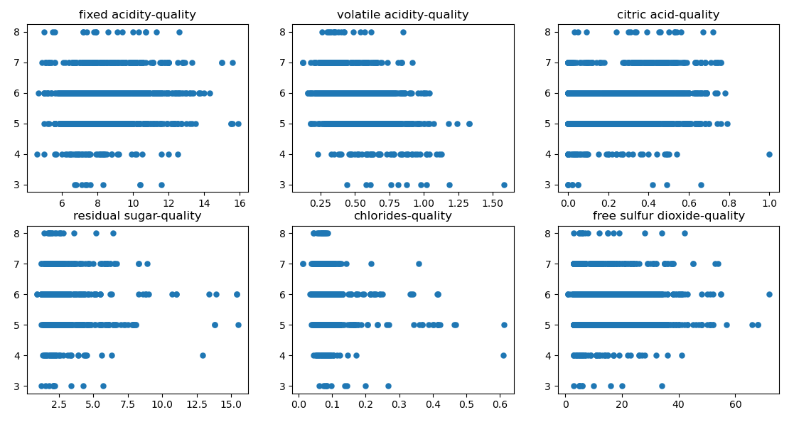
python-winequality-red

Slide 13
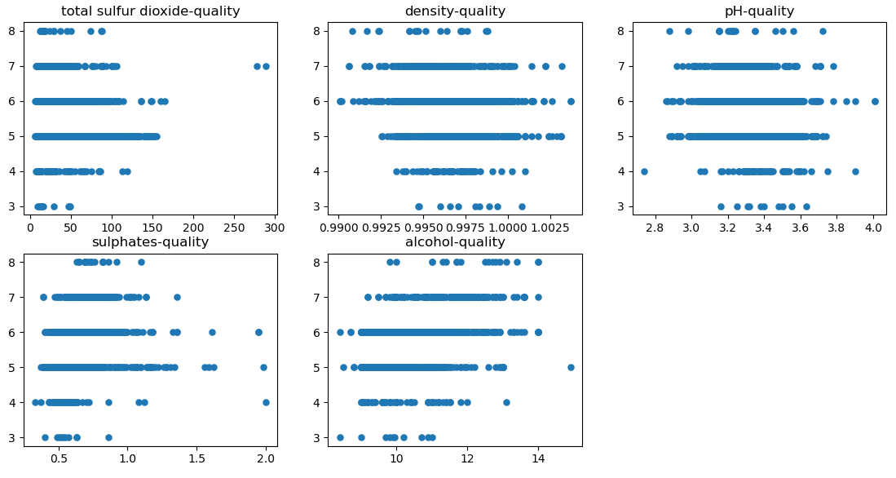
python-winequality-red

Slide 14
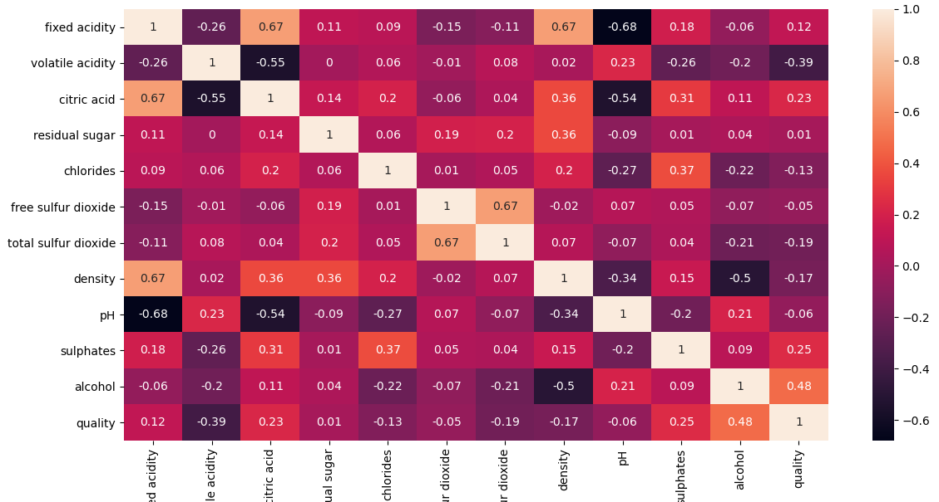
python-winequality-red

Slide 15
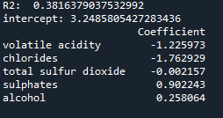
python-winequality-red

Slide 16
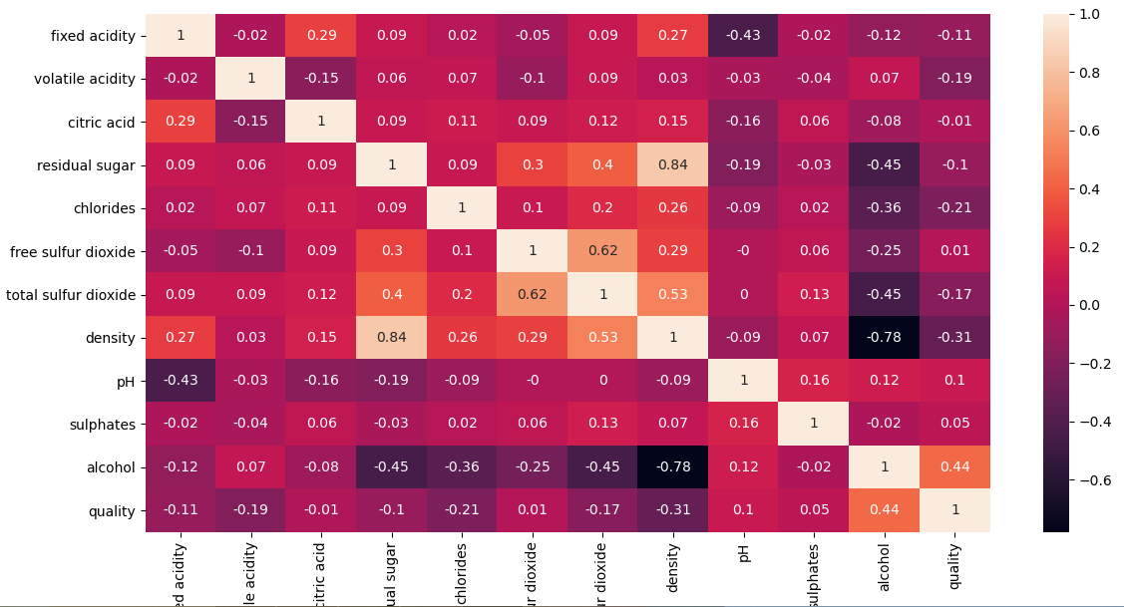
python-winequality-white

Slide 17
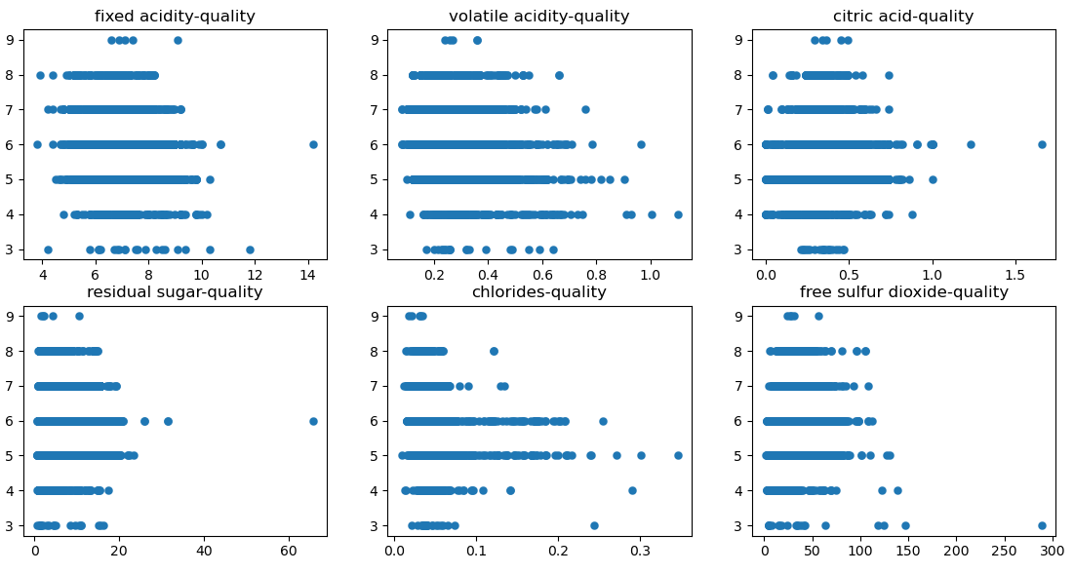
python-winequality-white

Slide 18
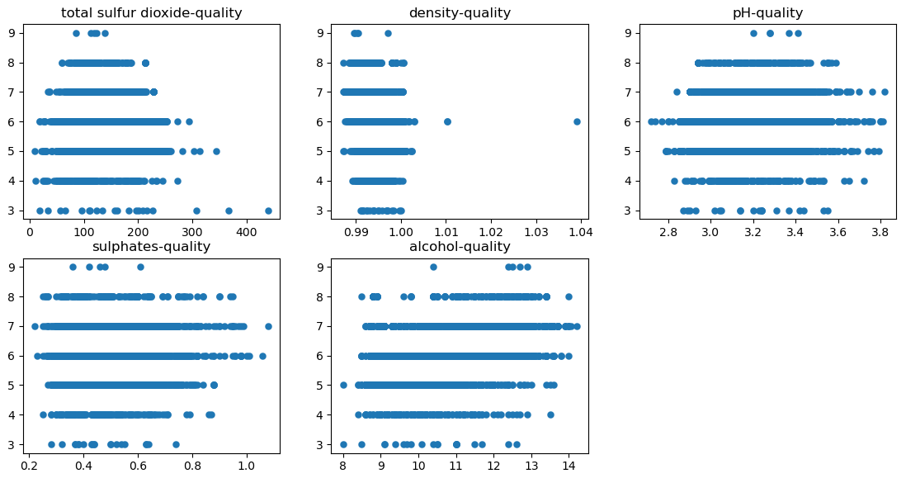
python-winequality-white

Slide 19
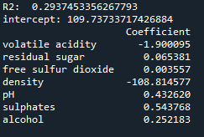
python-winequality-white

Slide 20
winequality-red
影響紅酒品質的負面因素:揮發性酸、氯化物、總二氧化硫
影響紅酒品質的正面因素:硫酸鹽、酒精

Slide 21
Winequality-white
影響白酒品質的負面因素:揮發性酸、密度
影響白酒品質的正面因素:殘糖、游離二氧化硫、酸鹼度、硫酸鹽、酒精

Slide 22
Thank you for listening!

