Slide 1
Data Flow

Slide 2
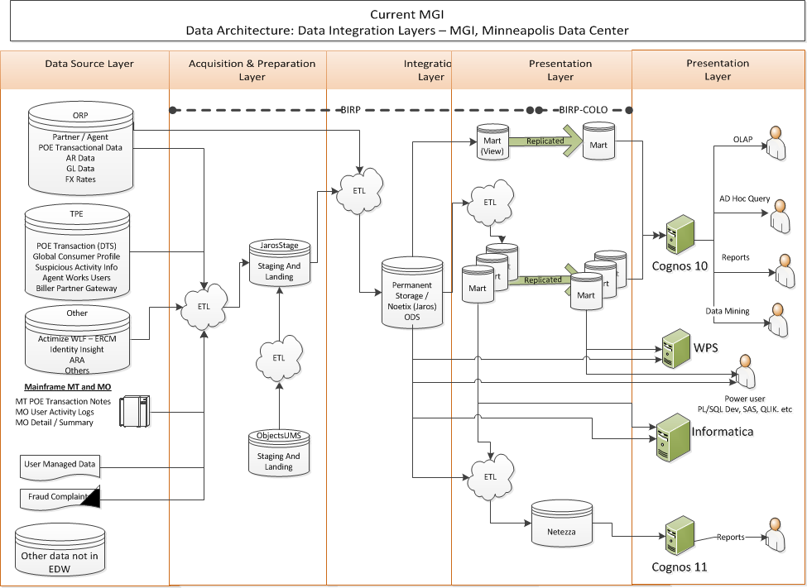

Slide 3
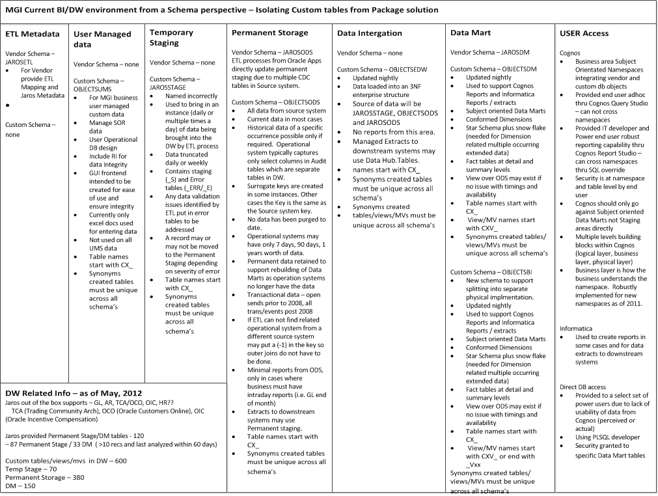

Slide 4
