Slide 1
MAIE 6000C · WEEK 7 MIDTERM MILESTONE
Project F.I.X.
Forecasting & Inventory Exceptions: a working vertical slice
Group 5 · CAO, Jun · SHAH, Pooja Zenit · ZHANG, Yitong · ZHOU, Guanxu
github.com/ShawnZhang0318/FIX_dashboard · tag: w07-midterm

Slide 2
OVERVIEW
One vertical slice, end to end
A planner imports daily sales, requests an analysis, a background worker calls a LightGBM model, and the planner reviews the saved exceptions.
1
2
3
4
5
Input enters
State persisted
Worker step
Output saved
Health & logs
CSV import and analysis request
Run queued, Job pending, in the database
Separate process claims the job and calls AI
Forecasts, exceptions and review
Readiness checks and correlated logs
Slide 4
Slide 5
Slide 6
Slides 7–8
Slide 9
Scope: store S001 · 20 products · manual Daily analysis · advisory only (no purchase orders, inventory unchanged by review)
Project F.I.X. · Group 5 · Week 7 milestone

Slide 3
ARCHITECTURE
Architecture of the slice
Design decisions
Database rows are the durable job queue — no Redis or Celery
API replies 202 immediately; the user never waits for AI
Worker commits its claim before calling the model
Model forecasts cumulative sales over each product’s lead time
Rules, not the model, create exception cases
CSV importer
Public API
verified, batches ≤100
FastAPI · validates, freezes inputs, returns 202
React dashboard
EN / 简体中文
Worker
AI service
Database
SQLite (demo) / PostgreSQL
polling process
private · LightGBM
Project F.I.X. · Group 5 · Week 7 milestone

Slide 4
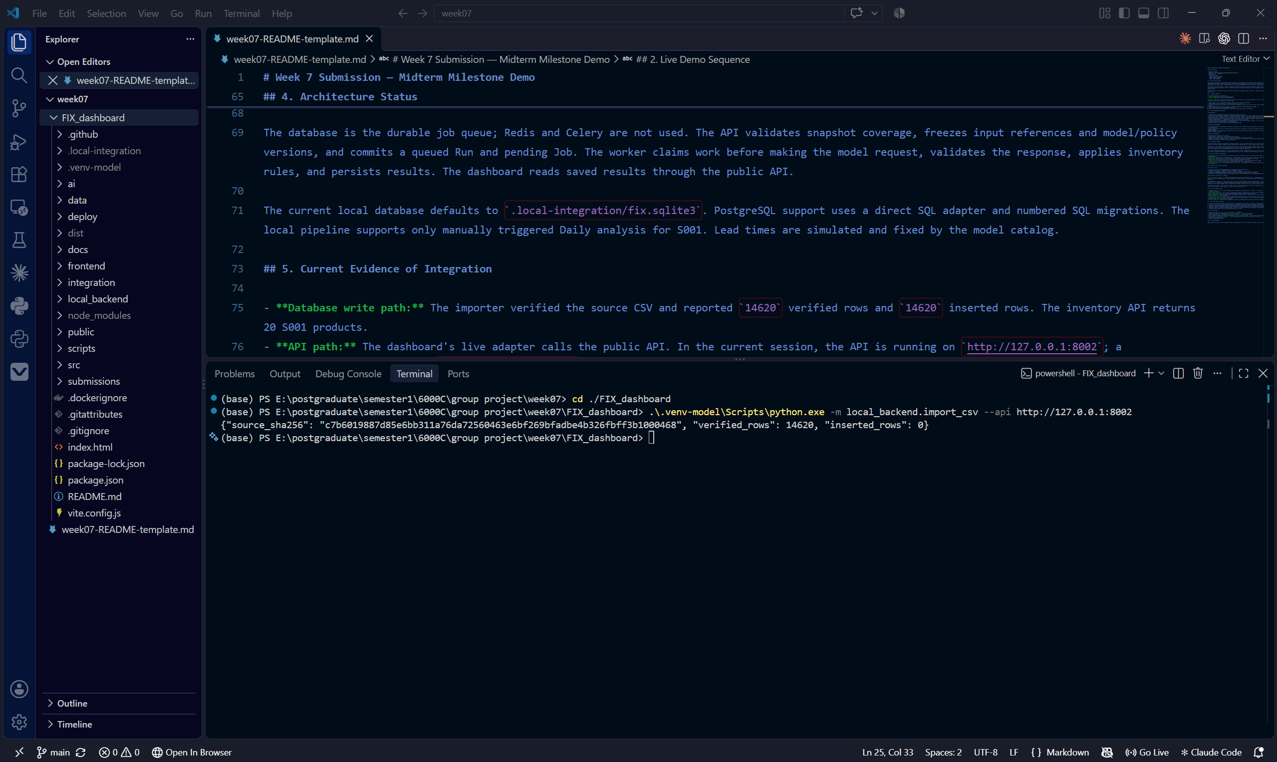
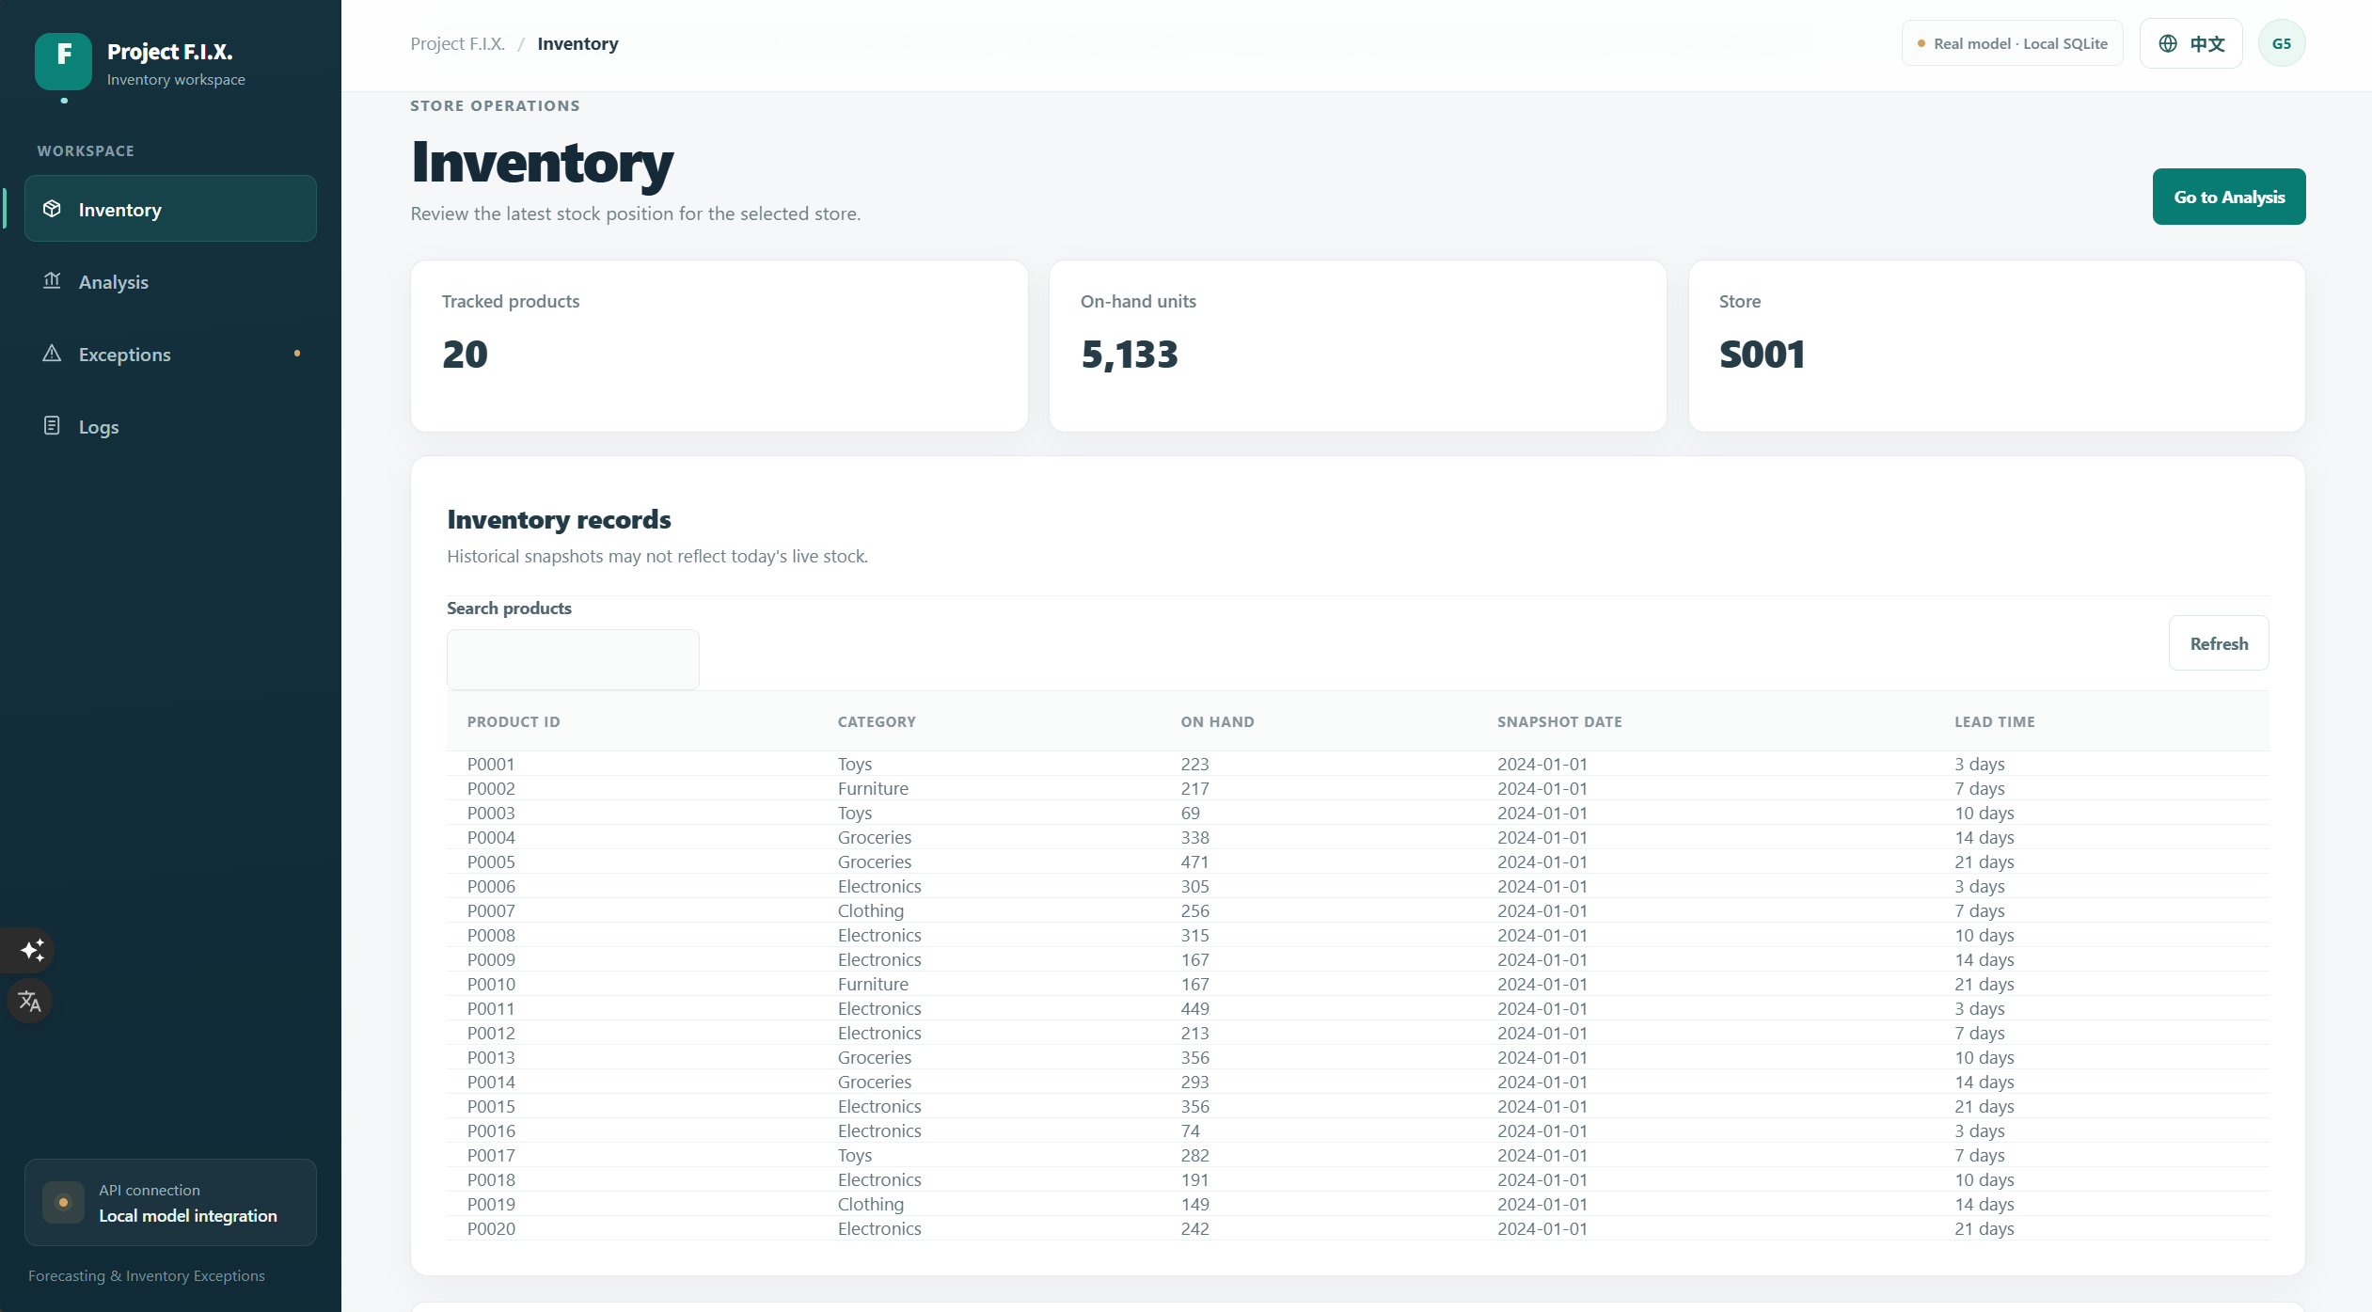
EVIDENCE 1 · INPUT
Importer terminal output
A request enters the system
“14620 verified rows, 14620 inserted rows”
(This output shows 0 inserted rows because it has been inserted once before)
Importer checks the source CSV’s SHA-256 hash
Sends 14,620 S001 observations to the public API, batches of ≤100
Result: 14,620 verified · 14,620 inserted
Inventory API now returns 20 products
INSERT SCREENSHOT
Inventory page
20 S001 products loaded from the database
Then the planner requests an analysis:
POST /analysis-runs
{"store_id":"S001","run_type":"daily",
"as_of_date":"2023-11-15"}
Project F.I.X. · Group 5 · Week 7 milestone

Slide 5
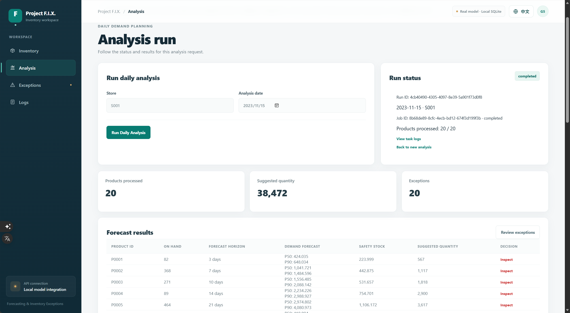
EVIDENCE 2 · PERSISTED STATE CHANGE
State is persisted before any AI runs
API checks coverage: all 20 cutoff snapshots and 29 days of history per product
One transaction saves the queued Run, the pending Job and the frozen inputs (model, policy, snapshot references)
HTTP 202 returns both IDs; the database now holds the work
{ "analysis_run": {"id": "<run-id>",
"status": "queued"},
"job": {"id": "<job-id>",
"status": "pending"} }
Analysis page after submit
Showing Product ID, Stock on Hand, Forecast Horizon and more
Project F.I.X. · Group 5 · Week 7 milestone

Slide 6
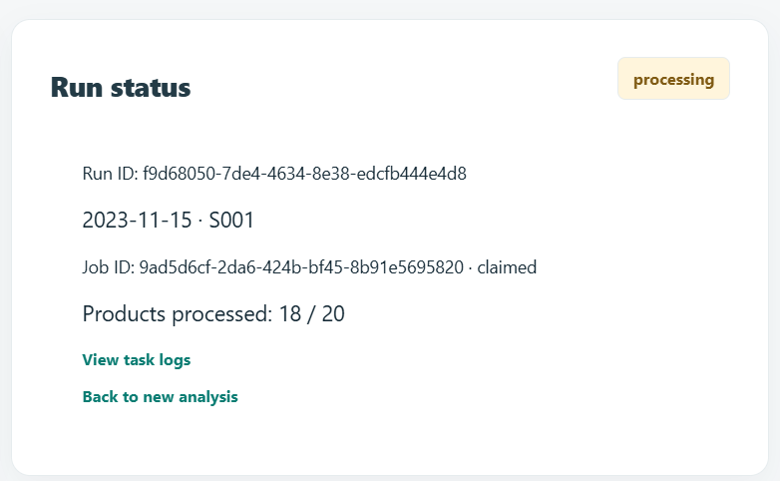
EVIDENCE 3 · ASYNCHRONOUS WORKER STEP
A separate worker runs the analysis
1 Claim
2 Read
3 Features
4 Call AI
5 Policy
6 Save
Run → processing, Job → claimed; committed first
Frozen 29-day history and cutoff stock
Lags, rolling means, lead time
Private /analyze returns P50 and P90
Reorder and unusual-demand rules
Result and optional case, atomic per product
Steps 2–6 repeat for each of the 20 products
The claim is committed before the model call — no long database transaction
Progress is saved after every product
If a later product fails, earlier results stay saved
Run in “processing”
Progress count + worker log line
Project F.I.X. · Group 5 · Week 7 milestone

Slide 7
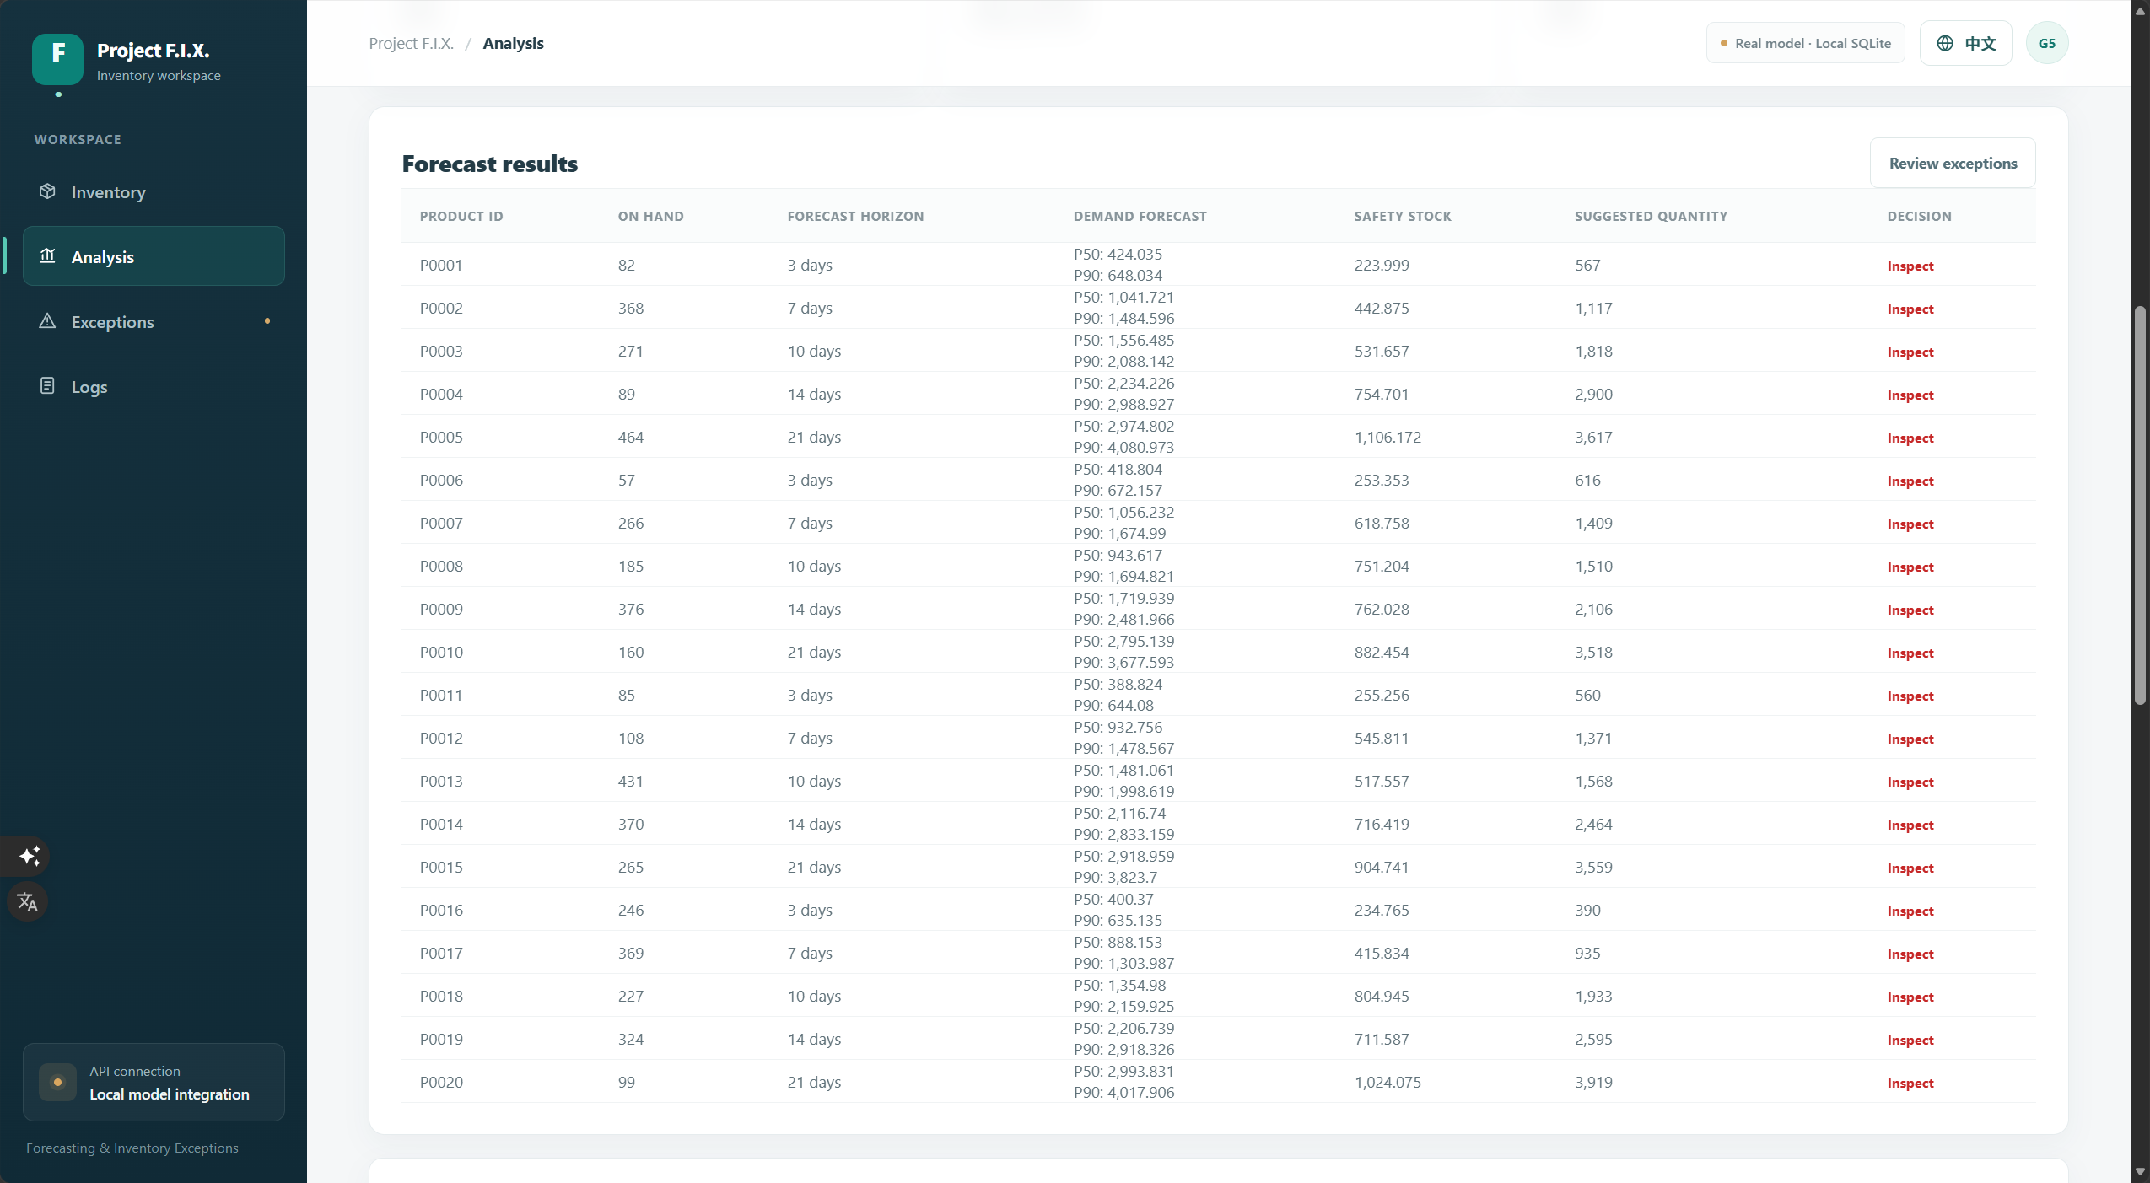
EVIDENCE 4 · PERSISTED OUTPUT
Forecasts and exceptions are saved
S001 · P0001 · cutoff 2023-11-15
424.04
648.03
P50 forecast
P90 forecast
82
567
Stock at cutoff
Recommended order
Results table
Order = ⌈max(0, P90 − stock)⌉ = ⌈648.03 − 82⌉ = 567
Completed run: P50 / P90 / recommended order
Cumulative sales over the product’s lead time. Recorded local acceptance run.
20 / 20 products saved, each with model version, policy and input reference
Project F.I.X. · Group 5 · Week 7 milestone

Slide 8
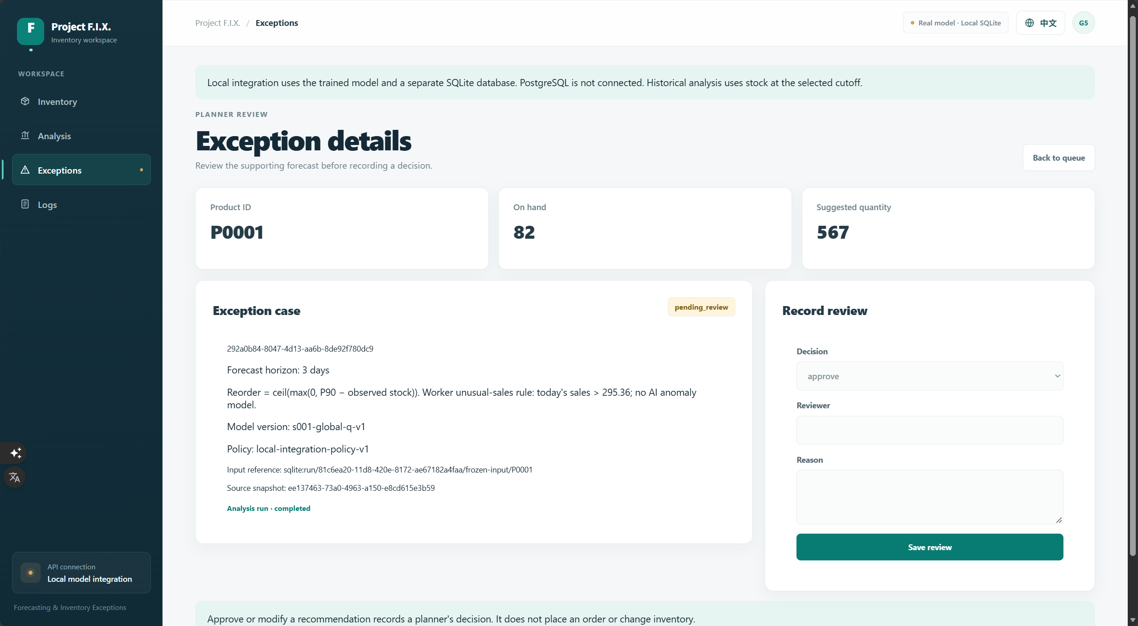
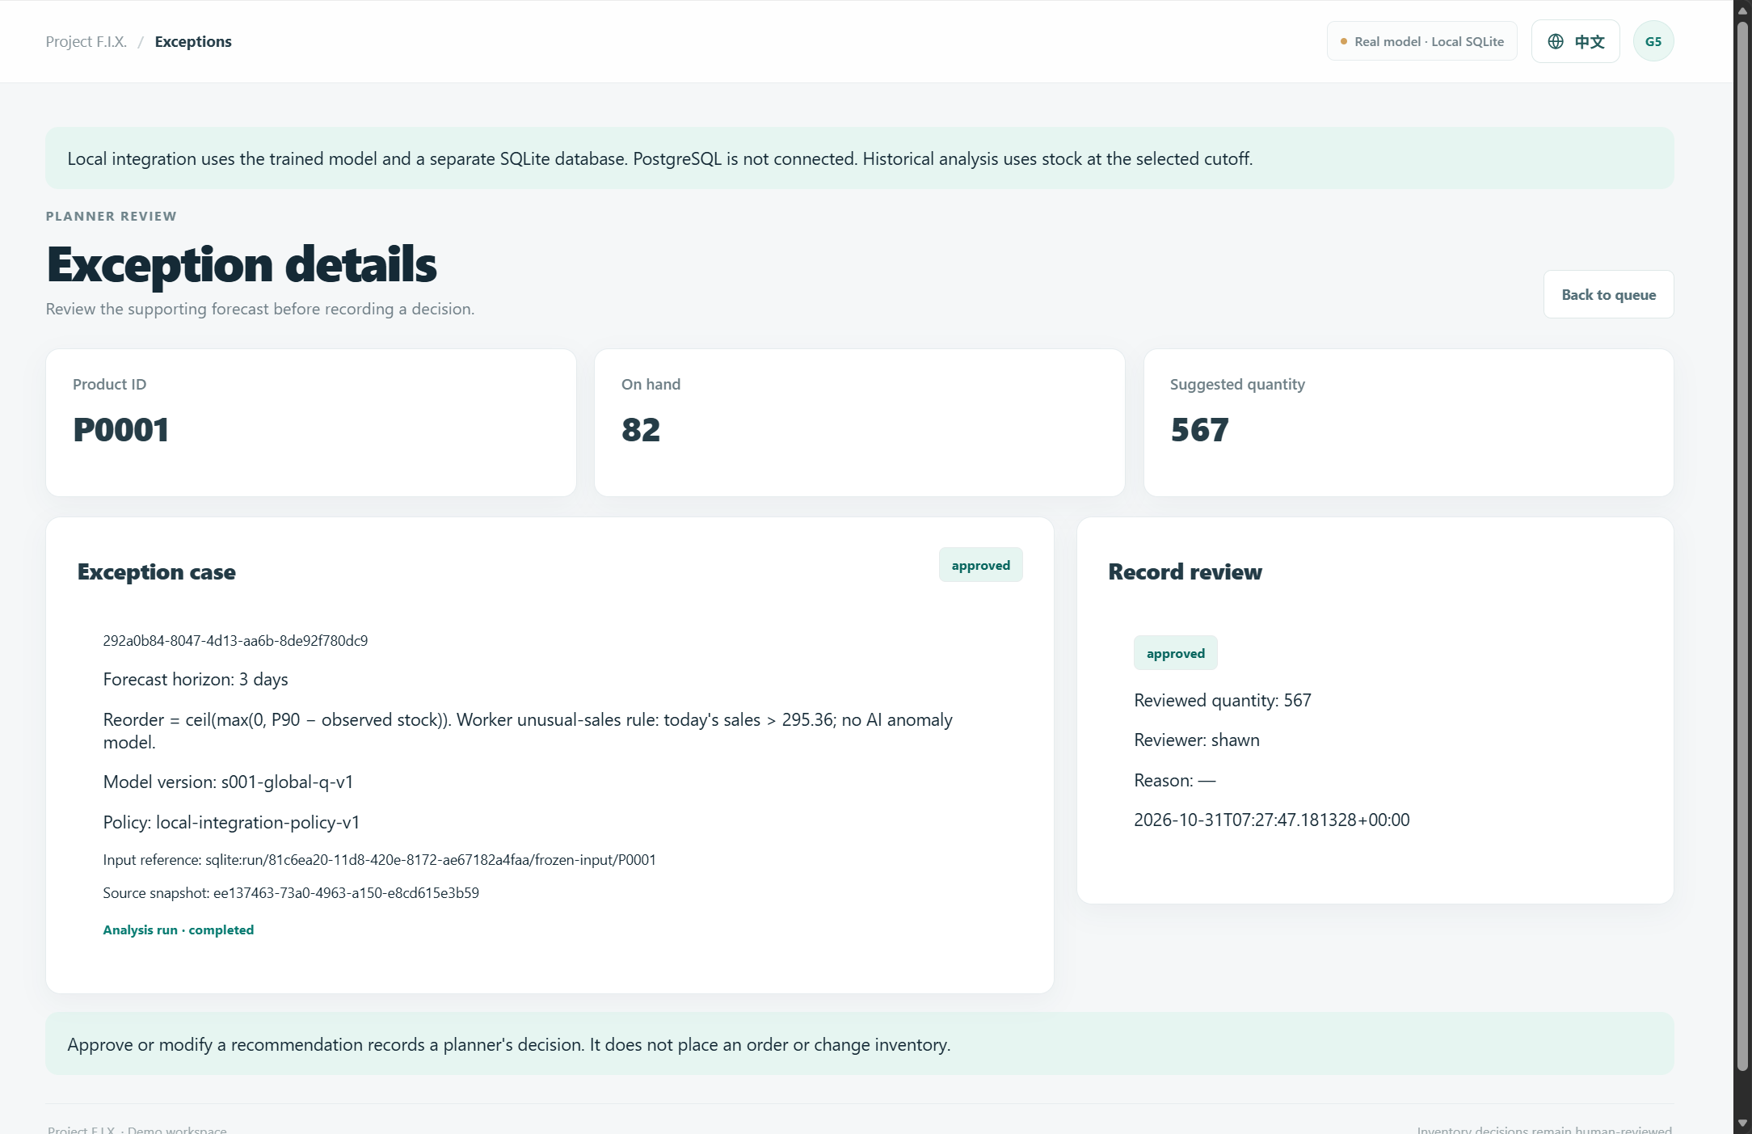
EVIDENCE 4 · PERSISTED OUTPUT
Review is saved; inventory is untouched
pending_review
→
approved
modified
rejected
resolved
Server stores the decision, reviewer label and time. Reorder cases: approve / modify / reject. Unusual-demand-only: resolve. A review never changes stock or places an order.
Exception case + review form
After reload: decision persisted
Project F.I.X. · Group 5 · Week 7 milestone

Slide 9
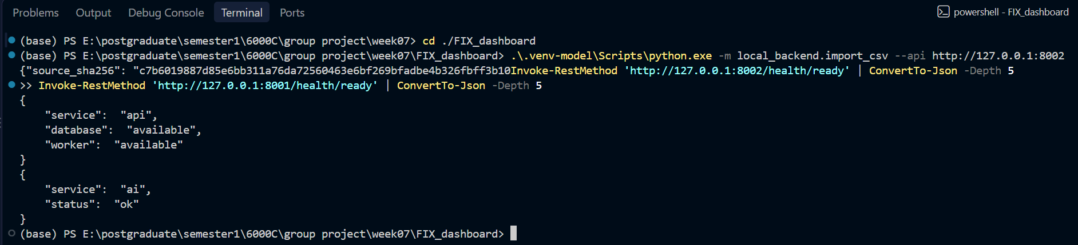
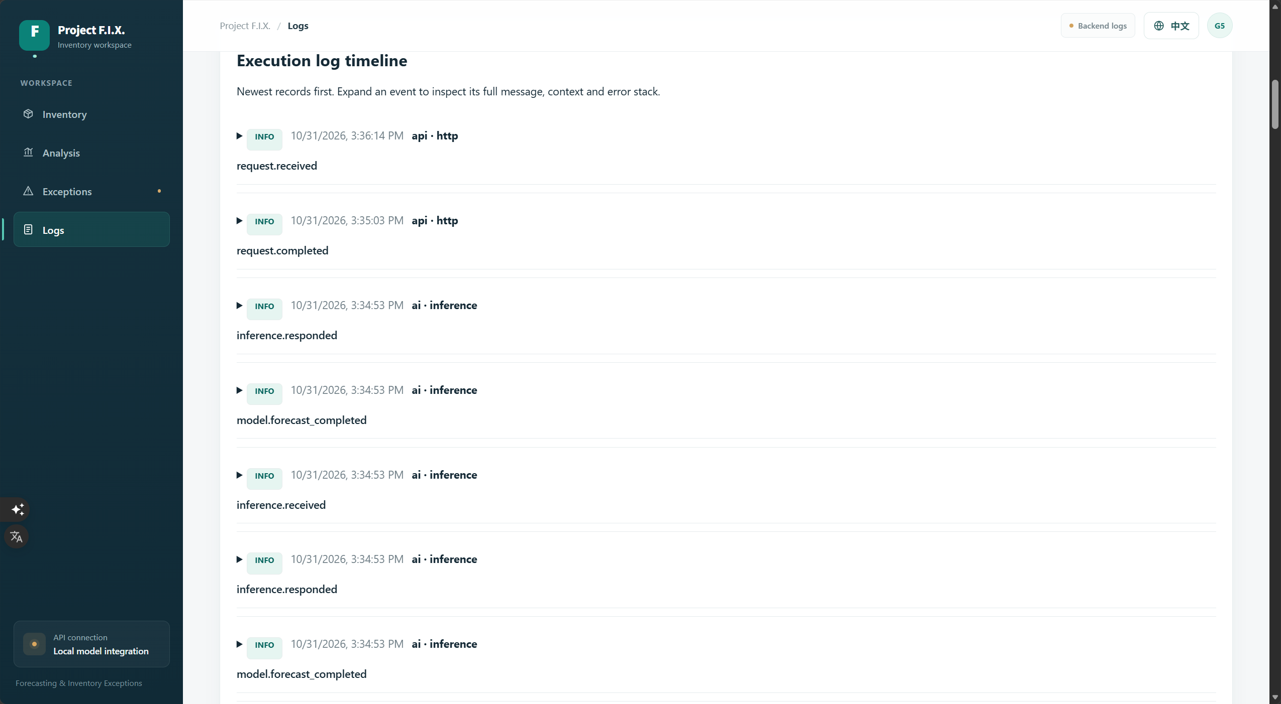
EVIDENCE 5 · OPERATIONAL SIGNAL
We can see what the system is doing
API /health/ready: database reachable and worker heartbeat under 30 s old
AI /health/ready: versioned model loaded
Every event carries Request, Run, Job and Case IDs — one filter shows the whole path
Recorded acceptance: 175 correlated API, worker and AI events, checked through pagination and export
Frozen query snapshot keeps pages stable; NDJSON export returns the full match set
Health check output
Logs Page Timeline
Not yet: metrics endpoint, automated alerting, availability target
Project F.I.X. · Group 5 · Week 7 milestone

Slide 10
CURRENT STATUS
What works, what is partial, what is not built
Implemented
Partial
Not yet
React dashboard in English and 简体中文
Public API: ingest, runs, results, review, logs
CSV importer with source-hash check; SQLite persistence
Polling worker + private LightGBM service (s001-global-q-v1)
Log filters, stable pagination, NDJSON export
PostgreSQL adapter and migrations exist; demo runs on SQLite
AI logs only collectable on a shared filesystem
Health and heartbeat exist; no metrics or alerts
Hosted fallback deployed; full cloud acceptance not recorded
Monthly and multi-store analysis
Authentication and verified reviewer identity
Auto-retry and stale-claim recovery
Scheduling, auto-purchasing, ERP / checkout integration
Log retention, backup and recovery policy
Project F.I.X. · Group 5 · Week 7 milestone

Slide 11
RISKS
Key risks and what we do about them
Risk | Why it matters | Next step
Worker stops after claiming a job | Run can stay “processing”; no retry or lease | Add lease, retry and stale-claim recovery
Forecast quality unproven | Sales are a demand proxy; lead times simulated | Evaluate against temporal baselines; no savings claims
No authentication | Reviewer label is not a verified identity | Add access control and verified reviewer
Hosted log gap | AI container logs not collected by the API | Add a shared logging mechanism
Strict data requirement | 29 consecutive days; cutoff from 2023-09-01 | Reject, never zero-fill; document limit
Protected core: manual Daily analysis, one store, snapshot → forecast → review. Cut first if needed: extra UI features and deployment work.
Project F.I.X. · Group 5 · Week 7 milestone

Slide 12
REMAINING WORK
Plan from Week 7 to Week 13
Capture local demo evidence: health, a completed Run, results, review, correlated logs, code revision
Verify the workflow from a clean checkout on the standard ports
1
2
Evaluate forecast quality against temporal baselines; assess the unusual-demand rule
PostgreSQL integration and hosted-service acceptance
3
4
Access control, verified reviewer, safe worker recovery, shared AI log collection, backup and retention
Monthly analysis, only after Daily is stable
5
6
Project F.I.X. · Group 5 · Week 7 milestone

Slide 13
DEMO READINESS
Run it yourself from the tag
Live demo path
Reproduce
Inventory: 20 S001 products
Analysis: run Daily Analysis for 2023-11-15
Follow Run and Job to completed
Open an exception, submit a review, reload
Confirm inventory unchanged; filter task logs by Run ID
git clone https://github.com/ShawnZhang0318/FIX_dashboard.git
git checkout w07-midterm
npm ci
py -3.12 -m venv .venv-model
.\.venv-model\Scripts\python.exe -m pip install -r ai/requirements-dev.txt
$env:VITE_BASE_PATH = "/FIX_dashboard/"
.\scripts\start-local-demo.ps1
.\.venv-model\Scripts\python.exe -m local_backend.import_csv
Local: 127.0.0.1:5174/FIX_dashboard/#/analysis
Fallback: fixdashboard-production.up.railway.app
AI use: OpenAI Codex was used to inspect code and docs, start the local demo services and draft the milestone summary.

