Slide 1
Comparative Analysis of Stream Processing Systems
Sulong Zhou
Shawn Zhong
Suyan Qu
Problem Statement
Approach
Benchmark & Discussion
In the past few decades, the explosion of modern information and technology has led to high demands for processing streaming data with low latency and high accuracy. In response, many different stream processing systems were developed.
With that many different systems, it is important to be able to evaluate the systems and know which system is more suitable for the workload we want.
Here we present our reviews for 5 different streaming processing systems: Apache Storm, Spark Streaming, Apache Flink, and Kafka Streams.
Also, we compare the performance of 2 of them: Spark streaming and Kafka Streams, based on Yahoo Streaming Benchmarks.
We compare these processing systems from two main aspects: performance and social factors
Performance metrics include latency, throughput, fault, etc.
Social factors consist of development activity and history,
Evaluation Design
For performance analysis, we use Yahoo Benchmarks, where the input data consist of randomly generated user actions with ad blocks. Each action includes a user ID, page ID, ad ID, ad type, event type, event time, and IP address. The processing system will count number of actions, such as views, clicks, on each ads.
For social factors, we focus on two areas: google search history, representing the popularity and trend of these stream processing systems, and GitHub commit histories, indicating if the system is actively being developed.
The latency was calculated in two steps. First, the timestamp of the latest record that was received for a pair of campaign and event-time-window during the windowed counts phase. Second, the latency was indicated by the difference between this timestamp and the Kafka ingestion timestamp of the output. As shown in above figure, we compared the latency between spark streaming and Kafka streams, the Kafka streams has much higher latency.
Stream Process Systems
Apache Storm: Twitter’s 1st-generation of real-time, fault-tolerant stream processing system. Here master communicates with worker nodes through Zookeepers, which is also responsible for monitoring workers.
Apache Heron: Twitter’s 2nd-generation stream processing system improved from Apache Storm. It separates monitoring from execution for scalability.
Spark Streaming: System based on Apache Spark. Spark Streaming uses micro-batches and accumulates result to achieve streaming data processing.
Apache Flink: Flink processes data as real streams. Data are processed upon arrival to provide low latency.
Kafka Streaming: Kafka streaming processes data in real-time. It is based on existing project Kafka and is designed to be light-weighted.
Social Factors
System | Commits Past Year | Committer | Lines of Code | Search Index* | Open Issues
Storm | 228 | 305 | 377,166 | 10 | 1033
Heron | 201 | 106 | 252,322 | 2 | 363
Spark** | 2565 | 1451 | 962,336 | 36 | 1859
Flink | 4312 | 595 | 1,429,183 | 79 | 2913
Kafka | 1201 | 606 | 459,984 | 23 | 2616
The throughput was denoted by the average number of records in the processing duration. As shown in above figure, the throughput in Spark Streaming achieved 2M/s, which completely outperformed Kafka streams.
* Search Index: the prevailing trend of the framework.
** Spark: statistics is for the entire Spark program.

Slide 2


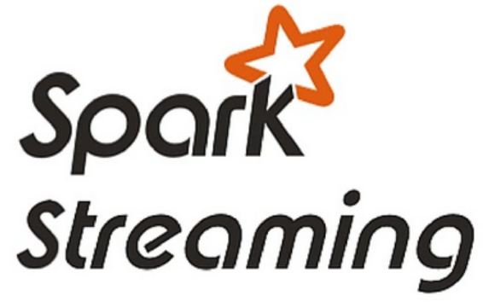
Kstream
(Ktable)
Ad Campaigns
windowed counts
Dataset
(Memory)

