Slide 1

Week 1 meeting
07/10/2020
Shawn

Slide 2
Meeting content
Status update
clarify actions that need to be done for projects to move forward
Goncalo:
share the overleaf's
start an overleaf for the EIS project
give access to WMG's data
planning
Richard/Shawn: start a Git.Repository for the EIS project
Calum: pass on know-how on getting the IR from the WMG data

Slide 3
My slides
Q1: time series of capacity is not consistent with EIS data
According to the statements in that paper ‘Out of all the states of I–IX, the model is most accurate at electrochemically stable states (i.e. the state V/IX, which is fully charged/discharged after resting), where electrochemical measurements on cells are more consistent.’
Therefore, the data of state 9 (25C02) is presented for an example, herein:
Capacity data recorded 181 cycles, however, the EIS data recorded 250 cycles
(very confused, should we use 180 cycles only?)
In addition, the time span of capacity test (180 cycles) is 2583496.703176448 seconds (y – output, in model)
The time span of EIS test (180 cycles) is 2629138.9913500003 seconds (x – input, in model)
The discrepancy is 45642.28817355214 seconds (around 760 minutes)
(imply - the quality of their data is suspicious and data is incomplete, missing data, should we ignore this time discrepancy between x and y and then assume one set of x does match y?)

Slide 4
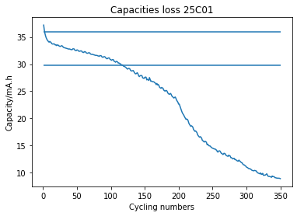
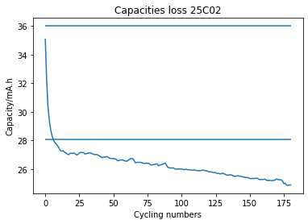
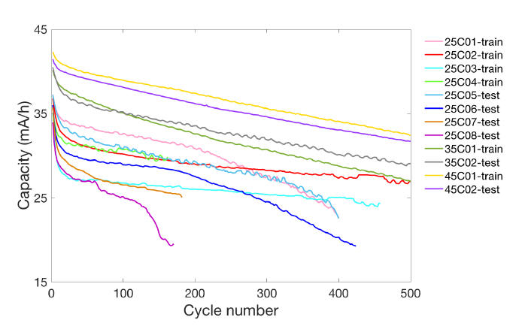
My slides
Q2: initial capacity
According to the statements in that paper ‘All cells underwent 30 cycles at room temperature of 25 °C before different temperatures were set. The battery is cycled until its end of life (EoL), which is defined as when capacity drops below 80% of its initial value after undergoing these 30 cycles.’
I am afraid that the valid capacity data before EoL may be not enough to identify the parameters
Their capacity retention curves are different from the data provided

Slide 5
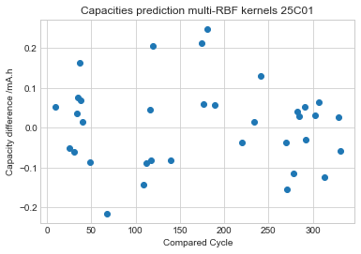
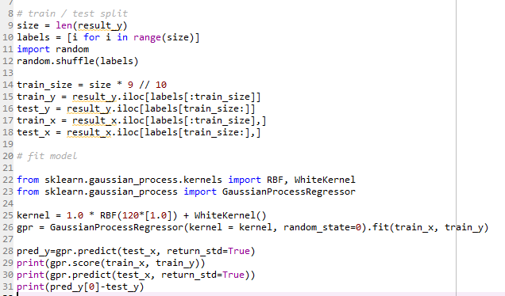
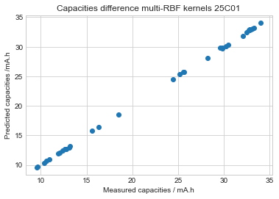
My slides
Model construction
According to the statements in that paper
Gaussian process regression is not different, herein, y is the capacity vector and x is a matrix with 120 variables represent the real (Zre) and imaginary (Zim) parts of impedance spectra collected at 60 different frequencies (ωn, n = 1, 2, ..., 60) in the range of 0.02 Hz–20 kHz at the current cycle
Therefore, I use multi-RBF GPR model with 120 kernels
R^2 = 0.9999553372939107

Slide 6
My slides
DC resistance extraction from EIS data
Lib installed, works, loop to extract the resistances – this week
Concern –
Have to compared with the measured impedance Z
May be compromised due to the estimation of Z, I will test the terminal voltage prediction later on

Slide 7
Summaries
Status update (done)
Richard+Shawn in contact re EIS
Shawn raises issues with the data EIS data, which makes the action point of figuring out if the data is good or not.
clarify actions that need to be done for projects to move forward
Goncalo:
share the overleaf's (done)
start an overleaf for the EIS project (done)
Richard/Shawn: start a Git.Repository for the EIS project (in progress)
action point: share the gib repo with goncalo & calum
Calum: pass on know-how on getting the IR from the WMG data (done; Richard will use this as basis to make progress on getting IR curves)
In terms of task breakdown.
Richard
WMG data for the internal resistance curves
catch up with Calum on Friday afternoon
(possibly continue to look at the EIS data); see MSc dissertation in attchmnt
Shawn
look into figuring out is the EIS data is good or not
Attempt to extract internal resistance curves from the EIS data, possibly using the python library shared earlier
Contribute to the "Where is the data" paper
Read the Msc dissertation I'm sharing
Calum
Provide support to Richard
Continue to do what you are doing
Next meeting
preliminarily, we're meting back on Tuesday next week

