Slide 1
PAPER DISCUSSION
Sparse Universal Transformer
Shared refinement with sparse experts
and adaptive computation
Shawn Tan, Yikang Shen, Zhenfang Chen,
Aaron Courville and Chuang Gan
EMNLP 2023
Methods, task-specific evidence, and structural comparison
01
Notes:
The paper asks whether a recurrent Transformer can retain the benefits of shared parameters while scaling its capacity economically. We will separate the shared-depth backbone, sparse selection of computation, and learned stopping. The final table will compare these structural choices across related architectures. This deck covers the paper, not results from our toy experiment.
Sources:
Tan et al., Sparse Universal Transformer, EMNLP 2023. Sections 1–5, Tables 1–5. https://aclanthology.org/2023.emnlp-main.12.pdf

Slide 2
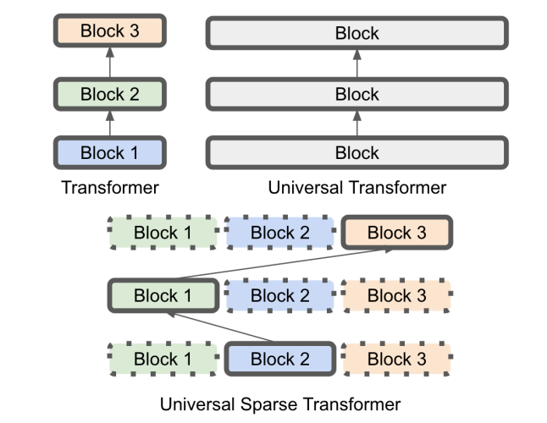
MOTIVATION
Why sparsify a Universal Transformer?
UT: reuse an update rule
Shared weights support repeated refinement across depth.
Scaling problem
A larger dense block costs more every time it runs.
SUT: select computation
Increase the expert pool while activating only a subset.
Original SUT Figure 1. Parameter sharing alone does not reduce executed depth.
02
Notes:
A vanilla Transformer allocates different parameters to successive layers. A UT reuses a block. At the same width, reuse reduces parameters but does not remove repeated computation. At matched total parameter count, a dense UT may require a larger repeated block. SUT activates only selected attention and FFN experts at each step. The original Figure 1 is a schematic, not a FLOP or runtime measurement. Avoid interpreting its illustrative scaling factors as universal laws.
Sources:
Tan et al., Sparse Universal Transformer, EMNLP 2023. Sections 1–5, Tables 1–5. https://aclanthology.org/2023.emnlp-main.12.pdf

Slide 3
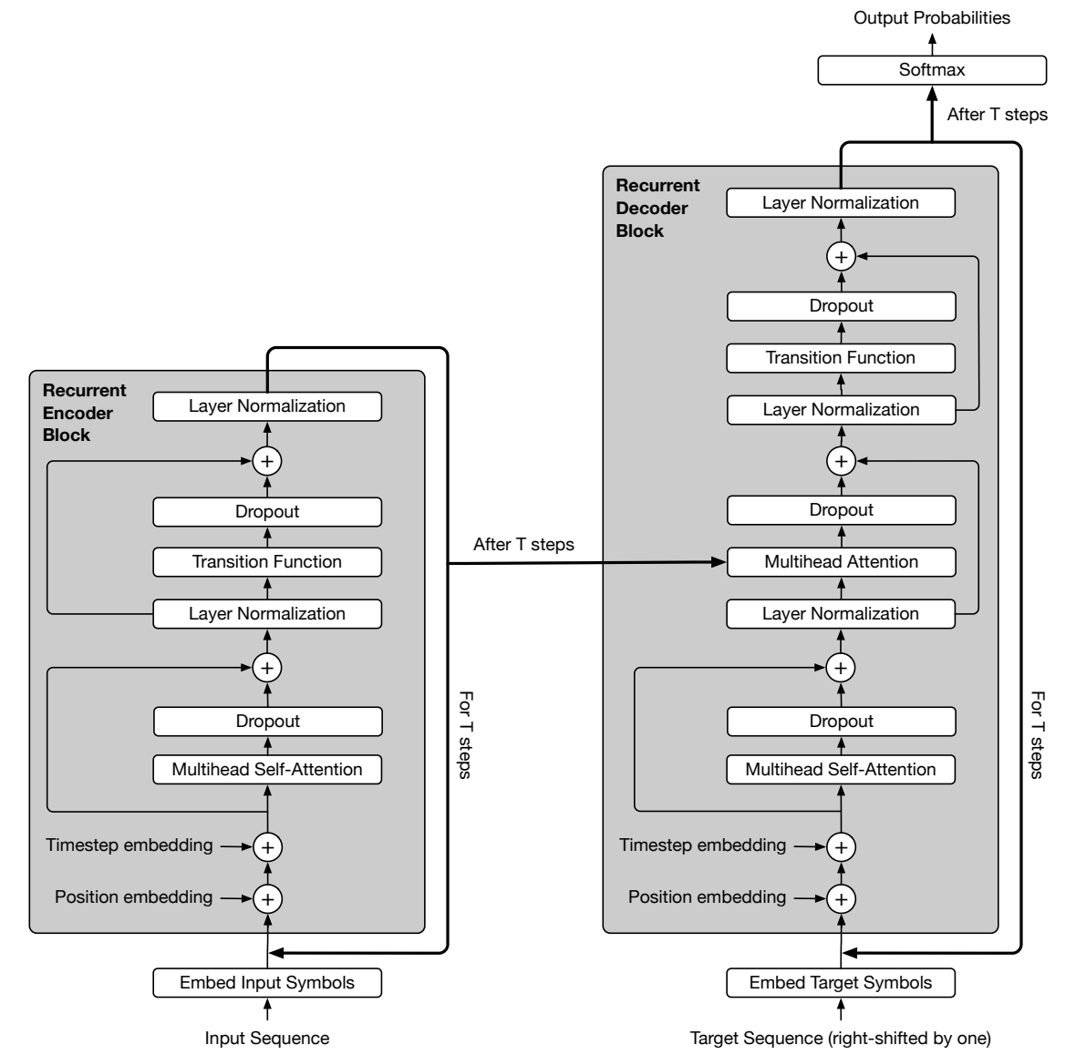
METHOD / FOUNDATION
Universal Transformer: the shared backbone
Same parameters at every step
Hₗ = Bθ(Hₗ₋₁)
Parallel across token positions
Sequential across refinement steps
Optional per-token halting
controls how long refinement continues.
Dehghani et al., Figure 4. Schematic equation omits positional and step signals.
03
Notes:
Use the original UT Figure 4 as the architectural anchor. Encoder and decoder each reuse their own block across refinement steps; this does not mean the encoder and decoder have identical parameters. Token positions update in parallel within a step, while refinement steps depend on earlier steps. Residual connections are not the source of recurrence. ACT is optional. This full diagram includes position and step signals, dropout, normalization and decoder cross-attention. We do not need to derive their details in this presentation.
Sources:
Dehghani et al., Universal Transformers, ICLR 2019. Figure 4 and Appendix C. https://arxiv.org/html/1807.03819v3

Slide 4
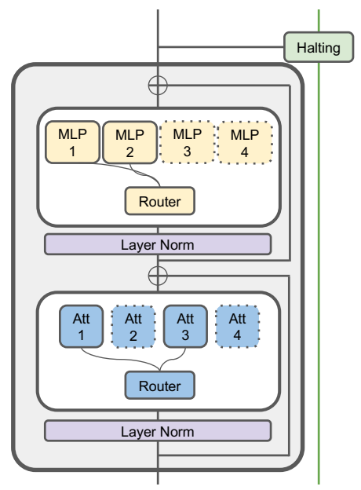
METHOD / SPARSE COMPUTATION
SUT block and sparse feedforward experts
FFN expert configuration: (E, k, D)
Symbol | Meaning
E | Number of FFN experts
k | Experts selected per token
D | Hidden width of each expert
y = ∑ₑ g(e | h) fₑ(h)
Only selected experts have nonzero routing weights.
Attention and FFN use separate expert pools.
SUT Section 3.1 and original Figure 3, left panel
04
Notes:
Figure 3 left locates the changes on the UT scaffold. SUT routes attention and FFN computation separately and reuses this block across depth. For a token state h, the router picks top-k experts and weights their outputs. The E experts are different parameter sets, reused across tokens and refinement steps. A token does not receive its own independently learned parameter matrix. The attention unit is a multi-head expert, which is detailed next. Auxiliary losses train these choices but are not extra inference blocks.
Sources:
Tan et al., Sparse Universal Transformer, EMNLP 2023. Sections 1–5, Tables 1–5. https://aclanthology.org/2023.emnlp-main.12.pdf

Slide 5
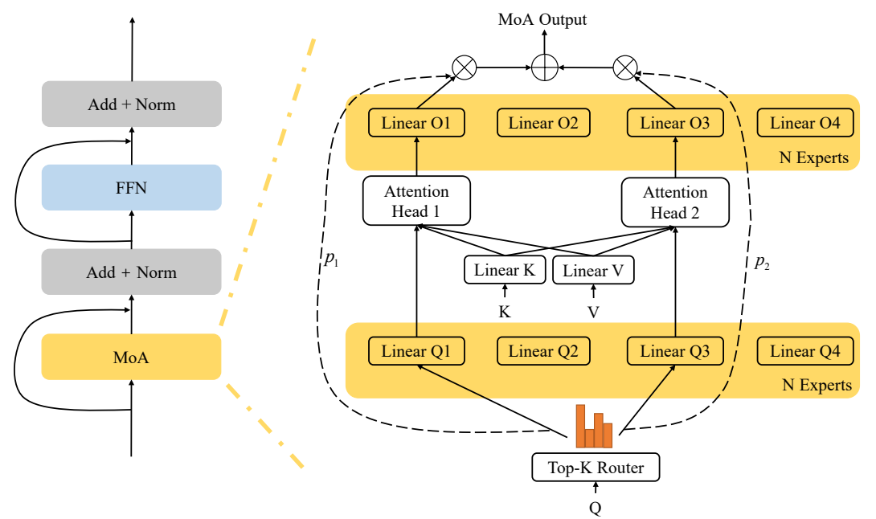
METHOD / ATTENTION ROUTING
Attention experts: MoA and SUT’s MoMHA
Shared K and V
Expert-specific Qₑ and Oₑ
Aₑ = softmax(QₑKᵀ / √d)
y = ∑ₑ gₑ (AₑV) Wᴼₑ
MoMHA: (E, k, H, D, W)
H: heads per expert
D: dimension per head
W: relative-position range
MoA: one head per expert
MoMHA: H heads per expert
Original MoA Figure 2. Displayed attention equations omit relative-position terms.
05
Notes:
Original MoA Figure 2 shows shared K/V projections, expert-specific query and output projections, and router-weighted output aggregation. These are paired projection banks with the same expert indices, not an extra FFN mixture. In MoA each expert is one head. SUT MoMHA uses H heads per expert: E sets of query projections and one H-head set of K/V projections shared across experts. The displayed equations describe the MoA head calculation; SUT extends the expert to multiple heads and uses relative positions. W is the relative-position range, not a hard restriction that attention can only see nearby tokens.
Sources:
Zhang et al., Mixture of Attention Heads, 2022. Figure 2, Equations 6–12. https://arxiv.org/html/2210.05144
Tan et al., Sparse Universal Transformer, EMNLP 2023. Sections 1–5, Tables 1–5. https://aclanthology.org/2023.emnlp-main.12.pdf

Slide 6
METHOD / AUXILIARY OBJECTIVE
Mutual-information maximization for routing
Minimize Lᴍɪᴍ = −H(E) + H(E | X)
Across inputs: use the pool
For each input: make a clear choice
Maximize H(E): avoid routing everything
to the same expert.
Minimize H(E | X): avoid uniform
routing for every token.
Two-expert illustration | −H(E) | H(E | X) | Loss
All inputs choose expert 1 | 0 | 0 | 0
Every input routes 50 / 50 | −0.693 | 0.693 | 0
Half choose 1, half choose 2 | −0.693 | 0 | −0.693
X denotes router inputs. This is the negative-MI form of SUT Equation 1.
06
Notes:
Minimize the printed negative mutual-information expression: minus marginal entropy plus conditional entropy. High marginal entropy distributes routing probability across the expert pool. Low conditional entropy encourages confident input-specific choices. This does not guarantee semantic specialization or perfectly equal discrete top-k loads. The toy numbers use natural logs and two experts. The paper prose says maximized beside the negative-MI equation; present the mathematically consistent minimization interpretation. Our reading audit also found that the current public repository appears to combine entropy signs differently. This slide explains the paper objective, not a verified reproduction of its implementation; resolve that discrepancy before implementing a comparison.
Sources:
Tan et al., Sparse Universal Transformer, EMNLP 2023. Sections 1–5, Tables 1–5. https://aclanthology.org/2023.emnlp-main.12.pdf

Slide 7
METHOD / ADAPTIVE DEPTH
Dynamic halting: addition versus stick breaking
 | UT | SUT
Gate output | qₗ | qₗ
Stopping accumulation | ∑ⱼ≤ₗ qⱼ | αₗ = qₗ ∏ⱼ<ₗ (1 − qⱼ)
Stop criterion | First sum > τ | First ∑ⱼ≤ₗ αⱼ > τ
ACT penalty | N + R | ∑ₗ l αₗ
Example: qₗ = 0.5 at every step, τ = 0.9
UT cumulative: 0.50, 1.00
Stops at step 2
SUT cumulative: 0.50, 0.75, 0.875, 0.9375
Stops at step 4
N = first stopping step. R = UT’s final remainder. Actual SUT uses τ = 0.999.
07
Notes:
Use common notation: l is refinement depth and q_l is the gate output for one token. UT adds raw gate scores until their sum crosses a threshold; at the last step it uses a remainder. SUT interprets q_l conditionally on surviving earlier decisions, so alpha_l equals q_l times the preceding survival product. Both use a cumulative stopping criterion. The example fixes q=.5 and threshold=.9 to isolate arithmetic; actual SUT threshold is .999. It does not show that trained SUT is inherently slower. UT ACT uses N+R; SUT uses expected depth. At a finite cap, remaining mass needs a terminal assignment. Expected depth is not executed depth or FLOPs.
Sources:
Dehghani et al., Universal Transformers, ICLR 2019. Figure 4 and Appendix C. https://arxiv.org/html/1807.03819v3
Graves, Adaptive Computation Time for Recurrent Neural Networks, 2016. https://arxiv.org/html/1603.08983
Tan et al., Sparse Universal Transformer, EMNLP 2023. Sections 1–5, Tables 1–5. https://aclanthology.org/2023.emnlp-main.12.pdf

Slide 8
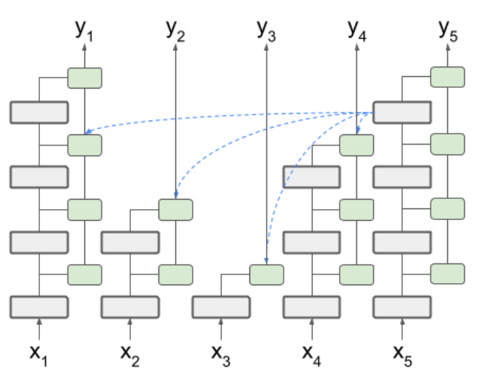
METHOD / STATE AGGREGATION
Combining states across refinement steps
UT: recursive interpolation
uₗ = wₗvₗ + (1 − wₗ)uₗ₋₁
Later gates rescale earlier contributions.
SUT: expected halted state
sₗ = ∑ⱼ<ₗ αⱼhⱼ + (1 − ∑ⱼ<ₗ αⱼ)hₗ
Active query: hₗ₋₁
Readable keys and values: Sₗ₋₁
A halted token remains
readable by other tokens.
Original SUT Figure 3, right panel. A no-op preserves a halted token’s state.
08
Notes:
Separate recurrence of the shared block from recursion in the output combination. UT Appendix C recursively interpolates a transformed state v_l and the previous accumulated output u_(l-1); repeated later gates change earlier contributions. SUT explicitly weights prior raw states by stopping probabilities, with survival mass on the current raw state. Its active token uses h_(l-1) as query input and S_(l-1) as K/V input, where capital S stacks halt-aware states for all tokens. Other token positions may already have stopped updating but their information remains readable. No-op means preserve state and skip its own update. Decoder masks still apply. Original Graves ACT has a direct weighted sum, so do not conflate it with UT Appendix C.
Sources:
Dehghani et al., Universal Transformers, ICLR 2019. Figure 4 and Appendix C. https://arxiv.org/html/1807.03819v3
Tan et al., Sparse Universal Transformer, EMNLP 2023. Sections 1–5, Tables 1–5. https://aclanthology.org/2023.emnlp-main.12.pdf

Slide 9
EXPERIMENTS / WMT’14
English–German translation: scale and cost
Model | Params | BLEU | MACs
Transformer base | 65M | 27.3 | 604M
Admin 6L–6L | 61M | 27.7 | 604M
MAE-7 | 63M | 28.4 | —
MoA base | 65M | 28.4 | 628M
UT (published) | 65M | 28.9 | —
UT base + SB | 64M | 29.3 | 1998M
SUT base | 66M | 29.2 | 787M
Transformer big | 210M | 29.3 | 2090M
LightConv | 202M | 28.9 | 1750M*
DynamicConv | 213M | 29.7 | 1790M*
Admin 18L–18L | 151M | 29.0 | 1490M
Admin 60L–12L | 256M | 30.1 | 2550M
MoA big | 200M | 29.4 | 1220M
UT big + SB | 105M | 29.6 | 3707M
SUT big | 110M | 29.4 | 787M
Matched-depth configurations
Model | E | Embed | Datt | Dff
UT base | 1 | 960 | 960 | 3840
UT big | 1 | 1344 | 1344 | 5376
SUT base | 24 | 512 | 256 | 512
SUT big | 48 | 512 | 256 | 512
All four: 6 encoder / 6 decoder steps
E applies to both expert pools.
SUT big versus UT big
≈4.7× fewer MACs, 0.2 lower BLEU
Table 1 and Appendix Table 6. SB = stick breaking. *Known MAC undercounts for convolutions.
09
Notes:
Input is English text, target is German text. Table 1 is reproduced completely, with abbreviated labels. MACs are the reported multiply–accumulate estimates, not wall-clock speed or FLOPs. LightConv and DynamicConv estimates are undercounted by the tool used, as the paper notes. Model configurations on the right come from the arXiv Appendix Table 6, absent from the supplied proceedings PDF. E is the number of experts in each pool; Datt is the table’s total attention-expert dimension, not the per-head D in the five-tuple. All four listed UT/SUT models use six encoder and six decoder steps. SUT big uses 110M parameters and 787M MACs versus dense UT big 105M and 3707M, at 29.4 versus 29.6 BLEU: approximately 4.7 times lower MACs, not a measured 4.7-times speedup. Relative to Transformer big, SUT big uses about half parameters and 38% of MACs. Training uses Adam, inverse-square-root learning-rate scheduling, label smoothing .1, 100 epochs and averaging the five best NLL checkpoints. Main paper Section 4.1 says vocabularies/embeddings are shared. Keep quality and cost trade-offs visible.
Sources:
Tan et al., Sparse Universal Transformer, EMNLP 2023. Sections 1–5, Tables 1–5. https://aclanthology.org/2023.emnlp-main.12.pdf
Tan et al., arXiv version, Appendix A and Table 6. https://arxiv.org/pdf/2310.07096

Slide 10
EXPERIMENTS / WMT’14
Translation: ablations and FFN specialization
Variant | Valid loss | BLEU | Params
SUT base | 2.192 | 29.2 | 66M
− MIM loss | 2.221 | 28.9 | 66M
− MoMHA | 2.232 | 28.7 | 66M
− ACT loss | 2.217 | 29.0 | 66M
− Halting | 2.219 | 29.1 | 65M
FFN expert–token associations
Expert | Top five tokens
6 | a, their, his, this, an
17 | he, they, his, He, you
41 | ed, ing, ted, y, red
46 | team, children, police, devices, system
“− MoMHA” replaces it with MoA.
FFN-MoE remains in the model.
Selected examples suggest specialization.
They do not measure redundancy.
SUT Tables 2–3. FFN experts are called FFD experts in the paper.
10
Notes:
Table 2: removing MIM means replacing it with a load-balancing loss, not removing every routing regularizer. Minus MoMHA means replacement with MoA, not MoE. The reported replacement reduces BLEU by .5, the largest of these ablations, but does not isolate H alone while holding every design choice fixed. FFN experts remain. Halting removal costs .1 BLEU, ACT loss removal .2, MIM replacement .3. Table 3 explicitly concerns FFD/FFN expert–word co-occurrences across layers. The authors selected four experts showing patterns. Associations suggest specialization, but neither demonstrate causal functions nor quantify redundancy. Retain that distinction when connecting to our experiment.
Sources:
Tan et al., Sparse Universal Transformer, EMNLP 2023. Sections 1–5, Tables 1–5. https://aclanthology.org/2023.emnlp-main.12.pdf

Slide 11
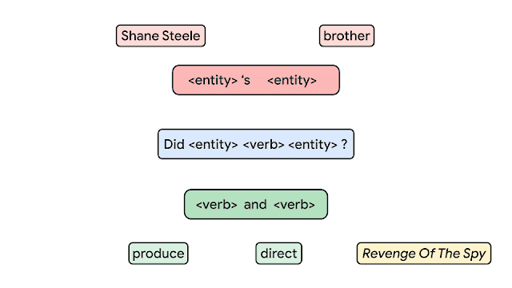
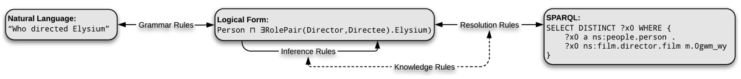
EXPERIMENTS / TASK DEFINITION
CFQ: familiar pieces, unfamiliar combinations
Model input
Natural-language question
Prediction target
SPARQL query text
MCD: familiar building blocks
in unfamiliar combinations
Google Research animation and Keysers et al., Figure 1. The logical form belongs to data generation.
11
Notes:
CFQ stands for Compositional Freebase Questions. The original Google Research animation illustrates how grammar building blocks compose into a sentence. The prediction task in SUT is semantic parsing: natural-language question to SPARQL query text. It is not predicting the parse tree shown by the animation, and the database answer is not the training target in this benchmark. MCD splits keep atomic distributions similar while changing combinations. The original CFQ Figure 1 at the bottom describes dataset generation, with an intermediate logical form. This logical form is not an extra required neural output. The animation is embedded as GIF; if the presentation viewer shows a still image, open the linked original article. SUT uses transformed query targets, so its preprocessing differs from an unmodified raw target comparison.
Sources:
Google Research, Measuring Compositional Generalization, 6 March 2020. Original animation: https://research.google/blog/measuring-compositional-generalization/
Keysers et al., Measuring Compositional Generalization, ICLR 2020. Figure 1. https://arxiv.org/pdf/1912.09713
Tan et al., Sparse Universal Transformer, EMNLP 2023. Sections 1–5, Tables 1–5. https://aclanthology.org/2023.emnlp-main.12.pdf

Slide 12
EXPERIMENTS / COMPOSITIONAL GENERALIZATION
CFQ results: the best setting uses one expert
Model | Pretrained | MCD1 | MCD2 | MCD3 | Average | MACs
T5-based UT (Bergen) | No | 42.7 | 9.5 | 11.6 | 21.3 | 1154M
Edge Transformer | No | 47.7 | 13.1 | 13.2 | 24.7 | 6504M
Transformer (Keysers) | No | 42.5 | 11.2 | 10.6 | 21.4 | 1154M
T5 | Yes | 61.6 | 31.3 | 33.3 | 42.1 | 1154M
RoBERTa | Yes | 60.6 | 33.6 | 36.0 | 43.4 | 1660M
Dangle | Yes | 78.3 | 59.5 | 60.4 | 66.1 | 51033M
T5-based UT (SUT paper) | No | 68.3 | 43.1 | 45.7 | 52.3 ± 1.6 | 441M
UT without halting | No | 71.0 | 48.6 | 51.3 | 56.9 ± 1.5 | 654M
UT with halting | No | 72.4 | 51.1 | 51.7 | 58.4 ± 1.2 | 654M
Attention (1, 1, 8, 64, 1) FFN (1, 1, 1024) Depth 8 / 8
Table 4. Accuracy (%). UT rows: five seeds. Per-split uncertainties and preprocessing details in notes.
12
Notes:
All Table 4 models and means are shown. Original full uncertainty for our rows: T5-based UT MCD1 68.3±2.9, MCD2 43.1±1.5, MCD3 45.7±1.8, average52.3±1.6; UT without halting71.0±3.5,48.6±2.3,51.3±.2,average56.9±1.5; UT with halting72.4±3.5,51.1±1.8,51.7±2.3,average58.4±1.2. Those UT results average five seeds. Hyperparameters were selected on MCD1 validation. Attention (E=1,k=1,H=8,D=64,W=1), FFN(E=1,k=1,D=1024), embedding512, 8 encoder/8 decoder steps, 7.2M with halting and6.7M without. Thus the winning CFQ model is a UT special case, not evidence that multiple sparse experts are needed on CFQ. Target preprocessing and positional/norm implementation details improve baselines. Dangle is better at66.1 but pretrained and much more expensive in reported MACs. Avoid presenting all rows as a controlled architectural-only comparison.
Sources:
Tan et al., Sparse Universal Transformer, EMNLP 2023. Sections 1–5, Tables 1–5. https://aclanthology.org/2023.emnlp-main.12.pdf
Tan et al., arXiv version, Appendix A and Table 6. https://arxiv.org/pdf/2310.07096

Slide 13
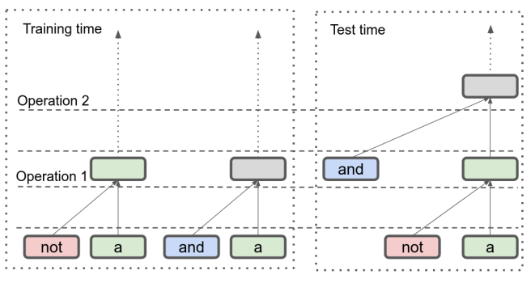
EXPERIMENTS / TASK AND CONFIGURATION
Logical inference: relational reasoning beyond training
Input: expression 1 #SEP# expression 2
Example: a #SEP# (a or b)
Target: forward entailment
Length generalization
Train: 0–6 logical operators
Test: 7–12 logical operators
SUT configuration
Attention (12, 4, 2, 32, 1)
FFN (12, 4, 128), depth 12 / 12
SUT Section 4.3, Figure 2 and Appendix Table 6. Output is one relation label.
13
Notes:
The task takes two propositional-logic expressions and predicts their semantic relation as a single label. Example a entails a OR b. The model receives sentence1 #SEP# sentence2, not a parse tree. Training has0–6 logical operators, evaluation7–12. The separate compositional splits A/B/C increase difficulty. Original SUT Figure2 illustrates a withheld combination of operations; it is not a literal input format for the model. The paper uses a12-layer encoder and12-layer decoder with attention(12,4,2,32,1), FFN(12,4,128), embedding512 and7.6M parameters. Halting is enabled. This is genuine multiple-expert SUT, unlike the CFQ winner.
Sources:
Tan et al., Sparse Universal Transformer, EMNLP 2023. Sections 1–5, Tables 1–5. https://aclanthology.org/2023.emnlp-main.12.pdf
Tan et al., arXiv version, Appendix A and Table 6. https://arxiv.org/pdf/2310.07096

Slide 14
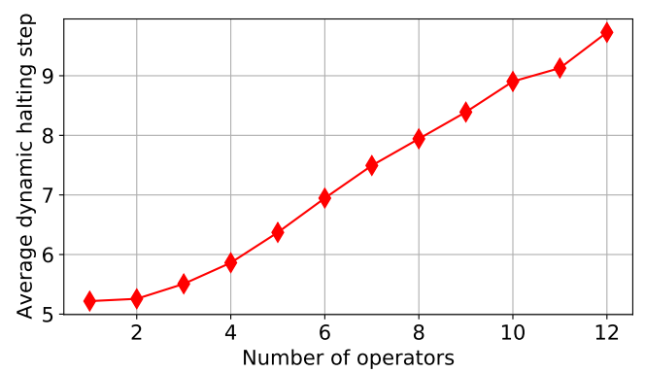
EXPERIMENTS / GENERALIZATION RESULTS
Logical inference: gains and remaining failures
Accuracy (%) | 7 | 8 | 9 | 10 | 11 | 12 | A | B | C
LSTM | 88 | 84 | 80 | 78 | 71 | 69 | 80 | 60 | 59
Transformer | 51 | 52 | 51 | 51 | 51 | 48 | 53 | 51 | 51
SUT | 98 | 97 | 94 | 90 | 88 | 81 | 97 | 94 | 52
More operators, deeper computation
Depth rises with operator count.
Length and complexity are correlated.
Split C remains difficult: 52% accuracy
SUT Table 5 and original Figure 4. Columns 7–12 are operator counts; A–C are composition splits.
14
Notes:
Table5 values are accuracy percentages. SUT substantially exceeds the Transformer and LSTM on length extrapolation here. It also improves A and B, but C remains52 compared with LSTM59. Do not call compositional generalization solved. The source Figure4 shows average halting depth increasing with operator count. Operator count also correlates with length, so this does not isolate reasoning difficulty from sequence length. Baseline references: LSTM Bowman2015, Transformer Shen2019. The paper says a newly trained12-layer vanilla Transformer achieves approximately the same result as the cited baseline. The original figure caption says UT, while the surrounding setting and Table5 call the model SUT; describe it as the paper model without silently changing the source image.
Sources:
Tan et al., Sparse Universal Transformer, EMNLP 2023. Sections 1–5, Tables 1–5. https://aclanthology.org/2023.emnlp-main.12.pdf

Slide 15
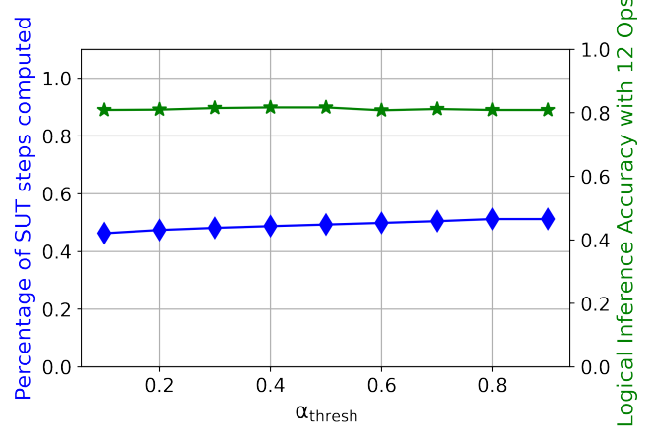
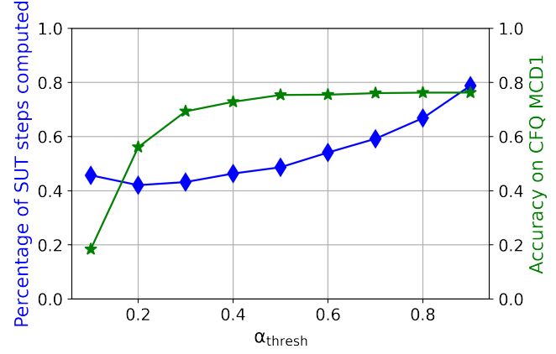
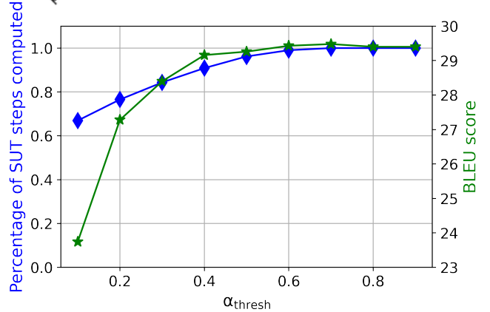
EXPERIMENTS / INFERENCE TRADE-OFF
Post-training computation reduction
Logical inference
CFQ
English–German
About 50% skipped steps
with stable accuracy
About 33% skipped
at threshold 0.8
9% less computation
while retaining 29.1 BLEU
Skipped block steps are an estimate of computation savings, not a measured speedup.
Section 4.4 and original Figures 5–7. Blue: fraction computed. Green: task quality.
15
Notes:
Section4.4 is valuable because it turns halting into a post-training control. Adjust the cumulative threshold and evaluate quality again. The original plots show fraction computed in blue and task quality in green. The estimates are based on decoder halting patterns with ground-truth source-target pairs, so these are skipped SUT block-step estimates, not measured end-to-end speedups. Logical inference has near-constant roughly50% skipped steps. CFQ text reports roughly33% skipped atthreshold.8 with stable quality in.8–.999, and about50% for a small .2% accuracy decrease; plots and prose have some inconsistencies, so avoid unsupported precision. Translation text reports9% less computation while retaining29.1 BLEU. Lowering threshold can alter token representations and subsequently other tokens’ halting, so monotonicity is not guaranteed. The cited images retain original axes.
Sources:
Tan et al., Sparse Universal Transformer, EMNLP 2023. Sections 1–5, Tables 1–5. https://aclanthology.org/2023.emnlp-main.12.pdf

Slide 16
DISCUSSION
Conclusions and questions for our experiments
What the paper supports
What remains unresolved
Sparse experts make a shared block
cheaper to scale on translation.
CFQ favors one expert.
Logical split C remains difficult.
Repeated refinement helps on several
generalization tests.
Expert associations do not establish
causal specialization or redundancy.
Halting provides a tunable
accuracy–computation trade-off.
Our tests should isolate routing, reuse
and depth with controlled budgets.
Discussion hypothesis: compare structural choices independently before combining them.
Paper conclusions and limitations. Proposed experiment questions are not new results.
16
Notes:
The structural hypothesis is that routing granularity, reuse across depth and stopping are separable choices. SUT combines them, but its experiments do not establish a universal principle. WMT supports parameter efficiency with a quality-cost trade-off; CFQ selects the one-expert UT setting; logical inference exposes failure on splitC. Token-expert associations are observational. For our controlled toy experiments, isolate changes, match parameter budgets and measure actual compute separately, select checkpoints on validation MSE, never expose regime labels to non-oracle models, and preserve negative results. These are proposed controls, not experimental findings. Toy-program results have not been added because they need a fresh audit and discussion; insert validated result slides before the final structural table later.
Sources:
Tan et al., Sparse Universal Transformer, EMNLP 2023. Sections 1–5, Tables 1–5. https://aclanthology.org/2023.emnlp-main.12.pdf

Slide 17
Structural comparison
Green: Yes Light green: qualified Yes* White: No or no router
Architecture | MHA | FFN MoE | Router | Recurrence | Halting / skipping
Vanilla Transformer | Yes | No |  | No | No
FFN-MoE Transformer | Yes | Yes | FFN | No | No
UT | Yes | No |  | Yes | Yes*
MoA | Yes* | No | Attention head | No | No
MoH | Yes* | No | Attention head | No | No
SUT | Yes | Yes | Attention expert + FFN | Yes | Yes
MoM | Yes | Yes | MHA module + FFN | Yes* | Yes*
* MHA includes routed variants (MoA, MoH). UT halting is optional.
Recurrence = reuse across depth. MoM reuses modules and optionally skips steps.
Configurations shown follow the cited papers. Sources and qualifications are in the slide notes.
Notes:
Final comparison slide for the planned SUT presentation. MHA means multi-head attention, including routed variants; it does not imply a full MHA block inside every MoA expert. MoA routes single heads, SUT MoMHA has H heads per expert. FFN MoE means a separately routed FFN expert pool. Router lists the selected unit, blank means no expert/head router (UT still has a halting gate). Recurrence means reuse of parameters across depth, not recursive state interpolation. Typical FFN-MoE shown uses separate layer pools. UT halting is optional. MoM reuses a module pool rather than one fixed block, and SKIP is optional; skipping does not imply permanent halting. MoM attention assembles projection parameters. MoH shared heads are always active, not necessarily shared KV projections. MoH and MoM are later 2024 comparisons, not predecessors of SUT.
Sources:
Transformer: https://arxiv.org/html/1706.03762
Switch: https://arxiv.org/html/2101.03961
UT: https://arxiv.org/html/1807.03819v3
MoA Sections 4-5: https://arxiv.org/html/2210.05144
MoH Section 3.2: https://arxiv.org/html/2410.11842
SUT Sections 3.1-3.2: https://aclanthology.org/2023.emnlp-main.12.pdf
MoM Sections 3.1-3.3: https://arxiv.org/html/2407.06677

