Slide 1
EMNLP 2023
Sparse Universal Transformer
Shawn Tan¹* Yikang Shen²* Zhenfang Chen²
Aaron Courville¹ Chuang Gan²
¹ Mila, University of Montreal
² MIT-IBM Watson AI Lab
Conference on Empirical Methods in Natural Language Processing
Tan et al., 2023. *Equal contribution.
01
Notes:
Shawn Tan and Yikang Shen contributed equally. Affiliations reproduced from the title page. This presentation covers the paper and related architectural context.
Sources:
Tan et al., Sparse Universal Transformer, EMNLP 2023. Sections 1–5, Tables 1–5. https://aclanthology.org/2023.emnlp-main.12.pdf

Slide 2
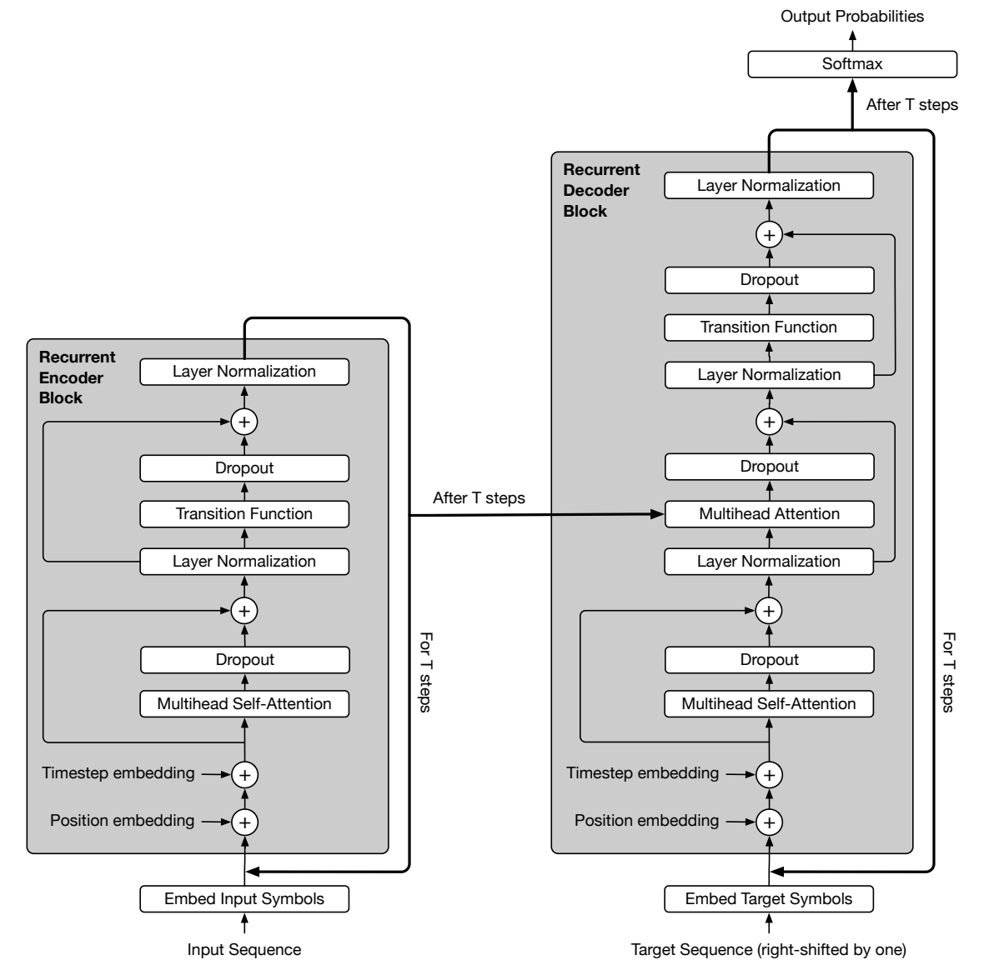
FOUNDATION / ICLR 2019
Universal Transformer: the shared backbone
Universal Transformers
Mostafa Dehghani, Stephan Gouws,
Oriol Vinyals, Jakob Uszkoreit
and Lukasz Kaiser
University of Amsterdam
DeepMind and Google Brain
ICLR 2019
Reuse the same block at each depth
Parallel across token positions
Sequential across refinement steps
Dehghani et al., original Figure 4. Dynamic per-token halting is optional.
02
Notes:
Universal Transformers, Dehghani, Gouws, Vinyals, Uszkoreit and Kaiser, ICLR 2019. Original affiliations: University of Amsterdam, DeepMind and Google Brain. Encoder and decoder each reuse their own block over refinement depth. This is not encoder-decoder weight tying. Residual connections are not the source of recurrence. Positions update in parallel within a step, while depth steps depend on earlier steps. ACT is optional.
Sources:
Dehghani et al., Universal Transformers, ICLR 2019. Figure 4 and Appendix C. https://arxiv.org/html/1807.03819v3

Slide 3
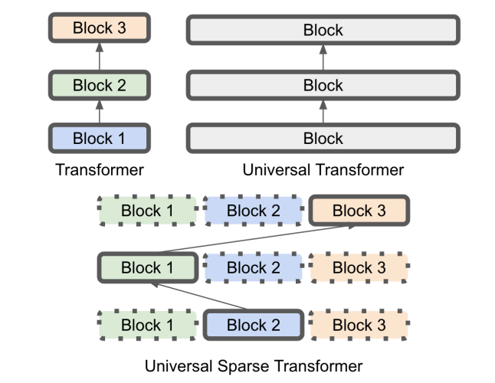
MOTIVATION / SCALING SHARED COMPUTATION
Vanilla Transformer, UT and SUT
Vanilla Transformer
Different block parameters
at different layers.
Universal Transformer
Reuse one block across depth.
A wider block costs more per step.
Sparse Universal Transformer
Reuse the expert pools, activating
only selected experts at each step.
Sparse Universal Transformer
Adapted SUT Figure 1: model-name label corrected to match the paper title.
03
Notes:
SUT Figure 1 is a schematic comparison. The bottom label has been corrected from Universal Sparse Transformer to Sparse Universal Transformer, matching the paper title. The original diagram is otherwise unchanged. Reuse reduces parameter duplication but does not eliminate repeated execution. A larger shared dense block is costly to execute at every depth. Sparse routing activates a subset of a larger expert pool.
Sources:
Tan et al., Sparse Universal Transformer, EMNLP 2023. Sections 1–5, Tables 1–5. https://aclanthology.org/2023.emnlp-main.12.pdf

Slide 4
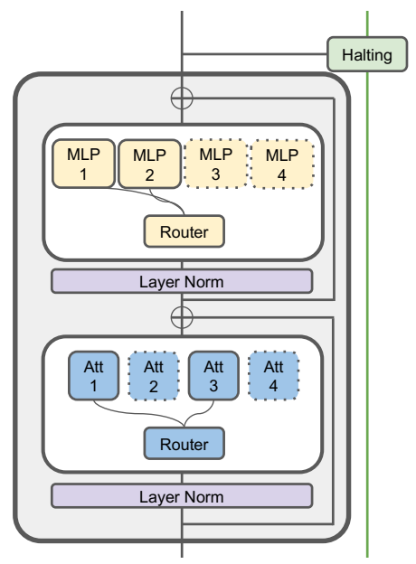

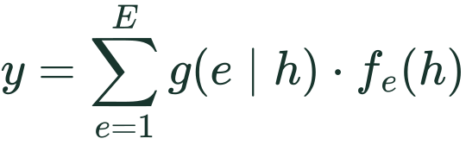
METHOD / SPARSE COMPUTATION
SUT block and sparse feedforward experts
FFN expert configuration
Symbol | Meaning
E | Total number of FFN experts
K | Experts selected for each token
D | Hidden width of each expert
Attention and FFN have separate expert pools.
SUT Section 3.1. Tuple notation uses capital K throughout this presentation.
04
Notes:
SUT Figure 3 left. Uppercase K is used consistently in configuration tuples, corresponding to lowercase k in the paper. An FFN expert is a separate parameter set, reused across tokens and refinement steps. Router inputs are token representations, not rows with individually learned token-specific weights. Only selected experts are evaluated.
Sources:
Tan et al., Sparse Universal Transformer, EMNLP 2023. Sections 1–5, Tables 1–5. https://aclanthology.org/2023.emnlp-main.12.pdf
LaTeX (ffn_tuple):
(E,K,D)
LaTeX (moe):
y=\sum_{e=1}^{E}g(e\mid h)\cdot f_e(h)

Slide 5
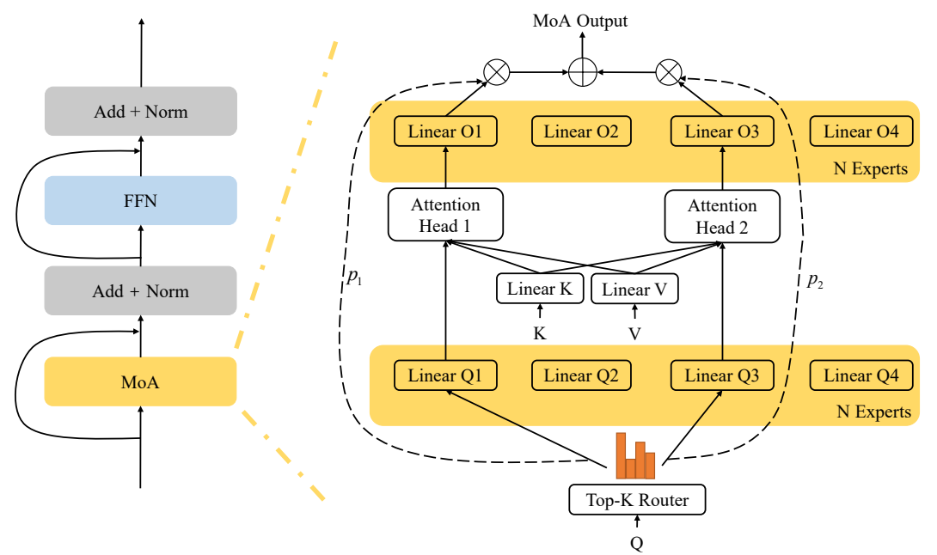
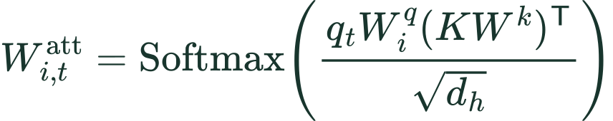


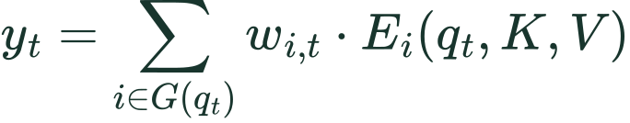
METHOD / ATTENTION EXPERTS
MoA: routing query and output projections
Shared key/value projections
Expert-specific query/output projections
MoA: one head per expert
MoMHA: a group of heads per expert
Zhang et al., Mixture of Attention Heads, original Figure 2 and Equations 6, 10–12.
05
Notes:
Original Figure 2 of Mixture of Attention Heads: Selecting Attention Heads Per Token, Zhang et al., 2022. In MoA, each expert is one attention head. Key and value projections are shared; each expert has its own query and output projections. The router chooses heads for each token and weights the corresponding outputs. SUT calls its multi-head-per-expert variant MoMHA. The figure is deliberately labeled as MoA, not as a diagram of SUT MoMHA.
Sources:
Zhang et al., Mixture of Attention Heads, 2022. Figure 2, Equations 6–12. https://arxiv.org/html/2210.05144
Tan et al., Sparse Universal Transformer, EMNLP 2023. Sections 1–5, Tables 1–5. https://aclanthology.org/2023.emnlp-main.12.pdf
LaTeX (moa_att):
W_{i,t}^{\mathrm{att}}=\mathrm{Softmax}\!\left(\frac{q_t W_i^q(KW^k)^{\mathsf T}}{\sqrt{d_h}}\right)
LaTeX (moa_value):
o_{i,t}=W_{i,t}^{\mathrm{att}}VW^v
LaTeX (moa_output):
E_i(q_t,K,V)=o_{i,t}W_i^o
LaTeX (moa_sum):
y_t=\sum_{i\in G(q_t)}w_{i,t}\cdot E_i(q_t,K,V)

Slide 6
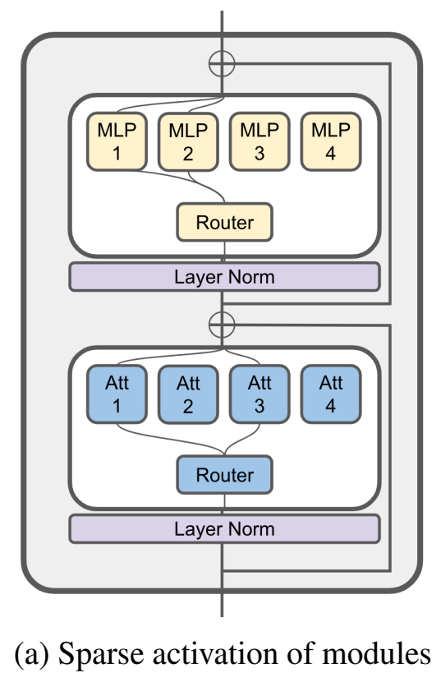

METHOD / MOMHA CONFIGURATION
SUT’s mixture of multi-head attention
Symbol | Meaning
E | Number of attention experts
K | Experts selected for each token
H | Attention heads inside each expert
D | Dimension of each head
W | Relative-position embedding range
One shared set of key/value projections for H heads.
Each of the E experts has its own query projections.
SUT Section 3.1 and Shen et al., ModuleFormer, Figure 1a. K denotes the paper’s top-k parameter.
06
Notes:
SUT Section 3.1 cites Zhang et al. 2022 (MoA) and Shen et al. 2023 (ModuleFormer). There is not a separately titled MoMHA paper among these references. ModuleFormer Figure 1a is a related sparse-attention/FFN block, not a detailed picture of SUT’s H-head grouping. ModuleFormer uses stick-breaking token attention, which must not be conflated with SUT’s stick-breaking halting over depth. SUT explicitly defines E experts of H heads with shared K/V projections and E query projection sets. W parameterizes a clipped relative-distance embedding range; it is not an attention visibility mask.
Sources:
Tan et al., Sparse Universal Transformer, EMNLP 2023. Sections 1–5, Tables 1–5. https://aclanthology.org/2023.emnlp-main.12.pdf
Zhang et al., Mixture of Attention Heads, 2022. Figure 2, Equations 6–12. https://arxiv.org/html/2210.05144
Shen et al., ModuleFormer: Learning Modular Large Language Models From Uncurated Data, 2023. Figure 1a and Section 3. https://arxiv.org/html/2306.04640v1
LaTeX (att_tuple):
(E,K,H,D,W)

Slide 7
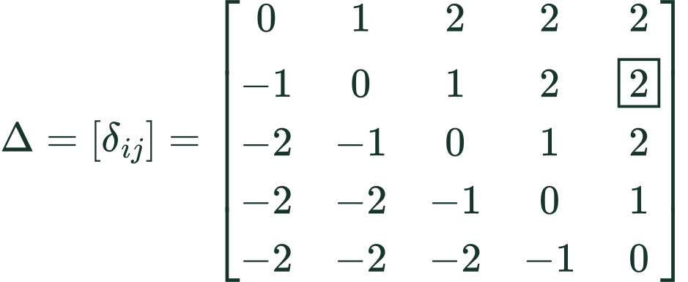
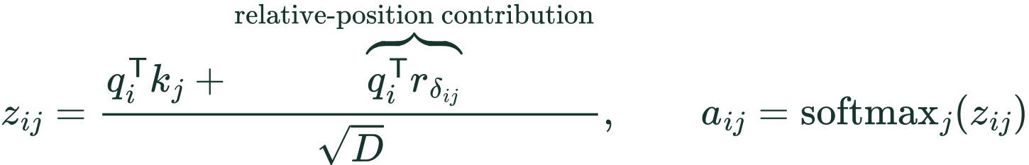
METHOD / RELATIVE POSITION IN MoMHA
W and the relative-position matrix
eg. Five tokens, W = 2
Rows: query position i Columns: key position j
δᵢⱼ: fixed distance label at row i, column j.
Δ: the complete relative-position matrix.
Each label selects a D-dimensional vector.
The vector components are learned during
training; the distance labels are not learned.
eg. Boxed entry: query 2, key 5
The matrix contains offsets, not attention scores.
All unmasked tokens remain available to attention.
SUT §3.1 and author code. Illustrative W = 2 clipping; batch, head, expert indices and masks omitted.
Notes:
Insert immediately after slide 6 of the revised deck. Standalone supplementary slide; the existing deck is unchanged. This revision replaces the distance table with a complete five-by-five matrix. Delta_ij is a scalar matrix entry, not theta, a learned vector, or an attention score. Delta is computed from token positions and the clipping range. Capital Delta denotes the full matrix. Rows enumerate query positions i; columns enumerate key positions j. The boxed entry at row 2, column 5 has raw offset 3, clipped to 2. It selects learned vector r_2, which interacts with query q_2 to produce the relative logit contribution. The vector is learned; the offset matrix is determined by positions. The same r_2 can give different scores for different queries.
W describes the relative-position embedding range in SUT's five-tuple (E,K,H,D,W). It is not the length of the token sequence or the top-K expert selection parameter. At each query position i, every allowed key position j has a pairwise offset. The relative-position vector selected by that offset contributes a query-dependent dot product to the attention logit, before softmax over keys. The sequence remains intact. Decoder causality and padding masks still apply.
The equations are a pedagogical one-head notation, not verbatim numbered equations in SUT. The paper states 2W+1 relative embeddings. The example uses the standard inclusive clipping convention [-W,W] to make the concept visible. In the public WMT code inspected on 2026-10-16, max_positions is 64, the lookup has 129 entries, and rel_pos_logits clips to [-63,63] before adding offset 64. Hence its extreme table slots are unused. Do not claim the illustrative W=2 example is that literal released-code configuration or infer all paper task configurations from the WMT implementation.
The code scales q by head_dim**-0.5 before both the content dot product and the relative-position dot product, consistent with the schematic score formula. rel_pos_logits computes j-i and gathers relative logits; forward adds them to attn_weights before softmax. For a new query position, the offset labels shift, so these are pairwise relations rather than one absolute vector added during sequence preprocessing.
Positive offsets select a different learned vector; they do not supply a positive scalar bias by themselves. This prevents the misconception that later tokens always receive more probability.
Sources:
https://aclanthology.org/2023.emnlp-main.12.pdf (Section 3.1)
https://github.com/shawntan/SUT/blob/main/sut_layer/moa_attention.py (rel_pos_logits and forward)
LaTeX:
matrix: \Delta=[\delta_{ij}]=\begin{bmatrix}0&1&2&2&2\\-1&0&1&2&\boxed{2}\\-2&-1&0&1&2\\-2&-2&-1&0&1\\-2&-2&-2&-1&0\end{bmatrix}
offset: \delta_{ij}=\operatorname{clip}(j-i,-W,W)
example: \delta_{2,5}=\operatorname{clip}(5-2,-2,2)=2
lookup: \delta_{2,5}=2\quad\longrightarrow\quad r_2\quad\longrightarrow\quad q_2^{\mathsf T}r_2
score: z_{ij}=\frac{q_i^{\mathsf T}k_j+\overbrace{q_i^{\mathsf T}r_{\delta_{ij}}}^{\text{relative-position contribution}}}{\sqrt{D}},\qquad a_{ij}=\operatorname{softmax}_j(z_{ij})

Slide 8
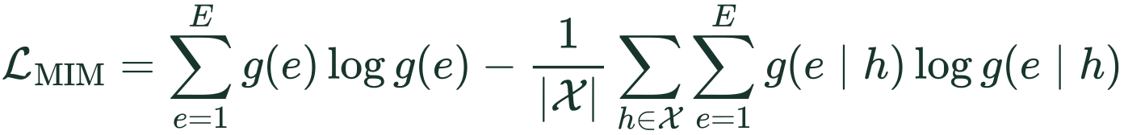
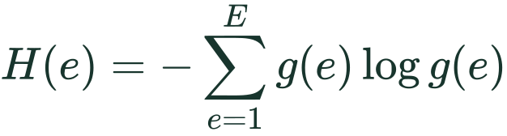
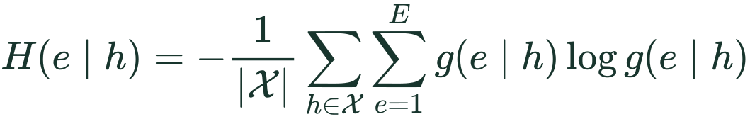
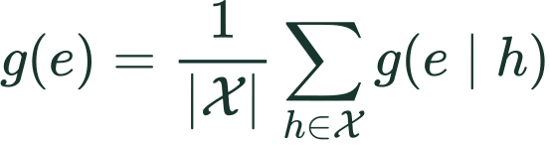
METHOD / AUXILIARY OBJECTIVE
Mutual-information maximization for routing
Marginal entropy: encourage use of the whole pool.
Conditional entropy: encourage a clear choice per input.
Average expert probability
Router probability: g(e | h)
Input representation: h
Router-input collection: X
Expert index: e; pool size: E
SUT Equation 1. Minimize the printed negative-MI loss to obtain the stated entropy effects.
07
Notes:
The main displayed expression is SUT Equation 1 in LaTeX, retaining the paper’s symbols. The loss symbol is calligraphic L, not capital Lambda. The marginal and entropy expansions clarify its terms without a numerical toy example. X is the collection of router inputs across token positions and refinement layers; g(e|h) is the router probability and g(e) its average. The printed expression is negative mutual information and should be minimized for the behavior described. The paper’s phrase to be maximised and the sign of its conditional-entropy underbrace are inconsistent with the displayed expression; we preserve the algebra and explain the sign consistently. The conditional entropy shown averages over router inputs.
Sources:
Tan et al., Sparse Universal Transformer, EMNLP 2023. Sections 1–5, Tables 1–5. https://aclanthology.org/2023.emnlp-main.12.pdf
LaTeX (mim):
\mathcal{L}_{\mathrm{MIM}}=\sum_{e=1}^{E}g(e)\log g(e)-\frac{1}{|\mathcal{X}|}\sum_{h\in\mathcal{X}}\sum_{e=1}^{E}g(e\mid h)\log g(e\mid h)
LaTeX (marginal):
g(e)=\frac{1}{|\mathcal{X}|}\sum_{h\in\mathcal{X}}g(e\mid h)
LaTeX (entropy):
H(e)=-\sum_{e=1}^{E}g(e)\log g(e)
LaTeX (condentropy):
H(e\mid h)=-\frac{1}{|\mathcal{X}|}\sum_{h\in\mathcal{X}}\sum_{e=1}^{E}g(e\mid h)\log g(e\mid h)
LaTeX (mi_identity):
\mathcal{L}_{\mathrm{MIM}}=-H(e)+H(e\mid h)=-I(e;h)

Slide 9
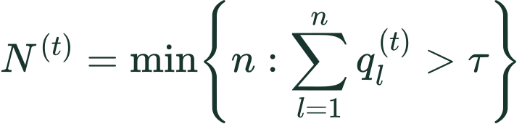
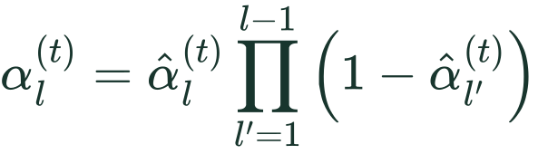
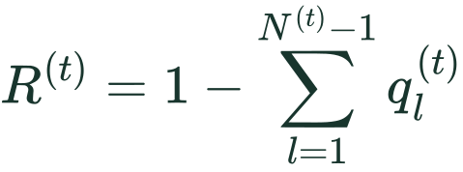
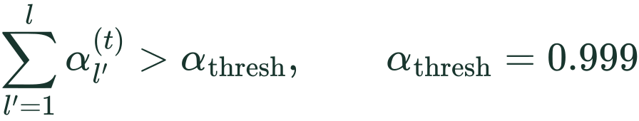
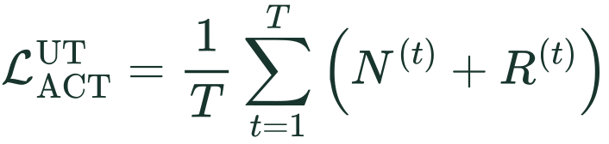
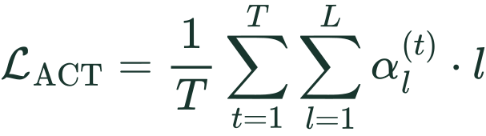
METHOD / ADDITION VERSUS STICK BREAKING
Dynamic halting and ACT objectives
UT: accumulated gate scores
SUT: probability of stopping
q: sigmoid-linear gate output
N: first step that crosses the threshold
R: mass left after steps before N,
assigned to the final update
α̂: conditional halt probability from an MLP
α: stopping mass after accounting for survival
T: token positions; L: maximum depth
ACT penalizes expected stopping depth.
UT: Appendix C / ACT, with indices aligned. SUT: Equations 2 and 4. t = token; l = depth; τ = UT threshold.
08
Notes:
UT formulas summarize Appendix C and Graves ACT with a common index convention: t is token position, l is depth. q is the UT sigmoid-linear gate output, N the first threshold-crossing step, R the remaining mass assigned to that last update. R is one minus accumulated scores strictly before N, not the distance to the threshold. A maximum depth cap applies if the threshold is never reached. SUT Equations 2 and 4 retain their original symbols. Alpha-hat is a conditional halt probability from an MLP. Alpha is unconditional stopping mass, the conditional probability multiplied by survival through earlier layers. T counts token positions and L is the maximum refinement depth. The SUT threshold is .999. The UT penalty uses N+R, while SUT penalizes expected stopping depth. A finite-depth implementation must handle remaining mass. ACT penalties are not measured FLOPs.
Sources:
Dehghani et al., Universal Transformers, ICLR 2019. Figure 4 and Appendix C. https://arxiv.org/html/1807.03819v3
Graves, Adaptive Computation Time for Recurrent Neural Networks, 2016. https://arxiv.org/html/1603.08983
Tan et al., Sparse Universal Transformer, EMNLP 2023. Sections 1–5, Tables 1–5. https://aclanthology.org/2023.emnlp-main.12.pdf
LaTeX (ut_stop):
N^{(t)}=\min\!\left\{n:\sum_{l=1}^{n}q_l^{(t)}>\tau\right\}
LaTeX (sut_stop):
\alpha_l^{(t)}=\hat\alpha_l^{(t)}\prod_{l'=1}^{l-1}\left(1-\hat\alpha_{l'}^{(t)}\right)
LaTeX (ut_remainder):
R^{(t)}=1-\sum_{l=1}^{N^{(t)}-1}q_l^{(t)}
LaTeX (sut_thresh):
\sum_{l'=1}^{l}\alpha_{l'}^{(t)}>\alpha_{\mathrm{thresh}},\qquad\alpha_{\mathrm{thresh}}=0.999
LaTeX (ut_act):
\mathcal{L}_{\mathrm{ACT}}^{\mathrm{UT}}=\frac{1}{T}\sum_{t=1}^{T}\left(N^{(t)}+R^{(t)}\right)
LaTeX (sut_act):
\mathcal{L}_{\mathrm{ACT}}=\frac{1}{T}\sum_{t=1}^{T}\sum_{l=1}^{L}\alpha_l^{(t)}\cdot l

Slide 10
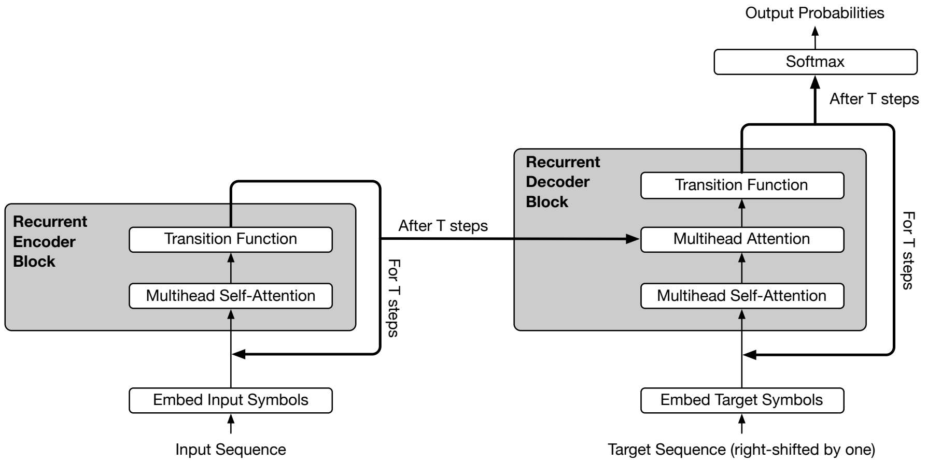

METHOD / REPEATED REFINEMENT
UT: recurrence and recursive state interpolation
What repeats at each step?
The same attention and transition
parameters process the current states.
Position and step signals enter
the attention update each iteration.
Recursive interpolation of states
Current transformed state + previous mixed state
UT Figure 2 and Equation 4 (t = refinement step here). Interpolation: SUT Section 3.2.
09
Notes:
Original UT Figure 2 gives a compact view of the repeated encoder and decoder blocks. The recurrence reuses the same transformation parameters at every step and passes the current hidden states into the next step. Original UT Equation 4 is shown. Here superscript t follows UT and denotes refinement step, unlike t as token position in SUT. P^t, which enters the attention update, contains position and step signals. The lower interpolation equation is the formula quoted by SUT Section 3.2 when discussing prior UT halting. The alpha weight is an interpolation coefficient, not the SUT stopping mass. Each new state is mixed with the already mixed previous state, so later factors rescale earlier contributions. The final UT update uses the remainder. Recurrence exists even when dynamic halting is disabled.
Sources:
Dehghani et al., Universal Transformers, ICLR 2019. Figure 4 and Appendix C. https://arxiv.org/html/1807.03819v3
Tan et al., Sparse Universal Transformer, EMNLP 2023. Sections 1–5, Tables 1–5. https://aclanthology.org/2023.emnlp-main.12.pdf
LaTeX (ut_update):
H^t=\mathrm{LayerNorm}\!\left(A^t+\mathrm{Transition}(A^t)\right)
LaTeX (recursive):
h_l=\alpha_l\cdot\hat h_l+(1-\alpha_l)\cdot h_{l-1}

Slide 11
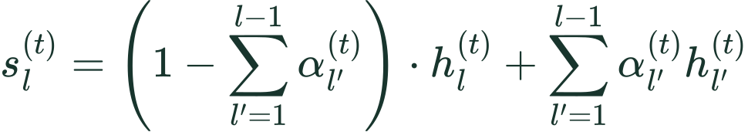
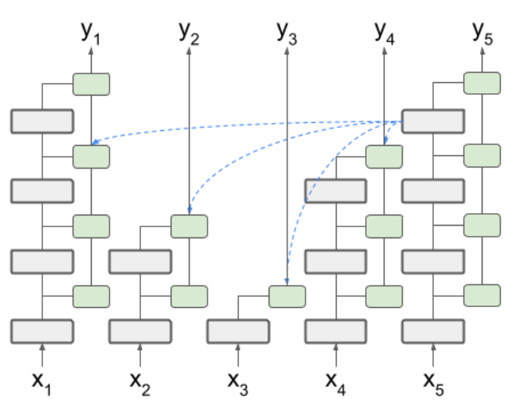
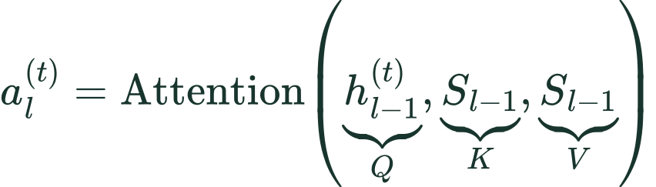

METHOD / STATE AGGREGATION AND ATTENTION
SUT: expected halted states remain readable
Survival mass × current state + earlier stopping masses × earlier states
h: unhalted state for the active token
s: expected halted state
S: collection of all tokens’ s states
SUT Equation 3, Algorithm 1 and Figure 3 (right). A no-op copies the halted token’s states.
10
Notes:
SUT Equation 3 and Algorithm 1. h is the unhalted state, s is the expected halted state, and capital S stacks the s states across token positions. The first term is survival mass assigned to the current state; the second sums earlier stopping mass times the corresponding raw state. Active queries use their own previous unhalted h, while keys and values use S so they can read tokens that halted earlier. A halted token stops its own update but stays available to other tokens. The no-op branch copies h and s. Figure 3 right explains this cross-token interaction; it does not depict recurrence through sequence time.
Sources:
Tan et al., Sparse Universal Transformer, EMNLP 2023. Sections 1–5, Tables 1–5. https://aclanthology.org/2023.emnlp-main.12.pdf
LaTeX (sut_state):
s_l^{(t)}=\left(1-\sum_{l'=1}^{l-1}\alpha_{l'}^{(t)}\right)\cdot h_l^{(t)}+\sum_{l'=1}^{l-1}\alpha_{l'}^{(t)}h_{l'}^{(t)}
LaTeX (sut_query):
a_l^{(t)}=\mathrm{Attention}\!\left(\underbrace{h_{l-1}^{(t)}}_{Q},\underbrace{S_{l-1}}_{K},\underbrace{S_{l-1}}_{V}\right)
LaTeX (sut_noop):
h_l^{(t)}=h_{l-1}^{(t)},\qquad s_l^{(t)}=s_{l-1}^{(t)}

Slide 12
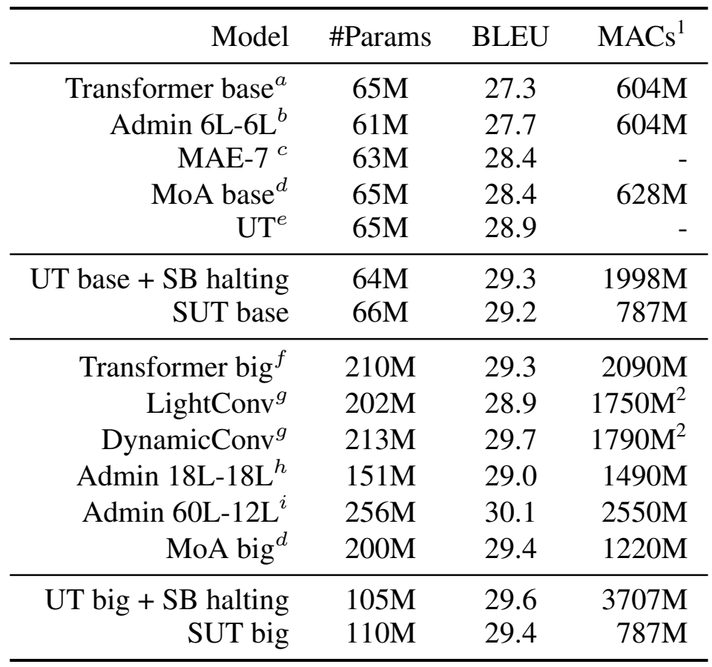
EXPERIMENTS / WMT’14
English–German translation: scale and cost
Matched-depth configurations
Model | E | Embed | Datt | Dff
UT base | 1 | 960 | 960 | 3840
UT big | 1 | 1344 | 1344 | 5376
SUT base | 24 | 512 | 256 | 512
SUT big | 48 | 512 | 256 | 512
All four: 6 encoder / 6 decoder steps
E applies to both expert pools.
SUT big versus UT big
≈4.7× fewer MACs, 0.2 lower BLEU
Table 1 and Appendix Table 6. SB = stick breaking. Superscript 2: MAC undercounts for convolutions.
11
Notes:
Input is English text, target is German text. Original Table 1 is embedded with all original rows, column headings and citation markers. MACs are the reported multiply–accumulate estimates, not wall-clock speed or FLOPs. LightConv and DynamicConv estimates are undercounted by the tool used, as the paper notes. Model configurations on the right come from the arXiv Appendix Table 6, absent from the supplied proceedings PDF. E is the number of experts in each pool; Datt is the table’s total attention-expert dimension, not the per-head D in the five-tuple. All four listed UT/SUT models use six encoder and six decoder steps. SUT big uses 110M parameters and 787M MACs versus dense UT big 105M and 3707M, at 29.4 versus 29.6 BLEU: approximately 4.7 times lower MACs, not a measured 4.7-times speedup. Relative to Transformer big, SUT big uses about half parameters and 38% of MACs. Training uses Adam, inverse-square-root learning-rate scheduling, label smoothing .1, 100 epochs and averaging the five best NLL checkpoints. Main paper Section 4.1 says vocabularies/embeddings are shared. Keep quality and cost trade-offs visible.
Sources:
Tan et al., Sparse Universal Transformer, EMNLP 2023. Sections 1–5, Tables 1–5. https://aclanthology.org/2023.emnlp-main.12.pdf
Tan et al., arXiv version, Appendix A and Table 6. https://arxiv.org/pdf/2310.07096

Slide 13
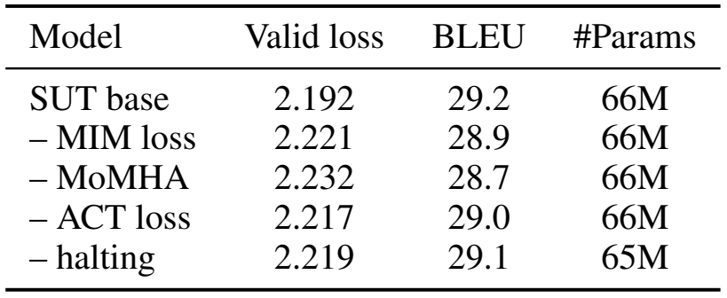
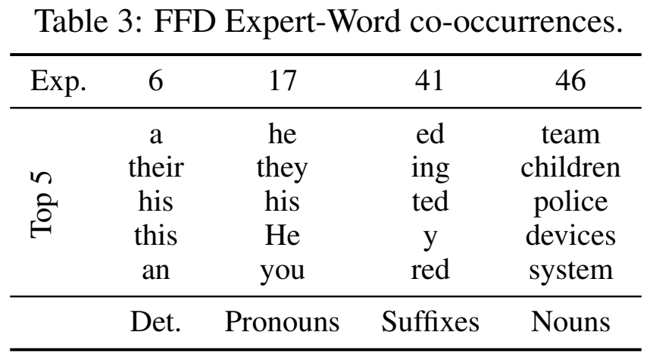
EXPERIMENTS / WMT’14
Translation: ablations and FFN specialization
“− MoMHA” replaces it with MoA.
FFN-MoE remains in the model.
Selected examples suggest specialization.
They do not measure redundancy.
SUT Tables 2–3. FFN experts are called FFD experts in the paper.
12
Notes:
Table 2: removing MIM means replacing it with a load-balancing loss, not removing every routing regularizer. Minus MoMHA means replacement with MoA, not MoE. The reported replacement reduces BLEU by .5, the largest of these ablations, but does not isolate H alone while holding every design choice fixed. FFN experts remain. Halting removal costs .1 BLEU, ACT loss removal .2, MIM replacement .3. Table 3 explicitly concerns FFD/FFN expert–word co-occurrences across layers. The authors selected four experts showing patterns. Associations suggest specialization, but neither demonstrate causal functions nor quantify redundancy. Retain that distinction when connecting to our experiment.
Sources:
Tan et al., Sparse Universal Transformer, EMNLP 2023. Sections 1–5, Tables 1–5. https://aclanthology.org/2023.emnlp-main.12.pdf

Slide 14
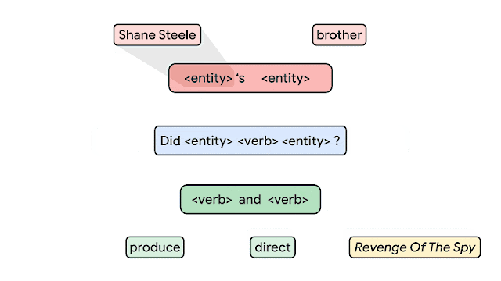

EXPERIMENTS / TASK DEFINITION
CFQ: familiar pieces, unfamiliar combinations
Model input
Natural-language question
Prediction target
SPARQL query text
MCD: familiar building blocks
in unfamiliar combinations
Original Google Research animation, shown as two still frames for reliable display. Target: SPARQL.
13
Notes:
CFQ stands for Compositional Freebase Questions. The original Google Research animation illustrates how grammar building blocks compose into a sentence. The prediction task in SUT is semantic parsing: natural-language question to SPARQL query text. It is not predicting the parse tree shown by the animation, and the database answer is not the training target in this benchmark. MCD splits keep atomic distributions similar while changing combinations. The original animation is now shown as two still frames, avoiding viewer-dependent GIF playback. It illustrates grammar composition, not the neural prediction target. The animation’s source is linked below. SUT uses transformed query targets, so its preprocessing differs from an unmodified raw target comparison.
Sources:
Google Research, Measuring Compositional Generalization, 6 March 2020. Original animation: https://research.google/blog/measuring-compositional-generalization/
Keysers et al., Measuring Compositional Generalization, ICLR 2020. Figure 1. https://arxiv.org/pdf/1912.09713
Tan et al., Sparse Universal Transformer, EMNLP 2023. Sections 1–5, Tables 1–5. https://aclanthology.org/2023.emnlp-main.12.pdf

Slide 15
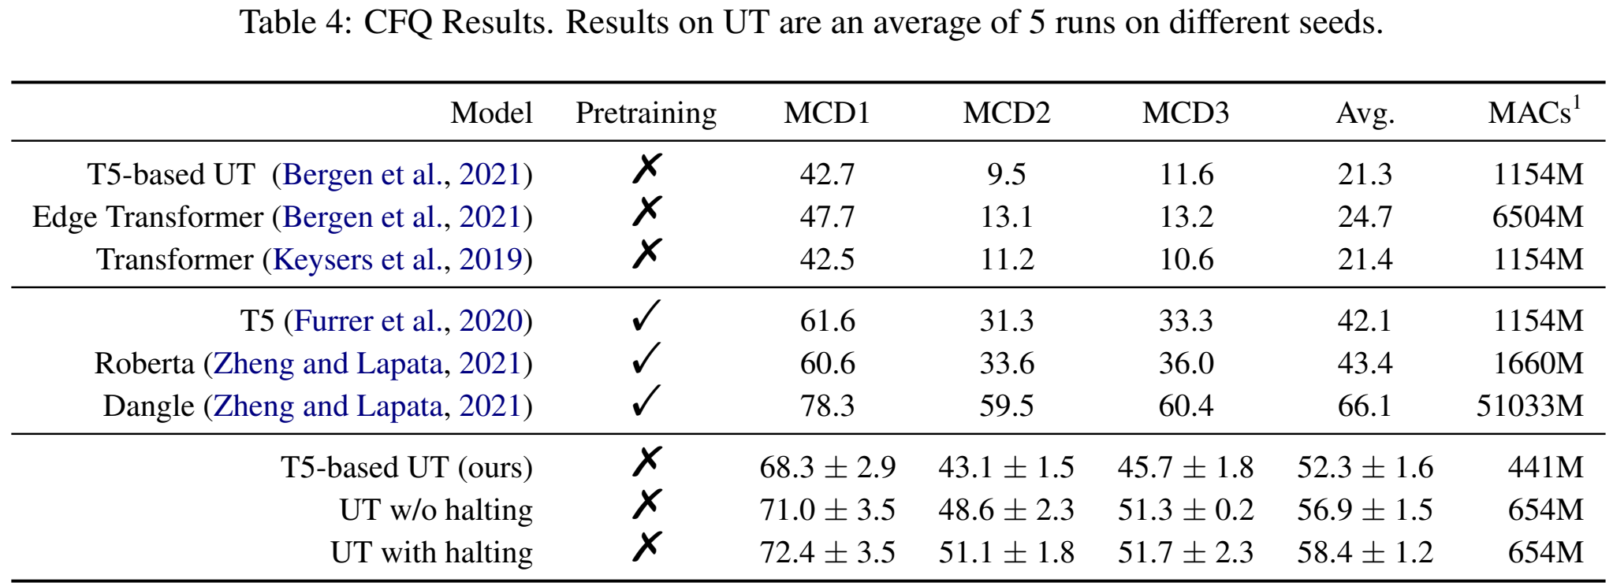
EXPERIMENTS / COMPOSITIONAL GENERALIZATION
CFQ results: the best setting uses one expert
8 encoder / 8 decoder steps. Best configuration: one expert in each pool.
Table 4. Accuracy (%). UT rows: five seeds. Original uncertainties retained. Configuration: Section 4.2 and Appendix A.
14
Notes:
All Table 4 models and means are shown. Original full uncertainty for our rows: T5-based UT MCD1 68.3±2.9, MCD2 43.1±1.5, MCD3 45.7±1.8, average52.3±1.6; UT without halting71.0±3.5,48.6±2.3,51.3±.2,average56.9±1.5; UT with halting72.4±3.5,51.1±1.8,51.7±2.3,average58.4±1.2. Those UT results average five seeds. Hyperparameters were selected on MCD1 validation. Attention (E=1,k=1,H=8,D=64,W=1), FFN(E=1,k=1,D=1024), embedding512, 8 encoder/8 decoder steps, 7.2M with halting and6.7M without. Thus the winning CFQ model is a UT special case, not evidence that multiple sparse experts are needed on CFQ. Target preprocessing and positional/norm implementation details improve baselines. Dangle is better at66.1 but pretrained and much more expensive in reported MACs. Avoid presenting all rows as a controlled architectural-only comparison.
Sources:
Tan et al., Sparse Universal Transformer, EMNLP 2023. Sections 1–5, Tables 1–5. https://aclanthology.org/2023.emnlp-main.12.pdf
Tan et al., arXiv version, Appendix A and Table 6. https://arxiv.org/pdf/2310.07096
LaTeX (cfq_att):
(E,K,H,D,W)=(1,1,8,64,1)
LaTeX (cfq_ffn):
(E,K,D)=(1,1,1024)

Slide 16

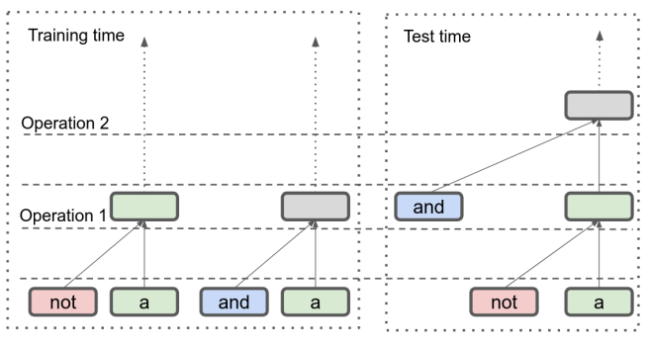
EXPERIMENTS / TASK AND CONFIGURATION
Logical inference: relational reasoning beyond training
Input: expression 1 #SEP# expression 2
Target: forward entailment
Length generalization
Train: 0–6 logical operators
Test: 7–12 logical operators
SUT configuration
SUT Section 4.3 and Figure 2. Output: relation label. Depth: 12 encoder / 12 decoder steps.
15
Notes:
The task takes two propositional-logic expressions and predicts their semantic relation as a single label. Example a entails a OR b. The model receives sentence1 #SEP# sentence2, not a parse tree. Training has0–6 logical operators, evaluation7–12. The separate compositional splits A/B/C increase difficulty. The jump twice to jump jump example belongs to SCAN-style command interpretation, not this logical-inference task. Original SUT Figure2 illustrates a withheld combination of NOT and AND operations; it is not a literal input format for the model. The paper uses a12-layer encoder and12-layer decoder with attention(12,4,2,32,1), FFN(12,4,128), embedding512 and7.6M parameters. Halting is enabled. This is genuine multiple-expert SUT, unlike the CFQ winner.
Sources:
Tan et al., Sparse Universal Transformer, EMNLP 2023. Sections 1–5, Tables 1–5. https://aclanthology.org/2023.emnlp-main.12.pdf
Tan et al., arXiv version, Appendix A and Table 6. https://arxiv.org/pdf/2310.07096
LaTeX (logic_example):
a\quad\#\mathrm{SEP}\#\quad(a\lor b)
LaTeX (logic_att):
(E,K,H,D,W)=(12,4,2,32,1)
LaTeX (logic_ffn):
(E,K,D)=(12,4,128)

Slide 17
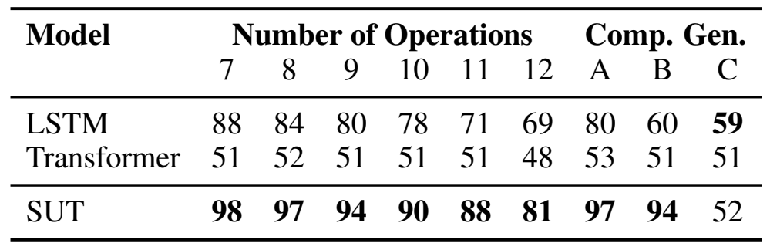
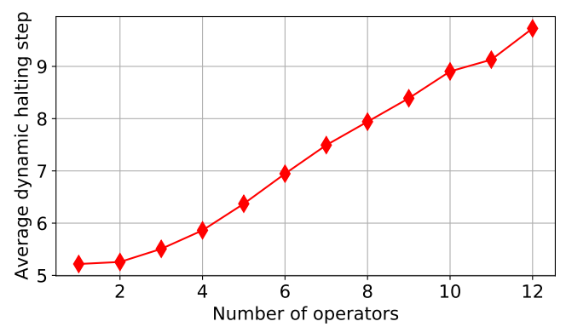
EXPERIMENTS / GENERALIZATION RESULTS
Logical inference: gains and remaining failures
More operators, deeper computation
Depth rises with operator count.
Length and complexity are correlated.
Split C remains difficult: 52% accuracy
SUT Table 5 and original Figure 4. Columns 7–12 are operator counts; A–C are composition splits.
16
Notes:
Table5 values are accuracy percentages. SUT substantially exceeds the Transformer and LSTM on length extrapolation here. It also improves A and B, but C remains52 compared with LSTM59. Do not call compositional generalization solved. The source Figure4 shows average halting depth increasing with operator count. Operator count also correlates with length, so this does not isolate reasoning difficulty from sequence length. Baseline references: LSTM Bowman2015, Transformer Shen2019. The paper says a newly trained12-layer vanilla Transformer achieves approximately the same result as the cited baseline. The original figure caption says UT, while the surrounding setting and Table5 call the model SUT; describe it as the paper model without silently changing the source image.
Sources:
Tan et al., Sparse Universal Transformer, EMNLP 2023. Sections 1–5, Tables 1–5. https://aclanthology.org/2023.emnlp-main.12.pdf

Slide 18
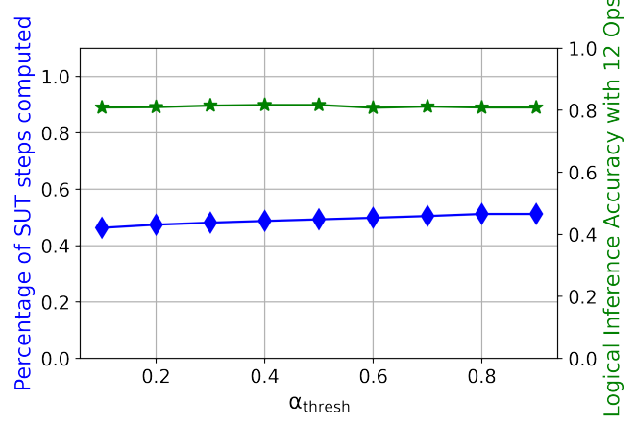
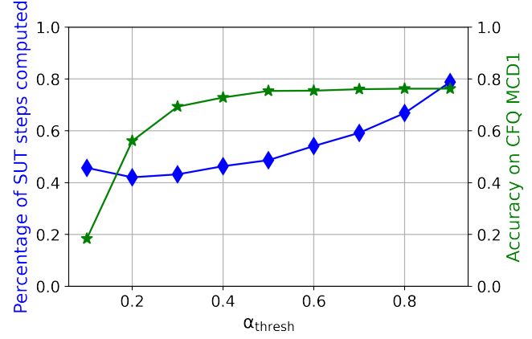
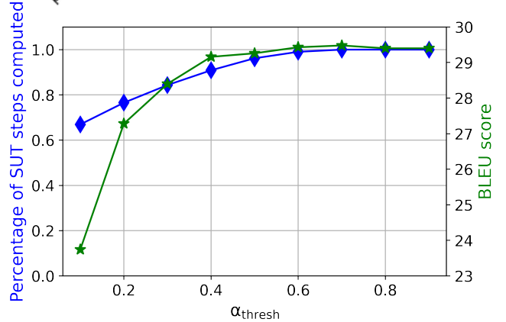
EXPERIMENTS / INFERENCE TRADE-OFF
Post-training computation reduction
Logical inference
CFQ
English–German
About 50% skipped steps
with stable accuracy
About 33% skipped
at threshold 0.8
9% less computation
while retaining 29.1 BLEU
Skipped block steps are an estimate of computation savings, not a measured speedup.
Section 4.4 and original Figures 5–7. Blue: fraction computed. Green: task quality.
17
Notes:
Section4.4 is valuable because it turns halting into a post-training control. Adjust the cumulative threshold and evaluate quality again. The original plots show fraction computed in blue and task quality in green. The estimates are based on decoder halting patterns with ground-truth source-target pairs, so these are skipped SUT block-step estimates, not measured end-to-end speedups. Logical inference has near-constant roughly50% skipped steps. CFQ text reports roughly33% skipped atthreshold.8 with stable quality in.8–.999, and about50% for a small .2% accuracy decrease; plots and prose have some inconsistencies, so avoid unsupported precision. Translation text reports9% less computation while retaining29.1 BLEU. Lowering threshold can alter token representations and subsequently other tokens’ halting, so monotonicity is not guaranteed. The cited images retain original axes.
Sources:
Tan et al., Sparse Universal Transformer, EMNLP 2023. Sections 1–5, Tables 1–5. https://aclanthology.org/2023.emnlp-main.12.pdf

Slide 19
DISCUSSION
Conclusions and questions for our experiments
What the paper supports
What remains unresolved
Sparse experts make a shared block
cheaper to scale on translation.
CFQ favors one expert.
Logical split C remains difficult.
Repeated refinement helps on several
generalization tests.
Expert associations do not establish
causal specialization or redundancy.
Halting provides a tunable
accuracy–computation trade-off.
Our tests should isolate routing, reuse
and depth with controlled budgets.
Discussion hypothesis: compare structural choices independently before combining them.
Paper conclusions and limitations. Proposed experiment questions are not new results.
18
Notes:
The structural hypothesis is that routing granularity, reuse across depth and stopping are separable choices. SUT combines them, but its experiments do not establish a universal principle. WMT supports parameter efficiency with a quality-cost trade-off; CFQ selects the one-expert UT setting; logical inference exposes failure on splitC. Token-expert associations are observational. For our controlled toy experiments, isolate changes, match parameter budgets and measure actual compute separately, select checkpoints on validation MSE, never expose regime labels to non-oracle models, and preserve negative results. These are proposed controls, not experimental findings. Toy-program results have not been added because they need a fresh audit and discussion; insert validated result slides before the final structural table later.
Sources:
Tan et al., Sparse Universal Transformer, EMNLP 2023. Sections 1–5, Tables 1–5. https://aclanthology.org/2023.emnlp-main.12.pdf

Slide 20
Structural comparison
Green: Yes Light green: qualified Yes* White: No or no router
Architecture | MHA | FFN MoE | Router | Recurrence | Halting / skipping
Vanilla Transformer | Yes | No |  | No | No
FFN-MoE Transformer | Yes | Yes | FFN | No | No
UT | Yes | No |  | Yes | Yes*
MoA | Yes* | No | Attention head | No | No
MoH | Yes* | No | Attention head | No | No
SUT | Yes | Yes | MHA expert + FFN | Yes | Yes
MoM | Yes | Yes | MHA module + FFN | Yes* | Yes*
* MHA includes routed variants (MoA, MoH). UT halting is optional.
Recurrence = reuse across depth. MoM reuses modules and optionally skips steps.
Configurations shown follow the cited papers. Sources and qualifications are in the slide notes.
Notes:
Final comparison slide for the planned SUT presentation. MHA means multi-head attention, including routed variants; it does not imply a full MHA block inside every MoA expert. MoA routes single heads, SUT MoMHA has H heads per expert. FFN MoE means a separately routed FFN expert pool. Router lists the selected unit, blank means no expert/head router (UT still has a halting gate). Recurrence means reuse of parameters across depth, not recursive state interpolation. Typical FFN-MoE shown uses separate layer pools. UT halting is optional. MoM reuses a module pool rather than one fixed block, and SKIP is optional; skipping does not imply permanent halting. MoM attention assembles projection parameters. MoH shared heads are always active, not necessarily shared KV projections. MoH and MoM are later 2024 comparisons, not predecessors of SUT.
Sources:
Transformer: https://arxiv.org/html/1706.03762
Switch: https://arxiv.org/html/2101.03961
UT: https://arxiv.org/html/1807.03819v3
MoA Sections 4-5: https://arxiv.org/html/2210.05144
MoH Section 3.2: https://arxiv.org/html/2410.11842
SUT Sections 3.1-3.2: https://aclanthology.org/2023.emnlp-main.12.pdf
MoM Sections 3.1-3.3: https://arxiv.org/html/2407.06677

