Slide 1
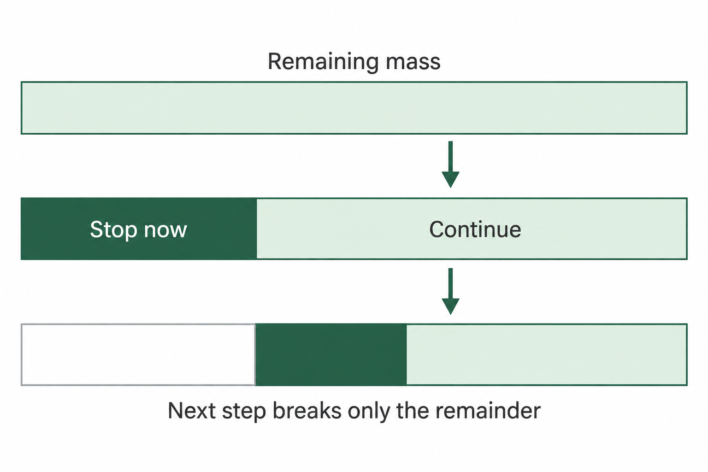
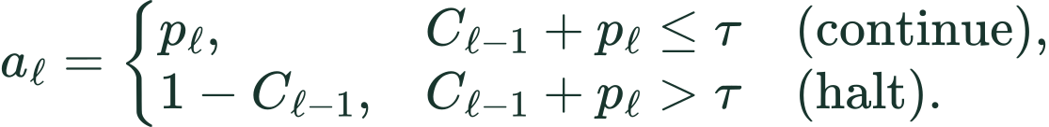
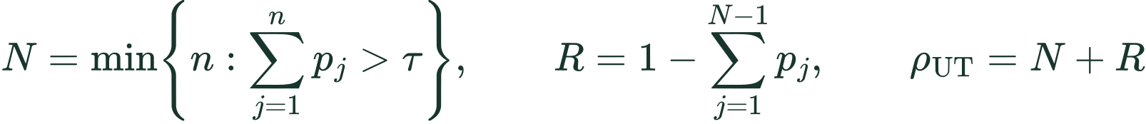
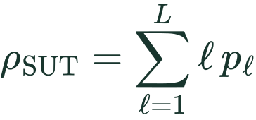
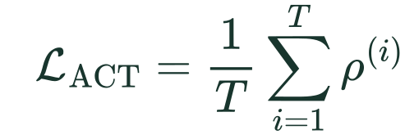
METHOD / HALTING AND SHARED DEPTH
Dynamic halting: addition versus stick breaking
One token across depth: q = gate output, m = remaining mass, p = mass assigned to stopping
UT: add the gate scores
SUT: break the remaining mass
Stop at the threshold-crossing step N.
Use the remainder R for the final update.
Stop when accumulated stopping mass reaches the threshold.
ACT: penalize computation during training
Aligned notation, one-token costs. N = stopping depth; R = final UT remainder. SUT ACT = expected depth.
Notes:
Suggested spoken explanation: Both models learn when to stop refining a token. UT adds gate scores. SUT interprets its gate as taking a fraction of the probability mass still available, like repeatedly breaking the remaining part of a stick. Once enough mass has been assigned to stopping, the token stops updating. ACT encourages earlier stopping.
Use one-token notation throughout. q_l is a gate output in [0,1]. C_0=0. SUT begins with m_0=1; p_l=q_l m_(l-1) is unconditional stopping probability and m_l=(1-q_l)m_(l-1) is survival mass. Therefore p_l=q_l product_(j<l)(1-q_j), exactly the stick-breaking algebra in SUT Equation 2 with q=alpha-hat and p=alpha. Cumulative SUT stopping mass is 1-m_l. UT uses cumulative q instead. The two learned gates need not have equal values or identical parameterizations; UT uses a sigmoid-linear gate, SUT an MLP.
UT N is the first depth at which the cumulative q exceeds its threshold, subject to a depth cap. Its last interpolation update uses R=1-sum_(j<N)q_j. This remainder fills to one, not merely to the threshold. R is distinct from SUT survival mass m. The per-token ACT ponder cost is N+R. SUT Equation 4 is expected stopping depth, sum_l l p_l. Average per-token costs over token positions and multiply by the training coefficient in the total loss. The full SUT objective is L_ACT=(1/T)sum_i sum_l l alpha_l^(i). The public ACTWrapper includes a surviving-mass-at-current-depth term for finite-depth accounting. These training penalties are not measured FLOPs or wall-clock runtime.
Threshold values are omitted to keep the distinction visible; SUT paper uses .999. The strip illustration is a newly generated conceptual teaching aid, not an original paper figure or an empirical chart. Segment lengths are illustrative only. White area on the third strip denotes mass already assigned at a previous step, dark green newly assigned mass, pale green surviving mass.
Sources:
https://arxiv.org/pdf/1807.03819v3
https://aclanthology.org/2023.emnlp-main.12.pdf
LaTeX ut_acc: C_{\ell}=C_{\ell-1}+q_{\ell}
LaTeX sut_break: p_{\ell}=q_{\ell}m_{\ell-1},\qquad m_{\ell}=(1-q_{\ell})m_{\ell-1}
LaTeX ut_act: \rho_{\mathrm{UT}}=N+R,\qquad R=1-\sum_{j<N}q_j
LaTeX sut_act: \rho_{\mathrm{SUT}}=\sum_{\ell=1}^{L}\ell\,p_{\ell}

Slide 2
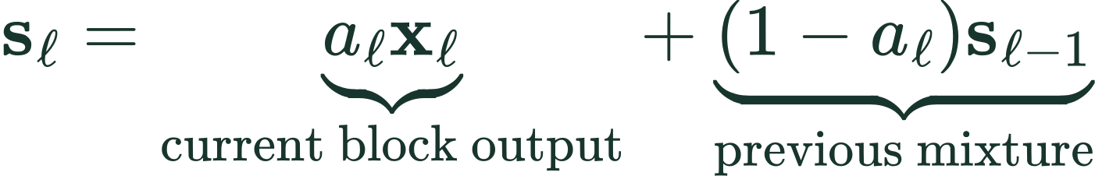
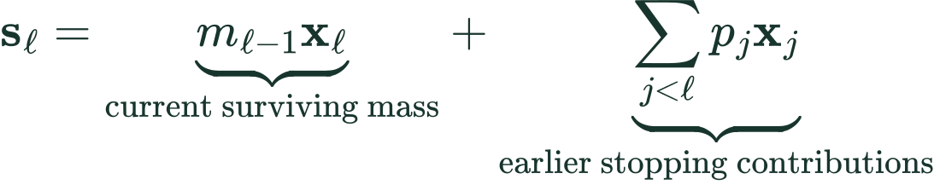
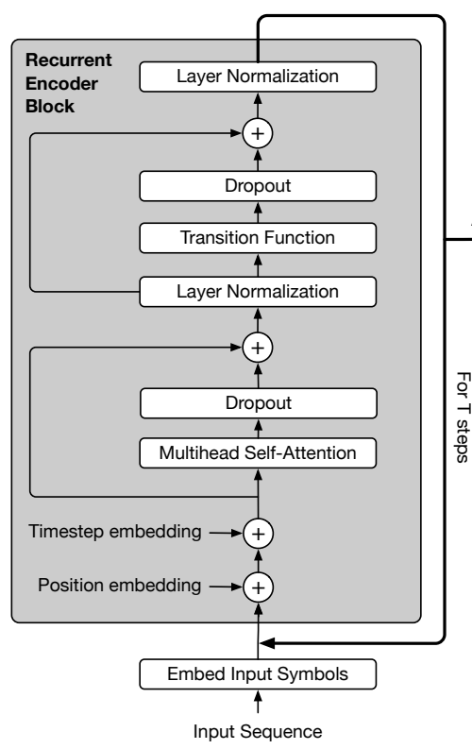
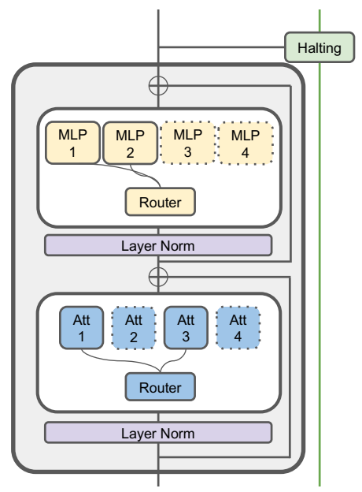
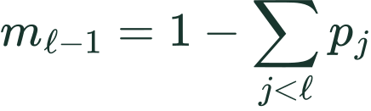
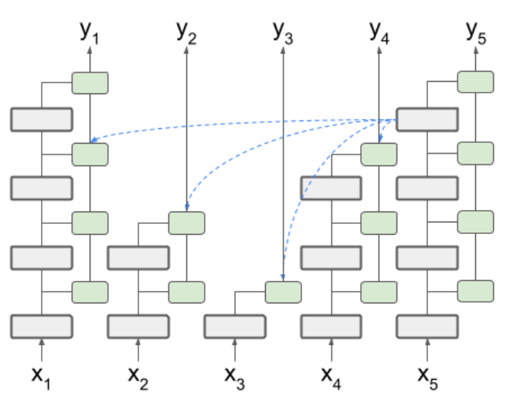

METHOD / HALTING AND SHARED DEPTH
State aggregation: compare the same quantities
Same symbols in both columns: x = block output, s = combined state, l = refinement depth
UT: update the previous mixture
SUT: retain explicit stopping weights
Earlier block outputs keep their stopping weights.
UT
SUT
SUT attention reads
combined states from
all allowed tokens.
UT Appendix C and SUT Equation 3 / Algorithm 1, rewritten in aligned notation. Capital S stacks token states.
Notes:
Suggested spoken explanation: Now both columns use x for the new block output and s for the combined output. UT combines the new x with the previous mixture s. SUT combines the surviving current x with explicitly weighted earlier x states. This is the difference in aggregation, not the fact that the block repeats. In SUT, an active query can read the combined states of other tokens, even if they have halted.
UT formula comes from Appendix C new_state = update_weights * transformed_state + (1-update_weights) * previous_state. w_l is q_l before the last step, the remainder R on the last step, and zero after stopping. SUT Equation 3 becomes s_l=m_(l-1)x_l+sum_(j<l)p_j x_j with m_(l-1)=1-sum_(j<l)p_j. This uses exactly the original strict j<l summation, avoiding an off-by-one interpretation that would count the current stopping probability twice. p_j=q_j product_(k<j)(1-q_k).
UT later factors (1-w_l) multiply the previous mixture, so older contributions are repeatedly rescaled. SUT exposes earlier stopping weights directly. Do not describe the original Graves ACT weighted sum as identical to UT Appendix C interpolation. UT raw transformed states, not merely its accumulated output, feed the next raw update in the Appendix C loop.
In SUT Algorithm 1 the active query representation is raw h_(l-1)^(i) (our x), whereas K and V use S_(l-1), the matrix of combined states. Q/K/V here name inputs to projections, not already projected vectors. For a halted token, x and s are copied/no-op and remain available to other tokens, subject to attention masks. s need not itself be a LayerNorm output; it is a mixture of block outputs. This corrects the ambiguity in the previous three slides.
The SUT paper has indexing edge cases around its pseudocode initialization; here we preserve Equation 3 and explain its state roles, rather than reproduce the first-iteration pseudocode literally.
Sources:
https://arxiv.org/pdf/1807.03819v3
https://aclanthology.org/2023.emnlp-main.12.pdf
LaTeX ut_mix: \mathbf{s}_{\ell}=\underbrace{w_{\ell}\mathbf{x}_{\ell}}_{\text{current block output}}+\underbrace{(1-w_{\ell})\mathbf{s}_{\ell-1}}_{\text{previous mixture}}
LaTeX sut_mix: \mathbf{s}_{\ell}=\underbrace{m_{\ell-1}\mathbf{x}_{\ell}}_{\text{current surviving mass}}+\underbrace{\sum_{j<\ell}p_j\mathbf{x}_j}_{\text{earlier stopping contributions}}
LaTeX weights: w_{\ell}=q_{\ell}\;(\ell<N),\qquad w_N=R
LaTeX survival: m_{\ell-1}=1-\sum_{j<\ell}p_j
LaTeX attention: Q\leftarrow\mathbf{x}_{\ell-1}^{(i)},\qquad K,V\leftarrow\mathbf{S}_{\ell-1}

