Slide 1
METHOD / HALTING AND SHARED DEPTH
Shared notation: block output and combined state
Entering state
New block output
Combined state
One row of the previous block’s H matrix.
At the first step: the token embedding.
One row of the new H matrix.
Computed before halting aggregation.
One row of the I matrix.
Combines outputs from different depths.
Where is H measured?
Original notation → shared notation
UT: after the final residual + LayerNorm.
SUT: at the complete block’s output;
pre-norm ends at the residual addition.
UT: transformed_state → h; new_state → z
SUT: h → h; s → z; matrix S → matrix I
All halting probabilities below are per token.
Recurrence repeats the shared block. Aggregation combines its outputs.
Aligned teaching notation; original operations preserved. Depth = ℓ; token index i is suppressed on the next slides.
Notes:
We align notation by role, not by pretending the original papers use the same letters. i is a token position; ell is recurrent depth; T is sequence length; each matrix has T rows and model-width columns. u is the entering state, h the new raw block output, z the halting-combined state. H_0 is the embedding matrix. UT Appendix C maps state to u, transformed_state to h, previous_state to z_(ell-1), new_state to z_ell. Its accumulator starts at zero. UT H^t maps to H_ell. SUT h_ell^(t) maps to h_ell^(i), s_ell^(t) to z_ell^(i), and S_ell to I_ell. SUT p=alpha-hat and b=alpha. UT p is the sigmoid gate and a is update_weights. These are per-token scalars; a is not the attention representation A^t in UT Equation 5, and p is not positional encoding P^t. The block contains attention, transition/FFN, residual, dropout and normalization. Shared weights mean the same block parameters are reused across depth. UT gate reads the entering raw state. SUT Algorithm 1 gates h_(ell-1) before computing h_ell; its p_j names the hazard associated with raw state h_j, preserving Equation 2 indexing. SUT gate is MLP-based; UT is sigmoid-affine. We do not force identical timing labels.
Sources: https://arxiv.org/html/1807.03819v3#A3 ; https://aclanthology.org/2023.emnlp-main.12.pdf (Section 3.2, Equations 2–4, Algorithm 1).
LaTeX states: \mathbf{u}_{\ell}=H_{\ell-1}[i,:],\qquad \mathbf{h}_{\ell}=H_{\ell}[i,:],\qquad \mathbf{z}_{\ell}=I_{\ell}[i,:]

Slide 2
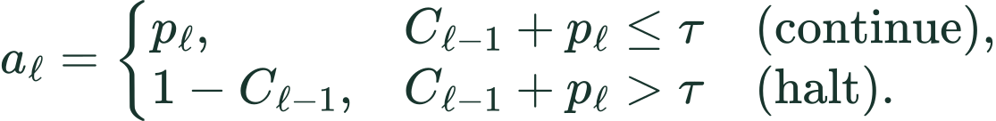
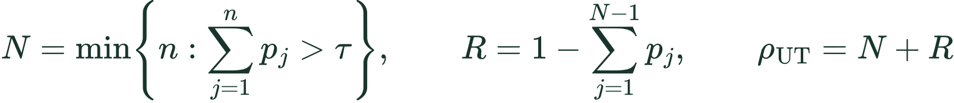
METHOD / HALTING AND SHARED DEPTH
UT: the complete halting update
1 Read the entering state and predict a gate
p is a scalar in (0, 1); C is the running total.
2 Choose the update weight; then update the total
3 Compute the block output h; interpolate with the previous combined state
Start with z₀ = 0. After halting: a = 0.
The final output is z at the halting step.
Stopping depth, final remainder, and ACT cost
UT Appendix C, translated into equations. Threshold-crossing case shown; the maximum-depth cap is a separate safeguard.
Notes:
Mathematical transcription of UT Appendix C, Listing 2, with aligned notation. For an active token, compute the sigmoid-affine gate from entering u_ell = H_(ell-1)[i,:]. Choose a_ell=p_ell when C_prev+p<=tau, otherwise use 1-C_prev. Thus C is the running halting accumulator, not a separate learned gate; the final update fills C to 1. The appendix uses strict greater-than for threshold crossing; equality continues. Already-halted tokens use a=0 and keep z. The newly computed h is transformed_state. z=a*h+(1-a)*zprev is the appendix interpolation and z0=0. The final token output is z_N, the corresponding row of I, not the raw block output h_N. Under natural threshold crossing, N=min{n:sum p>tau}, R=1-sum_(j=1)^(N-1)p_j, and a_N=R. A maximum-depth cap is a separate implementation condition; the displayed N/R expressions describe threshold-triggered stopping. Mean N+R is the UT ponder penalty, scaled in the total training objective. Ponder penalty need not be integer. State recurrence feeds raw transformed_state to the next block; the separate combined accumulator is returned as output.
Sources: https://arxiv.org/html/1807.03819v3#A3 ; https://aclanthology.org/2023.emnlp-main.12.pdf (Section 3.2, Equations 2–4, Algorithm 1).
LaTeX utgate: p_{\ell}=\sigma(\mathbf{w}^{\mathsf T}\mathbf{u}_{\ell}+b),\qquad C_0=0
LaTeX utweight: a_{\ell}=\begin{cases}p_{\ell},&C_{\ell-1}+p_{\ell}\leq\tau\quad\text{(continue)},\\1-C_{\ell-1},&C_{\ell-1}+p_{\ell}>\tau\quad\text{(halt)}.\end{cases}
LaTeX utacc: C_{\ell}=C_{\ell-1}+a_{\ell},\qquad C_N=1
LaTeX utmix: \mathbf{z}_{\ell}=a_{\ell}\mathbf{h}_{\ell}+(1-a_{\ell})\mathbf{z}_{\ell-1}
LaTeX utcost: N=\min\!\left\{n:\sum_{j=1}^{n}p_j>\tau\right\},\qquad R=1-\sum_{j=1}^{N-1}p_j,\qquad\rho_{\rm UT}=N+R

Slide 3
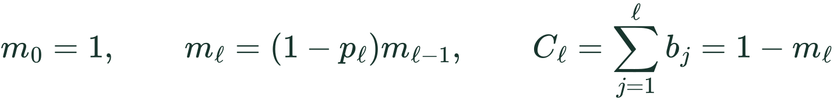
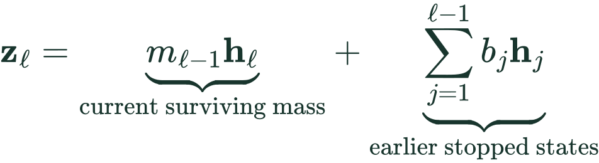
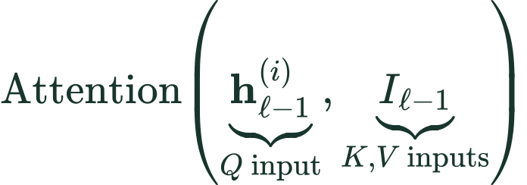
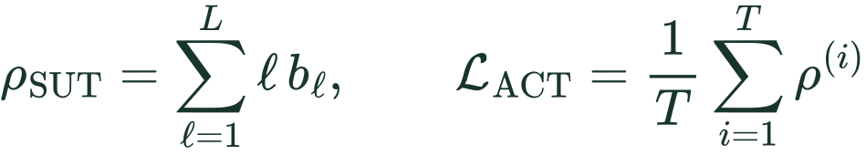
METHOD / HALTING AND SHARED DEPTH
SUT: stick-breaking weights and the combined state
1 Assign part of the remaining mass to stopping
p = conditional gate; b = stopping mass. Halt when cumulative C exceeds the threshold.
2 Combine raw block outputs using explicit stopping weights
UT recursively rescales its previous mixture.
SUT keeps earlier stopping contributions.
3 Use the combined matrix in attention; penalize expected depth
SUT Eqs. 2–4: p = α̂; b = α; z = s; I = S. Gate pℓ reads hℓ before the next block update (Algorithm 1).
Notes:
Uses the same H/h (raw block output) and I/z (combined output) as the UT slide. To match SUT Equation 2, p_ell=halt(h_ell) is the conditional hazard associated with layer ell; b_ell=p_ell product_(j<ell)(1-p_j) is the unconditional stopping probability at that depth. This gate is evaluated on h_ell before the next block update in Algorithm 1. The original source uses alpha-hat for p and alpha for b, and S for our I matrix. This preserves the source timing rather than moving the SUT gate to UT's entering-state index. m0=1, m_ell=(1-p_ell)m_prev, C=sum b=1-m. Thresholding is on cumulative b, not cumulative p. Original Equation 3 is z_ell=m_(ell-1)h_ell+sum_(j=1)^(ell-1)b_j h_j. Its current term carries the entire survival mass before depth ell; do not replace it by b_ell h_ell or include b_ell again in the earlier-state sum. Current p_ell is used in the next depth's accumulation. Algorithm 1 uses the raw token state h_(ell-1) for query input and the combined matrix I_(ell-1) for key/value input. Projection matrices are omitted. Halted tokens are copied and remain readable subject to attention masks. ACT equation is the paper's expected depth objective; finite caps require residual survival accounting, implemented in the authors' ACTWrapper. In UT earlier z is repeatedly rescaled, whereas SUT keeps explicit weights on earlier raw h states. Full scalar bookkeeping starts with empty sums=0 and empty products=1. Both methods average per-token ACT costs; coefficients weight them in the total task objective.
Sources: https://arxiv.org/html/1807.03819v3#A3 ; https://aclanthology.org/2023.emnlp-main.12.pdf (Section 3.2, Equations 2–4, Algorithm 1).
LaTeX sutgate: p_{\ell}=\mathrm{halt}(\mathbf{h}_{\ell}),\qquad b_{\ell}=p_{\ell}\prod\nolimits_{j=1}^{\ell-1}(1-p_j)=p_{\ell}m_{\ell-1}
LaTeX sutmass: m_0=1,\qquad m_{\ell}=(1-p_{\ell})m_{\ell-1},\qquad C_{\ell}=\sum_{j=1}^{\ell}b_j=1-m_{\ell}
LaTeX sutmix: \mathbf{z}_{\ell}=\underbrace{m_{\ell-1}\mathbf{h}_{\ell}}_{\text{current surviving mass}}+\underbrace{\sum_{j=1}^{\ell-1}b_j\mathbf{h}_j}_{\text{earlier stopped states}}
LaTeX att: \mathrm{Attention}\!\left(\underbrace{\mathbf{h}_{\ell-1}^{(i)}}_{Q\text{ input}},\underbrace{I_{\ell-1}}_{K,V\text{ inputs}}\right)
LaTeX sutcost: \rho_{\rm SUT}=\sum_{\ell=1}^{L}\ell\,b_{\ell},\qquad \mathcal{L}_{\rm ACT}=\frac{1}{T}\sum_{i=1}^{T}\rho^{(i)}

