Slide 1
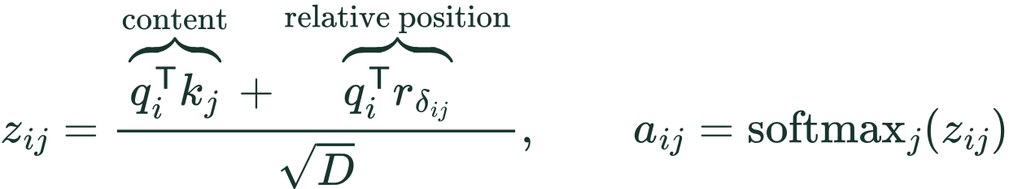
METHOD / RELATIVE POSITION IN MoMHA
W: relative-position information in attention scores
i: query position j: key position D: head dimension r: learned relative-position vector
Key position | 1 | 2 | 3 | 4 | 5 | 6 | 7
Offset from query | −2 | −1 | 0 | +1 | +2 | +3 | +4
Clipped offset | −2 | −1 | 0 | +1 | +2 | +2 | +2
All unmasked tokens remain visible. The relative term is learned and query-dependent.
A positive offset does not automatically mean a higher attention score.
SUT §3.1 and author code. Illustrative clipped-offset convention; batch, head, expert indices and masks omitted.
Notes:
Insert immediately after slide 6 of the revised deck. Standalone supplementary slide; the existing deck is unchanged.
W describes the relative-position embedding range in SUT's five-tuple (E,K,H,D,W). It is not the length of the token sequence or the top-K expert selection parameter. At each query position i, every allowed key position j has a pairwise offset. The relative-position vector selected by that offset contributes a query-dependent dot product to the attention logit, before softmax over keys. The sequence remains intact. Decoder causality and padding masks still apply.
The equations are a pedagogical one-head notation, not verbatim numbered equations in SUT. The paper states 2W+1 relative embeddings. The example uses the standard inclusive clipping convention [-W,W] to make the concept visible. In the public WMT code inspected on 2026-10-16, max_positions is 64, the lookup has 129 entries, and rel_pos_logits clips to [-63,63] before adding offset 64. Hence its extreme table slots are unused. Do not claim the illustrative W=2 example is that literal released-code configuration or infer all paper task configurations from the WMT implementation.
The code scales q by head_dim**-0.5 before both the content dot product and the relative-position dot product, consistent with the schematic score formula. rel_pos_logits computes j-i and gathers relative logits; forward adds them to attn_weights before softmax. For a new query position, the offset labels shift, so these are pairwise relations rather than one absolute vector added during sequence preprocessing.
Positive offsets select a different learned vector; they do not supply a positive scalar bias by themselves. This prevents the misconception that later tokens always receive more probability.
Sources:
https://aclanthology.org/2023.emnlp-main.12.pdf (Section 3.1)
https://github.com/shawntan/SUT/blob/main/sut_layer/moa_attention.py (rel_pos_logits and forward)
LaTeX:
score: z_{ij}=\frac{\overbrace{q_i^{\mathsf T}k_j}^{\text{content}}+\overbrace{q_i^{\mathsf T}r_{\delta_{ij}}}^{\text{relative position}}}{\sqrt{D}},\qquad a_{ij}=\operatorname{softmax}_{j}(z_{ij})
offset: \delta_{ij}=\operatorname{clip}(j-i,-W,W),\qquad r_{-W},\ldots,r_0,\ldots,r_W\quad(2W+1\text{ learned vectors})
example: W=2,\quad i=3\quad\Longrightarrow\quad 2W+1=5\text{ relative-position vectors}

