Slide 1
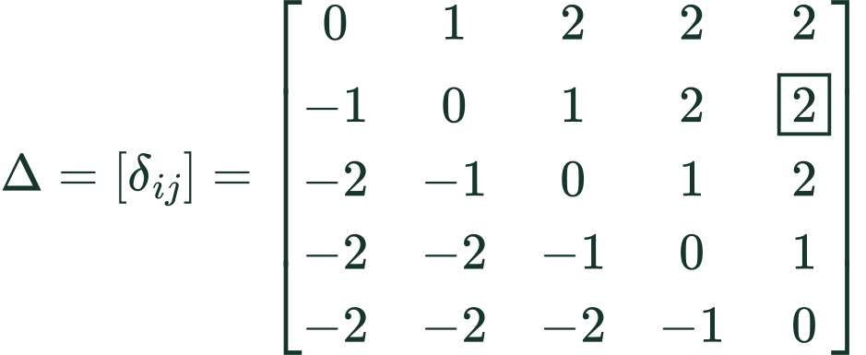
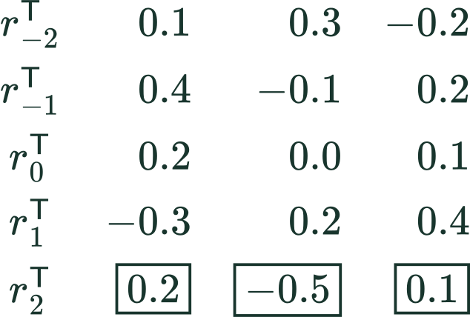
METHOD / RELATIVE POSITION IN MoMHA
Relative-position labels and learned vectors
Fixed distance labels
Learned embedding table
Computed from token positions; not learned.
Training updates these vector components.
Rows: query i Columns: key j
Illustrative values; each vector has D components.
δ = delta (a scalar label). R stores learned vectors as rows here. SUT §3.1 and author code; illustrative clipping.
Notes:
Insert immediately after slide 6 of the revised deck. This revision adds an explicit distinction between fixed distance labels and trainable relative-position vectors. In the displayed row-oriented table, R has five rows and three columns. Each row is the transpose of a column vector r_d in R^3. W controls the number of available distance vectors, D their dimension. All numeric vector entries are invented for illustration, not learned values extracted from the paper. During training the model loss backpropagates through the relative-position score to update the selected embedding vectors. The integer delta labels are not trained. With q_2=[1,2,3]^T and r_2=[.2,-.5,.1]^T, their dot product is -.5, a scalar. The symbol is delta, not theta. Standalone supplementary slide; the existing deck is unchanged. This revision replaces the distance table with a complete five-by-five matrix. Delta_ij is a scalar matrix entry, not theta, a learned vector, or an attention score. Delta is computed from token positions and the clipping range. Capital Delta denotes the full matrix. Rows enumerate query positions i; columns enumerate key positions j. The boxed entry at row 2, column 5 has raw offset 3, clipped to 2. It selects learned vector r_2, which interacts with query q_2 to produce the relative logit contribution. The vector is learned; the offset matrix is determined by positions. The same r_2 can give different scores for different queries.
W describes the relative-position embedding range in SUT's five-tuple (E,K,H,D,W). It is not the length of the token sequence or the top-K expert selection parameter. At each query position i, every allowed key position j has a pairwise offset. The relative-position vector selected by that offset contributes a query-dependent dot product to the attention logit, before softmax over keys. The sequence remains intact. Decoder causality and padding masks still apply.
The equations are a pedagogical one-head notation, not verbatim numbered equations in SUT. The paper states 2W+1 relative embeddings. The example uses the standard inclusive clipping convention [-W,W] to make the concept visible. In the public WMT code inspected on 2026-10-16, max_positions is 64, the lookup has 129 entries, and rel_pos_logits clips to [-63,63] before adding offset 64. Hence its extreme table slots are unused. Do not claim the illustrative W=2 example is that literal released-code configuration or infer all paper task configurations from the WMT implementation.
The code scales q by head_dim**-0.5 before both the content dot product and the relative-position dot product, consistent with the schematic score formula. rel_pos_logits computes j-i and gathers relative logits; forward adds them to attn_weights before softmax. For a new query position, the offset labels shift, so these are pairwise relations rather than one absolute vector added during sequence preprocessing.
Positive offsets select a different learned vector; they do not supply a positive scalar bias by themselves. This prevents the misconception that later tokens always receive more probability.
Sources:
https://aclanthology.org/2023.emnlp-main.12.pdf (Section 3.1)
https://github.com/shawntan/SUT/blob/main/sut_layer/moa_attention.py (rel_pos_logits and forward)
LaTeX:
offset: \delta_{ij}=\operatorname{clip}(j-i,-W,W)
matrix: \Delta=[\delta_{ij}]=\begin{bmatrix}0&1&2&2&2\\-1&0&1&2&\boxed{2}\\-2&-1&0&1&2\\-2&-2&-1&0&1\\-2&-2&-2&-1&0\end{bmatrix}
shape: W=2,\quad D=3,\quad R\in\mathbb{R}^{(2W+1)\times D}=\mathbb{R}^{5\times3}
learned: \begin{array}{c|rrr}r_{-2}^{\mathsf T}&0.1&0.3&-0.2\\r_{-1}^{\mathsf T}&0.4&-0.1&0.2\\r_0^{\mathsf T}&0.2&0.0&0.1\\r_1^{\mathsf T}&-0.3&0.2&0.4\\r_2^{\mathsf T}&\boxed{0.2}&\boxed{-0.5}&\boxed{0.1}\end{array}
lookup: \delta_{2,5}=2\quad\Longrightarrow\quad r_{\delta_{2,5}}=r_2=\begin{bmatrix}0.2&-0.5&0.1\end{bmatrix}^{\mathsf T}\in\mathbb{R}^{3}
scalar: q_2=\begin{bmatrix}1&2&3\end{bmatrix}^{\mathsf T}\quad\Longrightarrow\quad q_2^{\mathsf T}r_2=1(0.2)+2(-0.5)+3(0.1)=-0.5

