Slide 1
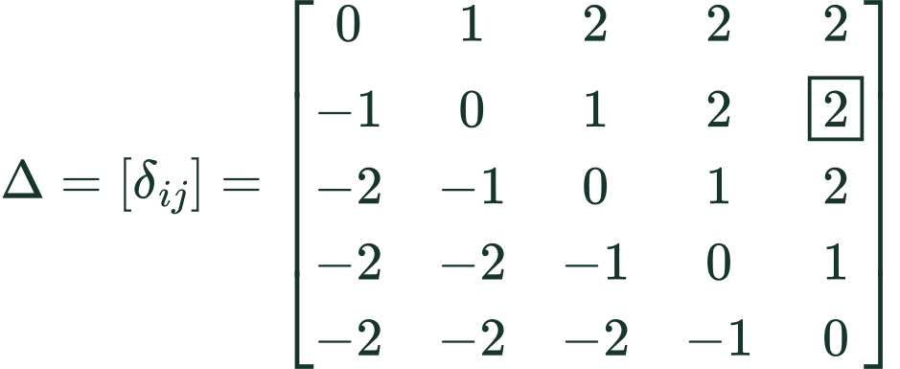
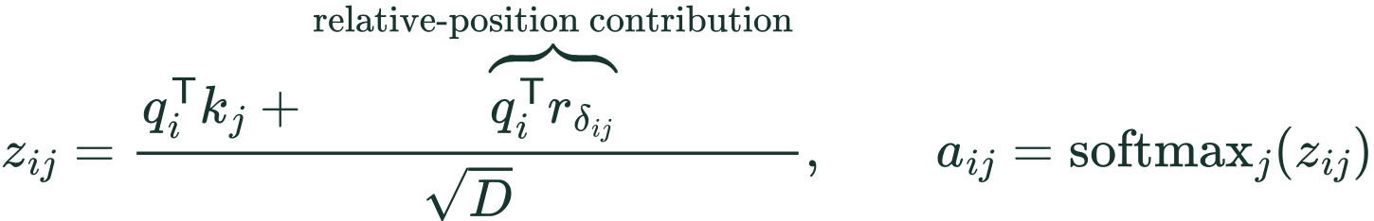
METHOD / RELATIVE POSITION IN MoMHA
W and the relative-position matrix
Five tokens, W = 2
Rows: query position i Columns: key position j
δ (delta): one integer distance label.
δᵢⱼ is the entry in row i, column j.
Δ (capital delta) is the whole matrix.
Boxed entry: query 2, key 5
Distance label selects a learned vector
The matrix contains offsets, not attention scores.
All unmasked tokens remain available to attention.
SUT §3.1 and author code. Illustrative W = 2 clipping; batch, head, expert indices and masks omitted.
Notes:
Insert immediately after slide 6 of the revised deck. Standalone supplementary slide; the existing deck is unchanged. This revision replaces the distance table with a complete five-by-five matrix. Delta_ij is a scalar matrix entry, not theta, a learned vector, or an attention score. Delta is computed from token positions and the clipping range. Capital Delta denotes the full matrix. Rows enumerate query positions i; columns enumerate key positions j. The boxed entry at row 2, column 5 has raw offset 3, clipped to 2. It selects learned vector r_2, which interacts with query q_2 to produce the relative logit contribution. The vector is learned; the offset matrix is determined by positions. The same r_2 can give different scores for different queries.
W describes the relative-position embedding range in SUT's five-tuple (E,K,H,D,W). It is not the length of the token sequence or the top-K expert selection parameter. At each query position i, every allowed key position j has a pairwise offset. The relative-position vector selected by that offset contributes a query-dependent dot product to the attention logit, before softmax over keys. The sequence remains intact. Decoder causality and padding masks still apply.
The equations are a pedagogical one-head notation, not verbatim numbered equations in SUT. The paper states 2W+1 relative embeddings. The example uses the standard inclusive clipping convention [-W,W] to make the concept visible. In the public WMT code inspected on 2026-10-16, max_positions is 64, the lookup has 129 entries, and rel_pos_logits clips to [-63,63] before adding offset 64. Hence its extreme table slots are unused. Do not claim the illustrative W=2 example is that literal released-code configuration or infer all paper task configurations from the WMT implementation.
The code scales q by head_dim**-0.5 before both the content dot product and the relative-position dot product, consistent with the schematic score formula. rel_pos_logits computes j-i and gathers relative logits; forward adds them to attn_weights before softmax. For a new query position, the offset labels shift, so these are pairwise relations rather than one absolute vector added during sequence preprocessing.
Positive offsets select a different learned vector; they do not supply a positive scalar bias by themselves. This prevents the misconception that later tokens always receive more probability.
Sources:
https://aclanthology.org/2023.emnlp-main.12.pdf (Section 3.1)
https://github.com/shawntan/SUT/blob/main/sut_layer/moa_attention.py (rel_pos_logits and forward)
LaTeX:
matrix: \Delta=[\delta_{ij}]=\begin{bmatrix}0&1&2&2&2\\-1&0&1&2&\boxed{2}\\-2&-1&0&1&2\\-2&-2&-1&0&1\\-2&-2&-2&-1&0\end{bmatrix}
offset: \delta_{ij}=\operatorname{clip}(j-i,-W,W)
example: \delta_{2,5}=\operatorname{clip}(5-2,-2,2)=2
lookup: \delta_{2,5}=2\quad\longrightarrow\quad r_2\quad\longrightarrow\quad q_2^{\mathsf T}r_2
score: z_{ij}=\frac{q_i^{\mathsf T}k_j+\overbrace{q_i^{\mathsf T}r_{\delta_{ij}}}^{\text{relative-position contribution}}}{\sqrt{D}},\qquad a_{ij}=\operatorname{softmax}_j(z_{ij})

