Slide 1

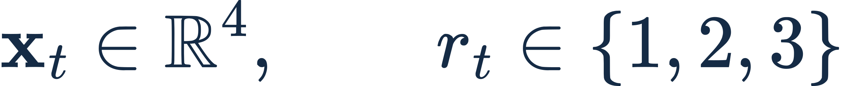
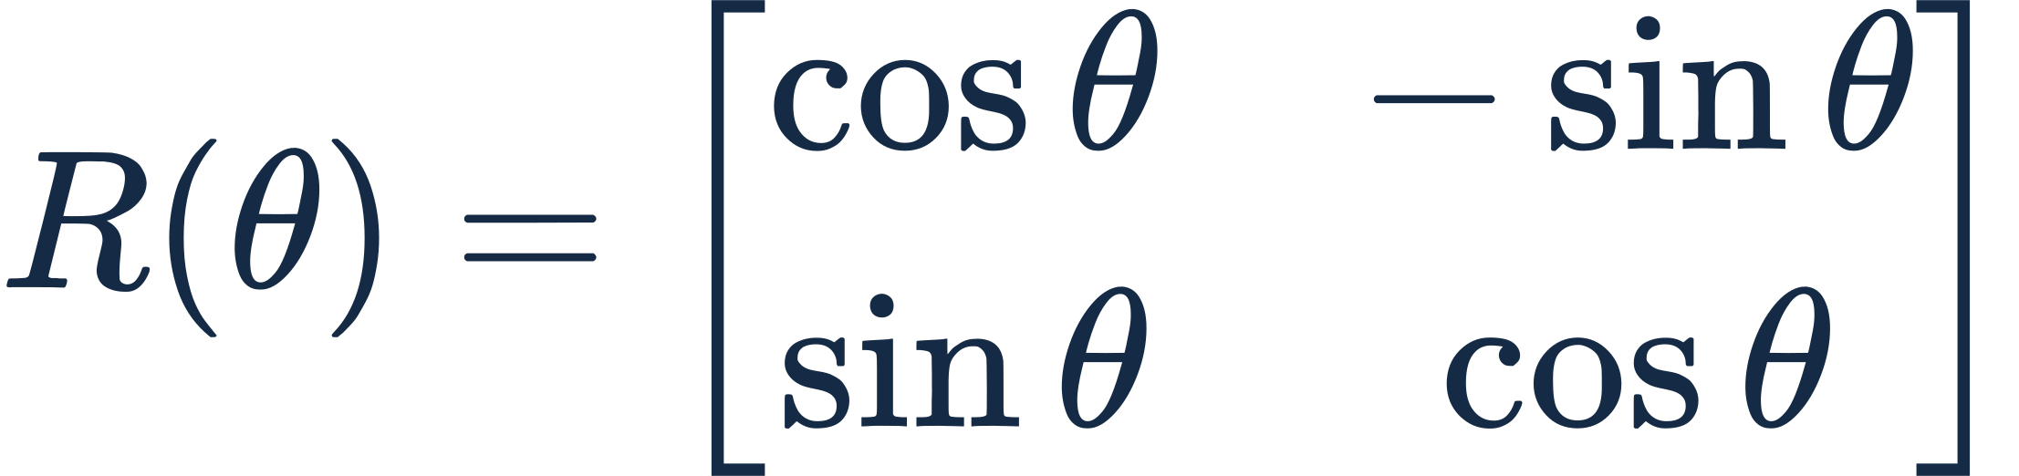
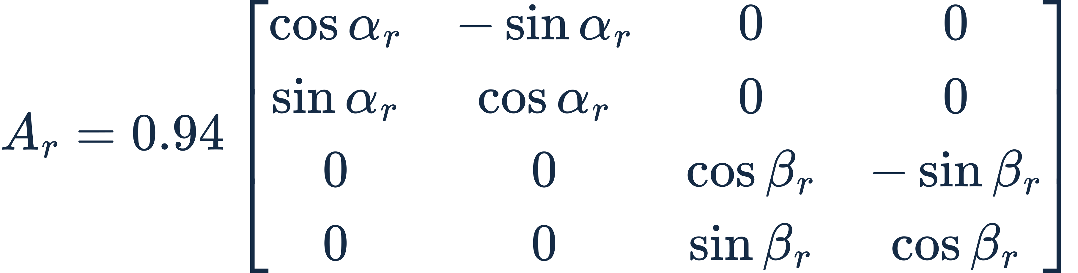

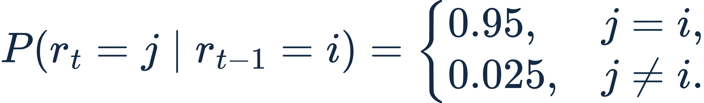
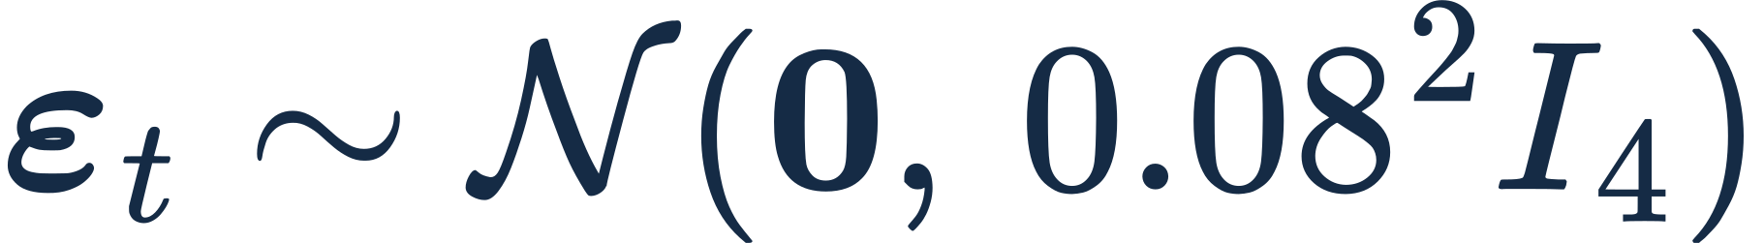
Data model: three switching rotations
2-D rotation
Two rotation planes
0.94 contracts the state. Rotation changes direction.
Preliminary experiment design
1
Notes:
LaTeX:
\mathbf{x}_t=A_{r_t}\mathbf{x}_{t-1}+\boldsymbol{\varepsilon}_t
LaTeX:
\mathbf{x}_t\in\mathbb{R}^4,\qquad r_t\in\{1,2,3\}
LaTeX:
R(\theta)=\begin{bmatrix}\cos\theta&-\sin\theta\\\sin\theta&\cos\theta\end{bmatrix}
LaTeX:
A_r=0.94\begin{bmatrix}\cos\alpha_r&-\sin\alpha_r&0&0\\\sin\alpha_r&\cos\alpha_r&0&0\\0&0&\cos\beta_r&-\sin\beta_r\\0&0&\sin\beta_r&\cos\beta_r\end{bmatrix}
LaTeX:
(x_1,x_2),\quad(x_3,x_4)
LaTeX:
\boldsymbol{\varepsilon}_t\sim\mathcal{N}(\mathbf{0},\,0.08^2 I_4)
LaTeX:
P(r_t=j\mid r_{t-1}=i)=\begin{cases}0.95,&j=i,\\0.025,&j\ne i.\end{cases}
Source: src/twilight_moe/dynamics.py. A_r is a contracted block-diagonal rotation. Angles are radians. Slide notation labels the observed transition x_(t-1) to x_t by r_t; code labels that transition at t-1 and uses IDs0/1/2 instead of1/2/3.

Slide 2



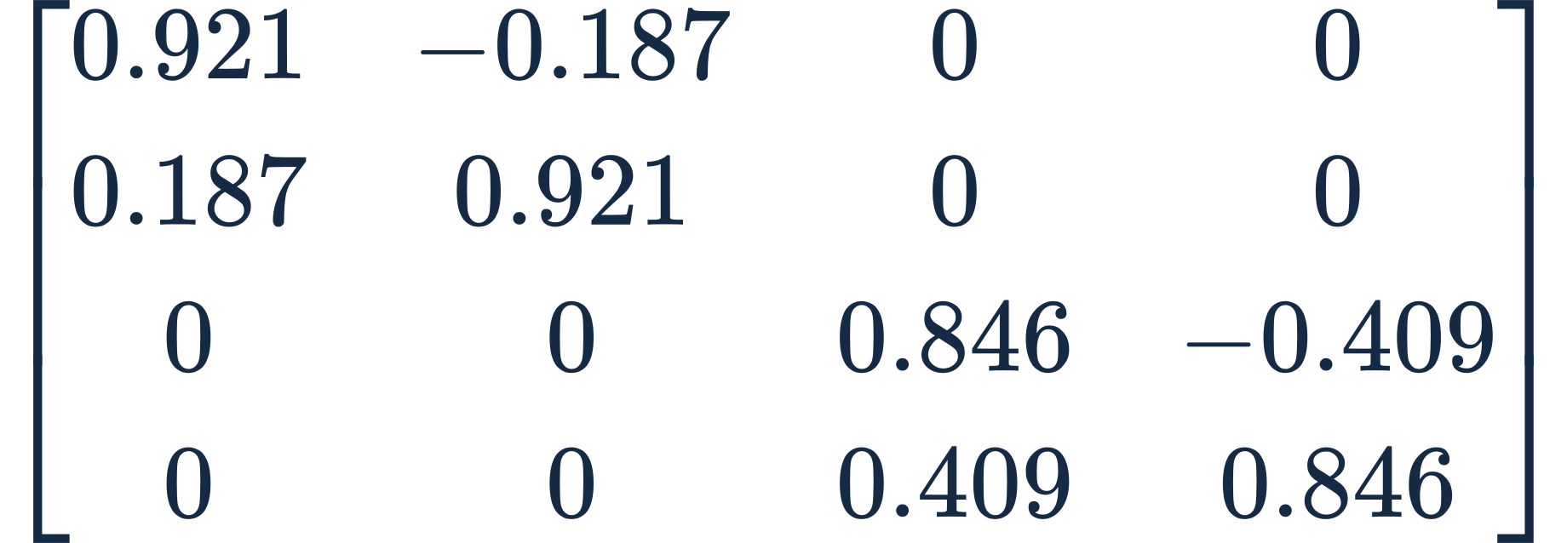
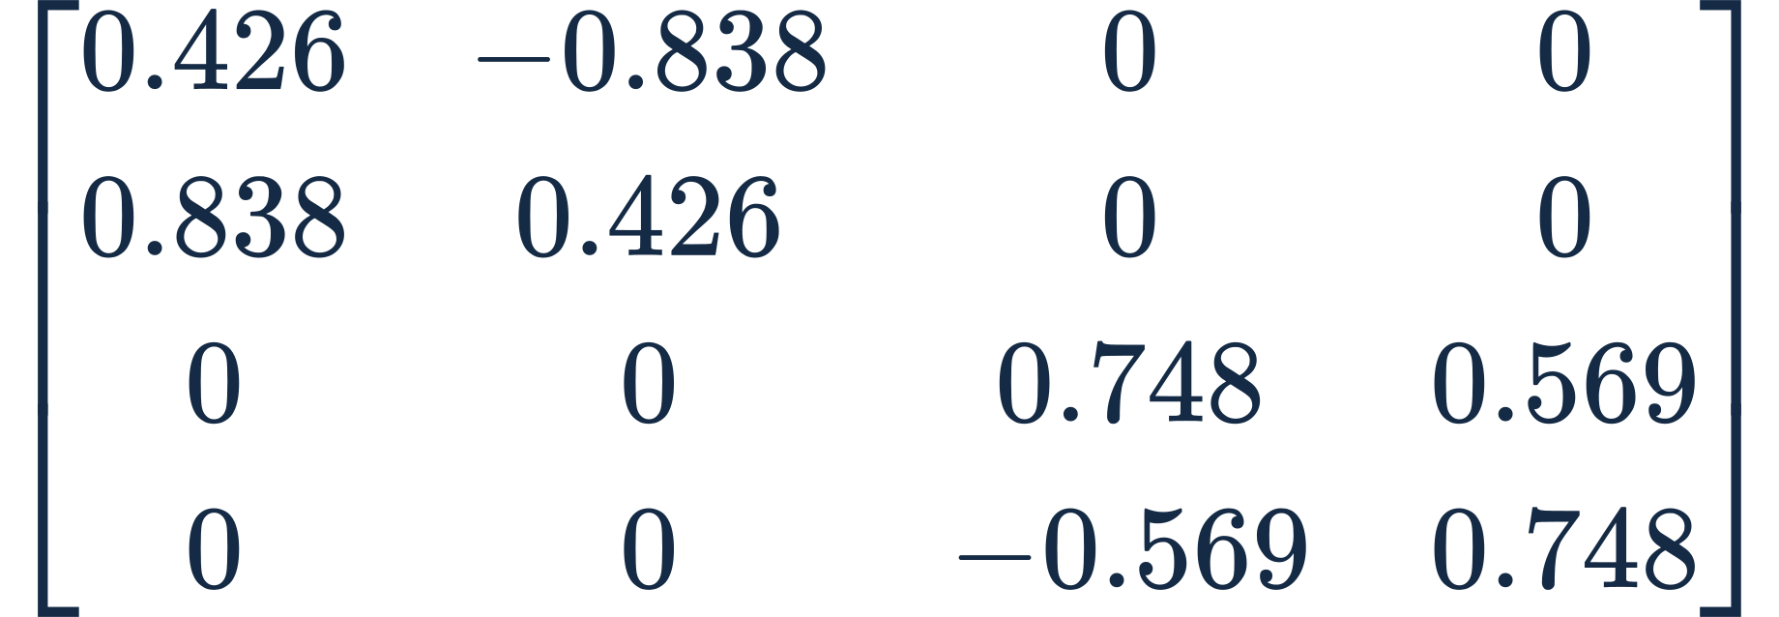
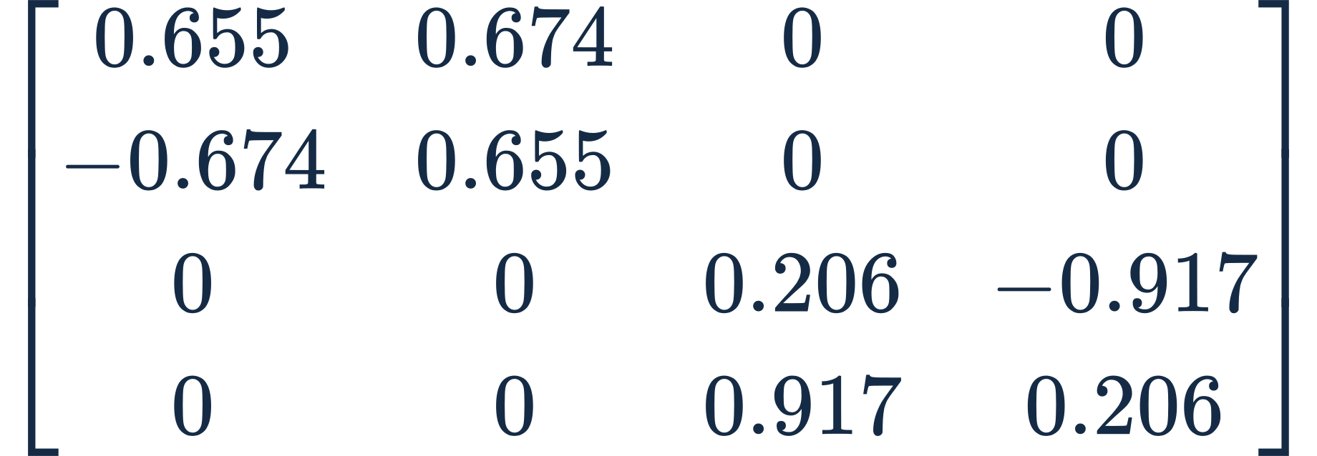



Three regimes and the identification task
Regime 1
Regime 2
Regime 3
Which regime generated the latest observed transition?
Observed history
Regime classifier
Estimated regime
Preliminary experiment design
2
Notes:
LaTeX:
\alpha=0.20,\quad\beta=0.45\;\mathrm{rad}
LaTeX:
A_{1}\approx
LaTeX:
\begin{bmatrix}0.921&-0.187&0&0\\0.187&0.921&0&0\\0&0&0.846&-0.409\\0&0&0.409&0.846\end{bmatrix}
LaTeX:
\alpha=1.10,\quad\beta=-0.65\;\mathrm{rad}
LaTeX:
A_{2}\approx
LaTeX:
\begin{bmatrix}0.426&-0.838&0&0\\0.838&0.426&0&0\\0&0&0.748&0.569\\0&0&-0.569&0.748\end{bmatrix}
LaTeX:
\alpha=-0.80,\quad\beta=1.35\;\mathrm{rad}
LaTeX:
A_{3}\approx
LaTeX:
\begin{bmatrix}0.655&0.674&0&0\\-0.674&0.655&0&0\\0&0&0.206&-0.917\\0&0&0.917&0.206\end{bmatrix}
LaTeX:
\mathbf{x}_{t-7},\ldots,\mathbf{x}_t
LaTeX:
f_\theta
LaTeX:
\hat r_t\in\{1,2,3\}
Numeric matrices include0.94 and round to three decimals. Proposed classification targets the regime of the latest observed transition, not a future regime. Existing saved models perform next-state regression; this slide proposes a different objective and claims no classification results. Source: dynamics.py and the revised user design.

