Slide 1
ASV-level Microbial Shifts Reveal Treatment Outcomes in FMT for patients with recurrent Clostridioides difficile infection
Shawn Wang
4/30/2025
Notes:
Hi everyone, I’m Shawn, and today I’ll be presenting a microbiome-based analysis that focuses on how strain-level microbial dynamics relate to treatment outcomes in patients with recurrent Clostridioides difficile infection.

Slide 2
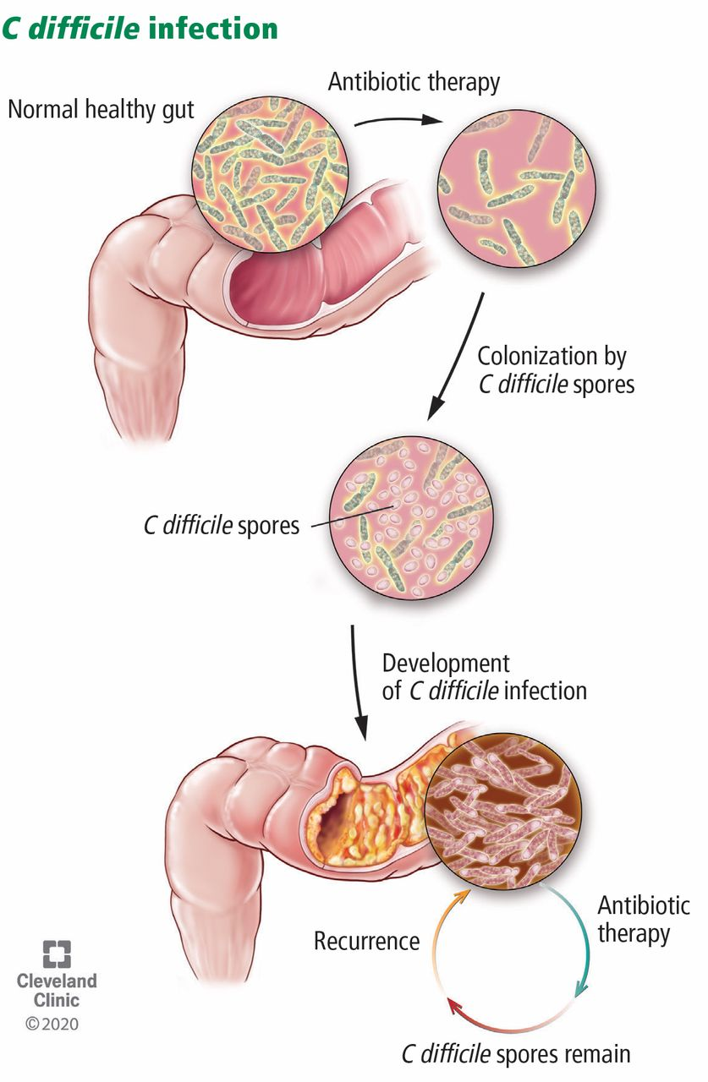
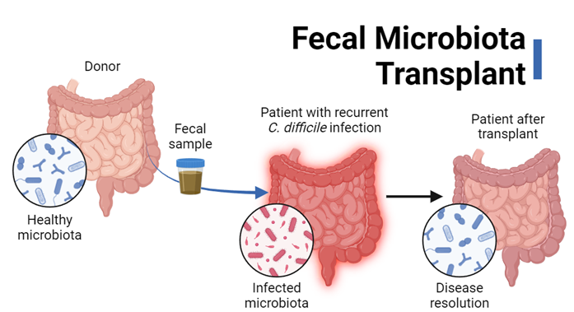
Background: CDI, Microbiota Disruption & FMT
Tsigrelis, CCJM, 2020
Arteaga-Muller et al., Nutrients, 2024
Notes:
First, a little background:
Clostridioides difficile infection, or CDI, is a serious and increasingly common disease, often triggered by antibiotics that disrupt the normal gut microbiota.
In a healthy gut, diverse commensal bacteria help protect against invaders like C. difficile. But after broad-spectrum antibiotics, these commensals are depleted, creating an opening for C. difficile spores to germinate, produce toxins, and cause disease.
Standard antibiotics like vancomycin can treat the symptoms, but they don't resolve the underlying dysbiosis. That’s why recurrence rates are so high—over 50% in some cases.
To address this, fecal microbiota transplantation, or FMT, introduces healthy donor stool to restore gut balance. It can be very effective, with cure rates over 80%.
But traditional FMT comes with challenges, including variability between donors and limited regulation. These concerns have led to more standardized approaches—like RBX2660, a microbiota-based therapeutic developed for recurrent CDI.

Slide 3
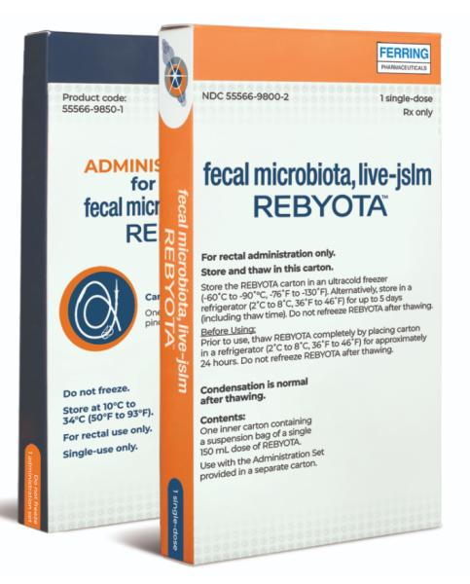
RBX2660: A Microbiota-Based Investigational Therapeutic
FDA-approved as REBYOTA™ in 2022 – first and only approved FMT product
Developed as a standardized alternative to traditional FMT
Contains screened donor microbiota in liquid suspension
Delivered via rectal enema
Manufactured under GMP conditions by Rebiotix Inc.
Evaluated in clinical trials for recurrent CDI (e.g., PUNCH CD study)
Shown to reduce CDI recurrence and antibiotic resistance gene burden
Notes:
RBX2660 is the first and only FDA-approved microbiota-based therapeutic for recurrent C. difficile infection, approved in 2022 as REBYOTA™.
Unlike traditional FMT, RBX2660 is standardized and clinically regulated. It contains carefully screened donor microbiota in liquid form, and is delivered via rectal enema.
In clinical trials, it not only reduced CDI recurrence but also lowered antibiotic resistance gene burden, suggesting broader ecological benefits.
However, not all patients respond equally—some achieve sustained remission, while others relapse.
This variability highlights the need to explore whether microbiota-level differences can explain treatment outcomes.

Slide 4
Scientific Question and Hypotheses
Scientific Question 1
Does RBX2660 treatment significantly alter the gut microbiota composition in patients with recurrent C. difficile infection?
Null Hypothesis (H₀₁):
RBX2660 treatment does not significantly change gut microbial diversity or composition.
Alternative Hypothesis (H₁₁):
RBX2660 treatment restores microbial diversity and shifts composition toward a healthier, donor-like profile.
Scientific Question 2
Do patients with better clinical outcomes (i.e., no need for repeat intervention) exhibit different microbiota than those who relapse?
Null Hypothesis (H₀₂):
There is no difference in microbial profiles between patients who required repeat intervention (RI) and those who did not (SI).
Alternative Hypothesis (H₁₂):
Patients with better clinical outcomes (SI) show greater engraftment of beneficial taxa and clearance of opportunists than RI patients.
Notes:
Based on the variability in clinical response to RBX2660, this study is guided by two key questions.
First, we asked whether RBX2660 treatment significantly alters the gut microbiota—does it actually restore diversity and shift composition in patients with recurrent CDI?
Second, we asked whether patients with better outcomes—those who didn’t need a second dose—show distinct microbial patterns compared to those who relapsed.

Slide 5
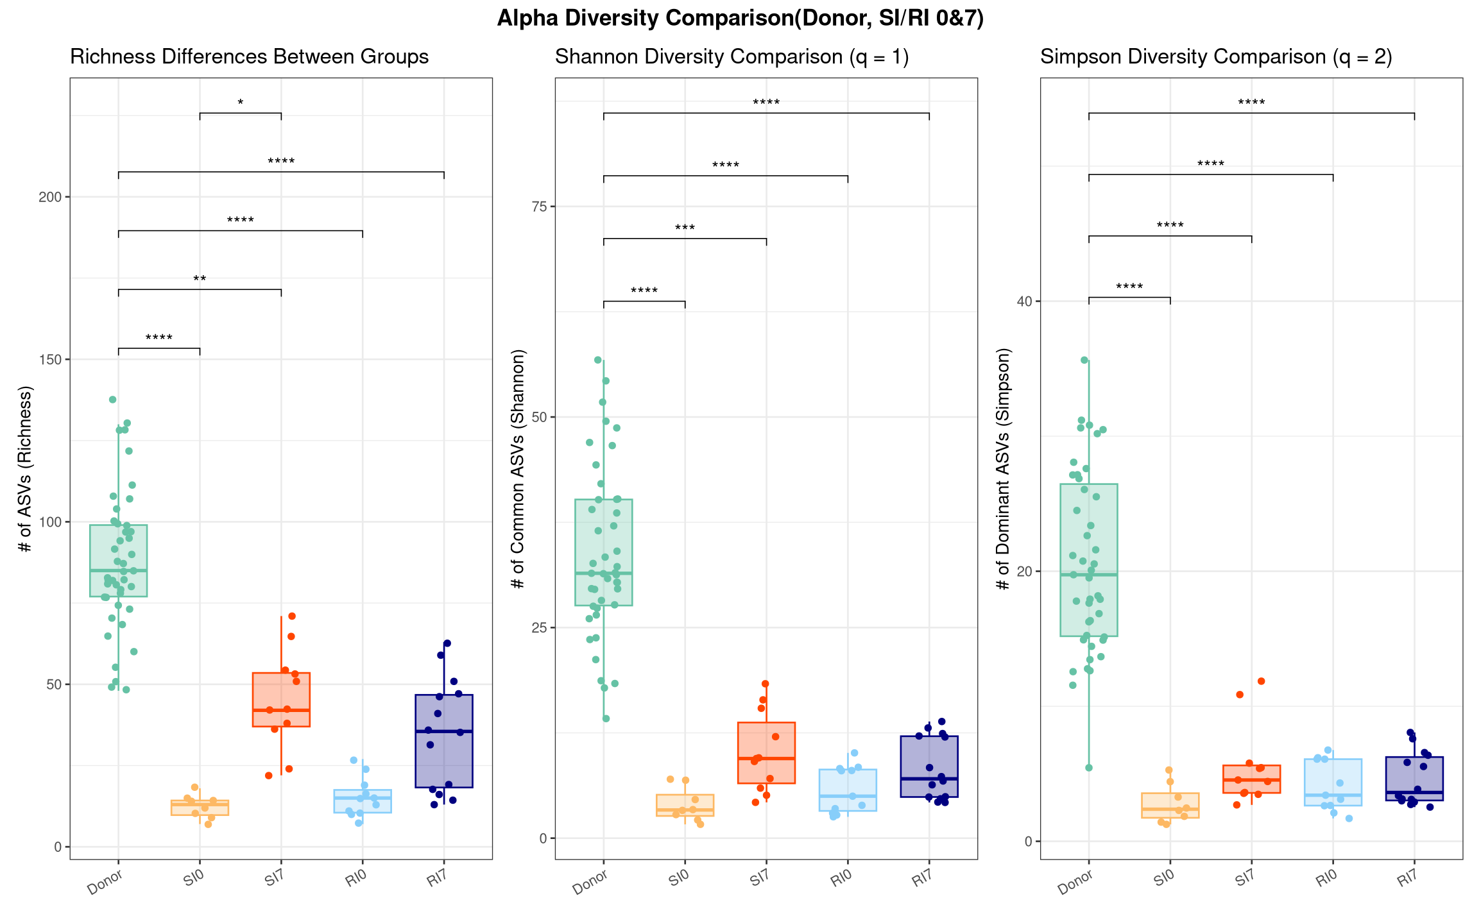
RBX2660 Increased Alpha Diversity in Both SI and RI, but to a Lesser Extent in RI
Alpha diversity improved after RBX2660 in SI7; RI7 showed partial recovery. All metrics remained lower than donor controls.
Notes:
This slide shows how alpha diversity changed before and after RBX2660 treatment, using Richness, Shannon, and Simpson indices.
As expected, donor samples had the highest diversity, while both patient groups showed low diversity at baseline—reflecting CDI-related dysbiosis.
I’ll refer to two groups throughout: SI patients didn’t need a second intervention; RI patients did.
After treatment, diversity increased in both groups, but the improvement was greater in SI7, suggesting better microbial recovery.
This supports the idea that RBX2660 helps restore diversity, especially in patients with better clinical outcomes.
Next, we’ll examine beta diversity to see if overall community structure also shifted toward a healthier, donor-like state.

Slide 6
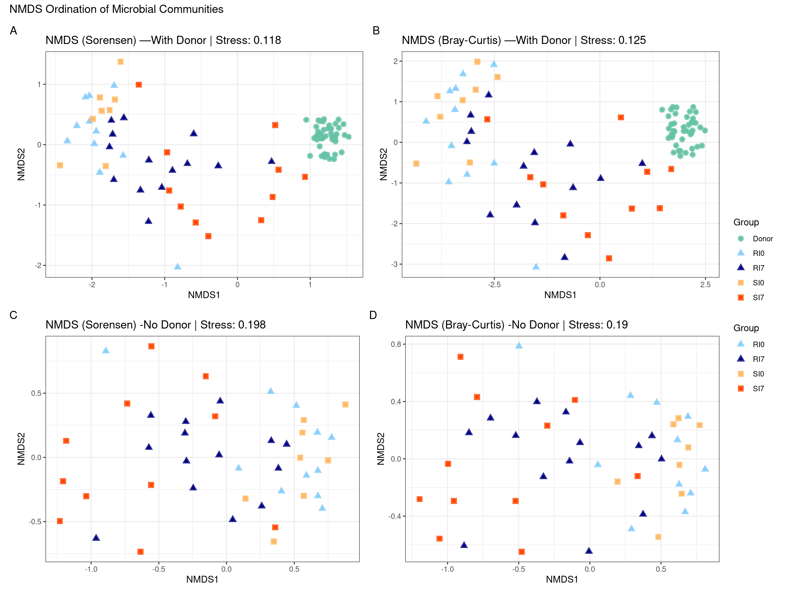
FMT Altered Microbial Community Composition, with Stronger Shifts in SI Group
NMDS plots show that SI patients shift more clearly toward donor-like microbiota structure than RI patients.
Notes:
This slide shows beta diversity to assess how overall microbiota composition changed after RBX2660.
These NMDS plots are based on Sorensen and Bray-Curtis distances. In the top row, donor samples (green) form a distinct cluster, while SI7 samples (orange) shift closer to the donor group after treatment.
In contrast, RI7 samples (dark blue) remain scattered and farther from the donor centroid, suggesting weaker or less consistent engraftment.
Even without the donor group (bottom row), we still see SI7 drifting from baseline, while RI samples cluster near RI0, indicating minimal structural change.
Overall, this supports what we saw in alpha diversity: RBX2660 shifts microbiota, and this shift is stronger in patients who had better clinical outcomes.

Slide 7
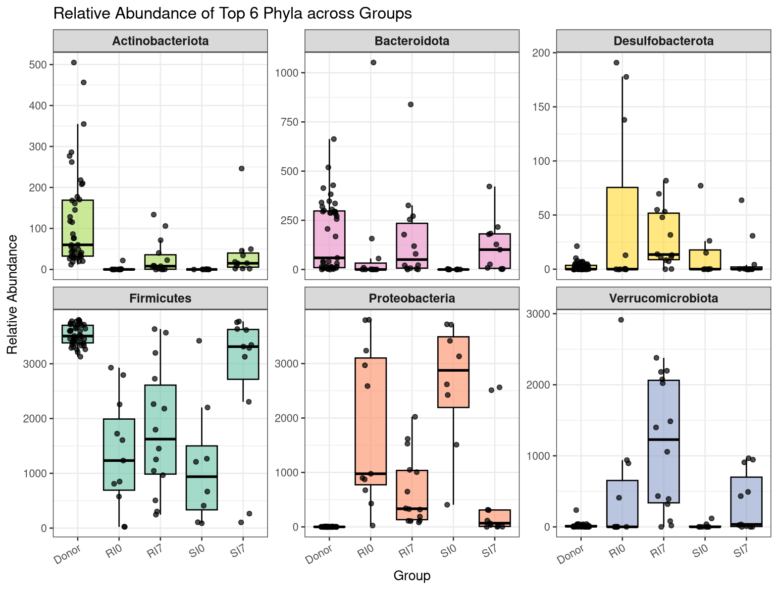
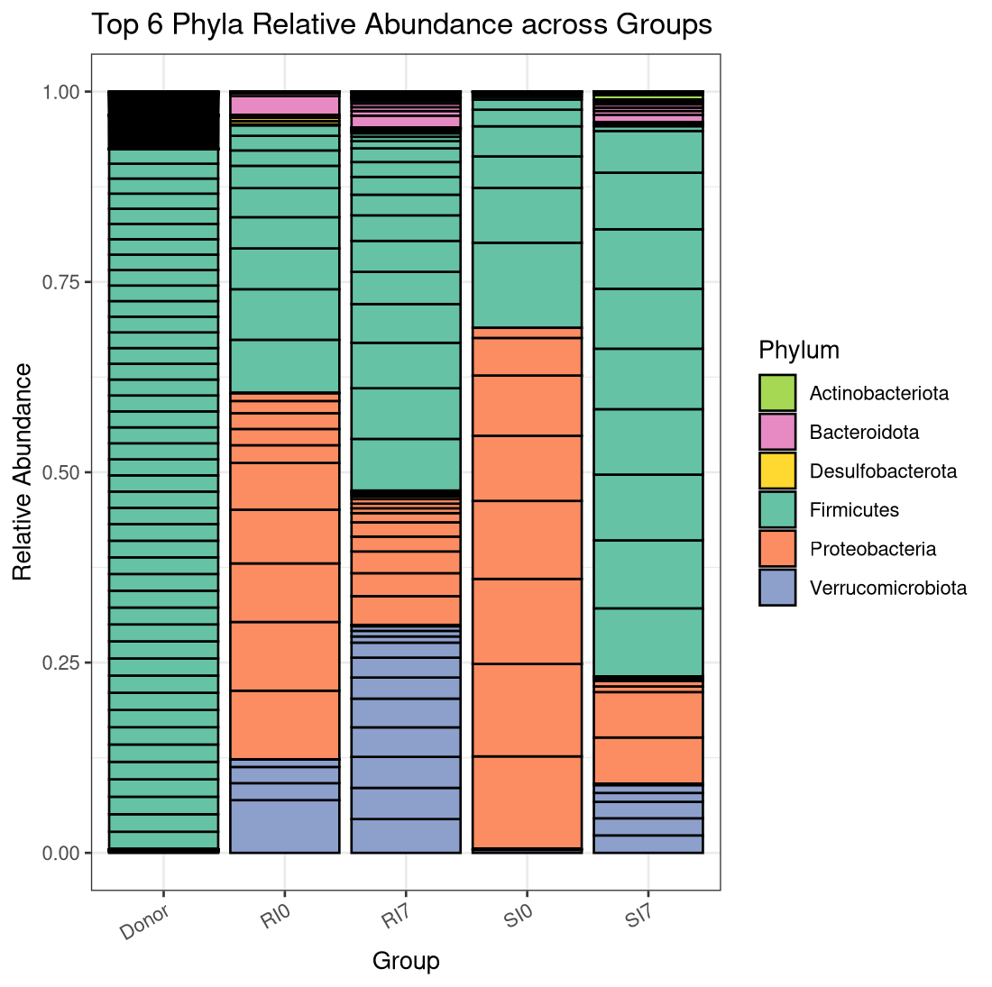
RBX2660 Promoted Recovery of Firmicutes and Reduction of Proteobacteria at the Phylum Level
Firmicutes increased and Proteobacteria decreased after treatment, more strongly in SI7. Actino- and Bacteroidota showed moderate recovery in both groups.
Notes:
This slide shows the top six phyla across all groups.
In healthy donors, Firmicutes dominate, with moderate Actinobacteriota and Bacteroidota, which are generally beneficial.
At baseline, both RI0 and SI0 show depleted Firmicutes and elevated Proteobacteria, a typical marker of dysbiosis and inflammation.
After RBX2660, SI7 samples show strong Firmicutes recovery and reduced Proteobacteria, indicating healthier composition.
The RI7 group shows more variability—Firmicutes rise slightly, but Proteobacteria remain higher, suggesting incomplete recovery.
We also see partial increases in Actino- and Bacteroidota in both groups.
Finally, Verrucomicrobiota increased post-treatment in both SI and RI, potentially as a microbial response to FMT.
Overall, these results suggest that RBX2660 partially restores a more balanced gut microbiota, especially in SI patients.

Slide 8
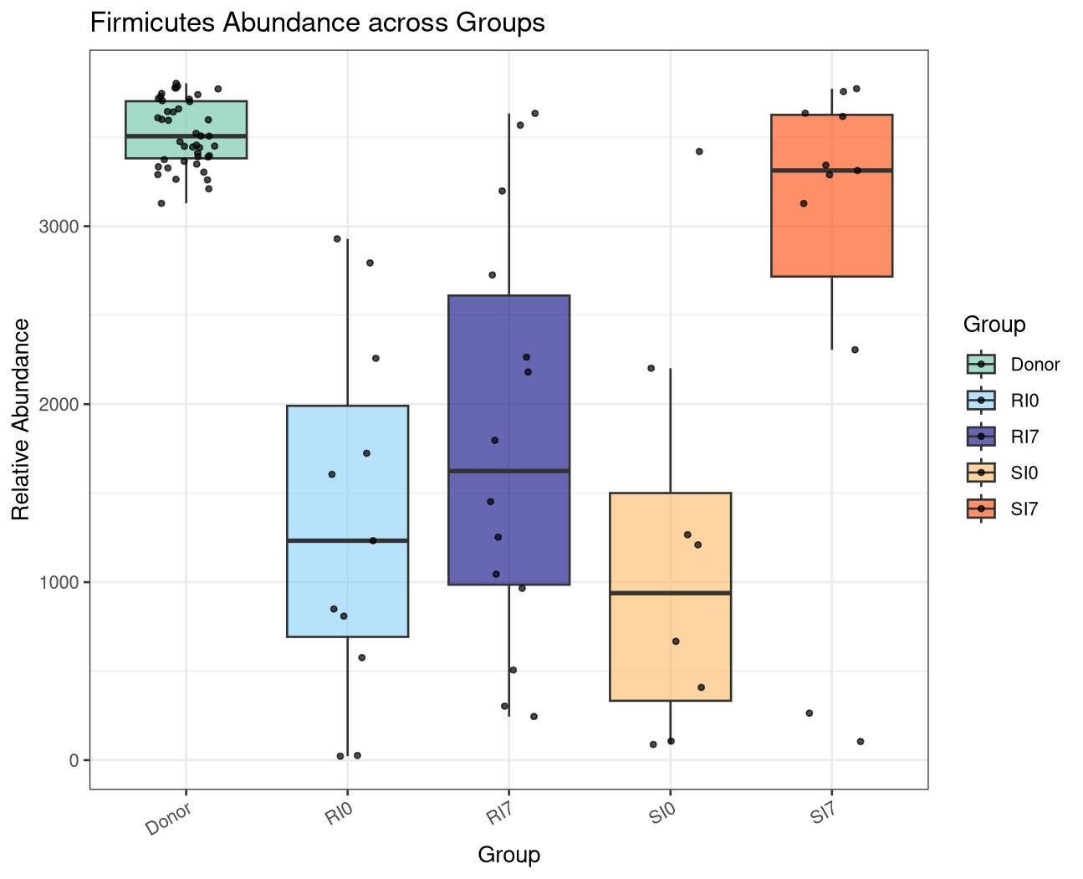
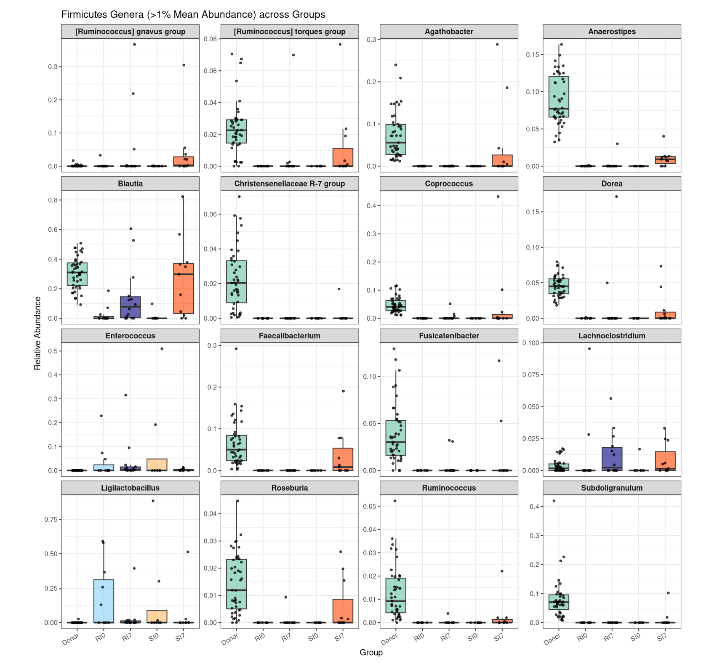
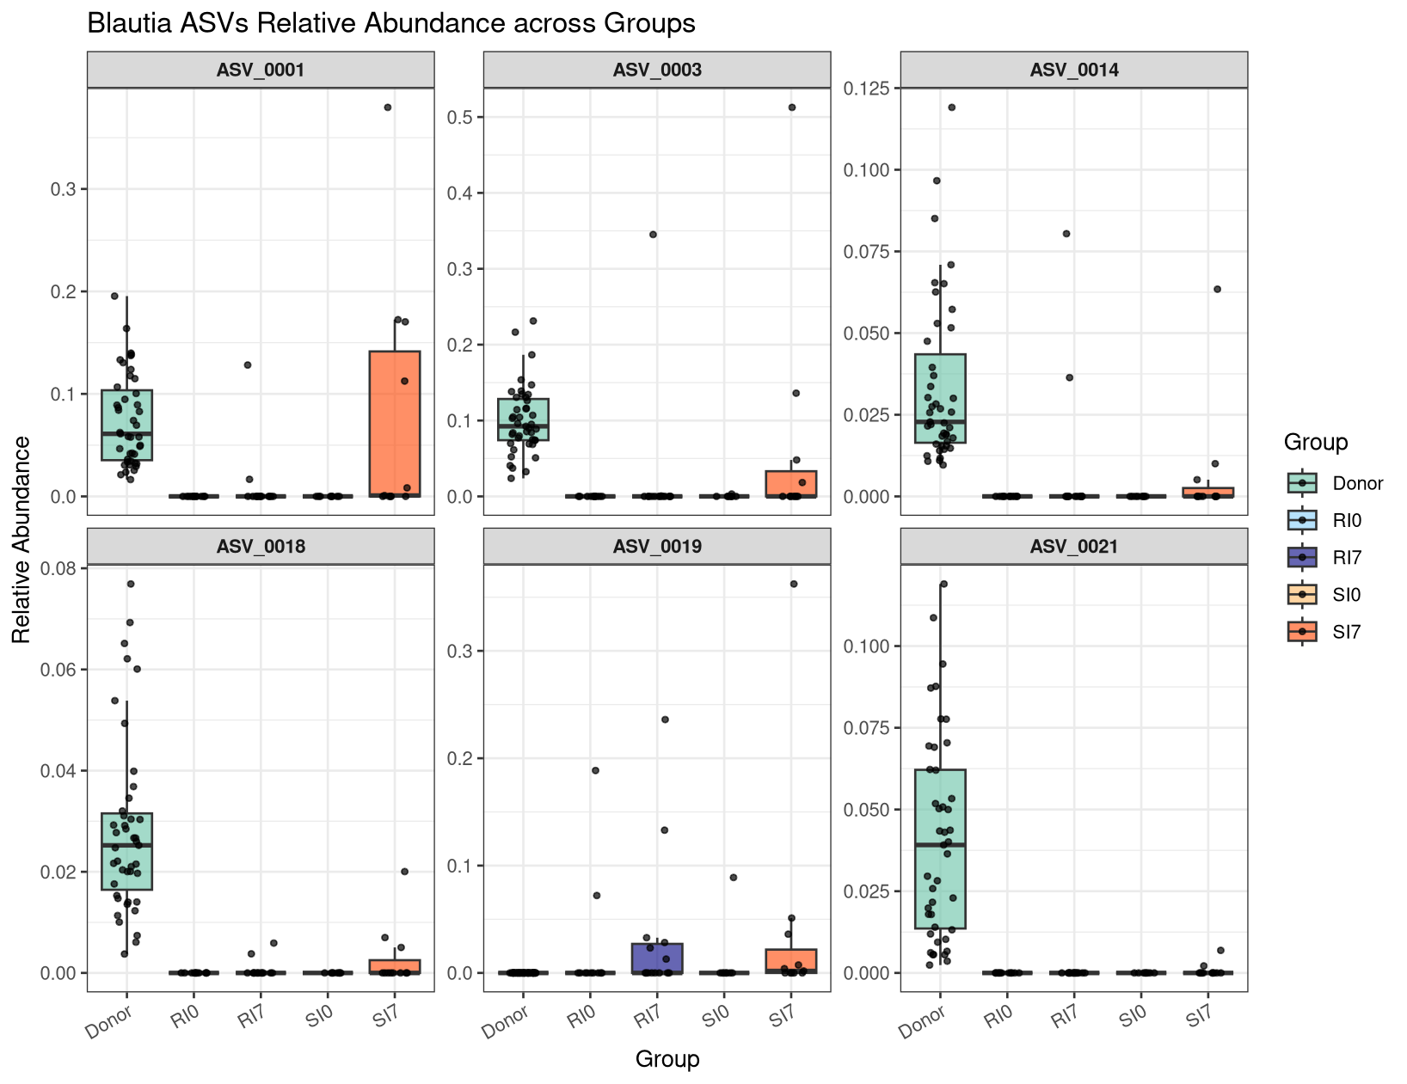
Engraftment of Blautia and Other Key Firmicutes Genera Marks Successful Microbiota Recovery
Notes:
In the top right, you can see the phylum-level Firmicutes abundance across groups—just to give some context.
The left panel breaks this down to the genus level. We can see that most beneficial genera, like Blautia and Roseburia (highlighted in green), are mainly restored in the SI7 group.
However, some genera—shown in red—remain low in both SI and RI after treatment, suggesting that RBX2660 has limitations in restoring the full spectrum of commensals.
In the bottom right, we zoom in on ASV-level changes within Blautia. ASVs like ASV_0001 and ASV_0003 reappear in SI7 but are almost absent in RI7.
This indicates that successful recovery involves not just genus-level shifts, but strain-level engraftment, and that the absence of these ASVs in RI may reflect failed colonization or host-related barriers.

Slide 9
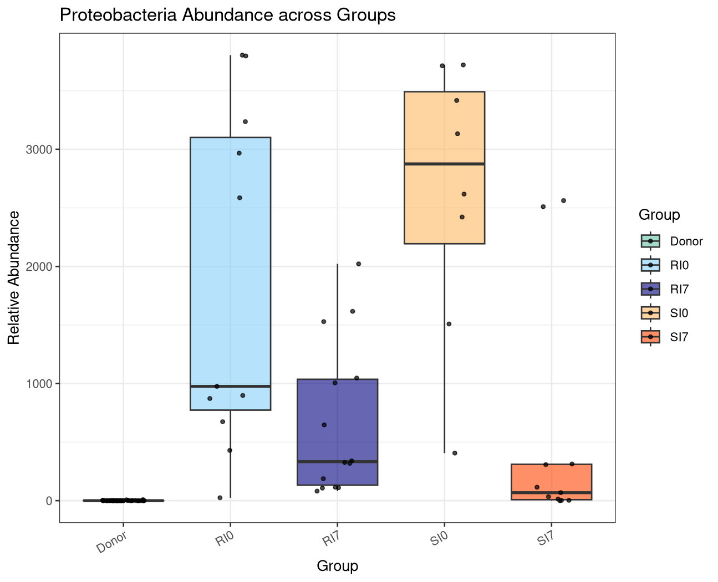
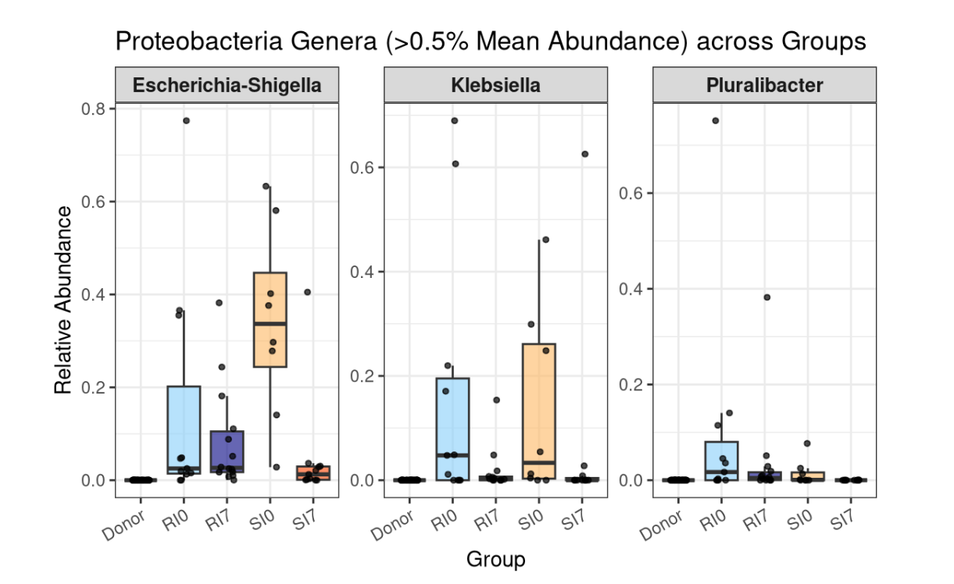
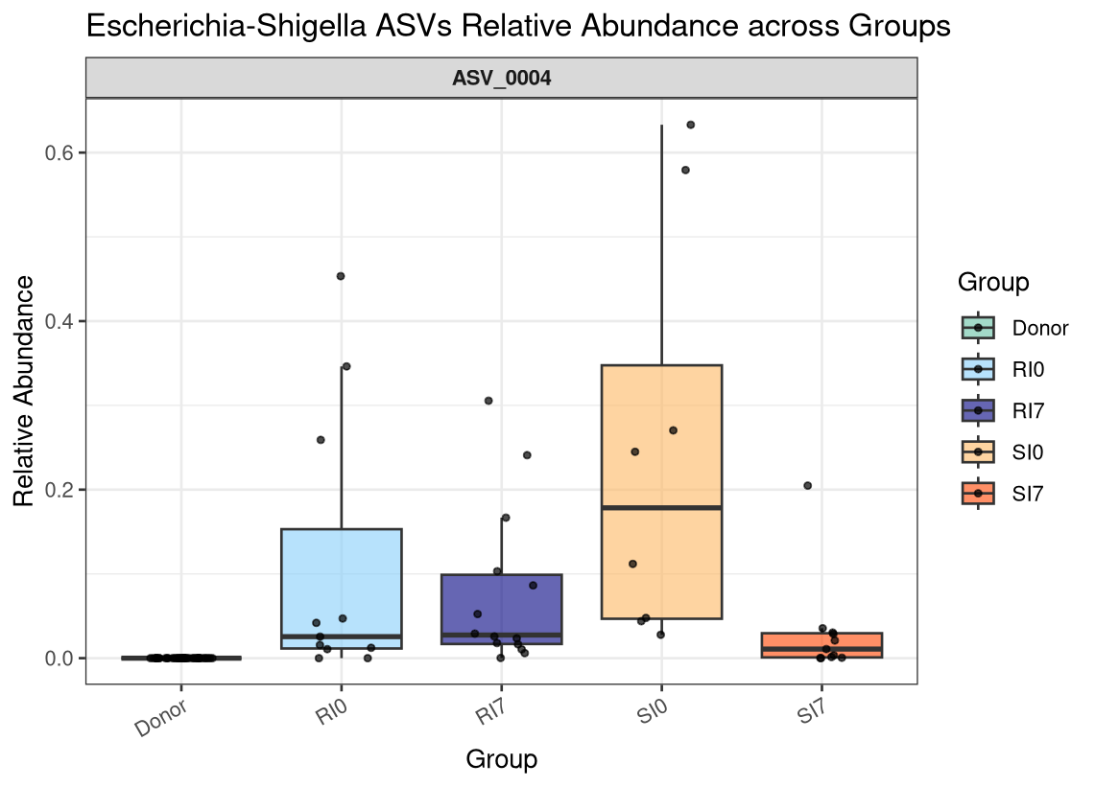
Failure to Suppress Opportunistic Proteobacteria Associates with Poor FMT Outcomes
Opportunistic Proteobacteria genera decreased in SI7 but remained in RI7.
ASV-level analysis confirmed clearance of Escherichia ASV_0004 in successful cases.
Notes:
Proteobacteria, it's a genera that include opportunistic pathogens typically elevated in dysbiotic guts and linked to inflammation and resistance.
The left panel breaks this down into key genera: Escherichia-Shigella, Klebsiella, and Pluralibacter. These were abundant at baseline in both SI0 and RI0.
After treatment, SI7 shows a clear reduction across all three, nearing donor levels. In contrast, RI7 shows more variable and incomplete suppression.
In the bottom right, we zoom in on ASV_0004, a representative Escherichia-Shigella strain. It persists in RI7 but is almost eliminated in SI7.
This suggests that successful FMT involves not just adding beneficial microbes, but also clearing harmful ones—and persistent Proteobacteria may indicate treatment failure.

Slide 10
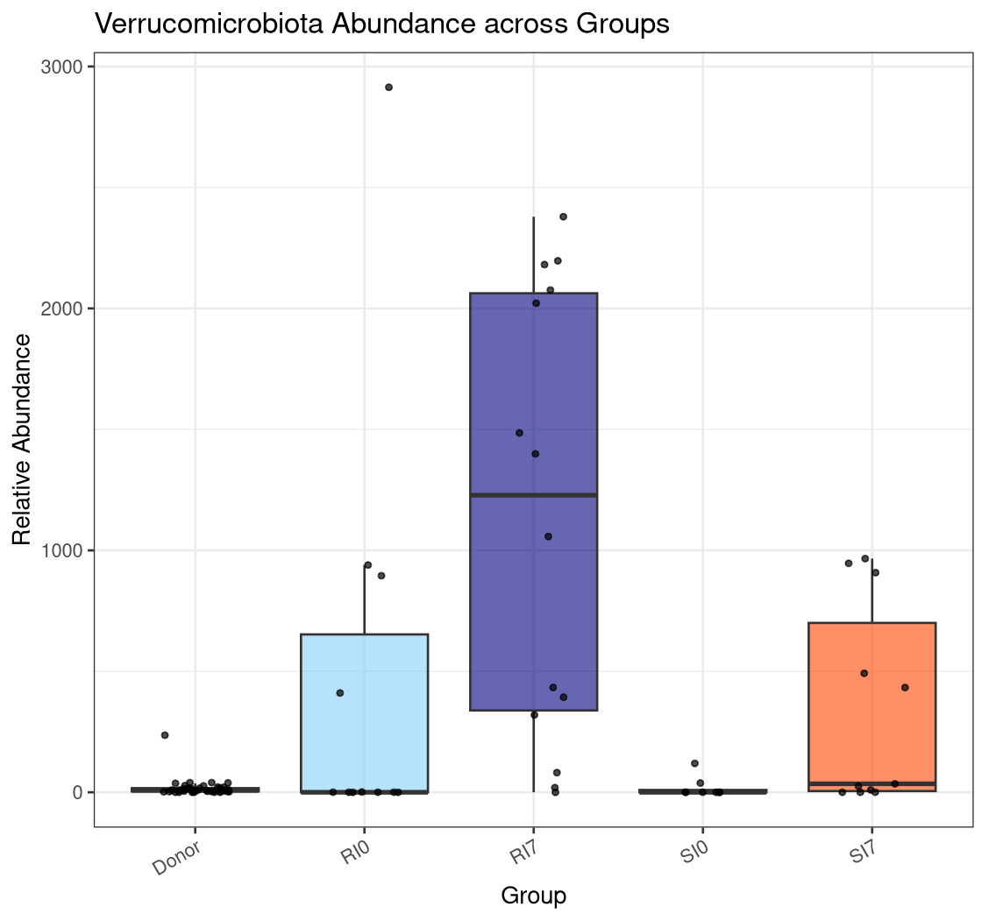
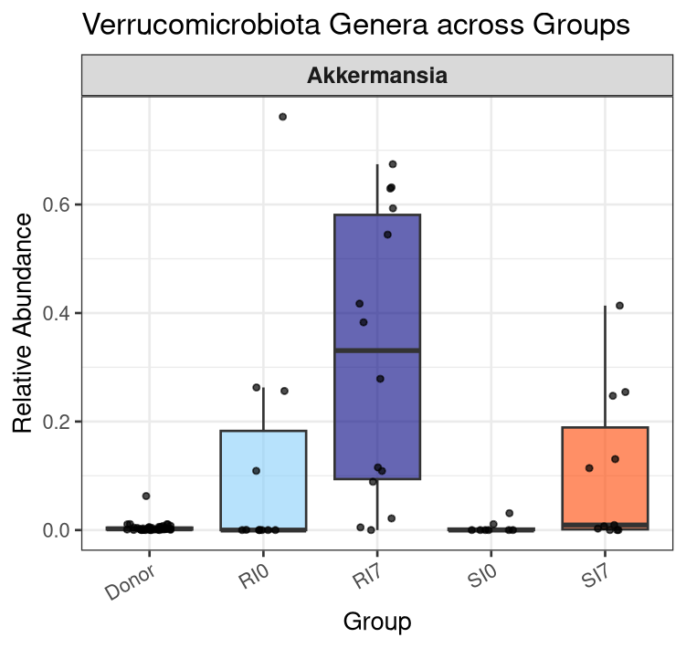
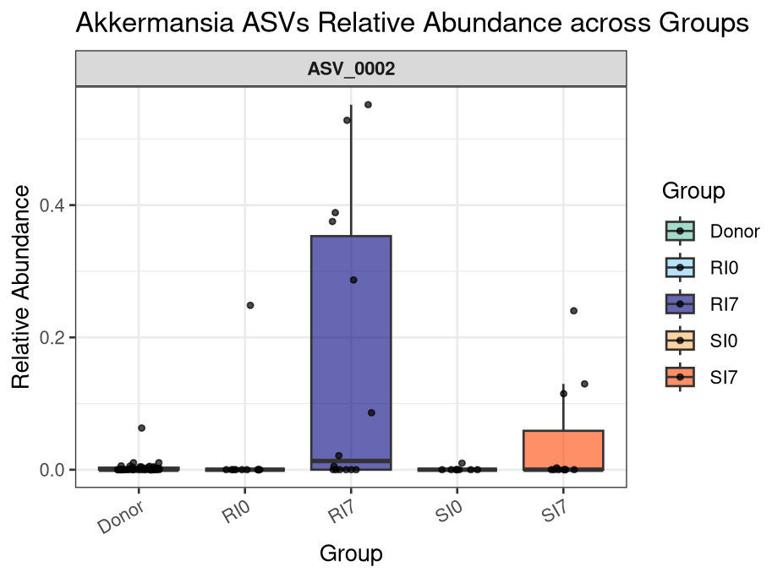
Akkermansia Increased After FMT,
with Greater and More Variable Expansion in RI7
Akkermansia expanded in both SI7 and RI7, but reached much higher levels in RI7. ASV_0002 dominated the expansion and may signal dysregulated recovery.
Notes:
Akkermansia is often considered beneficial due to its protein-degrading capacity and links to metabolic health. But its overgrowth can also reflect mucosal disruption, especially when other commensals are lacking.
In the left panel, we see that Akkermansia increased in both SI7 and RI7 after treatment—but RI7 showed much higher and more variable levels, with some samples above 60%.
On the right, the dominant ASV—ASV_0002—shows a similar trend: minimal in donors and SI, but spikes sharply in RI7, suggesting a strain-specific bloom.
This indicates that Akkermansia expansion doesn’t necessarily signal recovery. In fact, excessive overgrowth in RI7 may reflect ecological instability.
So while modest Akkermansia levels may be part of balanced recovery, its overrepresentation could mark dysregulated outcomes, and future studies may explore its role as a context-dependent indicator of FMT success.

Slide 11
Summary
Q1: Does RBX2660 treatment alter the gut microbiota in patients with recurrent CDI?
Yes!
RBX2660 treatment led to a partial restoration of microbial diversity and composition, including increased alpha diversity and a shift toward donor-like community structure.
At the genus and ASV levels, key commensals such as Blautia reappeared post-treatment, supporting microbiota recovery.
Q2: Do patients with better clinical outcomes exhibit different microbial trajectories?
Yes!
Patients who did not require repeat intervention (SI group) showed:
Stronger engraftment of beneficial taxa (e.g., Blautia, Roseburia)
Greater reduction of opportunistic Proteobacteria (e.g., Escherichia-Shigella, Klebsiella)
More stable Akkermansia levels, compared to RI group where overgrowth of ASV_0002 was observed.
Future Directions
Explore predictive microbial signatures (e.g., donor ASVs, recipient baseline features) for treatment outcome stratification.
Investigate host-microbe interactions driving Akkermansia overgrowth in non-responders.
Improve therapeutic formulations by enhancing colonization of beneficial taxa and targeting suppression of resistant opportunists.
Notes:
To summarize, RBX2660 treatment reshaped the gut microbiota in patients with recurrent CDI, but the degree of recovery varied.
In patients who responded to a single dose, we saw clear signs of beneficial taxa engraftment and suppression of Proteobacteria, both at genus and ASV levels.
In contrast, non-responders retained dysbiotic features, including high levels of opportunistic pathogens and unusual overgrowth of Akkermansia.
These patterns suggest that strain-level tracking is crucial for understanding FMT outcomes.
Looking forward, future research could focus on identifying early predictors of FMT success, refining donor selection, and possibly modifying formulations to improve engraftment while suppressing opportunists.
With that, I’d like to thank you all for your attention.

Slide 12
THANKS!

