Slide 1
Citi HackOverFlow 2022
5 Guys
Presentation
Notes:
good evening, we are team 5 presenting on our final project today.
https://docs.google.com/presentation/d/1UJWswc6VxTjOsTeluZ6csnigfKuDyW6Kb16f0mL2Xes/edit#slide=id.ga9469d1f40_0_50
Skipped: copied slides templates

Slide 2
Table of Contents
01
Background
02
Data
03
Analytics
04
Conclusion
Problem Statement,
Problem Formulation
Collection of Data,
Stocks chosen
Approaches,
Insights
Limitations,
Future Work
Notes:
these are the contents to be covered.
Bg (2m15s)
15 minute presentation followed by 5 minute Q&A. content should include the following (but not limited to):
Identification of the business problem/opportunity
Identify any challenges with the data that were encountered and how they were addressed
Choice of data subset and/or feature selection
Detailed explanation of choice of the analytics approach used and what insights they provide
Demonstrate the POC application features
Discuss what additional steps would be necessary to turn the POC into a full analytics solution
Potential challenges that may be encountered
How the benefits of using the application could be measured by the organization
How the results of the POC provide a competitive edge for the Organization
Each group will be assessed on their presentation based on the following criteria:
Problem statement and situation analysis (20%)
Methodology, identification of assumptions, and analysis approach
(20%)
Solution is interactive and user friendly (20)
Clear and useful recommendations provided by application (20%)
Oral presentation and handling of Q&A (20

Slide 3
01
Background
Business problem, Opportunities
Notes:
i will start by setting the context for our project.
Identification of the business problem/opportunity
Problem statement and situation analysis (20%)

Slide 4
Problem Statement
Design an application for both clients and bankers that positions Citi as the modern bank for wealth management solutions, to drive client acquisition and strengthen client relationships in the Asian market.
Notes:
We are stocksense, a fictional consulting company that aims to create innovative solutions for asset managers who manage investments on the behalf of others.
For Asset Managers, their main role is to determine investments to make, with the goal of growing portfolios while mitigating risk.
An asset manager – using stock and fund data to create an interactive application that supports analysis of financial instruments and portfolios (something that goes above and beyond basic technical analysis charting)

Slide 5

Target: New Age Investors
Reasons
Has been using traditional methods (e.g. market trends & technical analysis)
Relying heavily on social media and not doing their due diligence.
Notes:
Our target audience are New Age Investors as there is a surge in popularity of self-directed investing due to the increased social media presences of trading and the use of trading bots to manage an individual’s funds. Many individuals are making investing decisions by themselves in hopes for higher returns. However, most of them lack knowledge in analysing the market trends or technical analysis skills, and as such, often fail to make informed decisions, resulting in losses.
Another trend we observed is that they are also relying heavily on social media influence and not doing their due diligence before investing.
after losing clients to competitors, Our client company is Considering new methods and have sought us to help to that end.
They have been using traditional methods, for example fundamental analyses like studying a company's background, and technical analysis such as RSI. They have tried as much as possible to understand market sentiment by using sentiment indicators and keeping up with news, forums & social media
Our investment company is one that Has been using traditional methods, for example fundamental analyses like studying a company's background, and technical analysis such as RSI. They have tried as much as possible to understand market sentiment by using sentiment indicators and keeping up with news, forums & social media. However, after losing clients to competitors, they are Considering new methods and have sought us to help to that end.
Technical analysis e.g. RSI, Stochastic
news, forums & social media
business context first then why they need us
been using traditional analysis But not earning much
then they saw opportunities of stock volume/prices being affected
Mainly analyses sentiments of the market for investments
Clients believe that sentiments are an important factors in moving the market

Slide 6



Target Users’ Problem
Speed of
Sentiment analysis
Accuracy of Sentiment analysis
Prediction of Historical prices
Info overload due to manually analyzing news sources or social media posts
Difficulty of staying updated in real-time
Rising trend of online retail investors that can shift market prices
Sentiment of these individuals cannot be captured through news
Effect of these sentiment values and their correlation compared to the stocks cannot be determined easily
Hard to integrate findings with general price predictions
Notes:
To be more specific, we can break down the current problems that our new age investors face in more details. Given that we consider ourselves in this target audience as well, we find that most of their problems stem from the lack of sentiment analysis as well as incorrect predictions.
The first major issue is the slow speed when conducting manual sentiment analysis, and that is due to the presence of information overload and the lack of automated resources by individuals. As such, the time taken to collect all these data would already suggest that they are late to join or exit the market.
Secondly, with the rising trend of online retail investors, individuals can contribute in the shift of market prices. The sentiment of these individuals cannot be captured through the news. There is a need for an alternative source of information.
Lastly, predictions based on historical prices are challenging. the effect of these sentiment values and their correlation compared to the stocks cannot be determined easily, and it is hard to integrate findings with general price predictions
These are the challenges we identified for the company. Firstly, due to the overload of information, it has become Especially hard to combine findings from manual reading of media platforms with technical analysis.
Secondly, it is important to stay updated, Yet, statistics for fundamental analysis only comes out once a quarter, making it hard for the company to keep up.
Lastly, there is the need for an x-factor as almost all companies are already doing what this company is doing with the tools provided out there, namely fundamental analysis, technical analysis & manual reading of media platforms. Hence, it becomes hard to differentiate from competitors.
Hence, they are seeking novel ways to stand out. (competitive advantage)
Sentiment -> need a lot time to read news etc, and collate and understand them
Hard to combine findings from manually reading of news/twitters with technical analysis
Fundamental analysis -> only comes out once a quarter. dh timeseries/ much thing to analyse
Technical analysis -> everyone do

Slide 7
Business opportunity
Sentiment Analysis combined with Price prediction
Social media platforms
News outlets
Machine learning
Notes:
Given the problems mentioned in the previous slide, we aim to tackle the problems through the use of sentiment analysis of social media platforms & news outlets, combined with price prediction and machine learning, so that the clients and bankers can make more better informed decisions faster and more accurately.

Slide 8
Our solution:
Specialise in crafting modern solutions for wealth management by:
Managing investments for bankers efficiently
Growing clients’ portfolios consistently
Role: determine investments to make
Goal: grow portfolios ⇔ mitigate risk
Notes:
On a high level, our solution specialise in crafting a modern solution for wealth management by managing investments for bankers efficiently through our sentiment analysis coupled with our price prediction models and growing clients’ portfolios consistently with accurate prediction results. As such, the role of our solution is simply to determine what investments to make and as a result, grow clients’ portfolios while mitigating risk

Slide 9




Using social media
Freely available source of big data
Extract meaningful information that supports changes in the stock market
Fast & cheap compared to traditional methods
Notes:
We chose to analyse social media as In this era of Big Data, the comments of social media users are freely accessible and can serve as a fast and cheap methods of extracting meaningful information that supports real time stock market changes.

Slide 10


Using machine learning
Faster sentiment analysis and relatively accurate price prediction
Faster computation compared to manual analysis
Notes:
Additionally, using Machine Learning, we can speed up the sentiment analysis and accurately predict stock prices faster. Moreover, it provides faster computation compared to manual analysis.

Slide 11
02
Data
Scope, Challenges
Notes:
Now i will be sharing about the data that we have used for our sentiment analysis and price prediction models

Slide 12
Data collection
Data
Prices
Data Sources
Yahoo Finance
News
service
(Google News)
Social Media
(Twitter, Reddit)
Financial
Social Media Platform
(Stocktwits)
Notes:
We have scraped data for prices from yahoo finance which is used to do our price prediction.
We also scraped content from various sources like google news api, twitter, reddit and stocktwits.
These data were used to conduct our sentiment analysis for stocks
For our data subset, we initially wanted to scrape 1 year worth of data for accuracy but considering the amount of time needed to scrape the data, we decided to scrape 9 months worth of data instead.
We chose 9 months as 6 months worth of data is too little to achieve good accuracy and have meaningful correlation scores.

Slide 13


Getting our data
Stocktwits
Twitter
Reddit
News
GoogleNews
Newspaper3k
BeautifulSoup4
Twint
PushshiftAPI
395,972
13,923
203,950
128,817
word length > 5 likes > 200 followers > 50 reshare > 5
word length > 5 likes > 200 followers > 50 retweets > 5
word length > 5 likes > 200
Removes duplicates
Notes:
For our data, we have set certain criteria when scraping from each sources to ensure that we scrape the data that contain more sentiment value.
For example, for Stocktwits, we made sure to collect only content with more than 5 words, likes more than 200, followers more than 50 and reshare more than 5.

Slide 14
Stocks Chosen
Large Cap Stocks
Apple
Tesla
Microsoft
Google
Amazon
‘AAPL’
‘TSLA’
‘MSFT’
‘GOOGL’
‘AMZN’
Small Cap Stocks
ETFs
Aterian
Vaxart
ARKK
Russell 1000
‘ATER’
‘VXRT’
ARK Innovation ETF
Index that includes top 10 stocks
Notes:
We wanted a diversity of stocks hence we have chosen these stocks.
We focused on some stocks with big names like apple, tesla and microsoft.
For the small cap stocks we have chosen ater and vxrt and etfs with ark and russell 1000
Next we’ll talk about how our solution make use of these data to produce results.

Slide 15
Challenges with Data
Inconsistencies between Sources
Dirty Data
Unnecessary content etc → clean e.g. criteria-based selection, filters (NLP & REGEX)
Different data format E.g ( datetime) → standardize
Different site formats → specific scrape scripts
Reddit have both comments and posts → scrape separately
Social sentiment data includes the weekends while stock prices do not → weighted formula to combine weekend sentiments into Monday
Diminishing number of scrapes for older comments → limit scraping time frame
Large Size
Large data size results in long time to scrape, clean & arrive at sentiment results → factor in time constraint
Notes:
Our group has faced several challenges when working with our data.
FIrstly, Inconsistencies between sources
We have Data in different format especially datetime, and the solution to that is to standardize them before conducting analysis
Different sources required different criteria e.g. twitter where followers are set to be more than 50. To tackle this, we wrote a specific scrape script for each sources
For Reddit, there are both comments and posts hence we need to scrape separately
And Social sentiment data includes the weekend while stock prices do not include. So what our group did was to do a weighted sentiment between them with monday
Secondly, Dirty data : All our data are messy and required cleaning → thus, we wrote a script to clean them
Thirdly, the Size of the data: The large amount of social media sentiment data takes a long time to scrape, clean and arrive with sentiments. The solution for this is that we factor the time constraint into our schedule but setting a time limit of 1 week to scrape the data

Slide 16


Data Subset
Scraped data from 01/01/2021 to 30/09/2021
Strikes balance between:
Q1 | Q2 | Q3 | Q4
Time needed to scrape data
Accuracy (meaningful correlation scores)
Notes:
For our data subset, we have scraped data from 1st january 2021 to 30th september 2021
The reason Why did we chose to scrape this amount of data is because we wanted to go for one year worth of data for accuracy, but considering the amount of time needed to scrape the data, we decided to go for ¾ of the year as 6 months worth of data is too little to achieve good accuracy and have meaningful correlation scores

Slide 17
03
Analytics
Approaches, Insights
Notes:
Now that we have a pipeline set up for our solution, we need to ensure that our solution can actually work and produce good result —> as such, we will analyse the results produced by our models…

Slide 18
Approach
Sentimental Analysis
Technical Analysis
Correlation between sentimental analysis ⇔
stock market prices/volumes
Prediction of stock prices using time-series machine learning models
Notes:
For our solution we will be conducting sentimental analysis to see if there is a correlation with stock market prices and volumes.
As doing sentiment analysis alone is not sufficient, we will be using technical analysis to validate the result from sentimental analysis.
After getting the results from these analysis, it will then be displayed on the dashboard to help asset manager in decision making.

Slide 19
Analysis steps
Data
Models
Result
Select stocks for analysis
ETFs
Small Cap stocks
Big Cap stocks
Scraping from 4 media platforms
Preliminary data cleaning & analysis
Sentiment analysis to get sentiment scores
Finbert
Vader
Flair
Predict future prices
Arima
Auto Arima
Linear Regression
LSTM
Prophet
Correlation analysis with price and volume
Summarize & interpret results for decision making
Decision tree
Notes:
We have 3 main analysis steps
For our first step,
- we have conducted preliminary data cleaning & analysis,
- we have extracted comments for 2 stocks and
- we be conducting classification to check if the comments are useful using these 3models - regression, random forest, naive bayes
The next step will be applying our models
For sentimental analysis we will use unigram and arima model to get the sentiment scores
We will also be using technical analysis on prices, volume and moving average
For predicting of future prices and market trends we will be using multi linear regression (to spot possible market crash/spikes)
Our last step will be conducting correlation analysis of sentimental analysis with price and other metrics like volume and volatility
We will also be summarizing and interpreting result for decision making
------------
Choose 3 stocks and extract out the features of the text
News and Social media posts
1 years
2 years
Classification - see if comments valuable or not
Sentiment analysis on “valuable” comments to get sentiment scores
Correlation analysis with price and other metrics like volatility
Predict future stock prices with results from the different features - sentiment, volatility, ???
---
outline the steps planned for performing the analysis & T
Extract the features of the text
Models - separate classification, determine if good/bad comment - supervised learning based a dataset we labelled ourselves - data will be based on the past 6 months
Logistic regression
Random forest
Naive bayes
Technical Analysis: Volatility, Moving average - this is separate thing from sentiment analysis????
Models - sentiment analysis
Analyze based on different groups of words (Unigrams)
Arima
Models - predict prices/trends (e.g. market crash/spikes)
MLR - using volatility, annualized returns, sentiment analysis output?
---
plan B - portfolio optimisation : make recommendations to improve portfolio based on different factors (where sentiment analysis is one of those factors/ input).

Slide 20
Choice of Analytics Approach & Insights
Finbert
Flair
Vader
Sentiment Models
Pre-model with financial phrase bank dataset - implemented
A standard natural language processing (NLP) model for text
Popular rule based library for sentiment analysis
Most interpretable correlation scores, due to financial pretrained terms
Pre-trained models are not suitable for interpreting stock sentiments
Highest correlation scores for social media, due to lexicon based model that can analyze short text
Insights
Notes:
Sentiment models:
Finbert - pre-model with financial phrase bank dataset - includes over 40,000 financial terms
Flair - Flair is a natural language processing (NLP) models to your text, - most basic form of sentiment analysis model, benchmark use as control
Vader - popular rule based library for sentiment analysis - good for short text like comments
Insights:
Finbert has most interpretable correlation scores
Flair has the more inconsistent correlation scores
Vader has the highest correlation scores
Vader - lexicon - positive negative words
Flair - pretrained using IMDB database
Finbert - NN that is pretrained over 40k financial terms make sense to use
Moving average, percentage change of price, different weightages for likes and followers but ultimately realized that average gave the most promising results

Slide 21
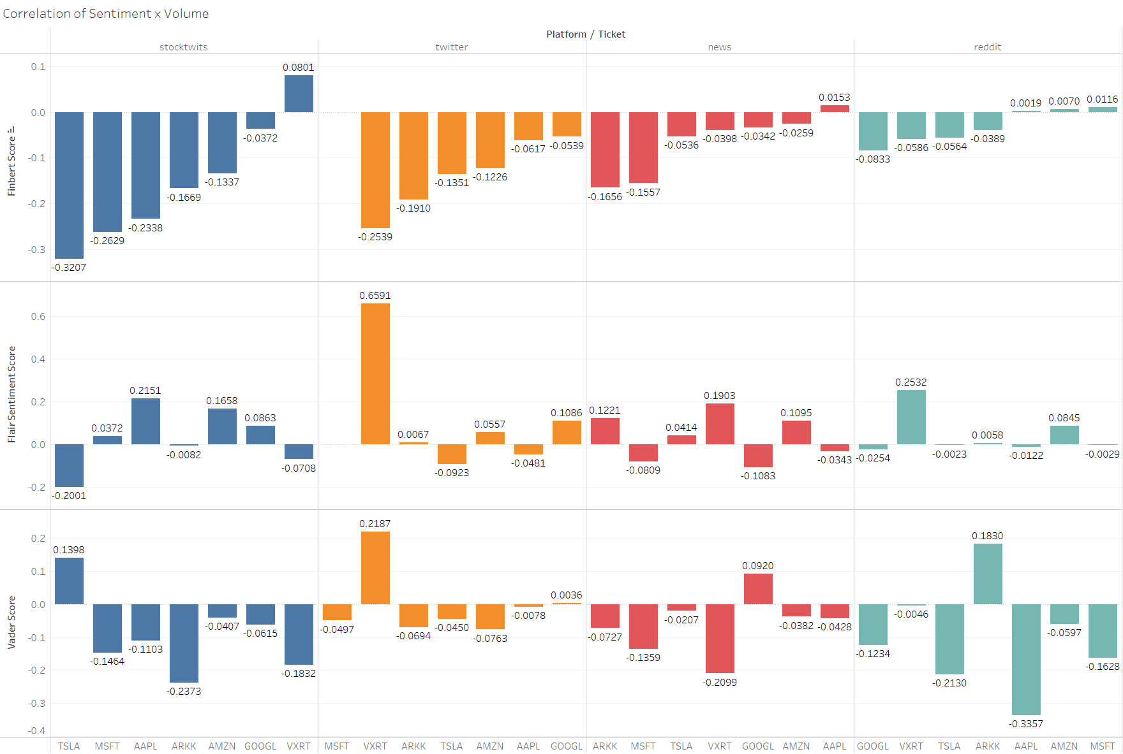
Volume correlation across the different platforms and stocks
Notes:
ML models:
Arima - a popular technique for time series modelling (best because it takes in the previous date lowest RMSE)
Autoarima - similar to arima but faster and easier to implement
Prophet - fast and automated forecasting, works well with time series of seasonal effects
LSTM - Long short-term memory is an artificial recurrent neural network architecture
Linear regression - classic model used for time series forecasting
Insights:
Which one more accurate? Which more efficient?
Will use RMSE to measure performance (to be calculated)
3 years data cannot draw enough insights. For historic price prediction.

Slide 22
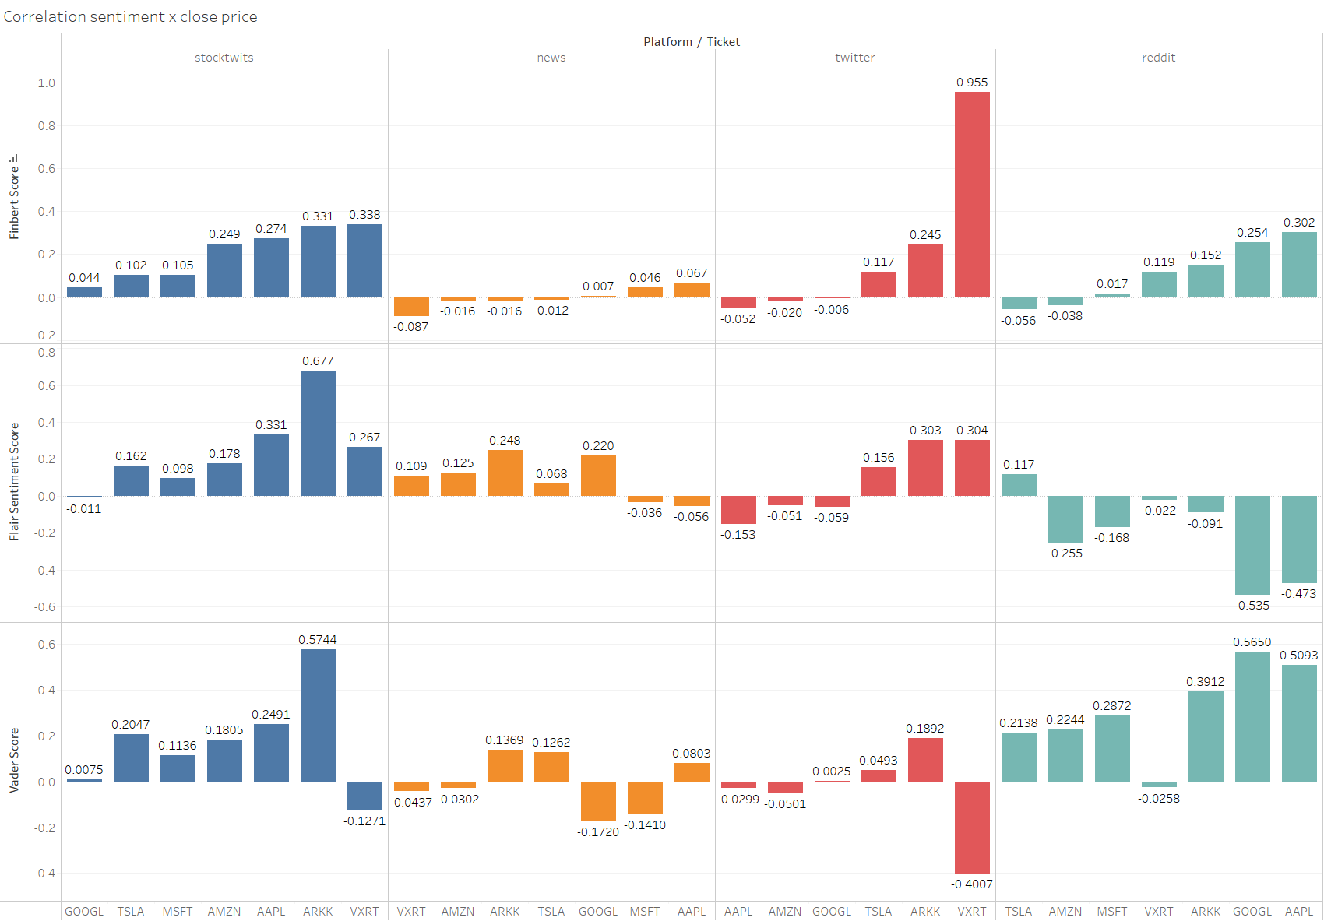
Close Price correlation across the different platforms and stocks
Notes:
ML models:
Arima - a popular technique for time series modelling (best because it takes in the previous date lowest RMSE)
Autoarima - similar to arima but faster and easier to implement
Prophet - fast and automated forecasting, works well with time series of seasonal effects
LSTM - Long short-term memory is an artificial recurrent neural network architecture
Linear regression - classic model used for time series forecasting
Insights:
Which one more accurate? Which more efficient?
Will use RMSE to measure performance (to be calculated)
3 years data cannot draw enough insights. For historic price prediction.

Slide 23
Choice of Analytics Approach & Insights
Avg RMSE
Avg Time (seconds)
Arima
606
8.655
Autoarima
22,606
7.004
Prophet
ML Models
13,643
2.545
LSTM
(long short-term memory)
6,537
8.639
Regression
427
1.172
Notes:
Supervised learning approach
ML models:
Arima - a popular technique for time series modelling (best because it takes in the previous date lowest RMSE)
Autoarima - similar to arima but faster and easier to implement
Prophet - fast and automated forecasting, works well with time series of seasonal effects
LSTM - Long short-term memory is an artificial recurrent neural network architecture
Linear regression - classic model used for time series forecasting
Insights:
Which one more accurate? Which more efficient?
Will use RMSE to measure performance (to be calculated)

Slide 24
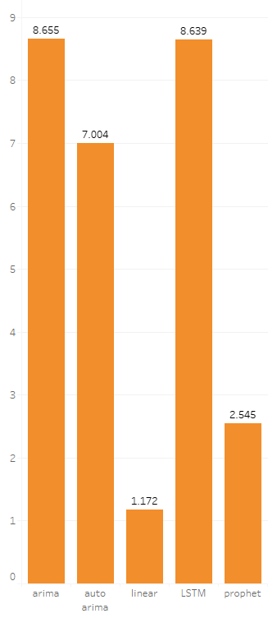
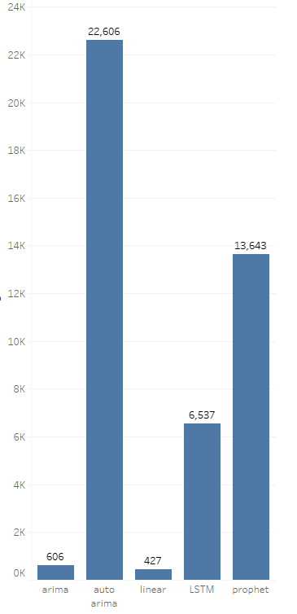
How to read?
Basically,
the lower the better!
Avg RMSE
Avg Time (seconds)
Notes:
ML models:
Arima - a popular technique for time series modelling (best because it takes in the previous date lowest RMSE)
Autoarima - similar to arima but faster and easier to implement
Prophet - fast and automated forecasting, works well with time series of seasonal effects
LSTM - Long short-term memory is an artificial recurrent neural network architecture
Linear regression - classic model used for time series forecasting
Insights:
Which one more accurate? Which more efficient?
Will use RMSE to measure performance (to be calculated)
3 years data cannot draw enough insights. For historic price prediction.

Slide 25
Choice of Analytics Approach
and Insights
Final decision derived based on
Average Sentiment Score of the day
Correlation score
Today’s prediction
Yesterday’s actual price
Insights:
Help predict price
Understand correlation of selected stock with sentiment (positive/negative)
Clients/Bankers will be able to make Buy/Sell/Hold decision using Decision Tree prediction
Notes:
FINAL DECISION Derived based on
average sentiment score of the day,
correlation,
today’s prediction and
yesterday price,
mean squared error
Insights:
Help to predict price
Correlation of selected stock with sentiment (positive/negative)
Asset manager will be able to make Buy/sell/hold decision using decision tree

Slide 26
Decision Tree
Gate 1
Gate 2
Prediction Price vs Yesterday’s price
Positive Correlation
Today’s Sentiment
If predicted > yesterday: +1
Else -1
If positive correlation + positive sentiment +1
If positive correlation + negative sentiment -1
If negative correlation + positive sentiment -1
If negative correlation + negative sentiment +1
*Scores are doubled if correlation >= 0.4 or <= -0.4
If gate >= 2 Buy
If gate <= -2 Sell
Else Hold
Notes:
FINAL DECISION Derived based on
average sentiment score of the day,
correlation,
today’s prediction and
yesterday price,
mean squared error
Insights:
Help to predict price
Correlation of selected stock with sentiment (positive/negative)
Asset manager will be able to make Buy/sell/hold decision using decision tree

Slide 27
04
POC App
Features, Challenges, Future work, Success measures, Competitive edge
Notes:
Demonstrate the POC application features
Discuss what additional steps would be necessary to turn the POC into a full analytics solution
Potential challenges that may be encountered
How the benefits of using the application could be measured by the organization
How the results of the POC provide a competitive edge for the Organization
Solution is interactive and user friendly (20)
Clear and useful recommendations provided by application (20%)

Slide 28
Conclusion

Slide 29




Solution Features
Recommendations
Word Cloud & Comments
Using a Decision Tree to give recommendations to buy/hold/sell
From cleaned content to see what word is frequently mentioned
Hourly Tracking of Sentiment Scores
Linear Scores
Sentiment score (positive/negative) & error
Scrape from latest then visualise results grouping by hour

Slide 30
Limitations
Lack of time
Limited Hyperparameter Tuning
As we are only given 4-5 days to implement a solution from scratch, our code is monolithic and relatively messy as we focused on correctness in our solution
Given the time constraint, we do not have sufficient time to perform grid search to find the optimal hyperparameters for our ML models. As such, the accuracy could have been better
Notes:
Coming back to the slides, we will be talking about the challenges encountered.
There were two main challenges faced during this project. Firstly, was the difficulty of data integration. As not all data was standardized, we faced the problem of inconsistent data types. One simple yet common example would be the changing of data between dataframes and json. Though simple to rectify, we had many functions that used the same data but in different data types. Some used dataframes while others required json format, resulting in a lot of headaches when integrating the functions together.
Secondly, there were numerous packages that have libraries that clashed and interfered with each other. Additionally, as some of the machine learning models were written in anaconda prompt, and the installation of these packages were different from that of command prompt. We even had to downgrade the python version a couple of times.

Slide 31
Additional Steps to turn solution into a Complete Analytical Product
1
Use a neural network to generate recommendations instead of an IF ELSE decision tree
2
Can use NLP and topic modelling to summarize the text & social media content together with the raw sentiment scores
3
Add nuance and explanations for the results, not just stating overall findings
4
Provide longer analysis and predictions for longer periods, since app only fetches last 24h
Notes:
Moving on to the additional steps to turn the POC into a full analytical solution. The team agreed that the 4 points on the screen should be addressed first

Slide 32
Potential Challenges
Correlation
Efficiency/Speed
Lack of data
Might not get strong correlation for certain stocks
App might take a long time to scrape data, clean data and run models
Less people mentioning about small cap stocks
Notes:
Some future challenges we foresee include:
1. The correlations for certain stocks might not be as strong
2. Speed of scraping, cleaning the data and running models on the data might be extremely long.
3. Lack of data – there are lesser people mentioning about small cap stocks compared to big cap stocks, which might result in inaccuracies due to its small sample size

Slide 33
How Benefits can be Measured
Improve operations
Increase
revenue
Measure time saved
Measure Profits & Costs
Sweet Spot
Reduce
risk
Measure difference between actual returns & expected returns
Notes:
Benefits can be measured based on the following:
1. Measure the time saved vs manually analyzing news sources
2. Measure of risk through the volatility of the user’s portfolio after using the application between actual and experted returns
3. Measure the overall revenue after using the application

Slide 34



How Results Provide a Competitive Edge
Help Asset manager make buy/sell/hold decision and show predicted price
Asset manager profit & save time without need to scroll social medias
Notes:
Ultimately, the asset managers themselves have to make the decision of whether to buy, sell, or hold. However, this POC provides fast, detailed and more technical viewpoint in assisting the asset managers decision. Allowing asset managers to save time while earning more profits

Slide 35
Solution Demo

Slide 36
Thank You!
Any questions?
Please keep this slide for attribution

Slide 37
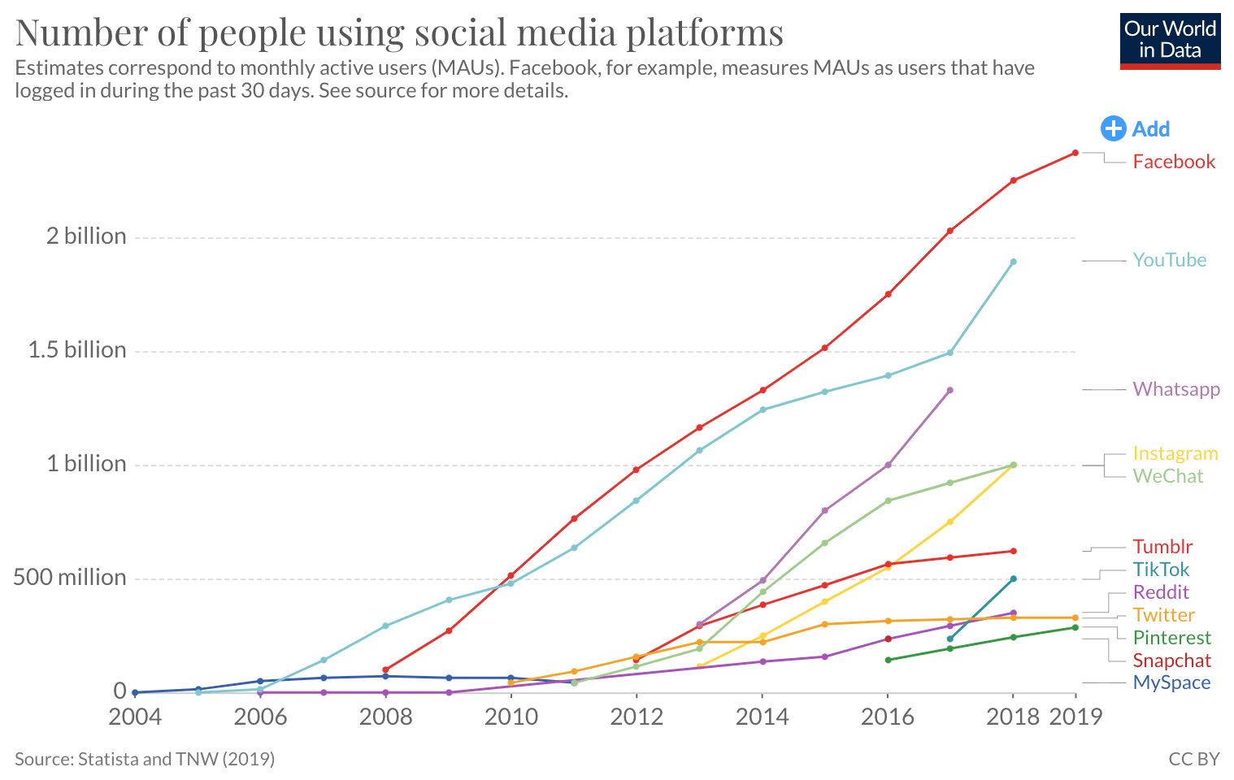
Fastest growing information system
Notes:
Social media platforms are gaining remarkable influence than ever before and are considered one of the fastest growing information systems for social applications.
They are considered the global centre of big data as people use their applications and spend excessive hours on these media outlets
All in all, social media sentiment analysis is a powerful tool in understanding the most important events and trends.

Slide 38
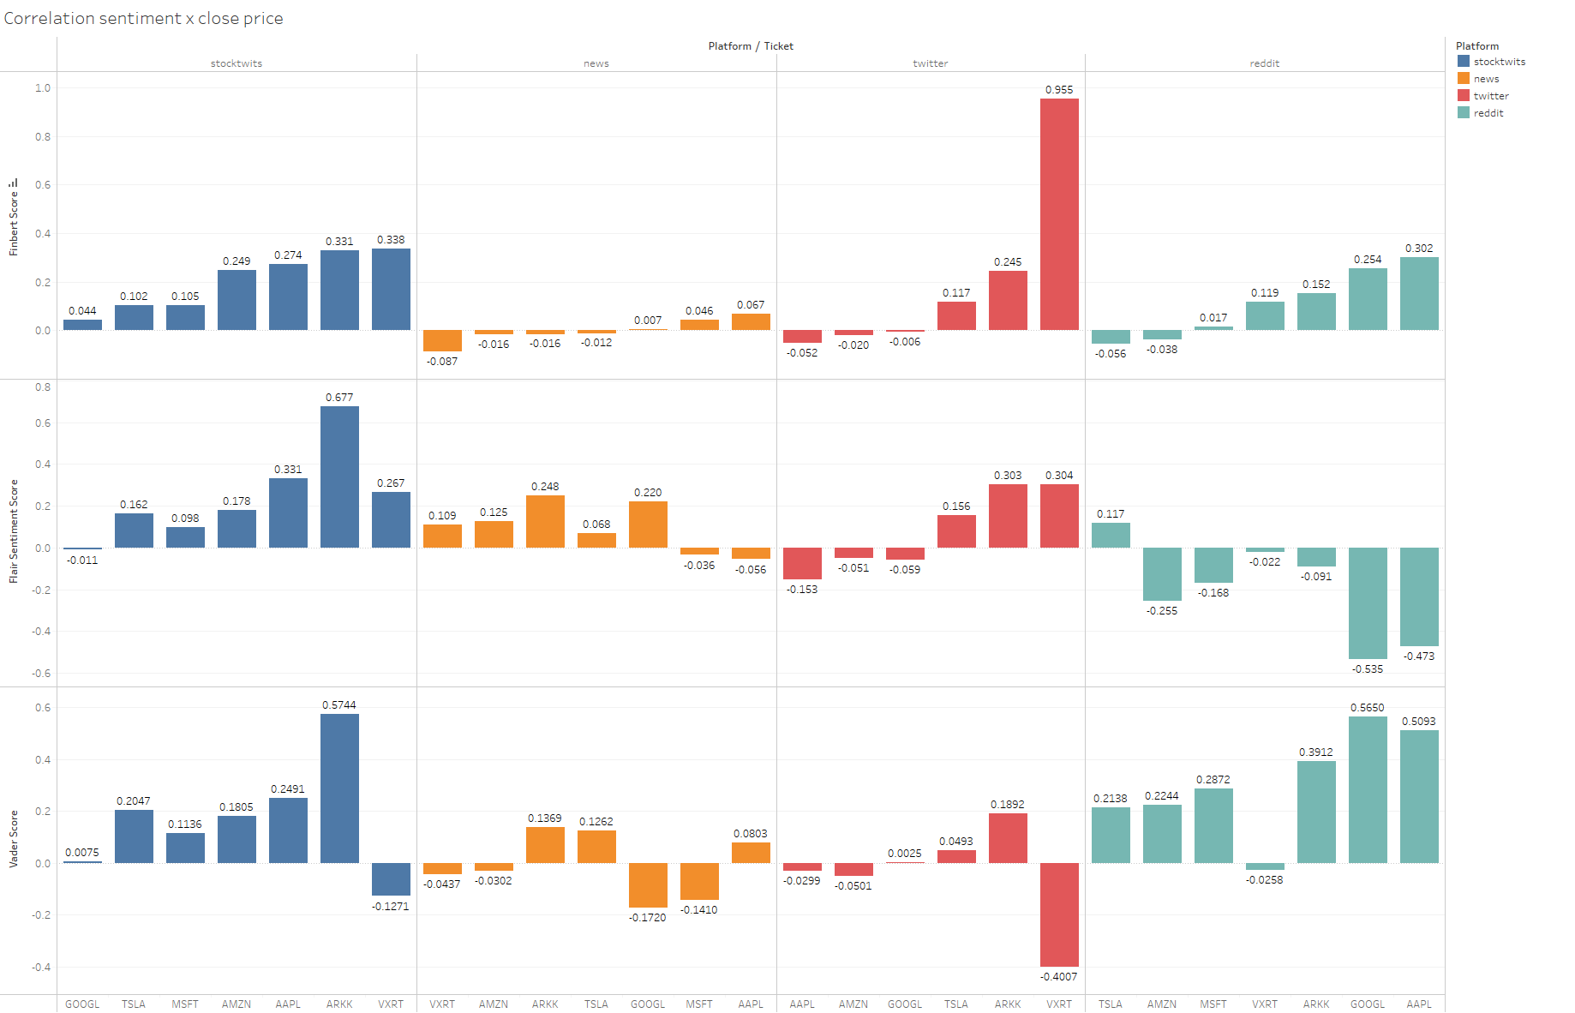
Price
Notes:
How i got this and to interpret this
Column meaning
Good correlation is above 0.2
Below -0.2
Price more correlation
Explain why

Slide 39
Challenges/opportunities
for sentiment analysis
Complexity
Sentiment indicators only give a quick overview of the general sentiment
Need complex solutions such as NLP for more detailed information
Includes news & social media, though difficult to collect, clean and analyze
Market Relevance
Very important & currently still very manual
Banks still hire 3rd party research teams to do this
Abstract nature
Opportunity to back up with other quantifiable analyses such as price predictions through ML
Notes:
As mentioned, company Tried to understand market sentiment by using sentiment indicators and keeping up with news, forums & social media
1
Sentiment indicators e.g. Put/Call ratio & Volatility Index are typically used to determine whether a market is “bullish” or “bearish”.
These indicators give a quick overview of the general sentiment in the market. However, to obtain detailed information on individual sectors or explicit investment assets, you have to use more complex methods. (NLP → sentiment analysis)
These include news (economic, political and industry related) and social media.
Which can impact stock market volatility, trading volume and company earnings.
These information are difficult to collect, clean and analyze
2 sentiment analysis is very important and currently its still very manual. banks still hire 3rd party research teams to do this
3 doing sentiment analysis alone is not sufficient is one of the problem. opportunity is to back up with some analysis that is not ambigious

Slide 40
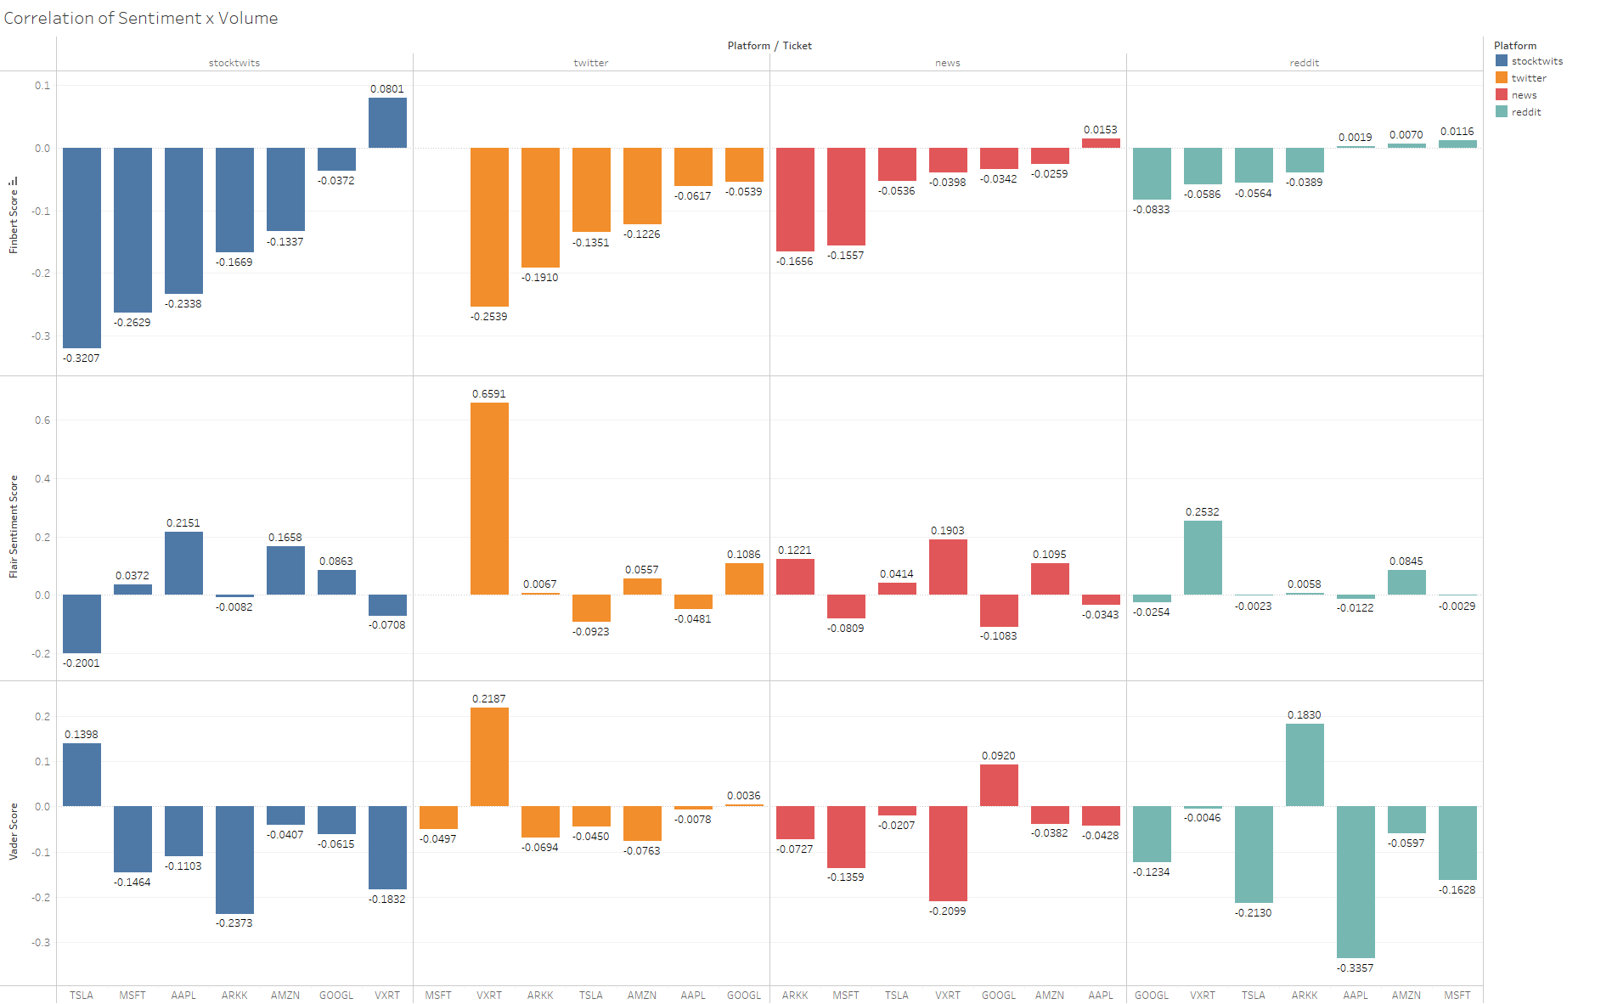
Volume
Notes:
Add more constraints
Weights are added but it can be hard to determine a good weight that is easily generalized
Likes is not a good measure
Followers is not a good measure
Moving average was used but
Best performance is being stricter with cleaner comments which increases correlation score which would give value to the user in terms of analyzing this info
How i got this and to interpret this
Column meaning
Color meaning

Slide 41
Challenges for company
X-Factor
Essential as most companies are already doing technical analysis
Hard to differentiate from competitors
Notes:
After analyzing Bluerock, we realised a couple of challenges.
Firstly, is the presence of information overload. As Bluerock is currently tracking the news manually, the time taken to collect all these data would already suggest that they are late to join or exit the market.
Secondly, with the rising trend of online retail investors, individuals can contribute in the shift of market prices. The sentiment of these individuals cannot be captured through the news. There is a need for an alternative source of information.
These are the challenges we identified for the company. Firstly, due to the overload of information, it has become Especially hard to combine findings from manual reading of media platforms with technical analysis.
Secondly, it is important to stay updated, Yet, statistics for fundamental analysis only comes out once a quarter, making it hard for the company to keep up.
Lastly, there is the need for an x-factor as almost all companies are already doing what this company is doing with the tools provided out there, namely fundamental analysis, technical analysis & manual reading of media platforms. Hence, it becomes hard to differentiate from competitors.
Hence, they are seeking novel ways to stand out. (competitive advantage)
Sentiment -> need a lot time to read news etc, and collate and understand them
Hard to combine findings from manually reading of news/twitters with technical analysis
Fundamental analysis -> only comes out once a quarter. dh timeseries/ much thing to analyse
Technical analysis -> everyone do

Slide 42
Market Sentiment
Investors’ opinions
→ demand & supply
→ price movements
Notes:
can be used to determine investors’ opinions of a specific stock or asset.
Sentiment drives demand and supply, which in turn leads to price movements.

Slide 43
Data cleaning
Selection
Keep needed columns only
Drop rows with empty content/datetime
Drop comments with <5 words
Filter: NLP
Stop words e.g. vulgarities
Repetitive/useless words
Filter: REGEX
URLs
#Hashtags
@Mentions
Emojis
Misc
Standardise format across all platforms e.g. datetime
Group by date, then get stats
Weighting some words
Notes:
Here is how we conducted our preliminary data cleaning. Some important things to note is that we removed,URLS, hashtags, mentions, emojis and stopwords. We also drop comments with less than 5 words as we felt most were redundant and spams. Additionally we standardised the format across all platforms to ensure fairness when conducting sentiment analysis.
& may possibly include some preliminary data analysis results
Remove
unnecessary columns or features
Remove stop words and repetitive words - eg you i him, tsla , stock
Remove comments with less than 5 words - spam or bots
Drop rows with empty comment or datetime
Using Regex, remove URLs, hashtags, mentions, emojis
Format datetime across all platforms
--
Preprocessing:
NLP: Remove useless words/vulgarities
wrote a script to remove all the nonsense from the sentence
put weights for some words
Group by date sum the sentiment - everyday will have 500 comments and tweets - take the mean

Slide 44



Platforms used
Stocktwits
Google News
Reddit
Twitter
Generally scaled towards younger generations
~ 2,000,000 monthly active users
Largest stock discussion in the world
~2,069,000
users
Capturing moments
~1,114,520
users
Embrace discussion & focus on community engagement
~1,300,000
users
Micro-blog
Notes:
So the team acknowledges that there is some form of biases in our findings. As each social media platforms has its own targeted age demographic, and taking from an individual social media platform would be bias. As such the team has explored a multitude of online platforms to make our findings more generalisable.
https://napoleoncat.com/stats/facebook-users-in-singapore/2020/01#:~:text=There%20were%204%20440%20000,group%20(1%20540%20000).
https://mediaonemarketing.com.sg/social-media-marketing-singapore-guide/
https://www.sphmagazines.com.sg/magazines/hardwarezone-com#:~:text=With%20over%20700%2C000%20members%2C%2045,specialized%20forum%20engagement%20package%20options.
https://napoleoncat.com/stats/instagram-users-in-singapore/2020/01#:~:text=There%20were%202%20069%20000,user%20group%20(830%20000).
https://sproutsocial.com/insights/instagram-vs-facebook/

Slide 45

Example of cleaned comments
$AAPL if short interest went down 7 percent in 2 days, that means we are at the beginning of a long squeeze, if we hodl, the squeeze will continue, SI is still 52%, that means we could see 20-30% gains per day(compounded) ....... for 2 weeks! I'm rich!!!!!!!!🚀🚀🚀🚀🚀🚀🚀🚀🚀🚀🚀🚀🚀🚀🤟🤟🤟🤟🤟🤟🤟💪💪💪💪💪💪💪💪💪😎😎😎😎😎😎😎😏😏😎🦍🦍🦍🦍🦍🦍🦍🦍💎💎💎💎💎💎💎🚀🚀🚀🚀🚀🚀🚀🚀🚀🚀🤑🤑🤑🤑🤑🤑🤑🤑🚀🚀🚨🚨🚨🚨🚨🚨🚨🚨🚨🚨🚨🚨💯💯💯💯💯💯💯💯💯💯📈📈📈📈📈📈📈📈📈📈📈📈😱😱😱😱😱😱🤤🤤🤤🤤🤤🤤🤤🤤🤤🤤🤤
Uncleaned Comment
AAPL short interest went 7 percent 2 days means beginning long squeeze hodl squeeze continue SI still 52 means could see 20-30 gains day compounded 2 weeks I'm rich
Cleaned
Comment
Notes:
To show examples of lousy comments -> so to prove the need for modelling

Slide 46
References
Research:
https://www.investopedia.com/terms/a/assetmanagement.asp
https://www.axovision.com/blog/2021/01/15/sentiment-analysis-and-nlp-in-asset-management/
https://www.researchgate.net/publication/304454096_Trading_on_Twitter_Using_Social_Media_Sentiment_to_Predict_Stock_Returns_Trading_on_Twitter
https://www.thetradenews.com/the-reddit-revolt-gamestop-and-the-impact-of-social-media-on-institutional-investors/
https://www.brunswickgroup.com/digital-investor-survey-2021-i18508/
Preliminary Data Analysis:
https://towardsdatascience.com/sentiment-analysis-for-stock-price-prediction-in-python-bed40c65d178
https://stackoverflow.com/questions/23199796/detect-and-exclude-outliers-in-pandas-data-frame

Slide 47
Performance & Methodology
Considering new methods after losing clients to competitors
Has been using traditional methods (e.g. fundamental & technical analysis)
Tried to understand market sentiment by using sentiment indicators and keeping up with media platforms only
Notes:
after losing clients to competitors, Our client company is Considering new methods and have sought us to help to that end.
They have been using traditional methods, for example fundamental analyses like studying a company's background, and technical analysis such as RSI. They have tried as much as possible to understand market sentiment by using sentiment indicators and keeping up with news, forums & social media
Our investment company is one that Has been using traditional methods, for example fundamental analyses like studying a company's background, and technical analysis such as RSI. They have tried as much as possible to understand market sentiment by using sentiment indicators and keeping up with news, forums & social media. However, after losing clients to competitors, they are Considering new methods and have sought us to help to that end.
Maybe can fluff up some fictional organisation background related stuff? E.g. name, whats their business context, generic problem statement
Technical analysis e.g. RSI, Stochastic
news, forums & social media
Or Supply chain company? But might affect stocks we choose
business context first then why they need us
been using traditional analysis But not earning much
then they saw opportunities of stock volume/prices being affected
Mainly analyses sentiments of the market for investments
Clients believe that sentiments are an important factors in moving the market

Slide 48
Preliminary Data Analysis Results
For one week only
Twitter - no. rows , >10 likes (spam and bots)
Reddit - no. rows,
News - no. rows
EDA (optional)
Wordcloud - before clean what we scraped
Notes:
Show the correlation is trash but we scrape all the sites but has a lot of noise
Show them how we reduce noise by sieving out useless comments and biases using a classification model.
Features: (How long ago the account was created (bots), How many tweets this account has (spam),
We will improve the sentiment analysis by improving our own analysis model adjusting
TSLA AAPL
(1 week)
Reddit
News
Twitter
Stocktwits
Per hour basis
Price 20th - 24th

Slide 49
AAPL & TSLA ratios for 5 days
(20th - 24th september)
 | AAPL | TSLA
Mean | $145.19 | $749.90
Standard Deviation | 1.889 | 16.717
Volatility | 0.112 | 0.164
Annualized Returns | 6.38% | 71.27%
Volume | 393,989,600 | 89,499,100
Notes:
Volatility Sharpe ratio returns series* for 5 days

