Slide 1
Learning to log: Helping developers make informed logging decisions
Zhu, J., He, P., Fu, Q., Zhang, H., Lyu, M. R., & Zhang, D. (2015, May). Learning to log: Helping developers make informed logging decisions. In Software Engineering (ICSE), 2015 IEEE/ACM 37th IEEE International Conference on (Vol. 1, pp. 415-425). IEEE.

Slide 2
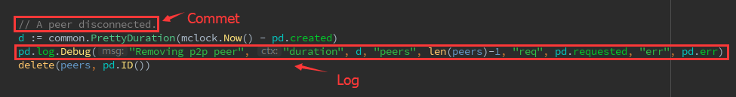
Prerequisite (前提基础)
What is log?
Comment
Log

Slide 3
Motivation
1. Lack of specifications or tools helping make logging decisions -> Strategic logging
2. Where to log & what to log
3. Current research has seldom focused on studying helping developers make logging decisions

Slide 4
Goal
Build a tool:
To automatically learn the common logging practice as a machine learning model, and then leverage the model to predict whether a code snippets should be logged, which guide developers to make logging decisions during new development.

Slide 5
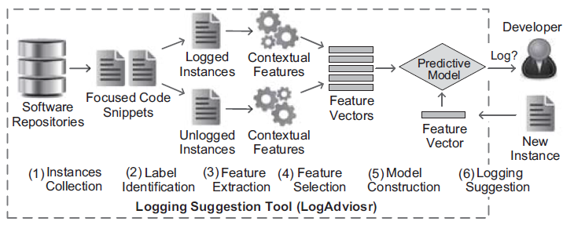
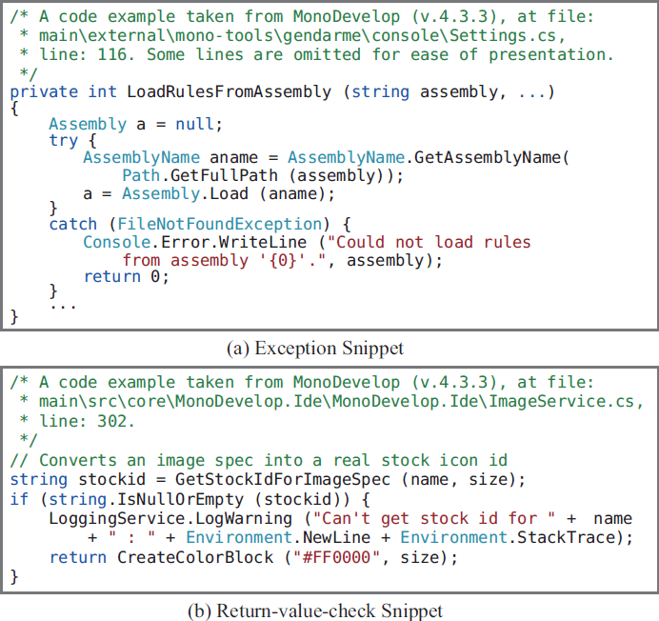
Method
1. Instances collection (get training data)
Using Roslyn, extract all focused code snippets, including 2 types: exception snippets & return-value-check snippets.

Slide 6
Method
2. Label identification (labeling)
“logged” & “unlogged”.
Using Roslyn, searching some keywords in method names, such as log/logging, trace, write/writeline, etc. Then label it.

Slide 7
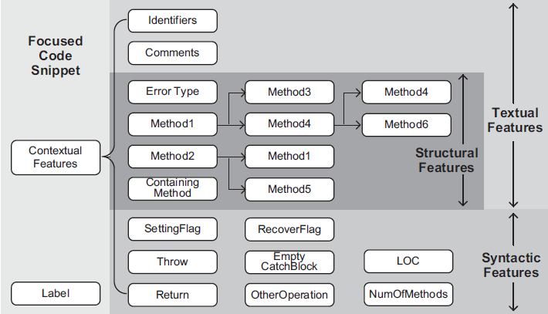
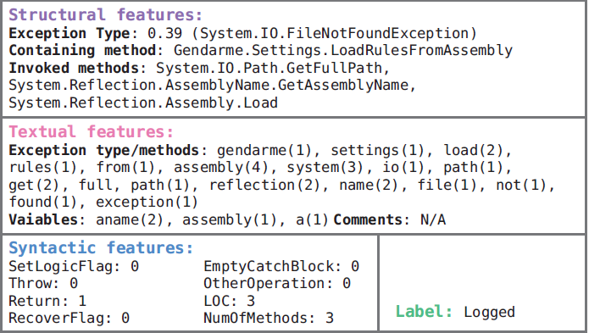
Method
3. Feature extraction
Structural features
Error Type (e.g. FileNotFoundException)
Methods (Containing method & Invoked methods)
Textual features
Using Weka (tokenization, stemming, stop words removal, and TF-IDF term weighting)
Syntactic features
SettingFlag, Throw, Return, RecoverFlag, OtherOperation, OtherOperation, LOC & NumOfMethods

Slide 8
Method
4. Feature selection (& remove noises)
Feature selection
Threshold (68%)
Information gain (1000 left)
Noise Handling
CLNI (modified K-Nearest Neighbors)

Slide 9
Method
5. Model training
Naïve Bayes, Bayes Net, Logistic Regression, SVM & Decision Tree

Slide 10
Method
6. Logging suggestion
Train offline
Build into a logging support tool
Provide online logging suggestions

