Slide 1
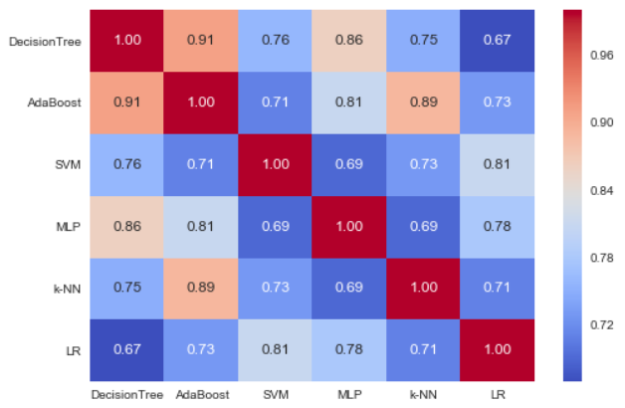
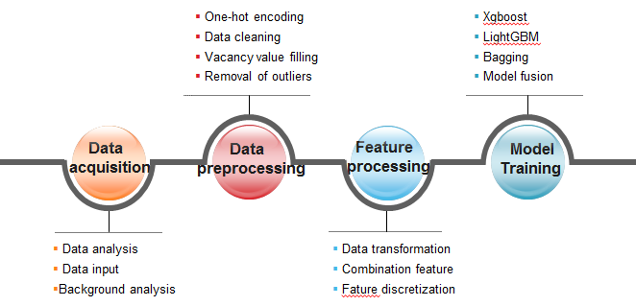
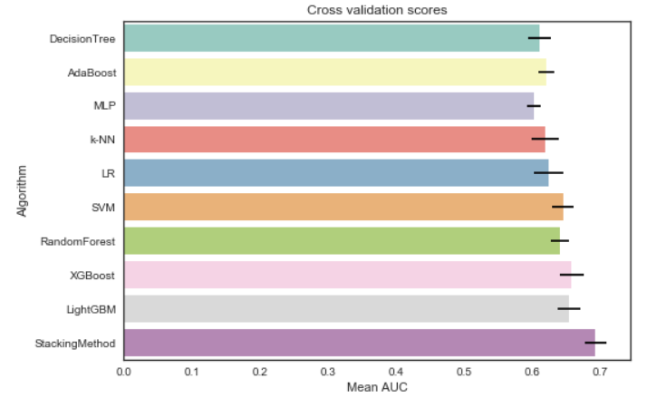
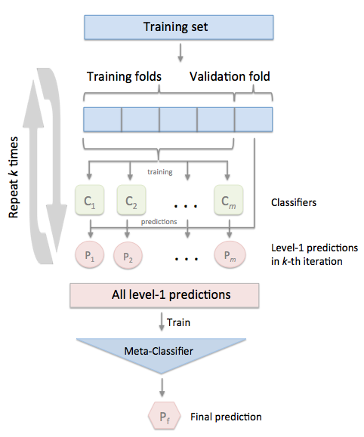
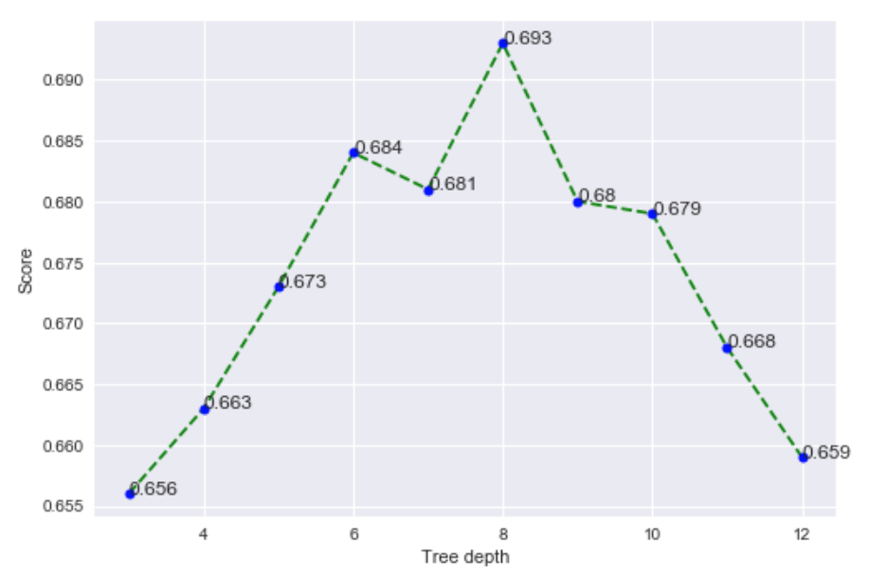
Predicting the Risk of Enterprise Exit
Zhenxian Zheng Jinjin Lin Xiaoyue Xiao
17214726 17214532 17274695
Introduction
Diversity between Base Models
Traditional enterprise evaluation is based on corporate financial information, borrowing and recording information, to judge the business status and whether it is possible to default [1]. There is no doubt that the evaluation method is more objective and reasonable for the large and medium-sized enterprises with a sound finance and record in the field of traditional bank lending. However, for a large number of small and micro enterprises, not only publicly available real business financial information, nor the public credit information of these enterprises, in the absence of variables, how to use the variable operating conditions weak objective and impartial evaluation of enterprise, is the major problem of the contest problems need to solve [2].
The contest from the more than 20 million enterprises in the country drawn part of the business (after desensitization), to provide business entities in many aspects of behavioral information data. We need to build predictive models of whether the business will run poorly in the future through data mining techniques and machine learning algorithms, and output the risk prediction probability values.
We do pairwise comparison on first level models. The results are provided in figure 6. As we can observe, in most of pairwise comparison the correlation is about 80%. Correlation between decision tree and AdaBoost is highest, 0.91%, which the reason may be that they are all tree-based model. Thus, we can say that, our first level models are be able to be diverse, which would be effective contributors for second level models
Method
Feature Engineering is the process of transforming raw data into features that better represent the underlying problem to the predictive models, resulting in improved model accuracy on unseen data. The original data in the project contains a great deal of noise, and the expression of information is not concise enough. Therefore, the purpose of the feature engineering is to use a series of engineering activities to express such information in a more efficient way of coding. With the information represented by the feature, the rules contained in the original data are still retained. In addition, the new encoding method also needs to minimize the impact of uncertainty in the original data. Feature engineering plays an important role in the accuracy of the result in this project. Feature engineering mainly includes two parts: data preprocessing and feature processing. The main flow chart is shown in Fig.1.
Fig.6: Correlation on first level models
The Effect of Different Learning Models
We also examine the impact of different learning models on the prediction accuracy. We have tried a few popular learning models, including decision tree, AdaBoost, multiple layer perceptron, k-NN, logistic regression, SVM, random forest, XGBoost and LightGBM. The evaluation results in figure 7 show that all the learning models lead to overall good prediction accuracy. In particular, our stacking approach is best effective among all models.
Fig.1: Flow chart of proposed algorithm
Modeling
Stacking is an ensemble learning technique to combine multiple classification models via a meta-classifier. In the standard stacking procedure, the first-level classifiers are fit to the same training set that is used prepare the inputs for the second-level classifier, which may lead to overfitting. Our method, however, uses the concept of cross-validation: the dataset is split into k folds, and in k successive rounds, k-1 folds are used to fit the first level classifier; in each round, the first-level classifiers are then applied to the remaining 1 subset that was not used for model fitting in each iteration. The resulting predictions are then stacked and provided as input data to the second-level classifier. After the training, the first-level classifiers are fit to the entire dataset as illustrated in the figure 5.
Fig.7: Cross validation scores of all models
The Impact of tree depth
For the number of tree depth, we experimented on a series of tree depth values between 3 to 12, and selected the tree depth that maximizes the AUC score in each model. Figure 8 shows the result. We observe that tree depth equals 8 gives the best AUC scores for all models.
Fig.8: Scores on different tree depth
Conclusion
In this competition, some important enterprise information can be obtained through the requirements of the competition and the analysis of the data. The key to solving the problem of the predicting the risk of enterprise exit lies in the feature engineering and the model training. What’s more, a large number of combination features and effective features ensure that the model can converge to a good value, and model fusion and multiple algorithms improve the accuracy of the result further. A better accuracy will also have some help for future enterprise risk prediction.
Fig.5: Overview of stacking

